Slide 1

從0到100的 LeetCode大挑戰！
陳政廷

Slide 2

LeetCode 功能
Explore
教學配題目，通常會給一篇文章講解概念，
然後提供leetcode題目解題，未完成上一章學習無法解鎖下一章題目
Study Plan
Leetcode 將部分題目組合成主題，提供使用者主題式解題
Deaily Problem
每天一題
Week Contest
周競賽
Tag
按主題標籤解題

Slide 3
LeetCode難度
Easy
主要以基礎概念、小試身手為主
可以用暴力解解決的問題
相當於CPE一星題
Medium
問題明確但有鑑別度
部分題目會要求在有限時間、空間內解決
相當於CPE二星-三題
Hard
看完題目了可能還不知道要怎麼解(洗咧供三小) 通常會要求使用演算法
動態程式規劃解決問題
相當於CPE四星以上

Slide 4



LeetCode Problems Topic
Top interview 150
LeetCode 75
Top 100 Liked Questions
150題常見面試題
75題基礎常見題
Easy 40 題
Medium 90 題
Hard 20 題
Easy 22 題
Medium 53 題
Easy 22 題
Medium 66 題
Hard 12 題

Slide 5



LeetCode Problems Topic – 其他
Dynamic Programming
Graph Theorty
SQL 50
SQL語法基礎題
Easy 4 題
Medium 35 題
Hard 7 題
Easy 1 題
Medium 28 題
Hard 7 題
Easy 32 題
Medium 22 題
Hard 1 題

Slide 6

LeetCode 75
Graph (DFS) 4題
Graph (BFS) 2題
Heap / Priority Queue 4題
Binary Search 4題
Backtracking 2題
DP – 1D 4題
DP – Multidimensional 4題
Bit Manipulation 3題
Trie 2題
Intervals 2題
Monotonic Stack 2題
Array/String 9題
Two Pointers 4題
Sliding Window 4 題
Prefix sum 4 題
Set 4題
Stack 3題
Queue 2題
LinkedList 4題
Binary Tree(DFS) 6題
Binary Tree(BFS) 2題

Slide 7
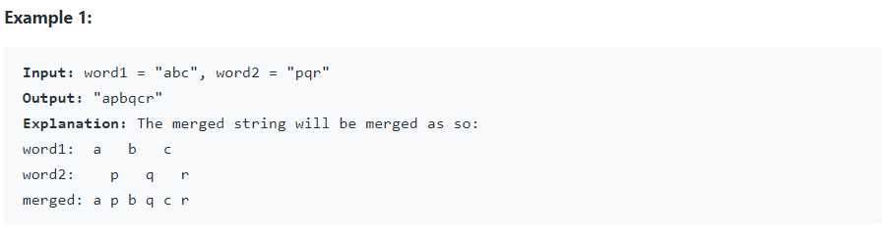
題目範例一 LeetCode 75 String Problem 1768. Merge Strings Alternately Easy
You are given two strings word1 and word2.
Merge the strings by adding letters in alternating order, starting with word1.
If a string is longer than the other, append the additional letters onto the end of the merged string.
Return the merged string.

Slide 8

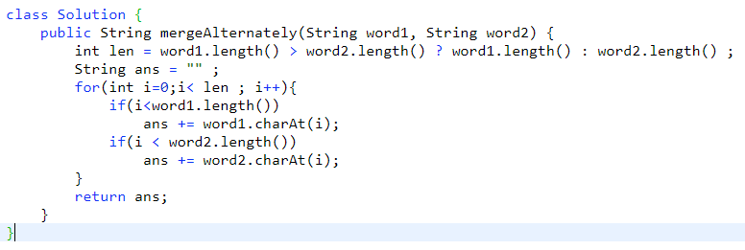
題目範例一 LeetCode 75 String Problem 1768. Merge Strings Alternately Easy
Input 測資
return 答案、print不算

Slide 9
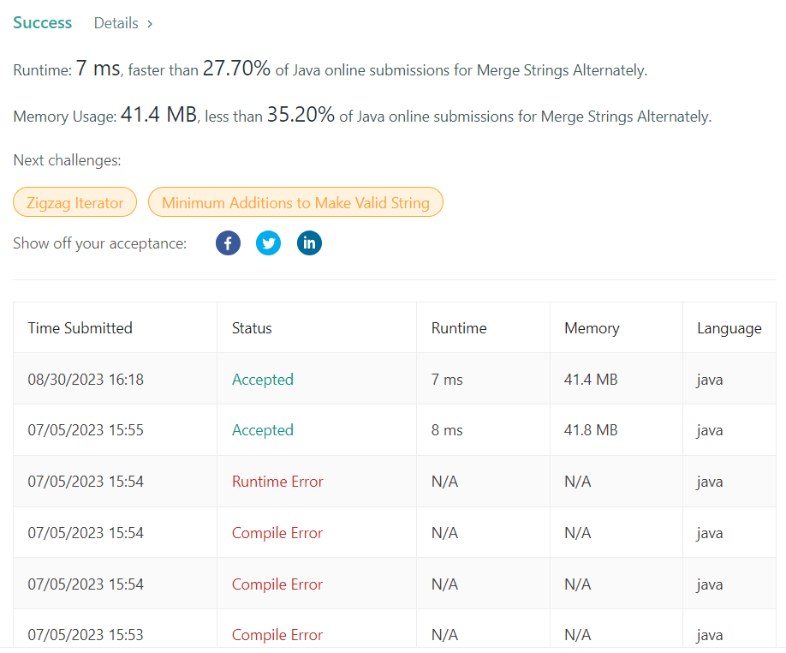
Runtime Error Compile Error Wrong Answer

Slide 10
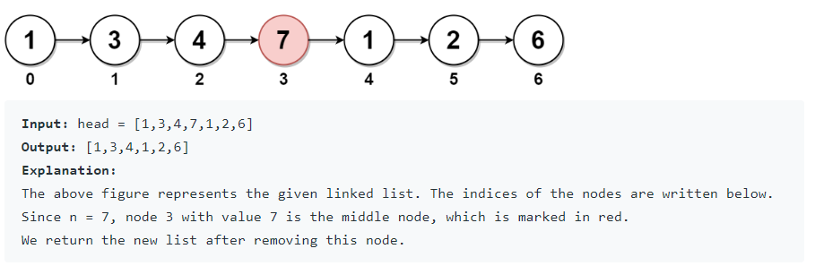
題目範例二 LeetCode 75 LinkedList Problem 2095. Delete the Middle Node of a Linked List Medium
You are given the head of a linked list. Delete the middle node, and return the head of the modified linked list.
The middle node of a linked list of size n is the ⌊n / 2⌋^{th} node from the start using 0-based indexing,
where ⌊x⌋ denotes the largest integer less than or equal to x.
For n = 1, 2, 3, 4, and 5, the middle nodes are 0, 1, 1, 2, and 2, respectively.

Slide 11
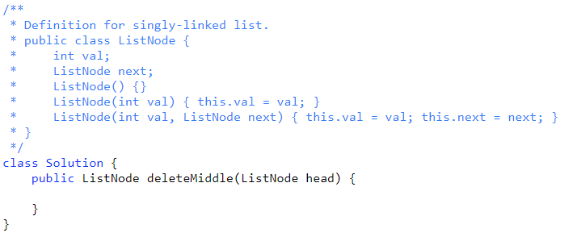
題目範例二 LeetCode 75 LinkedList Problem 2095. Delete the Middle Node of a Linked List Medium

Slide 12
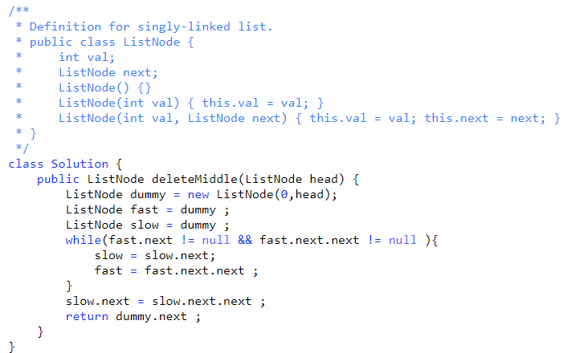
題目範例二 LeetCode 75 LinkedList Problem 2095. Delete the Middle Node of a Linked List Medium

Slide 13
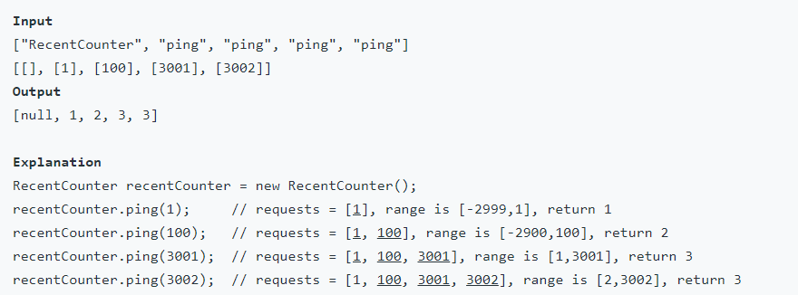
題目範例三 LeetCode 75 Queue Problem 933. Number of Recent Calls Easy
You have a RecentCounter class which counts the number of recent requests within a certain time frame.
Implement the RecentCounter class:
RecentCounter() Initializes the counter with zero recent requests.
int ping(int t) Adds a new request at time t, where t represents some time in milliseconds,
and returns the number of requests that has happened in the past 3000 milliseconds
(including the new request). Specifically,
return the number of requests that have happened in the inclusive range [t - 3000, t].
It is guaranteed that every call to ping uses a strictly larger value of t than the previous call.

Slide 14
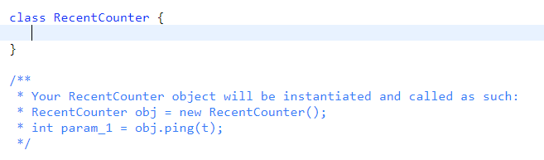
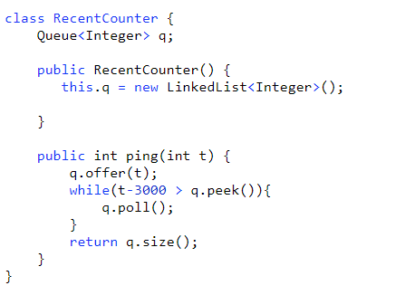
題目範例三 Problem 933. Number of Recent Calls Easy

Slide 15
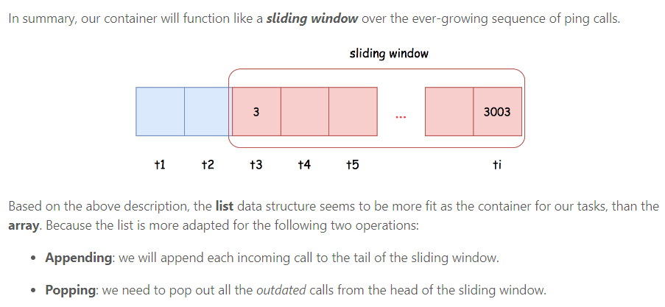
LeetCode 迷思 想破頭寫不出code? 題目越難越好嗎? 刷題的重點是？

Slide 16
討論項目 – 如何開始
方案一 LeetCode 75 + 自我加強25
方案二 Top 100 Liked Questions
如何監督
每周題數?
簡報報告梳理邏輯? + 共同討論
如何測驗

Slide 17
連結
https://leetcode.com/problem-list/top-100-liked-questions/?page=1
Top 100 liked questions
https://haren.medium.com/leetcode刷題新手先備與相關知識分享-681328997c86
[Leetcode] 刷題新手先備與相關知識分享
https://chiglife.medium.com/如何克服初期瓶頸-LeetCode初學者的刷題經驗分享-e596174262c5
如何克服初期瓶頸？LeetCode初學者的刷題經驗分享
https://zxi.mytechroad.com/blog/leetcode-problem-categories/
花花醬的題庫分享
https://fagao-programing.coderbridge.io/2022/02/26/how-to-start-leetcode/
如何開始使用LeetCode刷題？ -要努力讓自己閃閃發亮

