Slide 1

Capstone Three
Taxi Trip Duration

Slide 2
Background
Taxi trip durations in NYC can vary wildly because of several factors from weather and traffic to simply geography of the pickup and drop-off locations.
The goal of this analysis is to determine which factors predict the taxi trip's duration.

Slide 3
Problem
How can trip duration prediction help control costs and maintain a level of accuracy relating to ‘appropriate’ travel times for taxi drivers and benefit passengers by informing how long trips will take, ahead of time?

Slide 4
Data
The main data stems from the 2016 NYC Yellow Cab trip record data from Big Query on the Google Cloud Platform.
Two main datasets will be used for this project:
taxi_train
Consists of 1,458,644 observations and 11 variables corresponding to detailing pickup & drop off times, passenger count and other variables
taxi_test
Consists of 625,134 observations and 10 variables, like taxi_train, but without the target variable (trip_duration)

Slide 5
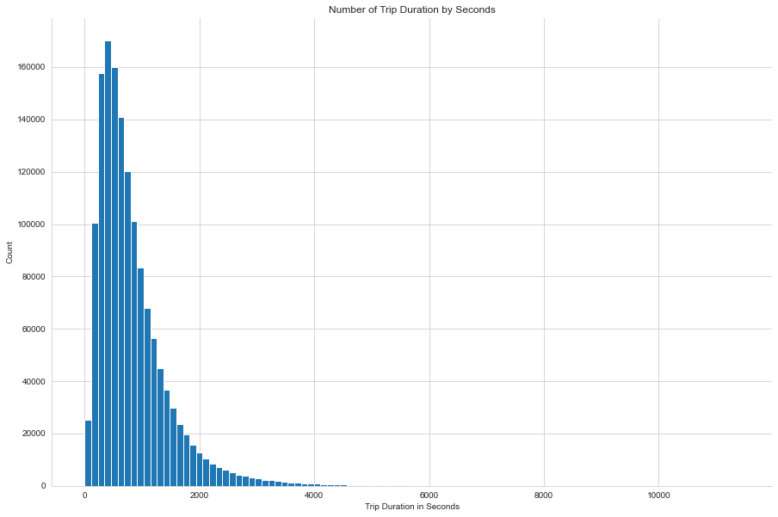
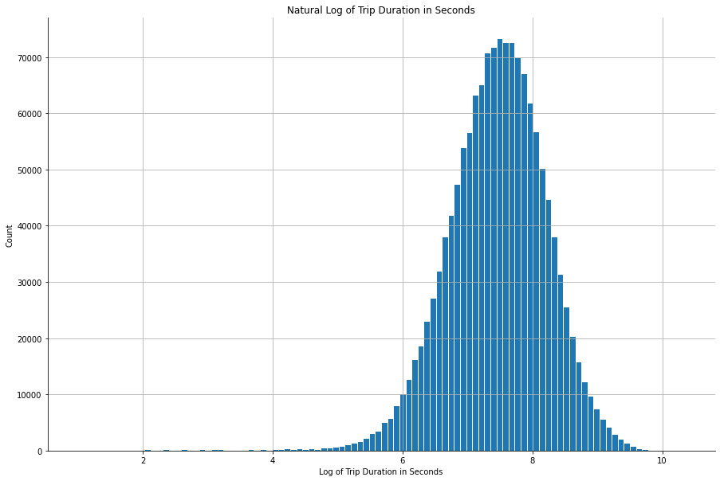
Exploratory Data Analysis: Trip Duration
It looks like most of the trips are between 600 & 1,000 seconds, or about 10 to 15 minutes.
There’s a lot of variability so we’ll implement a logarithmic scale to account for the plethora of values.

Slide 6
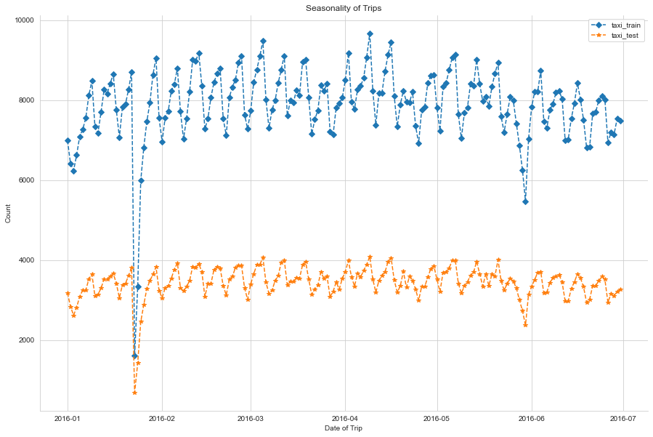
EDA: Seasonality
late January
Looks like there's quite the dip in trips in late January, with another modest dip in late May.
May
My initial guesses are around data errors versus anything season-related (winter in January or Spring in May). Outliers!

Slide 7
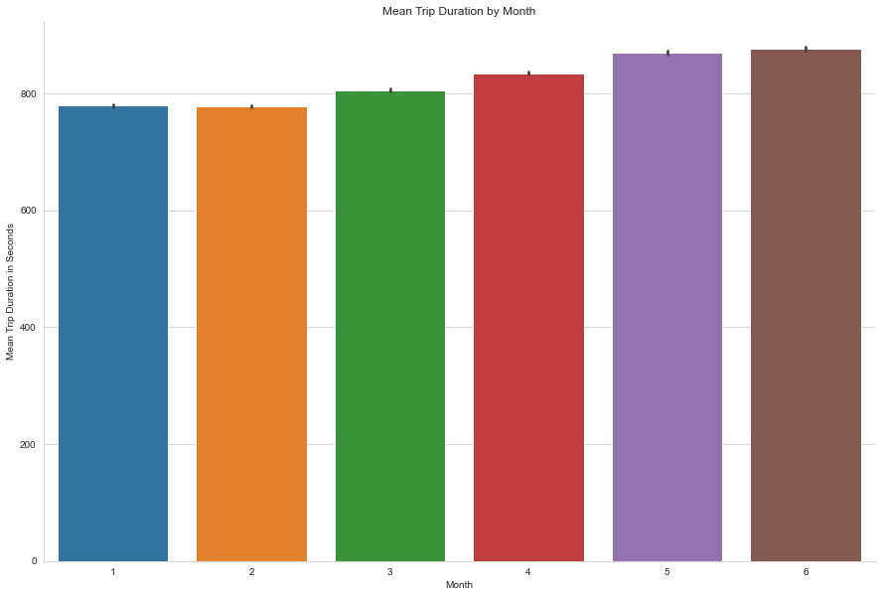
EDA: Month
Nothing really stands out here, across the first 6 months of the year.

Slide 8
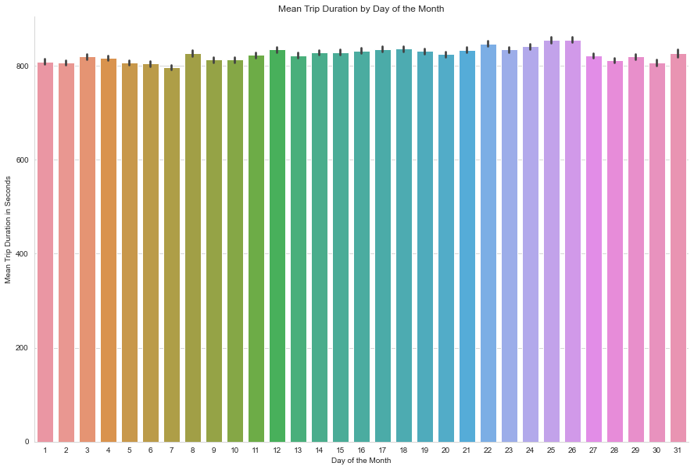
EDA: Day of the Month
Again, consistent.

Slide 9
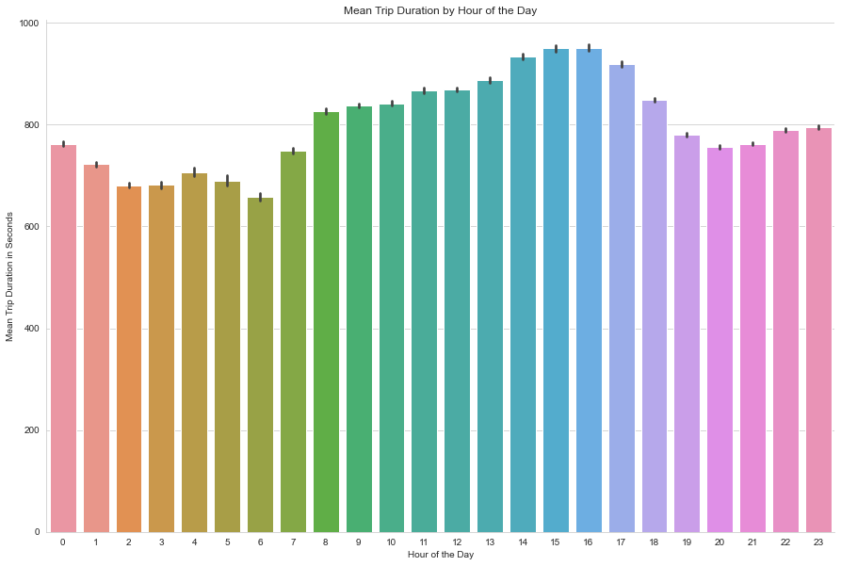
EDA: Hour of the Day
It makes sense that trip_duration during typical working hours of 8a - 5p are longer.
The assumption is that there're more people on the road, commuting and generally creating traffic.

Slide 10

Feature Engineering: Speed
Three functions created to calculate distance:
haversine_array: Haversine distance is great-circle distance between two points on a sphere using latitude & longitude
dummy_manhattan_distance: Calculates the summed distance traveled in Manhattan
bearing_array: Calculates the bearing of the distance traveled

Slide 11
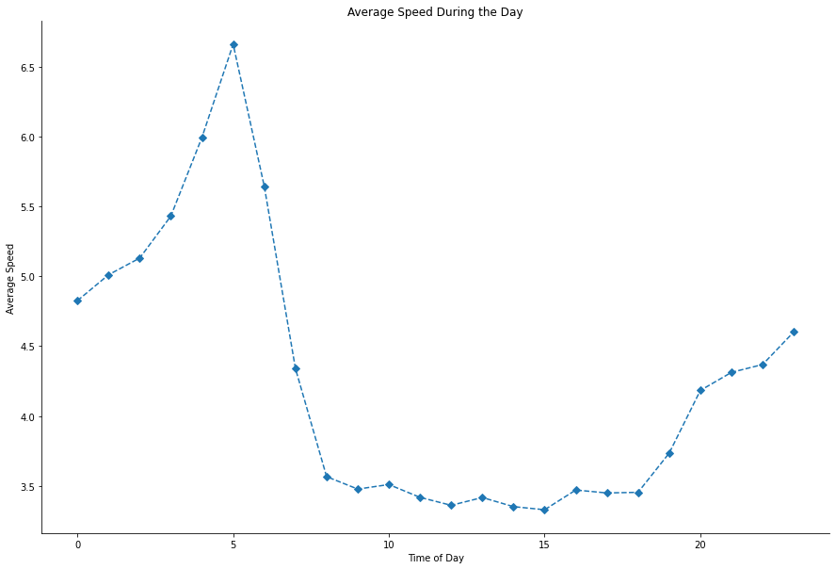
FE: Speed by Hour
During the day: typical work hours of 8a - 5p have the lowest average speed of taxi trip

Slide 12
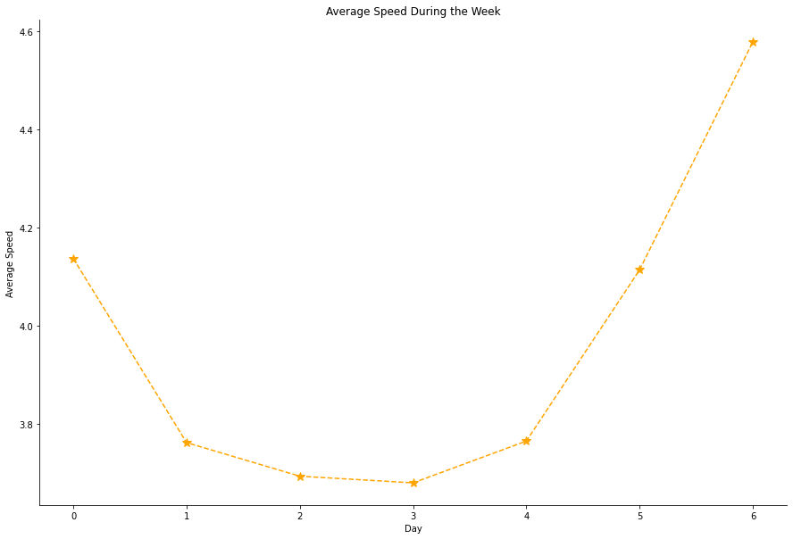
FE: Speed by Day of Week
During the week: Monday - Thursday have the lowest average speed of taxi trip

Slide 13
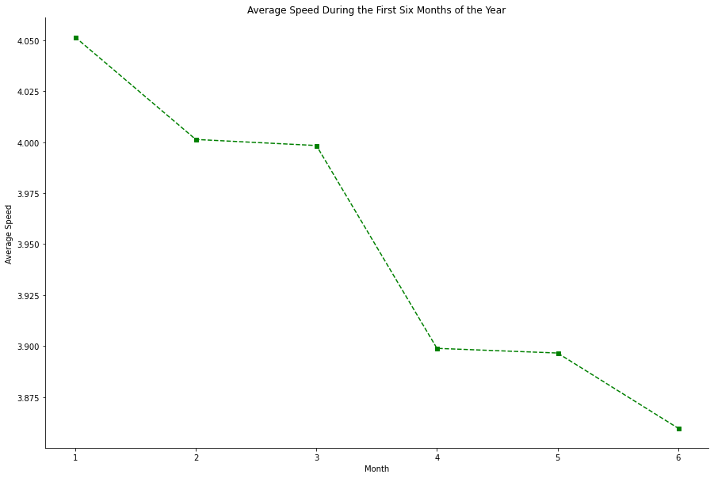
FE: Speed by Month
During the year: warmer months have lower average speed

Slide 14

Modeling: XGBoost
I need a validation set to use with XGBoost algorithm.
It'll take three datasets:
a training set
a test set
a validation set.
The validation dataset evaluates the accuracy of the training model.
The training model, of course, is used to make predictions against the test dataset.

Slide 15
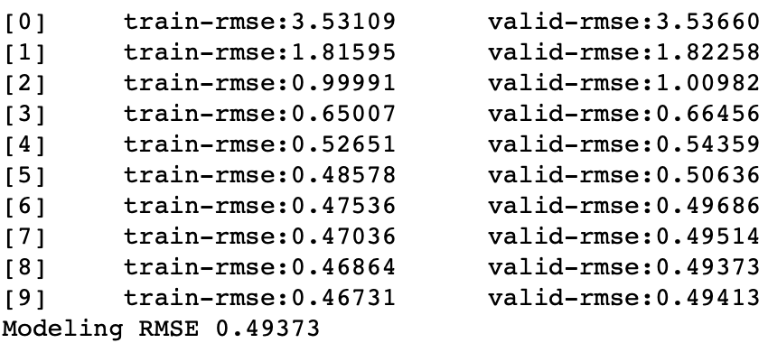
Modeling: XGBoost Parameters
This will train until valid-rmse hasn't improved in 10 rounds.
md = [6]
lr = [0.1, 0.3]
mcw = [20, 25, 30]
for m in md:
for l in lr:
for n in mcw:
t0 = datetime.now()
xgb_pars = {'min_child_weight': n, 'eta': l, 'colsample_bytree': 0.9,
'max_depth': m, 'subsample': 0.9, 'lambda': 1., 'nthread': -1,
'booster' : 'gbtree', 'silent': 1, 'eval_metric': 'rmse', 'objective': 'reg:squarederror'}
model = xgb.train(xgb_pars, xg_train, 50, watchlist, early_stopping_rounds=10,
maximize=False, verbose_eval=1)

Slide 16
Modeling: XGBoost Evaluation
The RMSE is below 0.5!
Based on a rule of thumb, it can be said that RMSE values between 0.2 and 0.5 show that the model can relatively predict the data accurately.

Slide 17
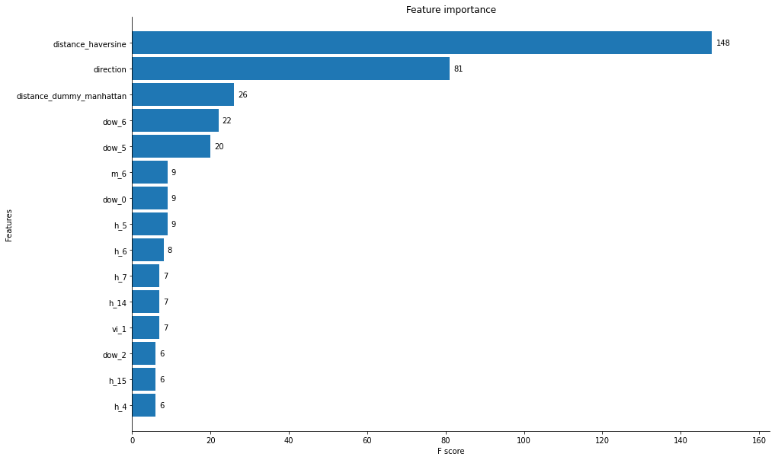
Modeling: Feature Effect
From the top-down, we're seeing which features have the greatest effect on trip duration.
It makes sense that (haversine) distance has the greatest effect since the further you're going, the longer it'll take to get there.

Slide 18
Recommendation
Between the hours of 8a & 5p, prioritizing nearby drop off locations, will result in shorter trips and better trip duration times.
It would behoove the taxi & limousine company to determine drop off location ahead of time via either an app where users enter their destination or via a dispatcher that’s organizing a driver’s pickup spots.

Slide 19

Future Analyses
There’s a machine learning algorithm called Open Source Routing Machine (OSRM) that’s determined the best route between two points. There’s already a Kaggle Kernel with these routes determined for this dataset.
There’re 2 reasons why I’d look at this for future analyses:
Would incorporating that kind of ML knowledge into how a driver gets around the city impact the mean trip duration?
If a ‘good’ route had been chosen during the typical rush hour, would it impact trip duration?

