Slide 1

Predicting Specialized High School Admissions Offers
What drives offers to attend NYC’s specialized high schools?
Domingo José Moronta | November 2020

Slide 2
Background
Performance on the Specialized High School Admissions Test (SHSAT) determines eligibility to one of the eight specialized high schools in New York City.
Of major concern is the racial & ethnic breakdown of admitted students, showing significant underrepresentation from Black and Latinx students.
This is especially apparent given the percentage of NYC that is represented by Black & Latinx residents.

Slide 3
Problem
What factors not only predict the number of specialized high school admissions offers received by students, across the board, but specifically for Black & Latinx students?

Slide 4
Data
Two main datasets are used:
2016 School Explorer
Consists of 1,272 schools in New York City, and 161 variables, provided via Kaggle.
Primarily, it’s school descriptors, e.g. grades, race & ethnicity student percentages, high/low performing percentages of students.
2017-2018 SHSAT Admissions Test Offers By Sending School
Consists of the 2017 SHSAT results, available via NYC’s Open Data Portal.
All test takers are 28,000+, grade 8 students, grouped by school.

Slide 5
Approach & Method
The goal of this analysis is to elicit which factors predict performance on the SHSAT. These factors will serve as beacons to direct or draw services, whether education-based or otherwise, towards improving the percentage of Black and Latinx students admitted to the specialized high schools.
As a bit of forecasting, I'll use linear regression models to determine how many admissions offers schools, that fit a certain testing aptitude standard could be getting, based on their standardized (yearly) testing scores.

Slide 6

Data Status & Feature Engineering
In order to better group the schools, several new features were created that account for scores on regularly adminitered standardized tests.
This data is broken up into two kinds of information, ELA (English Language Arts) & Math. Scoring on these tests top out at 4, with 1 representing the worst score.
This allows us to better train the linear regression model on fewer features/variables.

Slide 7
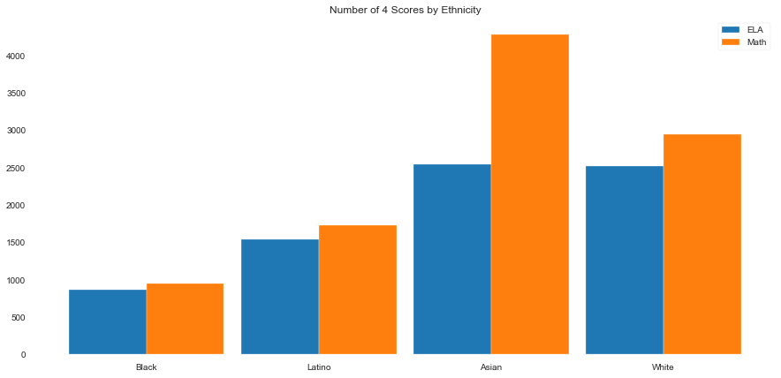
Exploratory Data Analysis: Race & Ethnicity
An initial assumption is that those students who perform well on standardized tests would equally perform well on the SHSAT.
This breakdown may hint, on these limited criteria, why less Black & Latinx students receive admissions offers.

Slide 8
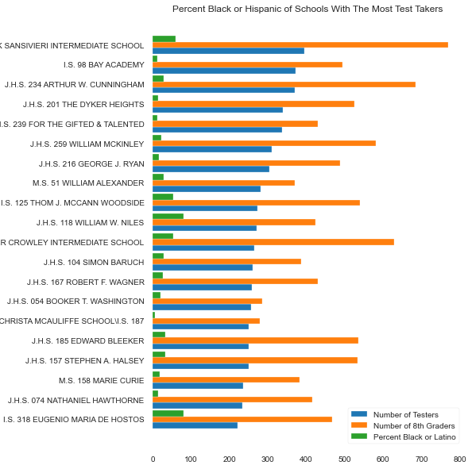
EDA: Highest Number of Test Takers
Looking at schools with the highest number of SHSAT test takers, we can see most of them have low percentages of Black & Latinx student bodies (green).

Slide 9
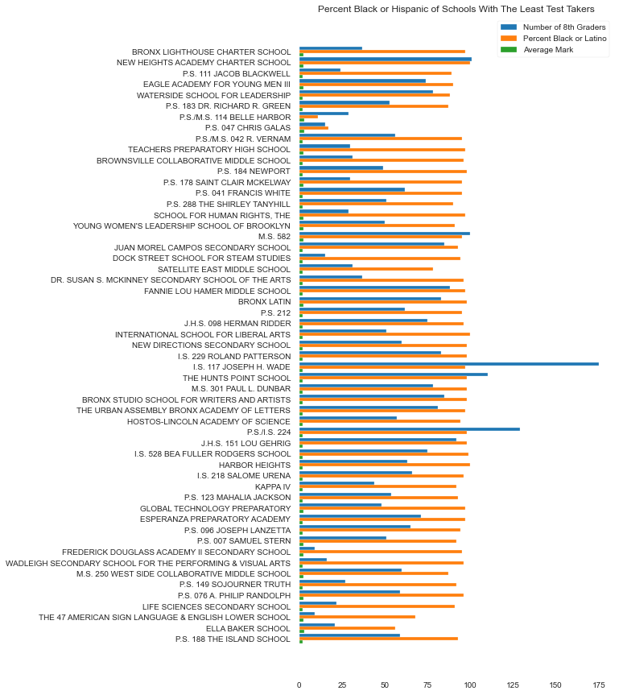
EDA: Least Number of Test Takers
Schools with the least number of SHSAT test takers have nearly 100% Black & Latinx student bodies (orange)

Slide 10
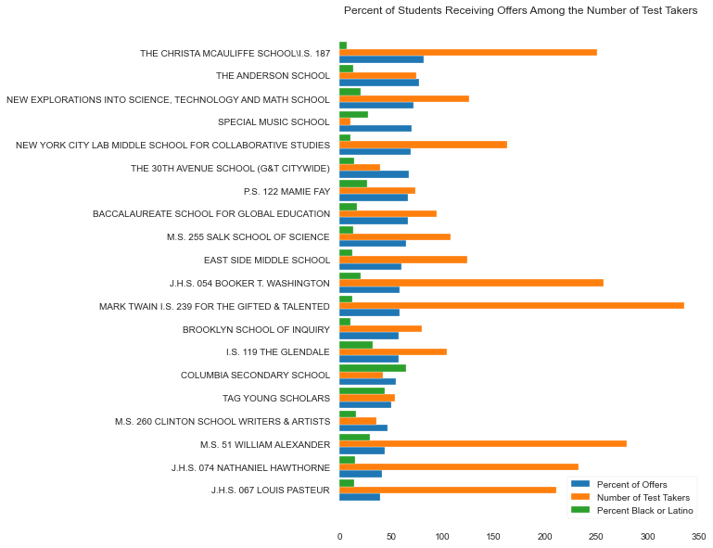
EDA: Most Percentage of Admissions Offers
Among the schools with the highest percentage of their test takers/students receiving admissions offers, nearly all have less than 50% Black & Latinx student bodies (green).

Slide 11
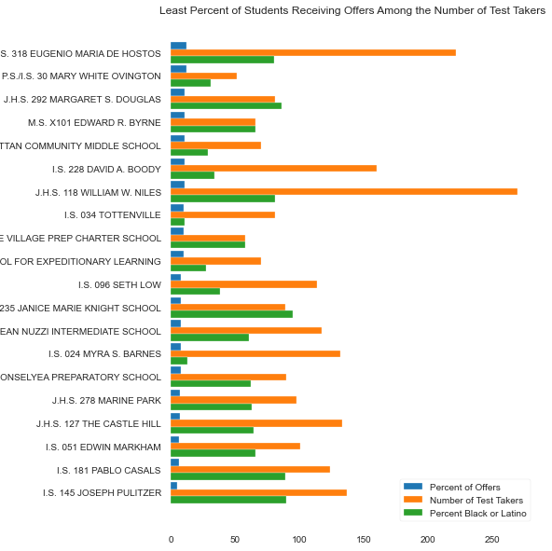
EDA: Least Percentage of Admissions Offers
Among the schools where the least percentage of their students received admissions offers, nearly all have 50% or more Black & Latinx student bodies (green).

Slide 12
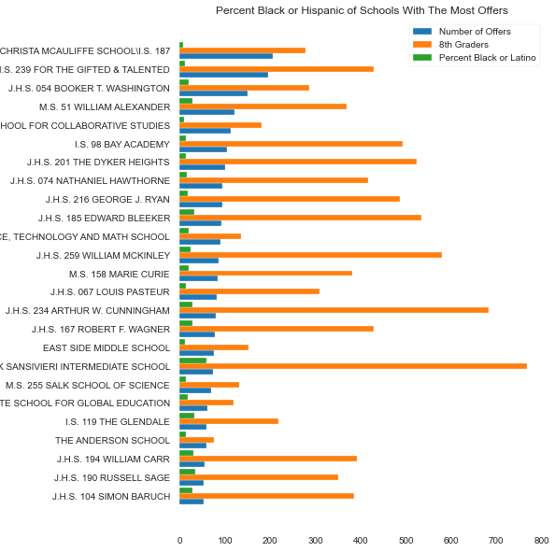
EDA: Highest Number of Offers
Among the schools that received the highest number of admissions offers for their test takers, only 1 has a 50+% Black & Latinx student body.

Slide 13
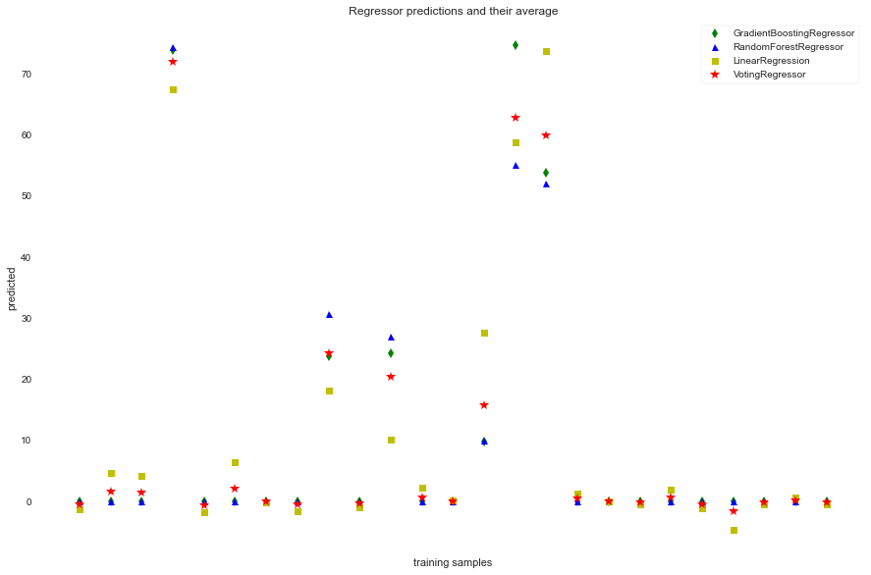
Model Comparison
I compared 3 different regression models and an ensemble method to determine which approach produced accurate results of predicting the number of offers a schools received.
I determined that the ensemble method’s (Voting) 3% increase in accuracy wasn’t worth the trade off of more time/complexity of the simpler linear regression (OLS).

Slide 14
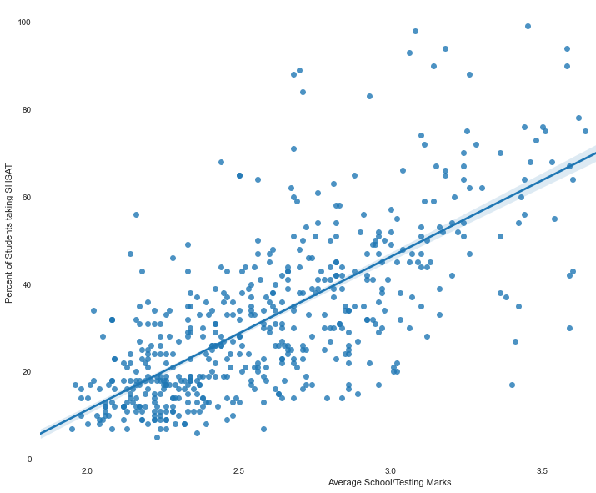
Recommendation #1: More Testers
There was a strong correlation between the number of admissions offers received and the actual number of SHSAT test takers the schools sent.

Slide 15
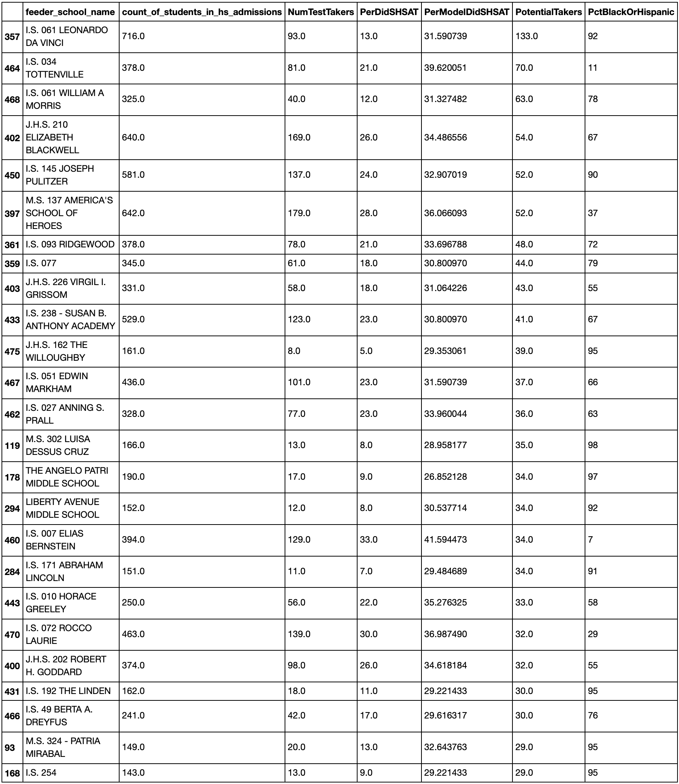
Recommendation #1: Schools
These are the top 20 schools that could’ve sent more SHSAT test takers (PotentialTakers).
Most have 50+% Black & Latinx student bodies (PctBlackOrHispanic).

Slide 16
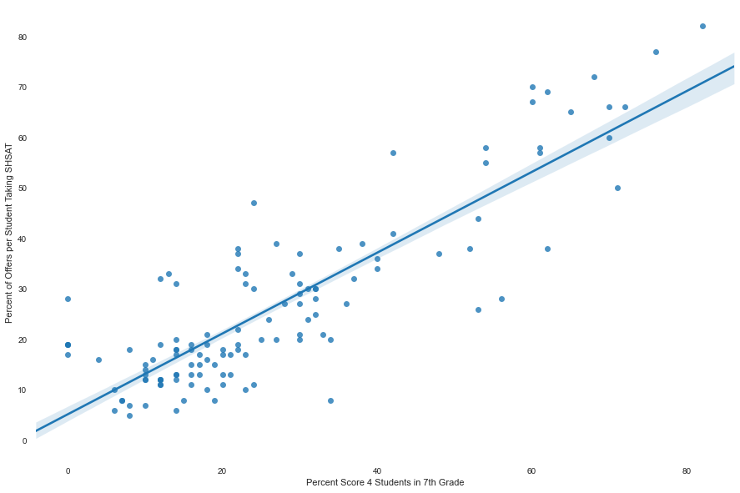
Recommendation #2: More Level 4s
The assumption proved true that those schools with high performers (level 4 ELA/Math scores) had a strong correlation to more admissions offers.

Slide 17
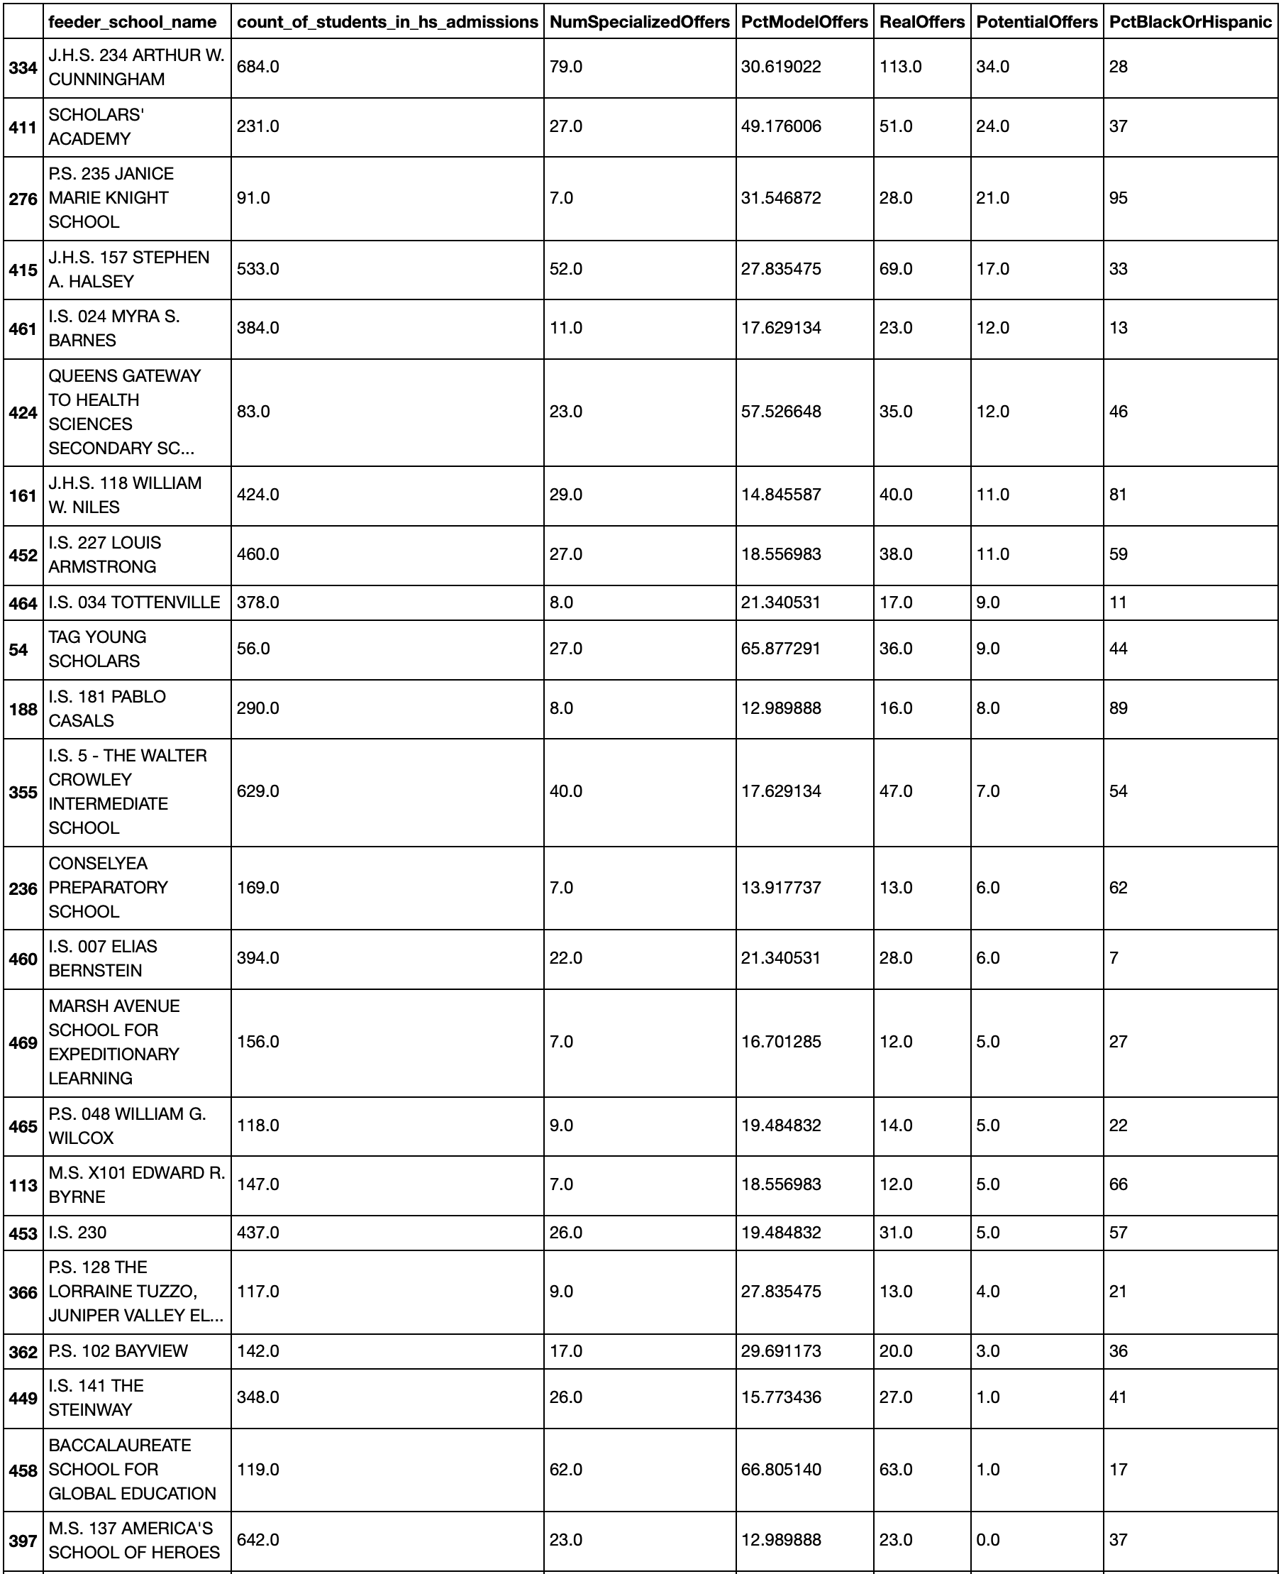
Recommendation #2: School
These are the top 20 schools that could’ve received 10+ more admissions offers by sending more of their level 4 students to take the SHSAT.
Many have 50+% Black & Latinx student bodies.

Slide 18

Future Analyses
Using GIS to determine if there’re any differences in admissions offers to schools/students based on how close the feeder school is to the specialized high school.
I was only able to use one year of admissions and test data. It would have been interesting to determine if there're any trends in the data across more than one year of data.
The data only contained the performance on tests that are administered to students during a typical school year.
It would be interesting to see how preparatory tests for the SHSAT relate to the number of offers received by schools/students.
Also, looking at any after-school prep programs' impact on the number of offers received, would be interesting

