Slide 1

Predicting Specialized High School Admissions Offers
What drives offers to attend NYC’s specialized high schools (SHS)?
Domingo José Moronta | November 2020

Slide 2
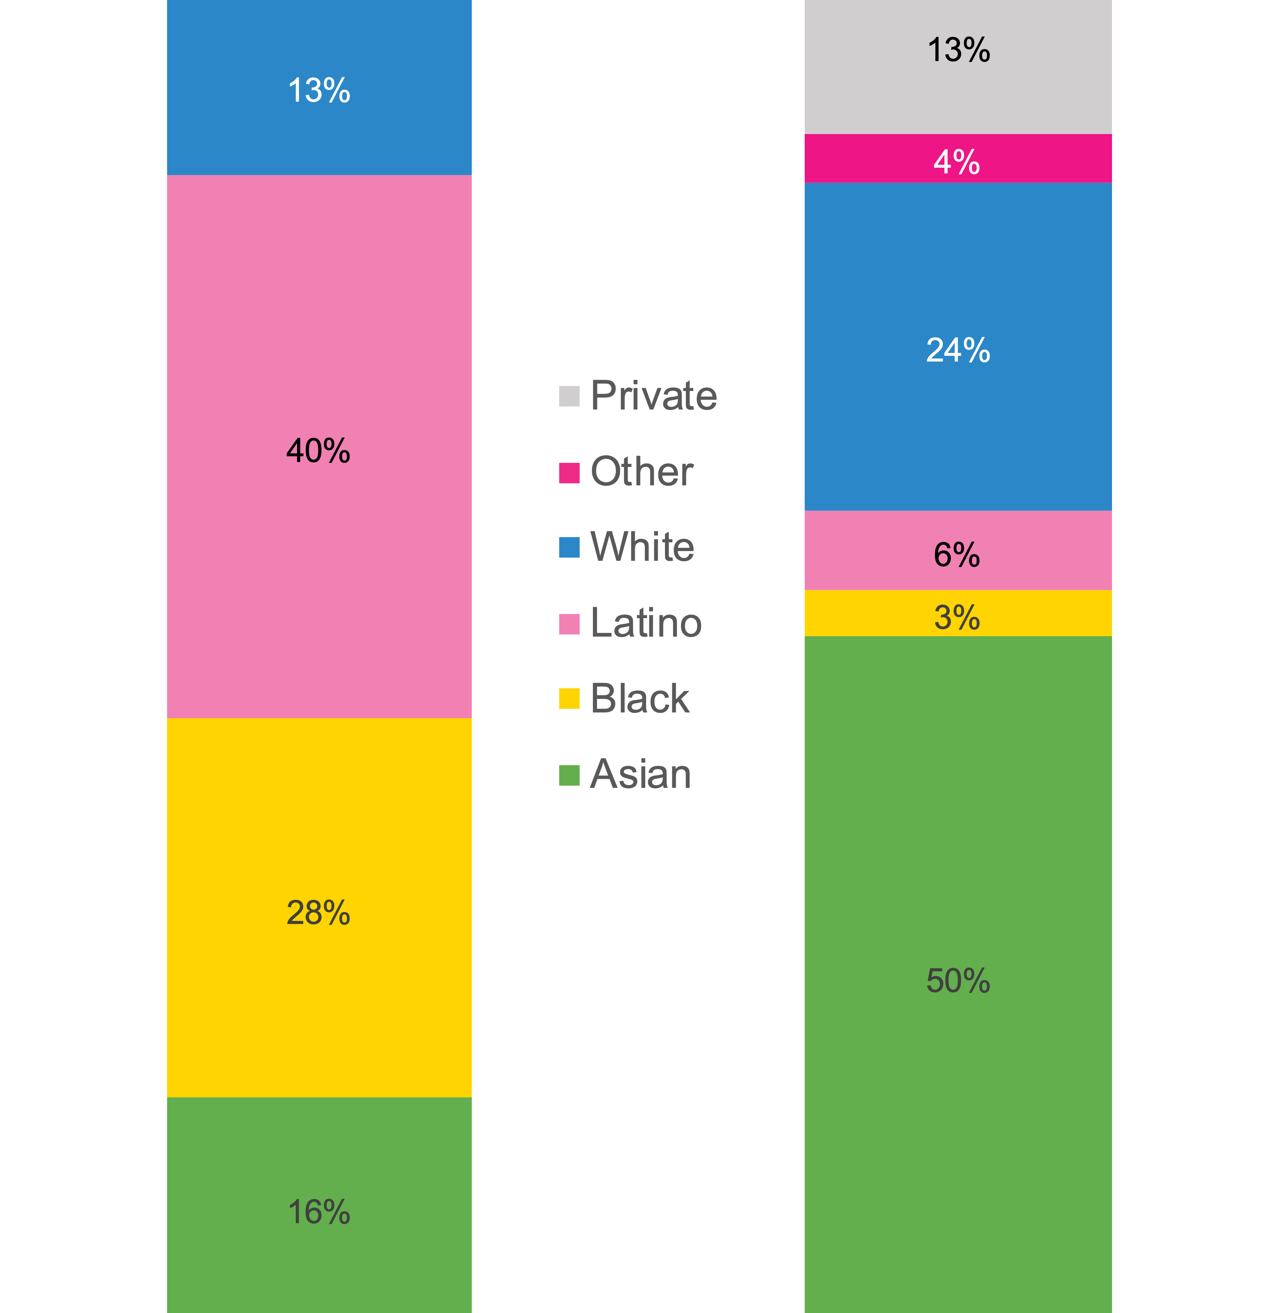
Background
Performance on the Specialized High School Admissions Test (SHSAT) determines eligibility to one of the eight specialized high schools in New York City.
Black or Latinx students represent significantly lower percentages, than other racial or ethnic groups, of SHS students:
Black & Latino students are 68% of the NYC high school population, but only 9% of the SHS offers.¹
¹ Exam Schools: Inside America’s Most Selective Public High Schools by Finn and Hockett

Slide 3

Problem Statement
Which factors that predict success on the SHSAT can increase the number of SHS admissions offers received by Black & Latinx students?

Slide 4
Data
Two main datasets are used:
2016 School Explorer
Consists of 1,272 NYC schools and 161 variables, provided via Kaggle.
Primarily, it’s school descriptors, e.g. grades, race & ethnicity demographics percentages, high/low performing percentages of students.
2017-2018 SHSAT Admissions Test Offers By Sending School
Consists of 595 schools and the number of SHS offers received, based on the 2017 SHSAT, available via NYC’s Open Data Portal.

Slide 5

Data Cleaning & Feature Engineering
For models to perform best, improvements to data dimensionality were implemented, and several summary features were created.
For example, scores on standardized tests that were in several columns for grades 3 – 8, were summarized into one, per test, for 7th graders:
Standardized test scores, for each grade, consisted of two kinds of information, ELA (English Language Arts) & Math.
Scoring on these tests top out at 4, with 1 representing the worst score.
I’m only focusing on 7th graders as those were the pool of students taking the SHSAT in the 2017-2018 SHSAT dataset.

Slide 6
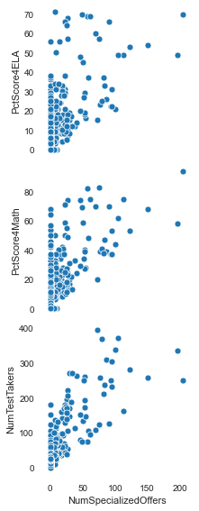
Exploratory Data Analysis: Initial Relationships
An initial plot of relationships points to a positive correlation between the number of SHS offers (NumSpecializedOffers) and the following:
Percent of the school that scored 4 in ELA (PctScore4ELA)
Percent of the school that scored 4 in Math (PctScore4Math)
Number of students sent to take the SHSAT (NumTestTakers)
We’ll explore these relationships further in our models.

Slide 7
Exploratory Data Analysis: Math by Race & Ethnicity
Seeing that ELA & Math 4 scores are tied to the number of SHS offers, we’ll dig a bit deeper.
This Math breakdown shows significantly less Black & Latinx students scoring 4s (best) on the standardized math test.

Slide 8
Exploratory Data Analysis: ELA by Race & Ethnicity
This ELA breakdown also shows significantly less Black & Latinx students scoring 4s (best).
With the strength of the relationship between ELA & Math 4 scores and SHS offers, we can potentially see why Black or Latinx students are generally receiving less SHS offers.

Slide 9
EDA: Highest Number of SHS Offers
Among the schools that received the highest number of SHS offers, nearly all are composed of fewer than 30% Black or Latinx students.

Slide 10
EDA: Highest Percent of SHS Offers
Among schools with the highest percentage of their test takers/students receiving SHS offers, all are composed of less than 30% Black or Latinx students.

Slide 11
EDA: Least Percent of SHS Offers
Among the schools where the least percentage of their students received SHS offers, nearly all are composed of 60% or more Black or Latinx students.

Slide 12
EDA: Highest Number of Test Takers
Looking at relationship between SHS offers and the number of SHSAT test takers:
Most of the schools with the highest number of SHSAT test takers are composed of less than 30% Black or Latinx students.

Slide 13
EDA: Least Number of Test Takers
Nearly all schools with the least number of SHSAT test takers are composed of 80% or more Black or Latinx students.

Slide 14
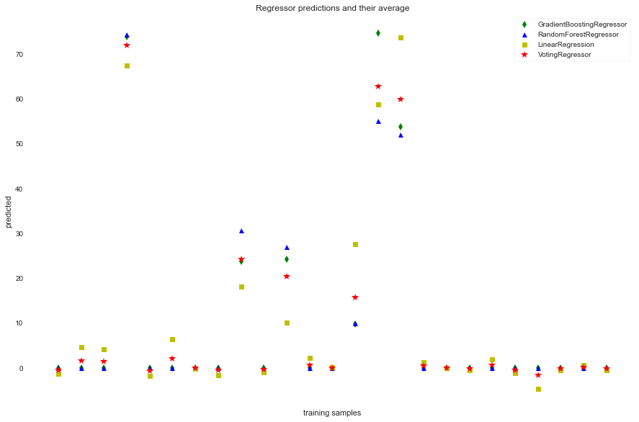
Regression Model Comparison
I compared 4 different regression models including an ensemble to predict the number of SH offers per school.
Using the first 25 schools as my training & testing sample I received the following R² values:
Gradient Boosting Regressor R²: 0.930
Random Forest Regressor R²: 0.946
Linear Regression R²: 0.930
Voting Regressor R²: 0.966
The ensemble’s (Voting) 3% increase in R² seemed like too much of a trade off compared to the linear regression model.

Slide 15
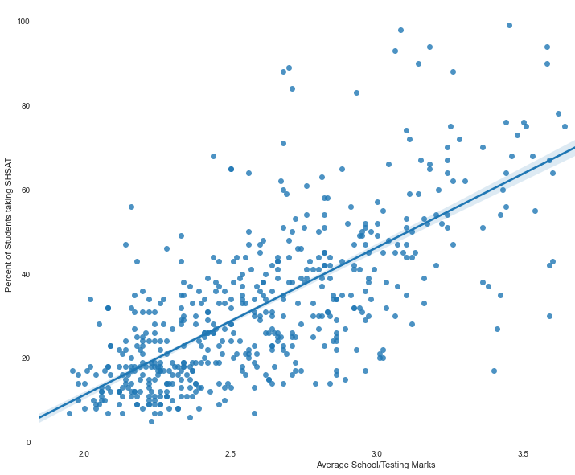
Recommendation #1: More (Qualified) Testers
We saw earlier the positive correlation between SHS offers and SHSAT test takers.
But which students to send?
Here we see the strong relationship between a student’s scores on standardized tests and taking the SHSAT.
A higher testing score means more students (in a school) took the SHSAT
Based on the ELA & Math test scores, which schools could’ve sent more students to take the SHSAT?

Slide 16
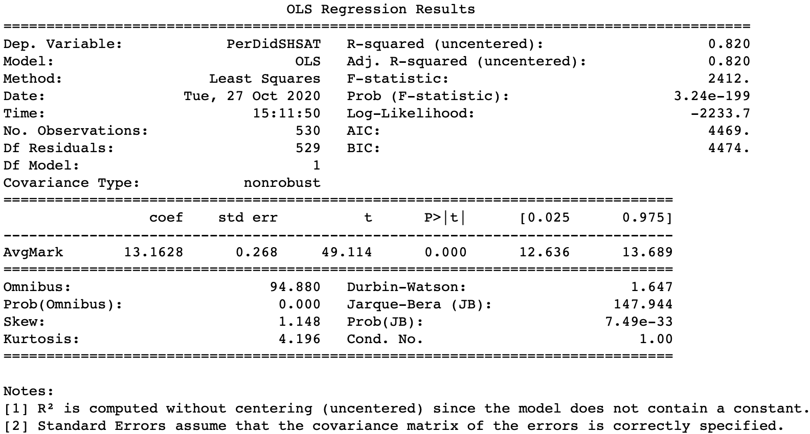
Recommendation #1: Model Metrics
Here we see a relatively strong relationship (R² = 0.820) between the percent of the school that took the SHSAT & the ELA/Math scores.

Slide 17
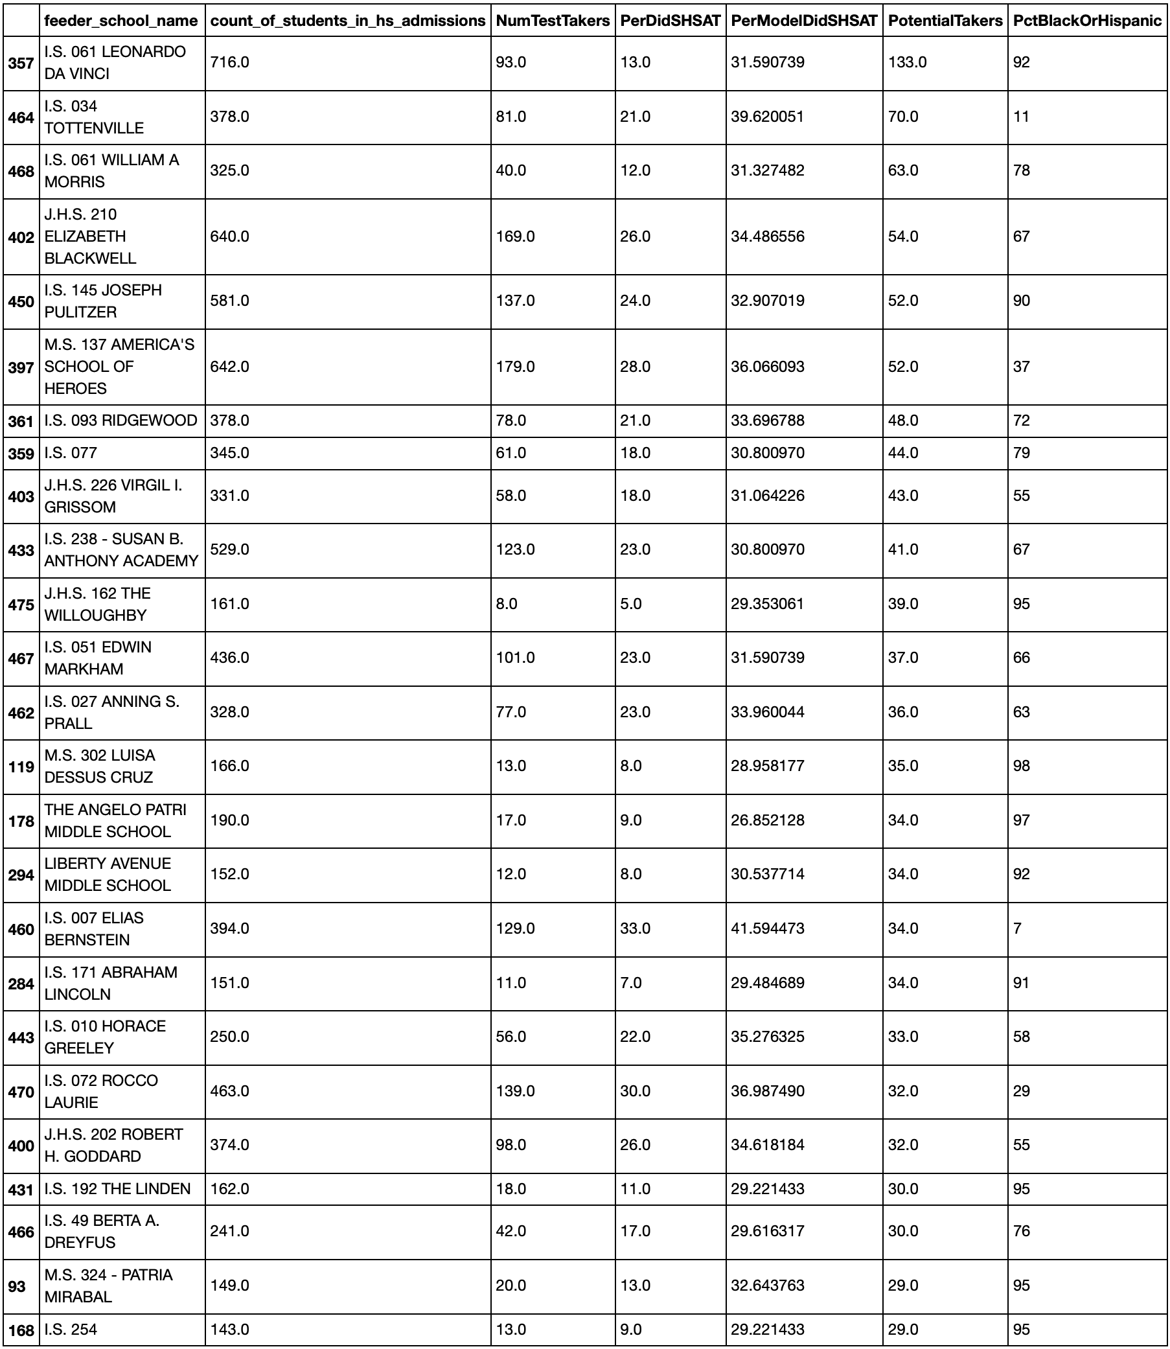
Recommendation #1: Schools
These are the top 20 schools that could’ve sent more SHSAT test takers (PotentialTakers).
Most are composed of at least 50% Black or Latinx students (PctBlackOrHispanic).

Slide 18
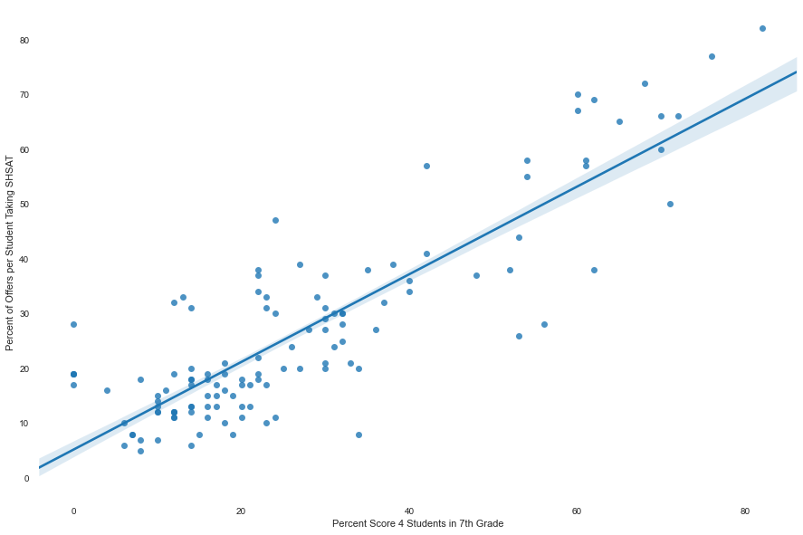
Recommendation #2: More SHS Offers
Earlier we also saw a strong relationship between high performing ELA & Math students and SHS Offers.
Here we see that the higher the percentage of ELA/Math 4 scorers you send to take SHSAT, the more of them receive SHS offers.
This is intuitive.

Slide 19
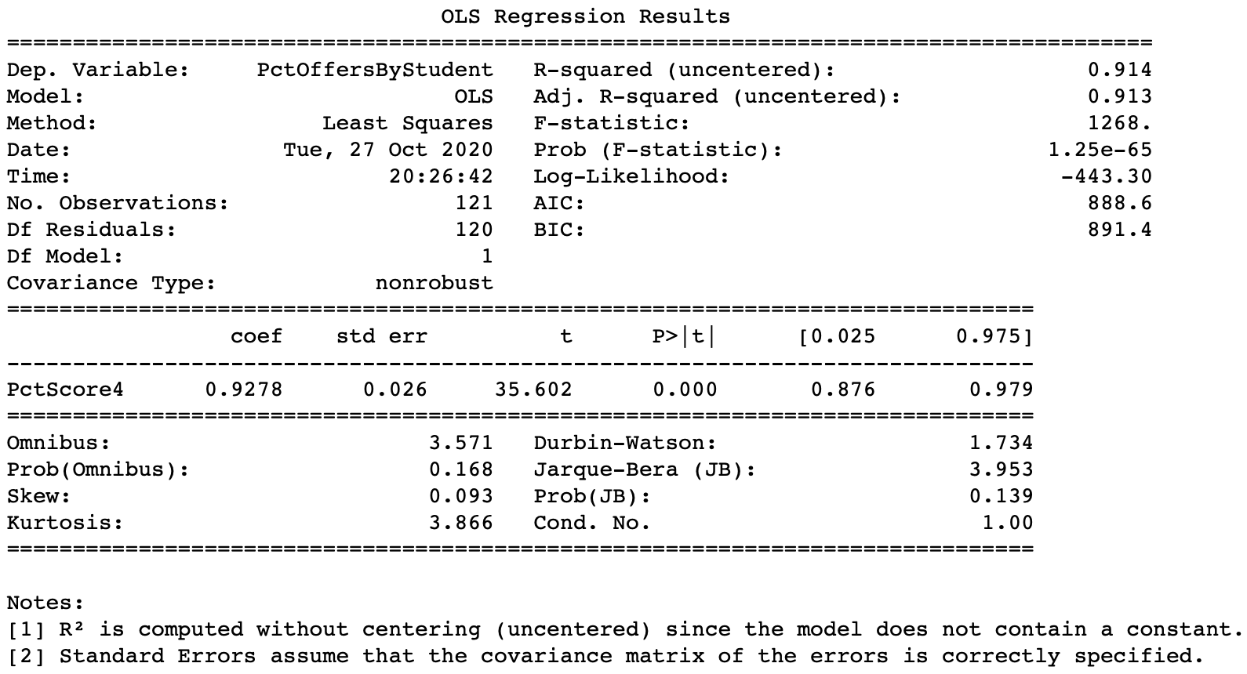
Recommendation #2: Model Metrics
Here we can see a very strong relationship (R² = 0.914) between those high performing students and SHS offers.

Slide 20
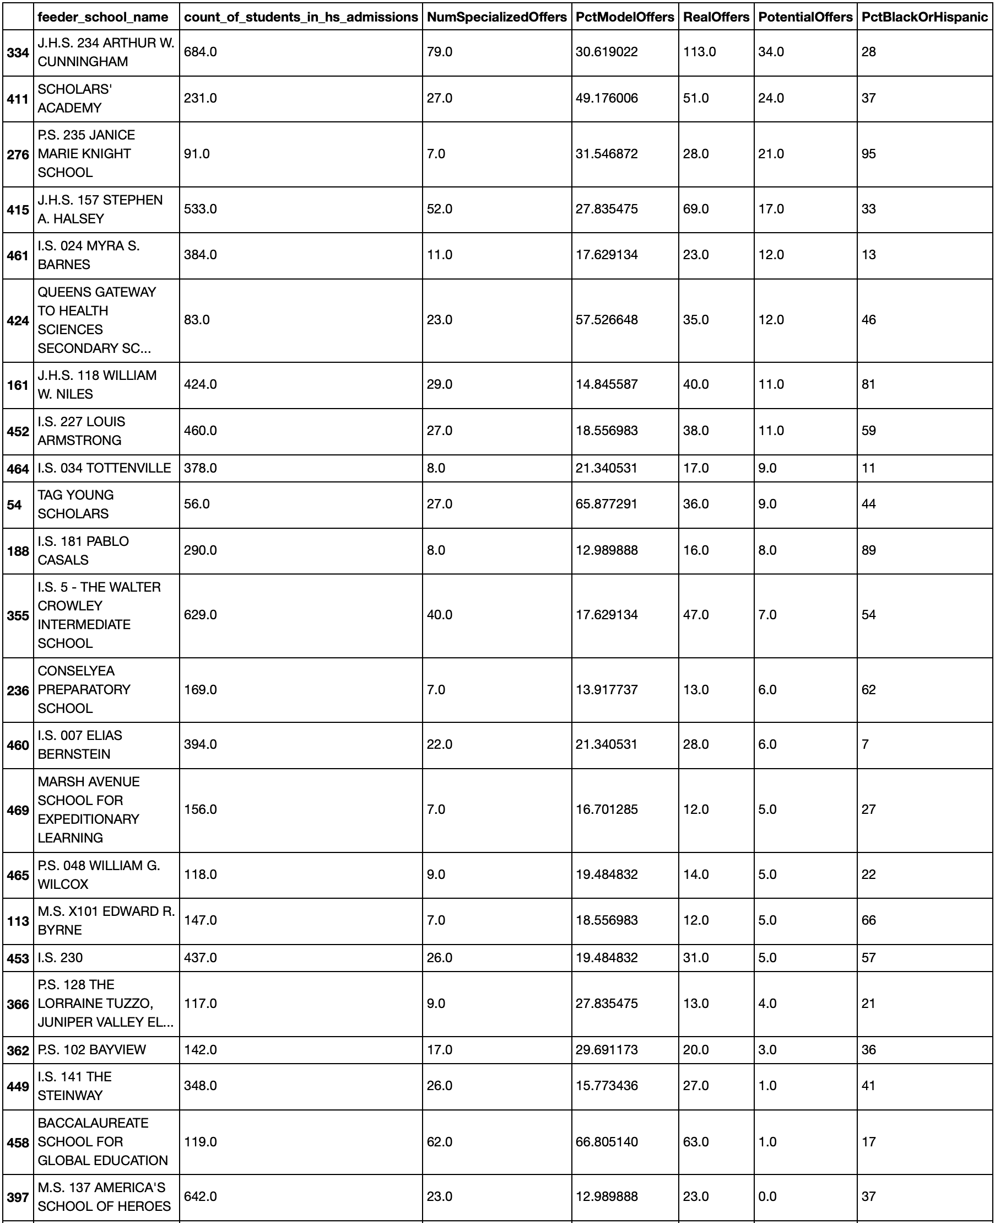
Recommendation #2: Schools
These are the top 20 schools that could’ve received 10+ more SHS offers by sending more of their 4 scorers to take the SHSAT.
Many are composed of at least 50% Black or Latinx students.

Slide 21

Future Analyses
Using GIS to determine if there’re any differences in admissions offers to schools/students based on how close the feeder school is to the specialized high school.
I was only able to use one year of admissions and test data. It would have been interesting to determine if there're any trends in the data across more than one year of data.
The data only contained the performance on tests that are administered to students during a typical school year.
It would be interesting to see how preparatory tests for the SHSAT relate to the number of offers received by schools/students.
Also, looking at any after-school prep programs' impact on the number of offers received, would be interesting

