Slide 1

Predicting Specialized High School Admissions Offers
What drives offers to attend NYC’s specialized high schools?
Domingo José Moronta | November 2020

Slide 2
Background
Performance on the Specialized High School Admissions Test (SHSAT) determines eligibility to one of the eight specialized high schools in New York City.
Black & Latinx student representation is significantly lower, than other race & ethnicities, amongst the specialized high school admitted students, given the demographics of NYC.

Slide 3
Problem
Which factors that predict success on the SHSAT can increase the number of specialized high school admissions offers received by Black & Latinx students?

Slide 4
Data
Two main datasets are used:
2016 School Explorer
Consists of 1,272 schools in New York City, and 161 variables, provided via Kaggle.
Primarily, it’s school descriptors, e.g. grades, race & ethnicity demographics percentages, high/low performing percentages of students.
2017-2018 SHSAT Admissions Test Offers By Sending School
Consists of school-level count of admissions offers based on the 2017 SHSAT, available via NYC’s Open Data Portal.

Slide 5

Feature Engineering
In order to improve the dimensionality of the data, several features were created
For example, scores on standardized tests that were in several columns were summarized into one:
Standardized test scores, for each grade, consisted of two kinds of information, ELA (English Language Arts) & Math.
Scoring on these tests top out at 4, with 1 representing the worst score.
These scores were averaged to the school level.

Slide 6
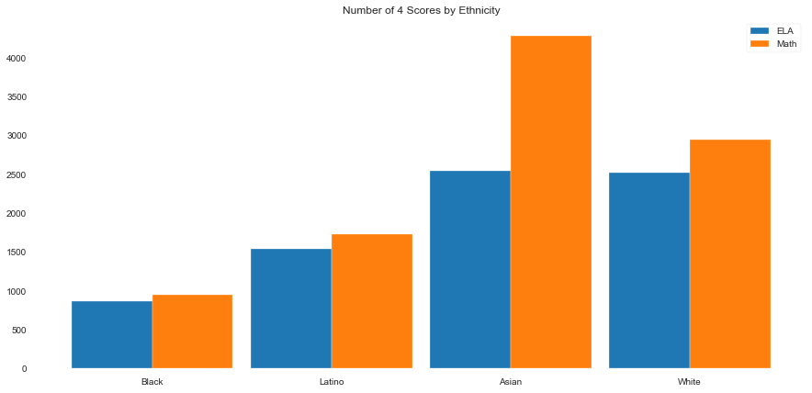
Exploratory Data Analysis: Race & Ethnicity
An initial assumption is that students who perform well on standardized tests also perform well on the SHSAT.
This breakdown may hint as to why Black & Latinx students receive less specialized high school admissions offers.

Slide 7
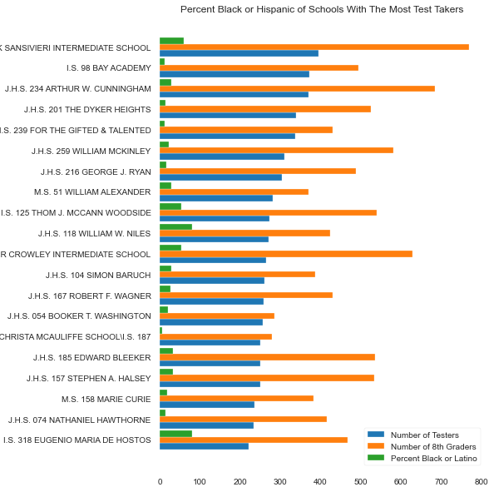
EDA: Highest Number of Test Takers
Looking at schools with the highest number of SHSAT test takers, we can see most of them have low percentages of Black & Latinx student bodies (green).

Slide 8
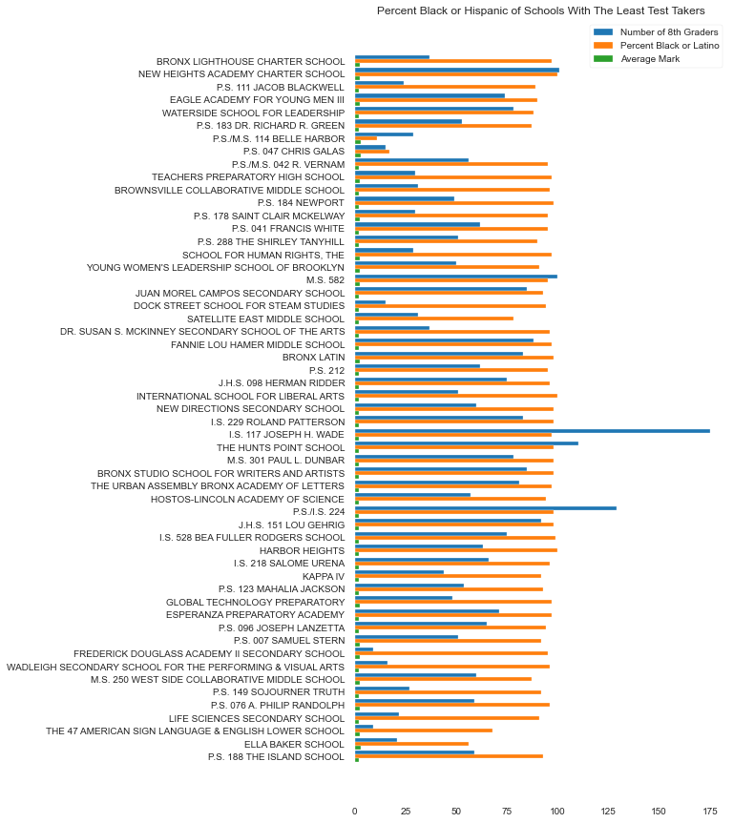
EDA: Least Number of Test Takers
Schools with the least number of SHSAT test takers have nearly 100% Black & Latinx student bodies (orange)

Slide 9
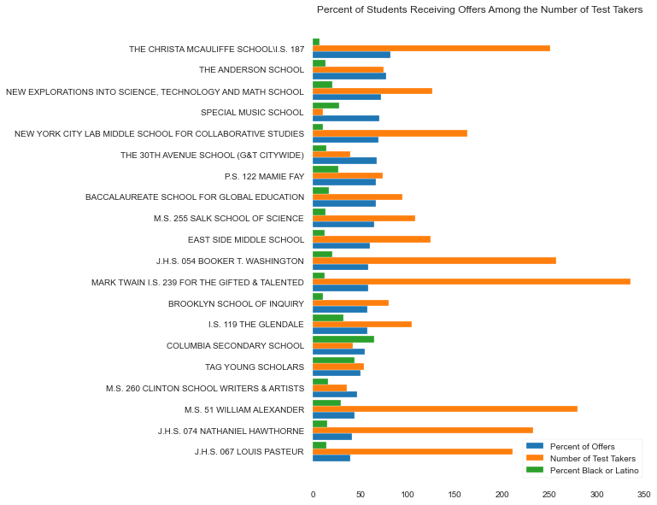
EDA: Most Percentage of Admissions Offers
Among the schools with the highest percentage of their test takers/students receiving admissions offers, nearly all have less than 50% Black & Latinx student bodies (green).

Slide 10
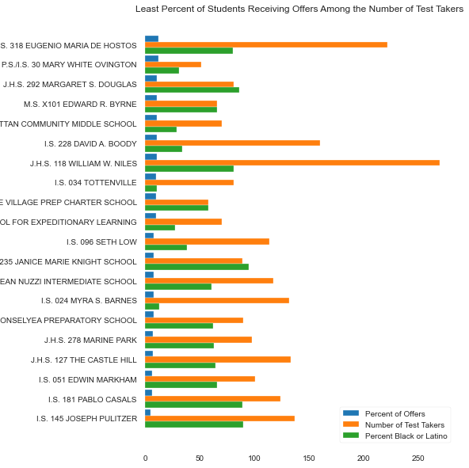
EDA: Least Percentage of Admissions Offers
Among the schools where the least percentage of their students received admissions offers, nearly all have 50% or more Black & Latinx student bodies (green).

Slide 11
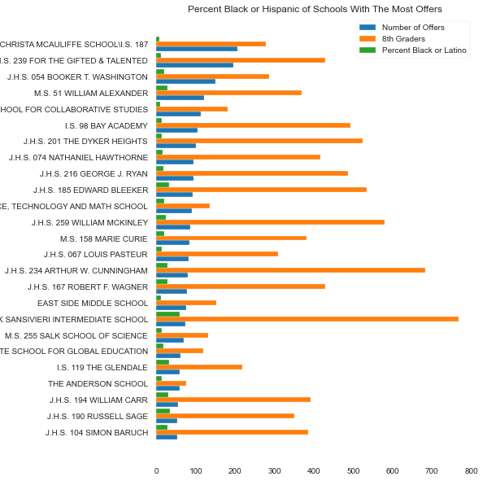
EDA: Highest Number of Offers
Among the schools that received the highest number of admissions offers for their test takers, only 1 has a 50+% Black & Latinx student body.

Slide 12
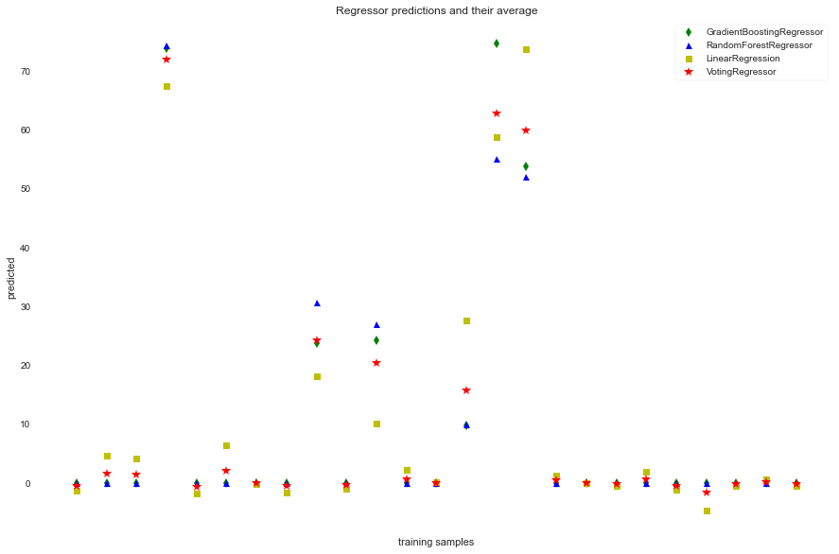
Model Comparison
I compared 3 different regression models and an ensemble method to determine which approach produced accurate results of predicting the number of offers a school received.
I determined that the ensemble method’s (Voting) 3% increase in R² (0.96 vs 0.93) wasn’t worth the trade off of more time/complexity of the simpler linear regression (OLS).

Slide 13
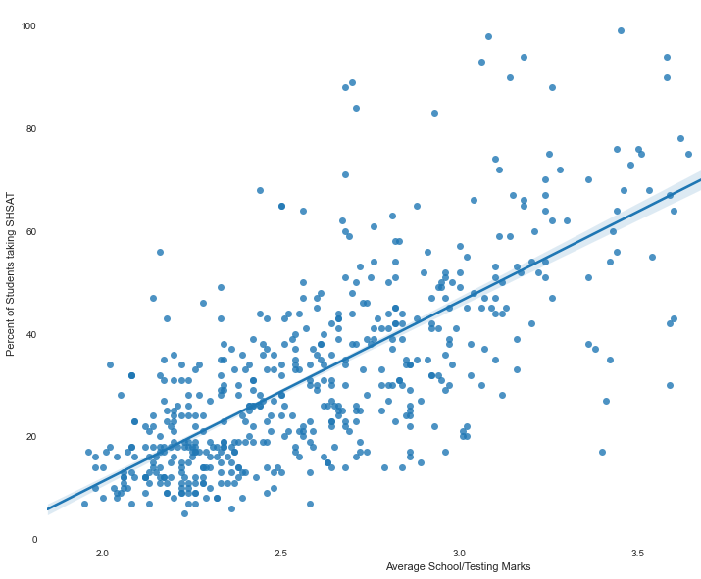
Recommendation #1: More Testers
There was a strong correlation between the number of admissions offers received and the actual number of SHSAT test takers the schools sent.

Slide 14
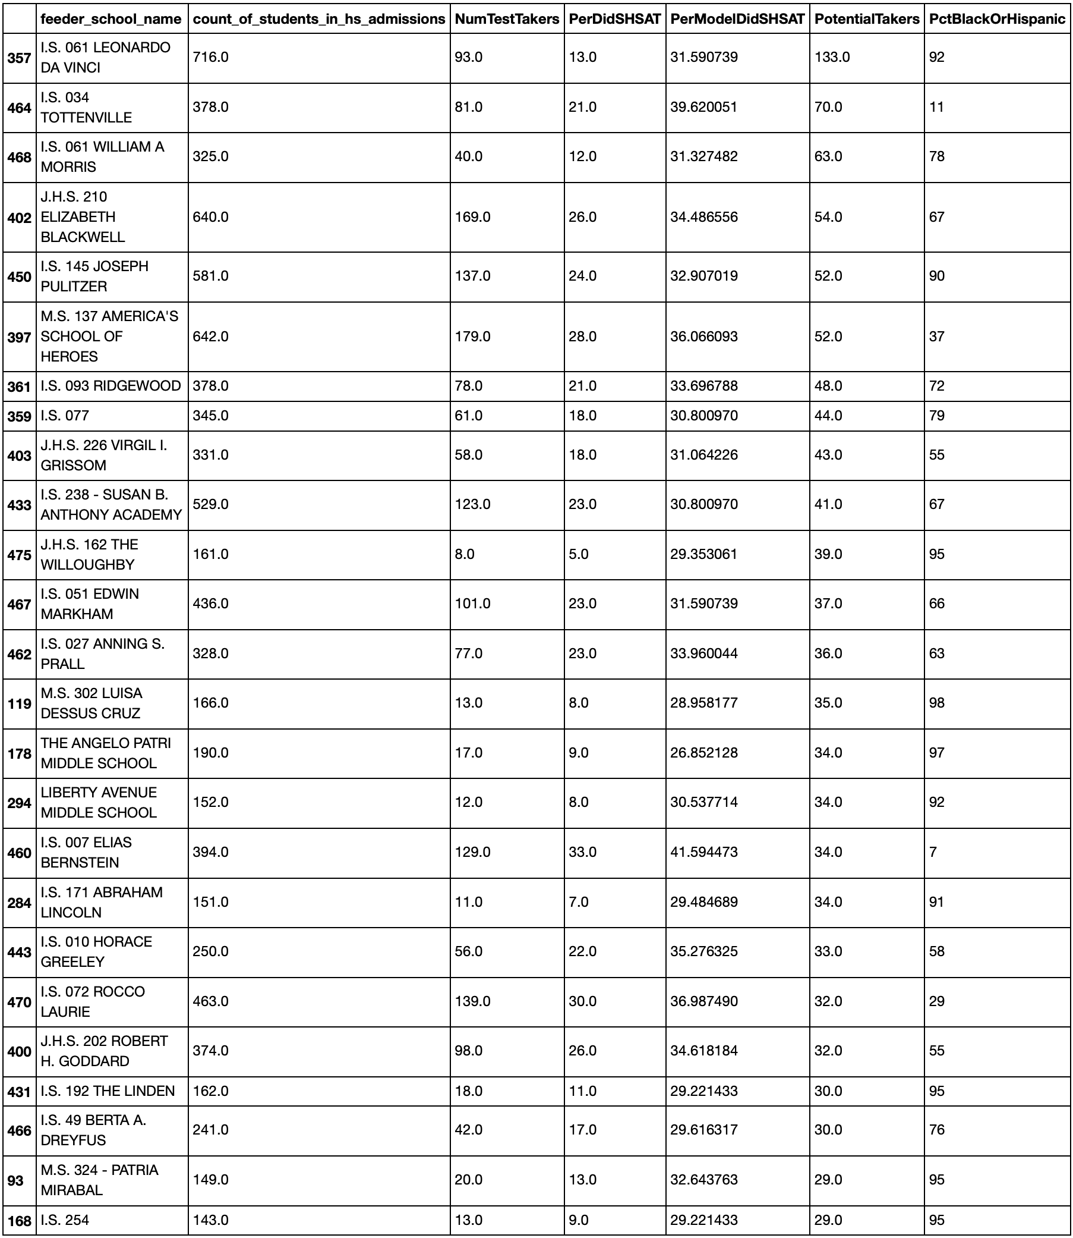
Recommendation #1: Schools
These are the top 20 schools that could’ve sent more SHSAT test takers (PotentialTakers).
Most have 50+% Black & Latinx student bodies (PctBlackOrHispanic).

Slide 15
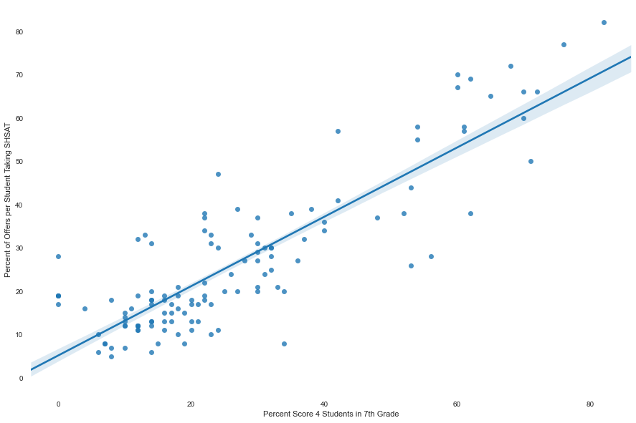
Recommendation #2: More Level 4s
The assumption proved true that those schools with high performers (level 4 ELA/Math scores) had a strong correlation to more admissions offers.

Slide 16
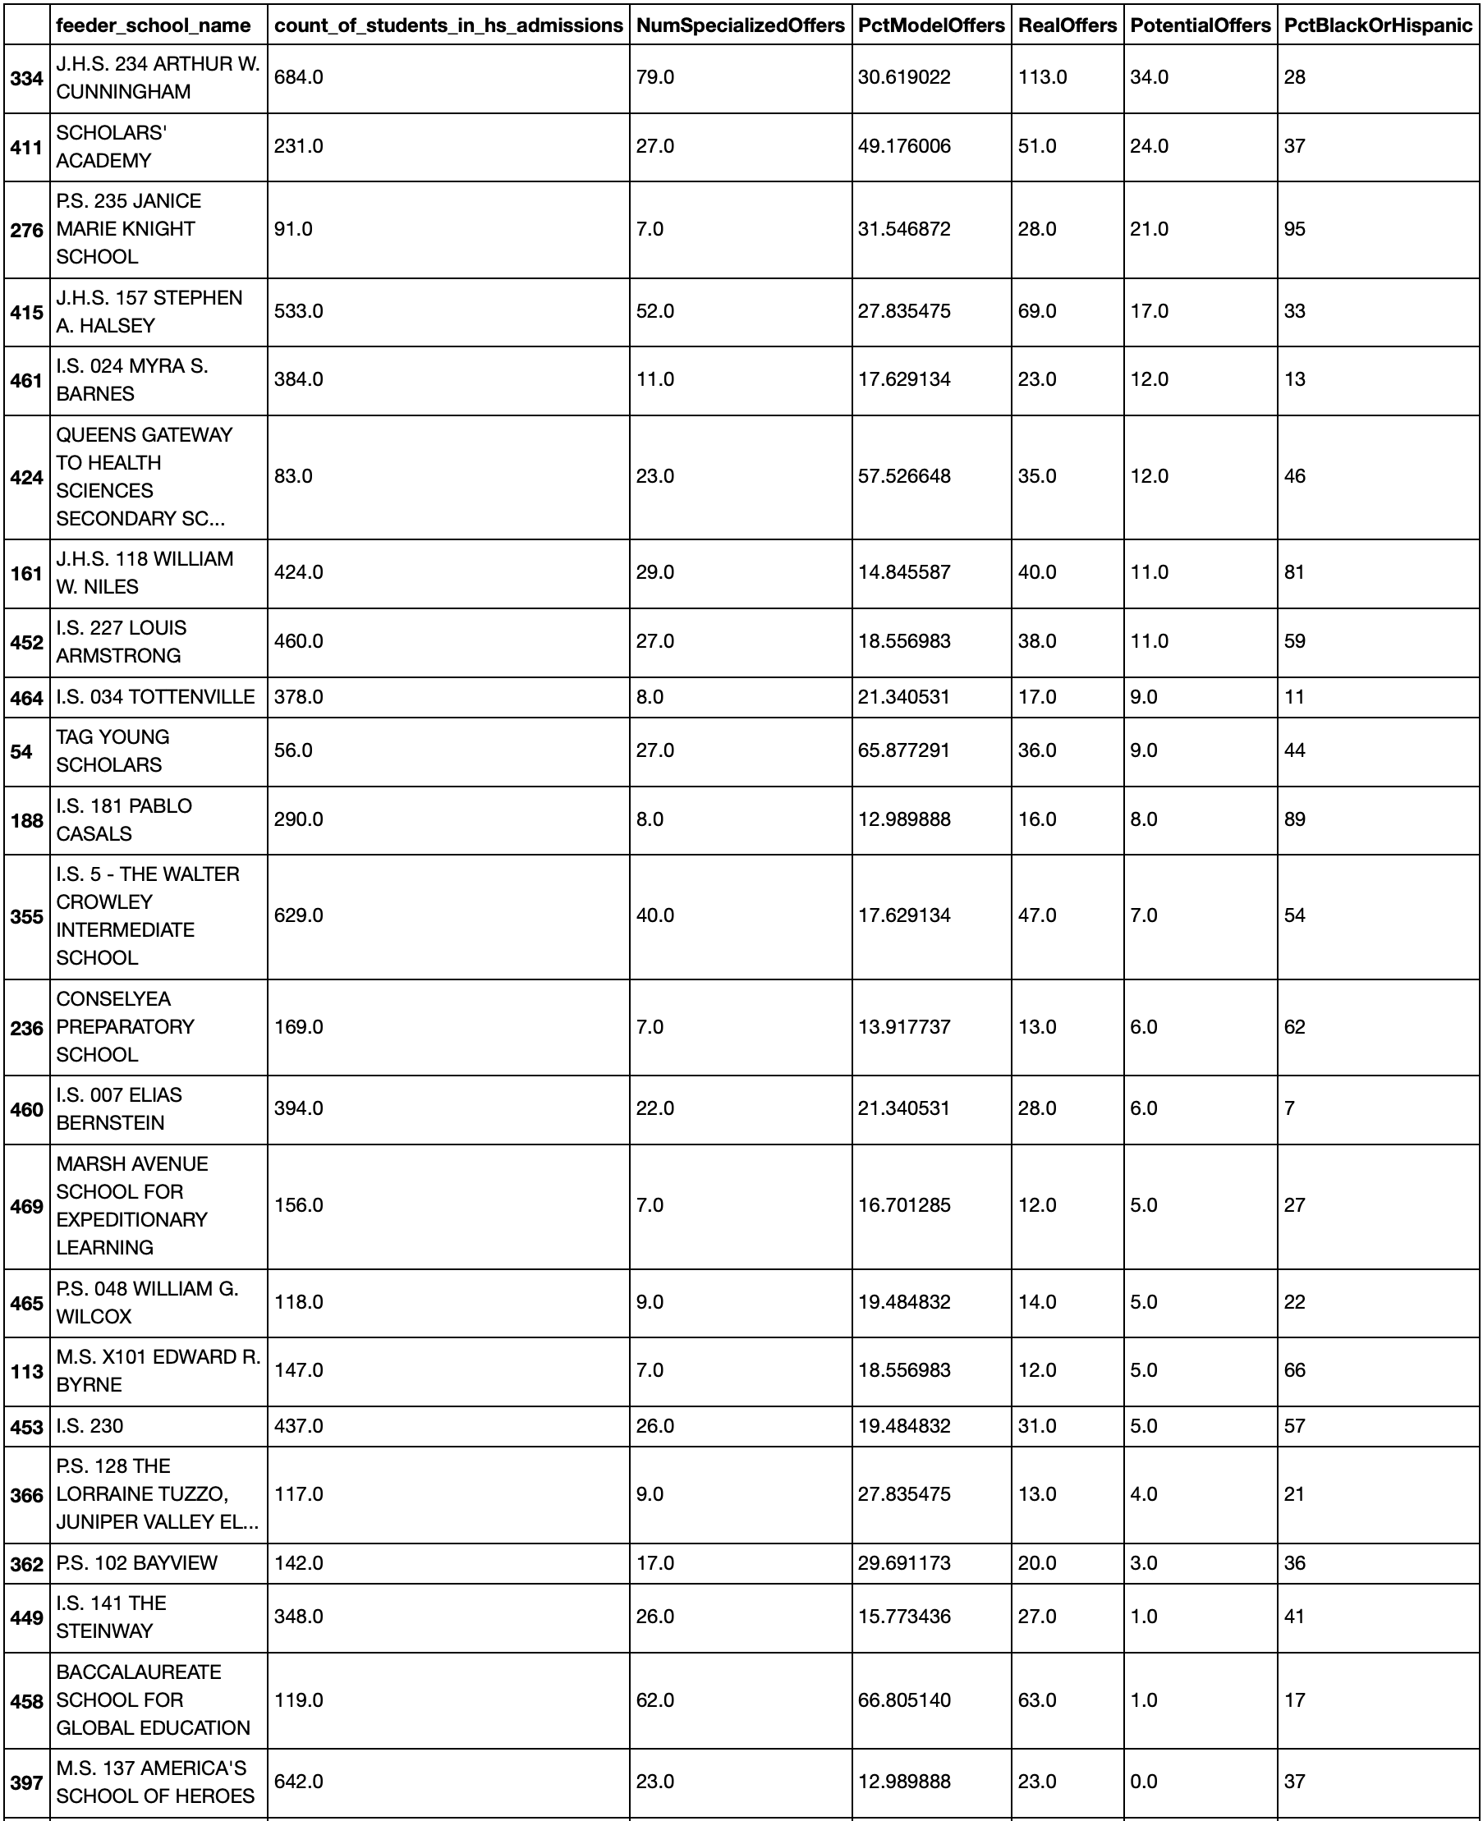
Recommendation #2: School
These are the top 20 schools that could’ve received 10+ more admissions offers by sending more of their level 4 students to take the SHSAT.
Many have 50+% Black & Latinx student bodies.

Slide 17

Future Analyses
Using GIS to determine if there’re any differences in admissions offers to schools/students based on how close the feeder school is to the specialized high school.
I was only able to use one year of admissions and test data. It would have been interesting to determine if there're any trends in the data across more than one year of data.
The data only contained the performance on tests that are administered to students during a typical school year.
It would be interesting to see how preparatory tests for the SHSAT relate to the number of offers received by schools/students.
Also, looking at any after-school prep programs' impact on the number of offers received, would be interesting

