Slide 1
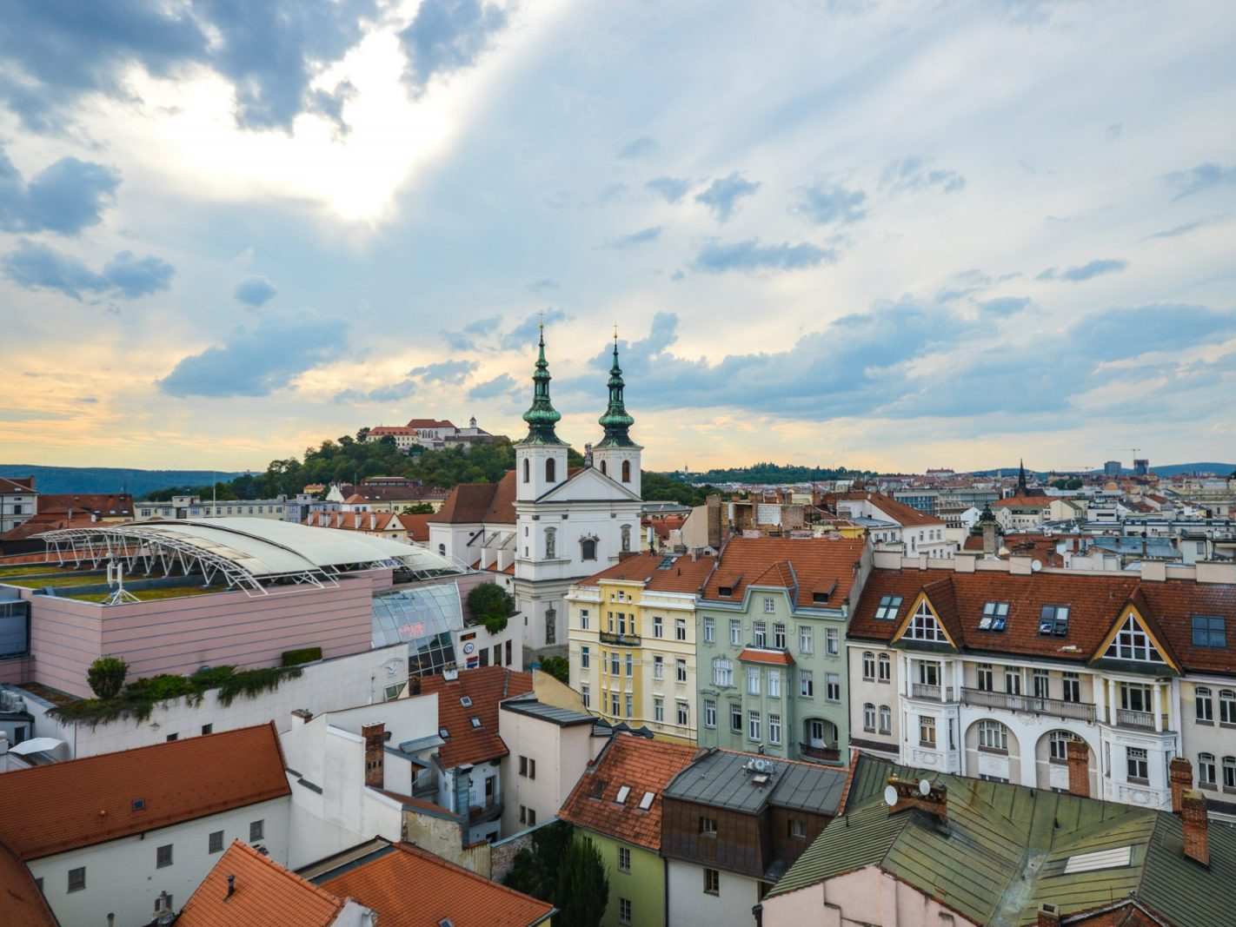

Brno – Czech Silicon Valley?
Stanislav Foltan

Slide 2

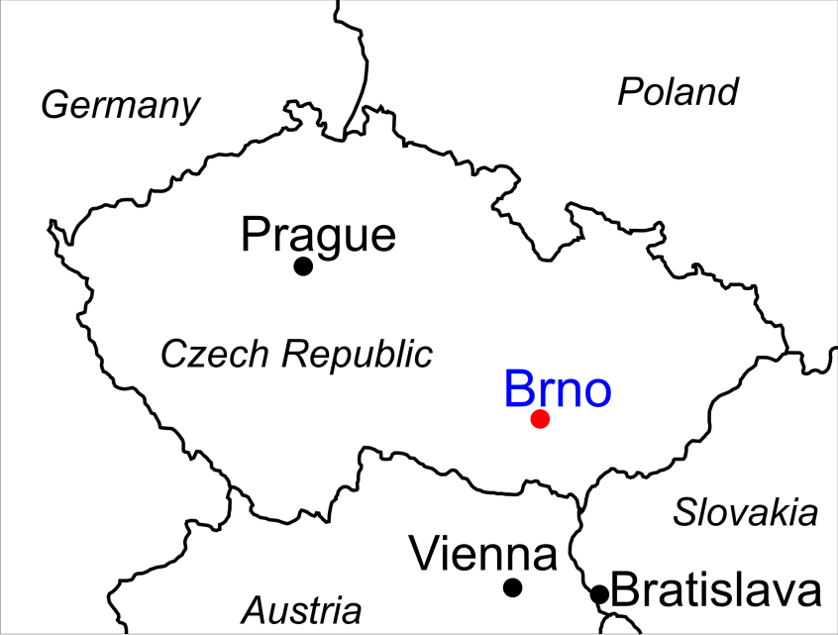
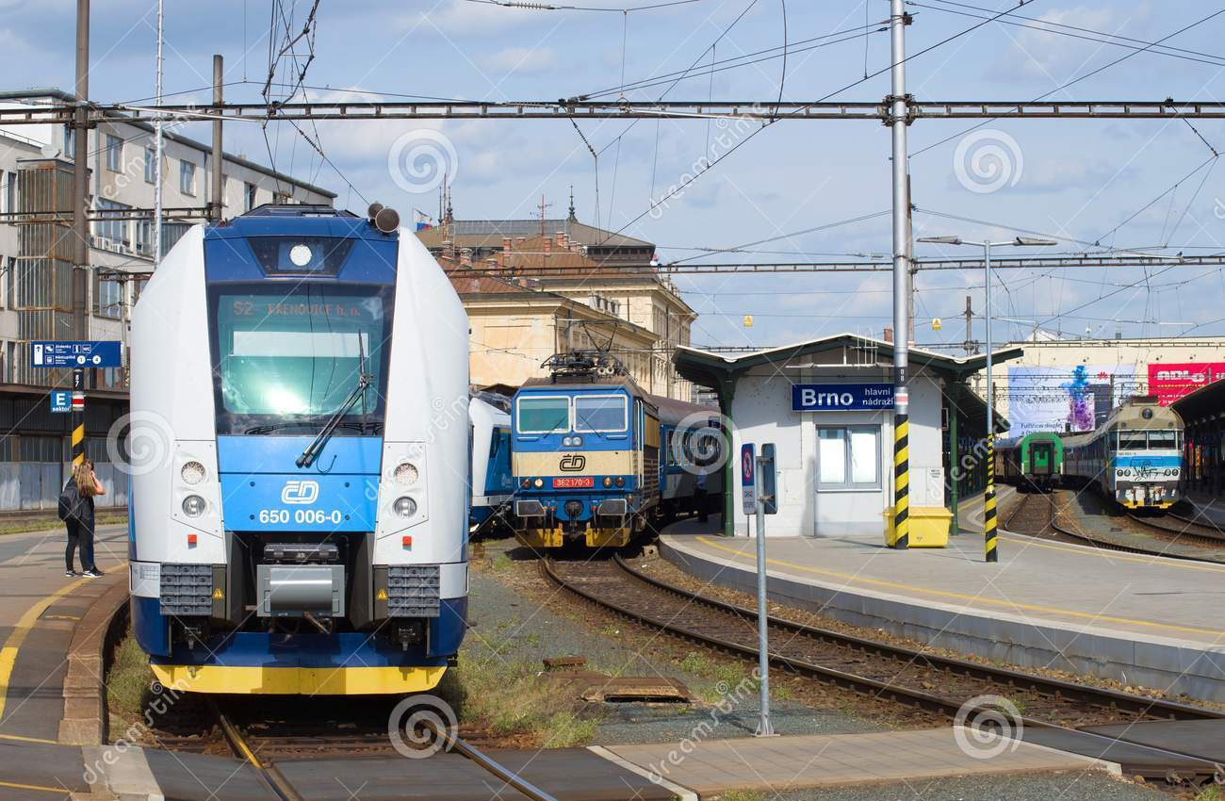
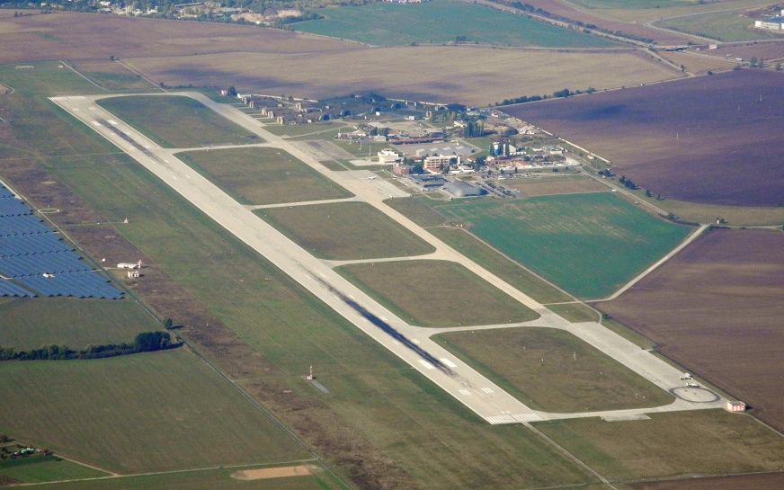
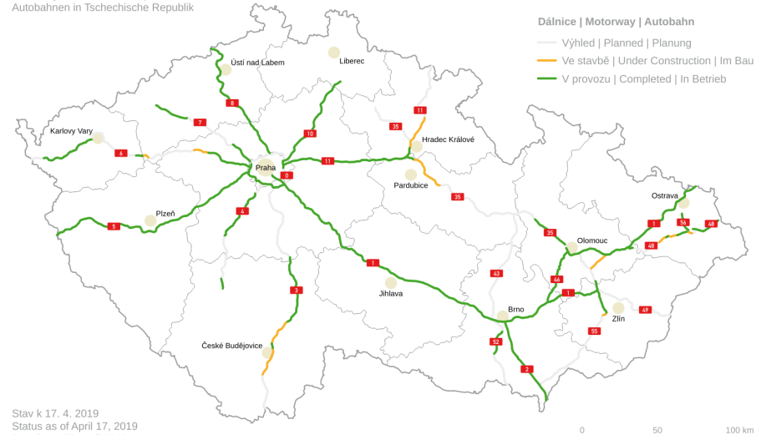
Location

Slide 3
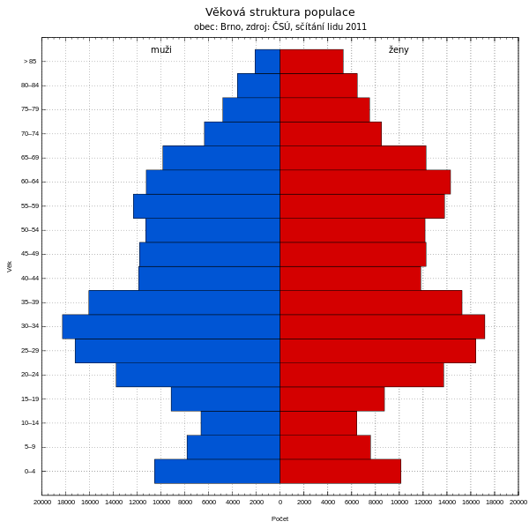
Why Brno?
Universities:
6 public
6 private
Education:
14% basic
58% secondary
28% higher
Source: Czech Statistic Institute

Slide 4




Why Brno?
Top IT achievments:
30% computers worldwide protected by AVG/AVAST antivirus programs
1/3 of the world production of electrone microscopes
Center of National Cyber-Security
International companies based in Brno:
Source: AVG, FEI

Slide 5
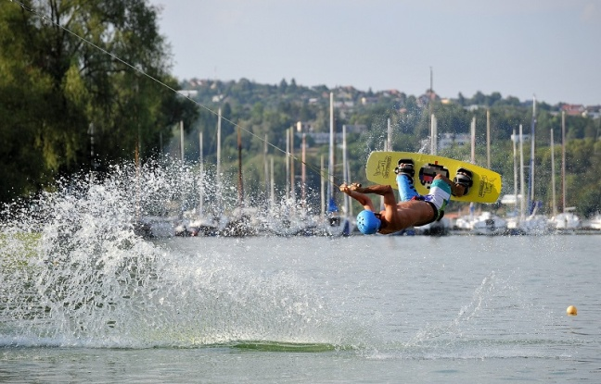


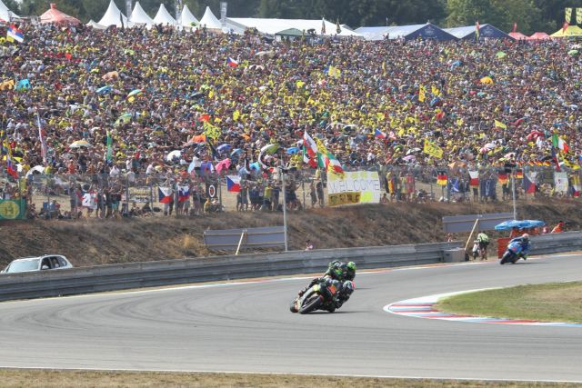
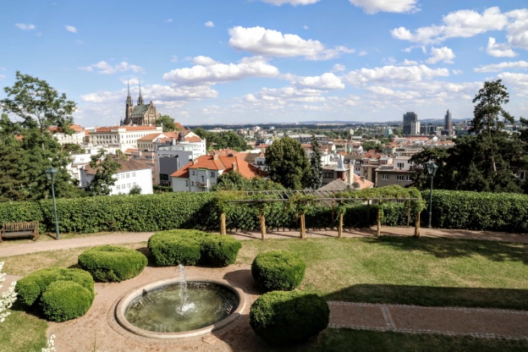

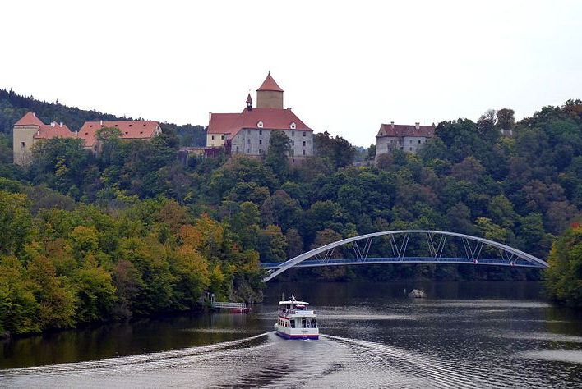

Recreational activities
Quality of life higher than Prague!
Source: Numbeo.com

Slide 6
Why Brno?
Qualified workforce
Massive investments into R&D
High quality of life

