Slide 1

Sophia Python - enabled Assistant
Dhananjay

Slide 2



Required tools
VS code
Powershell
Pycharm

Slide 3
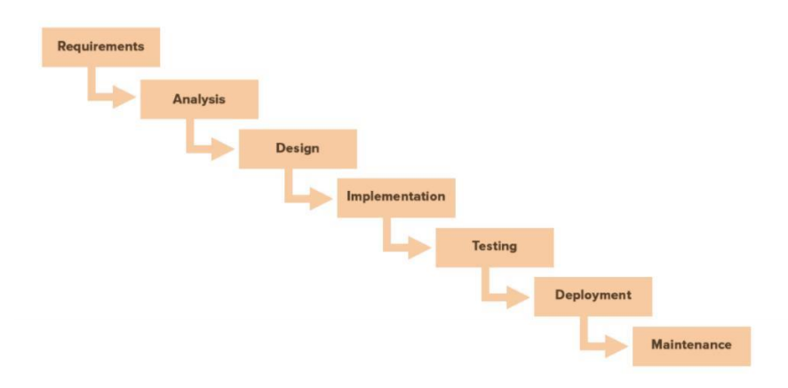
Planning work:

Slide 4
Required libraries and modules:
Webbrowser
Os
Wikipedia
Date-time
Speech recognization
Random
Operator
…..

Slide 5
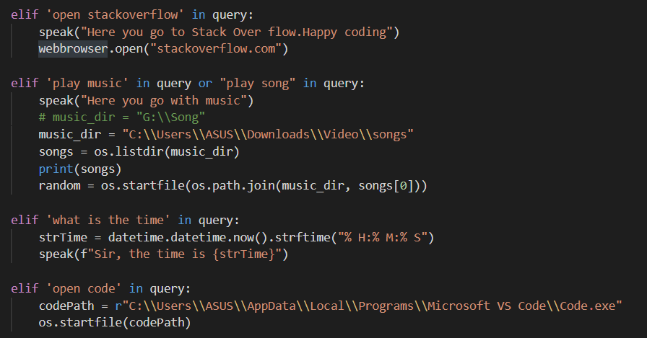
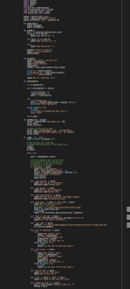
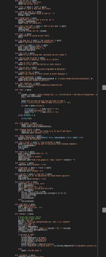
Code Snaps:

Slide 6
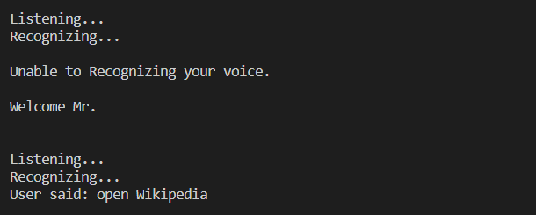
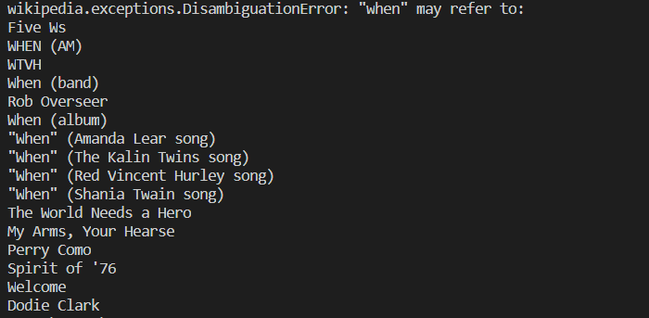
Virtualization of Project:

Slide 7
Gains:
It’s simple as possible, we consider time as money but we know that we can’t create any single moment so having an assistant for some usual and less priority work will add time to our slots.
Also I have made it when I was leaning python in the 4th semester. So, it was helpful for me to easily see the functions what I’m writing into working.

