Slide 1

MAHARASHTRA INSTITUTE OF TECHNOLOGY, PUNE Department of Computer Engineering Simulating detection and prevention from SQL injection and Cross-Site Scripting attacks Presented by - Dhananjay Gavade (402060) Aditya Bora (402042) Atharva Nirali (403051) Ajinkya Gatkal(402058)

Slide 2
Content
Introduction
Concept
Architecture
Snapshots
Advantages
Future scope
Conclusion
References

Slide 3
Introduction
Defender proxy – helps in detection and avoiding SQL injection and cross site scripting attack users s
Common types of attacks on web server – SQL injection and cross site scripting attacks
Leak of users sensitive data and attack users of web server are affected

Slide 4
Concept
Our systems detects SQL injection and XSS attacks on web servers.
For detection of these attacks we use policies.
Policies are basically regular expressions.
This regular expressions detects request with exploits.
SQL injection attacks are done on databases of web server.

Slide 5
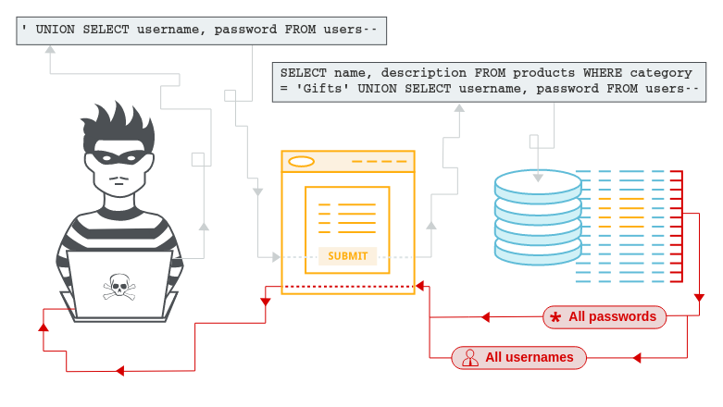
SQL Injection
A web security vulnerability that allows an attacker to interfere with the queries that an application makes to its database

Slide 6
Detecting SQL injection attacks
Regex for detection of SQL meta-characters
/(\%27)|(\')|(\-\-)|(\%23)|(#)/ix
Modified regex for detection of SQL meta-characters
/((\%3D)|(=))[^\n]*((\%27)|(\')|(\-\-)|(\%3B)|(;))/i
Regex for typical SQL Injection attack
/\w*((\%27)|(\'))((\%6F)|o|(\%4F))((\%72)|r|(\%52))/ix
Regex for detecting SQL Injection with the UNION keyword
/((\%27)|(\'))union/ix

Slide 7
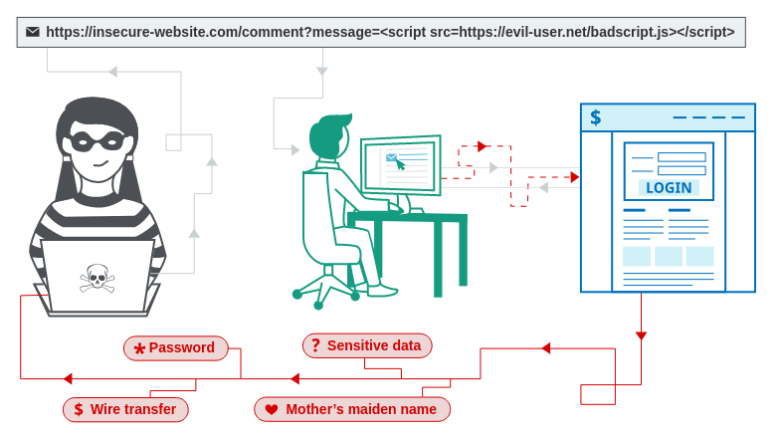
Cross-site Scripting attack (XSS):
A web security vulnerability that allows an attacker to compromise the interactions that users have with a vulnerable application.

Slide 8
Detecting XSS Attacks
Regex for simple CSS attack
/((\%3C)|<)((\%2F)|\/)*[a-z0-9\%]+((\%3E)|>)/ix
Regex for "<img src" CSS attack
/((\%3C)|<)((\%69)|i|(\%49))((\%6D)|m|(\%4D))((\%67)|g|(\%47))[^\n]+((\%3E)|>)/I
Paranoid regex for CSS attacks
/((\%3C)|<)[^\n]+((\%3E)|>)/I

Slide 9
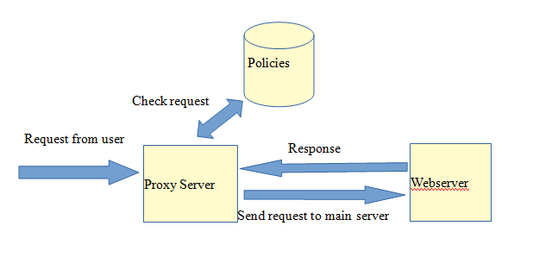
Architecture

Slide 10
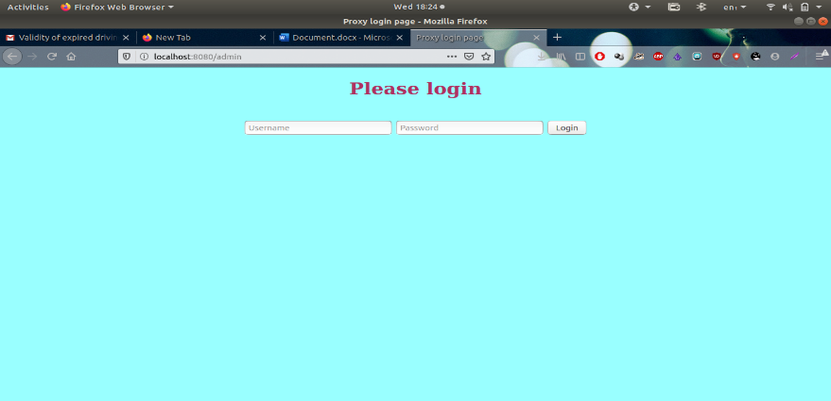
Snapshot
Login using admin id and password - sqlite Database.
Session Authentication – Flask

Slide 11
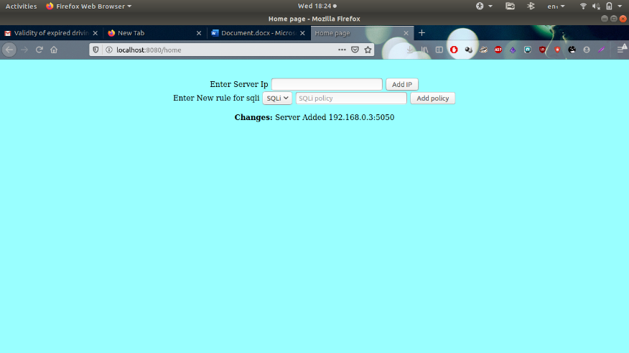
Adding Server
Servers address along with port can be added in admin page.
Once server is added request to server will be automatically filtered.

Slide 12
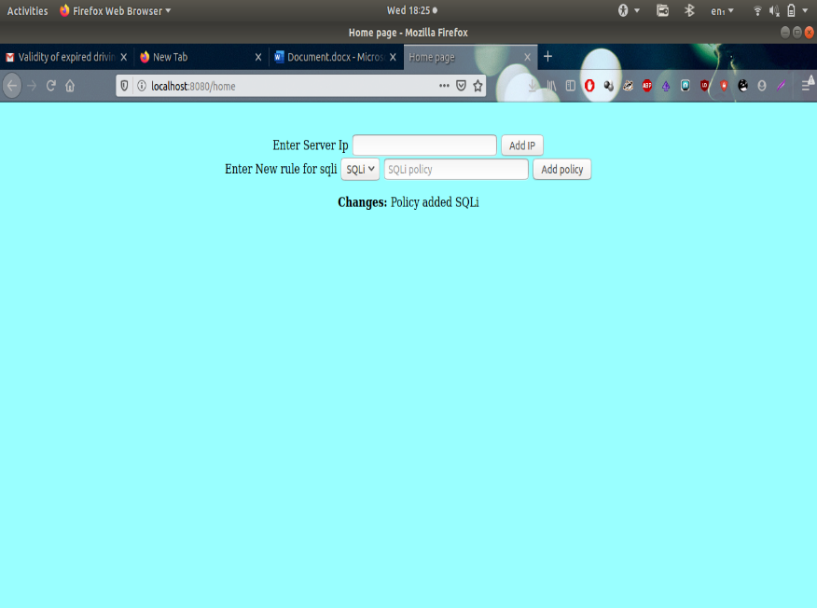
Adding Policies
New policies for sqli and xss attacks can be added in admin page.
Specific policies for servers can be added.

Slide 13
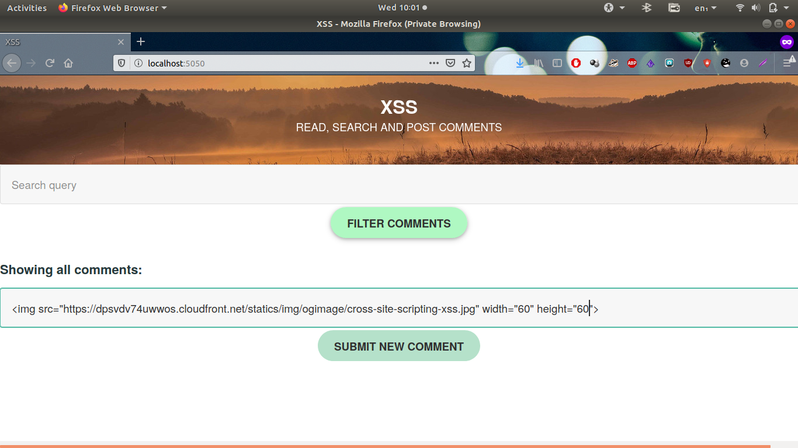
XSS Attacks
Without Proxy Server
1. IMG SRC attack

Slide 14
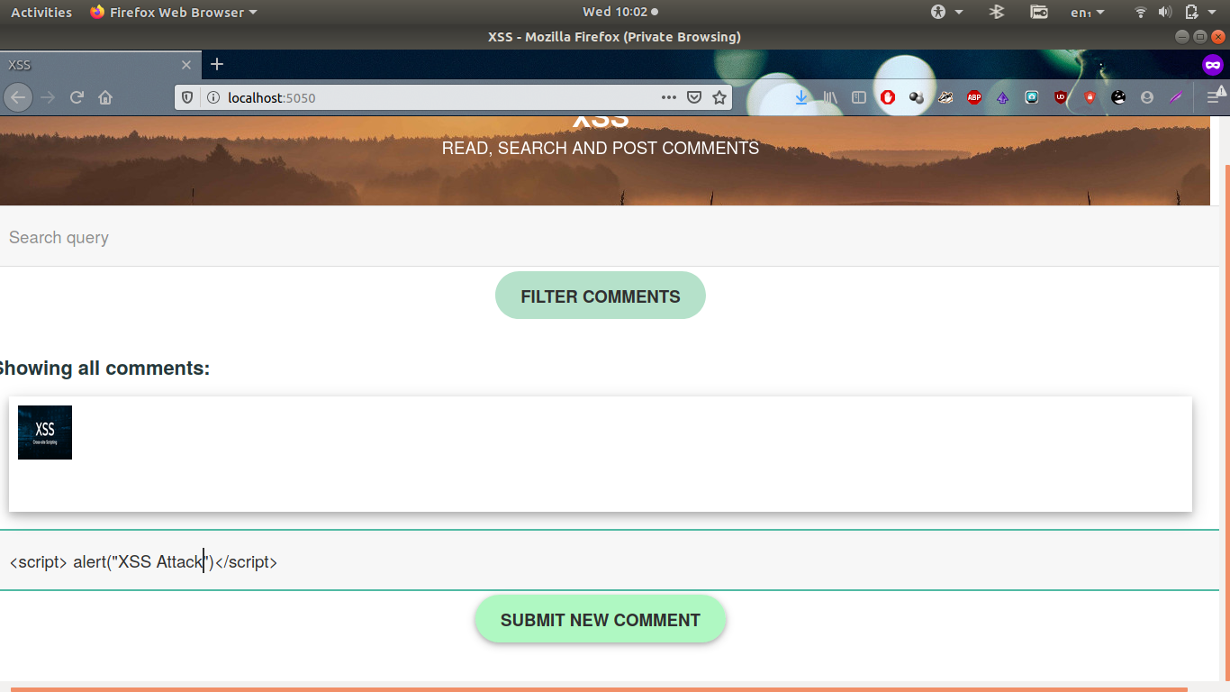
<Script> Attack

Slide 15
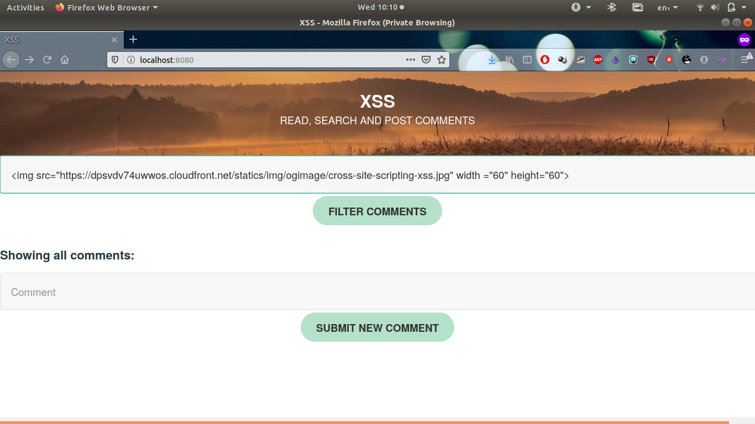
With Proxy Server
1. IMG SRC attack

Slide 16

2.<Script> Attack

Slide 17
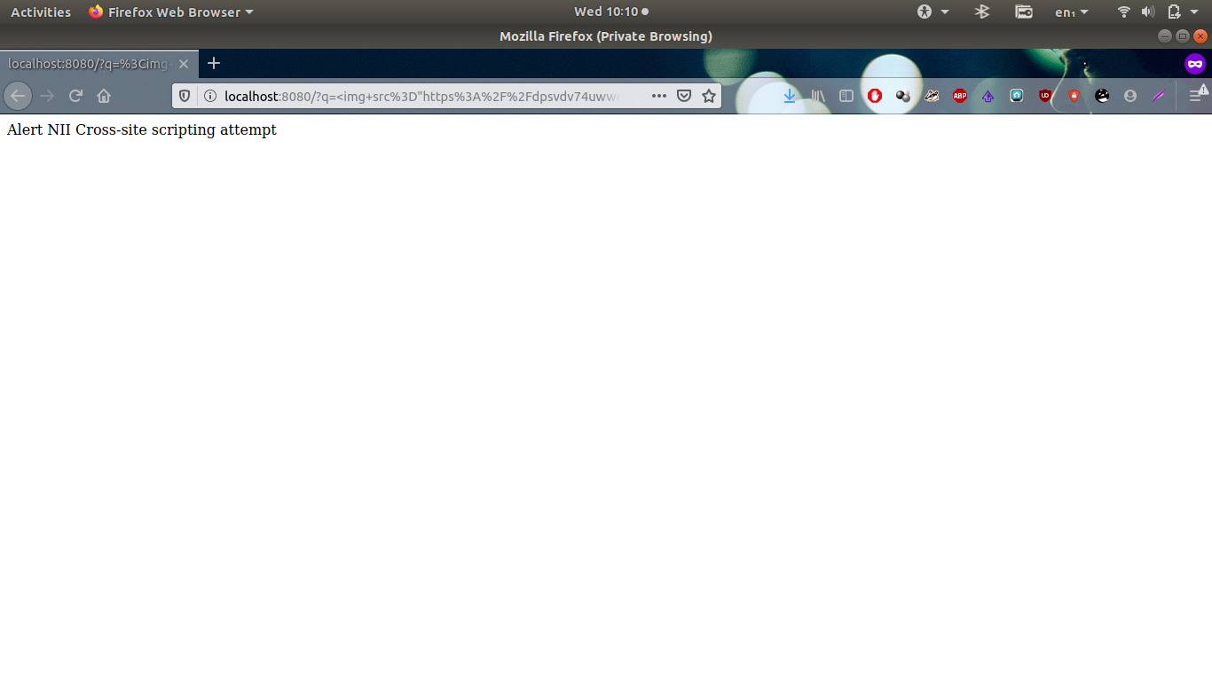

Slide 18
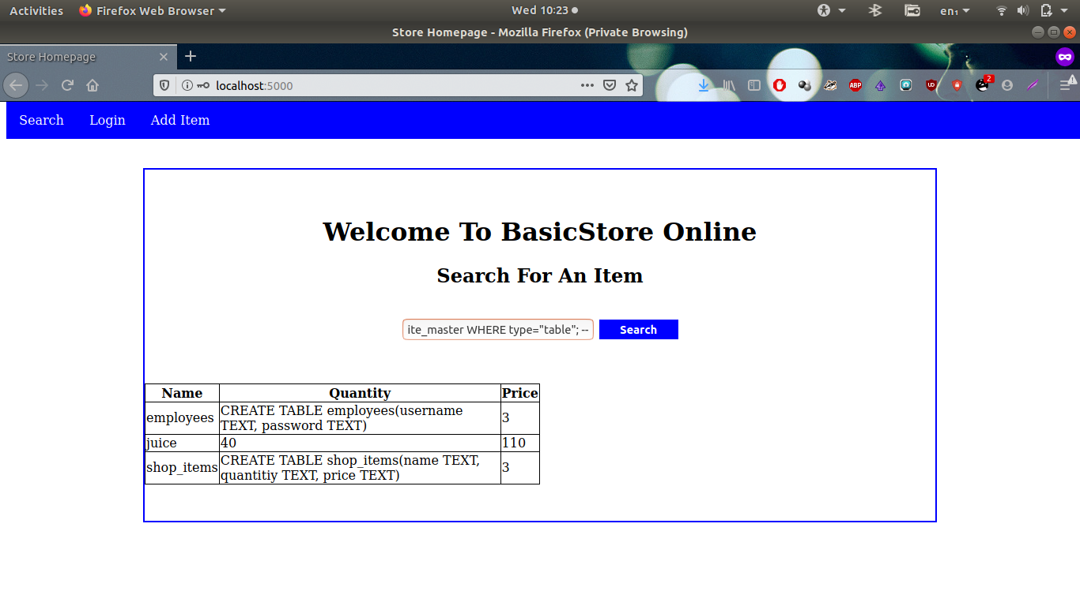
SQLi ATTACKS:

Slide 19
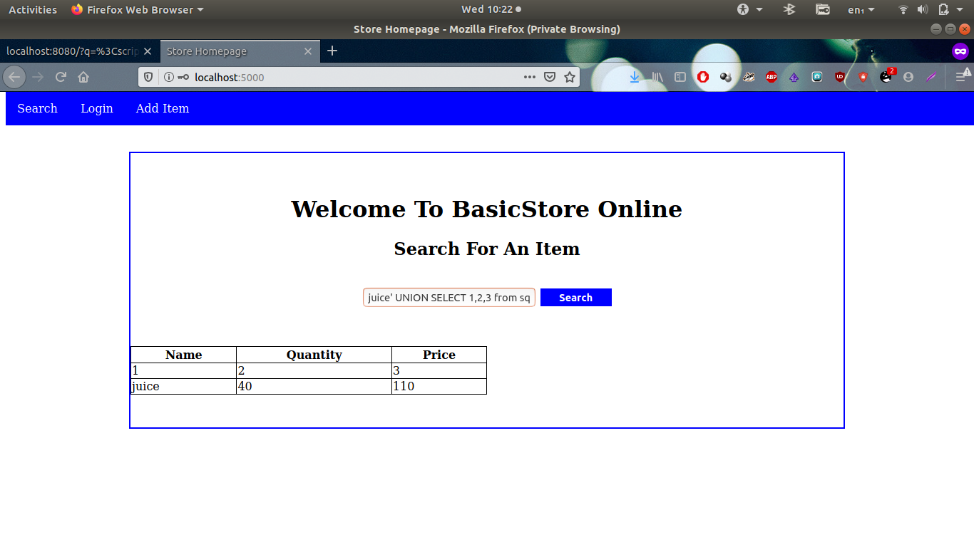
Without Proxy Server

Slide 20
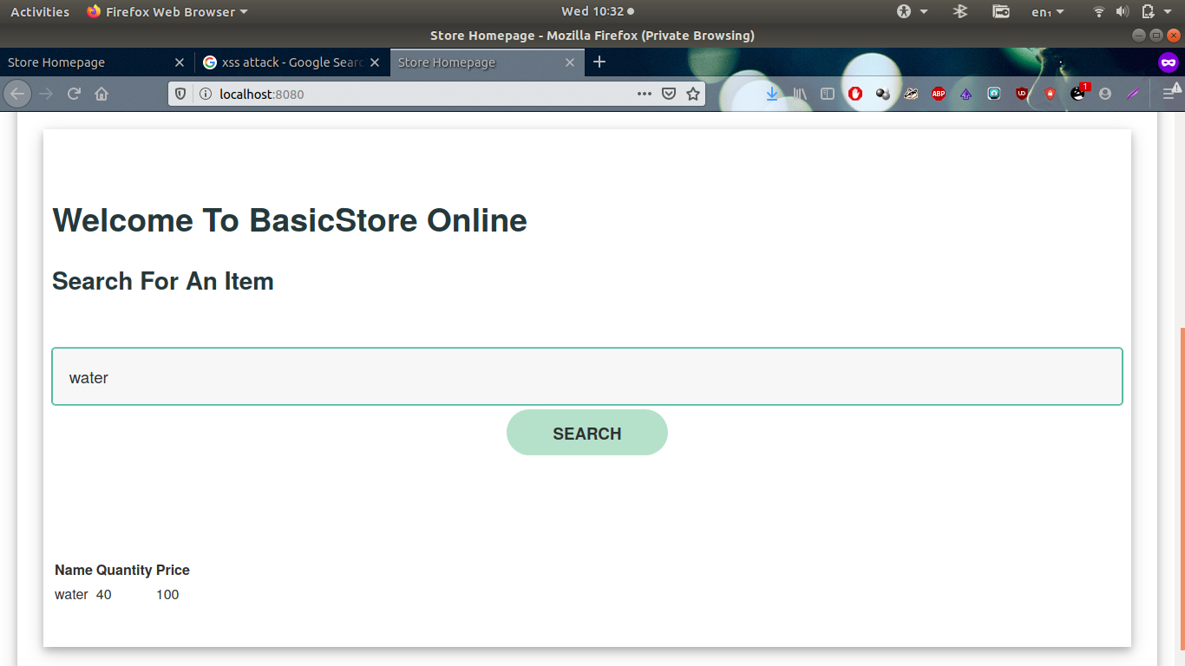
With Proxy Server

Slide 21
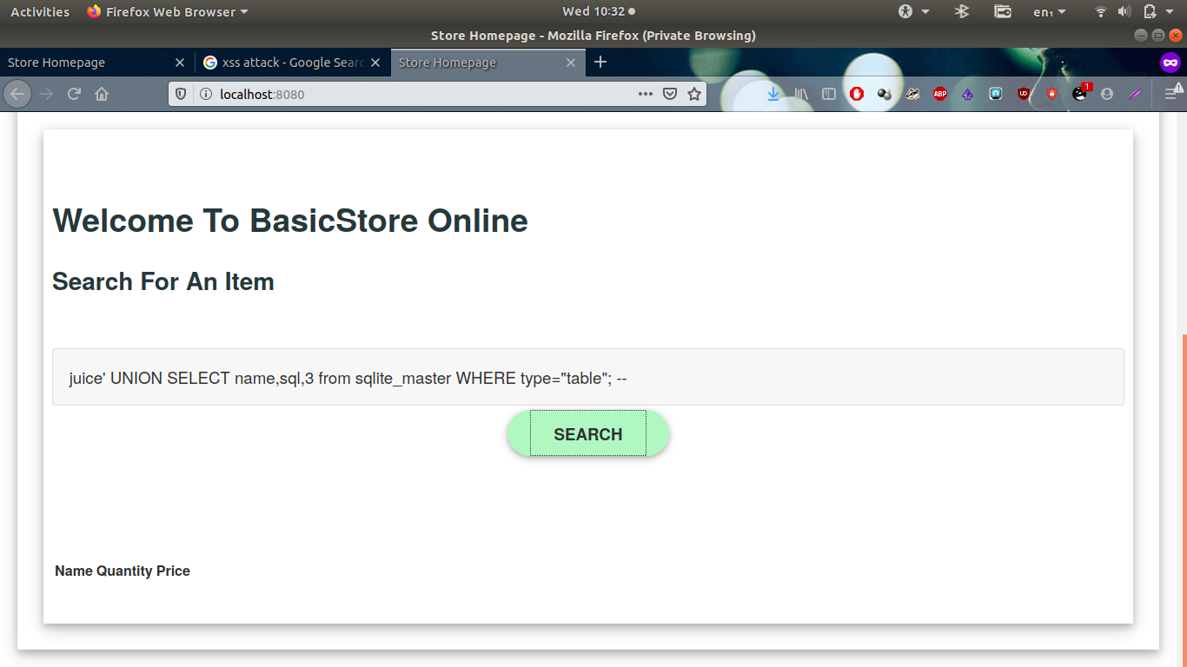

Slide 22
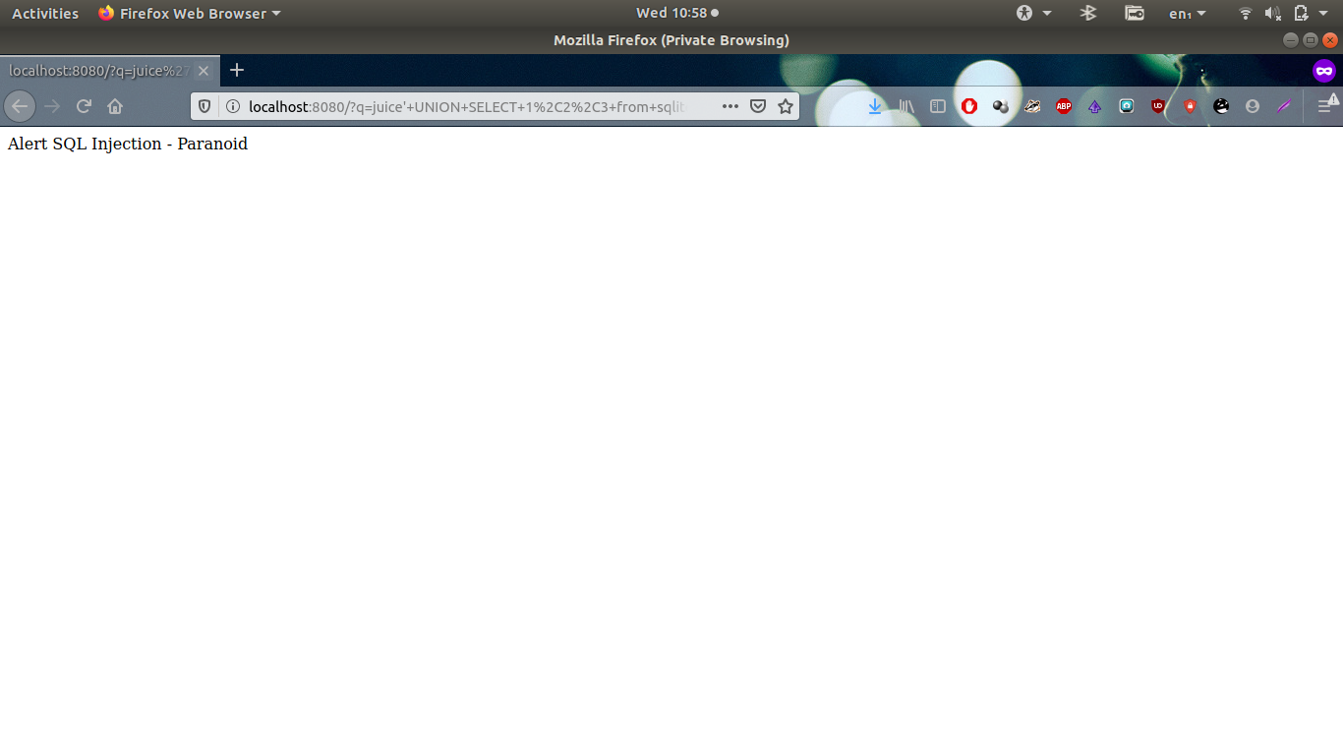

Slide 23
Advantages
Proxy server can detect and prevent both SQL injection and XSS.
Policies can be added easily.
Proxy server can be easily integrated with any type of web server (PHP, flask, django, asp).

Slide 24
Future Scope
It can be further extended to detect and prevent attacks like DDoS, buffer overflow, password cracking etc.
Also information gathering attacks such as port scanning , mirroring , source code disclosure etc can be detected and prevented.

Slide 25
Conclusion
Thus our project can help in detecting and preventing SQL injection and XSS attacks. Also it can be extended to detect and prevent other attacks on web server.

Slide 26
Reference
[1] W. G. J. Halfond, et al., "A Classification of SQLInjection Attacks and Countermeasures," in Proceedings of the IEEE International Symposium on Secure Software Engineering, Arlington, VA, USA, 2006.
[2] Indrani Balasundaram 1 Dr. E. Ramaraj, “An Approach to Detect and Prevent SQL Injection Attacks in Database Using Web Service,” in IJCSNS International Journal of Computer Science and Network Security, VOL.11 No.1, January 2011.
[3]Stephen W. Boyd and Angelos D. Keromytis Department of Computer Science Columbia University, “SQLrand: Preventing SQL Injection Attacks”.
[4] Joaquin Garcia-Alfaro ,Guillermo Navarro-Arribas ,“A Survey on Cross-Site Scripting Attack”, Autonomous University of Barcelona , 2009

Slide 27
Thank You

