Slide 1

★
AN
AlgoNova
Idée-Action Challenge · Juillet 2026
EB
ExamBoost Togo
Smart exam preparation for every Togolese student
BEPC
BAC
Adaptive AI
Offline
Présenté au DJANTA Tech Hub · Idée-Action Challenge · 24 Juillet 2026

Slide 2

PROBLEM
AlgoNova
Togo, 2024
A silent crisis
44%
46.7%
BEPC pass rate
BAC 2 pass rate
Ministry of Education, Togo · 2024
Ministry of Education, Togo · 2024
86%
0
Students can't read proficiently at age 10
Digital tools aligned with the Togolese curriculum
World Bank Learning Poverty · 2019
Field survey, Lomé · June 2026
“Togolese students don't have the tools to prepare effectively for their national exams — regardless of how hard they work.”
Sources: Ministry of Education Togo (2024) · World Bank (2019) · Field Survey Lomé (2026)
02 / 10

Slide 3




SOLUTION
AlgoNova
9:41
▮▮▮ ▾
Adaptive Revision · Maths
ExamBoost Togo
First-degree equations
The app that adapts to every student
Solve for x :
AI-adaptive revision
3x + 7 = 22
Personalized SRS + IRT algorithm targets each weak spot
→ x = ?
3,000+ questions
Official BEPC/BAC past papers, 2010–2025
100% offline
Works on Android 5+ with no internet connection
Easy
Free for every student
Got it
Hard
03 / 10

Slide 4
PRODUCT
AlgoNova
The ExamBoost experience in 5 screens
9:41
▮▮▮
9:41
▮▮▮
✕
Maths
8 / 20
MOCK EXAM · BEPC
9:41
▮▮▮
ExamBoost Togo
Choose a subject
Mathematics
My Progress
EB
Hi, Amina 👋
BEPC
BAC 1
BAC 2
47:12
5/20
First-degree equations
Time left
Questions
BEPC preparation
72%
72%
Solve for x :
Overall
Maths
French
3x + 7 = 22
QUESTION 5 · 4 POINTS
78% mastered
Area of a triangle with base 8 cm and height 5 cm?
64% mastered
386
12
4
What's next?
A
13 cm²
Reviewed
Day streak
Mastered
⚡ Adaptive Revision
Tap “Show answer” when ready
B
20 cm²
Maths
78%
⏱ Mock Exam
Physics
Biology
French
64%
52% mastered
41% mastered
C
40 cm²
📊 My Progress
Show answer
Physics
52%
D
26 cm²
Home
Subjects
SRS Revision
Mock Exam
Progress
Localized for Togo · Offline · Android 5+ · APK < 25 MB
04 / 10

Slide 5
MARKET SIZE
AlgoNova
3M · Francophone West Africa
A market of 800,000 students
800K · Togo secondary
50K
800,000
Secondary students in Togo
reachable by Year 2
150,000
BEPC + BAC candidates every year
3 countries
Benin · Côte d'Ivoire · Burkina Faso share the same curriculum
05 / 10

Slide 6
BUSINESS MODEL
AlgoNova
Free for students. Profitable for us.
B2B Licenses
Grants & Subsidies
Student Premium
100,000 FCFA
GPE · UNICEF · AFD
2,000 FCFA
per year · per school
education-impact funding
per month · optional
150 schools → 15M FCFA / yr
30–50M FCFA available
5% of active users
Break-even point
300 institutions → Year 2
06 / 10

Slide 7
COMPETITION
AlgoNova
We're the only ones doing this in Togo.
Criterion
Khan Academy
Afrilearn
PDF / WhatsApp
ExamBoost Togo
Togolese curriculum
✗
✗
✗
✓
Works offline
✗
✗
~
✓
In Togolese French
~
✗
✗
✓
Adaptive AI
✓
✗
✗
✓
Free for students
✓
✗
✓
✓
Our edge: deep localization that foreign players cannot replicate.
07 / 10

Slide 8
TRACTION
AlgoNova
Togolese students are waiting for us.
“
I revise with PDFs on WhatsApp, but it's completely disorganized.
87%
— Student, Final year (Terminale C), Lomé
of surveyed students have no digital tool to prepare for exams
“
94%
I'd love to know where I really stand in my revision.
— Student, Grade 9 (3ème), Atakpamé
are ready to use ExamBoost
Field survey · 30 students · Lomé · June 2026
08 / 10

Slide 9
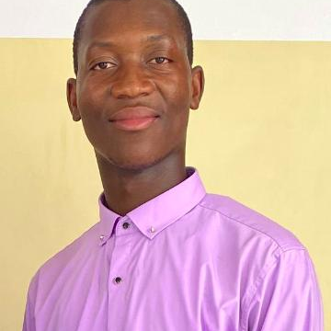
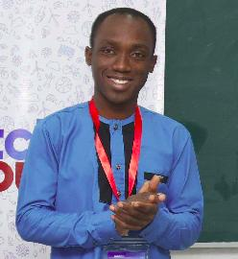
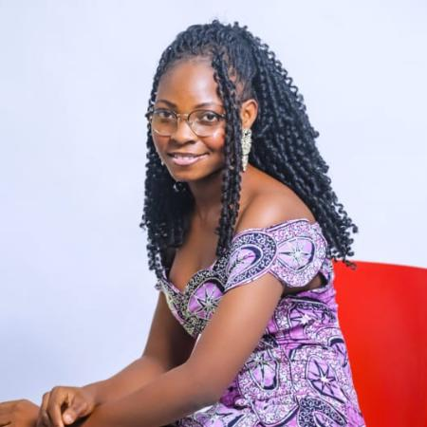
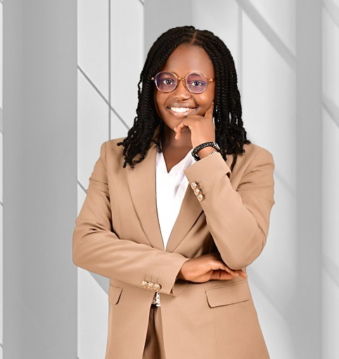
TEAM
AlgoNova
A complementary, committed team.
OD
RH
MT
EK
Ounimborbitibou Djabon
Roland Houkpè
Marthe Tossou
Esther Kolani
Project Lead · Data Science
Flutter Developer
UX / UI Designer
Marketing & Communication
AIMS Ghana · ML / AI
Mobile & Backend · Python
Product Design · User Experience
Growth · Go-to-market · Partnerships
Supported by AIMS Ghana · SmartFarm Togo · CcHub West Africa
09 / 10

Slide 10



WHAT WE'RE ASKING FOR
Help us give every Togolese student the same chances.
Working MVP
Pilot in 5 schools
First raise
Complete Android app in 3 months
300 student testers in Lomé
Access to CcHub funding opportunities
examboosttogo@gmail.com
github.com/djabelo712/examboost-togo

