Slide 1
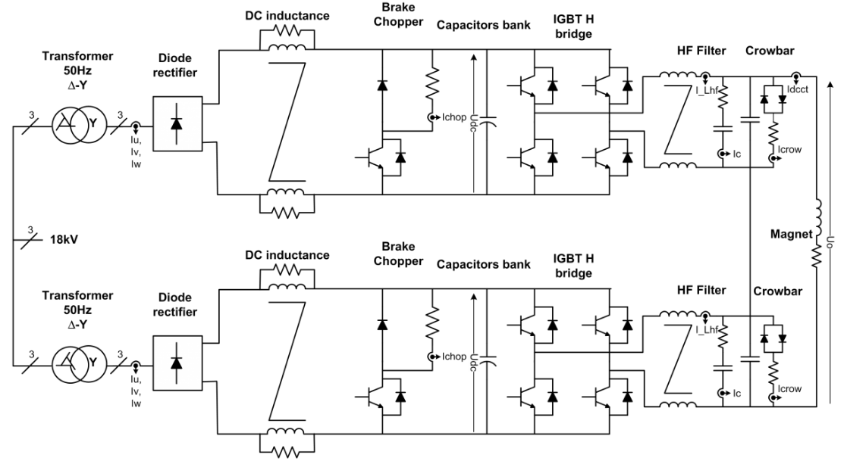
DSP
Measurement Board

Slide 2
