Slide 1


Parsing
Università di Pisa
Giuseppe Attardi
Dipartimento di Informatica
Università di Pisa

Slide 2
Dealing with text
Representation Applications
Bag of words enough for Information Retrieval, document classification
N-grams Language Modeling, POS tagging, NER, Phrase Based Machine Translation
Sequences Neural Machine Translation
?? Information Extraction
?? Question Answering, full Language Understanding

Slide 3
Sentence Structure
Recovering sentence structure in order to fully understand language
Words are composed into bigger units to convey complex ideas and to build statements to express
Such units are called constituents
Syntax refers to the way words are arranged together into constituents or larger units
Grammar is a formalism to describe the syntax of a language

Slide 4
Structural ambiguity
Prepositional attachment
Coordination scope
San Jose cops kill man with knife
Scientists count whales from space
Shuttle veteran and longtime NASA executive Fred Gregory appointed to board

Slide 5
Practical Uses of Parsing
Relation Extraction (Knowledge Graph enriched from relations extracted from dependency trees)
Semantic Relation (protein interaction in medical literature)
Translation (helps disambiguating sentences)
Sentiment Analysis (improves by dependency parsing)
Negation (determine the scope of negations)
Summarization (detects relevant parts)
Question Answering

Slide 6
Question Answering
S
VP
S
VP
PP
NP
NP
WP
VBD
DT
JJ
NNP
NP
TO
VB
IN
NN
Who was the first Russian astronaut to walk in space

Slide 7
Question semantic form
first
Russian
astronaut
Answer type
walk
space
PERSON
Question logic form:
first(x) ∧ astronaut(x) ∧ Russian(x) ∧ space(z) ∧ walk(y, z, x) ∧ PERSON(x)

Slide 8
Statistical Methods in NLP
Some NLP problems:
Information extraction
Named entities, Relationships between entities, etc.
Finding linguistic structure
Part-of-speech tagging, Chunking, Parsing
Can be cast as learning mapping:
Strings to hidden state sequences
NE extraction, POS tagging
Strings to strings
Machine translation
Strings to trees
Parsing
Strings to relational data structures
Information extraction

Slide 9
Parsing Approaches
Constituency Grammar
Dependency Grammar

Slide 10
Constituency Grammar
AKA Phrase Structure Grammar (Noam Chomsky)
Context Free Grammar (simplest common variant)
Context Free Production Rules
NP → Det Nominal
NP → ProperNoun Nominal → Noun | Nominal Noun
Det → a
Det → the
Noun → flight
NP
Det
Nominal
Noun
a
flight

Slide 11
Constituency Parse Tree Example
S
NP VP
Pro Verb NP
I prefer Det Nom
a Nom Noun
Noun flight
morning

Slide 12
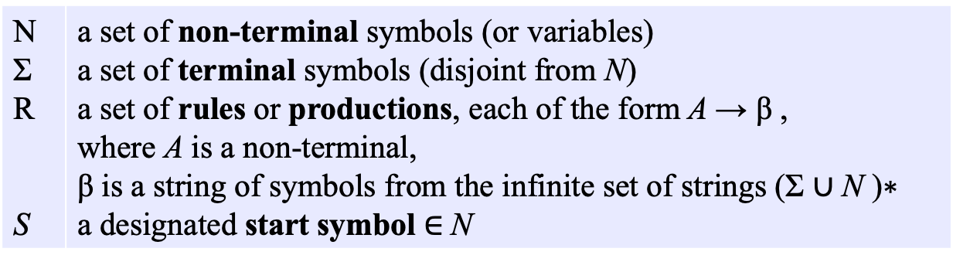
Context Free Grammar
N Σ R S | a set of non-terminal symbols (or variables) a set of terminal symbols (disjoint from N) a set of rules or productions, each of the form A → β , where A is a non-terminal, β is a string of symbols from the infinite set of strings (Σ ∪ N )∗ a designated start symbol $∈$N

Slide 13
Constituency Parsing
Requires Phrase Structure Grammar
CFG, PCFG, Unification Grammar
Produces phrase structure parse tree
VP
S
VP
S
VP
NP
NP
NP
VP
ADJP
Rolls-Royce Inc. said it expects its sales to remain steady

Slide 14
Statistical Parsers
Probabilistic Generative Model of Language which include parse structure (e.g. Collins 1997)
Learning consists in estimating the parameters of the model with simple likelihood based techniques
Conditional parsing models (Charniak 2000; McDonald 2005)

Slide 15
Linear Model for Statistical Constituency Parsing
Three components:
GEN is a function from a string to a set of candidates
Φ maps a candidate to a feature vector
W is a parameter vector

Slide 16
Component 1: GEN
GEN enumerates a set of candidates for a sentence
She announced a program to promote safety in trucks and vans
GEN

Slide 17
Examples of GEN
A context-free grammar
A finite-state machine
Top N most probable analyses from a probabilistic grammar

Slide 18
Component 2: Φ
Φ maps a candidate to a feature vector ∈R^{d}
Φ defines the representation of a candidate
Φ
<1, 0, 2, 0, 0, 15, 5>

Slide 19
Feature
A “feature” is a function on a structure, e.g.,
h(x) = Number of times is seen in x
Feature vector:
A set of functions h₁…h_{d} define a feature vector
Φ(x) = <h₁(x), h₂(x) … h_{d}(x)>
A
B
C

Slide 20
Component 3: W
W is a parameter vector ∈R^{d}
Φ • W map a candidate to a real-valued score

Slide 21
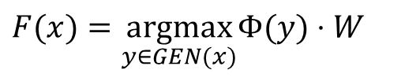
Putting it all together
X is set of sentences, Y is set of possible outputs (e.g. trees)
Need to learn a function F : X → Y
GEN, Φ, W define
Choose the highest scoring tree as the most plausible structure
$$F(x)=\underset{y∈GEN(x)}{\text{argmax}}Φ(y)⋅W$$

Slide 22
Model | F1 | Paper / Source
Label Attention Layer + HPSG + XLNet (Mrini et al., 2019) | 96.34 | Rethinking Self-Attention: An Interpretable Self-Attentive Encoder-Decoder Parser
HPSG Parsing + XLNet (Zhou and Zhao, 2019) | 96.33 | Head-Driven Phrase Structure Grammar Parsing on Penn Treebank
HPSG Parsing + BERT (Zhou and Zhao, 2019) | 95.84 | Head-Driven Phrase Structure Grammar Parsing on Penn Treebank
Self-attentive encoder + ELMo (Kitaev and Klein, 2018) | 95.13 | Constituency Parsing with a Self-Attentive Encoder
Model combination (Fried et al., 2017) | 94.66 | Improving Neural Parsing by Disentangling Model Combination and Reranking Effects
Semi-supervised LSTM-LM (Choe and Charniak, 2016) | 93.8 | Parsing as Language Modeling

Slide 23
Dependency Grammar

Slide 24
Dependency Structure
Dependency structure shows which words depend on (modify or are arguments of) which other words.
The syntactic structure of a sentence is described solely in terms of the words in a sentence and a set of directed binary grammatical relations among the words.
root
dobj
nmod
nsubj
det
nmod
case
I prefer the morning flight through Denver

Slide 25
Constituency vs Dependency Trees
S
NP VP
Pro Verb NP
I prefer Det Nom
a Nom Noun
Noun flight
morning
root
dobj
nmod
nsubj
det
nmod
case
I prefer the morning flight through Denver

Slide 26
Dependency paths identify relations
Example: protein interaction
[Erkan et al. EMNLP 07, Fundel et al. 2007]
KaiC ←nsubj− interacts −prep_with→ SasA
KaiC ←nsubj− interacts −prep_with→ SasA −conj_and→ KaiA
KaiC ←nsubj− interacts −prep_with→ SasA −conj_and→ KaiB
demonstrated
nsubj
ccomp
results
interacts
prep_with
compl
det
that
advmod
SasA
nsubj
conj_and
conj_and
The
KaiC
rythmically
KaiA
KaiB
slide by C. Manning
Notes:
Dependencies extracted
Positive and negative examples
Define a similarity measure, and used semi-supervised machine learning algorithms
Very good results

Slide 27
Dependency Parsing

Slide 28
Dependency Parsing
Produces dependency trees
Word-word dependency relations
Easier to understand and to annotate than constituent trees
SUBJ
OBJ
OBJ
MOD
SUBJ
SUBJ
TO
MOD
Rolls-Royce Inc. said it expects its sales to remain steady

Slide 29
Data-Driven Dependency Parsing
Graph Based
Consider possible dependency graphs
Define score and select graph with highest score
Transition Based
Define a transition system that leads to a parse tree while analyzing a sentence one word at a time

Slide 30
Transition-based Shift-Reduce Parsing
top
next
RightA
Shift
LeftA
He
PP
saw
VVD
a
DT
girl
NN
with
IN
a
DT
telescope
NN
.
SENT

Slide 31
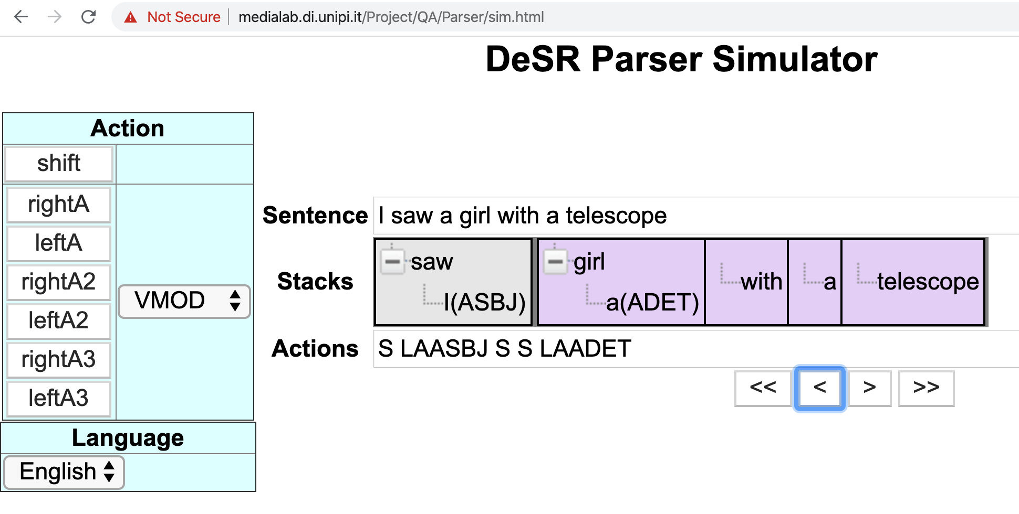
Interactive Simulator
Play with it at:
http://medialab.di.unipi.it/Project/QA/Parser/sim.html

Slide 32
Shift/Reduce Dependency Parser
Traditional statistical parsers are trained directly on the task of tagging a sentence
Instead an SR Parser is trained and learns the sequence of parse actions required to build the parse tree

Slide 33
Grammar Not Required
A traditional parser requires a grammar for generating candidate trees
An inductive parser needs no grammar

Slide 34
Parsing as Classification
Inductive dependency parsing
Parsing based on Shift/Reduce actions
Learn from annotated corpus which action to perform at each step

Slide 35
Dependency Graph
Let R = {r₁, … , r_{m}} be the set of permissible dependency types
A dependency graph for a sequence of words W = w₁ … w_{n} is a labeled directed graph D = (W, A), where
(a) W is the set of nodes, i.e. word tokens in the input sequence,
(b) A is a set of labeled arcs (w_{i}, w_{j}, r), w_{i}, w_{j} ∈ W, r ∈ R,
(c) ∀ w_{j} ∈ W, there is at most one arc (w_{i}, w_{j}, r) ∈ A.

Slide 36
Parser State
A transition-based parser processes its input by performing transitions on between parser states
The parser state is a triple ⟨S, B, A⟩, where
S is a stack of partially processed tokens
B is a buffer of (remaining) input tokens
A is the arc relation for the dependency graph
(h, d, r) ∈ A represents an arc h −r→ d, tagged with dependency r

Slide 37
Transition Systems
Set of rules used by a transition parser:
Nivre’s Arc Standard
Nivre’s Arc eager
Attardi’s non projective
Nivre’s swap

Slide 38
Arc Standard
Shift | ⟨S, n|B, A⟩
 | ⟨S|n, B, A⟩
Left-arc_{r} | ⟨S|s, n|B, A⟩
 | ⟨S, n|B, A∪{(n, s, r)}⟩
Right-arc_{r} | ⟨S|s, n|B, A⟩
 | ⟨S, s|B, A∪{(s, n, r)}⟩

Slide 39
Parser Algorithm
The parsing algorithm is fully deterministic
It uses a trained model to predict the next action, given a representation of the context current state
Input Sentence: (w₁, w₂, … , w_{n})
S = <>
B = <w₁, w₂, … , w_{n}>
A = {}
while B != <> do
x = getContext(S, B, A)
y = selectAction(model, x)
performAction(y, S, B, A)

Slide 40
Oracle
During training, the gold tree of each sentence can be used to suggest which actions to perform in order to rebuild such gold tree
There can be more than one possible sequence to produce the same parse tree
An Oracle is an algorithm that given the gold tree for a sentence, produces a proper sequence of actions that a parser may use to obtain that gold tree from the input sentence

Slide 41
Arc Standard Oracle
Emulate the parser
Input Sentence: (w₁, w₂, … , w_{n})
S = <>
B = <w₁, w₂, … , w_{n}>
while B != <> do
if B[0] −r→ S[0] and all children of S[0] are attached
perform Left-Arc_{r}
else if S[0] −r→ B[0] and all children of B[0] are attached
perform Right-Arc_{r}
else
perform Shift
Why?
saw girl with glasses
I a

Slide 42
Projectivity
An arc w_{i}→w_{k} is projective iff ∀j, i < j < k or i > j > k, w_{i} →* w_{j}
A dependency tree is projective iff every arc is projective
Intuitively: arcs can be drawn on a plane without intersections
All tokens between w_{i} and w_{k} form a subtree of w_{i}

Slide 43
Non Projectivity
I saw a girl yesterday wearing a ring

Slide 44
Properties of Arc Standard Algorithm
Does not deal with non-projectivity
Every transition sequence produces a projective dependency tree (soundness)
Every projective tree is produced by some transition sequence (completeness)
Fast deterministic linear algorithm: parsing n words requires 2n transitions

Slide 45
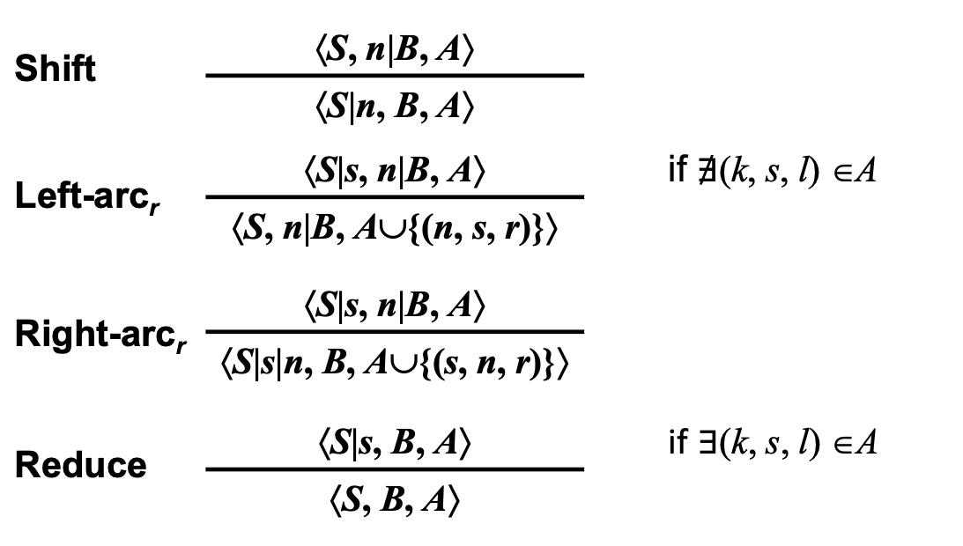
Arc Eager Transitions
Shift | ⟨S, n|B, A⟩
 | ⟨S|n, B, A⟩
Left-arc_{r} | ⟨S|s, n|B, A⟩ | if $∄$(k, s, l) ∈A
 | ⟨S, n|B, A∪{(n, s, r)}⟩
Right-arc_{r} | ⟨S|s, n|B, A⟩
 | ⟨S|s|n, B, A∪{(s, n, r)}⟩
Reduce | ⟨S|s, B, A⟩ | if $∃$(k, s, l) ∈A
 | ⟨S, B, A⟩

Slide 46
Arc Eager Oracle
Emulate the parser
Input Sentence: (w₁, w₂, … , w_{n})
S = <>
B = <w₁, w₂, … , w_{n}>
while B != <> do
if B[0] −r→ S[0]
perform Left-Arc_{r}
else if S[0] −r→ B[0]
perform Right-Arc_{r}
else if all children of S[0] are attached and S[0] is attached
perform Reduce
else
perform Shift

Slide 47
Arc Eager Parsing
Action | Stack | Buffer
 | [] | They told him a story
Shift | They | told him a story
LA-subj |  | told him a story
Shift | told | him a story
RA-obj | told him | a story
Reduce | told | a story
Shift | told a | story
LA-det | told | story
RA-obj | told story
Reduce | told

Slide 48
Non Projective Transitions

Slide 49
Actions for non-projective arcs (Attardi)
Right-arc2_{r} | ⟨S|s₂|s₁, n|B, A⟩
 | ⟨S|s₁, n|B, A∪{(s₂, n, r)}⟩
Left-arc2_{r} | ⟨S|s₂|s₁, n|B, A⟩
 | ⟨S|s₂, s₁|B, A∪{(n, s₂, r)}⟩
Right-arc3_{r} | ⟨S|s₃|s₂|s₁, n|B, A⟩
 | ⟨S|s₂|s₁, n|B, A∪{(s₃, n, r)}⟩
Left-arc3r | ⟨S|s₃|s₂|s₁, n|B, A⟩
 | ⟨S|s₃|s₂, s₁|B, A∪{(n, s₃, r)}⟩

Slide 50
Non Projectivity Example
Většinu těchto přístrojů lze take používat nejen jako fax , ale
Right-arc2 (nejen ← ale)
Left-arc3 (Většinu → fax)

Slide 51
Example
Většinu lze používat nejen fax ale
přístrojů
take
jako ,
těchto
Left-arc2

Slide 52
Example
Většinu lze používat fax ale
přístrojů
take
jako ,
nejen
těchto
Right-arc3

Slide 53
Example
Většin lze používat ale
přístrojů fax
take
, nejen
těchto jako
Leftt-arc2

Slide 54
Example
Většinu lze používat
přístrojů
fax
ale
take
těchto
jako
nejen
,

Slide 55
Examples
zou gemaakt moeten worden in
Left-arc2 (zou ← moeten)

Slide 56
Effectiveness for Non-Projectivity
Training data for Czech contains 28081 non-projective relations
26346 (93%) can be handled by Left2/Right2
1683 (6%) by Left3/Right3

Slide 57
Non-Projective Accuracy
language | total | DeSR | MaltParser
Czech | 104 | 77 | 79
Slovene | 88 | 34 | 21
Portuguese | 54 | 26 | 24
Danish | 35 | 10 | 9

Slide 58
Alternative: swap
Shift | ⟨S, n|B, A⟩
 | ⟨S|n, B, A⟩
Left-arc_{r} | ⟨S|s, n|B, A⟩ | no (k, s, l) ∈A
 | ⟨S, n|B, A∪{(n, s, r)}⟩
Right-arc_{r} | ⟨S|s, n|B, A⟩
 | ⟨S, s|I, A∪{(s, n, r)}⟩
Swap | ⟨S|s, n|B, A⟩ | s < n
 | ⟨S|n, s|I, A⟩

Slide 59
Arc Standard Swap Oracle
Emulate the parser
Input Sentence: (w₁, w₂, … , w_{n})
S = <>
B = <w₁, w₂, … , w_{n}>
while B != <> do
if B[0] −r→ S[0] and all children of S[0] are attached
perform Left-Arc_{r}
else if S[0] −r→ B[0] and all children of B[0] are attached
perform Right-Arc_{r}
else if S[0] < B[0] according to inorder traversal
perform Swap
else
perform Shift

Slide 60
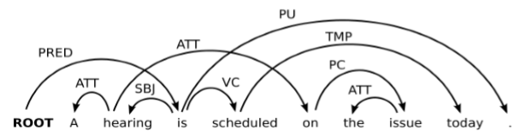
Example
Inorder traversal:
A hearing on the issue is scheduled today
1 2 5 6 7 3 4 8

Slide 61
Parsing with Swap
Action | Stack | Buffer
 | [] | A hearing is scheduled on the issue today
Shift | A | hearing is scheduled on the issue today
Shift | A hearing | is scheduled on the issue today
LA-ATT | hearing | Is scheduled on the issue today
Shift | hearing is | scheduled on the issue today
Shift | hearing is scheduled | on the issue today
Shift | hearing is scheduled on | the issue today
Swap | hearing is on | scheduled the issue today
Swap | hearing on | Is scheduled the issue today
Shift | hearing on is | scheduled the issue today
Shift | hearing on is scheduled | the issue today
Shift | hearing on is scheduled the | Issue today
Swap | hearing on is the | scheduled issue today
Swap | hearing on the | Is scheduled issue today

Slide 62
Learning Phase

Slide 63
Learning procedure
Go through each sentence in the treebank and extract the sequence of actions suggested by the oracle
Emulate the parser, and at each parser state, extract a context representation of the state, in terms of features
Provide thevfeatures as input and the suggested action as output to the classifier

Slide 64
Features
Feature ID | Value
F | form of token
L | lemma of token
P | part of speech (POS) tag
M | morphology
/F | form of the leftmost child node
/L | lemma of the leftmost child node
/P | POS tag of the leftmost child node, if present
M\ | Morphology of the rightmost child node
F\ | form of the rightmost child node
L\ | lemma of the rightmost child node
P\ | POS tag of the rightmost child node, if present
M\ | Morphology of the rightmost child node

Slide 65
Training Example
left context
target nodes
right context
Sosteneva
VER
che
PRO
leggi
NOM
anti
ADV
Serbia
NOM
che
PRO
,
PUN
le
DET
erano
VER
discusse
ADJ
context
(-3, F, che), (-3, P, PRO),
(-2, F, leggi), (-2, P, NOM), (-2, M, P), (-2, /F, le), (-2, /P, DET), (-2, /M, P),
(-1, F, anti), (-1, P, ADV),
(0, F, Serbia), (0, P, NOM), (0, M, S),
(+1, F, che), ( +1, P, PRO), (+1, F\, erano), (+1, P\, VER), (+1, M\, P),
(+2, F, ,), (+2, P, PUN)

Slide 66
DeSR (Dependency Shift Reduce)
Multilanguage statistical transition based dependency parser
Linear algorithm
Capable of handling non-projectivity
Trained on 28 languages
Available from: http://desr.sourceforge.net/

Slide 67
Parser Architecture
Modular learners architecture:
MLP, MaxEntropy, SVM, Perceptron
Features can be configured

Slide 68
Available Classifiers
Maximum Entropy
Fast, not very accurate
SVM
Slow, very accurate
Multilayer Perceptron
Fast, very accurate
Deep Learning
Word embeddings as features

Slide 69
Feature Model
Notation used in DeSR configuration files
LEMMA | -2 -1 0 1 2 3 prev(0) leftChild(-1) leftChild(0) rightChild(-1) rightChild(0)
POSTAG | -2 -1 0 1 2 3 next(-1) leftChild(-1) leftChild(0) rightChild(-1) rightChild(0)
CPOSTAG | -1 0 1
FEATS | -1 0 1
DEPREL | leftChild(-1) leftChild(0) rightChild(-1)

Slide 70
2nd, 3rd Order Features
2nd | CPOSTAG(-1) CPOSTAG(0)
2nd | CPOSTAG(0) CPOSTAG(1)
2nd | LEMMA(0) POSTAG(leftChild(0))
3rd | POSTAG(leftChild(0)) LEMMA(0) POSTAG(rightChild(0))

Slide 71
CoNLL-X Shared Task
To assign labeled dependency structures for a range of languages by means of a fully automatic dependency parser
Input: tokenized and tagged sentences
Tags: token, lemma, POS, morpho features, ref. to head, dependency label
For each token, the parser must output its head and the corresponding dependency relation

Slide 72
CoNLL-X: Data Format
N WORD LEMMA CPOS POS FEATS HEAD DEPREL PHEAD PDEPREL
1 A o art art <artd>|F|S 2 >N _ _
2 direcção direcção n n F|S 4 SUBJ _ _
3 já já adv adv _ 4 ADVL _ _
4 mostrou mostrar v v-fin PS|3S|IND 0 STA _ _
5 boa_vontade boa_vontade n n F|S 4 ACC _ _
6 , , punc punc _ 4 PUNC _ _
7 mas mas conj conj-c <co-vfin>|<co-fmc> 4 CO _ _
8 a o art art <artd>|F|S 9 >N _ _
9 greve greve n n F|S 10 SUBJ _ _
10 prossegue prosseguir v v-fin PR|3S|IND 4 CJT _ _
11 em em prp prp _ 10 ADVL _ _
12 todas_as todo_o pron pron-det <quant>|F|P 13 >N _ _
13 delegações delegaçõo n n F|P 11 P< _ _
14 de de prp prp <sam-> 13 N< _ _
15 o o art art <-sam>|<artd>|M|S 16 >N _ _
16 país país n n M|S 14 P< _ _
17 . . punc punc _ 4 PUNC _ _

Slide 73
CoNLL: Evaluation Metrics
Unlabeled Attachment Score (UAS)
proportion of tokens that are assigned the correct head
Labeled Attachment Score (LAS)
proportion of tokens that are assigned both the correct head and the correct dependency relation label
Context Word Labeled Attachment Score (CLAS)
Like LAS but disregards attachments of punctuations and function words, i.e. determiners (det), classifiers (clf), adpositions (case), auxiliaries (aux, cop), and conjunctions (cc, mark)

Slide 74
Annotation Issues
A dependency graph D = (W, A) is a directed rooted tree
D is (weakly) connected:
If i , j ∈ V, i ↔∗ j
D is acyclic:
If i → j, then not j →∗ i
D obeys the single-head constraint:
If i → j, then not i′ → j, for any i′ ≠ i
The single-head constraint causes problems in handling certain linguistic phenomena

Slide 75
Anomalous Cases
He designs and develops programs
Il governo garantirà sussidi a coloro che cercheranno lavoro

Slide 76
Solution
He designs and develops programs
PREDREL
SUBJ
OBJ
SUBJ
OBJ
Il governo garantirà sussidi a coloro che cercheranno lavoro

Slide 77
Problem with Oracles
Only suggest correct path
If a parser makes mistakes, it finds itself in a state never seen in training and does not know how to recover
This causes error propagation

Slide 78
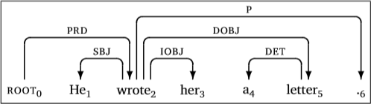
Spurious Ambiguities (Arc-eager Oracle)
Two possible parsing sequences:
SH LA RA SH RA SH LA RE RA RE RA
SH LA RA SH RA RE SH LA RA RE RA

Slide 79
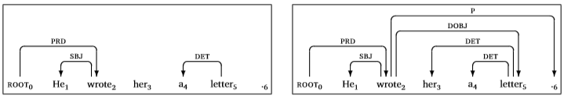
Error Propagation
Standard Oracle:
SH LA RA SH SH LA SH SH
Errors: 3
Dynamic Oracle:
SH LA RA SH LA LA RA RE RA
Errors: 1

Slide 80
Dynamic Oracle
Allows more than one transition sequence
Makes optimal predictions in all configurations
i.e. does not introduce any further errors
See: Y, Goldberg, J. Nivre. 2012. A Dynamic Oracle for Arc-Eager Dependency Parsing. Coling 2012. www.aclweb.org/anthology/C12-1059

Slide 81
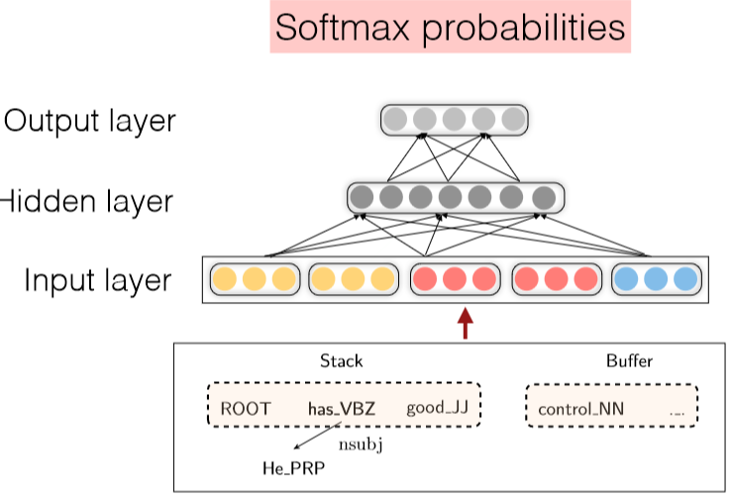
Dependency Parser using Neural Networks
Chen & Manning. A fast and accurate dependency parser using NN. EMNLP 2014.

Slide 82
State Representation
Extract a set of tokens from Stack/Buffer
Concatenate their vector embeddings
 | Word | POS | dep
S1 S2 B1 lc(S1) rc(S1) lc(S2) rc(S2) | good has control 0 0 He 0 | JJ VBZ NN 0 0 PRP 0 | 0 0 0 0 0 nsubj 0
Embeddings express similarities
POS: NN similar to NNS
deps: amod similar num

Slide 83
Accuracy UAS
Parser | Penn TB | Chinese TB | Sent/sec
Standard | 89.9 | 82.7
Malt | 90.1 | 82.4 | 470
MST | 92.0 | 83.0 | 10
NN | 92.0 | 83.9 | 650

Slide 84
Further Developments
Improvements:
Bigger, deeper networks with better tuned hyperparameters
Beam search
Bidirectional LSTM

Slide 85
State of the Art
Model | UAS | LAS | Paper / Source
Label Attention Layer + HPSG + XLNet (Mrini et al., 2019) | 97.33 | 96.29 | Rethinking Self-Attention: An Interpretable Self-Attentive Encoder-Decoder Parser
CVT + Multi-Task (Clark et al., 2018) | 96.61 | 95.02 | Semi-Supervised Sequence Modeling with Cross-View Training
Left-to-Right Pointer Network (Fernández-González and Gómez-Rodríguez, 2019) | 96.04 | 94.43 | Left-to-Right Dependency Parsing with Pointer Networks
Graph-based parser with GNNs (Ji et al., 2019) | 95.97 | 94.31 | Graph-based Dependency Parsing with Graph Neural Networks
Deep Biaffine (Dozat and Manning, 2017) | 95.74 | 94.08 | Deep Biaffine Attention for Neural Dependency Parsing

Slide 86
Graph-based Dependency Parsing

Slide 87
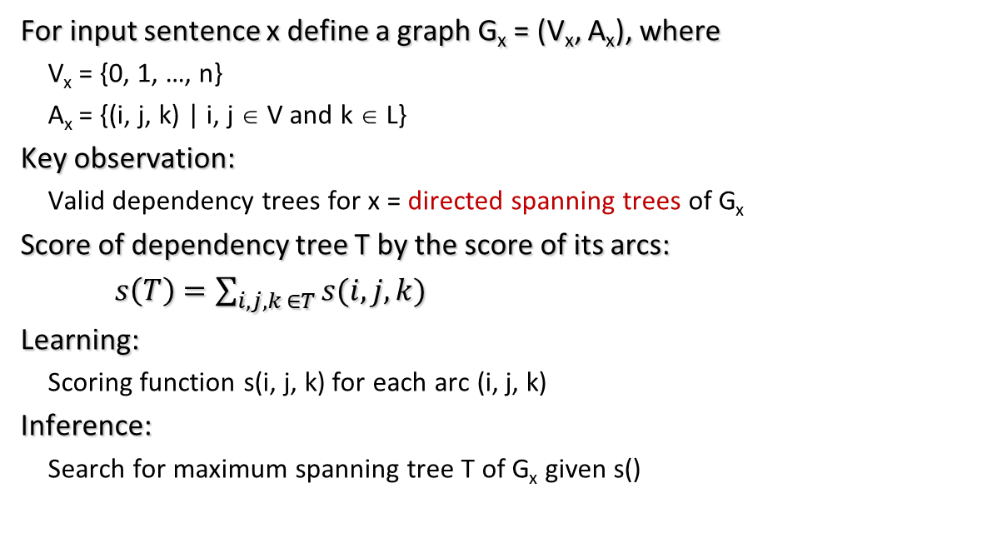
Graph-based Parsing
For input sentence x define a graph G_{x} = (V_{x}, A_{x}), where
V_{x} = {0, 1, …, n}
A_{x} = {(i, j, k) | i, j ∈ V and k ∈ L}
Key observation:
Valid dependency trees for x = directed spanning trees of G_{x}
Score of dependency tree T by the score of its arcs:
$s\left(T\right)=\sum_{i,j,k ∈T}{s(i, j, k)}$
Learning:
Scoring function s(i, j, k) for each arc (i, j, k)
Inference:
Search for maximum spanning tree T of G_{x} given s()

Slide 88
Finding Maximum Spanning Tree
Basic idea: choose the arc with highest score from each node
Not a tree!

Slide 89
Chu-Liu-Edmonds
If not a tree, identify cycle and contract
Recalculate arc weights into and out-of cycle
O(n²) complexity for non-projective trees

Slide 90
Neural Network Graph Parser
Biaffine Attention Model (Dozat&Manning)
http://aclweb.org/anthology/K18-2016

Slide 91
NN graph based parser
Revived graph-based dependency parsing in a neural world
Design a biaffine scoring model for neural dependency parsing
Uses a neural sequence model
Great results!
But slower than simple neural transition-based parsers
There are n² possible dependencies in a sentence of length n
Method | UAS | LAS (PTB 3.3)
Chen & Manning 2014 | 92.0 | 89.7
Weiss et al. 2015 | 93.99 | 92.05
Andor et al. 2016 | 94.61 | 92.79
Dozat & Manning 2017 | 95.74 | 94.08

Slide 92
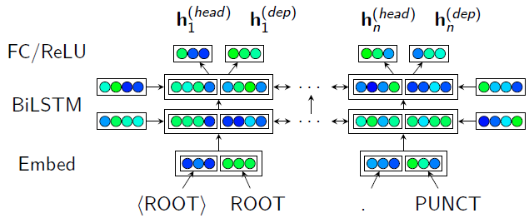
Architecture Overview
Bidirectional LSTM over word/tag embeddings
Word POS

Slide 93
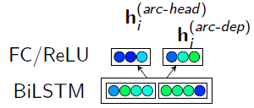
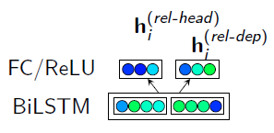
Parser
Arcs
Deps
Two separate FC (Fully Connected) ReLU layers:
One representing each token as a dependent trying to determine its label
One representing each token as a head trying to determine its dependents' labels
Two separate FC ReLU layers
One representing each token as a dependent trying to find (attend to) its head
One representing each token as a head trying to find (be attended to by) its dependents

Slide 94
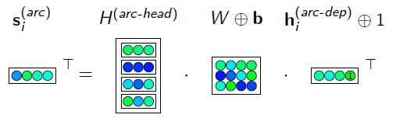
Self Attention
Biaffine self-attention layer to score possible heads for each dependent (n × n) matrix score
s_{i} = H^{(arc-head)}(Wh_{i}^{(arc-dep)} + b)
H^{(arc-head)} = [h₁^{(arc-head)}|…| h_{n}^{(arc-head)}]
Train with cross-entropy
Apply a spanning tree algorithm at inference time

Slide 95
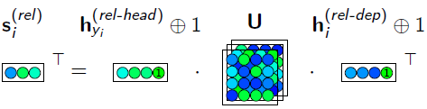
Classifier for Labels
Biaffine layer to score possible relations for each best-head/dependent pair (n × c)
Train with softmax cross-entropy, added to the loss of the unlabeled parser
Note: this is just a linear model with interaction effects!
label.scores ~ head.state * dep.state

Slide 96
Universal Dependencies SoTA 2017
TreeBank | LAS | CLAS | System
ru | 92.60 | 90.11 | Stanford
hi | 91.59 | 87.92 | Stanford
sl | 91.51 | 88.98 | Stanford
pt | 91.36 | 87.48 | Stanford
ja | 91.13 | 83.18 | TRL
ca | 90.70 | 86.70 | Stanford
it | 90.68 | 86.18 | Stanford
cs | 90.43 | 88.31 | Stanford
pl | 90.32 | 87.94 | Stanford
cs | 90.17 | 88.44 | Stanford

Slide 97
References
G. Attardi, Experiments with a Multilanguage Non-Projective Dependency Parser, Proc. of the Tenth Conference on Natural Language Learning, New York, (NY), 2006.
G. Attardi, F. Dell'Orletta, M. Simi, J. Turian. Accurate Dependency Parsing with a Stacked Multilayer Perceptron. Proc. of Workshop Evalita 2009, ISBN 978-88-903581-1-1, 2009.
H. Yamada, Y. Matsumoto. 2003. Statistical Dependency Analysis with Support Vector Machines. In Proc. IWPT.
M. T. Kromann. 2001. Optimality parsing and local cost functions in discontinuous grammars. In Proc. FG-MOL.

