Slide 1
Word Meaning and Similarity
Word Senses and Word Relations

Slide 2
Reminder: lemma and wordform
A lemma or citation form
Same stem, part of speech, rough semantics
A wordform
The “inflected” word as it appears in text
Wordform | Lemma
banks | bank
sung | sing
duermes | dormir

Slide 3
Lemmas have senses
One lemma “bank” can have many meanings:
…a bank can hold the investments in a custodial account…
“…as agriculture burgeons on the east bank the river will shrink even more”
Sense (or word sense)
A discrete representation
of an aspect of a word’s meaning.
The lemma bank here has two senses
Sense 1:
1
Sense 2:
2

Slide 4
Homonymy
Homonyms: words that share a form but have unrelated, distinct meanings:
bank₁: financial institution, bank₂: sloping land
bat₁: club for hitting a ball, bat₂: nocturnal flying mammal
Homographs (bank/bank, bat/bat)
Homophones:
Write and right
Piece and peace

Slide 5
Homonymy causes problems for NLP applications
Information retrieval
“bat care”
Machine Translation
bat: murciélago (animal) or bate (for baseball)
Text-to-Speech
bass (stringed instrument) vs. bass (fish)

Slide 6
Polysemy
1. The bank was constructed in 1875 out of local red brick.
2. I withdrew the money from the bank
Are those the same sense?
Sense 2: “A financial institution”
Sense 1: “The building belonging to a financial institution”
A polysemous word has related meanings
Most non-rare words have multiple meanings

Slide 7
Metonymy or Systematic Polysemy: A systematic relationship between senses
Lots of types of polysemy are systematic
School, university, hospital
All can mean the institution or the building.
A systematic relationship:
Building Organization
Other such kinds of systematic polysemy:
Author (Jane Austen wrote Emma)
Works of Author (I love Jane Austen)
Tree (Plums have beautiful blossoms)
Fruit (I ate a preserved plum)

Slide 8
How do we know when a word has more than one sense?
The “zeugma” test: Two senses of serve?
Which flights serve breakfast?
Does Lufthansa serve Philadelphia?
?Does Lufthansa serve breakfast and San Jose?
Since this conjunction sounds weird,
we say that these are two different senses of “serve”

Slide 9
Synonyms
Word that have the same meaning in some or all contexts.
filbert / hazelnut
couch / sofa
big / large
automobile / car
vomit / throw up
Water / H₂0
Two lexemes are synonyms
if they can be substituted for each other in all situations
If so they have the same propositional meaning

Slide 10
Synonyms
But there are few (or no) examples of perfect synonymy.
Even if many aspects of meaning are identical
Still may not preserve the acceptability based on notions of politeness, slang, register, genre, etc.
Example:
Water/H₂0
Big/large
Brave/courageous

Slide 11
Synonymy is a relation between senses rather than words
Consider the words big and large
Are they synonyms?
How big is that plane?
Would I be flying on a large or small plane?
How about here:
Miss Nelson became a kind of big sister to Benjamin.
?Miss Nelson became a kind of large sister to Benjamin.
Why?
big has a sense that means being older, or grown up
large lacks this sense

Slide 12
Antonyms
Senses that are opposites with respect to one feature of meaning
Otherwise, they are very similar!
dark/light short/long fast/slow rise/fall
hot/cold up/down in/out
More formally: antonyms can
define a binary opposition
or be at opposite ends of a scale
long/short, fast/slow
Be reversives:
rise/fall, up/down

Slide 13
Hyponymy and Hypernymy
One sense is a hyponym of another if the first sense is more specific, denoting a subclass of the other
car is a hyponym of vehicle
mango is a hyponym of fruit
Conversely hypernym/superordinate (“hyper is super”)
vehicle is a hypernym of car
fruit is a hypernym of mango
Superordinate/hyper | vehicle | fruit | furniture
Subordinate/hyponym | car | mango | chair

Slide 14
Hyponymy more formally
Extensional:
The class denoted by the superordinate extensionally includes the class denoted by the hyponym
Entailment:
A sense A is a hyponym of sense B if being an A entails being a B
Hyponymy is usually transitive
(A hypo B and B hypo C entails A hypo C)
Another name: the IS-A hierarchy
A IS-A B (or A ISA B)
B subsumes A

Slide 15
Hyponyms and Instances
WordNet has both classes and instances.
An instance is an individual, a proper noun that is a unique entity
San Francisco is an instance of city
But city is a class
city is a hyponym of municipality...location...

Slide 16
Word Meaning and Similarity
Word Senses and Word Relations

Slide 17
Word Meaning and Similarity
WordNet and other Online Thesauri

Slide 18
Applications of Thesauri and Ontologies
Information Extraction
Information Retrieval
Question Answering
Bioinformatics and Medical Informatics
Machine Translation

Slide 19
WordNet 3.0
A hierarchically organized lexical database
On-line thesaurus + aspects of a dictionary
Some other languages available or under development
(Arabic, Finnish, German, Portuguese…)
Category | Unique Strings
Noun | 117,798
Verb | 11,529
Adjective | 22,479
Adverb | 4,481

Slide 20
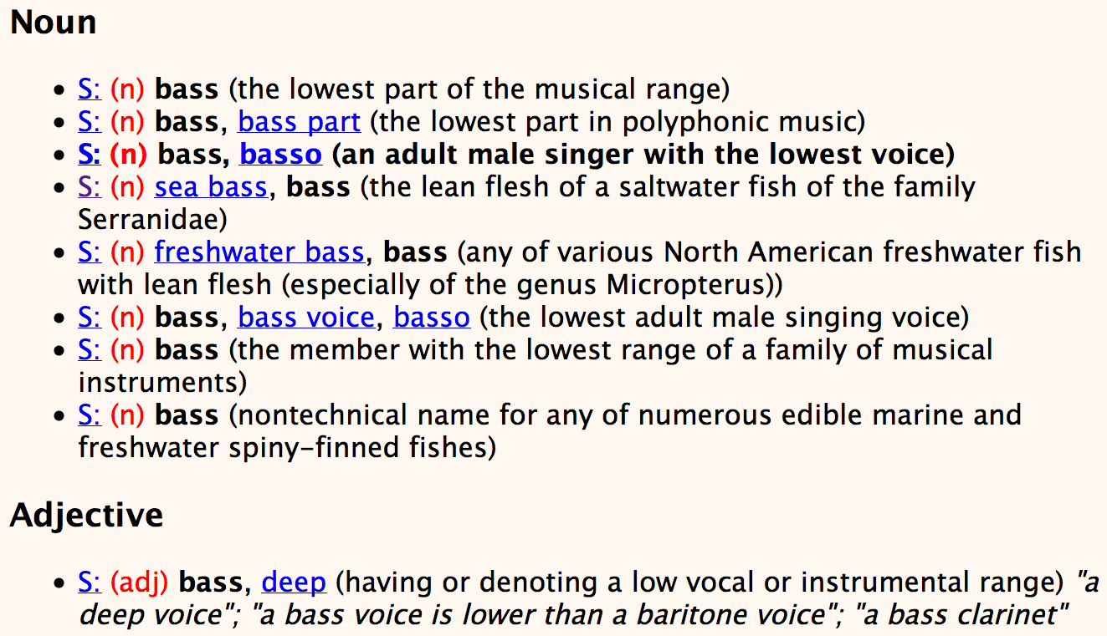
Senses of “bass” in Wordnet

Slide 21
How is “sense” defined in WordNet?
The synset (synonym set), the set of near-synonyms, instantiates a sense or concept, with a gloss
Example: chump as a noun with the gloss:
“a person who is gullible and easy to take advantage of”
This sense of “chump” is shared by 9 words:
chump¹, fool², gull¹, mark⁹, patsy¹, fall guy¹, sucker¹, soft touch¹, mug²
Each of these senses have this same gloss
(Not every sense; sense 2 of gull is the aquatic bird)

Slide 22
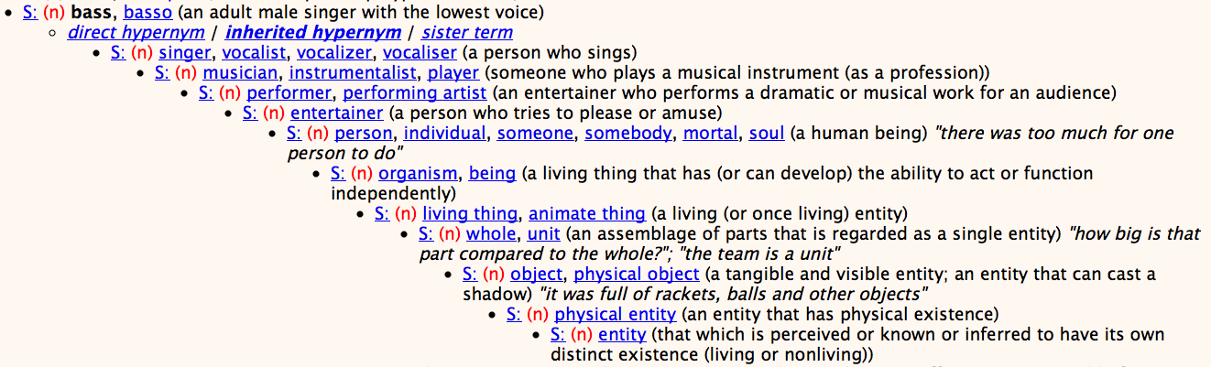
WordNet Hypernym Hierarchy for “bass”

Slide 23
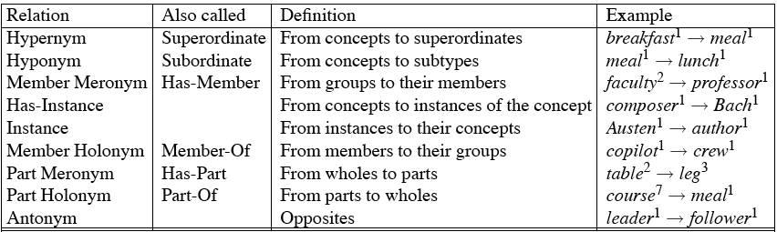
WordNet Noun Relations

Slide 24
WordNet 3.0
Where it is:
http://wordnetweb.princeton.edu/perl/webwn
Libraries
Python: WordNet from NLTK
http://www.nltk.org/Home
Java:
JWNL, extJWNL on sourceforge

Slide 25
MeSH: Medical Subject Headings thesaurus from the National Library of Medicine
MeSH (Medical Subject Headings)
177,000 entry terms that correspond to 26,142 biomedical “headings”
Hemoglobins
Entry Terms: Eryhem, Ferrous Hemoglobin, Hemoglobin
Definition: The oxygen-carrying proteins of ERYTHROCYTES. They are found in all vertebrates and some invertebrates. The number of globin subunits in the hemoglobin quaternary structure differs between species. Structures range from monomeric to a variety of multimeric arrangements
Synset

Slide 26
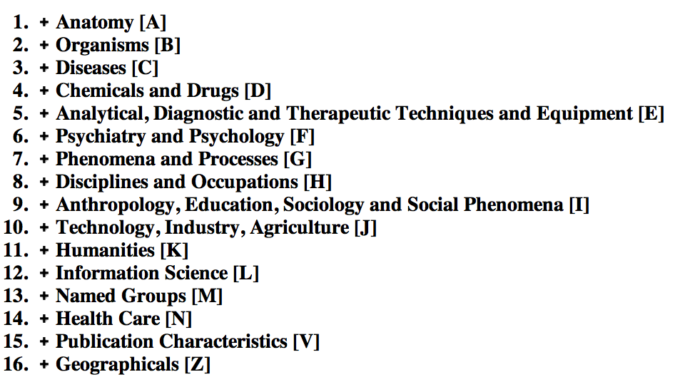
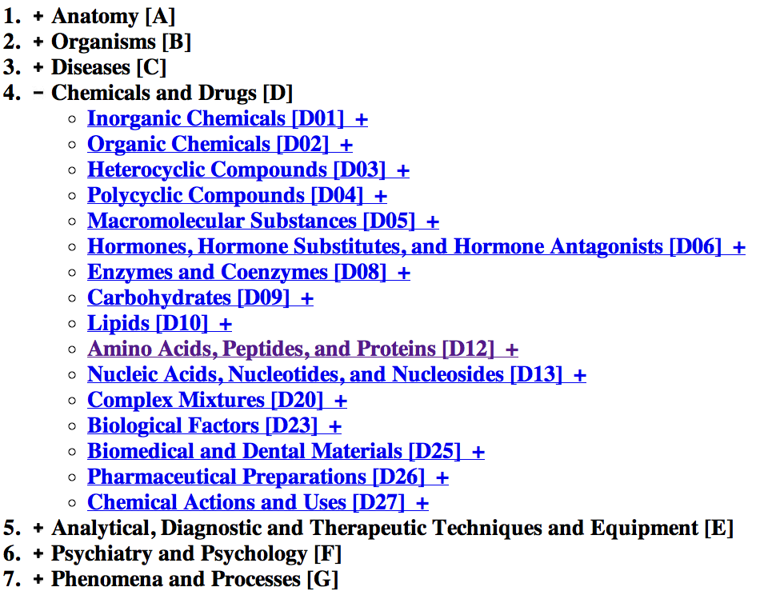
The MeSH Hierarchy
a

Slide 27
Uses of the MeSH Ontology
Provide synonyms (“entry terms”)
E.g., glucose and dextrose
Provide hypernyms (from the hierarchy)
E.g., glucose ISA monosaccharide
Indexing in MEDLINE/PubMED database
NLM’s bibliographic database:
20 million journal articles
Each article hand-assigned 10-20 MeSH terms

Slide 28
Word Meaning and Similarity
WordNet and other Online Thesauri

Slide 29
Word Meaning and Similarity
Word Similarity: Thesaurus Methods

Slide 30
Word Similarity
Synonymy: a binary relation
Two words are either synonymous or not
Similarity (or distance): a looser metric
Two words are more similar if they share more features of meaning
Similarity is properly a relation between senses
The word “bank” is not similar to the word “slope”
Bank¹ is similar to fund³
Bank² is similar to slope⁵
But we’ll compute similarity over both words and senses

Slide 31
Why word similarity
Information retrieval
Question answering
Machine translation
Natural language generation
Language modeling
Automatic essay grading
Plagiarism detection
Document clustering

Slide 32
Word similarity and word relatedness
We often distinguish word similarity from word relatedness
Similar words: near-synonyms
Related words: can be related any way
car, bicycle: similar
car, gasoline: related, not similar

Slide 33
Two classes of similarity algorithms
Thesaurus-based algorithms
Are words “nearby” in hypernym hierarchy?
Do words have similar glosses (definitions)?
Distributional algorithms
Do words have similar distributional contexts?

Slide 34
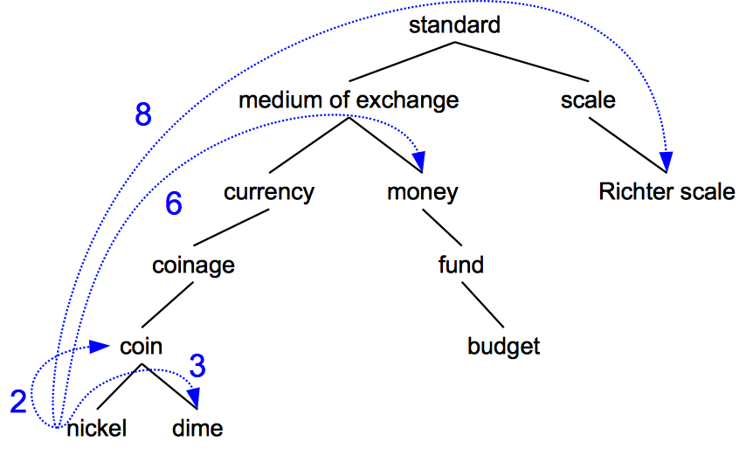
Path based similarity
Two concepts (senses/synsets) are similar if they are near each other in the thesaurus hierarchy
=have a short path between them
concepts have path 1 to themselves

Slide 35
Refinements to path-based similarity
pathlen(c₁,c₂) = 1 + number of edges in the shortest path in the hypernym graph between sense nodes c₁ and c₂
ranges from 0 to 1 (identity)
simpath(c₁,c₂) =
wordsim(w₁,w₂) = max sim(c₁,c₂)
c₁∈senses(w₁),c₂∈senses(w₂)

Slide 36
Example: path-based similarity simpath(c₁,c₂) = 1/pathlen(c₁,c₂)
simpath(nickel,coin) = 1/2 = .5
simpath(fund,budget) = 1/2 = .5
simpath(nickel,currency) = 1/4 = .25
simpath(nickel,money) = 1/6 = .17
simpath(coinage,Richter scale) = 1/6 = .17

Slide 37
Problem with basic path-based similarity
Assumes each link represents a uniform distance
But nickel to money seems to us to be closer than nickel to standard
Nodes high in the hierarchy are very abstract
We instead want a metric that
Represents the cost of each edge independently
Words connected only through abstract nodes
are less similar

Slide 38
Information content similarity metrics
Resnik 1995. Using information content to evaluate semantic similarity in a taxonomy. IJCAI
Let’s define P(c) as:
The probability that a randomly selected word in a corpus is an instance of concept c
Formally: there is a distinct random variable, ranging over words, associated with each concept in the hierarchy
for a given concept, each observed noun is either
a member of that concept with probability P(c)
not a member of that concept with probability 1-P(c)
All words are members of the root node (Entity)
P(root)=1
The lower a node in hierarchy, the lower its probability

Slide 39
Information content similarity
entity
…
geological-formation
Train by counting in a corpus
Each instance of hill counts toward frequency
of natural elevation, geological formation, entity, etc
Let words(c) be the set of all words that are children of node c
words(“geo-formation”) = {hill,ridge,grotto,coast,cave,shore,natural elevation}
words(“natural elevation”) = {hill, ridge}
natural elevation
cave
shore
hill
ridge
grotto
coast

Slide 40
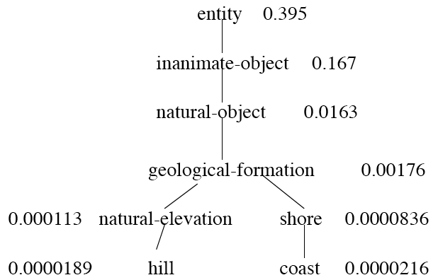
Information content similarity
WordNet hierarchy augmented with probabilities P(c)
D. Lin. 1998. An Information-Theoretic Definition of Similarity. ICML 1998

Slide 41
Information content: definitions
Information content:
IC(c) = -log P(c)
Most informative subsumer (Lowest common subsumer)
LCS(c₁,c₂) =
The most informative (lowest) node in the hierarchy subsuming both c₁ and c₂

Slide 42
Using information content for similarity: the Resnik method
Philip Resnik. 1995. Using Information Content to Evaluate Semantic Similarity in a Taxonomy. IJCAI 1995.
Philip Resnik. 1999. Semantic Similarity in a Taxonomy: An Information-Based Measure and its Application to Problems of Ambiguity in Natural Language. JAIR 11, 95-130.
The similarity between two words is related to their common information
The more two words have in common, the more similar they are
Resnik: measure common information as:
The information content of the most informative
(lowest) subsumer (MIS/LCS) of the two nodes
sim_{resnik}(c₁,c₂) = -log P( LCS(c₁,c₂) )

Slide 43
Dekang Lin method
Dekang Lin. 1998. An Information-Theoretic Definition of Similarity. ICML
Intuition: Similarity between A and B is not just what they have in common
The more differences between A and B, the less similar they are:
Commonality: the more A and B have in common, the more similar they are
Difference: the more differences between A and B, the less similar
Commonality: IC(common(A,B))
Difference: IC(description(A,B)-IC(common(A,B))

Slide 44
Dekang Lin similarity theorem
The similarity between A and B is measured by the ratio between the amount of information needed to state the commonality of A and B and the information needed to fully describe what A and B are
Lin (altering Resnik) defines IC(common(A,B)) as 2 x information of the LCS

Slide 45
Lin similarity function

Slide 46
The (extended) Lesk Algorithm
A thesaurus-based measure that looks at glosses
Two concepts are similar if their glosses contain similar words
Drawing paper: paper that is specially prepared for use in drafting
Decal: the art of transferring designs from specially prepared paper to a wood or glass or metal surface
For each n-word phrase that’s in both glosses
Add a score of n²
Paper and specially prepared for 1 + 2² = 5
Compute overlap also for other relations
glosses of hypernyms and hyponyms

Slide 47
Summary: thesaurus-based similarity

Slide 48
Libraries for computing thesaurus-based similarity
NLTK
http://nltk.github.com/api/nltk.corpus.reader.html?highlight=similarity - nltk.corpus.reader.WordNetCorpusReader.res_similarity
WordNet::Similarity
http://wn-similarity.sourceforge.net/
Web-based interface:
http://marimba.d.umn.edu/cgi-bin/similarity/similarity.cgi

Slide 49
Evaluating similarity
Intrinsic Evaluation:
Correlation between algorithm and human word similarity ratings
Extrinsic (task-based, end-to-end) Evaluation:
Malapropism (spelling error) detection
WSD
Essay grading
Taking TOEFL multiple-choice vocabulary tests
Levied is closest in meaning to:
imposed, believed, requested, correlated

Slide 50
Word Meaning and Similarity
Word Similarity: Thesaurus Methods

Slide 51
Word Meaning and Similarity
Word Similarity: Distributional Similarity (I)

Slide 52
Problems with thesaurus-based meaning
We don’t have a thesaurus for every language
Even if we do, they have problems with recall
Many words are missing
Most (if not all) phrases are missing
Some connections between senses are missing
Thesauri work less well for verbs, adjectives
Adjectives and verbs have less structured hyponymy relations

Slide 53
Distributional models of meaning
Also called vector-space models of meaning
Offer much higher recall than hand-built thesauri
Although they tend to have lower precision
Also called vector-space models of meaning
Offer much higher recall than hand-built thesauri
Although they tend to have lower precision
Zellig Harris (1954): “oculist and eye-doctor … occur in almost the same environments…. If A and B have almost identical environments we say that they are synonyms.
Firth (1957): “You shall know a word by the company it keeps!”

Slide 54
Intuition of distributional word similarity
Nida example:
A bottle of tesgüino is on the table
Everybody likes tesgüino
Tesgüino makes you drunk
We make tesgüino out of corn.
From context words humans can guess tesgüino means
an alcoholic beverage like beer
Intuition for algorithm:
Two words are similar if they have similar word contexts.

Slide 55
Reminder: Term-document matrix
Each cell: count of term t in a document d: tf_{t,d}:
Each document is a count vector in ℕ^{v}: a column below

Slide 56
Reminder: Term-document matrix
Two documents are similar if their vectors are similar

Slide 57
The words in a term-document matrix
Each word is a count vector in ℕ^{D}: a row below

Slide 58
The words in a term-document matrix
Two words are similar if their vectors are similar

Slide 59
The Term-Context matrix
Instead of using entire documents, use smaller contexts
Paragraph
Window of 10 words
A word is now defined by a vector over counts of context words

Slide 60
Sample contexts: 20 words (Brown corpus)
equal amount of sugar, a sliced lemon, a tablespoonful of apricot preserve or jam, a pinch each of clove and nutmeg,
on board for their enjoyment. Cautiously she sampled her first pineapple and another fruit whose taste she likened to that of
of a recursive type well suited to programming on the digital computer. In finding the optimal R-stage policy from that of
substantially affect commerce, for the purpose of gathering data and information necessary for the study authorized in the first section of this

Slide 61
Term-context matrix for word similarity
Two words are similar in meaning if their context vectors are similar

Slide 62
Should we use raw counts?
For the term-document matrix
We used tf-idf instead of raw term counts
For the term-context matrix
Positive Pointwise Mutual Information (PPMI) is common

Slide 63
Pointwise Mutual Information
Pointwise mutual information:
Do events x and y co-occur more than if they were independent?
PMI between two words: (Church & Hanks 1989)
Do words x and y co-occur more than if they were independent?
Positive PMI between two words (Niwa & Nitta 1994)
Replace all PMI values less than 0 with zero

Slide 64
Computing PPMI on a term-context matrix
Matrix F with W rows (words) and C columns (contexts)
f_{ij} is # of times w_{i} occurs in context c_{j}

Slide 65
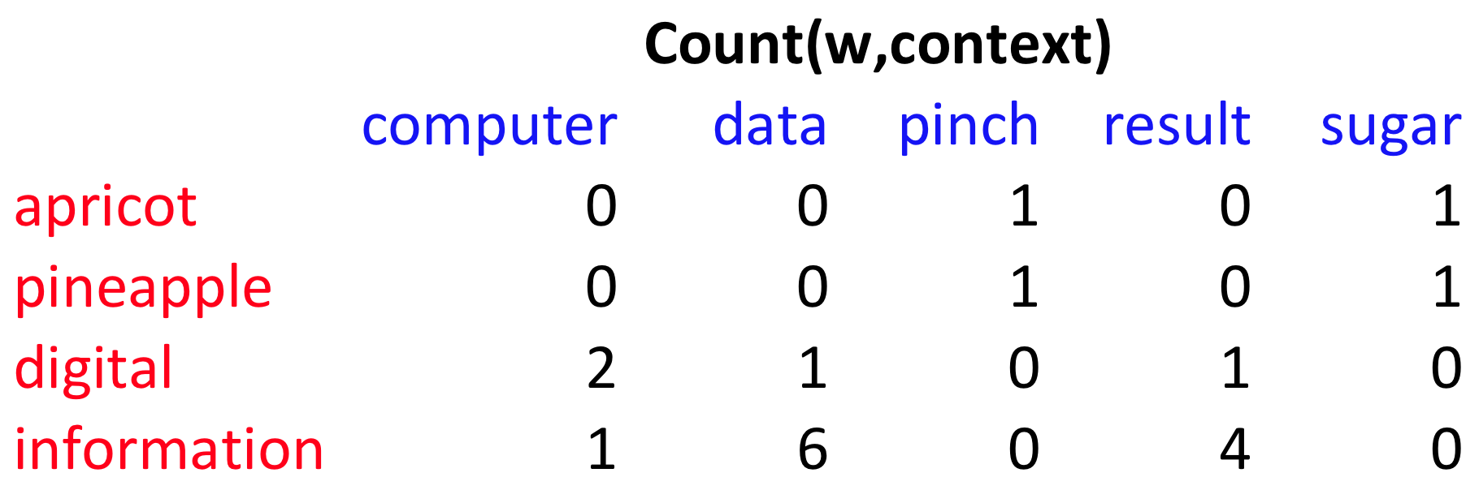
p(w=information,c=data) =
p(w=information) =
p(c=data) =
6/19
= .32
11/19
= .58
7/19
= .37

Slide 66
pmi(information,data) = log₂ (
.32 /
(.37*.58) )
= .58
(.57 using full precision)

Slide 67
Weighing PMI
PMI is biased toward infrequent events
Various weighting schemes help alleviate this
See Turney and Pantel (2010)
Add-one smoothing can also help

Slide 70
Word Meaning and Similarity
Word Similarity: Distributional Similarity (I)

Slide 71
Word Meaning and Similarity
Word Similarity: Distributional Similarity (II)

Slide 72
Using syntax to define a word’s context
Zellig Harris (1968)
“The meaning of entities, and the meaning of grammatical relations among them, is related to the restriction of combinations of these entities relative to other entities”
Two words are similar if they have similar parse contexts
Duty and responsibility (Chris Callison-Burch’s example)
Modified by adjectives | additional, administrative, assumed, collective, congressional, constitutional …
Objects of verbs | assert, assign, assume, attend to, avoid, become, breach …

Slide 73
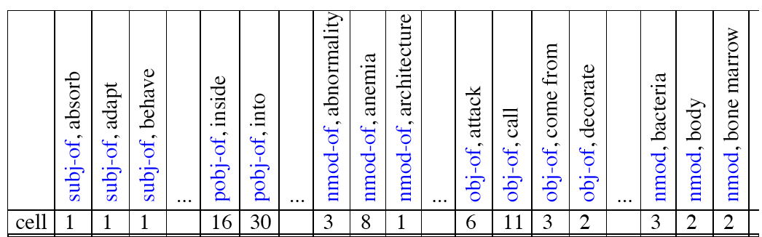
Co-occurrence vectors based on syntactic dependencies
Dekang Lin, 1998 “Automatic Retrieval and Clustering of Similar Words”
The contexts C are different dependency relations
Subject-of- “absorb”
Prepositional-object of “inside”
Counts for the word cell:

Slide 74
PMI applied to dependency relations
Hindle, Don. 1990. Noun Classification from Predicate-Argument Structure. ACL
Object of “drink” | Count | PMI
it | 3 | 1.3
anything | 3 | 5.2
wine | 2 | 9.3
tea | 2 | 11.8
liquid | 2 | 10.5
Object of “drink” | Count | PMI
tea | 2 | 11.8
liquid | 2 | 10.5
wine | 2 | 9.3
anything | 3 | 5.2
it | 3 | 1.3
“Drink it” more common than “drink wine”
But “wine” is a better “drinkable” thing than “it”

Slide 75
Reminder: cosine for computing similarity
Sec. 6.3
Dot product
Unit vectors
v_{i} is the PPMI value for word v in context i
w_{i} is the PPMI value for word w in context i.
Cos(v,w) is the cosine similarity of v and w
Notes:
See Law of Cosines (Cosine Rule) wikipedia page

Slide 76
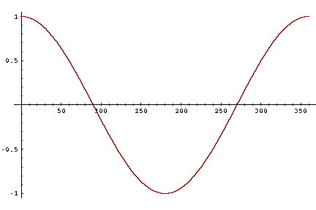
Cosine as a similarity metric
-1: vectors point in opposite directions
+1: vectors point in same directions
0: vectors are orthogonal
Raw frequency or PPMI are non-negative, so cosine range 0-1

Slide 77
 | large | data | computer
apricot | 1 | 0 | 0
digital | 0 | 1 | 2
information | 1 | 6 | 1
Which pair of words is more similar?
cosine(apricot,information) =
cosine(digital,information) =
cosine(apricot,digital) =

Slide 78
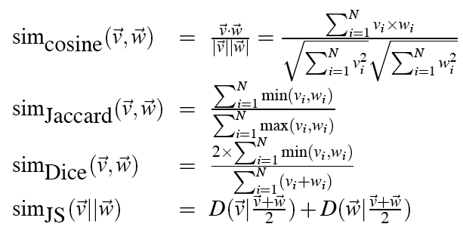
Other possible similarity measures

Slide 79
Evaluating similarity (the same as for thesaurus-based)
Intrinsic Evaluation:
Correlation between algorithm and human word similarity ratings
Extrinsic (task-based, end-to-end) Evaluation:
Spelling error detection, WSD, essay grading
Taking TOEFL multiple-choice vocabulary tests
Levied is closest in meaning to which of these:
imposed, believed, requested, correlated

Slide 80
Word Meaning and Similarity
Word Similarity: Distributional Similarity (II)

