Slide 1
Machine Translation: Introduction
Slides from: Dan Jurafsky

Slide 2
Outline for MT Week
Intro and a little history
Language Similarities and Divergences
Three classic MT Approaches
Transfer
Interlingua
Direct
Modern Statistical MT
Evaluation

Slide 3
What is MT?
Translating a text from one language to another automatically

Slide 4
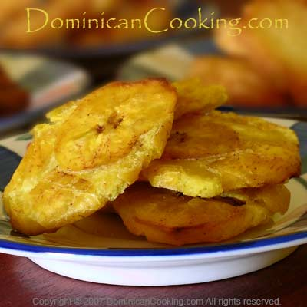
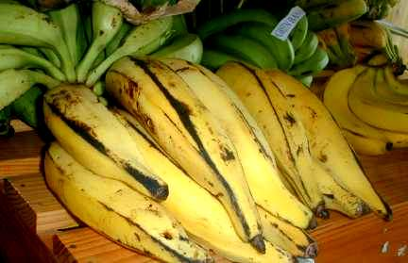
Google Translate
The translation
http://translate.google.com/translate?hl=en&sl=es&tl=en&u=http%3A%2F%2Fwww.cocinadominicana.com%2Facompanamientos-ensaladas-pastelones%2F1907-tostones.html
The original recipe for tostones
http://www.cocinadominicana.com/acompanamientos-ensaladas-pastelones/1907-tostones.html

Slide 5
Google Translate
http://translate.google.com/translate_t
http://translate.google.com/translate?hl=en&sl=fr&u=http://www.tarte-tatin.info/recette-tarte-tatin.html&ei=BduiSYK3C4KOsQObvLm_CQ&sa=X&oi=translate&resnum=4&ct=result&prev=/search%3Fq%3Dtarte%2Btatin%2Brecettes%26num%3D100%26hl%3Den%26lr%3D%26client%3Dsa

Slide 6

Machine Translation
The Story of the Stone (“The Dream of the Red Chamber”)
Cao Xueqin 1792
Chinese gloss: Dai-yu alone on bed top think-of-with-gratitude Bao-chai again listen to window outside bamboo tip plantain leaf of on-top rain sound sigh drop clear cold penetrate curtain not feeling again fall down tears come
Hawkes translation: As she lay there alone, Dai-yu’s thoughts turned to Bao-chai… Then she listened to the insistent rustle of the rain on the bamboos and plantains outside her window. The coldness penetrated the curtains of her bed. Almost without noticing it she had begun to cry.

Slide 7
Machine Translation
Issues:
Sentence segmentation: 4 English sentences to 1 Chinese
Grammatical differences
Chinese rarely marks tense:
As, turned to, had begun,
tou -> penetrated
No pronouns or articles in Chinese
Stylistic and cultural differences
Bamboo tip plaintain leaf -> bamboos and plantains
Ma ‘curtain’ -> curtains of her bed
Rain sound sigh drop -> insistent rustle of the rain

Slide 8
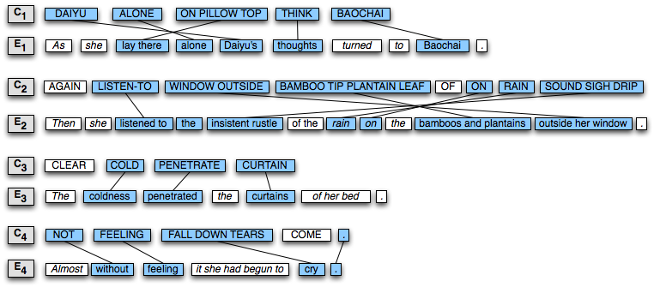
Alignment in Machine Translation

Slide 9
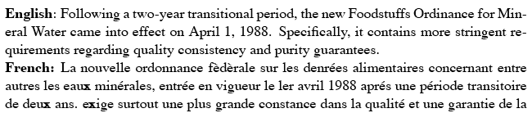
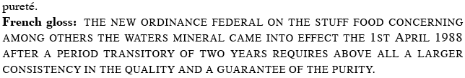
Not just literature
Hansards: Canadian parliamentary proceeedings

Slide 10
What is MT already good enough for?
Tasks for which a rough translation is fine
Extracting information (finding recipes!)
Web pages
email
Tasks for which MT can be post-edited
MT as first pass
“Computer-aided human translation
Tasks in sublanguage domains where high-quality MT is possible
FAHQT (Fully Automatic High Quality Translation)

Slide 11
What is MT not yet good enough for?
Really hard stuff
Literature
Natural spoken speech (meetings, court reporting)
Really important stuff
Medical translation in hospitals
911 calls

Slide 12
MT History
1946 Booth and Weaver discuss MT at Rockefeller foundation in New York
1947-48 idea of dictionary-based direct translation
1949 Weaver memorandum popularized idea
1952 all 18 MT researchers in world meet at MIT
1954 IBM/Georgetown Demo Russian-English MT
1955-65 lots of labs take up MT

Slide 13
Warren Weaver memo
http://www.stanford.edu/class/linguist289/weaver001.pdf
“There are certain invariant properties which are… to some statistically useful degree, common to all languages.”
On March 4, 1947, “having considerable exposure to computer design problems during the war, and being aware of the speed, capacity, and logical flexibility possible in modern electronic computers”, Weaver suggested that computers to be used for translation

Slide 14
History of MT: Pessimism
1959/1960: Bar-Hillel “Report on the state of MT in US and GB”
Argued FAHQT too hard (semantic ambiguity, etc)
Should work on semi-automatic instead of automatic
His argument: Little John was looking for his toy box. Finally, he found it. The box was in the pen. John was very happy.
Only human knowledge lets us know that ‘playpens’ are bigger than boxes, but ‘writing pens’ are smaller
His claim: we would have to encode all of human knowledge

Slide 15
History of MT: Pessimism
The ALPAC report
Headed by John R. Pierce of Bell Labs
Conclusions:
Supply of human translators exceeds demand
All the Soviet literature is already being translated
MT has been a failure: all current MT work had to be post-edited
Sponsored evaluations which showed that intelligibility and informativeness was worse than human translations
Results:
MT research suffered
Funding loss
Number of research labs declined
Association for Machine Translation and Computational Linguistics dropped MT from its name

Slide 16
History of MT
1976 Meteo, weather forecasts from English to French
Systran (Babelfish) been used for 40 years
1970’s:
European focus in MT; mainly ignored in US
1980’s
ideas of using early AI techniques in MT (KBMT, CMU)
Focus on “interlingua” systems, especially in Japan
1990’s
Commercial MT systems
Statistical MT
Speech-to-speech translation
2000’s
Statistical MT takes off
Google Translate

Slide 17
Language Similarities and Divergences
Some aspects of human language are universal or near-universal, others diverge greatly
Typology: the study of systematic cross-linguistic similarities and differences
What are the dimensions along with human languages vary?

Slide 18
Morphology
Morpheme
Minimal meaningful unit of language
Word = Morpheme+Morpheme+Morpheme+…
Stems: also called lemma, base form, root, lexeme
hope+ing → hoping hop → hopping
Affixes
Prefixes: Antidisestablishmentarianism
Suffixes: Antidisestablishmentarianism
Infixes: hingi (borrow) – humingi (borrower) in Tagalog
Circumfixes: sagen (say) – gesagt (said) in German
Notes:
Say (has) said

Slide 19
Morphological Variation
Isolating languages
Cantonese, Vietnamese: each word generally has one morpheme
Vs. Polysynthetic languages
Siberian Yupik (‘Eskimo’): single word may have very many morphemes
Agglutinative languages
Turkish: morphemes have clean boundaries
Vs. Fusion languages
Russian: single affix may have many morphemes

Slide 20
A Turkish word
uygarlaştıramadıklarımızdanmışsınızcasına
uygar+laş+tır+ama+dık+lar+ımız+dan+mış+sınız+casına
Behaving as if you are among those whom we could not cause to become civilized

Slide 21
Index of synthesis
isolating
synthetic
Vietnamese
English
Russian
Oneida

Slide 22
Isolating language
(1) Vietnamese (Comrie 1981: 43)
Khi tôi đến nhà bạn,
When I come house friend
‘When I came to my friend’s house,
chúng tôi bắt đầu làm bài.
PL I begin do lesson
‘we began to do lessons.’
Slide from Holger Diessel

Slide 23
Isolating language
Cantonese
keui wa chyuhn gwok jeui daaih gaan nguk haih li gaan
he say entire country most big building house is this building

Slide 24
Synthetic language
(2) Kirundi (Whaley 1997:20)
Y-a-bi-gur-i-ye abâna
CL1-PST-CL8.them-buy-APPL-ASP CL2.children
‘He bought them for the children.’
Slide from Holger Diessel

Slide 25
Polysynthetic language
Noun-incorporation (cf. fox-hunting, bird-watching)
(3) Mohawk (Mithun 1984: 868)
a. r-ukwe’t-í:yo
he-person-nice
‘He is a nice person.’
b. wa-hi-‘sereth-óhare-‘se
PST-he/me-car-wash-for
‘He car-wash for me.’ (= ‘He washed my car’)
c. kvtsyu v-kuwa-nya’t-ó:’ase
fish FUT-they/her-throat-slit
‘They will throat-slit a fish.’
Slide from Holger Diessel

Slide 26
Index of fusion
agglutinative
fusional
Swahili
Russian
Oneida
Slide from Holger Diessel

Slide 27
Agglutinative language
(1) Turkish (Comrie 1981: 44)
SG PL
Nominative adam adam-lar
Accusative adam-K adam-lar-K
Genitive adam-Kn adam-lar-Kn
Dative adam-a adam-lar-a
Locative adam-da adam-lar-da
Ablative adam-dan adam-lar-dan
Slide from Holger Diessel

Slide 28
Fusional language
(2) Russian
SG PL
Nominative stol stol-y
Accusative stol stol-y
Genitive stol-a stol-ov
Dative stol-u stol-am
Instrumental stol-om stol-ami
Prepositional stol-e stol-ax
SG PL
lip-a lip-y
lip-u lip-y
lip-y lip
lip-e lip-am
lip-oj lip-ami
lip-e lip-ax
Slide from Holger Diessel

Slide 29

Syntactic Variation
SVO (Subject-Verb-Object) languages
English, German, French, Mandarin
SOV Languages
Japanese, Hindi
VSO languages
Irish, Classical Arabic
SVO lgs generally prepositions: to Yuriko
VSO lgs generally postpositions: Yuriko ni

Slide 30
Segmentation Variation
Not every writing system has word boundaries marked
Chinese, Japanese, Thai, Vietnamese
Some languages tend to have sentences that are quite long, closer to English paragraphs than sentences:
Modern Standard Arabic, Chinese

Slide 31
Inferential Load: cold vs. hot lgs
Some ‘cold’ languages require the hearer to do more “figuring out” of who the various actors in the various events are:
Japanese, Chinese,
Other ‘hot’ languages are pretty explicit about saying who did what to whom.
English

Slide 32
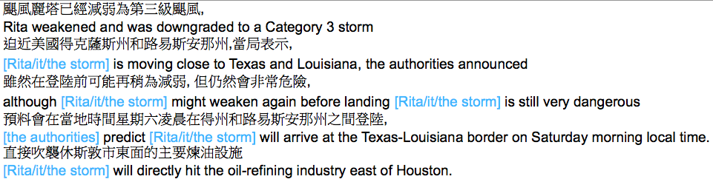
Inferential Load (2)
All noun phrases in
blue do not appear
in Chinese text …
But they are needed
for a good translation

Slide 33
Lexical Divergences
Word to phrases:
English “computer science” = French “informatique”
POS divergences
Eng. ‘she likes/VERB to sing’
Ger. Sie singt gerne/ADV
Eng ‘I’m hungry/ADJ
Sp. ‘tengo hambre/NOUN

Slide 34
Lexical Divergences: Specificity
Grammatical constraints
English has gender on pronouns, Mandarin not.
So translating “3rd person” from Chinese to English, need to figure out gender of the person!
Similarly from English “they” to French “ils/elles”
Semantic constraints
English `brother’
Mandarin ‘gege’ (older) versus ‘didi’ (younger)
English ‘wall’
German ‘Wand’ (inside) ‘Mauer’ (outside)
German ‘Berg’
English ‘hill’ or ‘mountain’

Slide 35
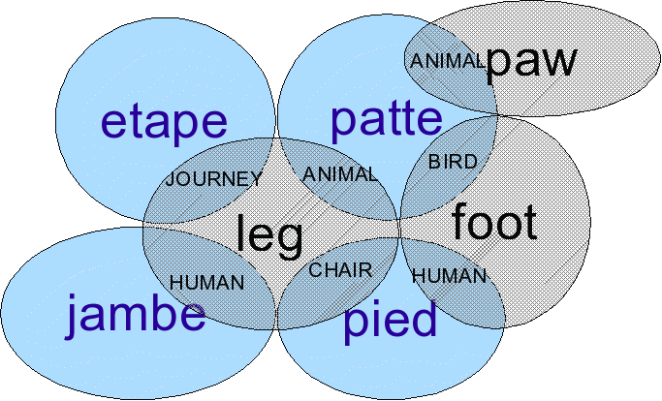
Lexical Divergence: many-to-many

Slide 36
Lexical Divergence: lexical gaps
Japanese: no word for privacy
English: no word for Cantonese ‘haauseun’ or Japanese ‘oyakoko’ (something like `filial piety’)
English ‘cow’ vs. ‘beef’, Cantonese ‘ngau’
English “fish”, Spanish “pez” vs. “pescado”

Slide 37
Event-to-argument divergences
English
The bottle floated out.
Spanish
La botella salió flotando.
The bottle exited floating
Verb-framed lg: mark direction of motion on verb
Spanish, French, Arabic, Hebrew, Japanese, Tamil, Polynesian, Mayan, Bantu familiies
Satellite-framed lg: mark direction of motion on satellite
Crawl out, float off, jump down, walk over to, run after
Rest of Indo-European, Hungarian, Finnish, Chinese

Slide 38
Structural divergences
G: Wir treffen uns am Mittwoch
E: We’ll meet on Wednesday

Slide 39
Head Swapping
E: X swim across Y
S: X crucar Y nadando
E: I like to eat
G: Ich esse gern
E: I’d prefer vanilla
G: Mir wäre Vanille lieber

Slide 40
Thematic divergence
Y me gusto
I like Y
G: Mir fällt der Termin ein
E: I forget the date

Slide 41
Divergence counts from Bonnie Dorr
32% of sentences in UN Spanish/English Corpus (5K)
Categorial | X tener hambre Y have hunger | 98%
Conflational | X dar puñaladas a Z X stab Z | 83%
Structural | X entrar en Y X enter Y | 35%
Head Swapping | X cruzar Y nadando X swim across Y | 8%
Thematic | X gustar a Y Y likes X | 6%

Slide 42
3 “Classical” methods for MT
Direct
Transfer
Interlingua

Slide 43
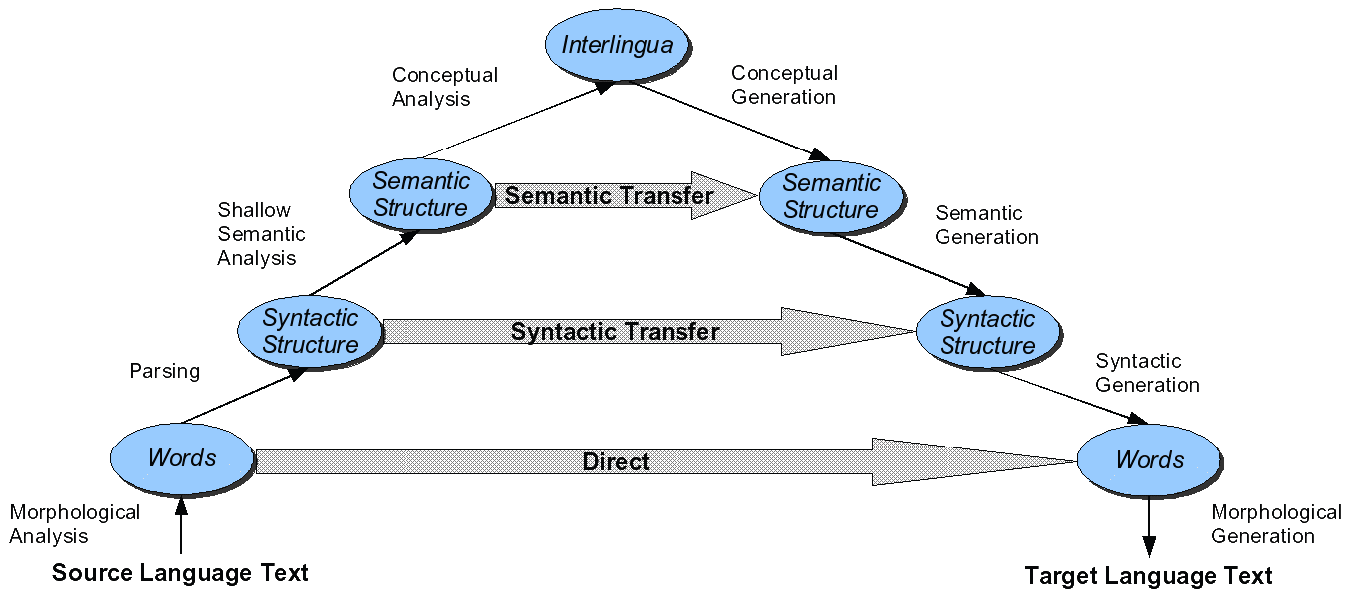
Three MT Approaches: Direct, Transfer, Interlingual

Slide 44
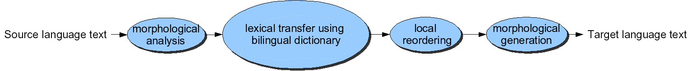
Direct Translation
Proceed word-by-word through text
Translating each word
No intermediate structures except morphology
Knowledge is in the form of
Huge bilingual dictionary
word-to-word translation information
After word translation, can do simple reordering
Adjective ordering English -> French/Spanish

Slide 45
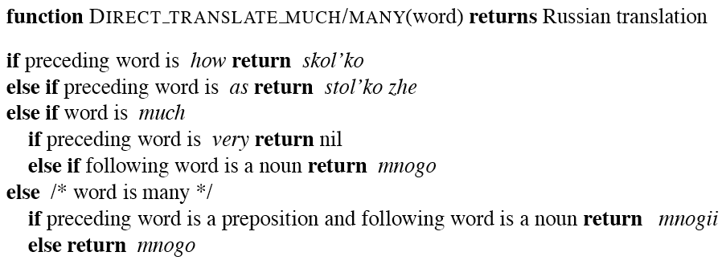
Direct MT Dictionary entry

Slide 46
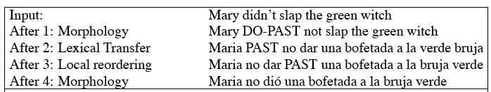
Direct MT

Slide 47
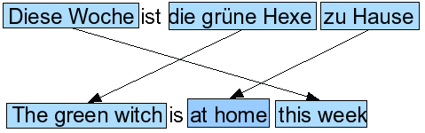
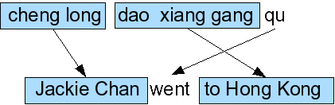
Problems with direct MT
German
Chinese

Slide 48
The Transfer Model
Idea: apply contrastive knowledge, i.e., knowledge about the difference between two languages
Steps:
Analysis: Syntactically parse Source language
Transfer: Rules to turn this parse into parse for Target language
Generation: Generate Target sentence from parse tree

Slide 49

English to French
Generally
English: Adjective Noun
French: Noun Adjective
Note: not always true
Route mauvaise ‘bad road, badly-paved road’
Mauvaise route ‘wrong road’)
But is a reasonable first approximation
Rule:

Slide 50
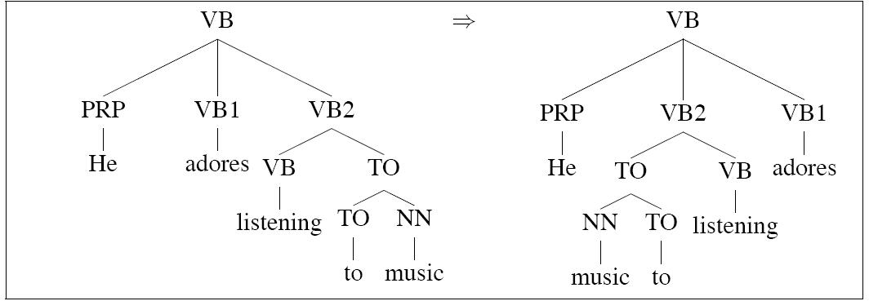
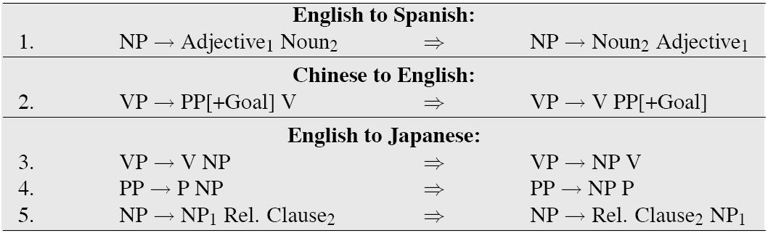
Transfer rules

Slide 51
Lexical transfer
Transfer-based systems also need lexical transfer rules
Bilingual dictionary (like for direct MT)
English home:
German
nach Hause (going home)
Heim (home game)
Heimat (homeland, home country)
zu Hause (at home)
Can list “at home <-> zu Hause”
Or do Word Sense Disambiguation

Slide 52
Systran: combining direct and transfer
Analysis
Morphological analysis, POS tagging
Chunking of NPs, PPs, phrases
Shallow dependency parsing
Transfer
Translation of idioms
Word sense disambiguation
Assigning prepositions based on governing verbs
Synthesis
Apply rich bilingual dictionary
Deal with reordering
Morphological generation

Slide 53
Transfer: some problems
N² sets of transfer rules!
Grammar and lexicon full of language-specific stuff
Hard to build, hard to maintain

Slide 54
Interlingua
Intuition: Instead of lg-lg knowledge rules, use the meaning of the sentence to help
Steps:
translate source sentence into meaning representation
generate target sentence from meaning.

Slide 55
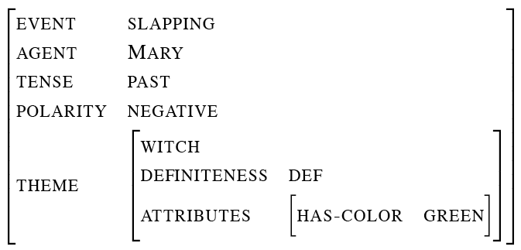
Interlingua
Mary did not slap the green witch

Slide 56
Interlingua
Idea is that some of the MT work that we need to do is part of other NLP tasks
E.g., disambiguating E:book S:‘libro’ from E:book S:‘reservar’
So we could have concepts like BOOKVOLUME and RESERVE and solve this problem once for each language

Slide 57
Direct MT: pros and cons (Bonnie Dorr)
Pros
Fast
Simple
Cheap
No translation rules hidden in lexicon
Cons
Unreliable
Not powerful
Rule proliferation
Requires lots of context
Major restructuring after lexical substitution

Slide 58
Interlingual MT: pros and cons (B. Dorr)
Pros
Avoids the N² problem
Easier to write rules
Cons:
Semantics is HARD
Useful information lost (paraphrase)

Slide 59
Moving toward Statistical MT!

Slide 60
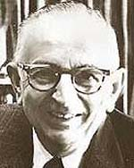
Warren Weaver (1947)
When I look at an article in Russian, I say to myself: This is really written in English, but it has been coded in some strange symbols. I will now proceed to decode.
Kevin Knight slide

Slide 61
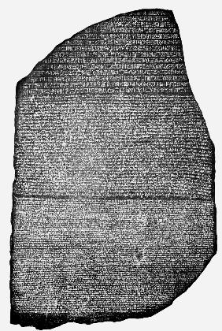
Rosetta Stone
Carved in 196 BC
Found in 1799
Decoded in 1822
Egyptian hieroglyphs
Egyptian Demotic
Greek
Kevin Knight slide

Slide 62
Centauri/Arcturan [Knight, 1997]
Your assignment, translate this to Arcturan:
farok crrrok hihok yorok clok kantok ok-yurp
Kevin Knight slide

Slide 63
Centauri/Arcturan [Knight, 1997]
1a. ok-voon ororok sprok .
1b. at-voon bichat dat .
7a. lalok farok ororok lalok sprok izok enemok .
7b. wat jjat bichat wat dat vat eneat .
2a. ok-drubel ok-voon anok plok sprok .
2b. at-drubel at-voon pippat rrat dat .
8a. lalok brok anok plok nok .
8b. iat lat pippat rrat nnat .
3a. erok sprok izok hihok ghirok .
3b. totat dat arrat vat hilat .
9a. wiwok nok izok kantok ok-yurp .
9b. totat nnat quat oloat at-yurp .
4a. ok-voon anok drok brok jok .
4b. at-voon krat pippat sat lat .
10a. lalok mok nok yorok ghirok clok .
10b. wat nnat gat mat bat hilat .
5a. wiwok farok izok stok .
5b. totat jjat quat cat .
11a. lalok nok crrrok hihok yorok zanzanok .
11b. wat nnat arrat mat zanzanat .
6a. lalok sprok izok jok stok .
6b. wat dat krat quat cat .
12a. lalok rarok nok izok hihok mok .
12b. wat nnat forat arrat vat gat .
Slide from Kevin Knight

Slide 64
Centauri/Arcturan [Knight, 1997]
translate this to Arcturan: farok crrrok hihok yorok clok kantok ok-yurp
1a. ok-voon ororok sprok .
1b. at-voon bichat dat .
7a. lalok farok ororok lalok sprok izok enemok .
7b. wat jjat bichat wat dat vat eneat .
2a. ok-drubel ok-voon anok plok sprok .
2b. at-drubel at-voon pippat rrat dat .
8a. lalok brok anok plok nok .
8b. iat lat pippat rrat nnat .
3a. erok sprok izok hihok ghirok .
3b. totat dat arrat vat hilat .
9a. wiwok nok izok kantok ok-yurp .
9b. totat nnat quat oloat at-yurp .
4a. ok-voon anok drok brok jok .
4b. at-voon krat pippat sat lat .
10a. lalok mok nok yorok ghirok clok .
10b. wat nnat gat mat bat hilat .
5a. wiwok farok izok stok .
5b. totat jjat quat cat .
11a. lalok nok crrrok hihok yorok zanzanok .
11b. wat nnat arrat mat zanzanat .
6a. lalok sprok izok jok stok .
6b. wat dat krat quat cat .
12a. lalok rarok nok izok hihok mok .
12b. wat nnat forat arrat vat gat .
Slide from Kevin Knight

Slide 65
Centauri/Arcturan [Knight, 1997]
Your assignment, translate this to Arcturan: farok crrrok hihok yorok clok kantok ok-yurp
1a. ok-voon ororok sprok .
1b. at-voon bichat dat .
7a. lalok farok ororok lalok sprok izok enemok .
7b. wat jjat bichat wat dat vat eneat .
2a. ok-drubel ok-voon anok plok sprok .
2b. at-drubel at-voon pippat rrat dat .
8a. lalok brok anok plok nok .
8b. iat lat pippat rrat nnat .
3a. erok sprok izok hihok ghirok .
3b. totat dat arrat vat hilat .
9a. wiwok nok izok kantok ok-yurp .
9b. totat nnat quat oloat at-yurp .
4a. ok-voon anok drok brok jok .
4b. at-voon krat pippat sat lat .
10a. lalok mok nok yorok ghirok clok .
10b. wat nnat gat mat bat hilat .
5a. wiwok farok izok stok .
5b. totat jjat quat cat .
11a. lalok nok crrrok hihok yorok zanzanok .
11b. wat nnat arrat mat zanzanat .
6a. lalok sprok izok jok stok .
6b. wat dat krat quat cat .
12a. lalok rarok nok izok hihok mok .
12b. wat nnat forat arrat vat gat .
Slide from Kevin Knight

Slide 66
Centauri/Arcturan [Knight, 1997]
Your assignment, translate this to Arcturan: farok crrrok hihok yorok clok kantok ok-yurp
1a. ok-voon ororok sprok .
1b. at-voon bichat dat .
7a. lalok farok ororok lalok sprok izok enemok .
7b. wat jjat bichat wat dat vat eneat .
2a. ok-drubel ok-voon anok plok sprok .
2b. at-drubel at-voon pippat rrat dat .
8a. lalok brok anok plok nok .
8b. iat lat pippat rrat nnat .
3a. erok sprok izok hihok ghirok .
3b. totat dat arrat vat hilat .
9a. wiwok nok izok kantok ok-yurp .
9b. totat nnat quat oloat at-yurp .
4a. ok-voon anok drok brok jok .
4b. at-voon krat pippat sat lat .
10a. lalok mok nok yorok ghirok clok .
10b. wat nnat gat mat bat hilat .
5a. wiwok farok izok stok .
5b. totat jjat quat cat .
11a. lalok nok crrrok hihok yorok zanzanok .
11b. wat nnat arrat mat zanzanat .
???
6a. lalok sprok izok jok stok .
6b. wat dat krat quat cat .
12a. lalok rarok nok izok hihok mok .
12b. wat nnat forat arrat vat gat .
Slide from Kevin Knight

Slide 67
Centauri/Arcturan [Knight, 1997]
Your assignment, translate this to Arcturan: farok crrrok hihok yorok clok kantok ok-yurp
1a. ok-voon ororok sprok .
1b. at-voon bichat dat .
7a. lalok farok ororok lalok sprok izok enemok .
7b. wat jjat bichat wat dat vat eneat .
2a. ok-drubel ok-voon anok plok sprok .
2b. at-drubel at-voon pippat rrat dat .
8a. lalok brok anok plok nok .
8b. iat lat pippat rrat nnat .
3a. erok sprok izok hihok ghirok .
3b. totat dat arrat vat hilat .
9a. wiwok nok izok kantok ok-yurp .
9b. totat nnat quat oloat at-yurp .
4a. ok-voon anok drok brok jok .
4b. at-voon krat pippat sat lat .
10a. lalok mok nok yorok ghirok clok .
10b. wat nnat gat mat bat hilat .
5a. wiwok farok izok stok .
5b. totat jjat quat cat .
11a. lalok nok crrrok hihok yorok zanzanok .
11b. wat nnat arrat mat zanzanat .
6a. lalok sprok izok jok stok .
6b. wat dat krat quat cat .
12a. lalok rarok nok izok hihok mok .
12b. wat nnat forat arrat vat gat .
Slide from Kevin Knight

Slide 68
Centauri/Arcturan [Knight, 1997]
Your assignment, translate this to Arcturan: farok crrrok hihok yorok clok kantok ok-yurp
1a. ok-voon ororok sprok .
1b. at-voon bichat dat .
7a. lalok farok ororok lalok sprok izok enemok .
7b. wat jjat bichat wat dat vat eneat .
2a. ok-drubel ok-voon anok plok sprok .
2b. at-drubel at-voon pippat rrat dat .
8a. lalok brok anok plok nok .
8b. iat lat pippat rrat nnat .
3a. erok sprok izok hihok ghirok .
3b. totat dat arrat vat hilat .
9a. wiwok nok izok kantok ok-yurp .
9b. totat nnat quat oloat at-yurp .
4a. ok-voon anok drok brok jok .
4b. at-voon krat pippat sat lat .
10a. lalok mok nok yorok ghirok clok .
10b. wat nnat gat mat bat hilat .
5a. wiwok farok izok stok .
5b. totat jjat quat cat .
11a. lalok nok crrrok hihok yorok zanzanok .
11b. wat nnat arrat mat zanzanat .
6a. lalok sprok izok jok stok .
6b. wat dat krat quat cat .
12a. lalok rarok nok izok hihok mok .
12b. wat nnat forat arrat vat gat .
Slide from Kevin Knight

Slide 69
Centauri/Arcturan [Knight, 1997]
Your assignment, translate this to Arcturan: farok crrrok hihok yorok clok kantok ok-yurp
1a. ok-voon ororok sprok .
1b. at-voon bichat dat .
7a. lalok farok ororok lalok sprok izok enemok .
7b. wat jjat bichat wat dat vat eneat .
2a. ok-drubel ok-voon anok plok sprok .
2b. at-drubel at-voon pippat rrat dat .
8a. lalok brok anok plok nok .
8b. iat lat pippat rrat nnat .
3a. erok sprok izok hihok ghirok .
3b. totat dat arrat vat hilat .
9a. wiwok nok izok kantok ok-yurp .
9b. totat nnat quat oloat at-yurp .
4a. ok-voon anok drok brok jok .
4b. at-voon krat pippat sat lat .
10a. lalok mok nok yorok ghirok clok .
10b. wat nnat gat mat bat hilat .
5a. wiwok farok izok stok .
5b. totat jjat quat cat .
11a. lalok nok crrrok hihok yorok zanzanok .
11b. wat nnat arrat mat zanzanat .
6a. lalok sprok izok jok stok .
6b. wat dat krat quat cat .
12a. lalok rarok nok izok hihok mok .
12b. wat nnat forat arrat vat gat .
Slide from Kevin Knight

Slide 70
Centauri/Arcturan [Knight, 1997]
Your assignment, translate this to Arcturan: farok crrrok hihok yorok clok kantok ok-yurp
1a. ok-voon ororok sprok .
1b. at-voon bichat dat .
7a. lalok farok ororok lalok sprok izok enemok .
7b. wat jjat bichat wat dat vat eneat .
2a. ok-drubel ok-voon anok plok sprok .
2b. at-drubel at-voon pippat rrat dat .
8a. lalok brok anok plok nok .
8b. iat lat pippat rrat nnat .
3a. erok sprok izok hihok ghirok .
3b. totat dat arrat vat hilat .
9a. wiwok nok izok kantok ok-yurp .
9b. totat nnat quat oloat at-yurp .
4a. ok-voon anok drok brok jok .
4b. at-voon krat pippat sat lat .
10a. lalok mok nok yorok ghirok clok .
10b. wat nnat gat mat bat hilat .
???
5a. wiwok farok izok stok .
5b. totat jjat quat cat .
11a. lalok nok crrrok hihok yorok zanzanok .
11b. wat nnat arrat mat zanzanat .
6a. lalok sprok izok jok stok .
6b. wat dat krat quat cat .
12a. lalok rarok nok izok hihok mok .
12b. wat nnat forat arrat vat gat .
Slide from Kevin Knight

Slide 71
Centauri/Arcturan [Knight, 1997]
Your assignment, translate this to Arcturan: farok crrrok hihok yorok clok kantok ok-yurp
1a. ok-voon ororok sprok .
1b. at-voon bichat dat .
7a. lalok farok ororok lalok sprok izok enemok .
7b. wat jjat bichat wat dat vat eneat .
2a. ok-drubel ok-voon anok plok sprok .
2b. at-drubel at-voon pippat rrat dat .
8a. lalok brok anok plok nok .
8b. iat lat pippat rrat nnat .
3a. erok sprok izok hihok ghirok .
3b. totat dat arrat vat hilat .
9a. wiwok nok izok kantok ok-yurp .
9b. totat nnat quat oloat at-yurp .
4a. ok-voon anok drok brok jok .
4b. at-voon krat pippat sat lat .
10a. lalok mok nok yorok ghirok clok .
10b. wat nnat gat mat bat hilat .
5a. wiwok farok izok stok .
5b. totat jjat quat cat .
11a. lalok nok crrrok hihok yorok zanzanok .
11b. wat nnat arrat mat zanzanat .
6a. lalok sprok izok jok stok .
6b. wat dat krat quat cat .
12a. lalok rarok nok izok hihok mok .
12b. wat nnat forat arrat vat gat .
Slide from Kevin Knight

Slide 72
Centauri/Arcturan [Knight, 1997]
Your assignment, translate this to Arcturan: farok crrrok hihok yorok clok kantok ok-yurp
1a. ok-voon ororok sprok .
1b. at-voon bichat dat .
7a. lalok farok ororok lalok sprok izok enemok .
7b. wat jjat bichat wat dat vat eneat .
2a. ok-drubel ok-voon anok plok sprok .
2b. at-drubel at-voon pippat rrat dat .
8a. lalok brok anok plok nok .
8b. iat lat pippat rrat nnat .
3a. erok sprok izok hihok ghirok .
3b. totat dat arrat vat hilat .
9a. wiwok nok izok kantok ok-yurp .
9b. totat nnat quat oloat at-yurp .
4a. ok-voon anok drok brok jok .
4b. at-voon krat pippat sat lat .
10a. lalok mok nok yorok ghirok clok .
10b. wat nnat gat mat bat hilat .
process of
elimination
5a. wiwok farok izok stok .
5b. totat jjat quat cat .
11a. lalok nok crrrok hihok yorok zanzanok .
11b. wat nnat arrat mat zanzanat .
6a. lalok sprok izok jok stok .
6b. wat dat krat quat cat .
12a. lalok rarok nok izok hihok mok .
12b. wat nnat forat arrat vat gat .
Slide from Kevin Knight

Slide 73
Centauri/Arcturan [Knight, 1997]
Your assignment, translate this to Arcturan: farok crrrok hihok yorok clok kantok ok-yurp
1a. ok-voon ororok sprok .
1b. at-voon bichat dat .
7a. lalok farok ororok lalok sprok izok enemok .
7b. wat jjat bichat wat dat vat eneat .
2a. ok-drubel ok-voon anok plok sprok .
2b. at-drubel at-voon pippat rrat dat .
8a. lalok brok anok plok nok .
8b. iat lat pippat rrat nnat .
3a. erok sprok izok hihok ghirok .
3b. totat dat arrat vat hilat .
9a. wiwok nok izok kantok ok-yurp .
9b. totat nnat quat oloat at-yurp .
4a. ok-voon anok drok brok jok .
4b. at-voon krat pippat sat lat .
10a. lalok mok nok yorok ghirok clok .
10b. wat nnat gat mat bat hilat .
5a. wiwok farok izok stok .
5b. totat jjat quat cat .
11a. lalok nok crrrok hihok yorok zanzanok .
11b. wat nnat arrat mat zanzanat .
cognate?
6a. lalok sprok izok jok stok .
6b. wat dat krat quat cat .
12a. lalok rarok nok izok hihok mok .
12b. wat nnat forat arrat vat gat .
Slide from Kevin Knight

Slide 74
Centauri/Arcturan [Knight, 1997]
Your assignment, put these words in order: { jjat, arrat, mat, bat, oloat, at-yurp }
1a. ok-voon ororok sprok .
1b. at-voon bichat dat .
7a. lalok farok ororok lalok sprok izok enemok .
7b. wat jjat bichat wat dat vat eneat .
2a. ok-drubel ok-voon anok plok sprok .
2b. at-drubel at-voon pippat rrat dat .
8a. lalok brok anok plok nok .
8b. iat lat pippat rrat nnat .
3a. erok sprok izok hihok ghirok .
3b. totat dat arrat vat hilat .
9a. wiwok nok izok kantok ok-yurp .
9b. totat nnat quat oloat at-yurp .
4a. ok-voon anok drok brok jok .
4b. at-voon krat pippat sat lat .
10a. lalok mok nok yorok ghirok clok .
10b. wat nnat gat mat bat hilat .
5a. wiwok farok izok stok .
5b. totat jjat quat cat .
11a. lalok nok crrrok hihok yorok zanzanok .
11b. wat nnat arrat mat zanzanat .
zero
fertility
6a. lalok sprok izok jok stok .
6b. wat dat krat quat cat .
12a. lalok rarok nok izok hihok mok .
12b. wat nnat forat arrat vat gat .
Slide from Kevin Knight

Slide 75
It’s Really Spanish/English
Clients do not sell pharmaceuticals in Europe => Clientes no venden medicinas en Europa
1a. Garcia and associates .
1b. Garcia y asociados .
7a. the clients and the associates are enemies .
7b. los clients y los asociados son enemigos .
2a. Carlos Garcia has three associates .
2b. Carlos Garcia tiene tres asociados .
8a. the company has three groups .
8b. la empresa tiene tres grupos .
3a. his associates are not strong .
3b. sus asociados no son fuertes .
9a. its groups are in Europe .
9b. sus grupos estan en Europa .
4a. Garcia has a company also .
4b. Garcia tambien tiene una empresa .
10a. the modern groups sell strong pharmaceuticals .
10b. los grupos modernos venden medicinas fuertes .
5a. its clients are angry .
5b. sus clientes estan enfadados .
11a. the groups do not sell zenzanine .
11b. los grupos no venden zanzanina .
6a. the associates are also angry .
6b. los asociados tambien estan enfadados .
12a. the small groups are not modern .
12b. los grupos pequenos no son modernos .
Slide from Kevin Knight

Slide 76
Summary
Intro and a little history
Language Similarities and Divergences
Three classic MT Approaches
Transfer
Interlingua
Direct

