Slide 1
Computational Lexical Semantics
Lecture 7: Semantic Role Labeling
Linguistic Institute 2005
University of Chicago

Slide 2
Semantic Role Labeling
Introduction

Slide 3
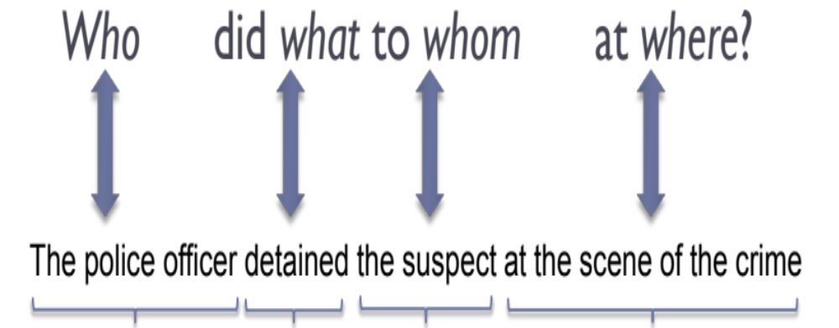
Semantic Role Labeling
Agent
Predicate
Theme
Location

Slide 4
Can we figure out that these have the same meaning?
XYZ corporation bought the stock.
They sold the stock to XYZ corporation.
The stock was bought by XYZ corporation.
The purchase of the stock by XYZ corporation...
The stock purchase by XYZ corporation...

Slide 5
A Shallow Semantic Representation: Semantic Roles
Predicates (bought, sold, purchase) represent an event
semantic roles express the abstract role that arguments of a predicate can take in the event
More specific
More general
buyer
agent
proto-agent

Slide 6
Semantic Role Labeling
Semantic Roles

Slide 7
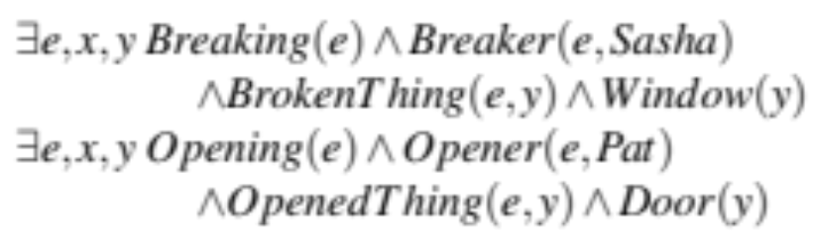
Getting to semantic roles
Neo-Davidsonian event representation:
  Sasha broke the window
  Pat opened the door
Subjects of break and open: Breaker and Opener
Deep roles specific to each event (breaking, opening)
Hard to reason about them for NLU applications like QA

Slide 8
Thematic roles
Breaker and Opener have something in common!
  Volitional actors
  Often animate
  Direct causal responsibility for their events
Thematic roles are a way to capture this semantic commonality between Breakers and Eaters.
They are both agents.
The BrokenThing and OpenedThing, are themes.
  prototypically inanimate objects affected in some way by the action

Slide 9
Thematic roles
One of the oldest linguistic models
  Indian grammarian Panini between the 7th and 4th centuries BCE
Modern formulation from Fillmore (1966,1968), Gruber (1965)
  Fillmore influenced by Lucien Tesnière’s (1959) Éléments de Syntaxe Structurale, the book that introduced dependency grammar
  Fillmore first referred to roles as actants (Fillmore, 1966) but switched to the term case

Slide 10
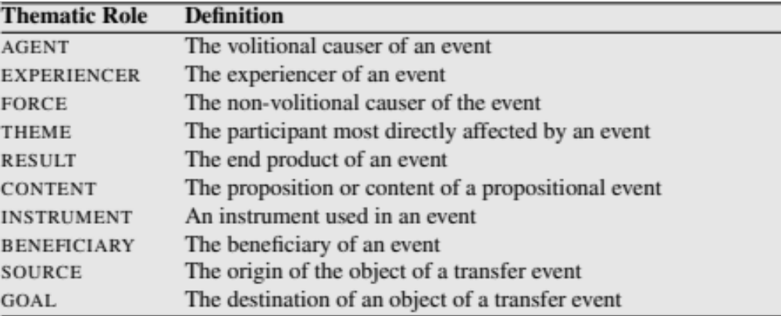
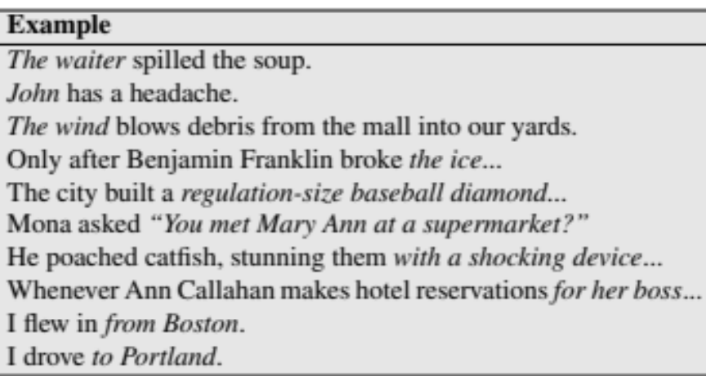
Thematic roles
A typical set:

Slide 11
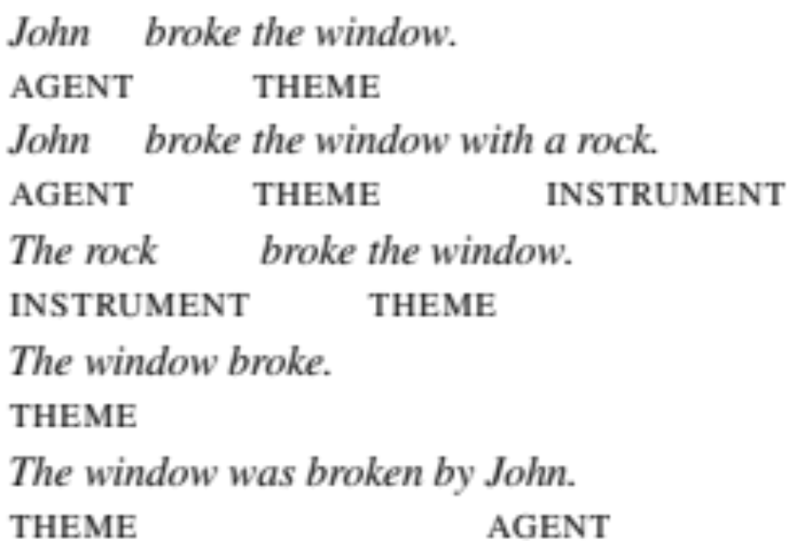
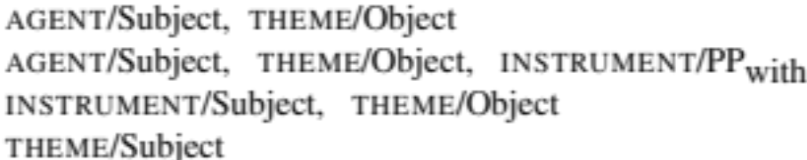
Thematic grid, case frame, θ-grid
Example usages of “break”
thematic grid, case frame, θ-grid
Break:
AGENT, THEME, INSTRUMENT.
Some realizations:

Slide 12
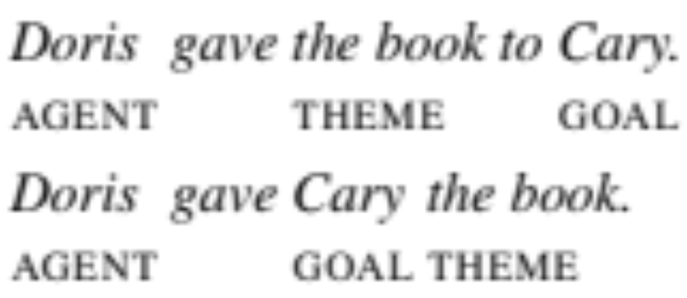
Diathesis alternations (or verb alternation)
Break: AGENT, INSTRUMENT, or THEME as subject
Give: THEME and GOAL in either order
Dative alternation: particular semantic classes of verbs, “verbs of future having” (advance, allocate, offer, owe), “send verbs” (forward, hand, mail), “verbs of throwing” (kick, pass, throw), etc.
Levin (1993): 47 semantic classes (“Levin classes”) for 3100 English verbs and alternations. In online resource VerbNet.

Slide 13
Problems with Thematic Roles
Hard to create standard set of roles or formally define them
Often roles need to be fragmented to be defined.
  Levin and Rappaport Hovav (2015): two kinds of instruments
      intermediary instruments that can appear as subjects
          The cook opened the jar with the new gadget.
          The new gadget opened the jar.
      enabling instruments that cannot
          Shelly ate the sliced banana with a fork.
          *The fork ate the sliced banana.

Slide 14
Alternatives to thematic roles
Fewer roles: generalized semantic roles, defined as prototypes (Dowty 1991)
  PROTO-AGENT
  PROTO-PATIENT
More roles: Define roles specific to a group of predicates
PropBank
FrameNet

Slide 15
Semantic Role Labeling
The Proposition Bank (PropBank)

Slide 16
PropBank
Palmer, Martha, Daniel Gildea, and Paul Kingsbury. 2005. The Proposition Bank: An Annotated Corpus of Semantic Roles. Computational Linguistics, 31(1):71–106

Slide 17
PropBank Roles
Following Dowty 1991
Proto-Agent
  Volitional involvement in event or state
  Sentience (and/or perception)
  Causes an event or change of state in another participant
  Movement (relative to position of another participant)
Proto-Patient
  Undergoes change of state
  Causally affected by another participant
  Stationary relative to movement of another participant

Slide 18
PropBank Roles
Following Dowty 1991
  Role definitions determined verb by verb, with respect to the other roles
  Semantic roles in PropBank are thus verb-sense specific.
Each verb sense has numbered argument: Arg0, Arg1, Arg2,…
  Arg0: PROTO-AGENT
  Arg1: PROTO-PATIENT
  Arg2: usually: benefactive, instrument, attribute, or end state
  Arg3: usually: start point, benefactive, instrument, or attribute
  Arg4 the end point
  (Arg2-Arg5 are not really that consistent, causes a problem for labeling)

Slide 19
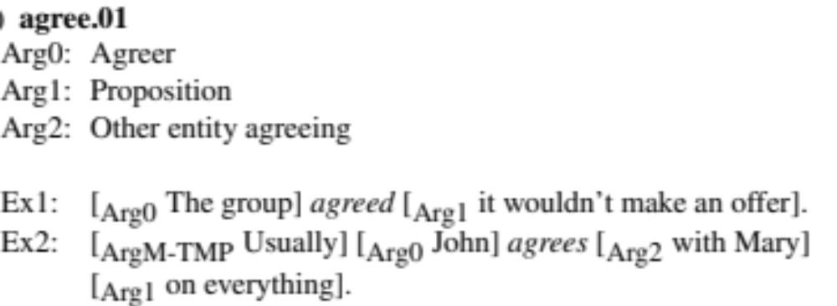
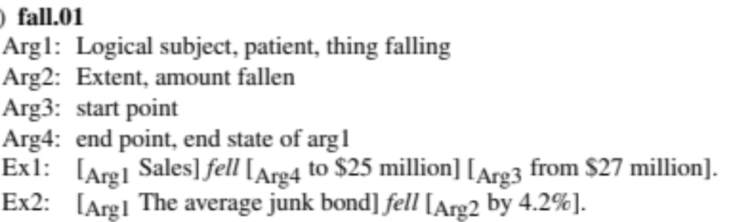
PropBank Frame Files
Notes:
Why doesn’t fall have an Arg0? No proto-agent!

Slide 20
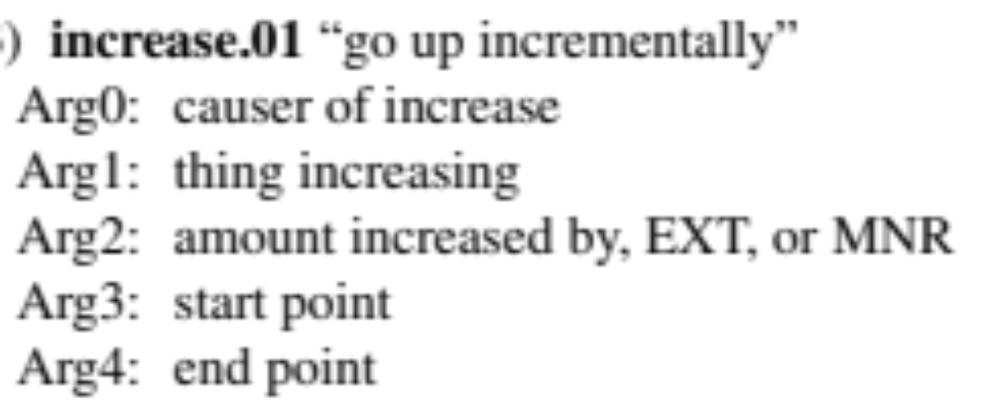
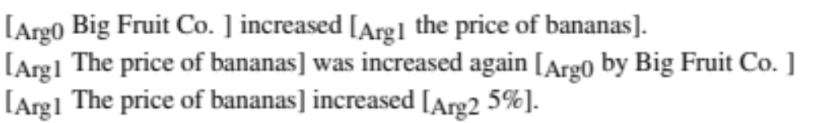
Advantage of a ProbBank Labeling
This would allow us to see the commonalities in these 3 sentences:

Slide 21
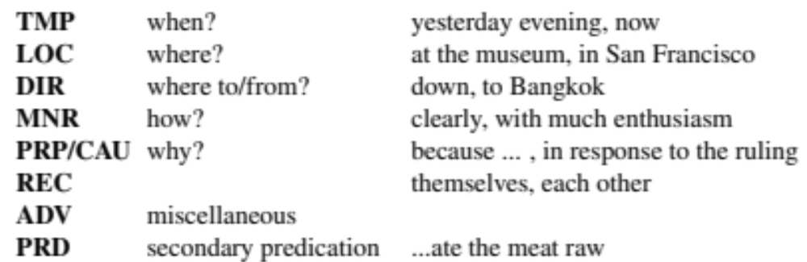
Modifiers or adjuncts of the predicate: Arg-M
ArgM-

Slide 22
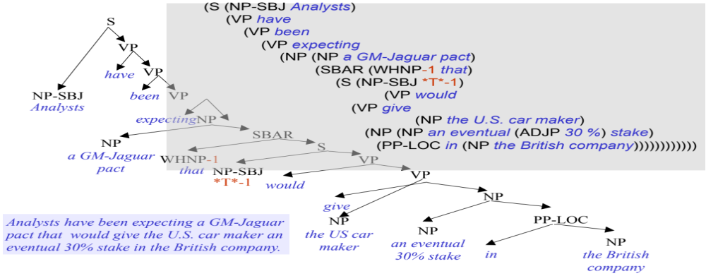
PropBanking a Sentence
Martha Palmer 2013
A sample
parse tree

Slide 23
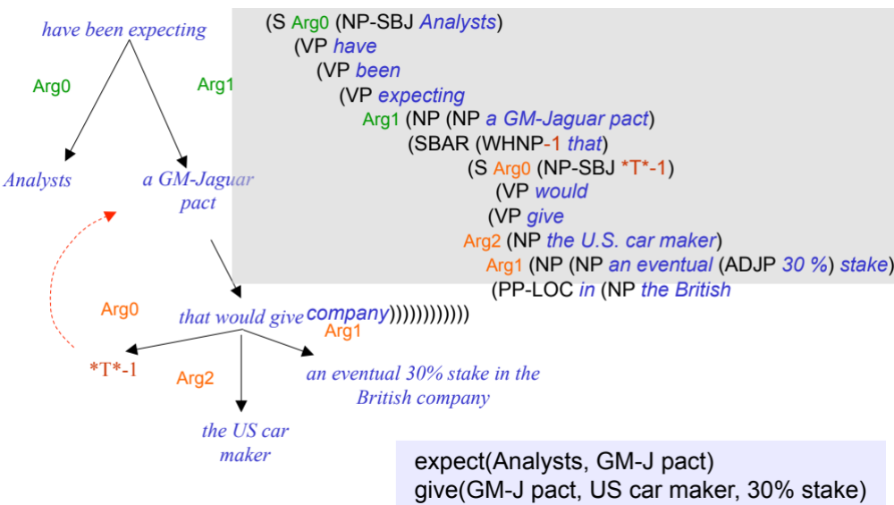
The same parse tree PropBanked
Martha Palmer 2013

Slide 24
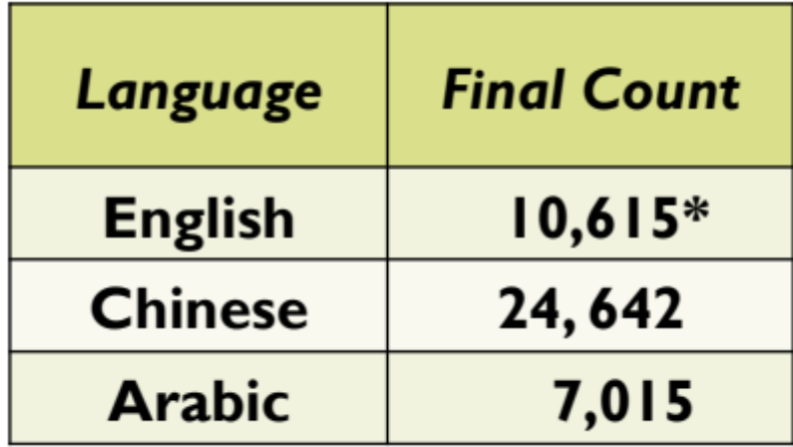
Annotated PropBank Data
2013 Verb Frames Coverage
Count of word sense (lexical units)
Penn English TreeBank,
OntoNotes 5.0.
  Total ~2 million words
Penn Chinese TreeBank
Hindi/Urdu PropBank
Arabic PropBank
From Martha Palmer 2013 Tutorial

Slide 25
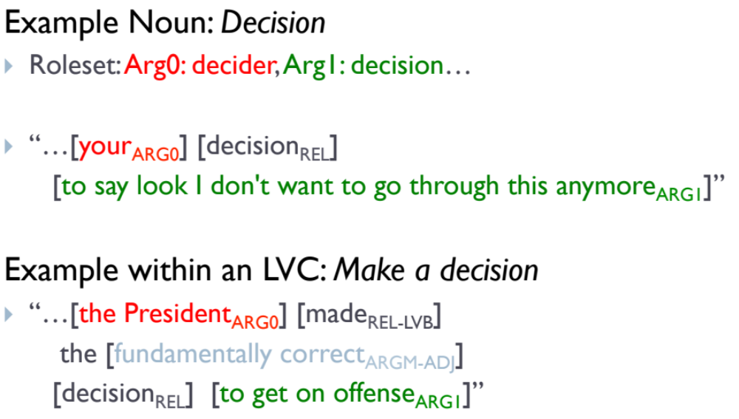
Plus nouns and light verbs
Slight from Palmer 2013

Slide 26
Semantic Role Labeling
FrameNet

Slide 27
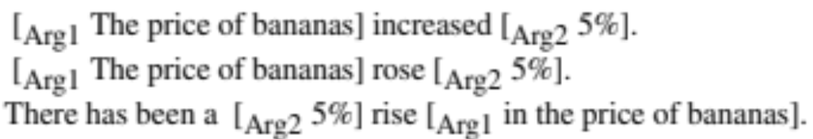
Capturing descriptions of the same event by different nouns/verbs

Slide 28
FrameNet
Baker et al. 1998, Fillmore et al. 2003, Fillmore and Baker 2009, Ruppenhofer et al. 2006
Roles in PropBank are specific to a verb
Role in FrameNet are specific to a frame: a background knowledge structure that defines a set of frame-specific semantic roles, called frame elements,
  includes a set of pred cates that use these roles
  each word evokes a frame and profiles some aspect of the frame

Slide 29
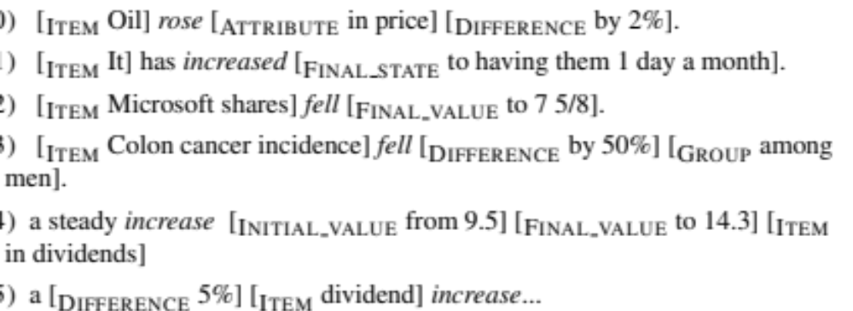
The “Change position on a scale” Frame
This frame consists of words that indicate the change of an Item’s position on a scale (the Attribute) from a starting point (Initial value) to an end point (Final value)

Slide 30
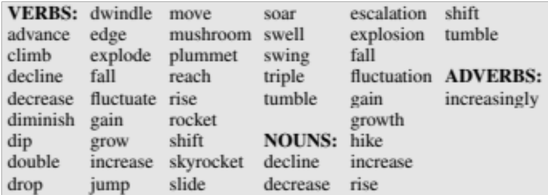
The “Change position on a scale” Frame

Slide 31
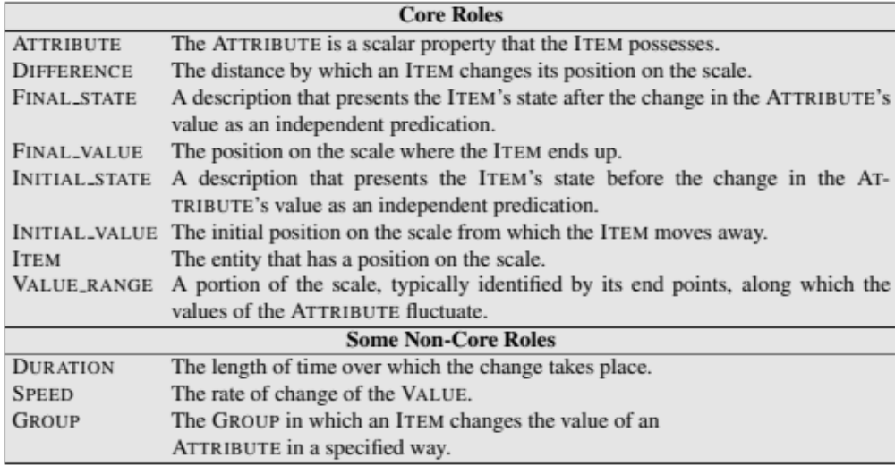
The “Change position on a scale” Frame

Slide 32
Relation between frames
Inherits from:
Is Inherited by:
Perspective on:
Is Perspectivized in:
Uses:
Is Used by:
Subframe of:
Has Subframe(s):
Precedes:
Is Preceded by:
Is Inchoative of:
Is Causative of:

Slide 33
Relation between frames
“cause change position on a scale”
Is Causative of: Change_position_on_a_scale
Adds an agent Role
add.v, crank.v, curtail.v, cut.n, cut.v, decrease.v, development.n, diminish.v, double.v, drop.v, enhance.v, growth.n, increase.v, knock down.v, lower.v, move.v, promote.v, push.n, push.v, raise.v, reduce.v, reduction.n, slash.v, step up.v, swell.v

Slide 34
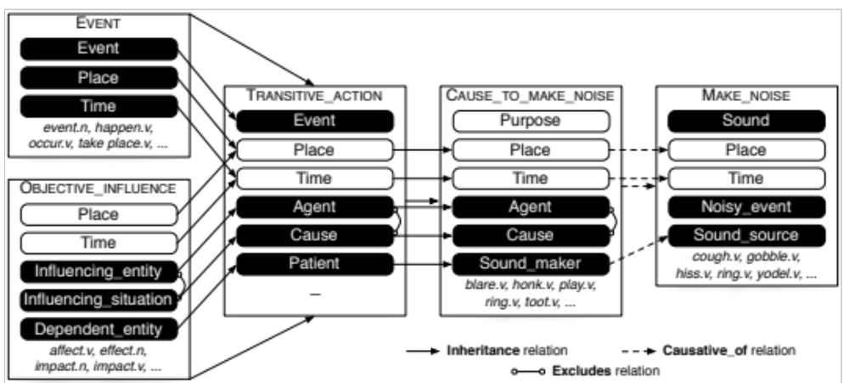
Relations between frames
Figure from Das et al 2010

Slide 35
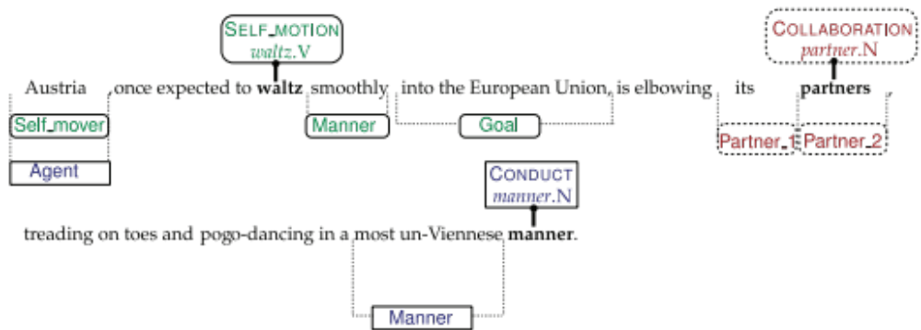
Schematic of Frame Semantics
Figure from Das et al (2014)

Slide 36
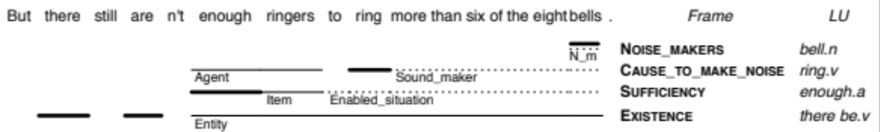
FrameNet Complexity
From Das et al. 2010

Slide 37
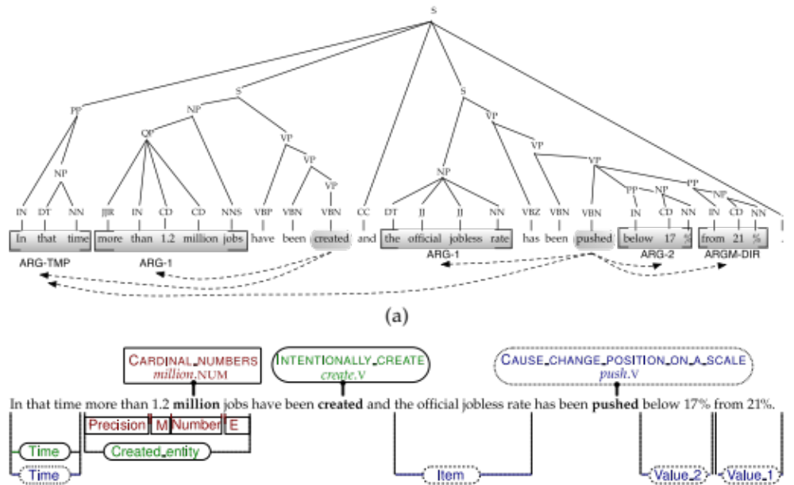
FrameNet and PropBank representations

Slide 38
Semantic Role Labeling
Semantic Role Labeling Algorithm

Slide 39
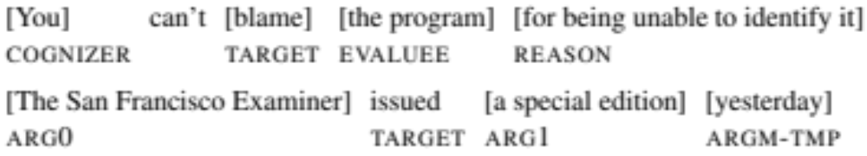
Semantic role labeling (SRL)
The task of finding the semantic roles of each argument of each predicate in a sentence.
FrameNet versus PropBank:

Slide 40
History
Semantic roles as a intermediate semantics, used early in
  machine translation (Wilks, 1973)
  question-answering (Hendrix et al., 1973)
  spoken-language understanding (Nash-Webber, 1975)
  dialogue systems (Bobrow et al., 1977)
Early SRL systems
  Simmons 1973, Marcus 1980:
    parser followed by hand-written rules for each verb
    dictionaries with verb-specific case frames (Levin 1977)

Slide 41
Why Semantic Role Labeling
A useful shallow semantic representation
Improves NLP tasks like:
  question answering
    Shen and Lapata 2007, Surdeanu et al. 2011
  machine translation
    Liu and Gildea 2010, Lo et al. 2013

Slide 42
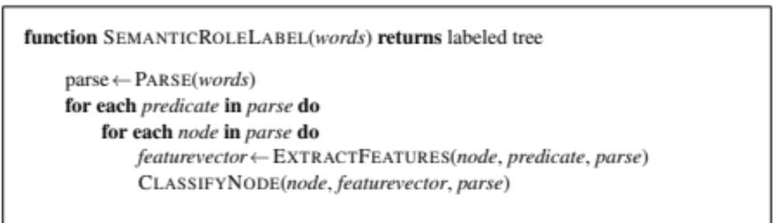
A simple modern algorithm

Slide 43
How do we decide what is a predicate
If we’re just doing PropBank verbs
  Choose all verbs
  Possibly removing light verbs (from a list)
If we’re doing FrameNet (verbs, nouns, adjectives)
  Choose every word that was labeled as a target in training data

Slide 44
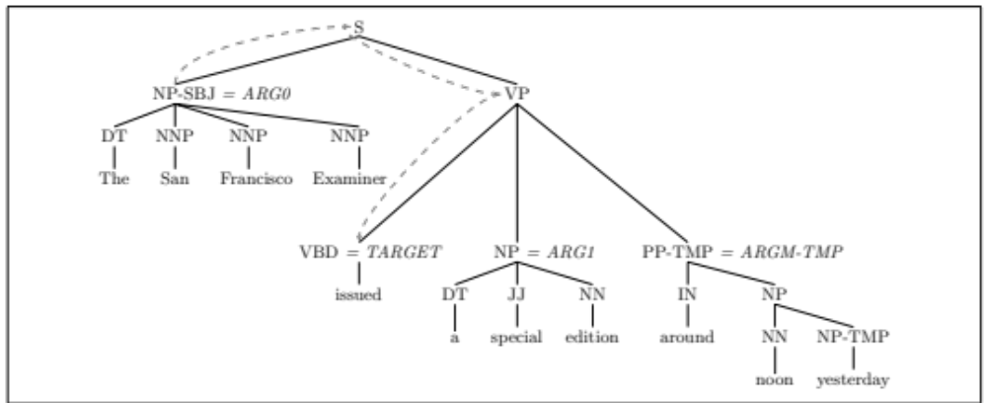
Semantic Role Labeling

Slide 45
Features
Headword of constituent
  Examiner
Headword POS
  NNP
Voice of the clause
  Active
Subcategorization of pred
  VP -> VBD NP PP
Named Entity type of constit
  ORGANIZATION
First and last words of constit
  The, Examiner
Linear position,clause re: predicate
before

Slide 46

Path Features
Path in the parse tree from the constituent to the predicate

Slide 47
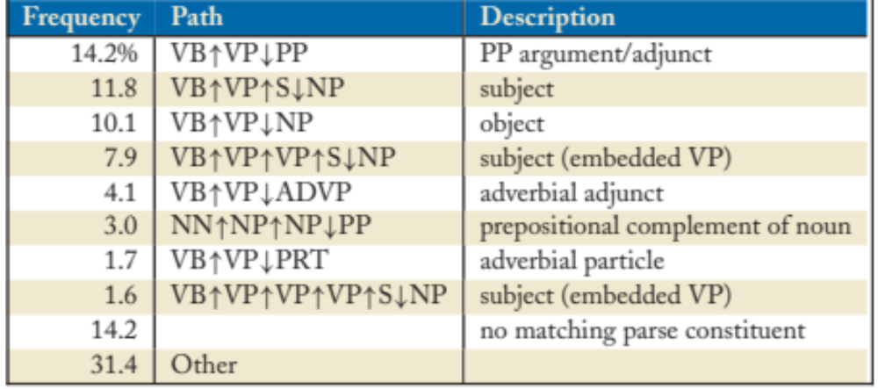
Frequent path features
From Palmer, Gildea, Xue 2010

Slide 48
Final feature vector
For “The San Francisco Examiner”,
Arg0, [issued, NP, Examiner, NNP, active, before, VP→NP PP, ORG, The, Examiner, ]
Other features could be used as well
  sets of n-grams inside the constituent
  other path features
    the upward or downward halves
    whether particular nodes occur in the path

Slide 49
3-step version of SRL algorithm
Pruning: use simple heuristics to prune unlikely constituents.
Identification: a binary classification of each node as an argument to be labeled or a NONE.
Classification: a 1-of-N classification of all the constituents that were labeled as arguments by the previous stage

Slide 50
Why add Pruning and Identification steps?
Algorithm is looking at one predicate at a time
Very few of the nodes in the tree could possible be arguments of that one predicate
Imbalance between
  positive samples (constituents that are arguments of predicate)
  negative samples (constituents that are not arguments of predicate)
Imbalanced data can be hard for many classifiers
So we prune the very unlikely constituents first, and then use a classifier to get rid of the rest.

Slide 51
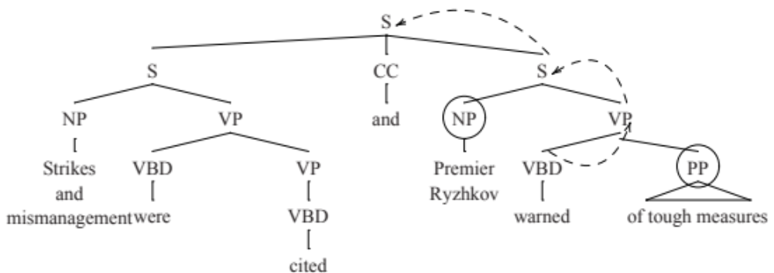
Pruning heuristics – Xue and Palmer (2004)
Add sisters of the predicate, then aunts, then great-aunts, etc
  But ignoring anything in a coordination structure

Slide 52
A common final stage: joint inference
The algorithm so far classifies everything locally – each decision about a constituent is made independently of all others
But this can’t be right: Lots of global or joint interactions between arguments
  Constituents in FrameNet and PropBank must be non-overlapping.
    A local system may incorrectly label two overlapping constituents as arguments
    PropBank does not allow multiple identical arguments
      labeling one constituent ARG0
      Thus should increase the probability of another being ARG1

Slide 53
How to do joint inference
Reranking
  The first stage SRL system produces multiple possible labels for each constituent
  The second stage classifier the best global label for all constituents
  Often a classifier that takes all the inputs along with other features (sequences of labels)

Slide 54
More complications: FrameNet
We need an extra step to find the frame
Predicatevector ← ExtractFrameFeatures(predicate,parse)
Frame ← ClassifyFrame(predicate,predicatevector)
, Frame)

Slide 55
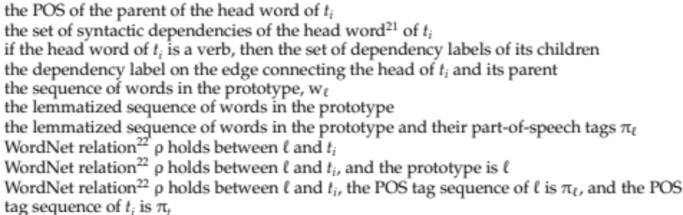
Features for Frame Identification
Das et al (2014)

Slide 56
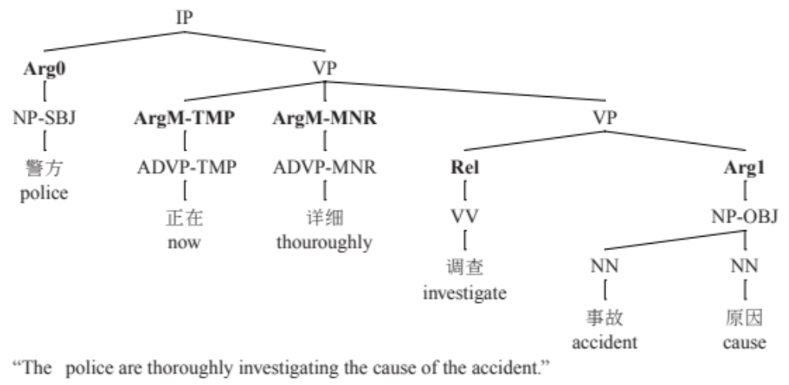
Not just English

Slide 57
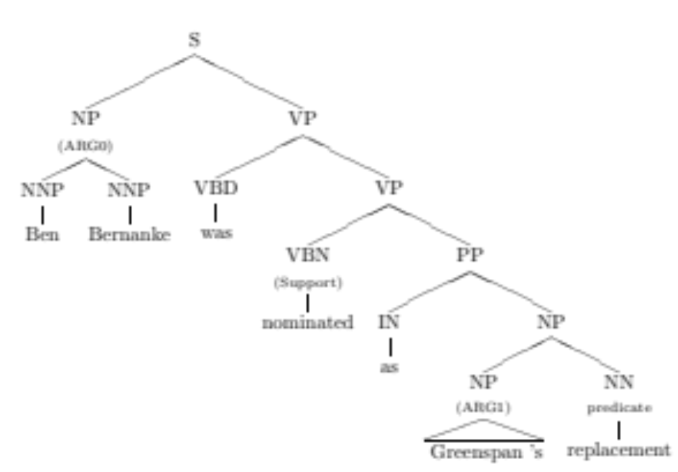
Not just verbs: NomBank
Meyers et al. 2004
Figure from Jiang and Ng 2006

Slide 58
Additional Issues for nouns
Features:
  Nominalization lexicon (employment→ employ)
  Morphological stem
    Healthcare, Medicate → care
Different positions
  Most arguments of nominal predicates occur inside the NP
  Others are introduced by support verbs
  Especially light verbs “X made an argument”, “Y took a nap”

Slide 59
Semantic Role Labeling
Conclusion

Slide 60
Semantic Role Labeling
A level of shallow semantics for representing events and their participants
  Intermediate between parses and full semantics
Two common architectures, for various languages
  FrameNet: frame-specific roles
  PropBank: Proto-roles
Current systems extract by
  parsing sentence
  Finding predicates in the sentence
    For each one, classify each parse tree constituent

