Slide 1

NATURAL LANGUAGE PROCESSING MATTEO CRISTANI
Computer Science Department
University of Verona - Italy

Slide 2
Text Classification and Naive Bayes
The Task of Text Classification

Slide 3
Is this spam?

Slide 4
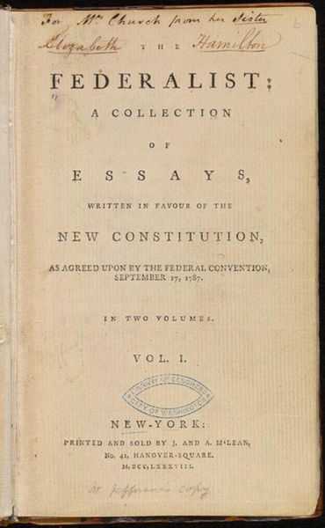
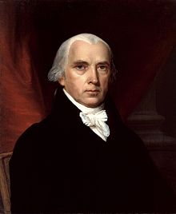
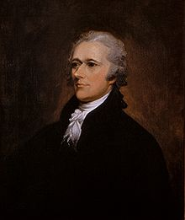
Who wrote which Federalist papers?
1787-8: anonymous essays try to convince New York to ratify U.S Constitution: Jay, Madison, Hamilton.
Authorship of 12 of the letters in dispute
1963: solved by Mosteller and Wallace using Bayesian methods
James Madison
Alexander Hamilton

Slide 5
What is the subject of this medical article?
MEDLINE Article
MeSH Subject Category Hierarchy
Antogonists and Inhibitors
Blood Supply
Chemistry
Drug Therapy
Embryology
Epidemiology
…
?

Slide 6
Positive or negative movie review?
+
...zany characters and richly applied satire, and some great plot twists
It was pathetic. The worst part about it was the boxing scenes...
...awesome caramel sauce and sweet toasty almonds. I love this place!
...awful pizza and ridiculously overpriced...
−
+
−

Slide 7
Positive or negative movie review?
+
...zany characters and richly applied satire, and some great plot twists
It was pathetic. The worst part about it was the boxing scenes...
...awesome caramel sauce and sweet toasty almonds. I love this place!
...awful pizza and ridiculously overpriced...
−
+
−

Slide 8
Why sentiment analysis?
Movie: is this review positive or negative?
Products: what do people think about the new iPhone?
Public sentiment: how is consumer confidence?
Politics: what do people think about this candidate or issue?
Prediction: predict election outcomes or market trends from sentiment

Slide 9
Scherer Typology of Affective States
Emotion: brief organically synchronized … evaluation of a major event
angry, sad, joyful, fearful, ashamed, proud, elated
Mood: diffuse non-caused low-intensity long-duration change in subjective feeling
cheerful, gloomy, irritable, listless, depressed, buoyant
Interpersonal stances: affective stance toward another person in a specific interaction
friendly, flirtatious, distant, cold, warm, supportive, contemptuous
Attitudes: enduring, affectively colored beliefs, dispositions towards objects or persons
liking, loving, hating, valuing, desiring
Personality traits: stable personality dispositions and typical behavior tendencies
nervous, anxious, reckless, morose, hostile, jealous

Slide 10
Scherer Typology of Affective States
Division in 3 groups:
Emotion: brief organically synchronized … evaluation of a major event
angry, sad, joyful, fearful, ashamed, proud, elated
Mood: diffuse non-caused low-intensity long-duration change in subjective feeling
cheerful, gloomy, irritable, listless, depressed, buoyant
Interpersonal stances: affective stance toward another person in a specific interaction
friendly, flirtatious, distant, cold, warm, supportive, contemptuous
Attitudes: enduring, affectively colored beliefs, dispositions towards objects or persons
liking, loving, hating, valuing, desiring
Personality traits: stable personality dispositions and typical behavior tendencies
nervous, anxious, reckless, morose, hostile, jealous

Slide 11
Basic Sentiment Classification
Sentiment analysis is the detection of attitudes
Simple task we focus on in this chapter
Is the attitude of this text positive or negative?
We return to affect classification in later chapters

Slide 12
Summary: Text Classification
Sentiment analysis
Spam detection
Authorship identification
Language Identification
Assigning subject categories, topics, or genres
…

Slide 13
Text Classification: definition
Input:
a document d
a fixed set of classes C = {c₁, c₂,…, c_{J}}
Output: a predicted class c ∈ C

Slide 14
Classification Methods: Hand-coded rules
Rules based on combinations of words or other features
spam: black-list-address OR (“dollars” AND “you have been selected”)
Accuracy can be high
If rules carefully refined by expert
But building and maintaining these rules is expensive

Slide 15
Classification Methods: Supervised Machine Learning
Input:
a document d
a fixed set of classes C = {c₁, c₂,…, c_{J}}
A training set of m hand-labeled documents (d₁,c₁),....,(d_{m},c_{m})
Output:
a learned classifier γ:d → c

Slide 16
Classification Methods: Supervised Machine Learning
Any kind of classifier
Naïve Bayes
Logistic regression
Neural networks
k-Nearest Neighbors
…

Slide 17
Text Classification and Naive Bayes
The Task of Text Classification

Slide 18
Text Classification and Naive Bayes
The Naive Bayes Classifier
Notes:
In this lecture we define the Naive Bayes classifier, a basic text classifier that will allow us to introduce many of the fundamental issues in text classification.

Slide 19
Naive Bayes Intuition
Simple ("naive") classification method based on Bayes rule
Relies on very simple representation of document
Bag of words

Slide 20
The Bag of Words Representation

Slide 21


The bag of words representation
seen | 2
sweet | 1
whimsical | 1
recommend | 1
happy | 1
... | ...
γ(
)=c

Slide 22
Bayes’ Rule Applied to Documents and Classes
For a document d and a class c

Slide 23
Naive Bayes Classifier (I)
MAP is “maximum a posteriori” = most likely class
Bayes Rule
Dropping the denominator

Slide 24
Naive Bayes Classifier (II)
"Likelihood"
"Prior"
Document d represented as features x1..xn

Slide 25
Naïve Bayes Classifier (IV)
O(|X|^{n}•|C|) parameters
How often does this class occur?
Could only be estimated if a very, very large number of training examples was available.
We can just count the relative frequencies in a corpus

Slide 26
Multinomial Naive Bayes Independence Assumptions
Bag of Words assumption: Assume position doesn’t matter
Conditional Independence: Assume the feature probabilities P(x_{i}|c_{j}) are independent given the class c.

Slide 27
Multinomial Naive Bayes Classifier

Slide 28
Applying Multinomial Naive Bayes Classifiers to Text Classification
positions ← all word positions in test document

Slide 29
Problems with multiplying lots of probs
There's a problem with this:
Multiplying lots of probabilities can result in floating-point underflow!
.0006 * .0007 * .0009 * .01 * .5 * .000008….
Idea: Use logs, because log(ab) = log(a) + log(b)
We'll sum logs of probabilities instead of multiplying probabilities!

Slide 30
We actually do everything in log space
Instead of this:
This:
Notes:
1) Taking log doesn't change the ranking of classes!
The class with highest probability also has highest log probability!
2) It's a linear model:
Just a max of a sum of weights: a linear function of the inputs
So naive bayes is a linear classifier

Slide 31
Text Classification and Naive Bayes
The Naive Bayes Classifier
Notes:
We've now seen the basic principles of naïve bayes classification!

Slide 32
Text Classification and Naïve Bayes
Naive Bayes: Learning

Slide 33
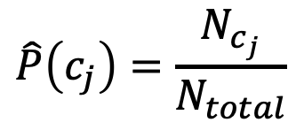
Learning the Multinomial Naive Bayes Model
Sec.13.3
First attempt: maximum likelihood estimates
simply use the frequencies in the data
$$\hat{P}\left(c_{j}\right)=\frac{N_{c_{j}}}{N_{total}}$$

Slide 34
Parameter estimation
fraction of times word w_{i} appears
among all words in documents of topic c_{j}
Create mega-document for topic j by concatenating all docs in this topic
Use frequency of w in mega-document

Slide 35
Problem with Maximum Likelihood
Sec.13.3
What if we have seen no training documents with the word fantastic and classified in the topic positive (thumbs-up)?
Zero probabilities cannot be conditioned away, no matter the other evidence!

Slide 36
Laplace (add-1) smoothing for Naïve Bayes

Slide 37
Multinomial Naïve Bayes: Learning
From training corpus, extract Vocabulary
Calculate P(c_{j}) terms
For each c_{j} in C do
docs_{j} ← all docs with class =c_{j}
Calculate P(w_{k} | c_{j}) terms
Text_{j} ← single doc containing all docs_{j}
For each word w_{k} in Vocabulary
n_{k} ← # of occurrences of w_{k} in Text_{j}

Slide 38
Unknown words
What about unknown words
that appear in our test data
but not in our training data or vocabulary?
We ignore them
Remove them from the test document!
Pretend they weren't there!
Don't include any probability for them at all!
Why don't we build an unknown word model?
It doesn't help: knowing which class has more unknown words is not generally helpful!

Slide 39
Stop words
Some systems ignore stop words
Stop words: very frequent words like the and a.
Sort the vocabulary by word frequency in training set
Call the top 10 or 50 words the stopword list.
Remove all stop words from both training and test sets
As if they were never there!
But removing stop words doesn't usually help
So in practice most NB algorithms use all words and don't use stopword lists

Slide 40
Stop word elimination matters
0.9904365 0.0257643 to
0.8844671 0.0045653 be
0.8447221 0.0038483 not
0.7504242 0.0031062 or
To be or not to be before SE
«» after SE

Slide 41
Text Classification and Naive Bayes
Naive Bayes: Learning

Slide 42
Text Classification and Naive Bayes
Sentiment and Binary Naive Bayes
Notes:
In this lecture we'll do a worked example of naïve bayes sentiment analysis, and also introduce the binary multinominal naïve bayes algorithm.

Slide 43
Let's do a worked sentiment example!

Slide 44
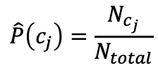

A worked sentiment example with add-1 smoothing
1. Prior from training:
$$\hat{P}\left(c_{j}\right)=\frac{N_{c_{j}}}{N_{total}}$$
P(-) = 3/5
P(+) = 2/5
2. Drop "with"
3. Likelihoods from training:
$$p\left(w_{i} | c\right)= \frac{count\left(w_{i},c\right)+1}{\left(\sum_{w∈V}{count\left(w,c\right)}\right)+|V|}$$
4. Scoring the test set:

Slide 45
Optimizing for sentiment analysis
For tasks like sentiment, word occurrence seems to be more important than word frequency.
The occurrence of the word fantastic tells us a lot
The fact that it occurs 5 times may not tell us much more.
Binary multinominal naive bayes, or binary NB
Clip our word counts at 1
Note: this is different than Bernoulli naive bayes; see the textbook at the end of the chapter.

Slide 46
Binary Multinomial Naïve Bayes: Learning
From training corpus, extract Vocabulary
Calculate P(c_{j}) terms
For each c_{j} in C do
docs_{j} ← all docs with class =c_{j}
Calculate P(w_{k} | c_{j}) terms
Text_{j} ← single doc containing all docs_{j}
For each word w_{k} in Vocabulary
n_{k} ← # of occurrences of w_{k} in Text_{j}
Remove duplicates in each doc:
For each word type w in doc_{j}
Retain only a single instance of w

Slide 47
Binary Multinomial Naive Bayes on a test document d
First remove all duplicate words from d
Then compute NB using the same equation:

Slide 48
Binary multinominal naive Bayes

Slide 49
Binary multinominal naive Bayes

Slide 50
Binary multinominal naive Bayes

Slide 51
Binary multinominal naive Bayes
Counts can still be 2! Binarization is within-doc!

Slide 52
Text Classification and Naive Bayes
Sentiment and Binary Naive Bayes

Slide 53
Text Classification and Naive Bayes
More on Sentiment Classification

Slide 54
Sentiment Classification: Dealing with Negation
I really like this movie
I really don't like this movie
Negation changes the meaning of "like" to negative.
Negation can also change negative to positive-ish
Don't dismiss this film
Doesn't let us get bored

Slide 55
Sentiment Classification: Dealing with Negation
Das, Sanjiv and Mike Chen. 2001. Yahoo! for Amazon: Extracting market sentiment from stock message boards. In Proceedings of the Asia Pacific Finance Association Annual Conference (APFA).
Bo Pang, Lillian Lee, and Shivakumar Vaithyanathan. 2002. Thumbs up? Sentiment Classification using Machine Learning Techniques. EMNLP-2002, 79—86.
Simple baseline method:
Add NOT_ to every word between negation and following punctuation:
didn’t like this movie , but I
didn’t NOT_like NOT_this NOT_movie but I

Slide 56
Sentiment Classification: Lexicons
Sometimes we don't have enough labeled training data
In that case, we can make use of pre-built word lists
Called lexicons
There are various publically available lexicons

Slide 57
MPQA Subjectivity Cues Lexicon
Theresa Wilson, Janyce Wiebe, and Paul Hoffmann (2005). Recognizing Contextual Polarity in
Phrase-Level Sentiment Analysis. Proc. of HLT-EMNLP-2005.
Riloff and Wiebe (2003). Learning extraction patterns for subjective expressions. EMNLP-2003.
Home page: https://mpqa.cs.pitt.edu/lexicons/subj_lexicon/
6885 words from 8221 lemmas, annotated for intensity (strong/weak)
2718 positive
4912 negative
+ : admirable, beautiful, confident, dazzling, ecstatic, favor, glee, great
− : awful, bad, bias, catastrophe, cheat, deny, envious, foul, harsh, hate

Slide 58
The General Inquirer
Philip J. Stone, Dexter C Dunphy, Marshall S. Smith, Daniel M. Ogilvie. 1966. The General Inquirer: A Computer Approach to Content Analysis. MIT Press
Home page: http://www.wjh.harvard.edu/~inquirer
List of Categories: http://www.wjh.harvard.edu/~inquirer/homecat.htm
Spreadsheet: http://www.wjh.harvard.edu/~inquirer/inquirerbasic.xls
Categories:
Positiv (1915 words) and Negativ (2291 words)
Strong vs Weak, Active vs Passive, Overstated versus Understated
Pleasure, Pain, Virtue, Vice, Motivation, Cognitive Orientation, etc
Free for Research Use

Slide 59
Using Lexicons in Sentiment Classification
Add a feature that gets a count whenever a word from the lexicon occurs
E.g., a feature called "this word occurs in the positive lexicon" or "this word occurs in the negative lexicon"
Now all positive words (good, great, beautiful, wonderful) or negative words count for that feature.
Using 1-2 features isn't as good as using all the words.
But when training data is sparse or not representative of the test set, dense lexicon features can help

Slide 60
Naive Bayes in Other tasks: Spam Filtering
SpamAssassin Features:
Mentions millions of (dollar) ((dollar) NN,NNN,NNN.NN)
From: starts with many numbers
Subject is all capitals
HTML has a low ratio of text to image area
"One hundred percent guaranteed"
Claims you can be removed from the list

Slide 61
Naive Bayes in Language ID
Determining what language a piece of text is written in.
Features based on character n-grams do very well
Important to train on lots of varieties of each language
(e.g., American English varieties like African-American English, or English varieties around the world like Indian English)

Slide 62
Summary: Naive Bayes is Not So Naive
Very Fast, low storage requirements
Work well with very small amounts of training data
Robust to Irrelevant Features
Irrelevant Features cancel each other without affecting results
Very good in domains with many equally important features
Decision Trees suffer from fragmentation in such cases – especially if little data
Optimal if the independence assumptions hold: If assumed independence is correct, then it is the Bayes Optimal Classifier for problem
A good dependable baseline for text classification
But we will see other classifiers that give better accuracy
Slide from Chris Manning

Slide 63
Text Classification and Naive Bayes
More on Sentiment Classification

Slide 64
Text Classification and Naïve Bayes
Naïve Bayes: Relationship to Language Modeling

Slide 65
Generative Model for Multinomial Naïve Bayes
c=+
X₁=I
X₂=love
X₃=this
X₄=fun
X₅=film

Slide 66
Naïve Bayes and Language Modeling
Naïve bayes classifiers can use any sort of feature
URL, email address, dictionaries, network features
But if, as in the previous slides
We use only word features
we use all of the words in the text (not a subset)
Then
Naive bayes has an important similarity to language modeling.

Slide 67
Each class = a unigram language model
Sec.13.2.1
Assigning each word: P(word | c)
Assigning each sentence: P(s|c)=Π P(word|c)
Class pos
0.1 I
0.1 love
0.01 this
0.05 fun
0.1 film
…
I
love
this
fun
film
0.1
0.1
.05
0.01
0.1
P(s | pos) = 0.0000005

Slide 68
Naïve Bayes as a Language Model
Sec.13.2.1
Which class assigns the higher probability to s?
Model pos
Model neg
0.2 I
0.001 love
0.01 this
0.005 fun
0.1 film
0.1 I
0.1 love
0.01 this
0.05 fun
0.1 film
I
love
this
fun
film
0.1
0.1
0.01
0.05
0.1
0.2
0.001
0.01
0.005
0.1
P(s|pos) > P(s|neg)

Slide 69
Text Classification and Naïve Bayes
Naïve Bayes: Relationship to Language Modeling

Slide 70
Text Classification and Naïve Bayes
Precision, Recall, and F measure

Slide 71
Evaluation
Let's consider just binary text classification tasks
Imagine you're the CEO of Delicious Pie Company
You want to know what people are saying about your pies
So you build a "Delicious Pie" tweet detector
Positive class: tweets about Delicious Pie Co
Negative class: all other tweets

Slide 72
The 2-by-2 confusion matrix

Slide 73
Evaluation: Accuracy
Why don't we use accuracy as our metric?
Imagine we saw 1 million tweets
100 of them talked about Delicious Pie Co.
999,900 talked about something else
We could build a dumb classifier that just labels every tweet "not about pie"
It would get 99.99% accuracy!!! Wow!!!!
But useless! Doesn't return the comments we are looking for!
That's why we use precision and recall instead

Slide 74
Evaluation: Precision
% of items the system detected (i.e., items the system labeled as positive) that are in fact positive (according to the human gold labels)

Slide 75
Evaluation: Recall
% of items actually present in the input that were correctly identified by the system.

Slide 76
Why Precision and recall
Our dumb pie-classifier
Just label nothing as "about pie"
Accuracy=99.99%
but
Recall = 0
(it doesn't get any of the 100 Pie tweets)
Precision and recall, unlike accuracy, emphasize true positives:
finding the things that we are supposed to be looking for.

Slide 77
A combined measure: F
F measure: a single number that combines P and R:
We almost always use balanced F₁ (i.e., β = 1)

Slide 78
Development Test Sets ("Devsets") and Cross-validation
Train on training set, tune on devset, report on testset
This avoids overfitting (‘tuning to the test set’)
More conservative estimate of performance
But paradox: want as much data as possible for training, and as much for dev; how to split?
Training set
Development Test Set
Test Set

Slide 79
Cross-validation: multiple splits
Pool results over splits, Compute pooled dev performance

Slide 80
Text Classification and Naive Bayes
Precision, Recall, and F measure

Slide 81
Text Classification and Naive Bayes
Evaluation with more than two classes

Slide 82
Confusion Matrix for 3-class classification

Slide 83
How to combine P/R from 3 classes to get one metric
Macroaveraging:
compute the performance for each class, and then average over classes
Microaveraging:
collect decisions for all classes into one confusion matrix
compute precision and recall from that table.

Slide 84
Macroaveraging and Microaveraging

Slide 85
Text Classification and Naive Bayes
Evaluation with more than two classes

Slide 86
Text Classification and Naive Bayes
Statistical Significance Testing

Slide 87
How do we know if one classifier is better than another?
Given:
Classifier A and B
Metric M: M(A,x) is the performance of A on testset x
𝛿(x): the performance difference between A, B on x:
𝛿(x) = M(A,x) – M(B,x)
We want to know if 𝛿(x)>0, meaning A is better than B
𝛿(x) is called the effect size
Suppose we look and see that 𝛿(x) is positive. Are we done?
No! This might be just an accident of this one test set, or circumstance of the experiment. Instead:

Slide 88
Statistical Hypothesis Testing
Consider two hypotheses:
Null hypothesis: A isn't better than B
A is better than B
We want to rule out H₀
We create a random variable X ranging over test sets
And ask, how likely, if H₀ is true, is it that among these test sets we would see the 𝛿(x) we did see?
Formalized as the p-value:

Slide 89
Statistical Hypothesis Testing
In our example, this p-value is the probability that we would see δ(x) assuming H₀ (=A is not better than B).
If H₀ is true but δ(x) is huge, that is surprising! Very low probability!
A very small p-value means that the difference we observed is very unlikely under the null hypothesis, and we can reject the null hypothesis
Very small: .05 or .01
A result(e.g., “A is better than B”) is statistically significant if the δ we saw has a probability that is below the threshold and we therefore reject this null hypothesis.

Slide 90
Statistical Hypothesis Testing
How do we compute this probability?
In NLP, we don't tend to use parametric tests (like t-tests)
Instead, we use non-parametric tests based on sampling: artificially creating many versions of the setup.
For example, suppose we had created zillions of testsets x'.
Now we measure the value of 𝛿(x') on each test set
That gives us a distribution
Now set a threshold (say .01).
So if we see that in 99% of the test sets 𝛿(x) > 𝛿(x')
We conclude that our original test set delta was a real delta and not an artifact.

Slide 91
Statistical Hypothesis Testing
Two common approaches:
approximate randomization
bootstrap test
Paired tests:
Comparing two sets of observations in which each observation in one set can be paired with an observation in another.
For example, when looking at systems A and B on the same test set, we can compare the performance of system A and B on each same observation x_{i}

Slide 92
Text Classification and Naive Bayes
Statistical Significance Testing

Slide 93
Text Classification and Naive Bayes
The Paired Bootstrap Test

Slide 94
Bootstrap test
Efron and Tibshirani, 1993
Can apply to any metric (accuracy, precision, recall, F1, etc).
Bootstrap means to repeatedly draw large numbers of smaller samples with replacement (called bootstrap samples) from an original larger sample.

Slide 95
Bootstrap example
Consider a baby text classification example with a test set x of 10 documents, using accuracy as metric.
Suppose these are the results of systems A and B on x, with 4 outcomes (A & B both right, A & B both wrong, A right/B wrong, A wrong/B right):
either A+B both correct, or

Slide 96
Bootstrap example
Now we create, many, say, b=10,000 virtual test sets x(i), each of size n = 10.
To make each x(i), we randomly select a cell from row x, with replacement, 10 times:

Slide 97
Bootstrap example
Now we have a distribution! We can check how often A has an accidental advantage, to see if the original 𝛿(x) we saw was very common.
Now assuming H₀, that means normally we expect 𝛿(x')=0
So we just count how many times the 𝛿(x') we found exceeds the expected 0 value by 𝛿(x) or more:

Slide 98
Bootstrap example
Alas, it's slightly more complicated.
We didn’t draw these samples from a distribution with 0 mean; we created them from the original test set x, which happens to be biased (by .20) in favor of A.
So to measure how surprising is our observed δ(x), we actually compute the p-value by counting how often δ(x') exceeds the expected value of δ(x) by δ(x) or more:

Slide 99
Bootstrap example
Suppose:
We have 10,000 test sets x(i) and a threshold of .01
And in only 47 of the test sets do we find that δ(x(i)) ≥ 2δ(x)
The resulting p-value is .0047
This is smaller than .01, indicating δ (x) is indeed sufficiently surprising
And we reject the null hypothesis and conclude A is better than B.

Slide 100
Paired bootstrap example
After Berg-Kirkpatrick et al (2012)

Slide 101
Text Classification and Naive Bayes
The Paired Bootstrap Test

Slide 102
Text Classification and Naive Bayes
Avoiding Harms in Classification

Slide 103
Harms in sentiment classifiers
Kiritchenko and Mohammad (2018) found that most sentiment classifiers assign lower sentiment and more negative emotion to sentences with African American names in them.
This perpetuates negative stereotypes that associate African Americans with negative emotions

Slide 104
Harms in toxicity classification
Toxicity detection is the task of detecting hate speech, abuse, harassment, or other kinds of toxic language
But some toxicity classifiers incorrectly flag as being toxic sentences that are non-toxic but simply mention identities like blind people, women, or gay people.
This could lead to censorship of discussion about these groups.

Slide 105
What causes these harms?
Can be caused by:
Problems in the training data; machine learning systems are known to amplify the biases in their training data.
Problems in the human labels
Problems in the resources used (like lexicons)
Problems in model architecture (like what the model is trained to optimized)
Mitigation of these harms is an open research area
Meanwhile: model cards

Slide 106
Model Cards
(Mitchell et al., 2019)
For each algorithm you release, document:
training algorithms and parameters
training data sources, motivation, and preprocessing
evaluation data sources, motivation, and preprocessing
intended use and users
model performance across different demographic or other groups and environmental situations

Slide 107
Introducing ranked retrieval

Slide 108
Ranked retrieval
Ch. 6
Thus far, our queries have all been Boolean.
Documents either match or don’t.
Good for expert users with precise understanding of their needs and the collection.
Also good for applications: Applications can easily consume 1000s of results.
Not good for the majority of users.
Most users incapable of writing Boolean queries (or they are, but they think it’s too much work).
Most users don’t want to wade through 1000s of results.
This is particularly true of web search.

Slide 109
Problem with Boolean search: feast or famine
Ch. 6
Boolean queries often result in either too few (≈0) or too many (1000s) results.
Query 1: “standard user dlink 650” → 200,000 hits
Query 2: “standard user dlink 650 no card found” → 0 hits
It takes a lot of skill to come up with a query that produces a manageable number of hits.
AND gives too few; OR gives too many
Notes:
Cf. our discussion of how Westlaw Boolean queries didn’t actually outperform free text querying

Slide 110
Ranked retrieval models
Rather than a set of documents satisfying a query expression, in ranked retrieval models, the system returns an ordering over the (top) documents in the collection with respect to a query
Free text queries: Rather than a query language of operators and expressions, the user’s query is just one or more words in a human language
In principle, there are two separate choices here, but in practice, ranked retrieval models have normally been associated with free text queries and vice versa

Slide 111
Feast or famine: not a problem in ranked retrieval
Ch. 6
When a system produces a ranked result set, large result sets are not an issue
Indeed, the size of the result set is not an issue
We just show the top k ( ≈ 10) results
We don’t overwhelm the user
Premise: the ranking algorithm works

Slide 112
Scoring as the basis of ranked retrieval
Ch. 6
We wish to return in order the documents most likely to be useful to the searcher
How can we rank-order the documents in the collection with respect to a query?
Assign a score – say in [0, 1] – to each document
This score measures how well document and query “match”.

Slide 113
Query-document matching scores
Ch. 6
We need a way of assigning a score to a query/document pair
Let’s start with a one-term query
If the query term does not occur in the document: score should be 0
The more frequent the query term in the document, the higher the score (should be)
We will look at a number of alternatives for this

Slide 114
Introducing ranked retrieval

Slide 115
Scoring with the Jaccard coefficient

Slide 116
Take 1: Jaccard coefficient
Ch. 6
A commonly used measure of overlap of two sets A and B is the Jaccard coefficient
jaccard(A,B) = |A ∩ B| / |A ∪ B|
jaccard(A,A) = 1
jaccard(A,B) = 0 if A ∩ B = 0
A and B don’t have to be the same size.
Always assigns a number between 0 and 1.

Slide 117
Jaccard coefficient: Scoring example
Ch. 6
What is the query-document match score that the Jaccard coefficient computes for each of the two documents below?
Query: ides of march
Document 1: caesar died in march
Document 2: the long march

Slide 118
Issues with Jaccard for scoring
Ch. 6
It doesn’t consider term frequency (how many times a term occurs in a document)
Rare terms in a collection are more informative than frequent terms
Jaccard doesn’t consider this information
We need a more sophisticated way of normalizing for length
Later in this lecture, we’ll use
. . . instead of |A ∩ B|/|A ∪ B| (Jaccard) for length normalization.

Slide 119
Scoring with the Jaccard coefficient

Slide 120
Term frequency weighting

Slide 121
Recall: Binary term-document incidence matrix
Sec. 6.2
Each document is represented by a binary vector ∈ {0,1}^{|V|}

Slide 122
Term-document count matrices
Sec. 6.2
Consider the number of occurrences of a term in a document:
Each document is a count vector in ℕ^{|V|}: a column below
Notes:
Underline count vector and circle a vector!

Slide 123
Term-document count matrices
Sec. 6.2
Consider the number of occurrences of a term in a document:
Each document is a count vector in ℕ^{|V|}: a column below

Slide 124
Bag of words model
Vector representation doesn’t consider the ordering of words in a document
John is quicker than Mary and Mary is quicker than John have the same vectors
This is called the bag of words model.
In a sense, this is a step back: The positional index was able to distinguish these two documents
We will look at “recovering” positional information later on
For now: bag of words model

Slide 125
Term frequency tf
The term frequency tf_{t,d} of term t in document d is defined as the number of times that t occurs in d.
We want to use tf when computing query-document match scores. But how?
Raw term frequency is not what we want:
A document with 10 occurrences of the term is more relevant than a document with 1 occurrence of the term.
But not 10 times more relevant.
Relevance does not increase proportionally with term frequency.
NB: frequency = count in IR

Slide 126
Log-frequency weighting
Sec. 6.2
The log frequency weight of term t in d is
Score for a document-query pair: sum over terms t in both q and d:
score
The score is 0 if none of the query terms is present in the document.
Notes:
0 → 0, 1 → 1, 2 → 1.3, 10 → 2, 1000 → 4, etc.

Slide 127
Log-frequency weighting
Sec. 6.2
The log frequency weight of term t in d is
0 → 0, 1 → 1, 2 → 1.3, 10 → 2, 1000 → 4, etc.
Score for a document-query pair: sum over terms t in both q and d:
score
The score is 0 if none of the query terms is present in the document.

Slide 128
Term frequency weighting

Slide 129
(Inverse) Document frequency weighting

Slide 130
Document frequency
Sec. 6.2.1
Rare terms are more informative than frequent terms
Recall stop words
Consider a term in the query that is rare in the collection (e.g., arachnocentric)
A document containing this term is very likely to be relevant to the query arachnocentric
→ We want a high weight for rare terms like arachnocentric.

Slide 131
Document frequency, continued
Sec. 6.2.1
Frequent terms are less informative than rare terms
Consider a query term that is frequent in the collection (e.g., high, increase, line)
A document containing such a term is more likely to be relevant than a document that doesn’t
But it’s not a sure indicator of relevance.
→ For frequent terms, we want positive weights for words like high, increase, and line
But lower weights than for rare terms.
We will use document frequency (df) to capture this.

Slide 132
idf weight
Sec. 6.2.1
df_{t} is the document frequency of t: the number of documents that contain t
df_{t} is an inverse measure of the informativeness of t
df_{t} ≤ N
We define the idf (inverse document frequency) of t by
We use log (N/df_{t}) instead of N/df_{t} to “dampen” the effect of idf.
Will turn out the base of the log is immaterial.

Slide 133
idf example, suppose N = 1 million
Sec. 6.2.1
term | df_{t} | idf_{t}
calpurnia | 1
animal | 100
sunday | 1,000
fly | 10,000
under | 100,000
the | 1,000,000
There is one idf value for each term t in a collection.
Notes:
6 4 3 2 1 0

Slide 134
Effect of idf on ranking
Question: Does idf have an effect on ranking for one-term queries, like
iPhone

Slide 135
Effect of idf on ranking
Question: Does idf have an effect on ranking for one-term queries, like
iPhone
idf has no effect on ranking one term queries
idf affects the ranking of documents for queries with at least two terms
For the query capricious person, idf weighting makes occurrences of capricious count for much more in the final document ranking than occurrences of person.

Slide 136
Collection vs. Document frequency
Sec. 6.2.1
The collection frequency of t is the number of occurrences of t in the collection, counting multiple occurrences.
Example:
Which word is a better search term (and should get a higher weight)?
Word | Collection frequency | Document frequency
insurance | 10440 | 3997
try | 10422 | 8760
Notes:
Why do you get these numbers?
Suggests df is better.

Slide 137
(Inverse) Document frequency weighting

Slide 138
tf-idf weighting

Slide 139
tf-idf weighting
Sec. 6.2.2
The tf-idf weight of a term is the product of its tf weight and its idf weight.
Best known weighting scheme in information retrieval
Note: the “-” in tf-idf is a hyphen, not a minus sign!
Alternative names: tf.idf, tf x idf
Increases with the number of occurrences within a document
Increases with the rarity of the term in the collection

Slide 140
Final ranking of documents for a query
Sec. 6.2.2

Slide 141
Binary → count → weight matrix
Sec. 6.3
Each document is now represented by a real-valued vector of tf-idf weights ∈ R^{|V|}

Slide 142
tf-idf weighting

Slide 143
The Vector Space Model (VSM)

Slide 144
Documents as vectors
Sec. 6.3
Now we have a |V|-dimensional vector space
Terms are axes of the space
Documents are points or vectors in this space
Very high-dimensional: tens of millions of dimensions when you apply this to a web search engine
These are very sparse vectors – most entries are zero

Slide 145
Queries as vectors
Sec. 6.3
Key idea 1: Do the same for queries: represent them as vectors in the space
Key idea 2: Rank documents according to their proximity to the query in this space
proximity = similarity of vectors
proximity ≈ inverse of distance
Recall: We do this because we want to get away from the you’re-either-in-or-out Boolean model
Instead: rank more relevant documents higher than less relevant documents

Slide 146
Formalizing vector space proximity
Sec. 6.3
First cut: distance between two points
( = distance between the end points of the two vectors)
Euclidean distance?
Euclidean distance is a bad idea . . .
. . . because Euclidean distance is large for vectors of different lengths.

Slide 147
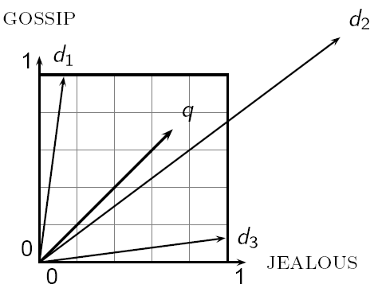
Why distance is a bad idea
Sec. 6.3
The Euclidean distance between q
and d₂ is large even though the
distribution of terms in the query q and the distribution of
terms in the document d₂ are
very similar.

Slide 148
Use angle instead of distance
Sec. 6.3
Thought experiment: take a document d and append it to itself. Call this document d′.
“Semantically” d and d′ have the same content
The Euclidean distance between the two documents can be quite large
The angle between the two documents is 0, corresponding to maximal similarity.
Key idea: Rank documents according to angle with query.

Slide 149
From angles to cosines
Sec. 6.3
The following two notions are equivalent.
Rank documents in decreasing order of the angle between query and document
Rank documents in increasing order of
cosine(query,document)
Cosine is a monotonically decreasing function for the interval [0º, 180º]

Slide 150
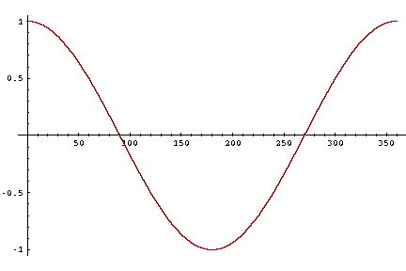
From angles to cosines
Sec. 6.3
But how – and why – should we be computing cosines?

Slide 151
Length normalization
Sec. 6.3
A vector can be (length-) normalized by dividing each of its components by its length – for this we use the L₂ norm:
Dividing a vector by its L₂ norm makes it a unit (length) vector (on surface of unit hypersphere)
Effect on the two documents d and d′ (d appended to itself) from earlier slide: they have identical vectors after length-normalization.
Long and short documents now have comparable weights

Slide 152
cosine(query,document)
Sec. 6.3
Dot product
Unit vectors
q_{i} is the tf-idf weight of term i in the query
d_{i} is the tf-idf weight of term i in the document
cos(q,d) is the cosine similarity of q and d … or,
equivalently, the cosine of the angle between q and d.
Notes:
See Law of Cosines (Cosine Rule) wikipedia page

Slide 153
Cosine for length-normalized vectors
For length-normalized vectors, cosine similarity is simply the dot product (or scalar product):
for q, d length-normalized.

Slide 154
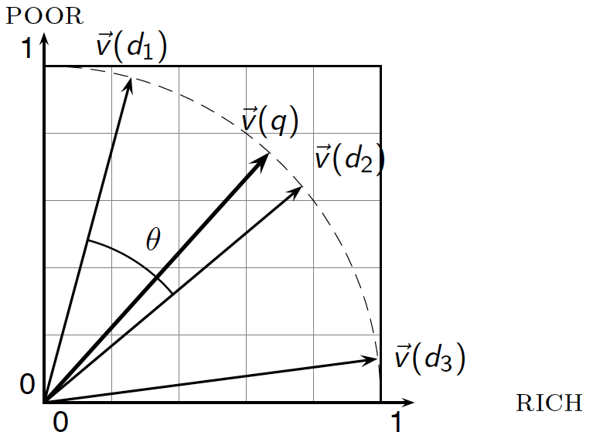
Cosine similarity illustrated

Slide 155
Cosine similarity amongst 3 documents
Sec. 6.3
How similar are
the novels
SaS: Sense and
Sensibility
PaP: Pride and
Prejudice, and
WH: Wuthering
Heights?
term | SaS | PaP | WH
affection | 115 | 58 | 20
jealous | 10 | 7 | 11
gossip | 2 | 0 | 6
wuthering | 0 | 0 | 38
Term frequencies (counts)
Note: To simplify this example, we don’t do idf weighting.

Slide 156
3 documents example contd.
Sec. 6.3
Log frequency weighting
After length normalization
term | SaS | PaP | WH
affection | 3.06 | 2.76 | 2.30
jealous | 2.00 | 1.85 | 2.04
gossip | 1.30 | 0 | 1.78
wuthering | 0 | 0 | 2.58
term | SaS | PaP | WH
affection | 0.789 | 0.832 | 0.524
jealous | 0.515 | 0.555 | 0.465
gossip | 0.335 | 0 | 0.405
wuthering | 0 | 0 | 0.588
cos(SaS,PaP) ≈
0.789 × 0.832 + 0.515 × 0.555 + 0.335 × 0.0 + 0.0 × 0.0 ≈ 0.94
cos(SaS,WH) ≈ 0.79
cos(PaP,WH) ≈ 0.69
Why do we have cos(SaS,PaP) > cos(SAS,WH)?

Slide 157
The Vector Space Model (VSM)

Slide 158
Calculating tf-idf cosine scores
in an IR system

Slide 159
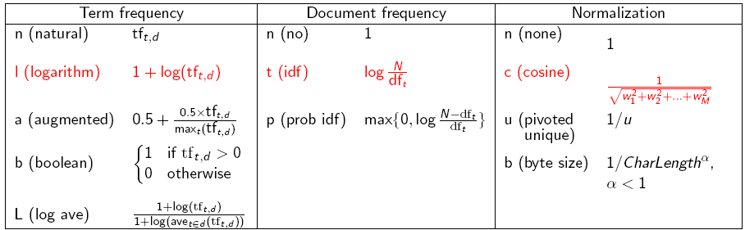
tf-idf weighting has many variants
Sec. 6.4
Columns headed ‘n’ are acronyms for weight schemes.
Why is the base of the log in idf immaterial?
Notes:
n default is just term frequency
ltc is best known form of weighting

Slide 160
tf-idf weighting has many variants
Sec. 6.4
Notes:
n default is just term frequency
ltc is best known form of weighting

Slide 161
Weighting may differ in queries vs documents
Sec. 6.4
Many search engines allow for different weightings for queries vs. documents
SMART Notation: denotes the combination in use in an engine, with the notation ddd.qqq, using the acronyms from the previous table
A very standard weighting scheme is: lnc.ltc
Document: logarithmic tf (l as first character), no idf and cosine normalization
Query: logarithmic tf (l in leftmost column), idf (t in second column), cosine normalization …
A bad idea?
Notes:
Leaving off idf weighting on documents is good for both efficiency and system effectiveness reasons.

Slide 162
tf-idf example: lnc.ltc
Sec. 6.4
Document: car insurance auto insurance
Query: best car insurance
Term | Query |  |  |  |  |  | Document |  |  |  | Prod
 | tf-raw | tf-wt | df | idf | wt | n’lize | tf-raw | tf-wt | wt | n’lize
auto | 0 | 0 | 5000 | 2.3 | 0 | 0 | 1 | 1 | 1 | 0.52 | 0
best | 1 | 1 | 50000 | 1.3 | 1.3 | 0.34 | 0 | 0 | 0 | 0 | 0
car | 1 | 1 | 10000 | 2.0 | 2.0 | 0.52 | 1 | 1 | 1 | 0.52 | 0.27
insurance | 1 | 1 | 1000 | 3.0 | 3.0 | 0.78 | 2 | 1.3 | 1.3 | 0.68 | 0.53
Exercise: what is N, the number of docs?
Doc length =
Score = 0+0+0.27+0.53 = 0.8

Slide 163
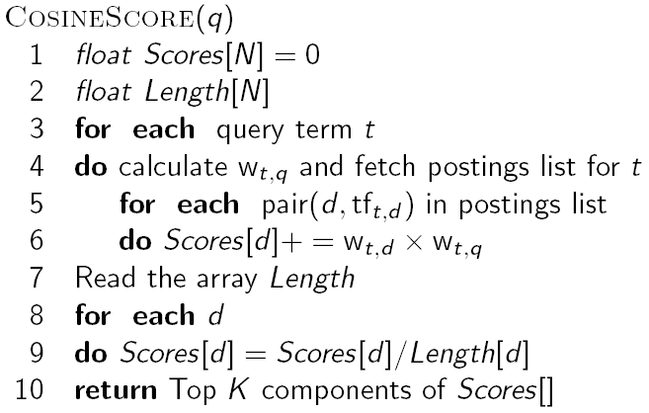
Computing cosine scores
Sec. 6.3
Notes:
Needs to be after the idea of separately weighting query and document terms.

Slide 164
Summary – vector space ranking
Represent the query as a weighted tf-idf vector
Represent each document as a weighted tf-idf vector
Compute the cosine similarity score for the query vector and each document vector
Rank documents with respect to the query by score
Return the top K (e.g., K = 10) to the user

Slide 165
Calculating tf-idf cosine scores
in an IR system

Slide 166
Evaluating search engines

Slide 167
Measures for a search engine
Sec. 8.6
How fast does it index
Number of documents/hour
(Average document size)
How fast does it search
Latency as a function of index size
Expressiveness of query language
Ability to express complex information needs
Speed on complex queries
Uncluttered UI
Is it free?

Slide 168
Measures for a search engine
Sec. 8.6
All of the preceding criteria are measurable: we can quantify speed/size
we can make expressiveness precise
The key measure: user happiness
What is this?
Speed of response/size of index are factors
But blindingly fast, useless answers won’t make a user happy
Need a way of quantifying user happiness with the results returned
Relevance of results to user’s information need

Slide 169
Evaluating an IR system
Sec. 8.1
An information need is translated into a query
Relevance is assessed relative to the information need not the query
E.g., Information need: I’m looking for information on whether drinking red wine is more effective at reducing your risk of heart attacks than white wine.
Query: wine red white heart attack effective
You evaluate whether the doc addresses the information need, not whether it has these words

Slide 170
Evaluating ranked results
Sec. 8.4
Evaluation of a result set:
If we have
a benchmark document collection
a benchmark set of queries
assessor judgments of whether documents are relevant to queries
Then we can use Precision/Recall/F measure as before
Evaluation of ranked results:
The system can return any number of results
By taking various numbers of the top returned documents (levels of recall), the evaluator can produce a precision-recall curve

Slide 171
Recall/Precision
R P
1 R
2 N
3 N
4 R
5 R
6 N
7 R
8 N
9 N
10 N
Assume 10 rel docs
in collection

Slide 172
Two current evaluation measures…
Sec. 8.4
Mean average precision (MAP)
AP: Average of the precision value obtained for the top k documents, each time a relevant doc is retrieved
Avoids interpolation, use of fixed recall levels
Does weight most accuracy of top returned results
MAP for set of queries is arithmetic average of APs
Macro-averaging: each query counts equally

Slide 173
Evaluating search engines

Slide 174


