Slide 1
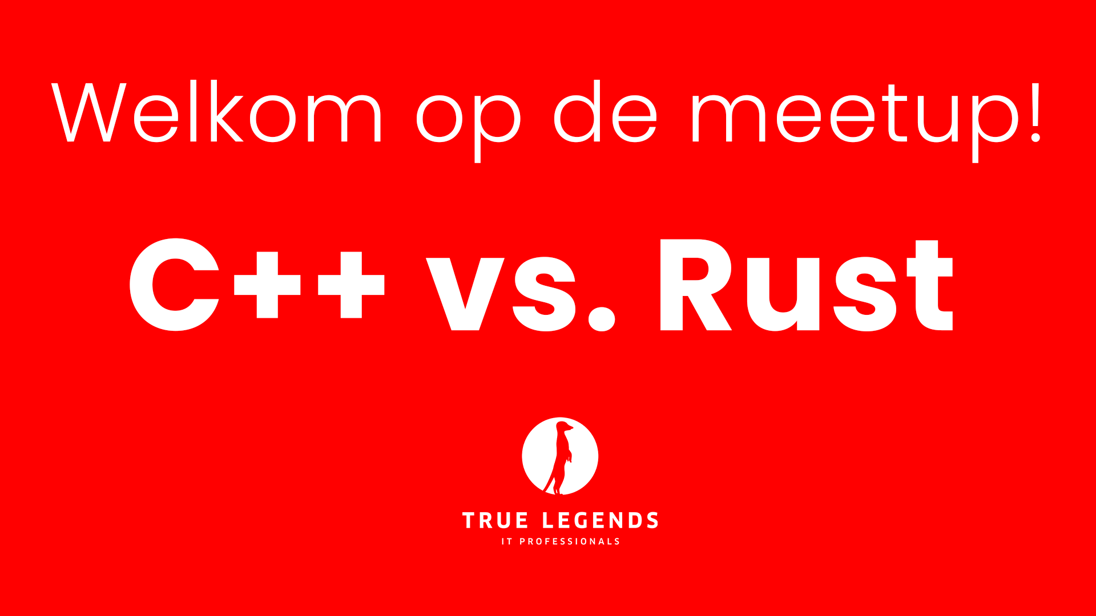
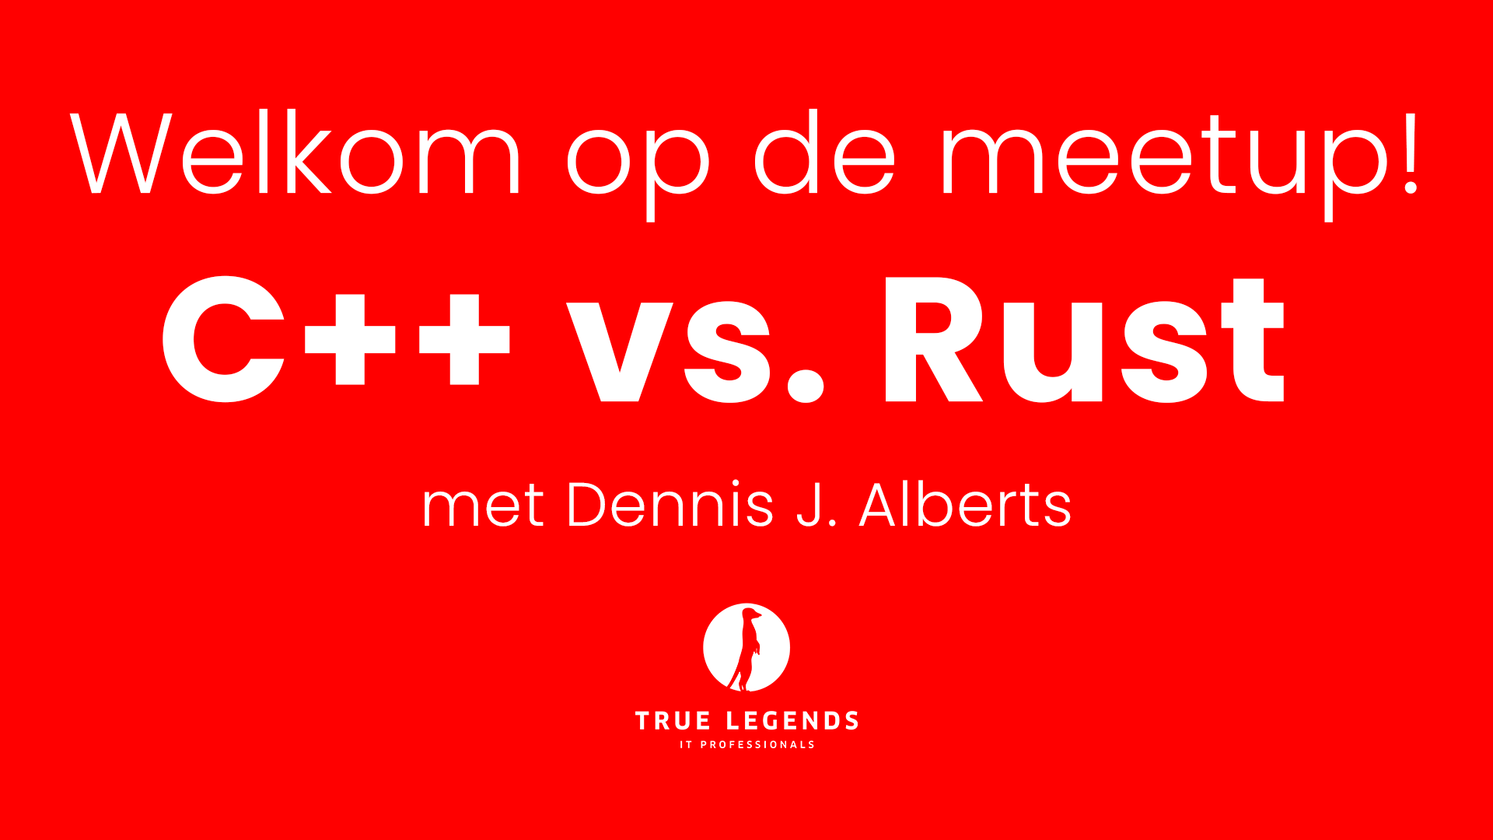

Slide 2
Table of Contents
Introduction
What is Rust?
Why use Rust?
C++ vs Rust
Discussion

Slide 3
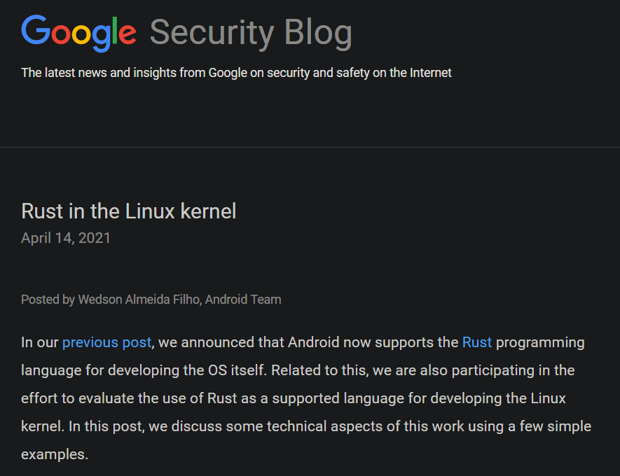
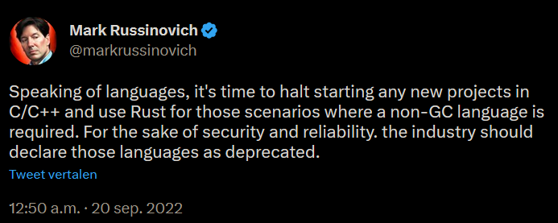
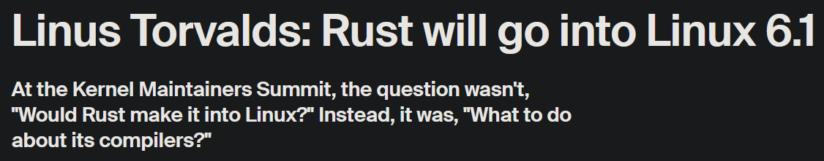
Introduction
Lately, we have been seeing the push to stop using languages that do not account for memory safety [1][2].
But also, the addition of Rust in the development of the 6.1 Linux Kernel [3] makes it even more popular.
Notes:
CTO of Microsoft Azure.

Slide 4

What is Rust?
Rust is a high-level, multi-paradigm, general-purpose language that emphasizes performance, type safety and concurrency.
Notes:
Ferris the mascot (Crab)
The rusty gear is the Rust logo.
Ownership is Rust’s most unique feature, and it enables Rust to make memory safety guarantees without garbage collection.
The ownership model only applies to data on the heap.
Ownership rules:
Each value in Rust has a variable that’s called its owner.
There can be only one owner at a time.
When the owner goes out of scope, the value will be dropped.
The Rules of References
Let’s recap what we’ve discussed about references:
At any given time, you can have either but not both of the following: one mutable reference or any number of immutable references.
References must always be valid.

Slide 5

What is Rust?
Rust ensures thread and memory safety with the use of their ownership model. The compiler checks if the program obeys the ownership rules while maintaining efficiency and performance.
Notes:
Ferris the mascot (Crab)
The rusty gear is the Rust logo.
Ownership is Rust’s most unique feature, and it enables Rust to make memory safety guarantees without garbage collection.
The ownership model only applies to data on the heap.
Ownership rules:
Each value in Rust has a variable that’s called its owner.
There can be only one owner at a time.
When the owner goes out of scope, the value will be dropped.
The Rules of References
Let’s recap what we’ve discussed about references:
At any given time, you can have either but not both of the following: one mutable reference or any number of immutable references.
References must always be valid.

Slide 6
What is Rust?
Rust was developed around 2006 by an employee within Mozilla and is now sponsored by Mozilla.
Notes:
Ferris the mascot (Crab)
The rusty gear is the Rust logo.
Ownership is Rust’s most unique feature, and it enables Rust to make memory safety guarantees without garbage collection.
The ownership model only applies to data on the heap.
Ownership rules:
Each value in Rust has a variable that’s called its owner.
There can be only one owner at a time.
When the owner goes out of scope, the value will be dropped.
The Rules of References
Let’s recap what we’ve discussed about references:
At any given time, you can have either but not both of the following: one mutable reference or any number of immutable references.
References must always be valid.

Slide 7
What is Rust?
Rust is seen as a promising replacement for C and C++, particularly for systems-level programming, infrastructure projects, and embedded software development.
Notes:
Ferris the mascot (Crab)
The rusty gear is the Rust logo.
Ownership is Rust’s most unique feature, and it enables Rust to make memory safety guarantees without garbage collection.
The ownership model only applies to data on the heap.
Ownership rules:
Each value in Rust has a variable that’s called its owner.
There can be only one owner at a time.
When the owner goes out of scope, the value will be dropped.
The Rules of References
Let’s recap what we’ve discussed about references:
At any given time, you can have either but not both of the following: one mutable reference or any number of immutable references.
References must always be valid.

Slide 8

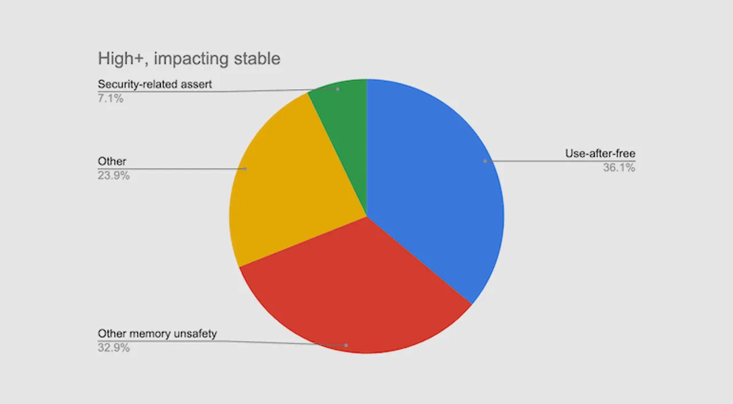
Why use Rust?
Memory safety bugs allow for accidental or intentional access to a system’s memory. These vulnerabilities can be exploited by malicious hackers.
In 2019 Microsoft showed that in the last 12 years, it has deployed 70% of all its patches in order to fix memory safety bugs and vulnerabilities in their system [4].
In 2020, Google weighted in on the topic, also reporting that 70% of its security bugs were due to memory safety bugs [5].
Notes:
Having memory safety bugs, when software accidentally or intentionally accesses system memory allows for malicious hackers to gain system and data.
The Slammer worm from 2003 was a buffer overflow (out-of-bounds write).
So was WannaCry (out-of-bounds write).
HeartBleed was a memory safety problem (out-of-bounds read).
Stagefright on Android too (out-of-bounds writes).
The Ghost vulnerability in glibc? You betcha (out-of-bounds write).

Slide 9
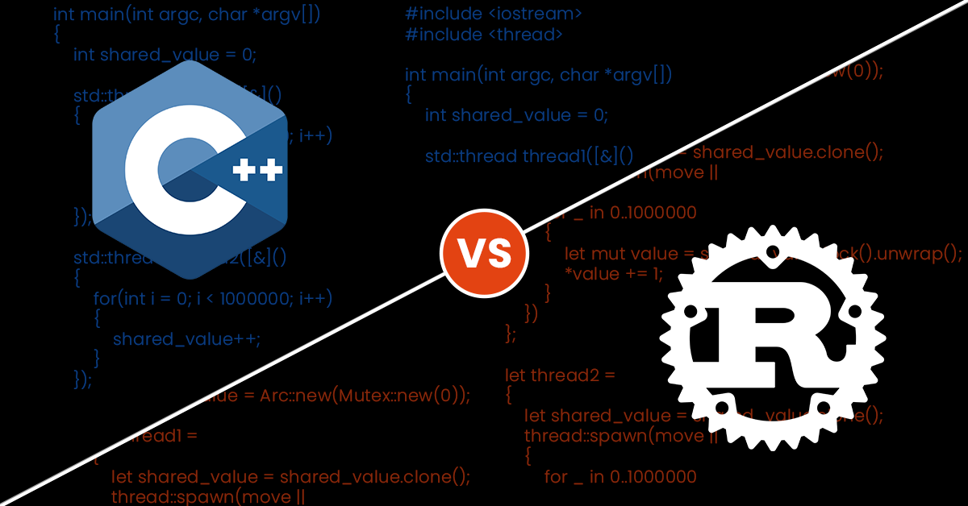
C++ vs Rust
Syntax
Project setup
Errors
Example 1: Memory allocation
Example 2: Integer overflow
Example 3: Use after free
Example 4: Array out of bounds
Example 5: Data races

Slide 10
Syntax
Syntax of both languages are similar in the use of curly braces, semicolons, functions and method supports, operators for different operations, and control flow statements.
The Rust syntax is considered to be more modern than C++, since it is simpler, allows for type inference, pattern matching, macros, and functional programming features.
#include <iostream>
int main(int argc, char *argv[])
{
std::cout << "Hello world!" << std::endl;
}
fn main()
{
println!("Hello world!");
}
Notes:
Both languages have operators for arithmetic, logical, and bitwise operations.
Both languages support control flow statements such as if/else, loops, and switches.
- Simpler Syntax: Rust's syntax is designed to be simple and easy to read and write. For example, Rust uses the = sign for variable assignment instead of the C++ = and == signs for assignment and comparison, respectively. This makes Rust code more concise and easier to understand.
- Type Inference: Rust has a powerful type inference system that allows the compiler to infer the types of variables and expressions in many cases. This reduces the need for explicit type annotations, which can make code more verbose in C++.
- Pattern Matching: Rust has powerful pattern matching capabilities that make it easier to write concise and readable code. For example, Rust's match expression can be used to handle complex pattern matching scenarios, such as matching on multiple conditions at once.
- Macros: Rust has a powerful macro system that allows developers to write code that generates other code at compile-time. This can be used to reduce boilerplate code and make code more modular and reusable.
- Functional Programming Features: Rust includes several features from functional programming languages, such as higher-order functions and closures. These features make it easier to write code that is more concise and expressive.

Slide 11

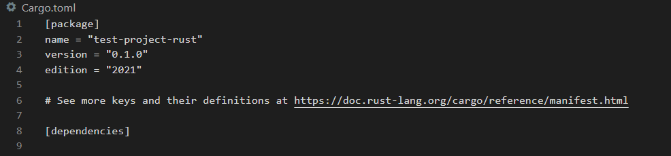
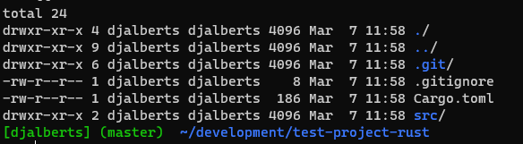
Project setup
Rust: Uses cargo. Package manager that provides everything need to build Rust project.
Cpp:
Uses build tools (such as Cmake, Qmake, Make file) in order to configure project and build project.
Alternative, use package manager (such as Conan, Vcpkg). However, these aren’t standardized and fully featured.
Notes:
TOML (Tom’s Obvious, Minimal Language) format, which is Cargo’s configuration format.

Slide 12
Errors
Rust has several error categories:
Errors at Compile Errors. For example, when ownership rules are not correctly followed.
Recoverable Errors, errors where the Result<T, E> can be used for error handling.
Unrecoverable Errors, errors which are always symptoms of bugs. These errors are also known as panics.

Slide 13
Example 1 – Memory allocation
int main(int argc, char *argv[])
{
int* ptr = new int(42);
}
fn main()
{
let mut ptr = Box::new(42);
}
C++: Will cause a memory leak, since the memory is never freed after allocation.
Rust: The memory allocation is handled automatically by the language’s ownership and borrowing system. Memory is automatically freed when a value goes out of scope.
Notes:
In Rust, Box is used to allocate memory on the heap. The new() method creates a new Box that contains the given value and returns a pointer to the boxed value. The * operator is used to dereference the pointer and access the value stored in the Box.
When the Box goes out of scope, the memory it allocated on the heap will be automatically freed.

Slide 14

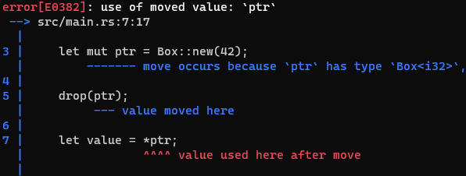
Example 2 – Use after free
int main(int argc, char *argv[])
{
int* ptr = new int(42);
delete ptr;
int value = *ptr;
std::cout << "Value = " << value << std::endl;
}
fn main()
{
let mut ptr = Box::new(42);
drop(ptr);
let value = *ptr;
println!("Value = {}", value);
}
C++: Will cause undefined behavior, since memory is accessed after being freed (nullptr). Value can be anything.
Rust: Will cause an ERROR at compile time, since num is moved and the value can, therefore, not be used after moved.
Notes:
In Rust, Box is used to allocate memory on the heap. The new() method creates a new Box that contains the given value and returns a pointer to the boxed value. The * operator is used to dereference the pointer and access the value stored in the Box. When the Box goes out of scope, the memory it allocated on the heap will be automatically freed.
Cpp, of course, has its own fixes for this problem. It is highly recommended that raw pointers are replaced with smart pointers.
In Cpp, this pattern of deallocating resources at the end of an item’s lifetime is sometimes called Resource Acquisition Is Initialization (RAII). The drop function in Rust will be familiar to you if you’ve used RAII patterns.

Slide 15

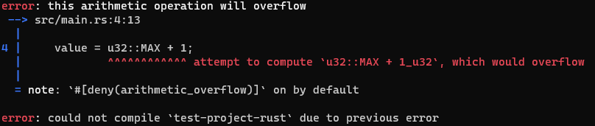
Example 3 – Integer overflow Compile time
int main(int argc, char *argv[])
{
unsigned int value = UINT_MAX;
//print statement
value = UINT_MAX + 1;
//print statement
}
fn main()
{
let mut value: u32 = u32::MAX;
println!("Value before addition: {}", value);
value = u32::MAX + 1;
println!("Value after addition: {}", value);
}
C++: Will simply run the code and produce an integer overflow. Resulting in a 0 as value.
Rust: Will cause an ERROR at compile time, since value can be evaluated. The addition of 1 to MAX will cause an integer overflow.
Notes:
Loops back to zero after incrementing the max integer value.
Max value is (2^n) – 1, since it is zero indexed.
The most famous is a heap overflow. Where the space allocated is going to be less than the file. This will then cause a buffer overflow.

Slide 16
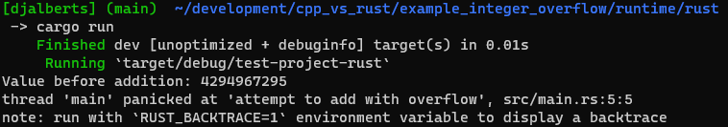
Example 3 – Integer overflow Runtime
int main(int argc, char *argv[])
{
unsigned int value = UINT_MAX;
//print statement
value += 1;
//print statement
}
fn main()
{
let mut value: u32 = u32::MAX;
println!("Value before addition: {}", value);
value += 1;
println!("Value after addition: {}", value);
}
C++: Same result as with compile time.
Rust: Since the value cannot be evaluated during compile time, the PANIC ERROR is given during runtime when incrementing the value beyond its maximum size.
Notes:
Loops back to zero after incrementing the max integer value.
Max value is (2^n) – 1, since it is zero indexed.
The most famous is a heap overflow. Where the space allocated is going to be less than the file. This will then cause a buffer overflow.

Slide 17

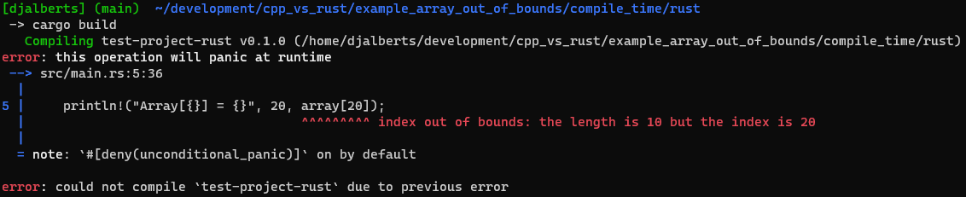
Example 4 – Array out of bounds Compile time
int main(int argc, char *argv[])
{
int array[10] = {0, 1, 2, 3, 4, 5,
6, 7, 8, 9};
std::cout << "Array[" << 20 << "] = " << array[20] << std::endl;
}
fn main()
{
let array:[i32;10] = [0, 1, 2, 3, 4, 5,
6, 7, 8, 9];
println!("Array[{}] = {}", 20, array[20]);
}
C++: Will cause undefined behavior as memory outside of array is accessed. Also known as buffer overflows.
Rust: Will cause an ERROR at compile time, since a literal is used that can be evaluated by the compiler to determine if the value exceeds the max length of the array.

Slide 18
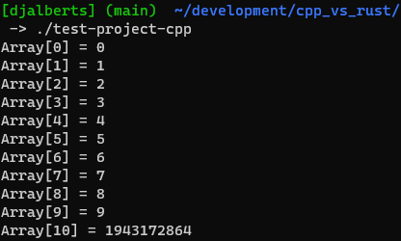
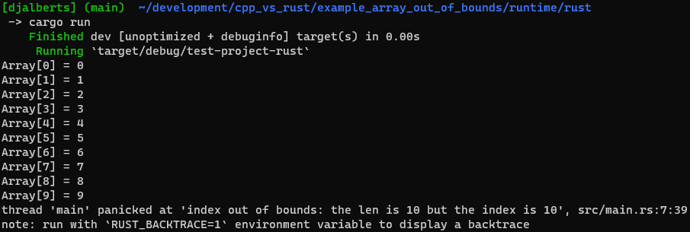
Example 4 – Array out of bounds Runtime
int main(int argc, char *argv[])
{
int array[10] = {0, 1, 2, 3, 4, 5,
6, 7, 8, 9};
for(int i = 0; i < 11; i++)
{
std::cout << "Array[" << i << "] = " << array[i] << std::endl;
}
}
fn main()
{
let array: [i32; 10] = [0, 1, 2, 3, 4, 5,
6, 7, 8, 9];
for i in 0..11
{
println!("Array[{}] = {}", i, array[i]);
}
}
C++: Will cause undefined behavior as memory outside of array is accessed. Also known as buffer overflows.
Rust: Will cause a runtime Panic, since the index exceeds the length of the array.

Slide 19
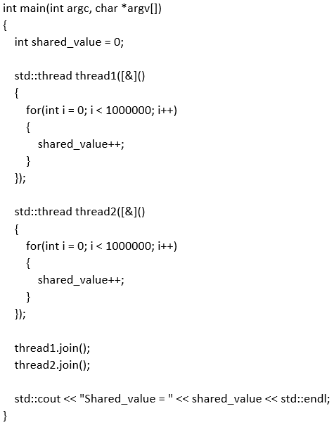
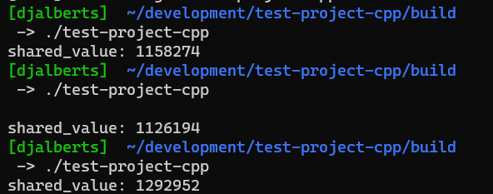
Example 5 – Data races
C++: Value will not be 2000000 as expected, since the there is no synchronization mechanism in place while concurrently incrementing. The threads might read the same value and miss the updated value resulting in above output.

Slide 20
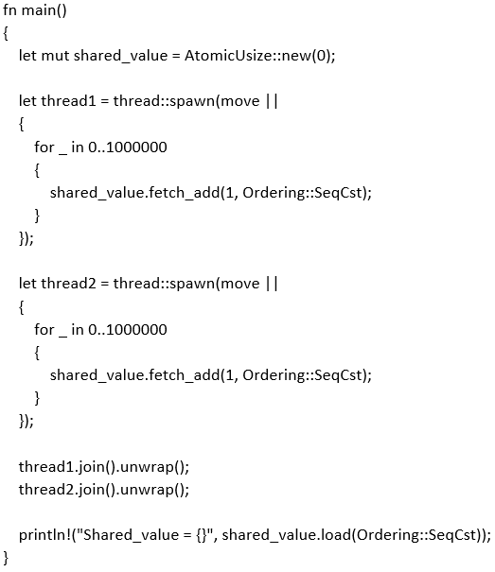
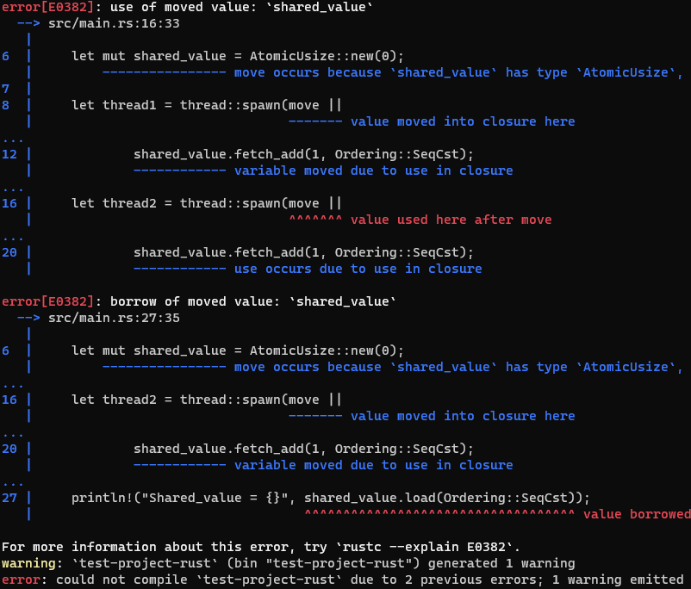
Example 5 – Data races
Rust: Will cause an ERROR at compile time. The ownership of the ‘shared_value’ is moved to the first thread and, therefore, cannot be used on other instances. This prevents a data race.
Notes:
AtomicUsize => An integer type which can be safely shared between threads.
Can be solved only with a clone of the variable when it is an ARC (smart pointer) and the synchronization between variables.
The benefit of having this restriction is that Rust can prevent data races at compile time. A data race is similar to a race condition and happens when these three behaviors occur:
Two or more pointers access the same data at the same time.
At least one of the pointers is being used to write to the data.
There’s no mechanism being used to synchronize access to the data.
Data races cause undefined behavior and can be difficult to diagnose and fix when you’re trying to track them down at runtime; Rust prevents this problem from happening because it won’t even compile code with data races!

Slide 21
C++ vs Rust
Advantages of Rust:
Safe and secure memory management
Modern syntax
Good performance
Prevents common programming errors
Disadvantages of Rust:
Steep learning curve for its unique approach to memory management
Ecosystem and libraries may not be as mature as those of C++
Can be more difficult to integrate with existing codebases written in other languages
But how about C++20, compilers and tooling?
Example #1 could be solved with smart pointers.
Example #2 could be prevented with using Asan or Valgrind.
Example #3 could be prevented with compiler functions that perform arithmetic with overflow checking.
Example #4 could be solved by using the std::vector.
Example #5 could be prevented with the use of lock_guards().

Slide 22
Discussion
Notes:
In C++, this pattern of deallocating resources at the end of an item’s lifetime is sometimes called Resource Acquisition Is Initialization (RAII). The drop function in Rust will be familiar to you if you’ve used RAII patterns.

Slide 23
Experiment
Want to experiment with the different examples?
Go to: https://gitlab.com/djalberts/cpp_vs_rust

Slide 24
Bibliography
[1] M. Russinovich, “Speaking of languages, it's time to halt starting any new projects in C/C++ and use rust for those scenarios where a non-GC language is required. for the sake of security and reliability. the industry should declare those languages as deprecated.,” Twitter, 19-Sep-2022. [Online]. Available: https://twitter.com/markrussinovich/status/1571995117233504257?lang=en. [Accessed: 14-Feb-2023].
[2] “Rust in the linux kernel,” Google Online Security Blog, 14-Apr-2021. [Online]. Available: https://security.googleblog.com/2021/04/rust-in-linux-kernel.html. [Accessed: 14-Mar-2023].
[3] “Linus Torvalds: Rust will go into linux 6.1,” ZDNET. [Online]. Available: https://www.zdnet.com/article/linus-torvalds-rust-will-go-into-linux-6-1/. [Accessed: 16-Mar-2023].
[4] “MSRC-security-research/2019_01 - bluehatil - trends, challenge ... - github.” [Online]. Available: https://github.com/Microsoft/MSRC-Security-Research/blob/master/presentations/2019_02_BlueHatIL/2019_01%20-%20BlueHatIL%20-%20Trends%2C%20challenge%2C%20and%20shifts%20in%20software%20vulnerability%20mitigation.pdf. [Accessed: 13-Mar-2023].
[5] “Chrome: 70% of all security bugs are memory safety issues,” ZDNET. [Online]. Available: https://www.zdnet.com/article/chrome-70-of-all-security-bugs-are-memory-safety-issues/. [Accessed: 13-Mar-2023].

