Slide 1
Django Unstuck
Suggestions for common challenges in your projects

Slide 2
About me
Notes:
I'm Johannes Spielmann, software developer-for-hire from Germany.
I've been doing Django projects for almost 15 years.
I've done projects both small and large, both in commercial and non-commercial settings
I've seen all of what we're about to do many times.
You should hire me!
Email me at j@spielmannsolutions.com!

Slide 3
Django Unstuck: Suggestions for common challenges in your projects

Slide 4
There are challenges that come up in every Django project.

Slide 5
How do we get past them?

Slide 6
Here are some solutions I’ve found
Notes:
Some people may call these things “best practices” or “patterns” or “recipes” or “ideas” or “opinions”.
These are just things I’ve found to work in these situations many times.
Some of these solutions are more directly applicable, others are more guideline-style.

Slide 7
App management
Templates
Middlewares and Context Processors
Code in models, views or managers?
Notes:
We are going to look at these four things:
App management and placement (and urlpatterns and settings)
How do we make sure we can find and understand our apps? How do we make it easy to decide where code goes?
How do we make our settings modular and easy to understand and modify?
Templates
Where to we put them? What do we call our blocks?
When to use Middlewares and context processors and what are they?
Code/Logic can go into many different places: models, views, managers or somewhere else entirely? So where should you put your logic then?

Slide 8
There are more...
App management and placement (and urlpatterns)
Username vs email address
Registration
Background tasks and long-running processes and Caching
Templates: Placement, folders, blocks and inheritance and namespaces
Should you do i18n and l10n right away?
When and how to start caching (memcached, redis etc.)
Fat models, fat views or fat managers or something else?
When to use Middlewares and context processors and what are they?
How to secure access: security middlewares or login_required (white vs black list)
How to create files and store them in file models
What to do about image scaling and thumbnailing (and hosting)?
How to serve content: coded pages, flatpages or Wagtail?

Slide 9
Join us!
https://github.com/shezi/django-unstuck
https://discord.gg/bUsu9B6Ek6
https://t.me/djangoRhein
Notes:
https://github.com/shezi/django-unstuck
https://discord.gg/bUsu9B6Ek6
https://t.me/djangoRhein

Slide 10
Part 1
App management and urlpatterns and settings

Slide 11

Let’s start a new Django project
Notes:
$ django-admin.py startproject tuque
$ cd tuque
$ ./manage.py startapp mytuque
Note: I took that name from a name generator. It’s a woolen hat.
Image credit: https://unsplash.com/photos/AQRp2NH-O8k

Slide 12
Challenge: organize your project such that:
🖫
🔗
🔍
〰
everything has its place
what belongs together, stays together
code/URLs are easily found
settings are flexible

Slide 13
Step 1
configuration
🖫
🔗
🔍
〰
Notes:
Create a config directory
Below that, a settings directory
Put the configuration in config directory
Put your config in config/settings/
Create base config, development config, production config (and optionally local config, but do not forget to .gitignore that one!)
Wire it all up so that it works.

Slide 14
Step 2
apps directory
🖫
🔗
🔍
〰
Notes:
Create an apps directory
Put the python path into manage.py and wsgi.py
Rejoice in the cleanness of your construction

Slide 15
Step 3
URL patterns
🖫
🔗
🔍
〰
Notes:
Put an urls.py into your new app, give it an app_name and urlpatterns.
Wire it up directly in config/urls.py

Slide 16
Step 4
template placement
🖫
🔗
🔍
〰
Notes:
Actually, no, that’s in Part 2

Slide 17
Part 2 Templates: Placement, folders, blocks and inheritance and namespaces

Slide 18
Where are your templates?
What are they called?

Slide 19
Challenge
All templates live in one big namespace.
Yet there are many places in the filesystem.
Decide where a template file goes!
Identify what a template belongs to!
Make sure namespace clashes are minimal!

Slide 20
Step 1 Main template directory
Notes:
Contains base.html and sub-bases, and global utilities (menu snippets, breadcrumbs, form snippets, …) -- everything that is part of the project as a whole.
Do not forget to wire it up in settings!
Note: easy to include, always at the same place (in template space and file system)

Slide 21
Step 2 In-app template directories
Notes:
These folders contain everything for that specific app. Each item in here should be tied either directly to a view or to some other template.
Always inside a sub-folder with the app name, never "on top".
Always named like the view function/class, and the URl pattern should have the same name. That way you can always find one from the other.
You should never need to include things from another app. If that is the case, think about whether you should migrate that specific thing to the main directory.

Slide 22
Step 3 Block names
Notes:
Standardizing block names makes it easy to write blocks you can use. But they do depend on the layout you have.
Here are some good names: page_title, title, content, inner_content, outer_content, left_content, right_content

Slide 23
Now do the same for static files!
Notes:
Static files are very similar to template files: have one global folder “static/” in your project root, where project-wide things go: CSS, JS, downloadable files etc.
Then each app gets its own static folder, with an app-name folder inside. This reduces clashes and makes files easy to find and understand.

Slide 24
Part 3
Middlewares and context processors
(and custom template tags)
Notes:
What are they?
When do we use each?
Note: This is not an implementation guide, those exist aplenty. This is a decision guide: which one should you implement?

Slide 25
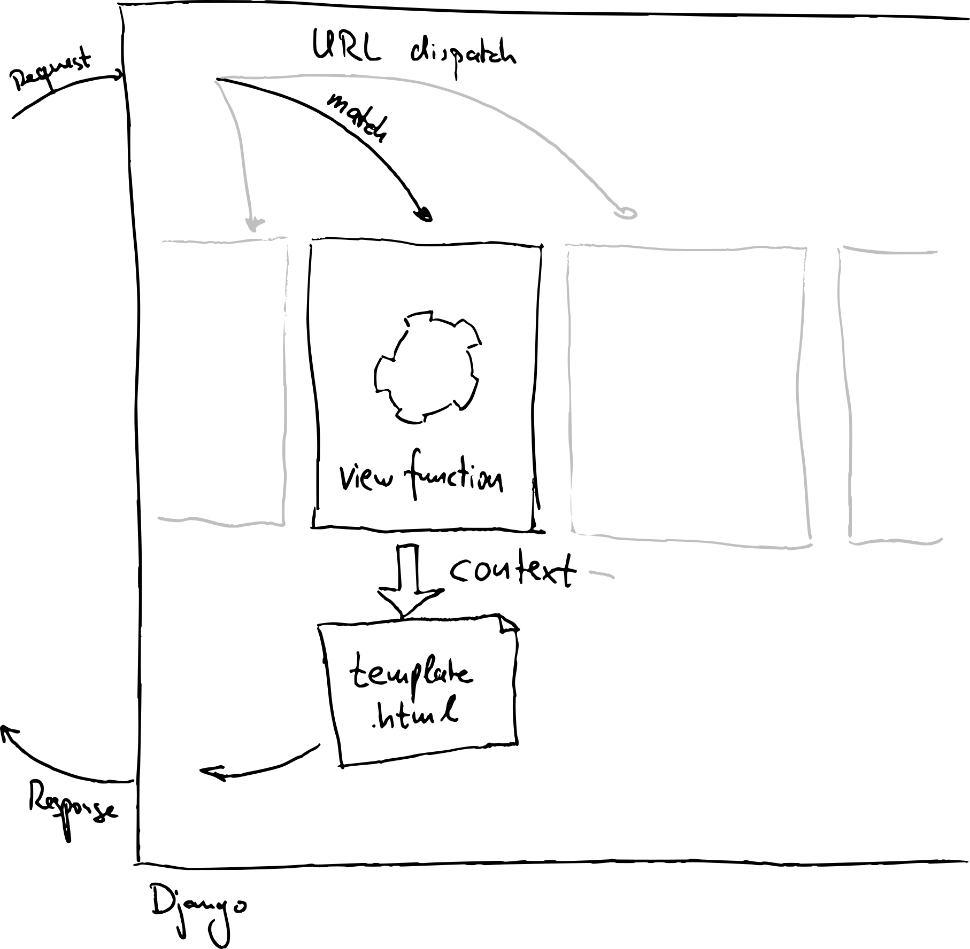
Drawing made during Sara Peeters’ workshop on Sketchnoting -- Thanks, Sara!
Notes:
The request cycle: a request comes in, gets processed by a view, rendered in a template
The result is a response.
Easy!

Slide 26
Context processors
Notes:
Sometimes you want to do things that show up in each rendered template. That’s what context processors do.

Slide 27
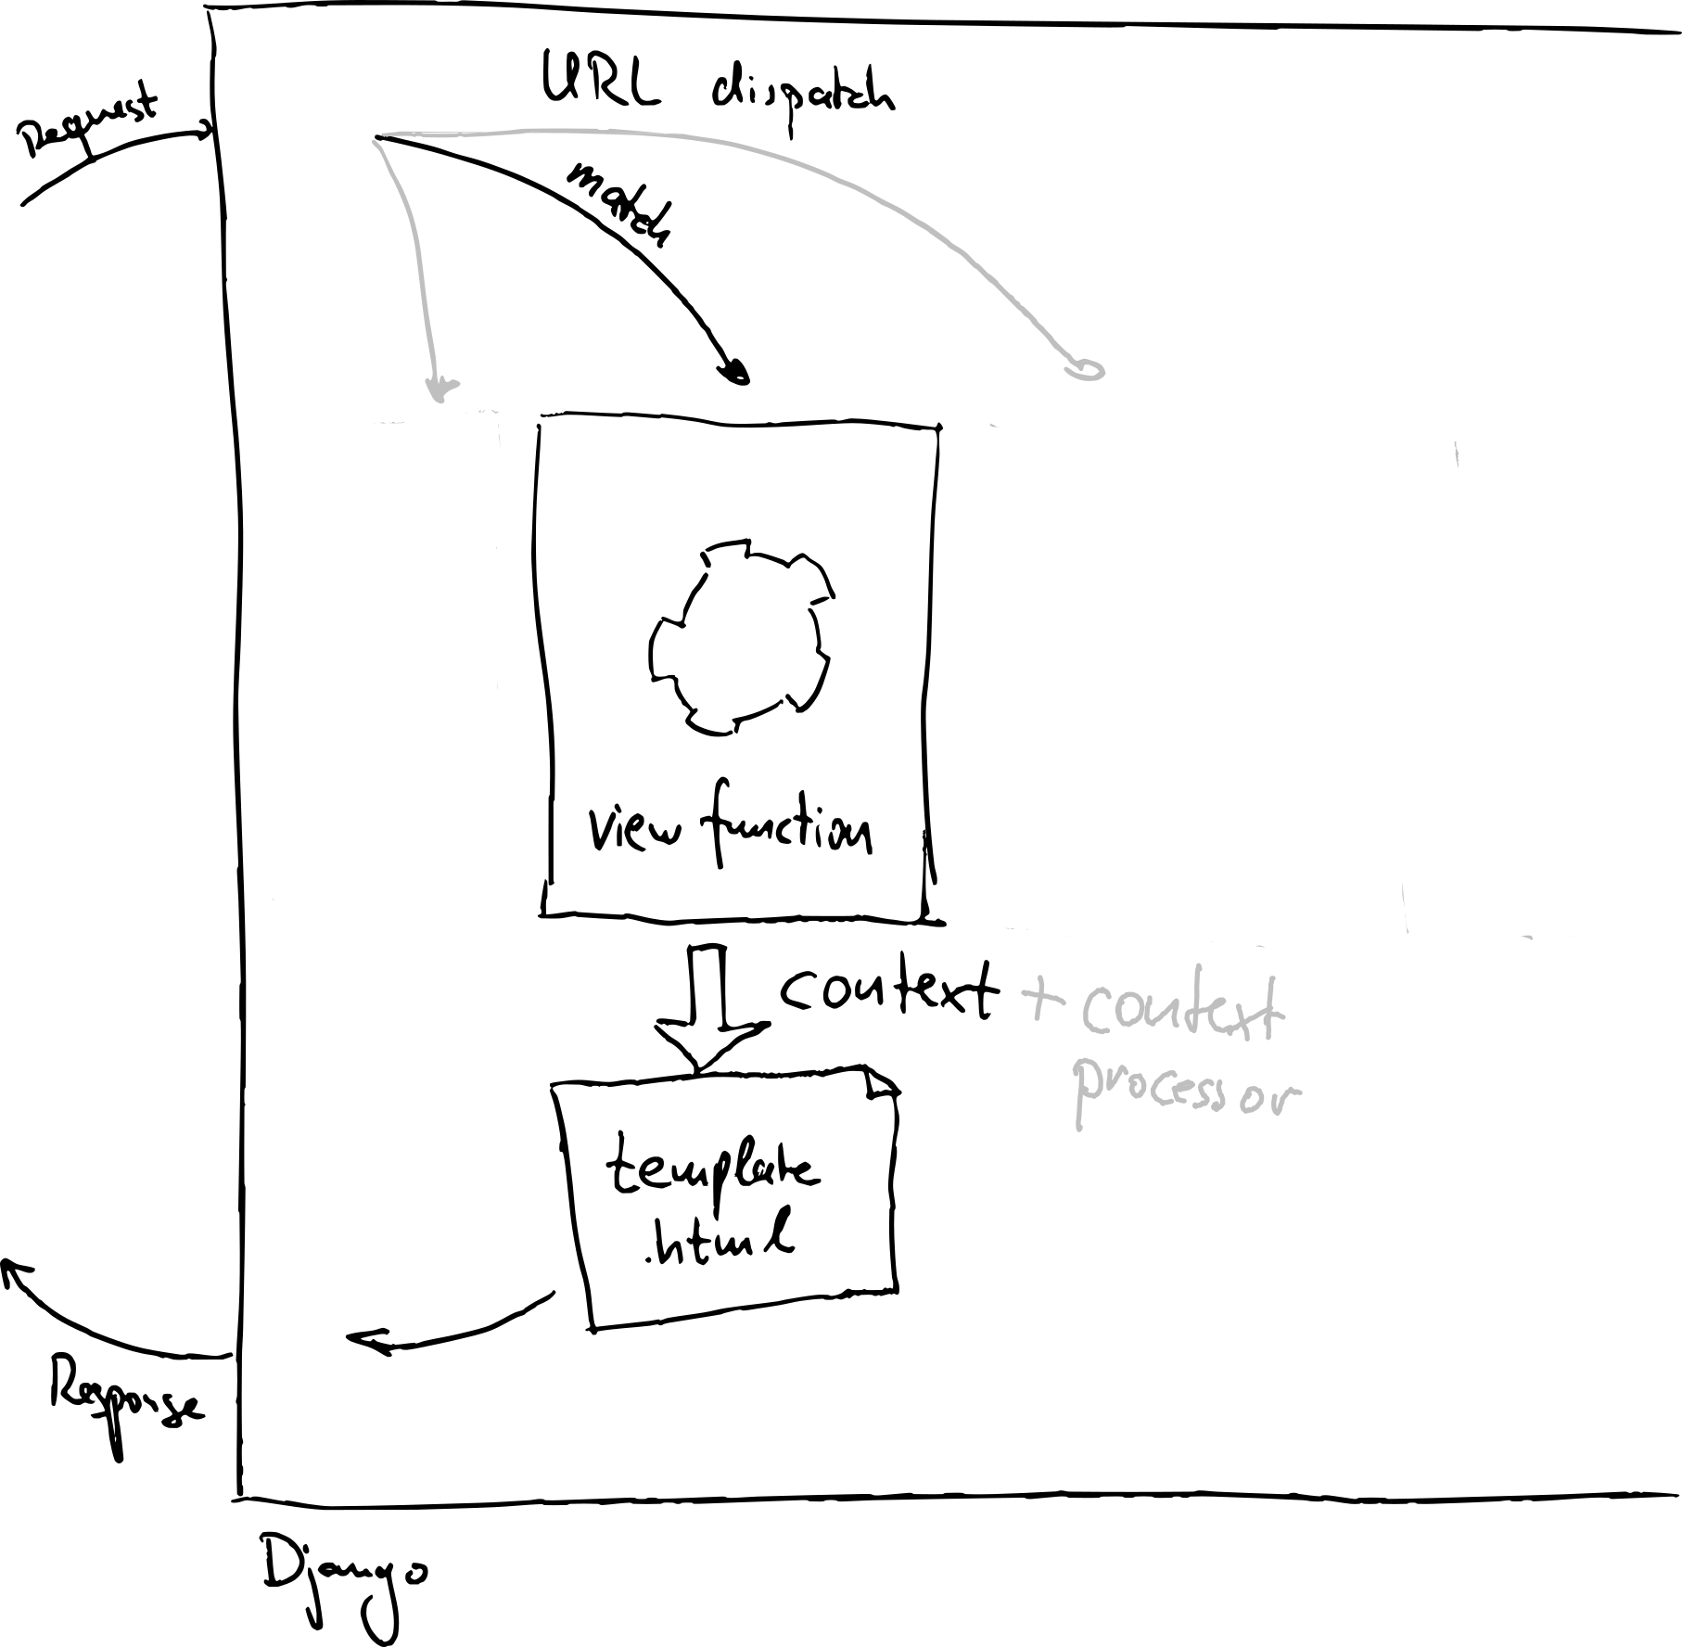
Notes:
The request cycle: a request comes in, gets processed by a view, rendered in a template
The result is a response.
Easy!

Slide 28
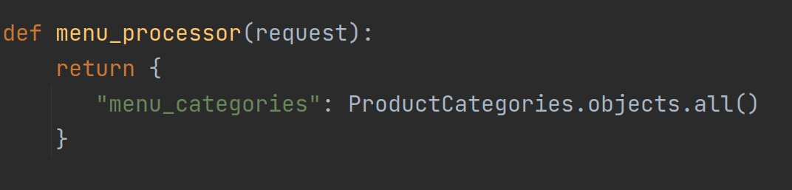
Notes:
A simple code example: Fetch product categories from the database, so you can render a menu on each page.

Slide 29
Custom template tags
Notes:
Can be loaded in template and can be functions
Also available in every template, but not called automatically
Can do more complicated things than context processors
Actually execute code
Depend on parameters or context in the template
Store state between executions
Examples:
Form rendering (crispy forms)
Handle get parameters (for filter+pagination)
Calculate values, or format values in specific way
Dynamic lookups (eg. translations)
Should you write custom template tags? Probably sometimes.

Slide 30
Middleware
Notes:
Finally, a middleware wraps the entire request/response cycle, so it can change every step of the process. This makes it more powerful, but also more complicated.

Slide 31
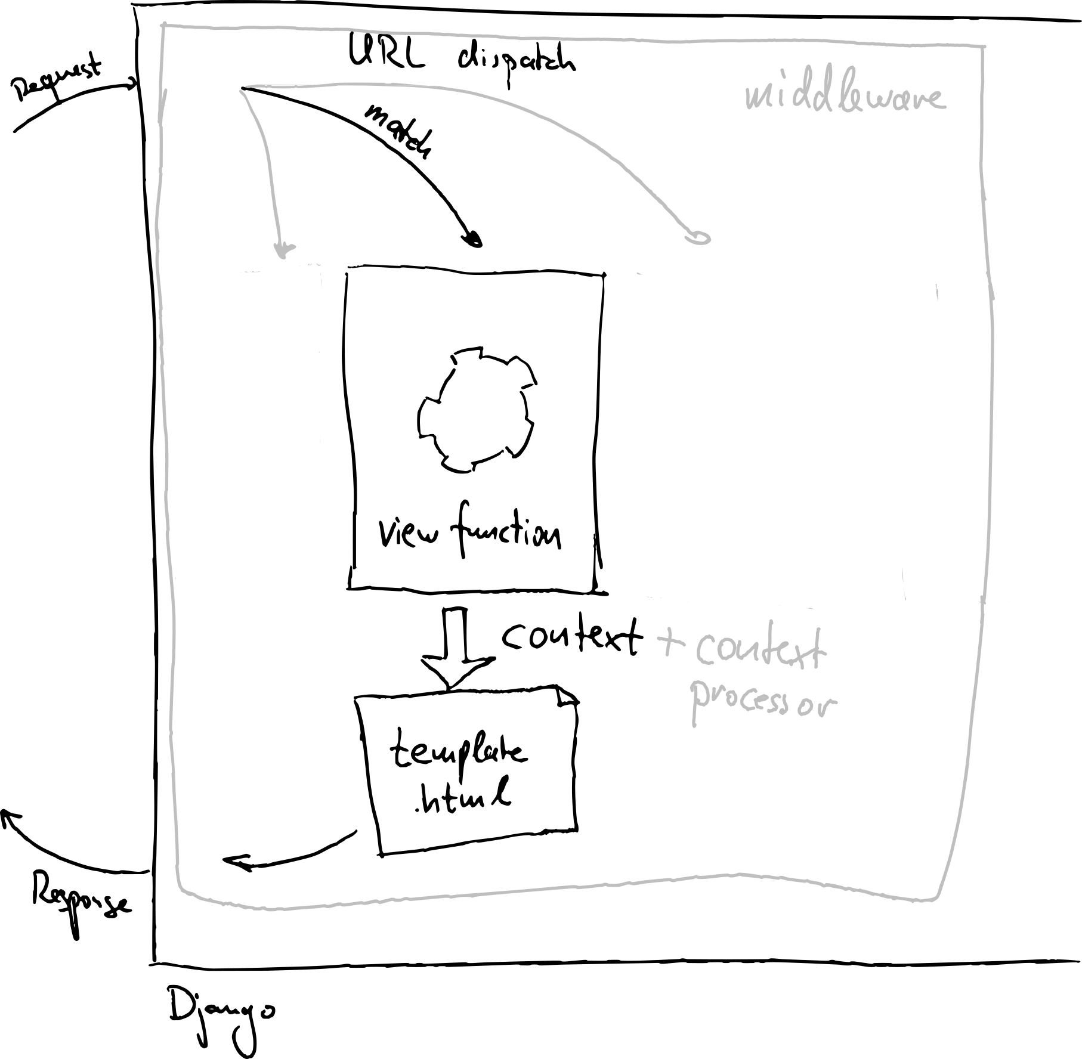
Notes:
The request cycle: a request comes in, gets processed by a view, rendered in a template
The result is a response.
Easy!

Slide 32
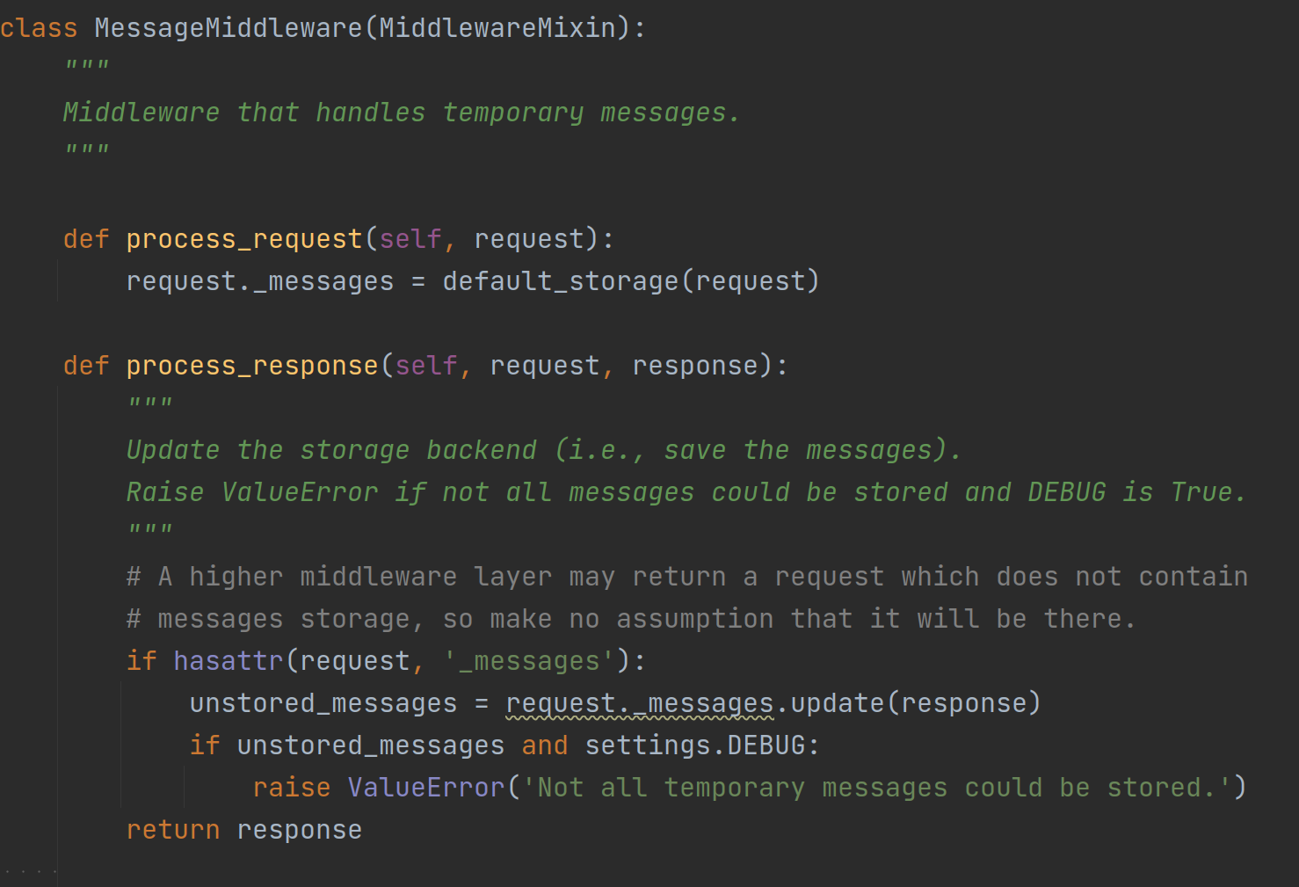
Notes:
An example from the Django code base: the message middleware from the messages framework.
The code itself is not important. What’s important here is the structure: a middleware is a class that has hooks into the request/response lifecycle.
Here, two hooks are used: process_request and process_response. But there are more. For details, see https://docs.djangoproject.com/en/3.2/topics/http/middleware/#other-middleware-hooks

Slide 33
When should you use which one?

Slide 34
Menu structure
Context processor

Slide 35
Content-Security-Policy headers
Middleware
Notes:
https://django-csp.readthedocs.io/

Slide 36
Detecting problematic DB queries
Middleware
Notes:
https://github.com/jmcarp/nplusone

Slide 37
Counting db queries
Middleware
Notes:
https://github.com/bradmontgomery/django-querycount

Slide 38
Show shopping basket
Context processor

Slide 39
Monitoring login attempts
Middleware
Notes:
https://github.com/jazzband/django-axes

Slide 40
CORS headers
Middleware
Notes:
https://github.com/adamchainz/django-cors-headers

Slide 41
Show most recent blog posts
Context processor

Slide 42
Monitoring server errors
Middleware
Notes:
https://raven.readthedocs.io/en/stable/integrations/django.html

Slide 43
Highlight items on sale
Context processor

Slide 44
Breadcrumbs
???

Slide 45
Show some items in dynamic page footer
Context processor

Slide 46
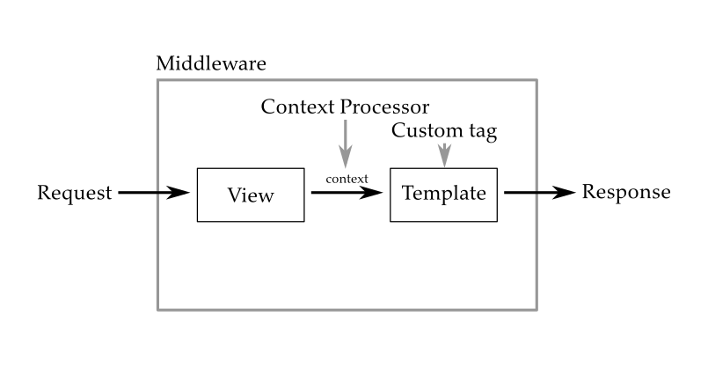
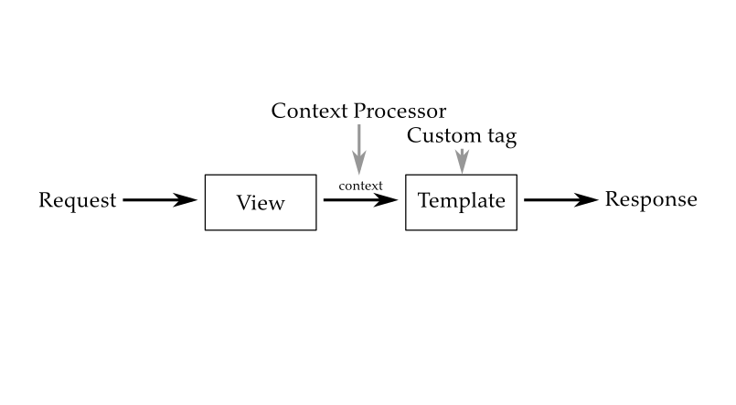
Notes:
This is the main takeaway of this section:
If you do something for every rendered template, use a context processor.
If you do something for every request, use a middleware.

Slide 47
Part 4 Code in models, views, managers or somewhere else?

Slide 48
Challenge:
Where do you put your code?
Notes:
We have some models, and these models need to do some things.
Where should we put the code for that?
Into the models
Into a model controller
Into the view
Into some other arbitrary place
Note: This is ALSO not an implementation tutorial, but a decision tutorial.
Note: there is no real answer!

Slide 49
Models
Notes:
Put everything in your model class.
- model classes are supposed to be storage abstractions
- no single purpose for model class
+ everything that has to do with data is in one place
We call these “massive models”.

Slide 50
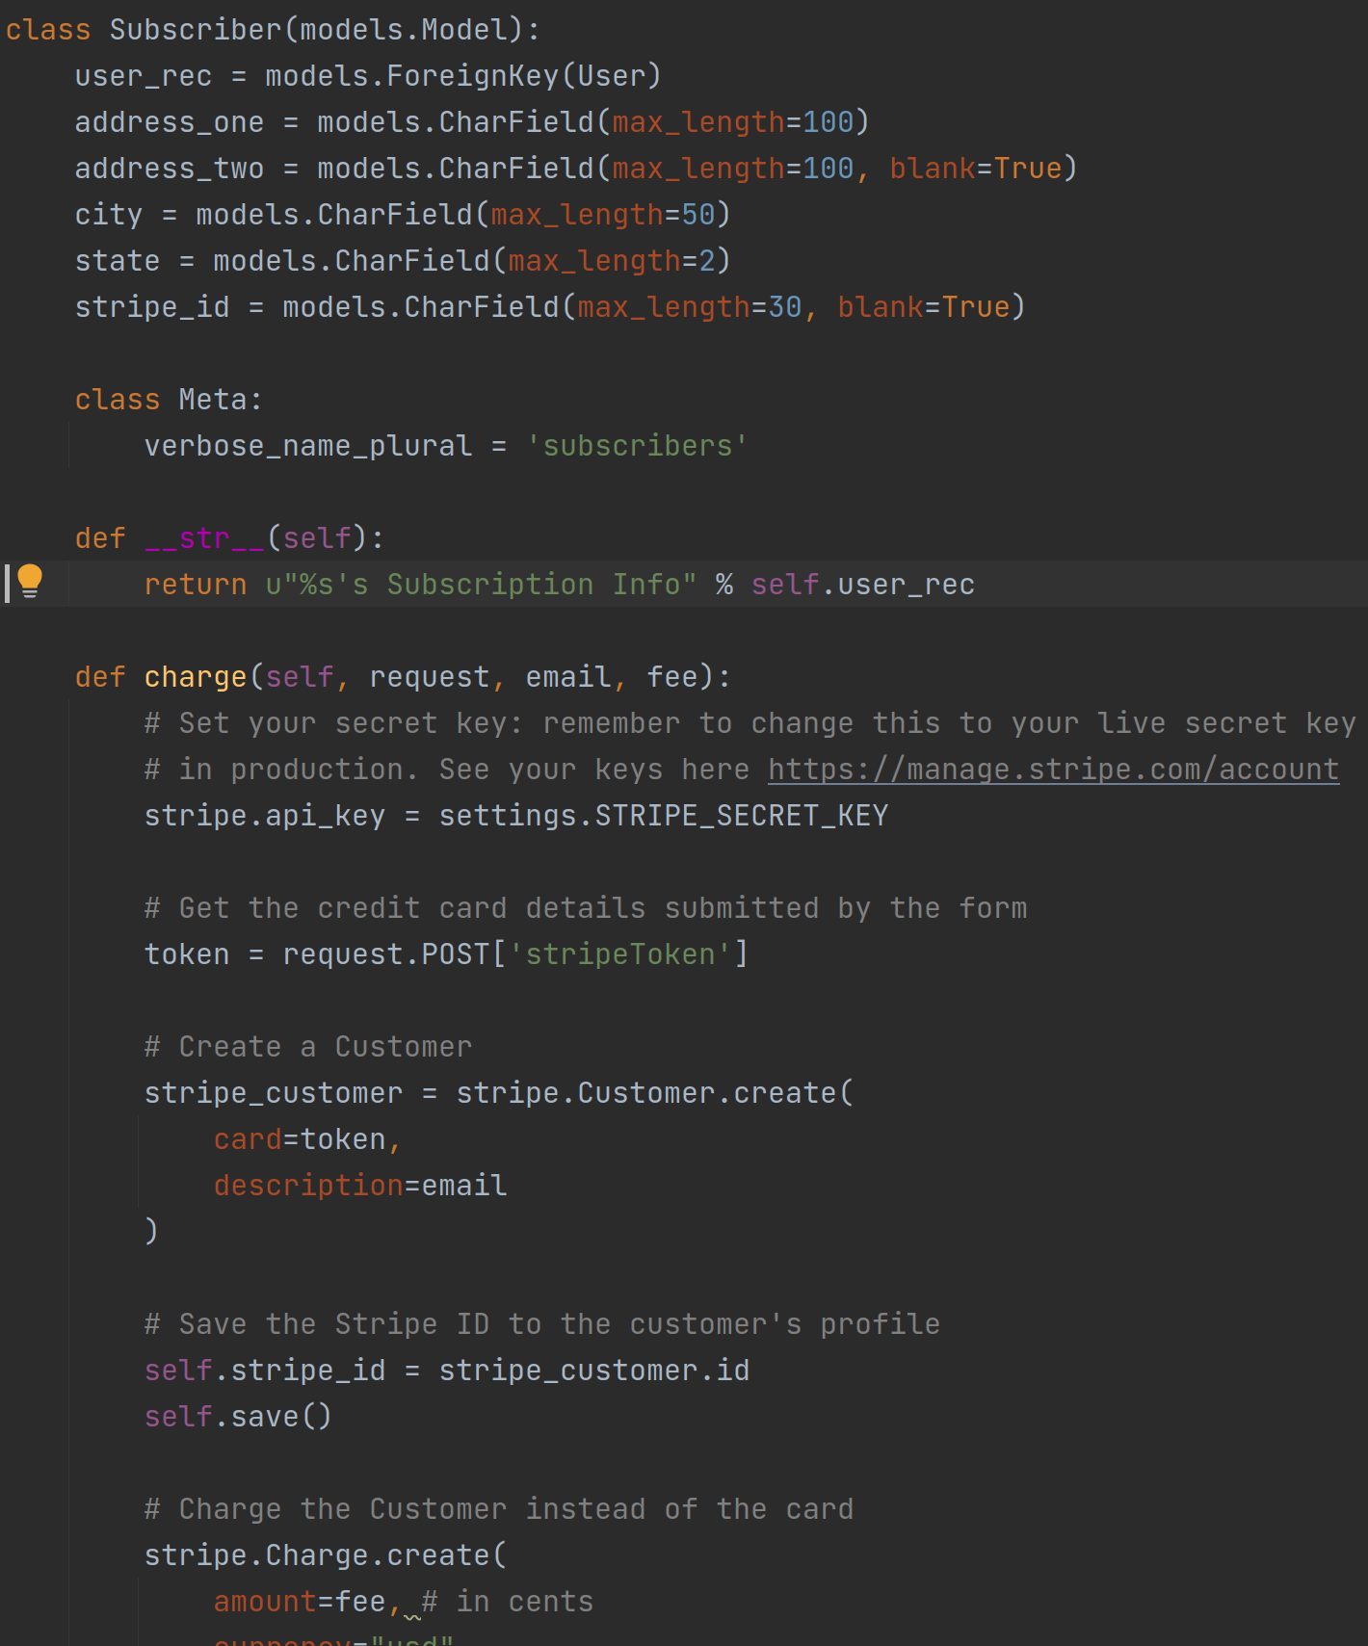
Notes:
An example: a subscriber that has methods for putting charges on their card.
Not really a storage abstraction any more. There is no clear purpose for this class, as it interacts with the database as well as with other APIs.
Also, this class will end up having 2000 lines and 100 methods. It is massive!

Slide 51
Model Managers
Notes:
Put some methods into model manager.
Model managers are abstractions for database access. Every model class has a default manager, which is ModelClass.objects
- a bit more inconvenient
- instances must be passed
- not very SOLID either: purpose is supposed to be storage retrieval
+ probably correct placement for creation/copy methods

Slide 52
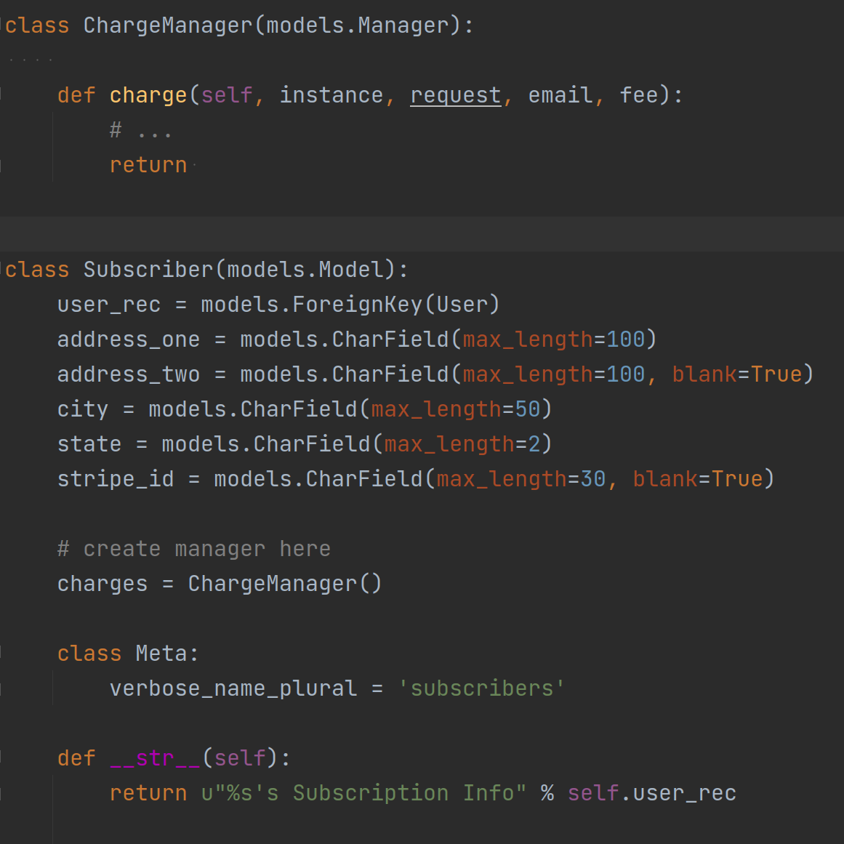
Notes:
Separating out the previous example into a model manager is much cleaner.

Slide 53
Views
Notes:
Let the view function do all the stuff.
Well, not all the stuff obviously: have auxiliary functions and classes and methods, of course!
- harder to reuse
- structure is ad-hoc, not easy to read
+ business logic is all in one place.

Slide 54
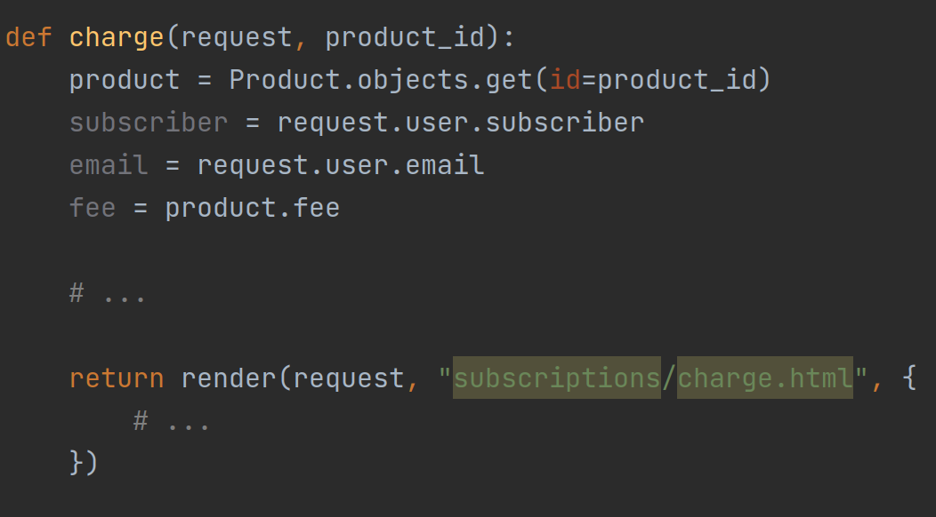
Notes:
Let the view function do all the stuff.
Well, not all the stuff obviously: have auxiliary functions and classes and methods, of course!
- harder to reuse
- structure is ad-hoc, not easy to read
+ business logic is all in one place.

Slide 55
Utility files/classes?
Notes:
They exist, too, yes. I have them in each and every one of my projects, because it is just so hard to decide where code goes.
And sometimes that’s the right place, too. For code that is needed in many different places or does not have a clear affiliation.

Slide 56
Examples
Notes:
Some examples:
Prepare some query: model or model manager, depends
Create new model instance and save it: manager
Create new model instance without saving: manager or model
Create a new model instance from something else: manager or model
Compute a value for a single model instance: model or view
Compute a value for a single model instance depending on some value in the request: view or model method with request

Slide 57
Prepare a query
Manager
Notes:
Some examples:
Prepare some query: model or model manager, depends
Create new model instance and save it: manager
Create new model instance without saving: manager or model
Create a new model instance from something else: manager or model
Compute a value for a single model instance: model or view
Compute a value for a single model instance depending on some value in the request: view or model method with request

Slide 58
Create new model instance
And save it
Manager
Notes:
Some examples:
Prepare some query: model or model manager, depends
Create new model instance and save it: manager
Create new model instance without saving: manager or model
Create a new model instance from something else: manager or model
Compute a value for a single model instance: model or view
Compute a value for a single model instance depending on some value in the request: view or model method with request

Slide 59
Create new model instance
Without saving
Model
Notes:
Some examples:
Prepare some query: model or model manager, depends
Create new model instance and save it: manager
Create new model instance without saving: manager or model
Create a new model instance from something else: manager or model
Compute a value for a single model instance: model or view
Compute a value for a single model instance depending on some value in the request: view or model method with request

Slide 60
Create new model instance
From something else
Manager
Notes:
Some examples:
Prepare some query: model or model manager, depends
Create new model instance and save it: manager
Create new model instance without saving: manager or model
Create a new model instance from something else: manager or model
Compute a value for a single model instance: model or view
Compute a value for a single model instance depending on some value in the request: view or model method with request

Slide 61
Compute a value
For a single model instance
Model method
Notes:
Some examples:
Prepare some query: model or model manager, depends
Create new model instance and save it: manager
Create new model instance without saving: manager or model
Create a new model instance from something else: manager or model
Compute a value for a single model instance: model or view
Compute a value for a single model instance depending on some value in the request: view or model method with request

Slide 62
Compute a value for a single model instance depending on some value in the request
View
Notes:
Some examples:
Prepare some query: model or model manager, depends
Create new model instance and save it: manager
Create new model instance without saving: manager or model
Create a new model instance from something else: manager or model
Compute a value for a single model instance: model or view
Compute a value for a single model instance depending on some value in the request: view or model method with request

Slide 63
Decisions, decisions!
Notes:
There is no right way to do it, but there’s also no wrong way to do it.
Don’t be afraid to try things out. Don’t be afraid to go back and change or rearrange things.
Do write tests, they will give you confidence when rearranging your code!

Slide 64
That’s all!

Slide 65
There’s more!
https://github.com/shezi/django-unstuck
https://discord.gg/bUsu9B6Ek6
https://t.me/djangoRhein
Notes:
https://github.com/shezi/django-unstuck
https://discord.gg/bUsu9B6Ek6
https://t.me/djangoRhein
My name is Johannes Spielmann. Email me at j@spielmannsolutions.com!
I’m looking forward to talking to all of you!

