Slide 1
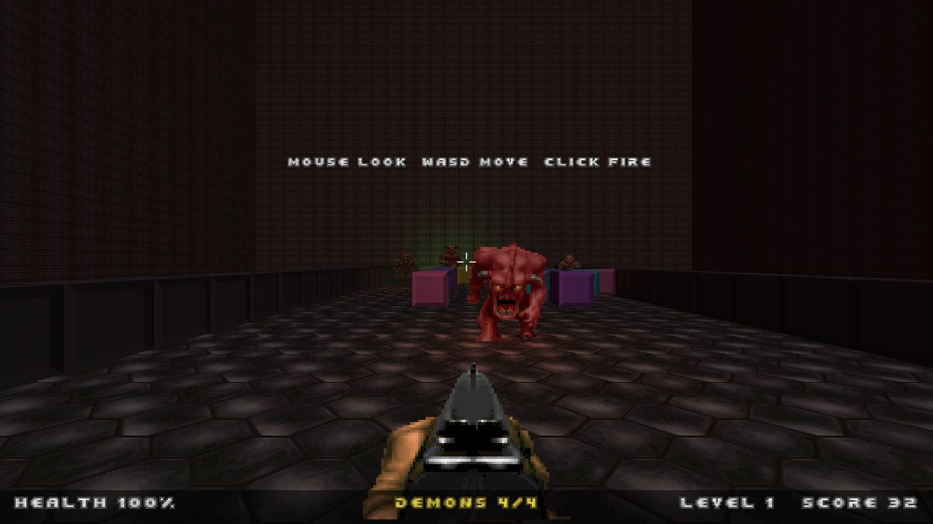
REDLINE
How an AI built a Doom-flavoured Tetris in one afternoon
A Claude Code case study for the engineering team · September 2026
Native Vulkan 1.3 · C++20 · 22 commits · ~12,000 lines · one working day
Notes:
Frame the talk: this is not a demo of the game, it is a demo of a way of working. Everything you will see was produced from plain-English requests in a single session on 14 September 2026.

Slide 2
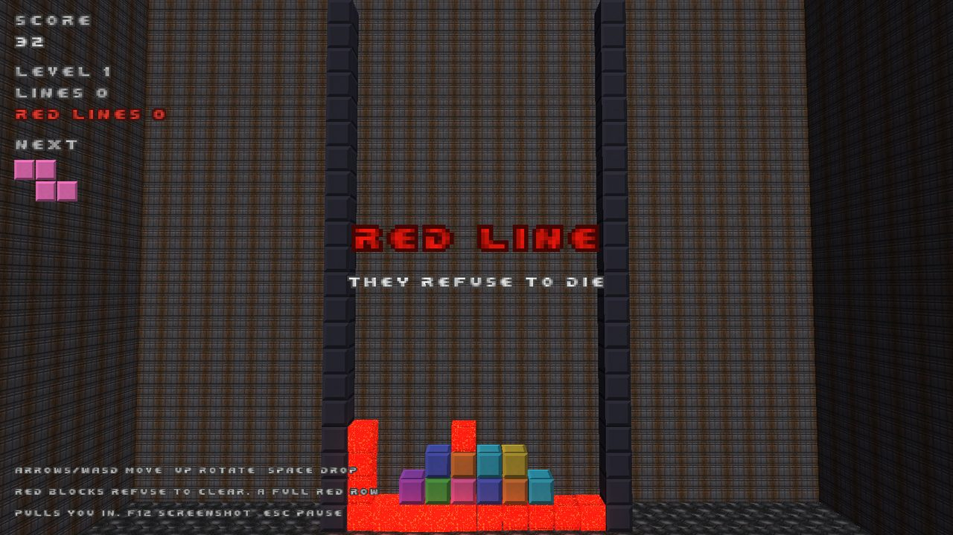
STEP 0
It started as one paragraph
“A Tetris-style game that uses Vulkan… every once in a while the game switches to a first-person Doom-style mode when certain blocks refuse to explode. Red blocks go all the way across, the player flies in with a gun, and the blocks turn into enemies. When they are destroyed they take the regular blocks around them with them. We can use assets from the Doom games.”
That was the whole specification. No architecture, no stack beyond “Vulkan” and “RTX Remix”, no art. The AI had to decide the rest and say so when the request and reality disagreed.
The red row completes; the board is about to tip over.
First decision: RTX Remix is a Windows D3D9 runtime, not a Linux Vulkan SDK. The AI said so up front, built a native Vulkan renderer with a Remix-shaped material model, and documented the Windows path instead of pretending.
REDLINE · built with Claude Code · 2
Notes:
Read the quote. Point out how little was specified. The RTX Remix correction is the first example of the AI pushing back rather than guessing.

Slide 3
THE OUTPUT
One session, by the numbers
7.5 h
22
12.4k
304
2
wall clock, first
commit to last
commits, each a
playable increment
lines of C++20,
GLSL and tests
automated checks
in four test suites
subagents delegated
self-contained modules
What shipped: a Vulkan renderer, a Doom WAD reader, a rules engine, a first-person combat sim with seven monster classes and four weapons, an OPL3 synthesizer for Doom's music, streamed Ogg soundtracks, gamepad support, player profiles, trophies, high scores, and display options. All from conversation.
REDLINE · built with Claude Code · 3
Notes:
Numbers come from git log and wc. Stress the test count: the AI wrote its own regression net as it went, not afterwards.

Slide 4






THE METHOD
The loop that repeated all afternoon
Specify
1
Skeleton + tests
2
Delegate
3
Turn the request into concrete rules and interfaces
Pure logic first, unit tests before pixels
Self-contained modules to subagents with a written contract
Integrate
4
Verify
5
Commit + iterate
6
Wire the pieces, build with -Wall -Wextra clean
Scripted scenarios, a bot player, screenshots, logs
Small commit, docs updated, next request
REDLINE · built with Claude Code · 4
Notes:
Every feature request went through these six steps. The important habit is step 5: the AI does not declare something done until a run proves it.

Slide 5
STEP 1 · 12:30 – 12:56
Foundations before pixels
Rules engine first, renderer second
The block game lives in a dependency-free module with a deterministic seed. It was written and unit-tested before a single Vulkan call existed, so every later rule change had a place to be proven.
What the first hour produced
CMake build with shaders compiled and embedded at build time
Vulkan 1.3 context: dynamic rendering, two frames in flight, screenshot read-back
Instanced cubes and billboards from one texture atlas
Procedural fallback art and sounds so it runs without a WAD
Nine rule tests that grew to 119 checks by the end of the day
tests/tetris_test.cpp
testClassicLineClear
testRedCellSurvivesClear
testRedCellsStayInPiece
testRedLineTrigger
testRedRowDoesNotClear
testRedRegions
testScoring / testCascadeChain
testCorruption
testEvilSpawn
testPanicAndPurge
testPrizes
testDeterminism
REDLINE · built with Claude Code · 5
Notes:
The rules engine is the contract. Point at the test list: each name is a rule the user asked for, expressed as code that fails if the rule regresses.

Slide 6
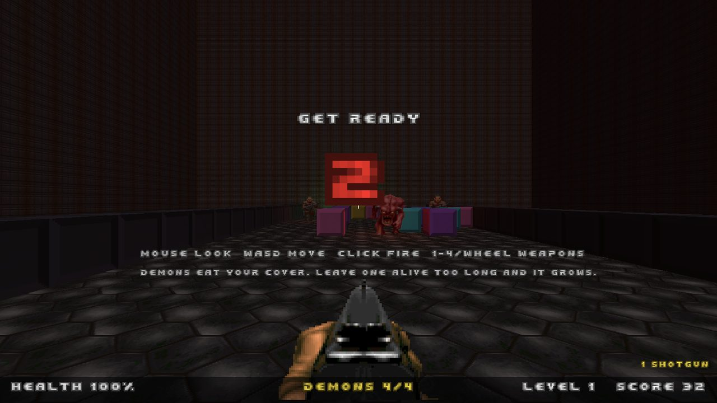
STEP 2 · DELEGATION
Hand off a module, keep the contract
The WAD reader was written by a subagent
While the main session built the renderer, a second agent got a written spec: the exact public API, the binary formats, robustness rules, and a synthetic-WAD test to write first.
It came back with a report, not just code:
1,456 checks passing, clean under ASan and UBSan
Validated against the real doom.wad and doom2.wad: 764 sprites, 287 textures, 122 sounds, all decoded
Ten listed deviations from the spec, each explained
Later the same pattern produced the OPL3 synthesizer.
Real Doom sprites, textures, font and sounds, decoded by the delegated WAD reader.
REDLINE · built with Claude Code · 6
Notes:
Delegation works when the interface is fixed in writing before the work starts. The parent integrated the module without reading its internals.

Slide 7
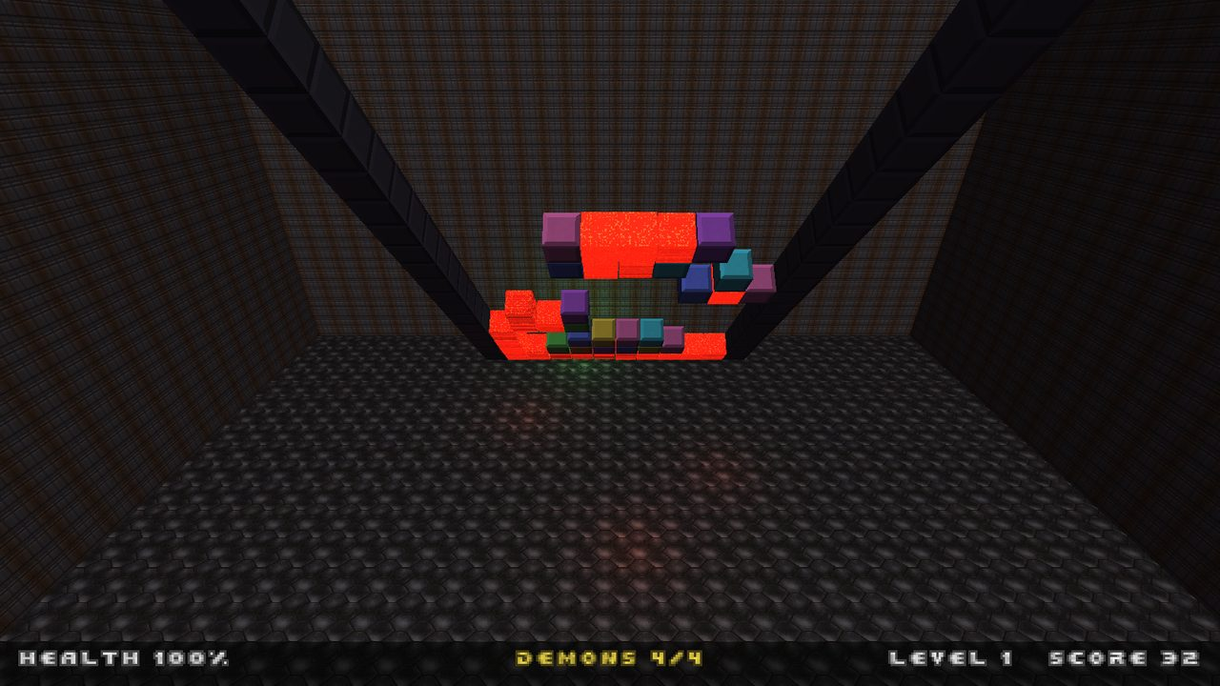
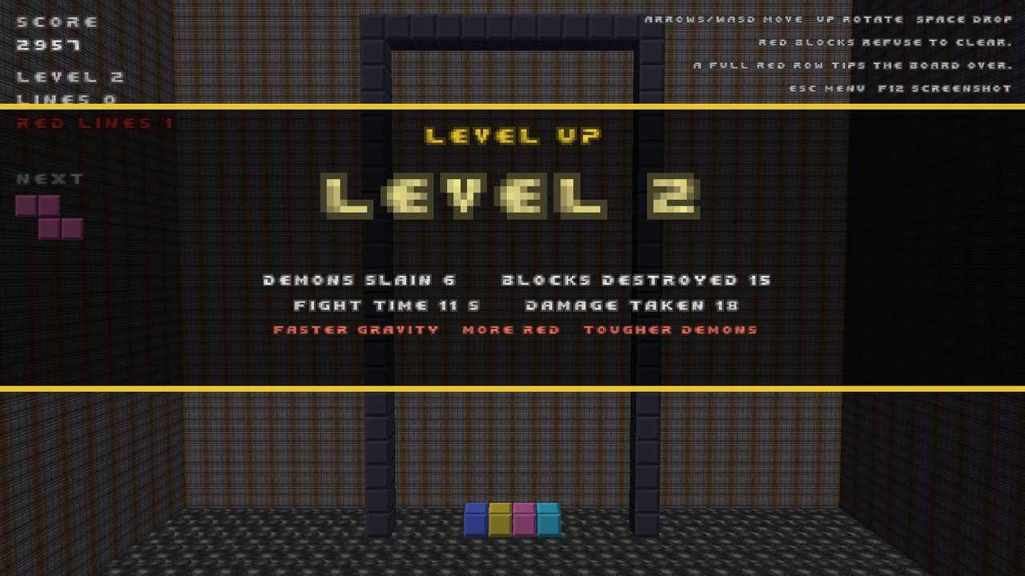
STEP 3 · 12:56
The first playable loop
Blocks
›
Alert
›
Fly-in
›
Countdown
›
Fight
›
Fly-out
›
Level up
The board hinges over onto the floor; the player lands inside it.
Surviving raises the level; the collapse plays behind the card.
The first version put the player in front of a standing wall. Forty minutes later a one-line request (“rotate the play space”) turned it into the board tipping over, which needed per-instance rotation in the shader, a new coordinate mapping, and collision against the block grid.
REDLINE · built with Claude Code · 7
Notes:
The whole state machine existed 25 minutes after the first commit. The tip-over redesign shows how a small request can ripple through renderer, physics and camera, and still land the same hour.

Slide 8
THE ROSTER
What you fight, and what you fight with
Monster classes by red-cluster size
HP scales with level (×0.45 at level 1 up to ×2.5); a level cap limits spawns; a monster left alive absorbs blocks and grows a class.
Class | Red cluster | HP | Attack | Eats cover every | Bounty
Zombieman | 1 | 20 | hitscan pistol | 11 s | 100
Imp | 2–3 | 60 | fireball | 7.5 s | 200
Demon | 4–6 | 150 | charges, bites | 5 s | 350
Cacodemon | 7–11 | 400 | flies, fast fireball | 3.5 s | 600
Baron | 12–17 | 1000 | green fireball | 2.5 s, 3×3 | 1200
Cyberdemon | 18–24 | 2200 | splash rockets | 2 s, 3×3 | 2500
Spider Mastermind | 25+ | 2600 | chaingun hitscan | 1.5 s, 3×3 | 3000
Weapons
Kills drop health, ammo and weapons; bigger classes drop more. A hidden BFG9000 wipes all red once per game.
Weapon | Damage | Cycle | Ammo / max | Notes
Shotgun | 40 | 0.75 s | infinite | ×1.4 damage up close; always available
Chaingun | 12 | 0.10 s | 60 / 200 | fast hitscan with slight spread
Rocket launcher | 110 | 0.80 s | 4 / 30 | 2.2 m splash that also blasts blocks (and you, if close)
Plasma rifle | 22 | 0.12 s | 40 / 200 | bolts at 28 m/s
REDLINE · built with Claude Code · 8
Notes:
Every number here is a constant in one of two tables in fps_mode.cpp; the AI tuned them from bot runs (the first version had ten imps firing freely, which killed the bot in seconds) and from the user's feedback. Loot: stimpacks, medikits, ammo and weapons pop out of every kill; cacodemons and up always drop a medikit, barons and up usually a weapon. Secret: hold B, F and G for two seconds while stacking to fire the BFG9000 once per game.

Slide 9
STEP 5 · VERIFICATION
Proof the machine can run by itself
Built-in hooks made every feature checkable from a shell
--scenario redline | fps | corrupt | prize · hand-made boards
--bot · an auto-aiming player that finishes fights
--frames N --screenshot x.png · deterministic 60 Hz stepping
--keys BFG@30x150 · scripted key presses and chords
REDLINE_MUSIC_DUMP · capture the audio mix to a WAV
XDG_DATA_HOME · isolate test save data from the real profile
Every claim in the session's reports traced back to one of these runs: a log line, a screenshot the AI looked at, or a rendered WAV.
$ redline --scenario redline --bot --frames 3000
[app] mode Blocks -> Alert (frame 0, score 32)
[app] mode Alert -> FlyIn (frame 85)
[app] mode FlyIn -> Countdown (frame 218)
[fps] level 1 roster: DEMON(4), IMP(3),
DEMON(6), DEMON(5), IMP(3), ZOMBIE(1)
[app] mode Countdown -> Fps (frame 399)
[fps] pickup rocket launcher (health 86)
[fps] rocket blast destroyed 1 blocks
[app] trophy unlocked: FIRST BLOOD
[app] mode Fps -> FlyOut (frame 1183)
[app] mode FlyOut -> Blocks (frame 1268)
[app] trophy unlocked: RED LINE
REDLINE · built with Claude Code · 9
Notes:
This is the slide to dwell on. The AI cannot play the game, so it built ways to make the game prove itself: the bot completed the loop dozens of times during the day.

Slide 10
STEP 6 · ITERATING ON FEEDBACK
Twenty-two commits, one conversation
First playable loop
Loot drops, four weapons
Corruption, combo scoring
Panic mode, hidden BFG
Gamepad, profiles, trophies
12:56
13:51
15:29
17:24
19:15
13:37
14:57
16:08
18:30
20:31
Board tips over; monster tiers; menus
Countdown, cover erosion, absorb-and-grow
Level caps, region splitting
OPL3 music, high scores
Display options
Each request became a commit with a test where a rule changed, a docs update, and a verification run. Corrections were treated the same way as features: “red blocks break off pieces, that's not right” became a rewritten test, then an engine change, in one commit.
REDLINE · built with Claude Code · 10
Notes:
Walk the timeline quickly. The gaps between commits are the conversation: the user played, said what felt wrong, the AI changed it.

Slide 11
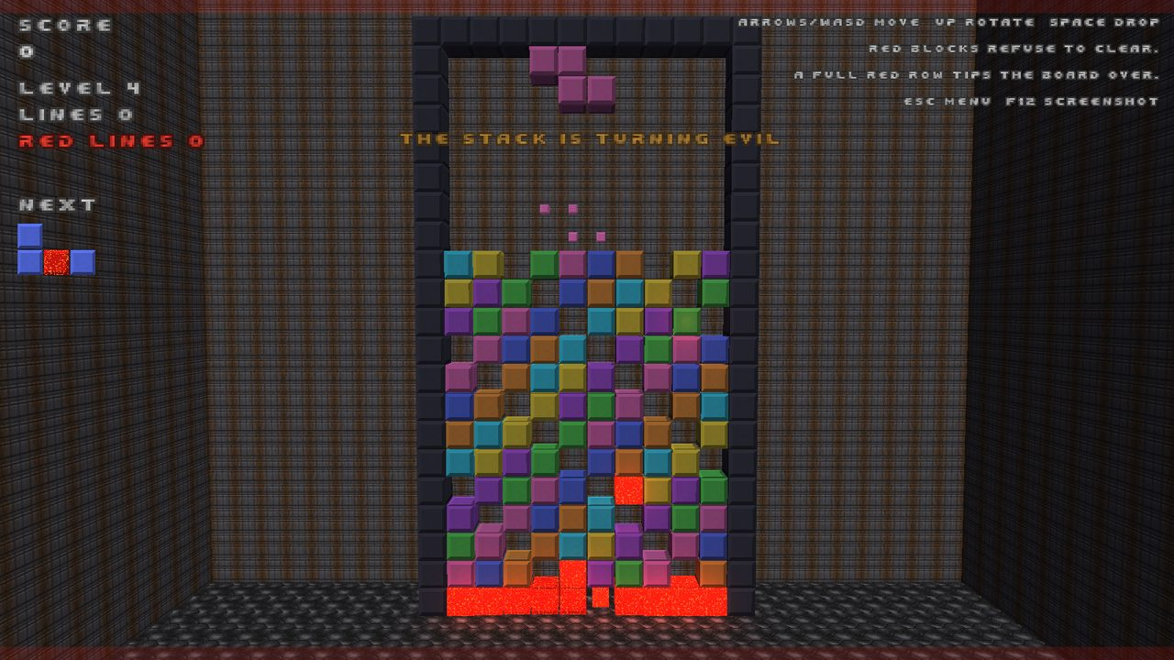
HOW A RULE CHANGES
Feedback becomes a test first
// evil spawn: a hole needs a full red surround
fill(g, 19, CellKind::Red, 5); // bottom row, hole at 5
g.setCell(5, 18, Cell{CellKind::Red, 0}); // red above
auto holes = g.evilSpawnCandidates();
CHECK(holes.size() == 1 && holes[0] == {5, 19});
// open sky above never qualifies
Game h(4, r); fill(h, 19, CellKind::Red, 5);
CHECK(h.evilSpawnCandidates().empty());
// mid-board: all four neighbours must be red
m.setCell(4, 11, Cell{CellKind::Normal, 0});
CHECK(m.evilSpawnCandidates().empty());
m.setCell(4, 11, Cell{CellKind::Red, 0});
CHECK(m.evilSpawnCandidates().size() == 1);
The user asked: “it has to have a full surround before spawning, right? Unless it's the bottom row.” The first version had been looser. The fix started with the cases above, and the engine was changed until they passed. The old, wrong behaviour can never come back silently.
REDLINE · built with Claude Code · 11
Notes:
This is the discipline to sell: the correction is encoded as a test with the exact edge cases the user described, then the code follows.

Slide 12




DEEP DIVE · 18:30
Music from a chip written to spec
MUS + GENMIDI
Doom's music is stored as compact MIDI-like scores with an Adlib instrument bank. Both parsers were written and tested against the real WAD.
OPL3 emulator
No soundfont on the machine, so a subagent implemented the Yamaha YMF262 from its documented behaviour: log-sin tables, envelopes, feedback, 18 voices. 48 checks including a 440 Hz pitch measurement; 1.7% of one core.
Three soundtracks
The rerelease ships Ogg recordings in a 625 MB WAD. The game indexes it by directory only and streams the Modern (Hulshult) or SC-55 sets; Classic falls back to the emulator.
Verified by ear and by numbers
Tracks were rendered to WAV for the user to hear, and the mix was captured in-game to prove the streaming path.
REDLINE · built with Claude Code · 12
Notes:
The point is not that the AI knows about OPL chips. It is that when the easy route (install a soundfont) needed sudo, it took the harder route that would work immediately, and told the user how to get the easy route too.

Slide 13

WHAT THE PROCESS CAUGHT
Bugs found by the AI's own checks
Crash on exit
Crash on exit, again
Audio streams were destroyed after SDL_Quit. Every earlier run used --mute, so it hid until a run with sound checked its exit code.
The music stream had the same lifetime bug. Found because the previous fix made exit codes something the AI now checked every time.
Fix: Explicit shutdown order
Fix: Music::shutdown() before SDL_Quit
Segfault with --fullscreen
A test that lied
Display settings applied before the Vulkan context existed. Caught by the very run meant to prove the new option.
A helper swapped the queued piece, not the falling one, so a combo test passed for the wrong reason. Spotted when a stronger assertion failed.
Fix: Null guard; context sizes itself
Fix: Helper fixed, assertions tightened
REDLINE · built with Claude Code · 13
Notes:
None of these were reported by the user. They were found because the AI's habit is to run the thing and read the exit code, not to assume.

Slide 14
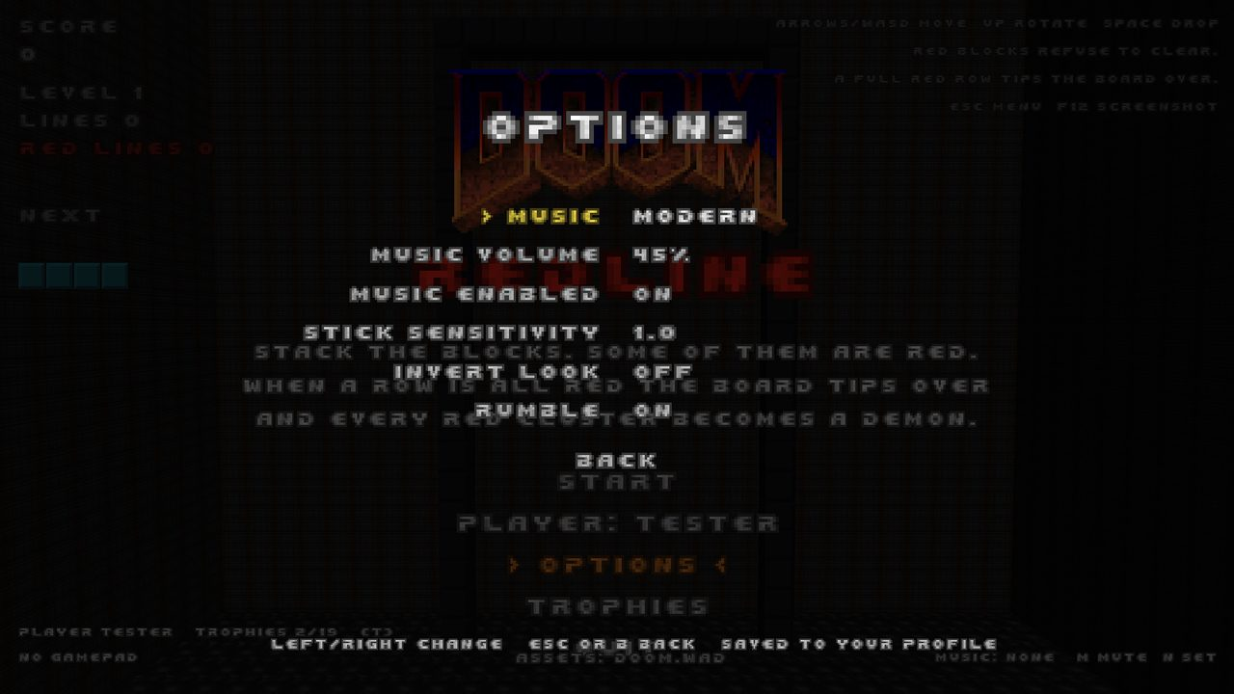




JUDGEMENT
Where the AI said no, or said “not verified”
RTX Remix
Asked for “Vulkan + RTX Remix SDK”. Explained that Remix is a Windows D3D9 runtime, built Vulkan natively, and shaped the renderer so a Remix backend is a drop-in later.
Controller support
Implemented against SDL3's gamepad API, but no pad was attached. The report says so plainly instead of claiming it was tested.
Things it cannot do
Installing a soundfont needs sudo. It gave the one-line command and built the no-dependency route so music worked immediately anyway.
Options screen: music sets, controller settings, display modes, all persisted per player or per machine.
Design calls
Interpretations that changed gameplay (tipping the board, what “surround” means) were stated as assumptions and revised when the user clarified.
REDLINE · built with Claude Code · 14
Notes:
Trust comes from the AI distinguishing what it did, what it verified, and what it could not. Engineers should expect and demand that distinction.

Slide 15
WHAT GOT BUILT
Architecture and where the lines went
core
Rules engine, image and PNG helpers. No dependencies.
wad
Doom WAD reader: patches, sprites, textures, fonts, DMX sounds.
render
Vulkan 1.3 context, atlas packer, instanced renderer.
audio
SDL3 mixer, MUS sequencer, GENMIDI, OPL3 emulator, Ogg streaming.
game
Assets, FPS simulation, app state machine, HUD, profiles, trophies.
REDLINE · built with Claude Code · 15
Notes:
Layering kept the AI's changes local: gameplay rules never touched the renderer, and the audio stack was added without changing the game loop.

Slide 16




TAKEAWAYS
What to copy into your own AI-assisted work
Write the contract down
Tests are the memory
Give the program ways to prove itself
Interfaces, formats and edge cases in prose before code. It is what makes delegation and review possible.
Every rule the user cares about becomes a check. Corrections become tests first.
Scenarios, bots, screenshot flags, dumps. If the AI can't observe it, it can't verify it.
Small commits, real messages
Demand the honesty line
Keep the human on design
Each increment playable; the history reads as the story of the design.
Done, verified, and unverified are three different words. Insist on all three.
The AI proposed mechanics; the user decided what felt right and said so in one sentence.
REDLINE · built with Claude Code · 16
Notes:
Close on the practices, not the game. These six habits are what made the afternoon productive and what will transfer to real product work.

Slide 17
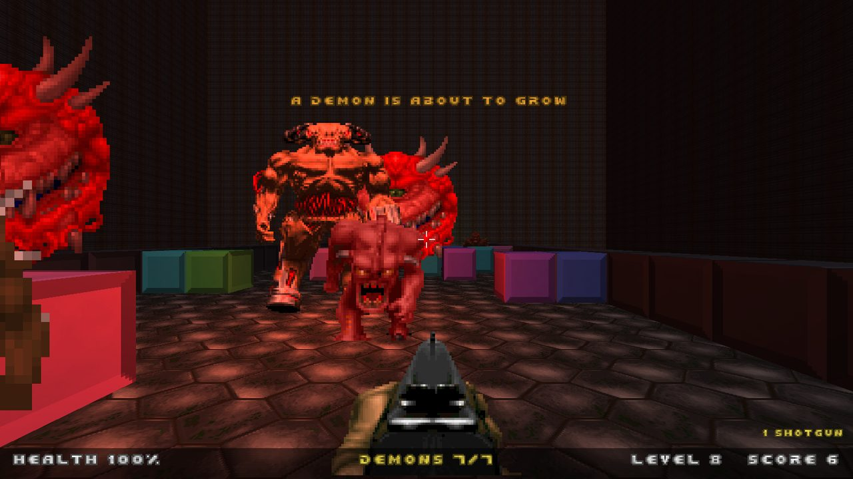
Try it
cd "/home/davidj/Claude Data/redline" && cmake -S . -B build -G Ninja && ninja -C build && ./build/redline
Needs: Arch/CachyOS packages cmake, ninja, gcc, vulkan-headers, shaderc, sdl3, glm, and a Doom IWAD (found automatically from Steam). Full docs in README.md and docs/design.md.
Next on the list: ray-query shadows on the Vulkan path, and the RTX Remix backend on Windows, both already scoped in docs/remix.md.
Questions? Ask the AI to walk you through any commit: the history is the documentation.
Notes:
End with the invitation: clone it, run it, read the git log. Every design decision is a commit message with a test next to it.

