Slide 1
$${\text{x}}_{\text{1}}$$
$${\text{x}}_{\text{2}}$$$$\text{⋮}$$
$${\text{x}}_{\text{n}}$$
$$f$$
$${\text{f}}_{\text{1}}\text{(}\text{x}\text{)}$$
$$\text{⋮}$$
$${\text{f}}_{\text{m}}\text{(}\text{x}\text{)}$$
Vektor
Vektor
$${\text{x}}_{\text{1}}$$
$${\text{x}}_{\text{2}}$$$$\text{⋮}$$
$${\text{x}}_{\text{n}}$$
$$f$$
$$\text{f}\text{(}\text{x}\text{)}$$
Vektor
Reelle Zahl

Slide 2
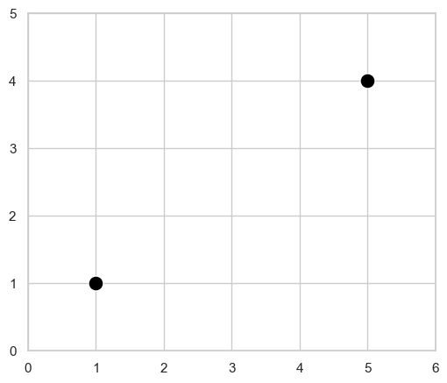

Slide 3
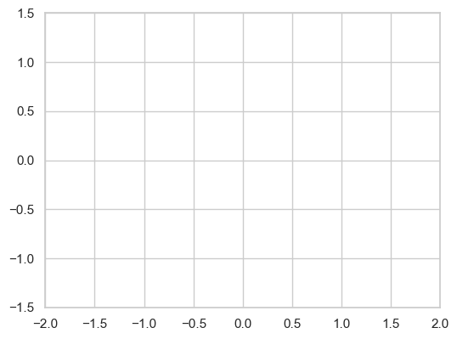

Slide 4
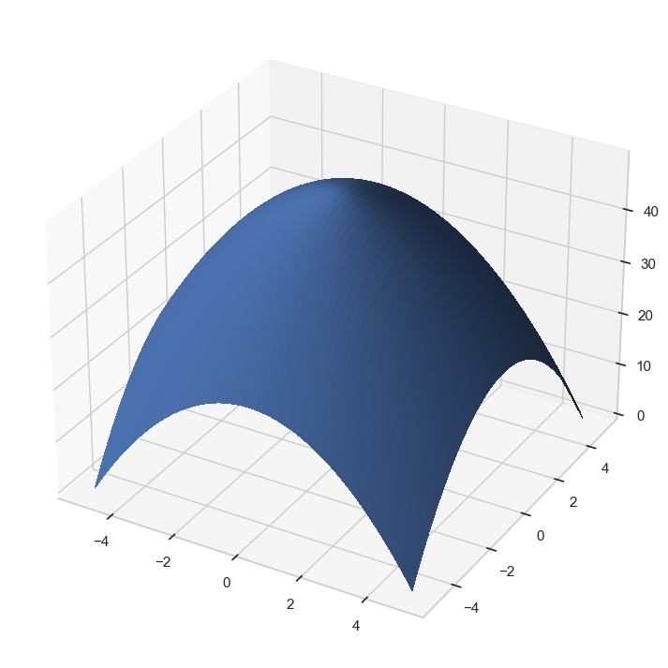
$$x_{0}$$

Slide 5
$$x_{0}$$

Slide 6
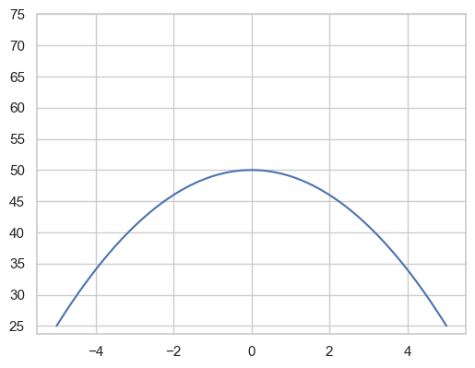
$$x_{0}$$

Slide 7
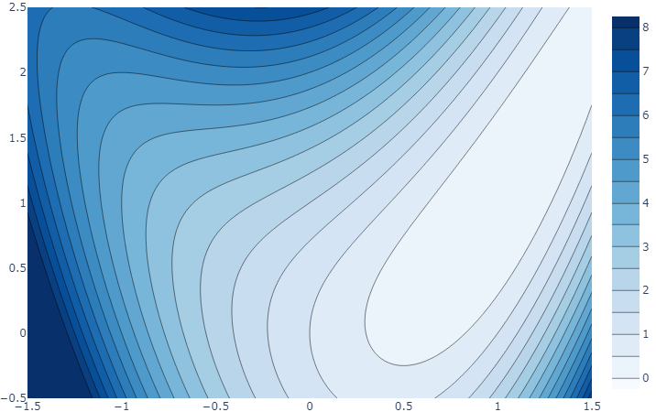
$$\frac{∂f}{∂x_{1}}(x_{0})$$
$$∇f(x_{0})$$
$$\frac{∂f}{∂x_{2}}(x_{0})$$
$$a$$
$$x_{0}$$

Slide 8
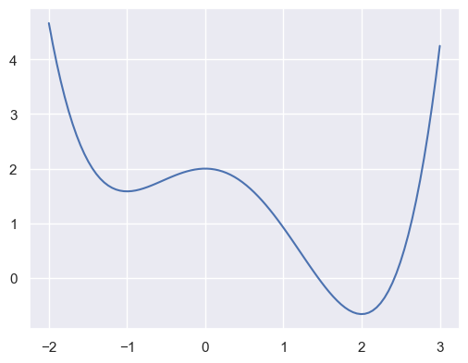
Lokales Maximum
Globales Minimum
Lokales Minimum

Slide 9
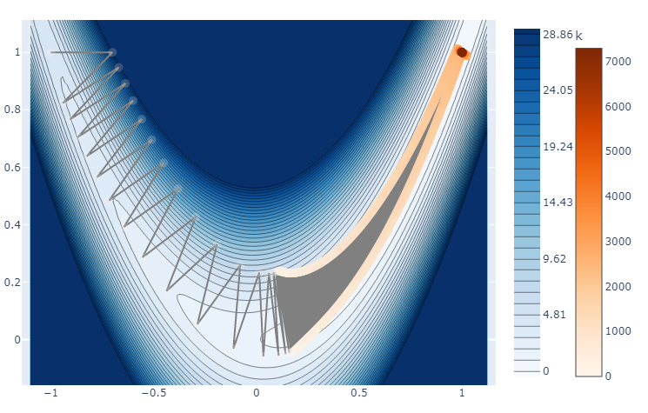
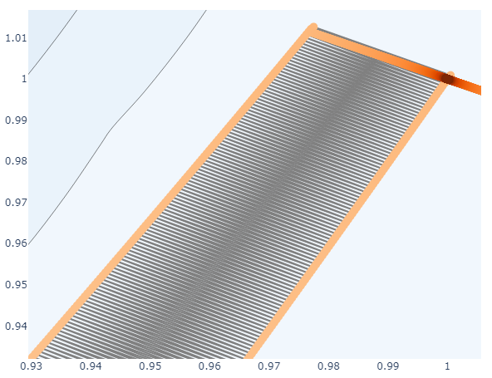
Richtung des steilsten Abstiegs
Tal des besten Abstiegs

Slide 10
$$10$$
$$9$$
$$8$$
$$7$$
$$6$$
$$5$$
$$4$$
$$3$$
$$2$$
$$1$$
$$0$$
Begrenzung Nachfrage Produkt B
$$x_{2}$$
Begrenzung Nachfrage Produkt C
Begrenzung Nachfrage Produkt A
$$1 2 3 4 5 6 7 8 9 10$$
$$x_{1}$$

Slide 11

$$10$$
$$9$$
$$8$$
$$7$$
$$6$$
$$5$$
$$4$$
$$3$$
$$2$$
$$1$$
$$0$$
Begrenzung Nachfrage Produkt B
$$x_{2}$$
Begrenzung Nachfrage Produkt C
Höhenlinie von $$f$$
Optimallösung
Begrenzung Nachfrage Produkt A
Optimierungs-richtung
$$1 2 3 4 5 6 7 8 9 10$$
$$x_{1}$$
Notes:
sdsdsdds

Slide 12
$$\min{\max{\begin{aligned}\{s_{1}+d_{1} \\ \begin{aligned} s_{2}+d_{2}, \\ \begin{aligned} s_{3}+d_{3}, \\ s_{4}+d_{4}\}\end{aligned}\end{aligned}\end{aligned}}}$$
$$d_{1}$$
$$s_{1}$$
$$d_{2}$$
$$s_{2}$$
$$d_{3}$$
$$s_{3}$$
$$d_{4}$$
$$s_{4}$$

Slide 13
$$\min{\min{\begin{aligned}\{s_{1} \\ \begin{aligned} s_{2}, \\ \begin{aligned} s_{3}, \\ s_{4}\}\end{aligned}\end{aligned}\end{aligned}}}$$
$$d_{1}$$
$$s_{1}$$
$$d_{2}$$
$$s_{2}$$
$$d_{3}$$
$$s_{3}$$
$$d_{4}$$
$$s_{4}$$

Slide 14
$$2$$
$$2$$
$$2$$
$$3$$
$$3$$
$$…$$
$$B=4$$

Slide 15
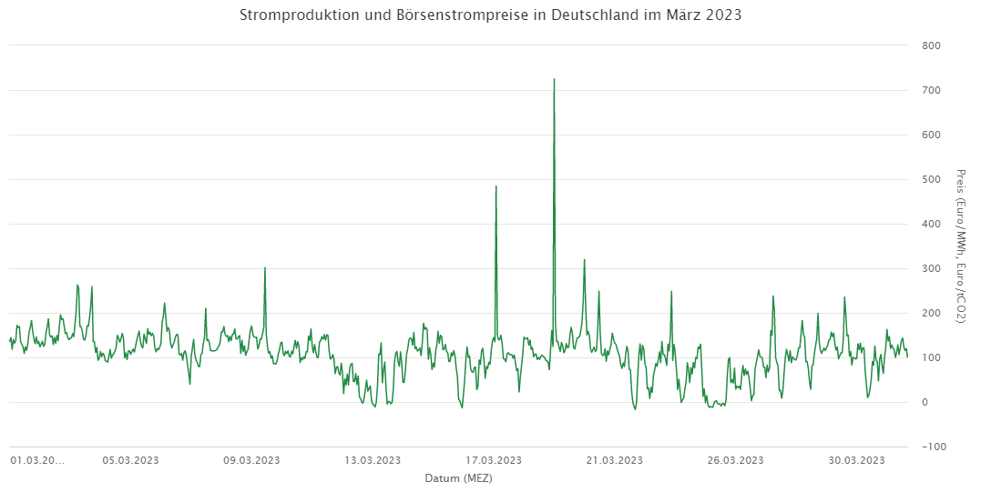
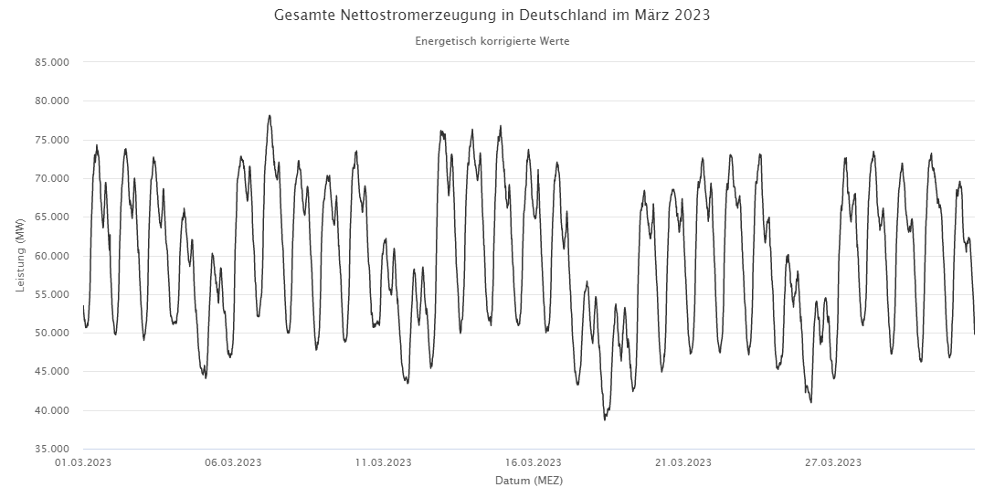



Strompreis $$p_{t}$$
Bedarf $$d_{t}$$
Stromspeicherstand
?
$$s_{t}^{+}$$
$$k_{t}$$
$$s_{t}^{−}$$

Slide 16
Stunde | $$0$$ | $$1$$ | $$2$$ | $$3$$ | $$4$$ | $$5$$ | $$…$$
Preis |  | $$p_{1}$$ | $$p_{2}$$ | $$p_{3}$$ | $$p_{4}$$ | $$p_{5}$$ | $$…$$
Verbrauch |  | $$d_{1}$$ | $$d_{2}$$ | $$d_{3}$$ | $$d_{4}$$ | $$d_{5}$$ | $$…$$
Speicherstand | $$s_{0}$$ | $$s_{1}$$ | $$s_{2}$$ | $$s_{3}$$ | $$s_{4}$$ | $$s_{5}$$ | $$…$$
Einspeicherung |  | $$s_{1}^{+}$$ | $$s_{2}^{+}$$ | $$s_{3}^{+}$$ | $$s_{4}^{+}$$ | $$s_{5}^{+}$$ | $$…$$
Ausspeicherung |  | $$s_{1}^{−}$$ | $$s_{2}^{−}$$ | $$s_{3}^{−}$$ | $$s_{4}^{−}$$ | $$s_{5}^{−}$$ | $$…$$
Strombezug |  | $$k_{1}$$ | $$k_{2}$$ | $$k_{3}$$ | $$k_{4}$$ | $$k_{5}$$ | $$…$$
$$+$$
$$+$$
$$+$$
$$+$$
$$+$$
$$−$$
$$+$$
$$−$$
$$+$$
$$−$$
$$+$$
$$−$$
$$+$$
$$−$$
$$+$$
$$+$$
$$−$$
$$+$$
$$−$$
$$+$$
$$−$$
$$+$$
$$−$$
$$+$$
$$−$$
$$+$$
$$+$$
$$+$$
$$+$$
$$+$$
Für jede Stunde $$t$$:
Speicherstand Vorstunde + Einspeicherung – Ausspeicherung = Speicherstand aktuelle Stunde
$$s_{t−1} + s_{t}^{+} − s_{t}^{−} = s_{t}$$
Strombezug – Einspeicherung + Ausspeicherung = Bedarf
$$k_{t} − s_{t}^{+} + s_{t}^{−} = d_{t}$$

Slide 17
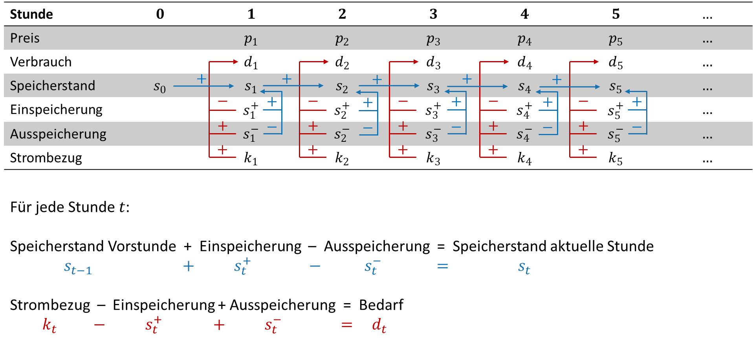

Slide 18
a
a
a
b
c
b
c
b
c
d
e
d
e
d
e

Slide 19
$$x$$
$$f\left(x\right)=x²$$
$$g\left(y\right)=\cos{y}$$
$$x$$
$$y=f(x)$$
$$g(f\left(x\right))=\cos{x²}$$

Slide 20
$$h\left(y\right)=\sin{y}$$
$$x$$
$$y=g(x)$$
$$v=\sin{y}$$
$$g\left(x\right)=x²$$
$$k\left(v, w\right)=v+w$$
$$x$$
$$f\left(x\right)=\sin{x²}+\cos{x²}$$
$$z=g(x)$$
$$i\left(z\right)$$
$$=\cos{z}$$
$$w=\cos{z}$$

Slide 21
$$x$$
$$x^{2}$$
$$x⁴$$
$$x^{8}$$
$$x^{16}$$
$$x$$
$$x^{32}$$
$$x$$
$$x^{2}$$
$$x⁴$$
$$x^{8}$$
$$x^{16}$$

Slide 22
$$x_{3}=\sin{x_{2}}$$
$${\overline{x}}_{3}=?$$
$$x_{1}=x$$
$${\overline{x}}_{1}=?$$
$$x_{2} =x_{1}^{2}$$
$${\overline{x}}_{2}=?$$
$$x_{5}=x_{3}+x_{4}$$
$${\overline{x}}_{5}=?$$
$$f(x)=\sin{x²}+\cos{x²}$$
$$x_{4}=\cos{x_{2}}$$
$${\overline{x}}_{4}=?$$

Slide 23
Nachfrage $$e_{t}$$
Geöffnet
Geschlossen
01.01.
?
?
31.12.

Slide 24
$$x_{1}$$
$${\overline{x}}_{1}=?$$
$$x_{3} =x_{1}x_{2}$$
$${\overline{x}}_{3}=?$$
$$x_{4}=\exp{x_{3}}$$
$${\overline{x}}_{4}=?$$
$$x_{5}=\frac{x_{4}}{x_{2}}$$
$${\overline{x}}_{5}=?$$
$$f(x_{1,}x_{2})=\frac{\exp{x_{1}x_{2}}}{x_{2}}$$
$$x_{2}$$
$${\overline{x}}_{2}=?$$

Slide 25
$$x_{2} =Hx_{1}$$
$${\overline{x}}_{2}=?$$
$$x_{1}$$
$${\overline{x}}_{1}=?$$
$$x_{3}={x_{1}}^{T}x_{2}$$
$${\overline{x}}_{3}=?$$
$$f(x)=x^{T}Hx$$

