Slide 1
Enhancing the Effectiveness of Software Test Automation
By
David W. Jansing
Notes:
The title of this thesis is Enhancing the Effectivenes of Software Test Automation. This is a subject that is not often covered in computer science courses, and most people (including me) learn it on the job. Without formal training, one can easily learn bad habits, usually amounting to not following the usual software development procedures when creating automated test scripts. For example, in my first assignment, the test scripts were not placed under version control, so anyone with the proper permissions can edit the scripts, sometimes leading to disaster. One of the goals of my work is to formalize what I would consider good practices regarding test automation.

Slide 2
Introduction
Member SUNYIT Class of 1998
Most recent testing assignment – test automation in Java at BAE Systems.
Notes:
As many of you may remember, I earned my BS in computer science in December 1998 here at the Institute. I was involved in student government, and often brought my son with me to the Campus Center to play fussball and video games, and take in the occasional movie at the Cat’s Den. He hopes to have his MSCS by the end of next year. I can’t wait.
After graduation, I went to work at what became part of BAE Systems at Griffis Business and Technology Park in Rome., Although I have also done quite a bit of work working with bug reports and implementing fixes, the role in which I was most often placed was in system testing. Since I appear to be most valued at BAE for my work in testing and test automation, it follows that my experiences would make a good subject for a master’s thesis.
*That is, up until around 9 October. After that, I took a job as a Java Solution Developer at Pomeroy out of Hebron, Kentucky. I do not expect to do very much work on a system test team in my new position.

Slide 3
Contents
Research based on existing literature
Personal observations
Practical exercises
Notes:
My thesis is based on a survey of the existing literature – academic papers, white papers from the industry, and some of the books written on the subject of automated testing and testing in general. My take on most of this body of work is that much of it is repetitive and doesn’t break very much new ground. It is also often based on observations, personal interviews, and such.
I have also included my own personal observations that I have made over the years drawing on my considerable experience in software testing. These augment and support what I have gleaned through my research effort. One such observation is that automation is not universally trusted, mainly because it’s not hands-on. One thing that the professional literature says about this is that the utility of automated testing and its place in software development processes are often misunderstood throughout the industry.
Finally, there are some demonstrations of automated tests done by means of third-party tools as well as those I have written from scratch in Java. These closely track similar work that I have done in the past. Since they were done from scratch, I had an opportunity to develop them the way I thought they ought to be developed.

Slide 4
Why not automate?
Not every organization believes that test automation pays off.
Mentality that tests that aren’t “hands-on” can’t possibly be valid.
Testing the tests.
Notes:
One question I have always wondered about is, why would an organization not take advantage of test automation?
For one thing, it’s can be expensive, at least at first. If tools are used, those will likely need licenses. Otherwise, you have to pay engineers to develop the test scripts, methods, JAR files, or whatever executables. This requires design and the whole gamut of software development processes about which some members of the test team may not be familiar, so it will also require training.
There appears to be a mentality at some organizations that tests that run without user supervision don’t really test anything, that somehow the person using the automated test suites isn’t doing his or her job when the reality is that test automation is adding to and facilitating the other testing that is typically done.
We know how the actual software product has been tested, but one common question that remains is “how are the tests tested?” The answer is, of course, that at some point, the automated tests have to be verified manually.

Slide 5
Why Automate Testing?
Accuracy
Expense reduction over hand testing
Productivity
Coverage
Notes:
Computer programs are deterministic things, and automating testing ensures that the tests are executed the same way every time.
Automated tests run, ideally, with no user supervision. Thus, they can run overnight when no one is working or using the company’s computing resources. We had an expression about this – “keeping the building warm.“ If everything goes well, all that remains when I return in the morning is to generate a report on the previous night’s testing that will hopefully be short. Since no one is sitting behind a terminal doing these tasks by hand, the test team is free to perform tasks that are best done by live humans, like testing a specific bug fix included in the latest build, or troubleshooting a problem brought to us by a customer. Or writing new tests for the test suite. However, even when I am doing testing “by hand,” some automated processes are still helpful in supporting my manual testing activities. For example, system setup and generation of test data are tasks that are best automated.
An automated test suite can execute far faster and do more tests than a human can, thus increasing productivity. For example, the project in which I am currently working has a requirement that the install script not assume anything at all about the setup, and leave nearly the entire configuration for afterwards. This makes setting up the new build for testing a tedious, error-prone affair that can take hours. The same setup, assuming that my test environment has not changed since the previous build, takes a few seconds using an automation script.
(possible FAQ: Why? A: Partly due to security concerns – some configuration items are classified. Other parts require possibly different setups for different types of files to be processed.)
Finally, like the productivity argument, since automated tests can do more than a room full of testers, automated tests can run more times on more data, which means more scenarios can be run, possibly finding problems that were unanticipated during development, providing greater “coverage” than would otherwise be possible while still meeting deadlines. For example, the various test configuration items for the desired data to be used in subsequent test runs can be kept in an XML or CSV table.

Slide 6
Types of Test Strategies
Defect prevention strategies
Test Driven Development
Defect detection strategies
Waterfall
Testability
Notes:
Testing strategies can usually be placed in two groups:
The first is a defect prevention strategy is one that “provides the greatest cost and schedule savings over the course of a project because they are employed from the outset of a software project and therefore tend to find defects earlier, when they can be more easily resolved.” This is a goal of the test-driven development strategy of most Agile development processes.
A defect detection strategy, on the other hand, supplements prevention strategies, and are implemented after a runnable software product has been produced.
IEEE’s definition of testability:
The degree to which a system or component facilitates the establishment of test criteria and the performance of tests to determine whether those criteria have been met.
The degree to which a requirement is stated in terms that permit establishment of test criteria and performance of tests to determine whether those criteria have been met.
What this means is that given an initial system state and set of inputs, the outputs of the tests are predictable and repeatable. When it is not possible to guarantee this, such as when developing a video game, automated testing is likely not to be possible.

Slide 7
Good candidates for automation
Not every kind of test is a good candidate for automation. Ex. Bug fixes
Most commonly automated test types
Unit tests – tests of programming logic.
Regression tests – accumulated tests of existing functionality.
Notes:
One common mistake made by test leads is assuming that everything can be automated, where this is not really the case. Manual and automated testing are actually very different. You wouldn’t, for example, waste time automating a test for most bug fixes. Insisting that the test for every bug fix be added to the automated test suite would not provide very much value for the effort. The bugs probably were not discovered by your regression tests, so the tests for the fixes probably shouldn’t be added to them because the bug report represents a problem that was only evident under a very specific set of circumstances.
Two types of tests are particularly good candidates.
Unit tests, which are generally run by the developer prior to turning in a piece of work, and are usually written, at least in part, prior to the actual code. Netbeans generates unit tests for each method, with the specifics to be filled in by the developer. Assertions indicate the expected outputs of the test. Tests can be repeated on lists of data to check things like boundary conditions.
Regression tests, usually outlined in the test plan, which are run to ensure that existing functionality still works. Initially, these are run by hand, but later automated. The automated tests accumulate over time. Performing these tests overnight using automation saves money, increases productivity, and frees testers to perform other tests during the workday.
Not good candidates for automation: most bug fixes (one-off testing), tests done near the end of lifecycle, those that cannot be broken down to relatively simple sub-tasks, or those with outputs that are nondeterministic, such as video games.

Slide 8
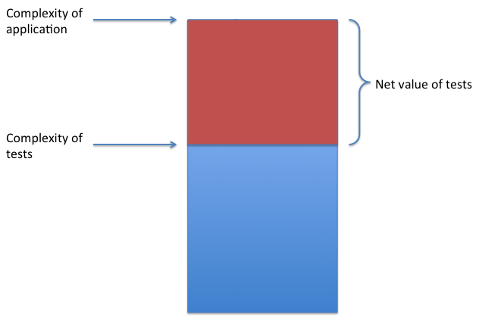
Prioritizing testing
Basic testing first, then more detailed testing. Answers the question – “Is the main battery of tests likely to pass?”
Notes:
I have a short suite of smoke tests that I run before the main battery of tests that verifies that the install went well and that the software works at least on the basic level. If anything in this suite fails, there is little point in continuing and I can raise the red flag right away (or fix my installation), not the next day when all 90-odd tests have failed due to the same issue. For this reason, I like to start testing around 2:30 or 3:00 in the afternoon, so I can watch the first few tests pass or fail before leaving them to run on their own.
It is important to note that not every test can be automated. This is because automated testing and manual testing are two different processes. Much of manual testing involves activities that are done once or just a few times. It would make little sense to automated those tasks.

Slide 9
Making automation work
Tests should be simple (counter-example: Prodigy’s “Gremlin” project)
Tests should be maintainable
Tests should be well-documented
Test components should be reusable
Notes:
Chapter 4 describes a failed attempt at automation by Prodigy, an online service we older people might be familiar with that predates the commercial Internet. In the beginning, developers were intrigued by the automated tests, but ultimately found that they were too complex and required too much setup to be of practical use, so it eventually became “shelfware.” In my experience, tools were developed and run by one or two developers who could make them work well, but when they left the team, they fell into disuse.
I was the inheritor of one such effort. It took me three months to get the suite running again after it had sat for a year. It still didn’t live up to expectations, and did not survive my being reassigned myself. Actually, other developers would ask me about the autotest effort from time to time; apparently, since there were considerable sunk costs in terms of man-hours, management found it difficult to just let it go. I would refer them to the README I had written describing my effort at resuscitating this set of suites, but it ended up raising more questions than it answered.
This system violated the first three rules stated on this slide. They were excessively elaborate in design, they were far from maintainable as a result, and I was provided with practically no documentation when I took the project over.
In general, the best tests are simple, that is, they test just one thing. They are designed to the same standards as the rest of the software, which means they are maintainable, well-documented, and are comprised of many reusable components. (but I don’t need to tell you all that)

Slide 10
Commercial testing tools
Capture/replay – most common type of tool.
QF-Test
T-Plan Robot
Quick Test Pro
Notes:
This concludes the discussion of the existing literature. The following slides will focus on some testing tools I explored, some of which I have used in the past, and others that I have learned about during my research.
Most commercial test tools operate by means of capture/replay. A record button on the test IDE is clicked, then the software under test is put through its paces. The tool records mouse clicks and keyboard input and assembles that into a script. When you’re done, you click the STOP button, and a script is generated that can be rerun over and over. This script is then further refined and optimized, depending upon the programming skill of the user. Many commercial testing tools use their own proprietary “language” for these scripts, which make them more difficult for a non-programmer to use to their maximum effectiveness.
I used two commercially available test tools for my practical exercises. The first of QF-Test, which we use at BAE Systems for regression testing. This tool tracks the various objects in the GUI. This comes in handy should the locations of the GUI elements move from build to build, so long as they haven’t been renamed (and we don’t do that very often, right?). A single-user license costs about $2300, but I was able to get a 30-day temporary license for evaluation purposes. Knowing what I wanted it for, the sales reps at QF-Test were even willing to grant an extension, should that be needed.
The other tool I tried that works well is called Robot. This is a much simpler tool than the others (at least the free version is). Instead of tracking GUI objects, it is mainly concerned with the location of the mouse as it is being clicked, wherever in the GUI that might be. Verification of test success is done by comparing screenshots against one depicting a run that previously determined to be good. The version I used was free, but not as full-featured as the commercial version.
I did not test Quick Test Pro. This is supposedly the most commonly used tool, but it is quite expensive. It is also more difficult to recoup costs in terms of productivity, since pricing is scaled according to how much it is used and the scale of the project.

Slide 11
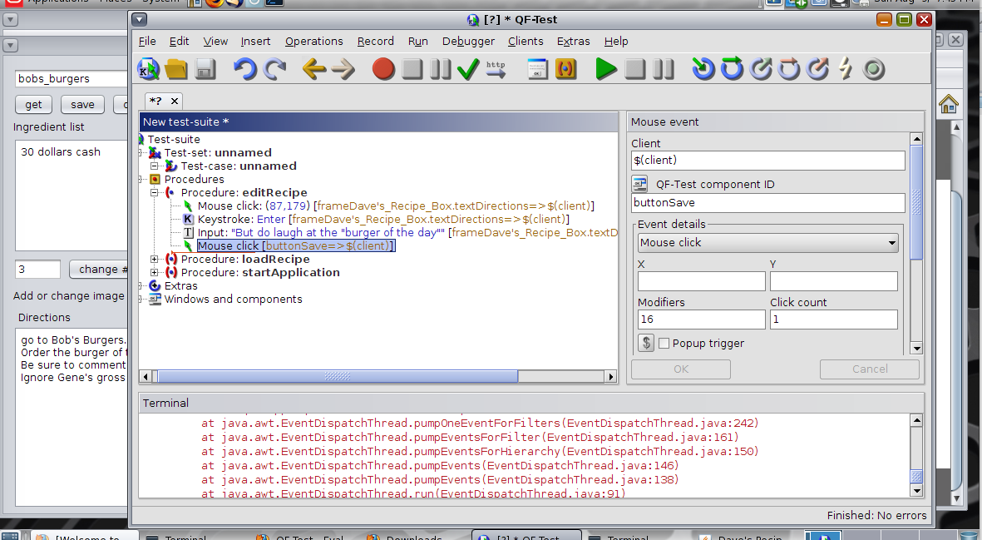
QF-Test
Notes:
QF-Test is a considerably more robust testing system than Robot. The reason I say this is that instead of sending the mouse to a particular screen location, although you can do that, QF-Test keeps track of your Java or Web objects. A command here might go something like, “click the Get Recipe button.” You see RecipeBox running in a VNC window behind the QF-Test window while I’m working with a representation of the test script that contains just the test steps. The actual test script is a rather large file that resembles XML and is harder to work with.
Again, I am running this in a Solaris 11 VM because to my knowledge, there is no version of QF-Test that is compatible with Mac OS X.

Slide 12
QF-Test generated test step
<ComponentStep class="Button" classcount="14” classindex="12” feature="change # of servings” height="27” id="buttonChange___of_servings” uid="_M" width="161” x="83" y="267">
<extrafeature name="qfs:class" negate="false" regexp="false” state="0">javax.swing.Jbutton
</extrafeature>
<extrafeature name="qfs:genericclass" negate="false" regexp="false” state="0">Button</extrafeature>
<extrafeature name="qfs:label" negate="false" regexp="false” state="1">change # of servings</ extrafeature>
<extrafeature name="qfs:systemclass" negate="false" regexp="false” state="0”>javax.swing.Jbutton
</extrafeature>
</ComponentStep>
Notes:
This code represents one test step in the code generated by QF-Test. You can pretty much tell what it does – change the “servings” quantity in my sample program (RecipeBox), although you would have to be somewhat familiar with XML. No way would you attempt to write one of these from scratch; fortunately the IDE is there to handle this for you. The test steps shown in the previous slide (click back to it) are a lot easier to deal with than this.

Slide 13
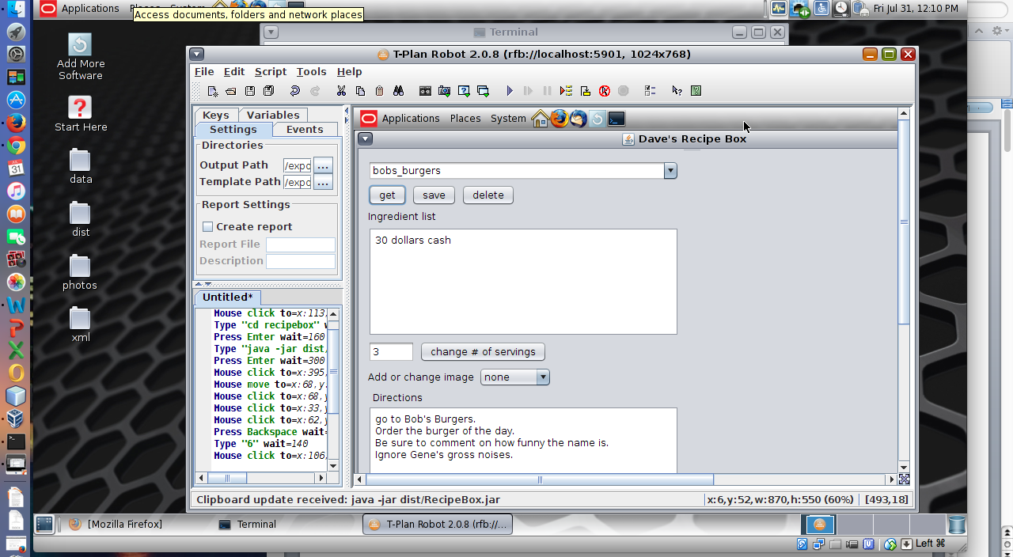
Robot
Notes:
This is a screenshot I took while running T-Plan Robot on a small application I wrote called RecipeBox. I won’t go into too much detail about RecipeBox because its purpose was solely to provide a system to test. As you can see on the left, the test script is shown, which consists of a series of commands such as “move the mouse to screen position 340,120 and click.” The user interface is shown at the right. As long as the interface doesn’t change very much from build to build, the script shouldn’t have much problem finding anything. In fact, the test software doesn’t even know what the interface looks like – verification of test success or failure is accomplished by comparing screenshots against known good output. To keep from generating too many false failures, a tolerance level can be set by the tester, for example, that 90% of the pixels should match.
The test scripts can also be converted to Java code in order to make tests that do more than is possible with the native script language.
This and the other third-party test tool I chose for the demonstrations use Virtual Network Computing (VNC). Because my MacBook doesn’t like to play nice with the version of VNC used by the test tools, and because of other compatibility issues, I am also using Oracle VirtualBox to set up testing environments in different operating systems. This is Solaris 11 you see here.

Slide 14
Robot-generated test script
Mouse move to=x:113,y:239 wait=100
Mouse click to=x:113,y:239 wait=100 Type "cd recipebox" wait=100 Press Enter wait=100 Type "java -jar dist/RecipeBox.jar" wait=100 Press Enter wait=300 Mouse click to=x:395,y:83 wait=100 Mouse move to=x:68,y:139 wait=100 Mouse click to=x:68,y:139 wait=100 Mouse click to=x:33,y:110 wait=100 Mouse click to=x:62,y:308 wait=100 Press Backspace wait=100 Type "6" wait=100 Mouse click to=x:106,y:314 wait=100
Notes:
As you can see here, the scripts generated by Robot are fairly straightforward. Unlike the QF-Test snippet from two slides back, this is the entire test. While it appears to be simple, you really can’t tell what the script does by looking at it once the command-line tasks are finished. It is likely that a change to the software might require re-recording the entire test.

Slide 15
Open source test tools
Selenium – a browser plug-in used for testing web applications.
JUnit – a Java package for unit testing.
assertions
matchers
TestNG – extends JUnit with more funtionality.
Notes:
The more popular open-source testing tools facilitate Agile requirements for test-driven development, mainly that the tests are written before the actual code. That doesn’t make a lot of sense for someone who has never worked in an Agile environment, but these kind of tests exercise the methods, functions, procedures, or whatever your language calls them, rather than the sort of functionality an end-user might be concerned with. For example, given input x, does the method return y? If so, your unit test is successful.
Selenium was mentioned in much of the literature; it is a popular tool for testing Web applications, which I found to be very easy to use, even though I had never used it before. I was able to begin writing scripts on the webpage I chose (Google’s homepage) in a few minutes with minimum tutoring. It is installed as a browser plug-in, and can be used to record black-box tests for anything found on the Internet, whether your organization owns it or not.
Junit is included in Netbeans, and is commonly used for unit testing, but I also used it in the homegrown test packages I wrote against my user requirements. The most commonly used feature of Junit is the assertion, by which test outputs can be verified.
Closely related to assertions are matchers, which take the form assertThat([value], [matcher statement]), where value is the output from the test, and the matcher statement is some expected value or condition.
TestNG is also included in NetBeans, and is similar to JUnit with some new features. For example, there is wider use of annotations than in JUnit. In addition to @BeforeClass and @AfterClass, which designate methods to run before and after the set of tests, respectively, TestNG also has @BeforeSuite and @AfterSuite, @BeforeTest and @AfterTest, and @BeforeGroup and @AfterGroup, which set methods to run before or after suites, individual tests, or groups of tests.

Slide 16
Homegrown test suites
Use of commonly available programming languages to create custom test scripts.
Perl, csh, bash, etc.
Java, C++, etc.
Notes:
I have been involved in this sort of project for a long time. If the SUT can be run from the command line, Perl or something similar is perfectly fine for creating automated scripts. Expect is useful in the case where user input is required, such as with on-screen menus. Since Robot only cares about screenshots, there is nothing keeping one from using it to test a command-line program.
In my latest real-world project, I used Java to create a more elaborate set of test suites than would likely be possible with one of the Unix/Linux scripting languages. In chapter 7 of the thesis, I demonstrated how to exercise a Swing interface using a non-graphical Java command-line executable. My preferred method involves including accessor methods to use the various objects in the GUI (which Netbeans creates as private members) without actually displaying it.

Slide 17
Basic test structure
Test UI
Test utilities
Test main
Test suite 1
Test suite 2
Test suite 3
Test suite n
Notes:
If I had to design a set of test suites from scratch for a new project, this is approximately what it would look like.
There would be a user interface, which would be upgraded to a graphic interface (if time/resources permit) to make things easier for the tester, who might not be comfortable with the command line. This would allow a tester to pick and choose which tests to run.
This list would be passed to TestMain, which would then run each test suite in turn and report the results back to the UI.
The test suites themselves would do one and only one test. This makes the test suites more maintainable, and less likely to be considered “too complicated to work.” Each test suite would be responsible for its own setup and tear down, so as to be able to run independently and not interfere with subsequent testing.
Common functions would be accumulated into a TestUtilities package for easier maintenance, possibly subdivided into separate classes based on function.

Slide 18
Sample Java test
1 public void testSetServings()
2 {
3 rb.recipeList.setSelectedItem("bobs_burgers");
4 rb.getRecipeButton.doClick();
5 assertEquals("bobs_burgers",
6 rb.recipeList.getSelectedItem());
7 rb.servingsBox.setText("6");
8 rb.servingsButton.doClick();
9 assertEquals("60.00 dollars cash\n",
10 rb.ingredientListBox.getText());
11 }
Notes:
In this version of the Java regression tests, the GUI elements have all been made “package private,” that is, they are available to the test code because they are in the same package as the application code. This works, but access control is compromised. The whole point of making something private is that you don’t want other programmers messing around with your code. If they want to use something in your class, they have to use the getter method.

Slide 19
Java test using accessor methods
1 public void testSetServingsWithAccessorMethods()
2 {
3 rb.getRecipeList().setSelectedItem("bobs_burgers");
4 rb.getRButton().doClick();
5 assertEquals("bobs_burgers",
6 rb.getRecipeList().getSelectedItem());
7 rb.getServingsBox().setText("6");
8 rb.getServingsButton().doClick();
9 assertEquals("60.00 dollars cash\n",
10 rb.getIngredientListBox().getText());
11 }
Notes:
Here, we have not downgraded the access level of any of the GUI elements, and they are still private. However, accessor and mutator methods were added where needed in order for the test program to do its job. For example, the code at line 4 clicks the Get Recipe button by means of the command doClick() as the other program does, but the button is accessed by the method getRButton() instead of accessed directly.
I haven’t seen developers creating accessors for GUI elements, probably because they don’t get used externally, but that doesn’t mean it can’t be done.

Slide 20
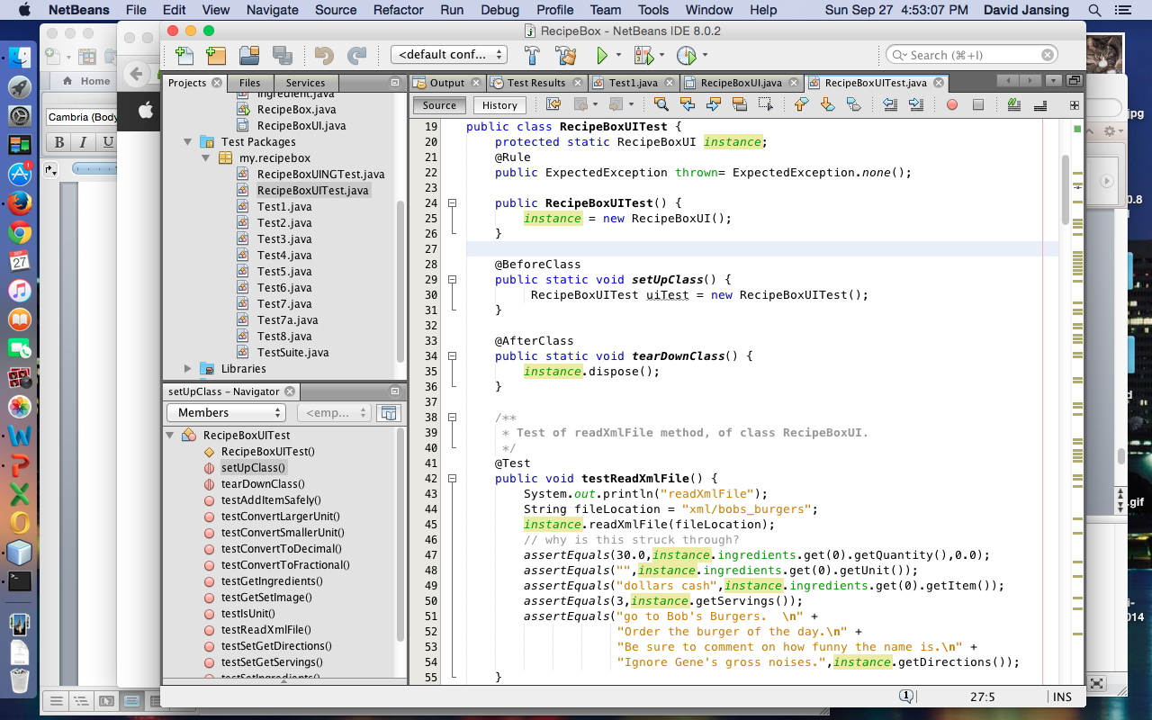
Unit testing with JUnit, TestNG
Notes:
Netbeans will generate unit tests shells on each method of the application code. It is then up to the developer to fill in the details. The easiest kind of test would be to run the method with such-and-such parameters, and assert something about the return value, all without assuming anything at all about the details of the method’s contents. Once the code is actually written, the test is immediately usable and can tell the developer whether the method works by running the test and checking to see if it passed or failed.
Here you see a screen capture where I have Netbeans running with the unit tests for RecipeBox selected. There is a constructor that instantiates the RecipeBox GUI, followed by setup and teardown methods, followed by the test methods, the first of which you see here. This method calls the method to read an XML file and set the class variables based on its contents. A number of assertions ensure that the file was read properly.
Junit and TestNG are included with most IDEs, including Netbeans and Eclipse.

Slide 21
Conclusions
Notes:
Test automation can increase both the quantity and the quality of the testing done in a software project. In particular, tests that are often repeated are good candidates for automation. Automated testing is often executed after hours, thus getting a lot of work done for almost free, that is, after the automated testing suite has been written.
There are costs associated with test automation that are often not recouped until the second major release of the software being tested. Managers need to understand that the payoff usually occurs down the road.
I have demonstrated some third party tools as well as some tests that I wrote from scratch. There is a trade-off between programming effort and the use of third-party tools versus just making your own testing framework. Third party tools can be easier to work with, but there is am up-front cost to be considered. Homegrown tools will require programming effort from your own staff and require greater skill than recording capture/replay tests. Either way, the same software engineering practices that are followed when developing the main software code should also be followed when writing test code. Which approach is best may depend on the scope of your software project.
This concludes my presentation. Does anyone have questions for me?

