Slide 1
Vignette 1
Cleaning

Slide 2
Vignette # 1:
You are a clinical researcher studying the relationship between hospitalizations and subsequent emergency department visits in a Medicaid population. Your institution's data warehouse gives you a hospitalization file — one row per claim, not one row per hospitalization.
Before you can ask any scientific question, you need to answer a more mundane one: "Do I know how many times each patient was hospitalized?" This sounds simple. It is not.
Your file has 11,500 rows and 499 unique patients.
Problem 1 — Duplicate claims: A single 5-day hospitalization generates multiple rows — one per billing day, one per diagnosis code, one per provider. You have 11,500 rows but far fewer actual visits.
Problem 2 — Overlapping stays: A patient transferred between units generates two overlapping intervals. Counting rows overestimates their hospitalization burden.
Problem 3 — Missing admit dates: 3% of rows have a null admit date. Another 1% have a null patient ID. These need to be removed — and your IRB report will ask how many and why.
Problem 4 — Implausible dates: System errors produce admit dates in 1899 or 2090. A script that silently keeps these corrupts every downstream analysis.
Problem 5 — Same-day readmissions vs. continuous stays: A patient discharged Monday and readmitted Tuesday — one stay or two? The answer depends on your research question and must be a deliberate, documented choice.
Problem 6 — Overlapping stays at different hospitals are not the same event. Patient P0023 has two overlapping records — one at Hospital A, one at Hospital B. That is a transfer, not a duplicate. A cleaner that merges all overlapping intervals regardless of hospital just destroyed a clinically meaningful distinction. The hospital is part of what defines a hospitalization episode.

Slide 3
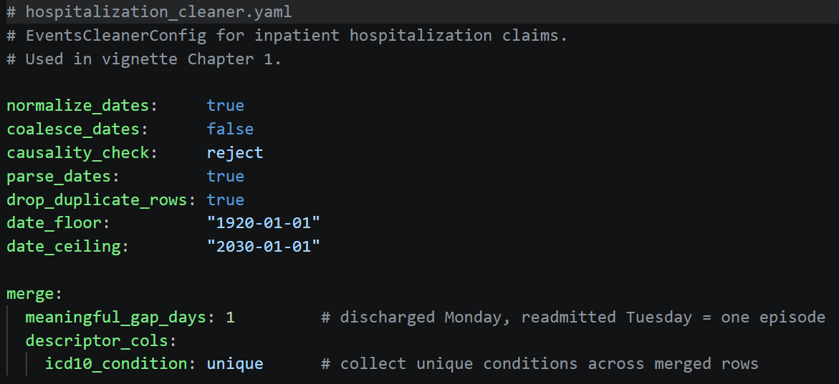
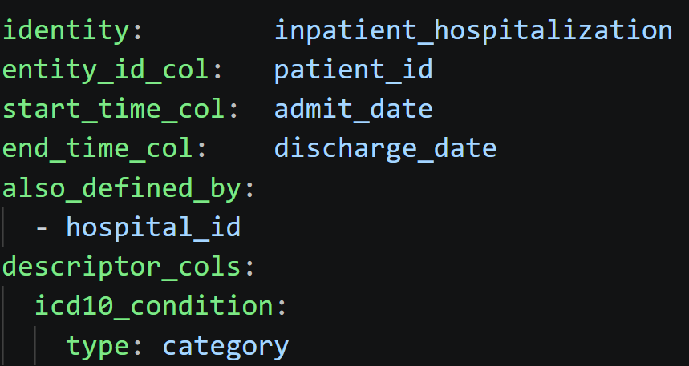
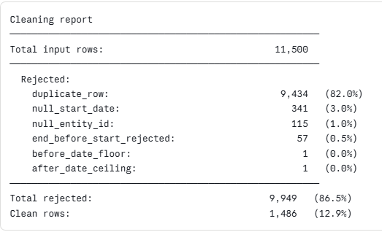
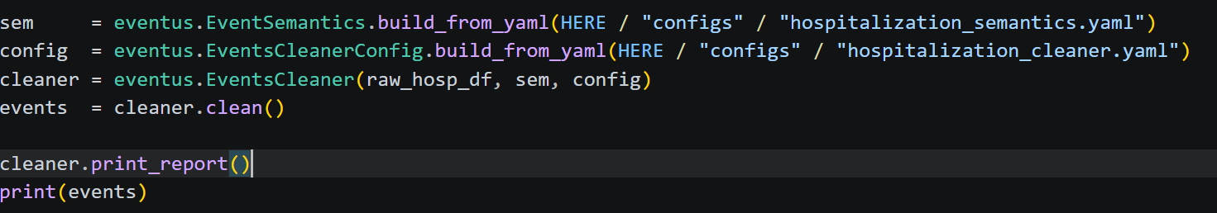
With Eventus:
Cleaner Config YAML
Semantics YAML
Report
Code

Slide 4
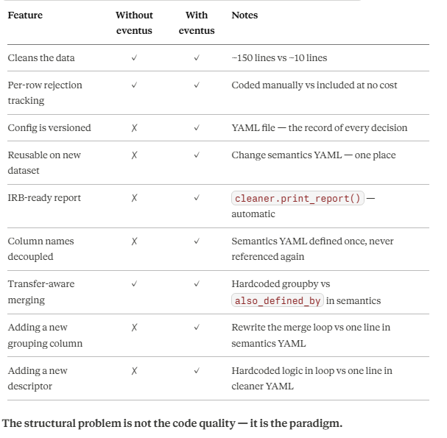
Without Eventus:
To illustrate the limitations of the script-based paradigm, we askeda large language model to implement the same cleaning pipeline. The script is atvignettes/without_eventus/clean_hospitalizations_no_eventus.py

Slide 5
Bonus
Occurrences

Slide 6
Vignette # 1 Bonus
ED visit data is simpler than hospitalization data — a patient, a date, no duration. But the same design decisions apply. An ED visit is also defined by its hospital — a patient who visits Hospital A and Hospital B on the same day had two visits, not one.

Slide 7
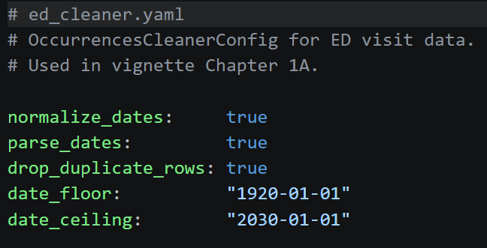
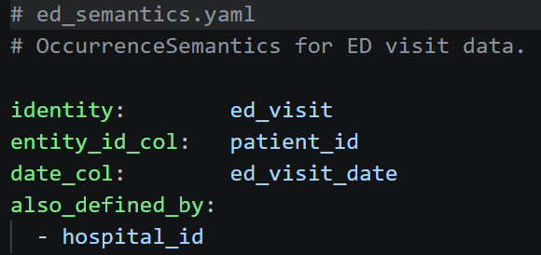
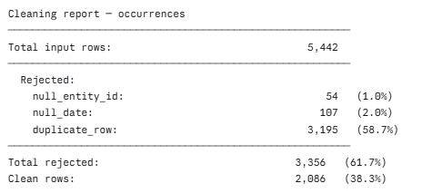
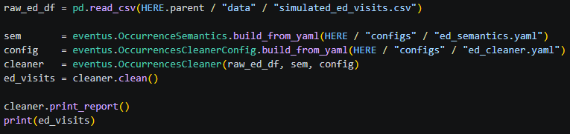
With Eventus:
Cleaner Config YAML
Semantics YAML
Report
Code

Slide 8
Architecture
Abstraction
Transparency
Reproducibility

Slide 9
Reproducibility: Configuration-friendly objects
EventSemantics
type: str
entity_id_col: str
start_time_col: str
end_time_col: str event_id_col: str|None event_type_col: str|None metadata_cols: list[str]
Constructor
__post__init()
Constructors as Class Methods
build_from_yaml(path) -> EventSemantics
Methods
__repr__() -> str
Why is the semantics abstraction needed:
A pandas DataFrame does not know what its columns mean — 'begin_date' could be a birth date, a coverage start, or a contract signing.
Semantics objects solve this once. Define them at the top of your analysis, pass them into data objects, and everything downstream just works — regardless of what your columns are named.

Slide 10
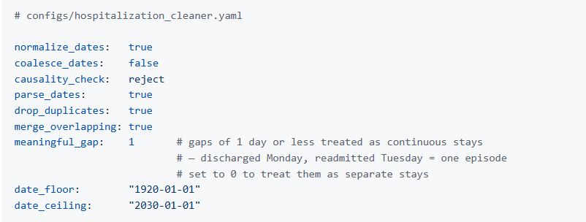
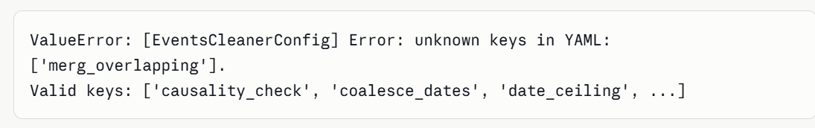
Reproducibility: Configuration-friendly objects
EventsCleanerConfig.build_from_yaml(filename)
EventsCleanerConfig object
Validates on construction that the entries in the configuration are sensical. If you write a cleaning-thing that does not exist or an option that does not exist, it throws the error.
Once again, declarative construction acts both as configuration and documentation"
Examples of raised errors:
*** Lets make this snapshot from either linux or VSCode

Slide 11
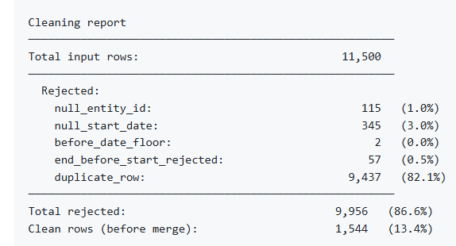
A YAML can create a configuration object
CleanerConfig
Declarative construction. Unknown keys and invalid options raise immediately — your cleaning choices are explicit, versioned, and reproducible
The cleaner then consumes a dataframe and the configuration object
The DataFrame inside this object is clean. Every row passed every rule.
Events
EventsCleaner
Complete transparency — every dropped row has a named reason, with counts and percentages. Ready for your methods and results section.
pd.Dataframe

Slide 12
EventsCleanerConfig
normalize_dates: bool
coalesce_dates: bool
causality_check: bool
parse_dates: bool
drop_duplicates: bool
merge_overlapping: bool
meaningful_gap: int
date_floor: str
date_celing: str
Constructors as Class Methods
build_from_yaml(path) -> EventsCleanerConfig
build_with_defaults() -> EventsCleanerConfig
Methods
to_yaml(path) -> None
__repr__() -> str
EventsCleaner
data: pd.DataFrame
semantics: EventSemantics
config: EventsCleanerConfig|None
Constructor
__init__(dataframe, semantics, config|None) -> EventsCleaner
Methods
clean() -> Events
calc_report() -> dict
print_report() -> None
__repr__() -> str

Slide 13
Vignette 2
Cleaning with Aggregation

Slide 14
Vignette # 2:
You are analyzing residents of a long-term nursing facility. Eachresident has monthly clinical assessments — blood pressure, BMI, andmobility status recorded by nursing staff. Your data warehouse givesyou one row per assessment, not one row per stay.Before you can analyze anything, you need to collapse the assessmentsinto one row per resident per stay. This sounds like a groupby. It isnot that simple.
Problem 1 — Every column needs its own aggregation rule. BMI mightneed median. Systolic BP might need mean. Mobility status is categorical— averaging it makes no sense. A script that hardcodes these rulesburies each decision in a different line of a groupby block.
Problem 2 — Category and numeric columns are fundamentally different. Nothing in a pandas script stops you from accidentally applying mean to mobility_status. The error won't surface until the output looks wrong — if you notice at all.
Problem 3 — "Sequence" and "unique" are different scientific claims. A sequence of "independent" | "assisted" | dependent tells a story of decline. A unique set "assisted" | "dependent" | "independent" loses the order entirely. Which one did you use? If it's buried in a lambda on line 89, your co-author cannot tell.
Problem 4 — Changing one rule requires finding the right line. When your statistician asks you to use median instead of mean for systolic BP, you go hunting through the script. When they ask you to add a fourth column with a different rule, you add another aggregation block. Each change is a surgery on the code.
Problem 5 — A facility transfer is not a merged stay. ResidentNF0023 spent 90 days at Facility A and then 60 days at Facility B.Those are two different stays and must not be merged. The facility ispart of what defines a nursing facility stay.

Slide 15
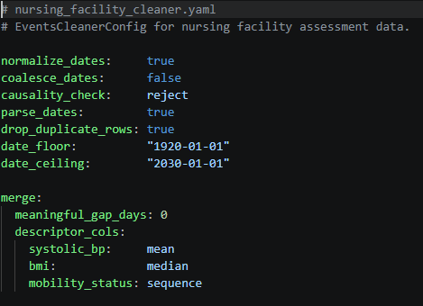
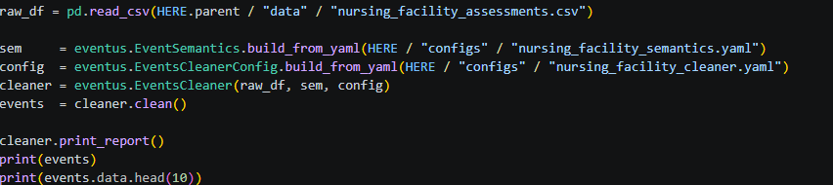
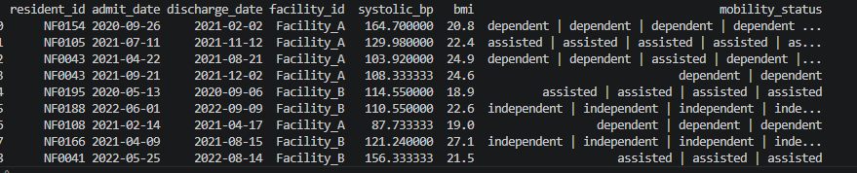
With Eventus:
Cleaner Config
Code

Slide 16
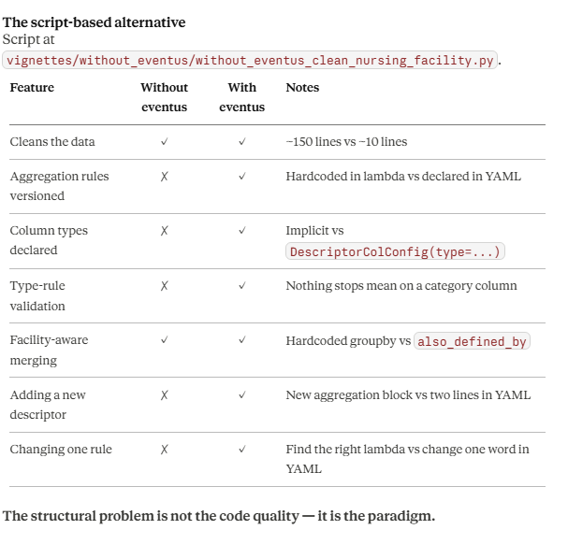
Without Eventus:
To illustrate the limitations of the script-based paradigm, we askeda large language model to implement the same cleaning pipeline.

Slide 17
Vignette 3
Calculate and visualize events duration

Slide 18
Vignette # 3: Calculate and visualize events duration
You have 227 clean nursing facility stays across 200 residents. Thefirst question your clinical collaborator asks is: "How long were the stays?" You reach for matplotlib. Before you write a single line of plotting code, you need to answer a question that sounds trivial: "What exactly am I plotting, and will I be able to reproduce it?"
Problem 1 — Bin width is a scientific choice. A 7-day bin alignswith clinical discharge patterns. A 30-day bin hides variation. A 1-daybin shows noise. That choice belongs in your methods section — not buried in bins=range(0, 200, 7) on line 34 of a script.
Problem 2 — Percentile lines require decisions too. Whichpercentiles — 25th, 50th, 75th, 90th? Do you label them? At what fontsize? A script that hardcodes np.percentile(durations, [25, 50, 75])has made all of these choices silently.
Problem 3 — The KDE bandwidth is a choice. Scott's rule and Silverman's rule produce different curves. That choice is invisible ina script.
Problem 4 — Stratification multiplies the problem. When your collaborator asks for duration by facility, you need consistent bins,consistent colors, and consistent percentile lines across bothfacilities. A script hardcoded for the unstratified case has to berewritten.

Slide 19
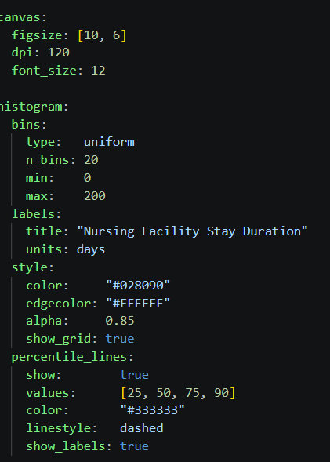
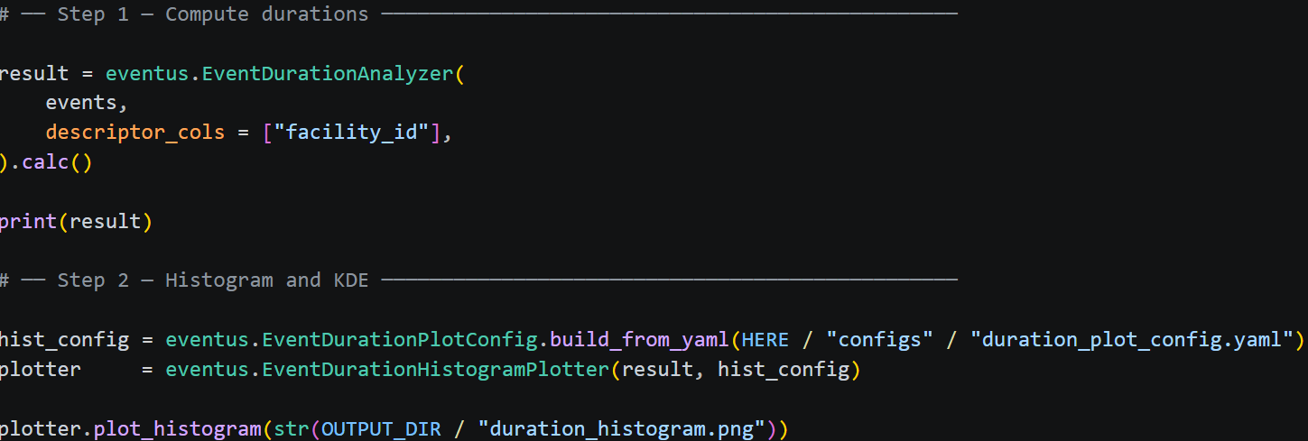
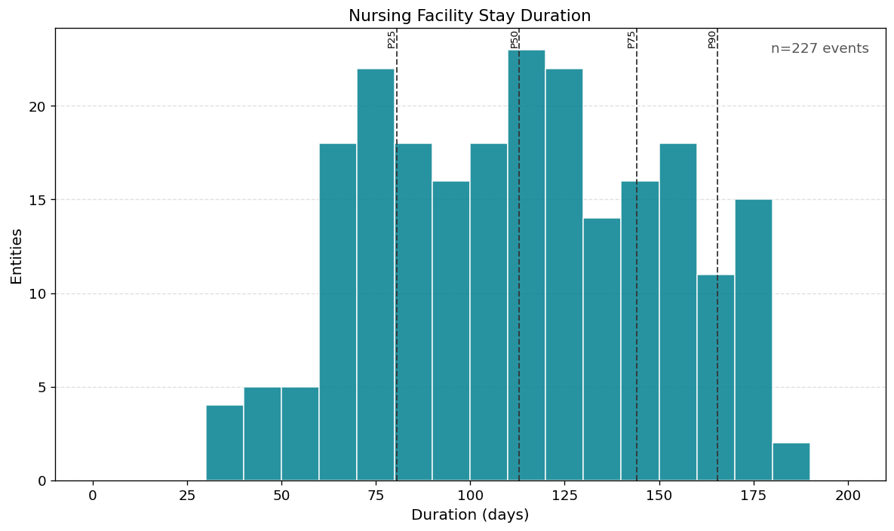
Plot Config
Code

Slide 20
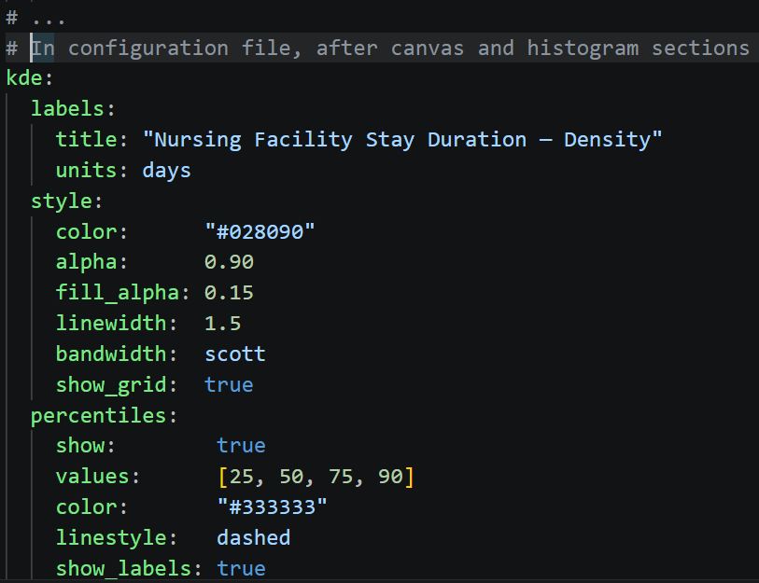
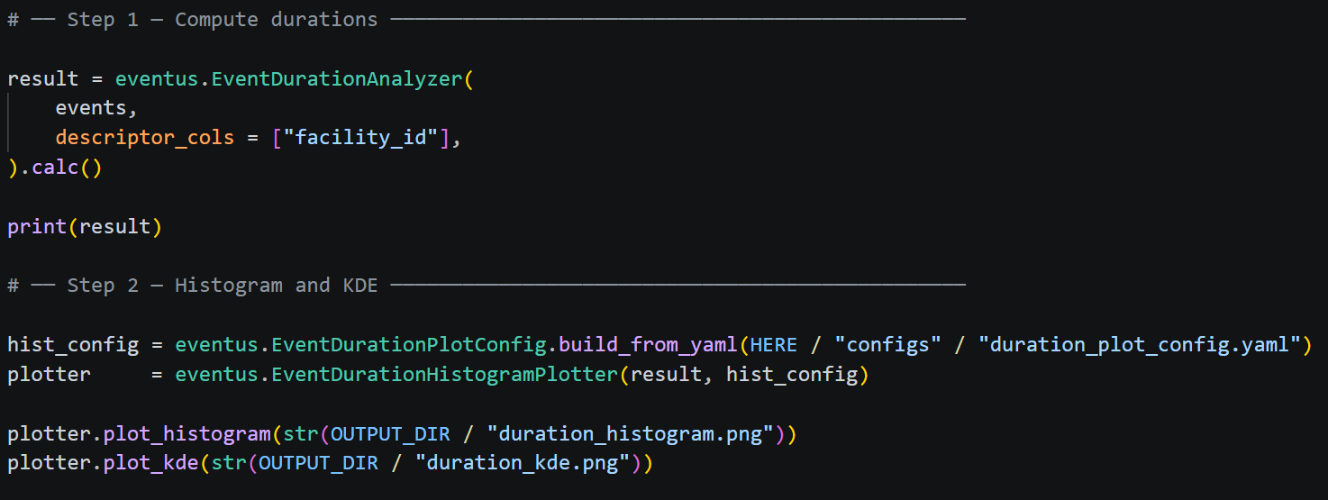
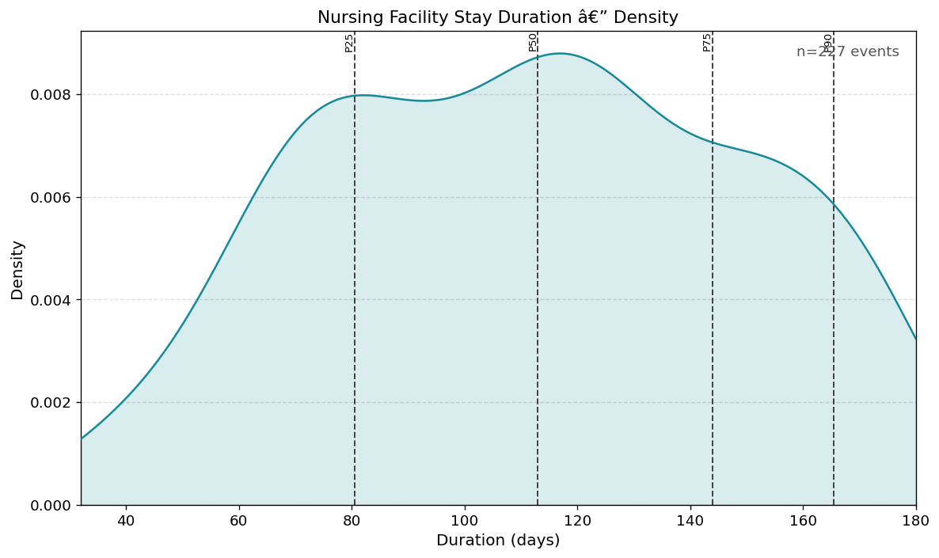
Additional KDE info on Config
Code

Slide 21
Stratification with Violin Plots

Slide 22
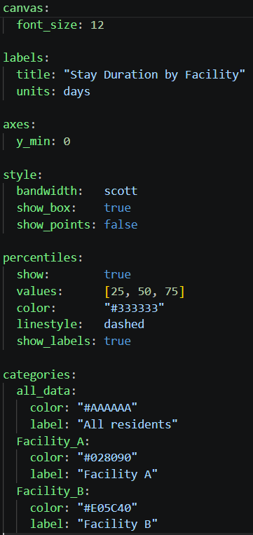
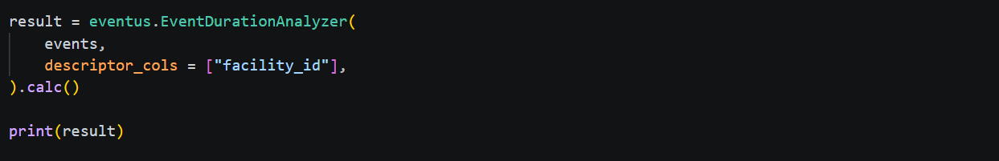
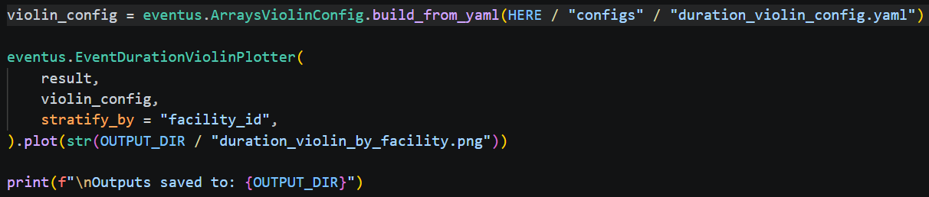
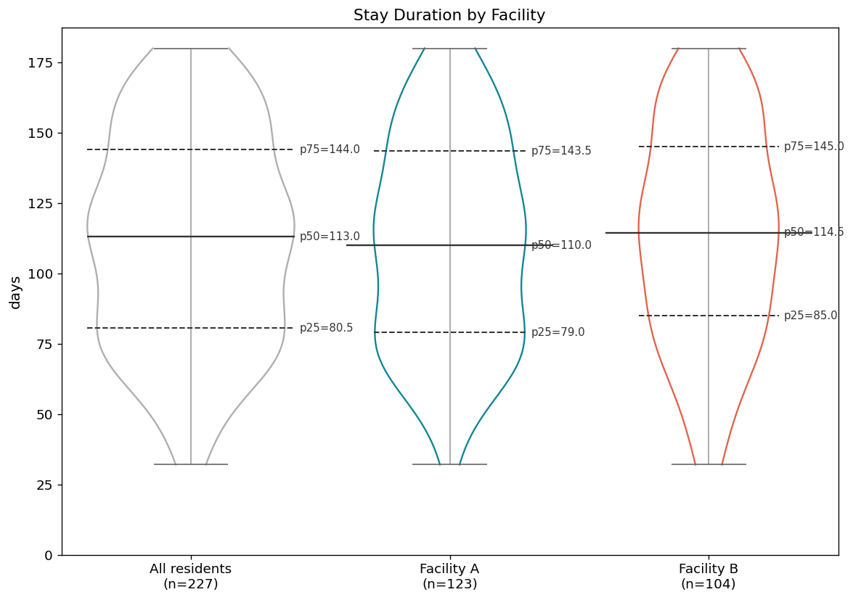
Violin Config
Code

Slide 23
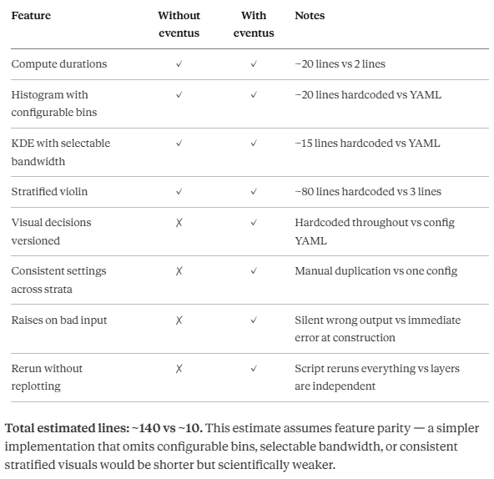
Without Eventus:
A script-based equivalent was not implemented for this chapter. Focusing on only the stratified violin plot with configurable bins, KDE bandwidth,and percentile lines requires ~140 lines of matplotlib code withevery visual decision hardcoded. Instead we summarize the structural differences:

Slide 24
Architecture: Object Honesty
If the objects exist, they are already validated
Analyzers analyze
Plotters plot

Slide 25
It does not check whether the data is clean, does not validate column names, does notverify that dates are parsed.
It does not need to — if an Events object exists, it passed construction, which means it is structurally sound, fully validated, and semantics-aware.
The column names, the entity identifier, the start and end dates — all of that is carriedby the object. The analyzer just asks the object what it needs.
A script that takes a raw DataFrame must either trust it blindly oradd its own validation — and that validation is never as thorough aswhat the data object already guarantees.
Events
The analyzer CAN trust the object it receives.
It accepts an Events object not a dataframe.
EventDurationAnalyzer
EventDurationResult
data: pd.Dataframe
entity_col: str
identity: str | None
descriptor_cols: List[str] | None

Slide 26
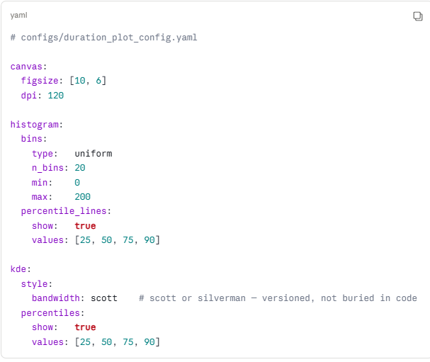
Every analytical and visual choice lives in the YAML — bin width, percentile lines, colors, figure size. Change one number in one file. Nothing in your code changes
EventDurationPlotConfig
The plotter receives a Config object — not a dictionary, not keyword arguments. If it exists, it passed validation. No defensive checks needed inside the plotter
EventDurationHistogramPlotter
EventDurationResult
The Plotter consumes an EventDurationResult object. If it exists, it is because it was successfully produced by an analyzer.
This means: Validated durations, a known entity column, a known identity, and declared descriptor columns.
The plotter just draws.This is the contract that makes each layer independently testable, independently rerunnable, and independently replaceable.

Slide 27
Constructor
__init__(data, semantics
Methods copy() -> Events __len__ -> int
__repr__ -> str
Events
data: pd.Dataframe
semantics: EventSemantics
EventDurationAnalyzer
events: Events
descriptor_cols: list[str] | None
Constructor
__init__(events, descriptor_cols
Methods calc() -> EventDurationResult
__repr__ -> str
Constructor
__init__(data, entity, identity, descriptor_cols)
Methods build_arrays() -> Dict[str, np.ndarray]
__len__ -> int
__repr__ -> str
EventDurationResult
data: pd.Dataframe
entity_col: str
identity: str | None
descriptor_cols: List[str] | None

Slide 28
Vignette 4
Handling Observation Periods

Slide 29
Vignette #4
You have coverage records for 500 Medicaid members. Before you canask any scientific question — who was covered, for how long, were there gaps — you need to answer a structural one: "What is each member's observation window, and what happened inside it?" This question has two versions. The first is simple: everyone sharesthe same calendar year. The second is harder and more realistic: each member has a different window based on their age.
Problem 1 — Coverage records are not the same as coverage withina period. A member may have a coverage period starting in 2021 and ending in 2023. Their coverage in 2022 is the intersection of that period with the observation window — not the raw record. Computing that intersection correctly for every member requires interval arithmetic that a simple date filter cannot provide.
Problem 2 — Gaps, lapses, and partial coverage require careful denominators. "19.4% of members had gaps" means 19.4% of members with any coverage. "13.6% had no coverage" means 13.6% of the full cohort. Mixing denominators silently produces wrong statistics. A script that computes these inline has no mechanism to enforce denominator consistency.
Problem 3 — Age-based windows are per-entity. When the observation window is each member's 18th to 25th birthday, every member has a different start and end date. Members who turned 25 before the data starts, or who turn 18 after the data ends, have zero-length windows. A script that applies a single date filter silently includes or excludes them incorrectly.
Problem 4 — Carrying calculations forward. After computing coverage statistics, those columns should be available for every downstream step — sorting, filtering, visualizing — without recomputing. A script that computes them inline must recompute them every time they are needed..

Slide 30
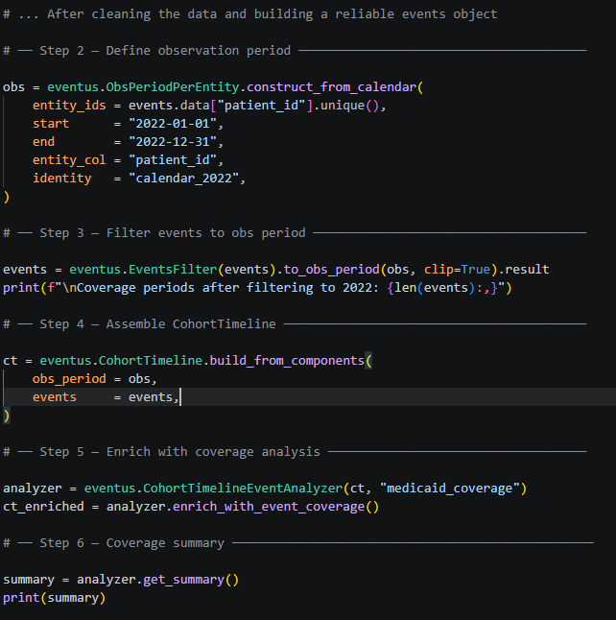
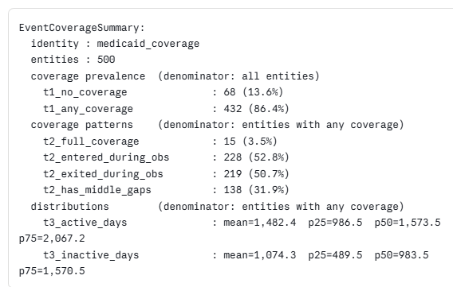
With Eventus:
Code
Observation Period is a simple calendar
Report

Slide 31
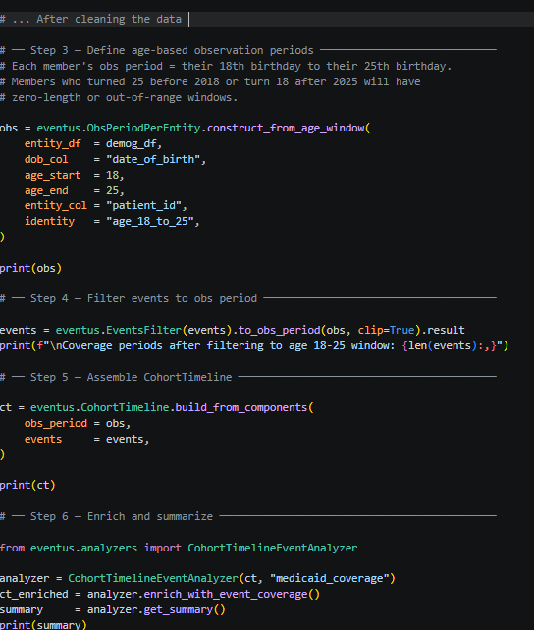
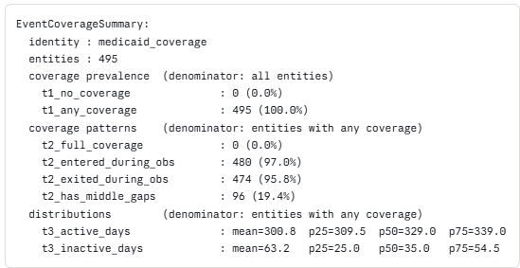
With Eventus:
Code
Bonus: Observation Period changes per entity
Here is an example where the observation period is chosen by an age window
Report

Slide 32
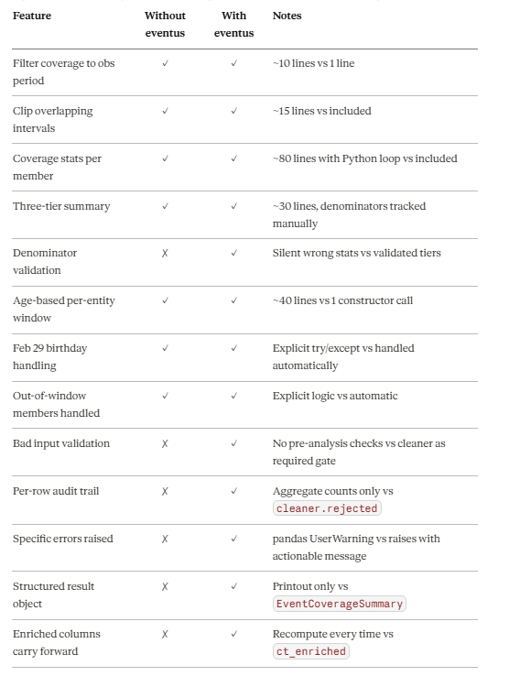
Without Eventus:
We asked a large language model to implement the equivalent pipelinewithout eventus, attempting full feature parity. The resulting scriptis available at vignettes/without_eventus/without_eventus_observation_periods.py.
It required 275 lines and still produced a pandas UserWarning from boolean indexing — a subtle bug that could silently produce wrong results in certain cohort configurations.

Slide 33
Architecture
ObservationPeriod objects
CohortTimeline objects

Slide 34
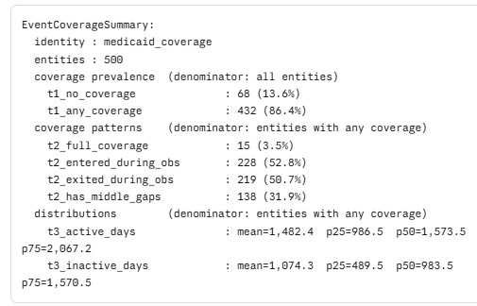
ObsPeriodPerEntity is a first-class object.
Owns construction paths(construct_from_calendar, construct_from_age_window,construct_from_events)
Owns validation rules, and a construction_path attribute that records how it was built.
You can inspect it, print it, and pass it downstream as a guaranteed-validobject.
Events
ObsPeriodPerEntity
CohortTimeline
CohortTimeline is a validated intermediate
It does not accept raw dataframes, only validated objects
By the time CohortTimelien is assembled, every layer has been validated.
It knows what it contains: what identies are present and what has been computed
CohortTimelineEventAnalyzer
CohortTimeline
CohortTimeline can be enriched
It can be enriched progressively
The enriched object can produce structured summaries

Slide 35
Vignette 5
Visualizing events within observation periods

Slide 36
Vignette # 5:
You know from Chapter 4 that 13.6% of members had no Medicaidcoverage during their 18-25 window, that only 3.5% were continuouslycovered for the full seven years, and that 31.9% had gaps. A table of statistics tells you what happened. It cannot show you the pattern. Which members had gaps early in their window? Which had gaps late? Which were barely enrolled at all? Which had fragmented coverageacross the full seven years? A stacked timeline answers all of these at once — one bar per member, colored by coverage status.
Problem 1 — Each member has a different observation window. In a standard time series plot, every row shares the same x-axis. Here, one member's bar spans 2001-2008 (ages 18-25), another's spans 2006-2013, another's spans 2018-2025. A single shared x-axis cannot represent this correctly. The bars need to be aligned to each member's personal window, not to a calendar.
Problem 2 — Four segment types require consistent color coding. Each bar has up to four segments: days before the first coverage period, active coverage periods, gaps between coverage periods, and days after the last coverage period. These color decisions are scientific choices — the gap color signals a lapse, the before/after color signals out-of-window time. If these colors are hardcoded in a script, they are invisible to any collaborator reading the output.
Problem 3 — Plotting 500 members produces an unreadable figure. The full cohort has 500 members. A meaningful visualization needs a representative sample. Which 50? With what seed? That is a reproducibility decision. A script that samples with random.sample() on line 47 has made that decision silently.
Problem 4 — Every visual decision is buried in the script. Colors, font sizes, tick intervals, sample size, random seed — all hardcoded across dozens of lines. When a collaborator asks for a different color scheme, you hunt. When a reviewer asks for monthly ticks instead of quarterly, you edit and hope nothing else breaks. When you rerun the analysis six months later — are you using the same colors? The same sample? If those decisions live in your script, the answer is "probably, unless someone edited it."

Slide 37
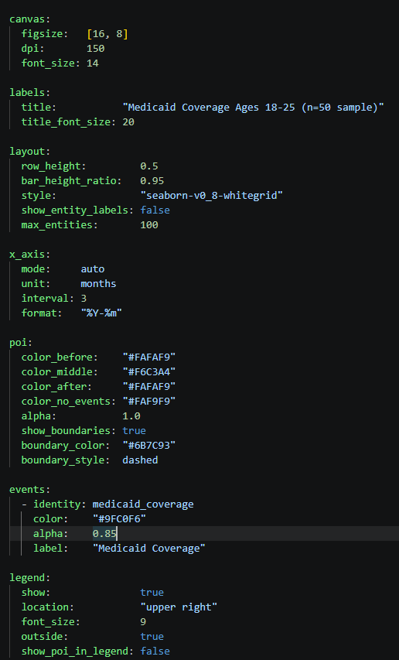
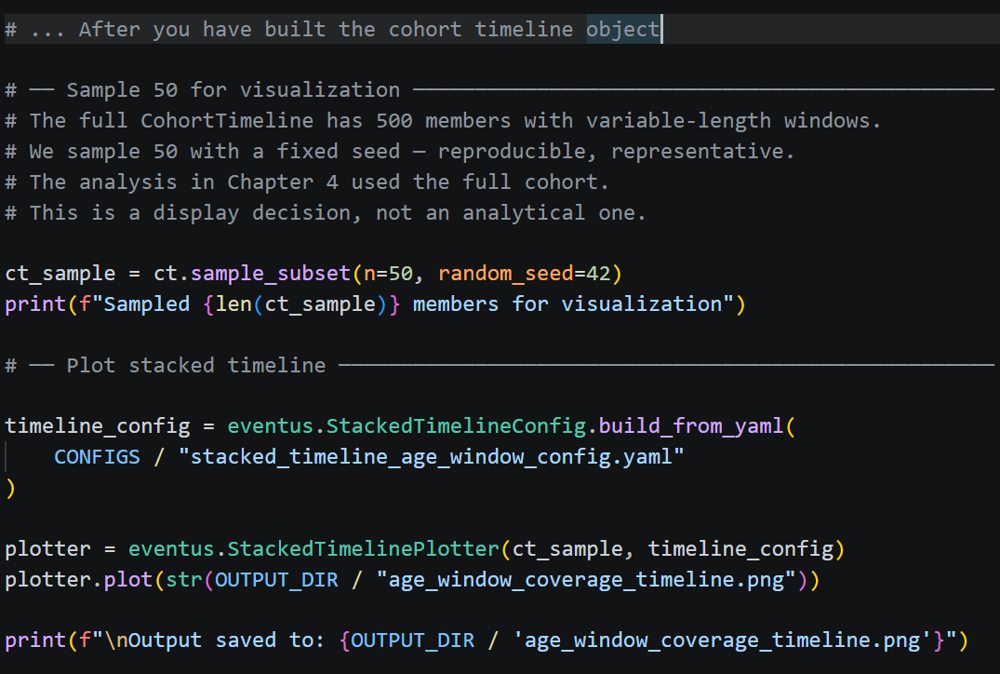
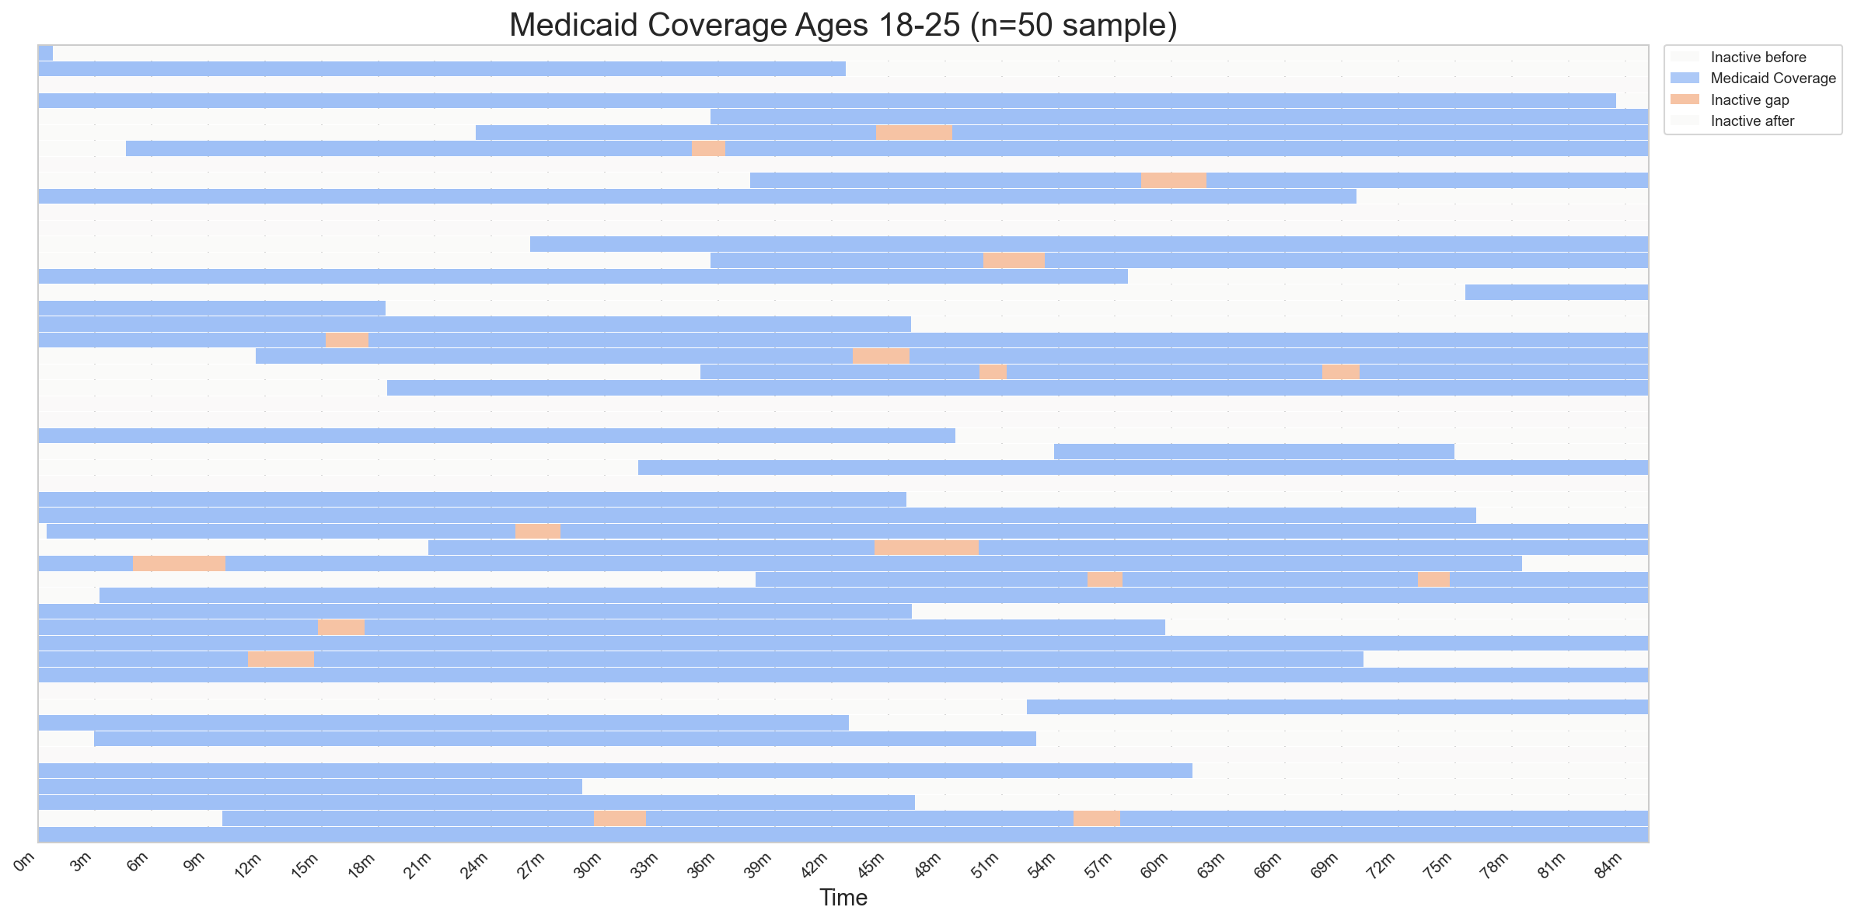
With Eventus:
Visualization
Config
Code

Slide 38
ObsPeriodPerEntity
Events
CohortTimeline
StackedTimelinePlotConfig
StackedTimelinePlotter

Slide 41
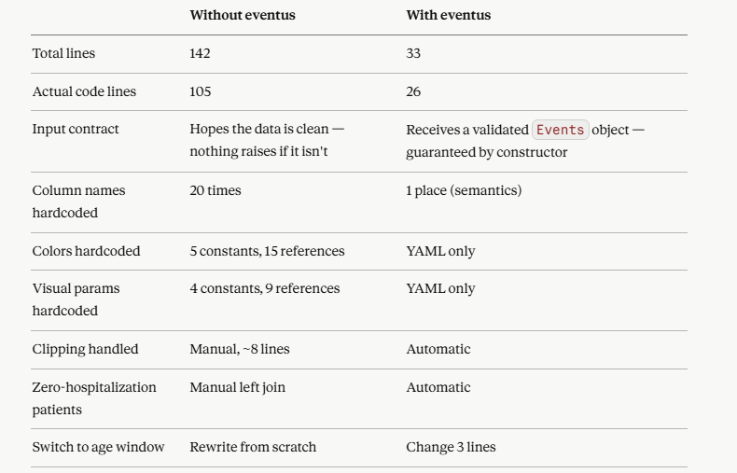
We asked Claude to write code to visualize hospitalization timelines for a cohort of patients over a fixed calendar year. The data was already clean. We asked for one horizontal bar per patient, with different colors for inactive time before the first hospitalization, gaps between hospitalizations, inactive time after the last hospitalization, and patients with no hospitalizations at all. Patients were sorted by total active days.
Result: 142 total lines, 105 lines of actual code

Slide 42
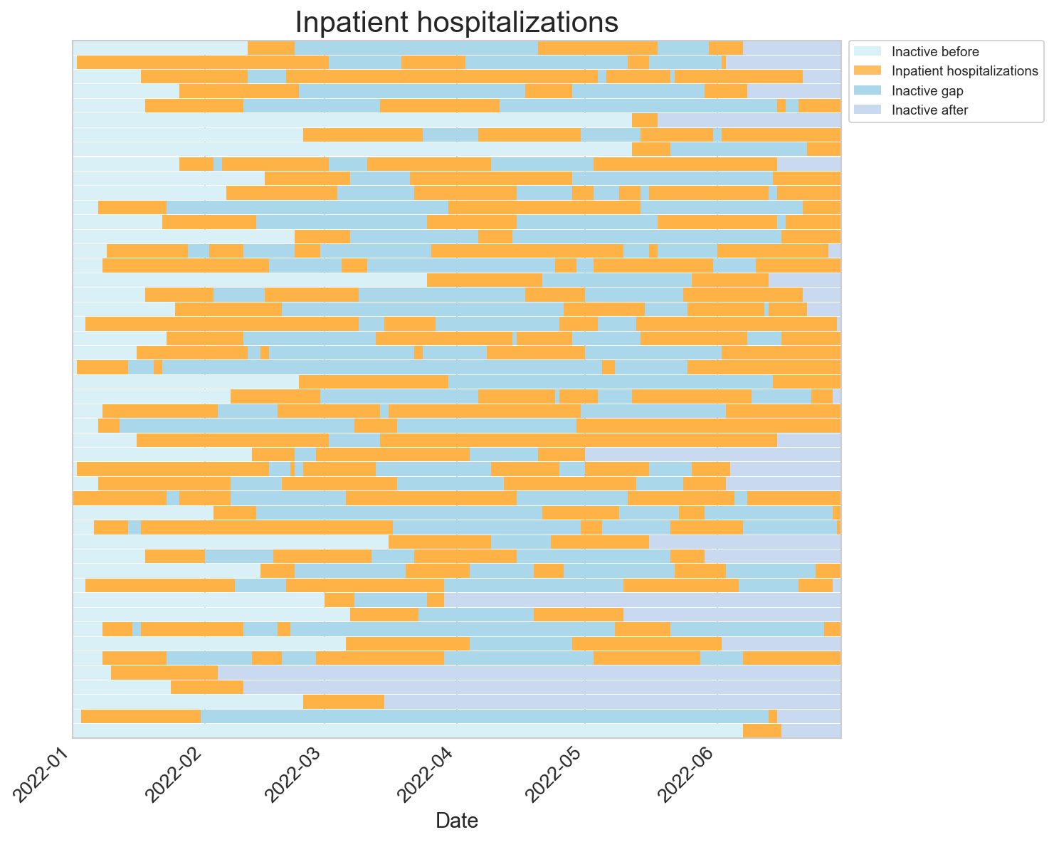
Events
ObsPeriodPerEntity
configuration YAML
StackedTimelineConfig
Objects are designed as concepts:
To exist I need:
1) events to plot 2) period of interest to plot 3) what colors and styles, how are events identified, ...
StackedTimeLinePlotter
With different colors you can see
- Time before first hospitalization
- Time between hospitalizations
- Time after last hosp
You also have the option of sorting by total duration of events, first event, etc...

Slide 43
Vignette #3B
Your collaborator asks: "Can we look at the year following each patient's 65th birthday instead?" This sounds like a one-line change. It is not.
Problem 1 — Every patient has a different observation window: Age windows mean patient A's window is 1957-03-14 → 1958-03-14 and patient B's is 1959-11-02 → 1960-11-02. Every downstream calculation now operates on a different time range per patient.
Problem 2 — Date of birth arithmetic is treacherous: Adding one year to a date sounds trivial. A patient born February 29 exposes your convention immediately. pd.DateOffset(years=65) and timedelta(days=365*65) give different answers. Neither documents which is right.
Problem 3 — The x-axis in your matplotlib is no longer shared: Day 0 now means "the day the patient turned 65" — not a calendar date. A script that hardcodes calendar ticks produces a misleading plot.
Problem 4 — Clipping is now patient-specific: The two global constants OBS_START and OBS_END from vignette 3A no longer exist. Every clip is now a per-row operation against two columns that vary by patient.
Problem 5 — The demographics file is now load-bearing: You need date of birth for every patient — including those with no hospitalizations. A script that reads demographics only for patients in the hospitalization file silently drops zero-hospitalization patients. Again.

Slide 44
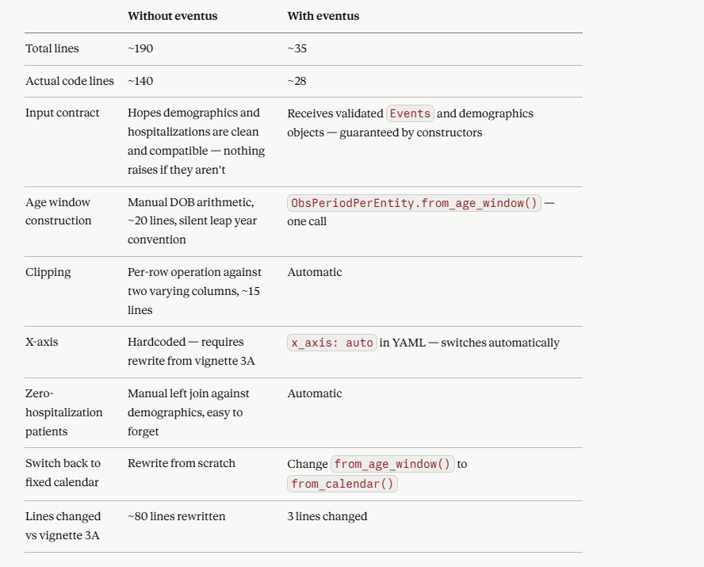

Slide 45
Constructor
__init__(events, obs_period, entity_col)
Methods
compute_event_coverage() -> PipeDelimitedIntermediateEvents
EventsWithinObsPeriodsAnalyzer
events: Events
obs_period: ObsPeriodPerEntity
entity_col: str | None

Slide 52
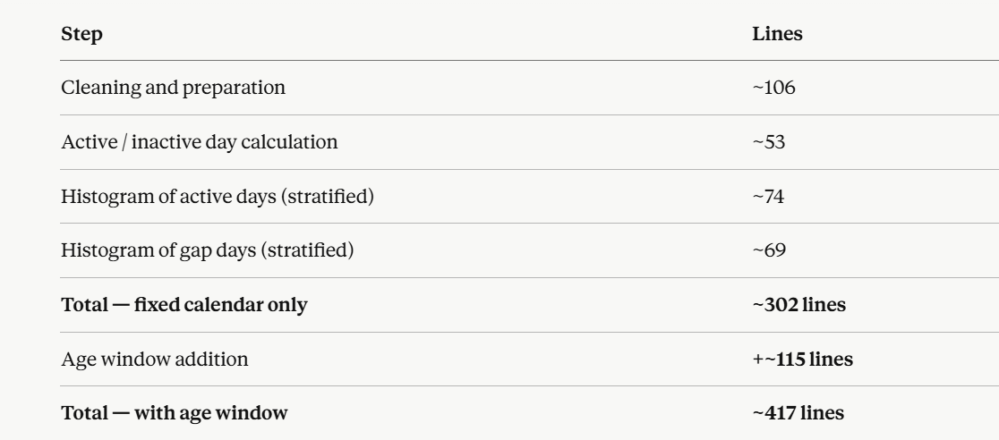
No configuration files. No specific error messages — a wrong column name gives you a KeyError, a bad date gives you a silent NaN, a logic error gives you wrong numbers with no warning. The meaningful gap is hardcoded.
The eventus version is 6 lines of code, two YAML files, and specific errors that tell you exactly what went wrong.

Slide 54
Vignette #4:
You have cleaned your Medicaid coverage data. Each row represents one continuous coverage episode — a span of days during which a senior was enrolled. Now you want to understand the structure of coverage gaps across your cohort from age 65 to 70.Before running any statistical models, you want to do something simple first: look at a sample of the data. Then you want to understand the distribution of coverage gaps — not just how many days patients were uncovered, but where in their five-year window those gaps fell
Problem 1 — Coverage gaps are not one thing: A patient uncovered for 90 days before their first coverage episode is scientifically different from a patient uncovered for 90 days between two episodes. The first may reflect delayed enrollment. The second may reflect a lapse. A script that computes inactive_days as a single number destroys this distinction.
Problem 2 — The denominator changes for each question: "Days before first coverage" only applies to patients whose coverage started after age 65. "Gap between coverage episodes" only applies to patients with ≥ 2 episodes. A script that computes these without tracking the denominator produces misleading statistics.
Problem 3 — Problem 3 — The distributions are only comparable if the denominators are visible: If 800 patients had any gap but only 200 had gaps between episodes, percentiles are only understandable if you know what fraction of the cohort each violin represents. A plot where both violins appear the same width implies equal denominators — and is actively misleading.
Problem 4 — The observation period is age-derived: Each patient's window runs from their 65th to their 70th birthday — a different calendar range for every patient. A script that hardcodes a fixed calendar period assigns the wrong observation window to every patient.

Slide 55
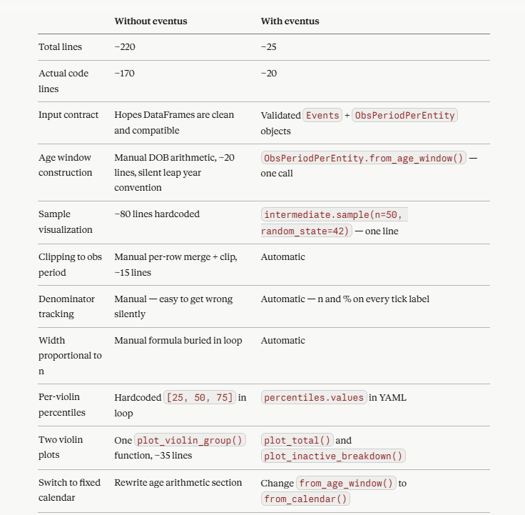

Slide 56
Five Main Abstractions
Semantics
"I know what columns mean"
EventSemantics, OccurrenceSemantics
Data Objects
"I hold clean/validated data"
Events, EventsPerEntity, Spans, Occurrences, OccurrencesPerEntity
Analyzers
"I compute shareable stuff"
EventsWithinSpanAnalyzer, OccurrencesWithinSpanAnalyzer, ***OccurrencesWithinEventsAnalyzer
Intermediates
"Pipe-delimited columnar contract"
PipeDelimitedIntermediate, PipeDelimitedIntermediateEvents, PipeDelimitedIntermediateOccurrences, ***EventsOccurrences
Visualizers
"I draw pictures"
StackedBarsPlotter(change name), ActivityOverTimePlotter, EventWithinSpanAnalysisHistogramPlotter

Slide 57
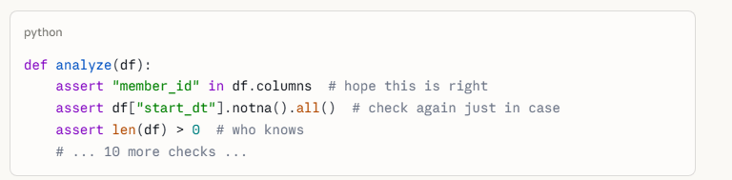
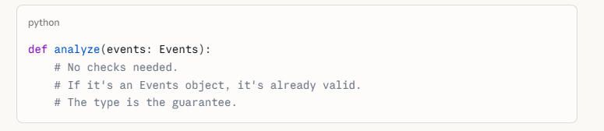
A DataFrame tells you what the numbers are. Semantics tells you what they mean. Every eventi data object carries both — so the pipeline never loses context.
Anatomy of Objects
Events
data: pd.Dataframe
semantics: EventSemantics
ObsPeriodPerEntity
data: pd.Dataframe
semantics: EventSemantics
Ocurrences
data: pd.Dataframe
semantics: OccurrenceSemantics
Why this level of abstraction:
The type is the guarantee.
No checking if the column still exists. No asserting the dates parsed correctly. No confirming the entity ID is not null. No re-validating what you already validated three functions ago. No praying that whoever called your function remembered to clean the data first.
If an Events object exists, it is clean

Slide 58
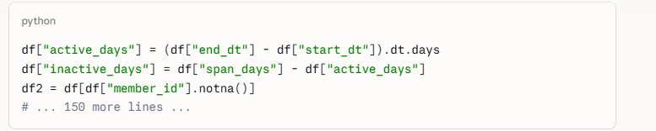

Analyzers utilize object contracts
EventsWithinSpanAnalyzer
events: Events
spans: Spans
entity_col: str
meaningful_gap: int

Slide 59
Parallelism and Composability
Events (i.e. insurance-coverage)
Occurrences
(i.e. ED day, vaccine day)
EventsWithinSpanAnalyzer
.calc_active_vs_inactive()
OccurrencesWithinSpanAnalyzer
.calc()
PipeDelimitedIntermediateEvents
.self_analyze(), .tier1/2/3()
PipeDelimitedIntermediateOccurences
.self_analyze(), .print_summary()
add objects
Plotter can therefore plot either occurrences within an span; or events within a span; or both within a span. All orchestrated by a YAML that understands the objects.
The plotter does not care which path was taken.
StackedBarsPlotter

Slide 60
Events
data: pd.Dataframe
semantics: EventSemantics
Constructor
__init__(data, semantics) -> Events
Methods
filter_by_entities(ids) -> Events
filter_by_dates(start, end) -> Events copy() -> Events build_summary() -> dict
print_summary() -> None
__len__ -> int
__repr__ -> str
EventsPerEntity
data: pd.Dataframe
semantics: EventSemantics
Constructor
__init__(data, semantics) Methods
return_as_obs_period() -> ObsPeriodPerEntity
ObsPeriodPerEntity
data: pd.Dataframe
semantics: EventSemantics
Constructors as Class Methods
construct_from_calendar(entity_ids, start, end, entity_col, identity|None)
construct_from_age_window(entity_df, dob_col, age_start, age_end, entity_col, age_unit, identity)
construct_from_events(events, identity|None)

Slide 61
Occurrences
data: pd.Dataframe
semantics: OccurrenceSemantics
Constructor
__init__(data, semantics)
Methods
filter_by_entities(ids) -> Occurrences
filter_by_dates(start, end) -> Occurrences count_per_entity() -> pd.Series
copy() -> Occurrences build_summary() -> dict
print_summary() -> None
__len__ -> int
__repr__ -> str
OccurrencesPerEntity
data: pd.Dataframe
semantics: EventSemantics
Constructor
__init__(data, semantics) Methods
filter_by_entities(ids) -> OccurrencesPerEntity
copy() -> OccurrencesPerEntity
build_obs_period(identity) -> ObsPeriodPerEntity

Slide 62
EventsWithinObsPeriodAnalyzer
events: Events
obs_period: ObsPeriodPerEntity
entity_col: str | None meaningful_gap: int
Constructor
__init__(events, obs_period, entity_col, meaningful_gap)
Methods
compute_event_coverage() -> PipeDelimitedIntermediateEvents
StackedTimelinePlotterConfig
general: GeneralConfig span: SpanConfig
event_settings: list[EventLayerConfig] occurrences_settings: list[OccLayerConfig]
legend: LegendConfig x_axis_labels: XAxisConfig
***
StackedTimelinePlotter
intermediate: PipeDelimitedIntermediate
config: StackedTimelineConfig | None
Constructor
__init__(intermediate, config)
Methods
plot(path)

