Slide 1
Vignette # 1:
You are a clinical researcher studying the relationship between inpatient hospitalizations and subsequent emergency department visits in a Medicaid population. Your institution's data warehouse gives you a hospitalization file — one row per claim, not one row per visit.
Before you can ask any scientific question, you need to answer a more mundane one:"Do I actually know how many times each patient was hospitalized?"This sounds simple. It is not.
Problem 1 — Duplicate claims: A single 5-day hospitalization generates multiple rows — one per billing day, or one per diagnosis code, or one per provider. You have 47,000 rows but far fewer actual visits.
Problem 2 — Overlapping stays: A patient transferred between units or facilities generates two overlapping intervals. Naively counting rows double-counts this patient's hospitalization burden.
Problem 3 — Missing admit dates: 3% of rows have null admit_date. Another 1% have null patient_id. These need to be removed — but you need to know how many and why, because your IRB report will ask.
Problem 4 — Implausible dates: System errors produce admit dates in 1899 or 2087. A script that silently keeps these will corrupt every downstream analysis.
Problem 5 — Same-day readmissions vs. continuous stays: A patient discharged on Monday and readmitted on Tuesday — is that one stay or two? The answer depends on your research question and needs to be a conscious, documented choice, not an accident of how you sorted a DataFrame.

Slide 2
Without Eventus:
We asked Claude to write code to clean hospitalization data with these choices:
Drop nulls on patient_id, admit_date, discharge_date
Drop implausible dates (before 1920, after 2100)
Enforce causality (admit ≤ discharge)
Drop exact duplicates
Merge overlapping stays (gap = 0 days)
Result:
61 total lines, 42 lines of actual code
The column name "patient_id", "admit_date", "discharge_date" appear hardcoded 33 times across the script.
What you don't get:
No count of rows dropped at each step
No named reason per dropped row
The gap=0 choice is a <= buried inside a loop on line 40 — undocumented, not configurable
Script is single-use — rename one column in your data warehouse and it breaks in multiple placesN
No errors raised — silent failures
Further tweaks were added to move column names and cleaning choices to global constants at the top — refactored to ~59 lines. Still no audit trail per row, and no documented record of cleaning choices outside of a long script.z
There were also no errors raised. Claude estimated that ~90 lines of code were required to add error transparency.

Slide 3
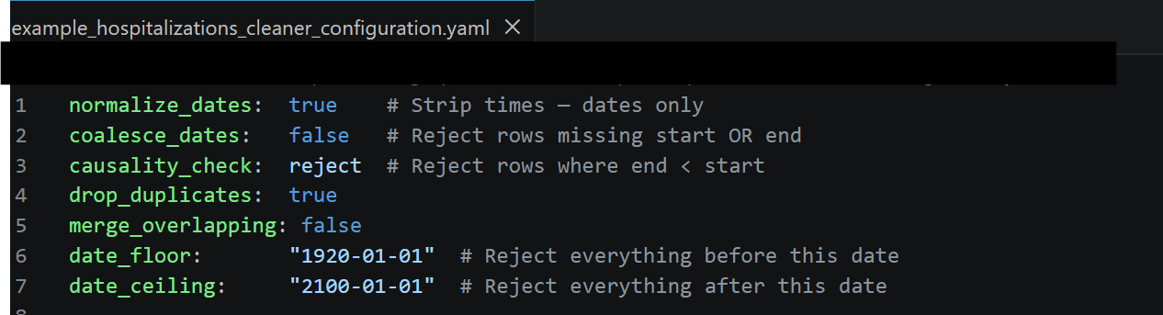
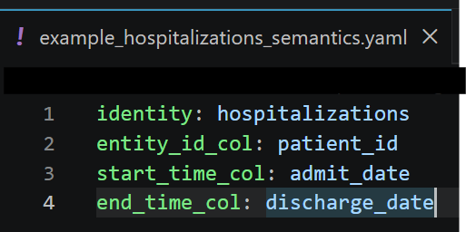
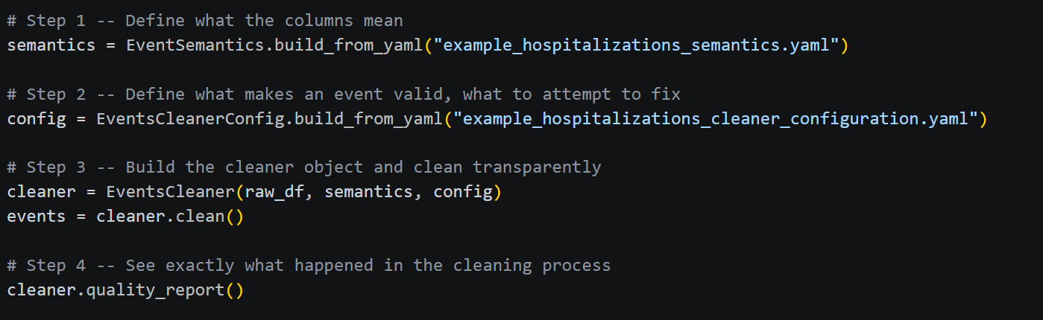
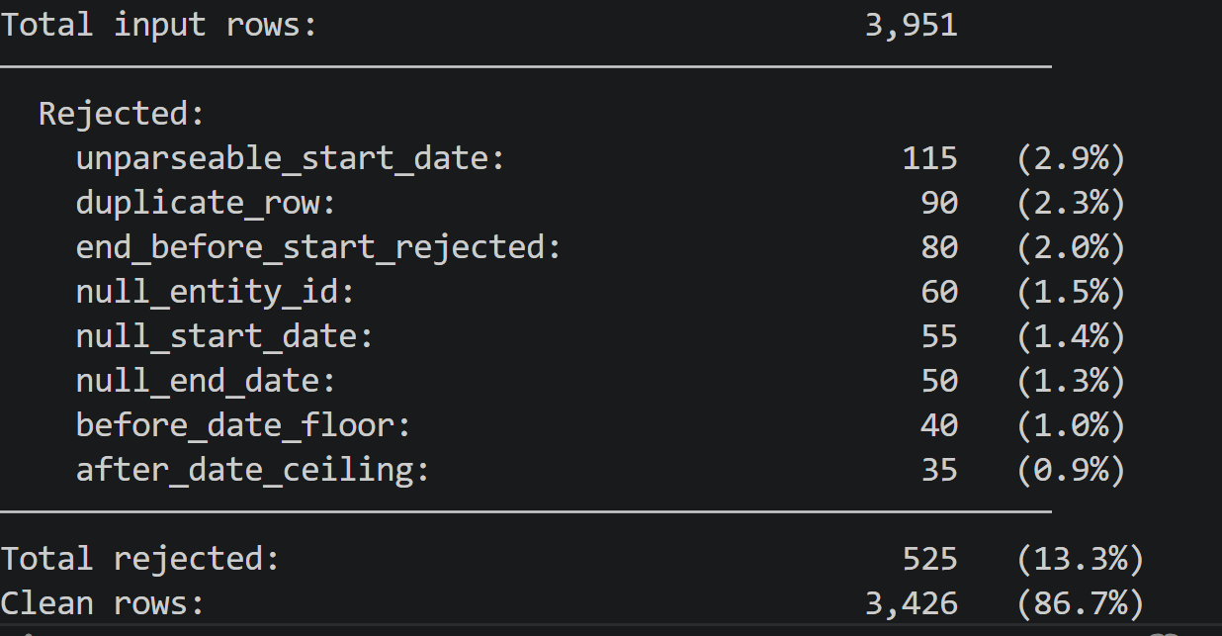


With Eventus:
Two config files: 11 lines
Easier to save and audit later Script: 6 lines
Detailed report of what was dropped or changed

Slide 4
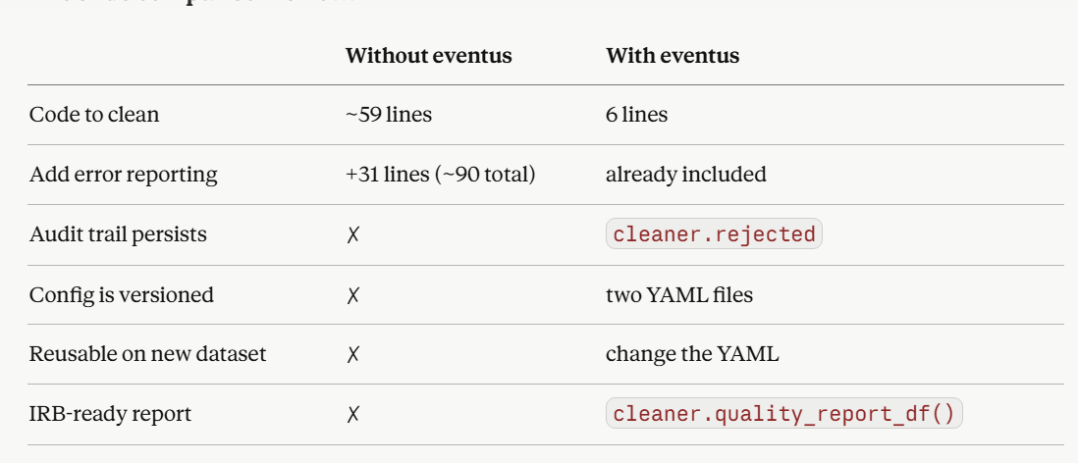

Slide 5
Reproducibility: Configuration-friendly objects
EventSemantics
type: str
entity_id_col: str
start_time_col: str
end_time_col: str event_id_col: str|None event_type_col: str|None metadata_cols: list[str]
Constructor
__post__init()
Constructors as Class Methods
build_from_yaml(path) -> EventSemantics
Methods
__repr__() -> str
Why is the semantics abstraction needed:
A pandas DataFrame does not know what its columns mean — 'begin_date' could be a birth date, a coverage start, or a contract signing. EventSemantics is built for exactly one purpose: to hold that meaning explicitly, validate it on construction, and carry it through the entire pipeline so no downstream function ever has to guess.

Slide 6
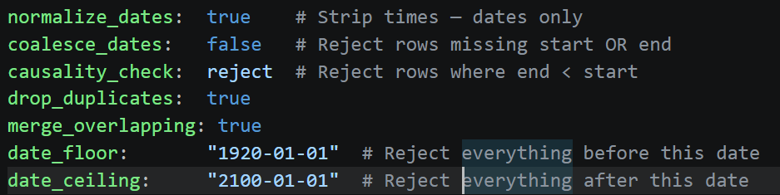
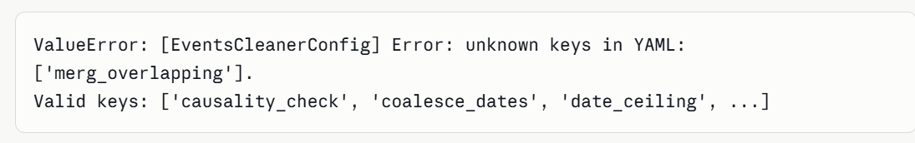
Reproducibility: Configuration-friendly objects
EventsCleanerConfig.build_from_yaml(filename)
EventsCleanerConfig object
Validates on construction that the entries in the configuration are sensical. If you write a cleaning-thing that does not exist or an option that does not exist, it throws the error.
Once again, declarative construction acts both as configuration and documentation"
Examples of raised errors:
*** Lets make this snapshot from either linux or VSCode

Slide 7
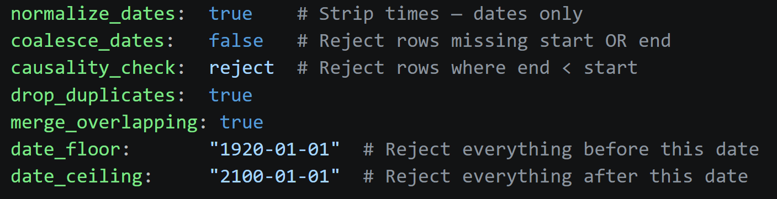
CleanerConfig
Declarative construction. Unknown keys and invalid options raise immediately — your cleaning choices are explicit, versioned, and reproducible
The DataFrame inside this object is clean. Every row passed every rule.
Events
EventsCleaner
pd.Dataframe
Complete transparency — every dropped row has a named reason, with counts and percentages. Ready for your methods and results section.

Slide 8
EventsCleanerConfig
normalize_dates: bool
coalesce_dates: bool
causality_check: bool
parse_dates: bool
drop_duplicates: bool
merge_overlapping: bool
meaningful_gap: int
date_floor: str
date_celing: str
Constructors as Class Methods
build_from_yaml(path) -> EventsCleanerConfig
build_with_defaults() -> EventsCleanerConfig
Methods
to_yaml(path) -> None
__repr__() -> str
EventsCleaner
data: pd.DataFrame
semantics: EventSemantics
config: EventsCleanerConfig|None
Constructor
__init__(dataframe, semantics, config|None) -> EventsCleaner
Methods
clean() -> Events
calc_report() -> dict
print_report() -> None
__repr__() -> str

Slide 9
Vignette # 2:
You have cleaned your hospitalization data. You now have 11,200 stays across 8,400 patients. Before you can report anything, you need to understand how long hospitalizations last. You reach for matplotlib.Before you write a single line of plotting code, you need to answer a question that sounds trivial: "What exactly am I plotting, and will I be able to reproduce it?
Problem 1 — The bin width is a scientific choice, not a formatting detail: A 1-day bin width shows noise. A 30-day bin width hides clinically meaningful variation. 7-day bins align with weekly discharge patterns. The choice belongs in your methods section — not buried in bins=range(0, 180, 7) on line 34 of a script.
Problem 2 — Percentile lines require decisions too: Which percentiles do you report — 25th, 50th, 75th, 90th? Do you label them on the plot? At what font size? A script that hardcodes np.percentile(durations, [25, 50, 75]) has made all of these choices silently.
Problem 3 — Stratification multiplies the problem: When your supervisor asks you to break the histogram down by hospital or DRG category, you now need consistent bin widths, consistent colors, and consistent percentile lines across every stratum. A script that hardcodes these for the unstratified case has to be rewritten for every stratification.
Problem 4 — Rerunning next month on updated data: Your data warehouse refreshes quarterly. When you rerun the analysis, are you using the same bins? The same color? The same percentile cutoffs? If these choices live in your script, the answer is "probably, unless someone edited it."

Slide 10
Without Eventus:
We asked Claude to write code to plot a duration histogram with the following choices:
7-day bins from 0 to 180 days
Percentile lines at p25, p50, p75, p90
Single color, white edges, 0.85 alpha
Save to PNG at 150 dpi
Unstratified: 34 lines, 25 lines of actual code
We then asked Claude to add stratification by hospital
Stratified: 53 lines, 41 lines of actual code
What you don't get:
Bin width, max, and start are three silent choices buried in bins=range(0, 181, 7) on one line
Percentile choices appear in two different places in the stratified script
Color list breaks silently if you have more strata than hardcoded colors
No shared configuration between the two scripts — changing bin width requires editing both
No validation — negative or null durations are silently plotted
Rerun next month on updated data: are you using the same bins? Only if nobody touched the script

Slide 11
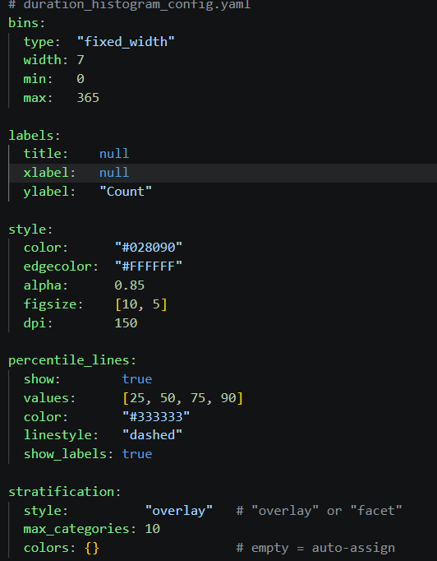
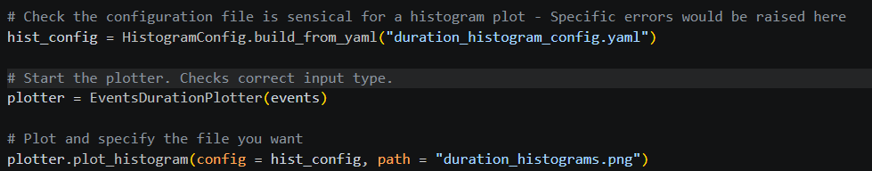
With Eventus
30 lines in the configuration
8 lines in the code
Now available compared to previous script
Ability to change colors of percentile lines, title, etc...

Slide 12
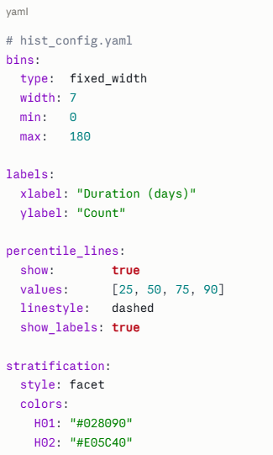
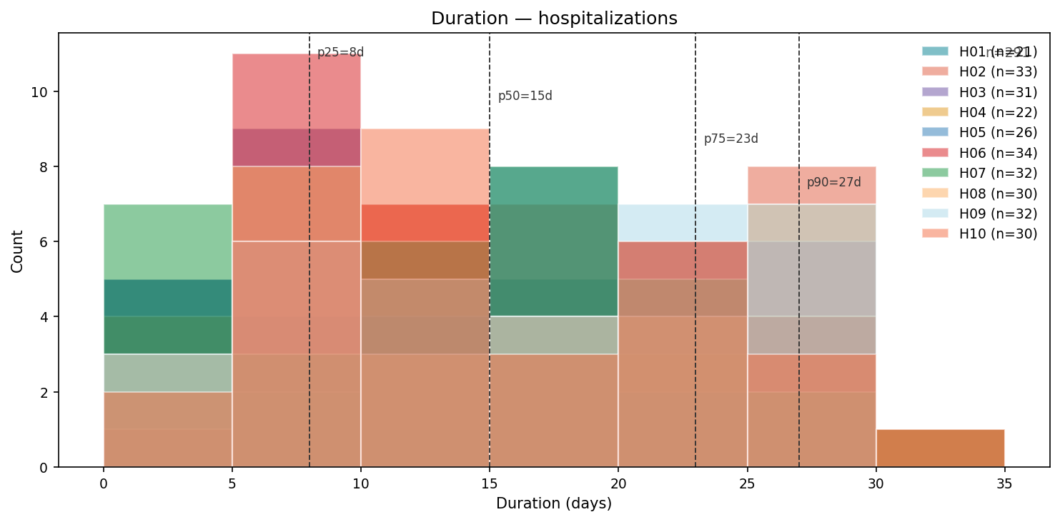
Every analytical and visual choice lives in the YAML — bin width, percentile lines, colors, figure size. Change one number in one file. Nothing in your code changes
HistogramConfig
The plotter receives a HistogramConfig object — not a dictionary, not keyword arguments. If it exists, it passed validation. No defensive checks needed inside the plotter."
EventsDurationPlotter
Events
The plotter receives an Events object — not a raw DataFrame. The contract was already enforced at construction. The plotter knows exactly what it's getting: clean data, valid columns, no nulls

Slide 13
Events
data: pd.Dataframe
semantics: EventSemantics
Constructor
__init__(data, semantics) -> Events
Methods
filter_by_entities(ids) -> Events
filter_by_dates(start, end) -> Events copy() -> Events build_summary() -> dict
print_summary() -> None
__len__ -> int
__repr__ -> str

Slide 14
HistogramConfig
bins: BinsConfig
labels: LabelsConfig
style: StyleConfig
percentile_lines: PercentilesConfig
stratification: StratificationConfig
Class Method Constructors
build_with_defaults() -> HistogramConfig
build_from_yaml(path) -> HistogramConfig
Method
to_yaml(path) -> None
subclasses check that there is enough information for bins, labels, etc...
EventsDurationPlotter
events: Events
stratify_by: str | None
Constructor
__init__(events, stratify_by) -> EventsDurationPlotter
Methods
plot_histogram(path, histogram_config) plot_violin(violin_config)

Slide 15
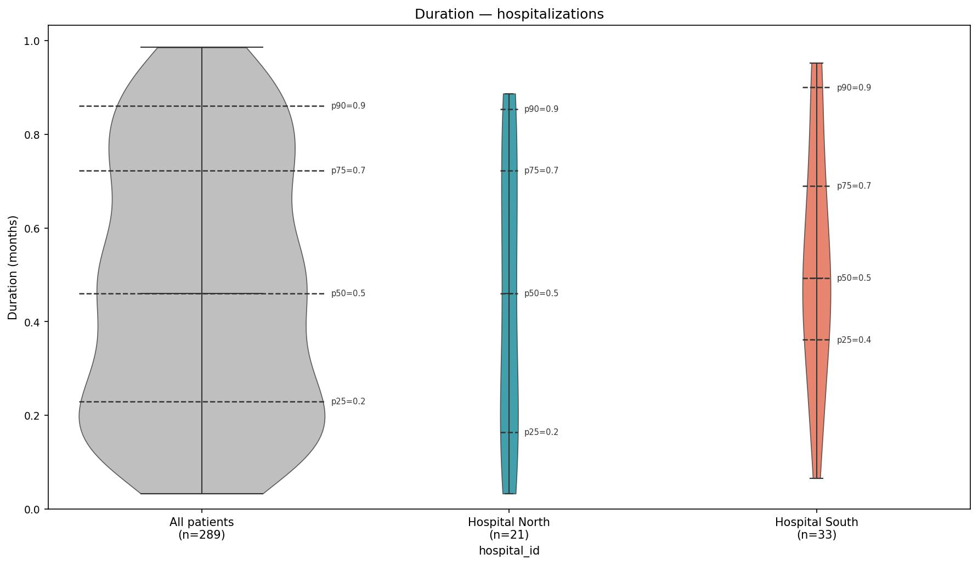
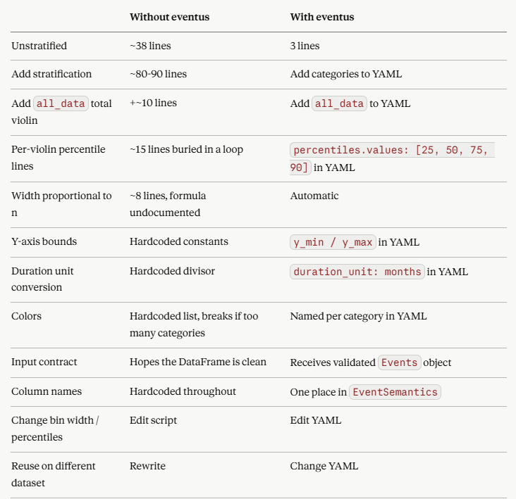
Bonus

Slide 16
Vignette #3A
You have cleaned your hospitalization data. You now have 11,200 stays across 8,400 patients. Before you can ask any scientific question about hospitalization burden, you want to do something simple first: look at the data.Not a table. Not a summary statistic. A picture — one row per patient, showing where in the year their hospitalizations fell, how long each stay lasted, and how much of the year they spent not hospitalized.
Problem 1 — The observation period is a first-class object: Every patient shares the same calendar window — January 1 to December 31, 2022. But a hospitalization admitted December 15 and discharged January 20 must be clipped to December 31. A script that does not clip overcounts active days and draws bars that extend past the observation window.
Problem 2 — Patients with no hospitalizations are real patients: They have an observation period. They belong in the plot — as a full bar with no event segments. A script that joins on hospitalizations silently drops them. Your denominator is wrong and the plot is misleading.
Problem 3 — The plot has to be reproducible: Row height, bar height ratio, colors, marker sizes, font sizes, DPI — a script that hardcodes these cannot be versioned, shared, or rerun
consistently. Next month's update will look different unless someone is very careful.
Problem 4 — You may want to plot times without hospitalization may in three colors, not two: Inactive time before the first hospitalization tells a different story than inactive time between hospitalizations, which tells a different story than inactive time after the last one. For a Medicaid coverage vignette, you may be more interested in gaps between events and want to color them differently.

Slide 17
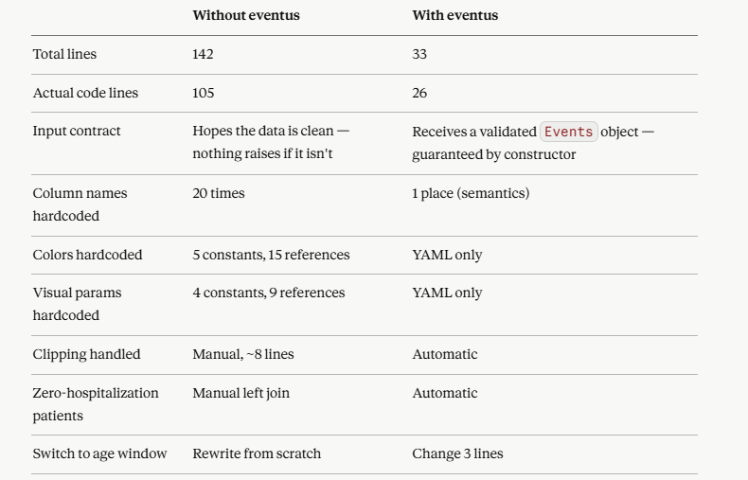
We asked Claude to write code to visualize hospitalization timelines for a cohort of patients over a fixed calendar year. The data was already clean. We asked for one horizontal bar per patient, with different colors for inactive time before the first hospitalization, gaps between hospitalizations, inactive time after the last hospitalization, and patients with no hospitalizations at all. Patients were sorted by total active days.
Result: 142 total lines, 105 lines of actual code

Slide 18
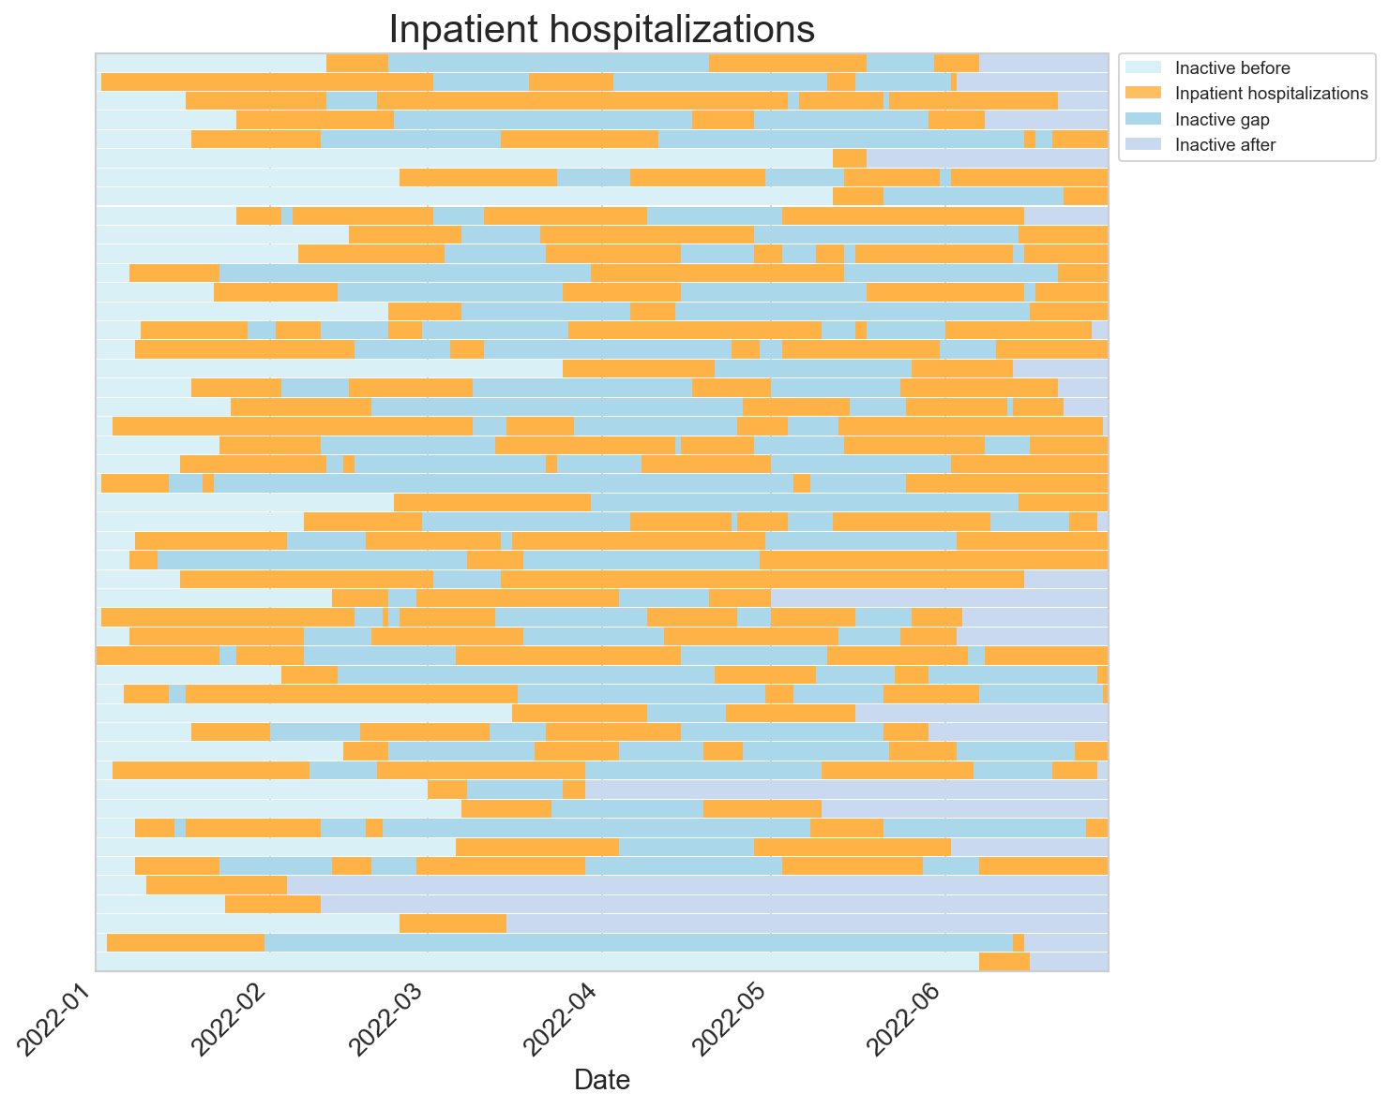
Events
ObsPeriodPerEntity
configuration YAML
StackedTimelineConfig
Objects are designed as concepts:
To exist I need:
1) events to plot 2) period of interest to plot 3) what colors and styles, how are events identified, ...
StackedTimeLinePlotter
With different colors you can see
- Time before first hospitalization
- Time between hospitalizations
- Time after last hosp
You also have the option of sorting by total duration of events, first event, etc...

Slide 19
Vignette #3B
Your collaborator asks: "Can we look at the year following each patient's 65th birthday instead?" This sounds like a one-line change. It is not.
Problem 1 — Every patient has a different observation window: Age windows mean patient A's window is 1957-03-14 → 1958-03-14 and patient B's is 1959-11-02 → 1960-11-02. Every downstream calculation now operates on a different time range per patient.
Problem 2 — Date of birth arithmetic is treacherous: Adding one year to a date sounds trivial. A patient born February 29 exposes your convention immediately. pd.DateOffset(years=65) and timedelta(days=365*65) give different answers. Neither documents which is right.
Problem 3 — The x-axis in your matplotlib is no longer shared: Day 0 now means "the day the patient turned 65" — not a calendar date. A script that hardcodes calendar ticks produces a misleading plot.
Problem 4 — Clipping is now patient-specific: The two global constants OBS_START and OBS_END from vignette 3A no longer exist. Every clip is now a per-row operation against two columns that vary by patient.
Problem 5 — The demographics file is now load-bearing: You need date of birth for every patient — including those with no hospitalizations. A script that reads demographics only for patients in the hospitalization file silently drops zero-hospitalization patients. Again.

Slide 20
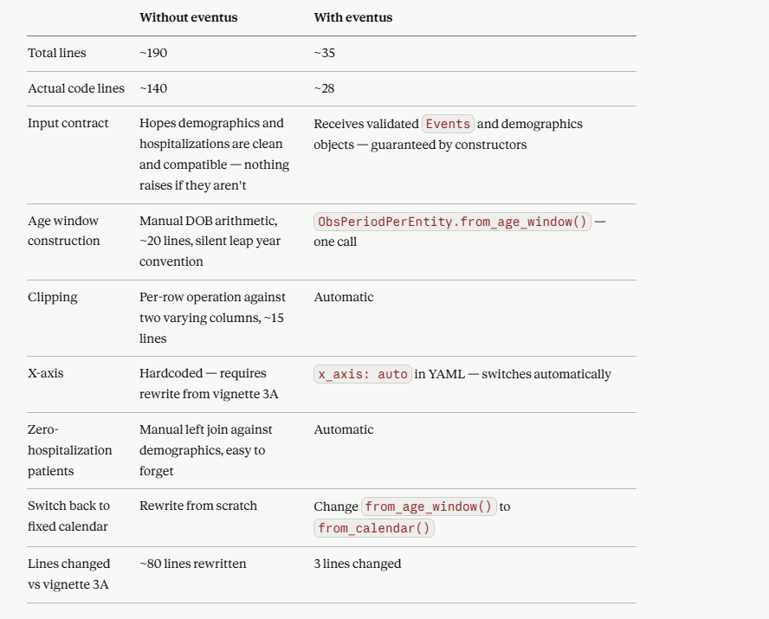

Slide 21
Constructor
__init__(events, obs_period, entity_col)
Methods
compute_event_coverage() -> PipeDelimitedIntermediateEvents
EventsWithinObsPeriodsAnalyzer
events: Events
obs_period: ObsPeriodPerEntity
entity_col: str | None

Slide 22
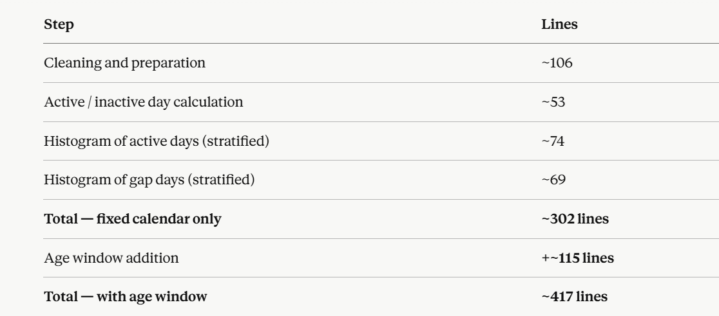
No configuration files. No specific error messages — a wrong column name gives you a KeyError, a bad date gives you a silent NaN, a logic error gives you wrong numbers with no warning. The meaningful gap is hardcoded.
The eventus version is 6 lines of code, two YAML files, and specific errors that tell you exactly what went wrong.

Slide 24
Vignette #4:
You have cleaned your Medicaid coverage data. Each row represents one continuous coverage episode — a span of days during which a senior was enrolled. Now you want to understand the structure of coverage gaps across your cohort from age 65 to 70.Before running any statistical models, you want to do something simple first: look at a sample of the data. Then you want to understand the distribution of coverage gaps — not just how many days patients were uncovered, but where in their five-year window those gaps fell
Problem 1 — Coverage gaps are not one thing: A patient uncovered for 90 days before their first coverage episode is scientifically different from a patient uncovered for 90 days between two episodes. The first may reflect delayed enrollment. The second may reflect a lapse. A script that computes inactive_days as a single number destroys this distinction.
Problem 2 — The denominator changes for each question: "Days before first coverage" only applies to patients whose coverage started after age 65. "Gap between coverage episodes" only applies to patients with ≥ 2 episodes. A script that computes these without tracking the denominator produces misleading statistics.
Problem 3 — Problem 3 — The distributions are only comparable if the denominators are visible: If 800 patients had any gap but only 200 had gaps between episodes, percentiles are only understandable if you know what fraction of the cohort each violin represents. A plot where both violins appear the same width implies equal denominators — and is actively misleading.
Problem 4 — The observation period is age-derived: Each patient's window runs from their 65th to their 70th birthday — a different calendar range for every patient. A script that hardcodes a fixed calendar period assigns the wrong observation window to every patient.

Slide 25
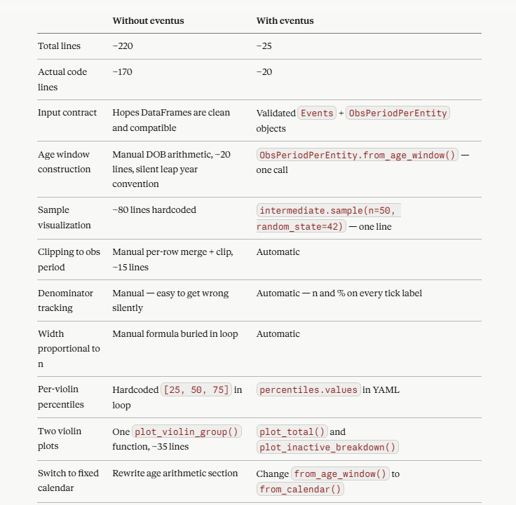

Slide 26
Five Main Abstractions
Semantics
"I know what columns mean"
EventSemantics, OccurrenceSemantics
Data Objects
"I hold clean/validated data"
Events, EventsPerEntity, Spans, Occurrences, OccurrencesPerEntity
Analyzers
"I compute shareable stuff"
EventsWithinSpanAnalyzer, OccurrencesWithinSpanAnalyzer, ***OccurrencesWithinEventsAnalyzer
Intermediates
"Pipe-delimited columnar contract"
PipeDelimitedIntermediate, PipeDelimitedIntermediateEvents, PipeDelimitedIntermediateOccurrences, ***EventsOccurrences
Visualizers
"I draw pictures"
StackedBarsPlotter(change name), ActivityOverTimePlotter, EventWithinSpanAnalysisHistogramPlotter

Slide 27
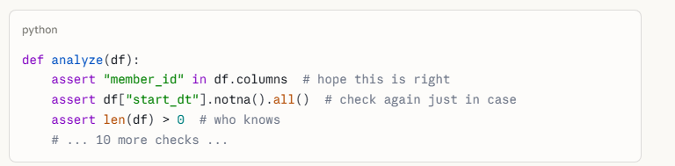
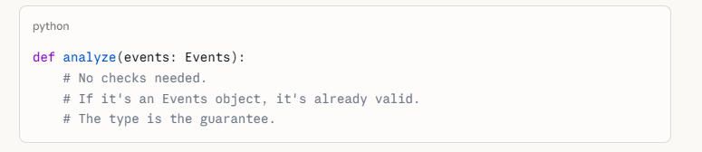
A DataFrame tells you what the numbers are. Semantics tells you what they mean. Every eventi data object carries both — so the pipeline never loses context.
Anatomy of Objects
Events
data: pd.Dataframe
semantics: EventSemantics
ObsPeriodPerEntity
data: pd.Dataframe
semantics: EventSemantics
Ocurrences
data: pd.Dataframe
semantics: OccurrenceSemantics
Why this level of abstraction:
The type is the guarantee.
No checking if the column still exists. No asserting the dates parsed correctly. No confirming the entity ID is not null. No re-validating what you already validated three functions ago. No praying that whoever called your function remembered to clean the data first.
If an Events object exists, it is clean

Slide 28
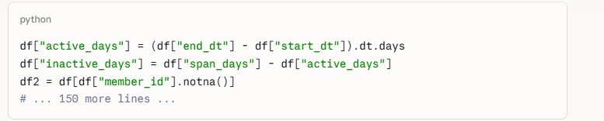

Analyzers utilize object contracts
EventsWithinSpanAnalyzer
events: Events
spans: Spans
entity_col: str
meaningful_gap: int

Slide 29
Parallelism and Composability
Events (i.e. insurance-coverage)
Occurrences
(i.e. ED day, vaccine day)
EventsWithinSpanAnalyzer
.calc_active_vs_inactive()
OccurrencesWithinSpanAnalyzer
.calc()
PipeDelimitedIntermediateEvents
.self_analyze(), .tier1/2/3()
PipeDelimitedIntermediateOccurences
.self_analyze(), .print_summary()
add objects
Plotter can therefore plot either occurrences within an span; or events within a span; or both within a span. All orchestrated by a YAML that understands the objects.
The plotter does not care which path was taken.
StackedBarsPlotter

Slide 30
Events
data: pd.Dataframe
semantics: EventSemantics
Constructor
__init__(data, semantics) -> Events
Methods
filter_by_entities(ids) -> Events
filter_by_dates(start, end) -> Events copy() -> Events build_summary() -> dict
print_summary() -> None
__len__ -> int
__repr__ -> str
EventsPerEntity
data: pd.Dataframe
semantics: EventSemantics
Constructor
__init__(data, semantics) Methods
return_as_obs_period() -> ObsPeriodPerEntity
ObsPeriodPerEntity
data: pd.Dataframe
semantics: EventSemantics
Constructors as Class Methods
construct_from_calendar(entity_ids, start, end, entity_col, identity|None)
construct_from_age_window(entity_df, dob_col, age_start, age_end, entity_col, age_unit, identity)
construct_from_events(events, identity|None)

Slide 31
Occurrences
data: pd.Dataframe
semantics: OccurrenceSemantics
Constructor
__init__(data, semantics)
Methods
filter_by_entities(ids) -> Occurrences
filter_by_dates(start, end) -> Occurrences count_per_entity() -> pd.Series
copy() -> Occurrences build_summary() -> dict
print_summary() -> None
__len__ -> int
__repr__ -> str
OccurrencesPerEntity
data: pd.Dataframe
semantics: EventSemantics
Constructor
__init__(data, semantics) Methods
filter_by_entities(ids) -> OccurrencesPerEntity
copy() -> OccurrencesPerEntity
build_obs_period(identity) -> ObsPeriodPerEntity

Slide 32
EventsWithinObsPeriodAnalyzer
events: Events
obs_period: ObsPeriodPerEntity
entity_col: str | None meaningful_gap: int
Constructor
__init__(events, obs_period, entity_col, meaningful_gap)
Methods
compute_event_coverage() -> PipeDelimitedIntermediateEvents
StackedTimelinePlotterConfig
general: GeneralConfig span: SpanConfig
event_settings: list[EventLayerConfig] occurrences_settings: list[OccLayerConfig]
legend: LegendConfig x_axis_labels: XAxisConfig
***
StackedTimelinePlotter
intermediate: PipeDelimitedIntermediate
config: StackedTimelineConfig | None
Constructor
__init__(intermediate, config)
Methods
plot(path)

Slide 36
eventi
A Domain-Agnostic Python Framework for Analyzing
Events, Spans, and Occurrences
Architecture & Design

Slide 37
The Same Challenge Appears Everywhere
Domain
Span
Events
Occurrences
Insurance
Enrollment year
Coverage periods
ED visits
Clinical Trials
Study period
Treatment windows
Adverse events
HR Analytics
Employment period
Benefit enrollment
Salary changes
Education
Academic year
Enrollment periods
Absences
No general-purpose Python tool existed for this structure — until eventi.

Slide 38
The Four-Layer Architecture
Semantics
"I know what columns mean"
EventSemantics, OccurrenceSemantics
Decouples logic from schema
Validated Objects
"My data is validated"
Events, EventsPerEntity, Occurrences
Triage, rejected rows, audit trail
Analyzers
"I compute the analysis"
EventsWithinSpansAnalyzer, OccurrencesWithinSpansAnalyzer
Single responsibility per analyzer
Intermediates
"I am the handshake"
PipeDelimitedIntermediateEvents + Occurrences
Pipe-delimited columnar contract
Visualizers
"I know how to draw"
StackedEventsPlotter, ActivityOverTimePlotter
Pure renderers, no data transforms

Slide 39
Object Hierarchy
EventSemantics
OccurrenceSemantics
Events
EventsPerEntity
Occurrences
OccurrencesPerEntity
build_span()
EventsWithinSpansAnalyzer
OccurrencesWithinSpansAnalyzer
PipeDelimitedIntermediate (base — columnar contract + combine())
PipeDelimitedIntermediateEvents
PipeDelimitedIntermediateOccurrences
StackedEventsPlotter
ActivityOverTimePlotter
EventAnalysisHistogramPlotter

Slide 40
The Pipe-Delimited Intermediate
One row per entity. Columns follow strict naming conventions.
Example row
entity_id
entity_id
M001
Required
span_start
2024-01-01
span_start / span_end
Optional pair
span_end
2024-12-31
event_starts / event_ends
Optional pair (pipe-delimited)
event_starts
2024-03-01 | 2024-07-01
occ_{identity}
One column per occurrence type
event_ends
2024-05-31 | 2024-10-01
active_days
214
occ_hepb
2024-04-15
combine() merges intermediates for joint visualization →

Slide 41
eventi as a Framework, Not Just a Package
eventi organizes and connects existing analytical tools rather than duplicating them.
lifelines
Survival analysis outputs map onto span-event structure
→ PipeDelimitedIntermediateEvents
tick
Hawkes process models fit on occurrence inter-event times
→ PipeDelimitedIntermediateOccurrences
scikit-learn
Feature matrices built from intermediate columns
→ Any ML pipeline
statsmodels
Regression on active_days, gap statistics, density
→ Any analyzer output
Any analyzer producing a PipeDelimitedIntermediate-compliant DataFrame participates in the eventi pipeline.

Slide 42
Structured APIs and LLMs are Complementary
Without eventi
With eventi
df['cov'] = (df['end'] - df['start']).dt.days mask = df['cov'] > 0 df2 = df[mask].groupby('id')... # LLM must reverse-engineer intent # from 200 lines of mutations
events = Events(df, sem) result = analyzer .calc_active_vs_inactive() # LLM reasons at object level: # which class? which analyzer? # which intermediate?
✓ Readable concepts
✓ Navigable by LLMs
❌ Hard to reason about
"Packages provide the infrastructure. LLMs navigate it."

Slide 43
From Pipeline to Insight
Stacked Events Bar
Activity Over Time
One bar per entity. Active (green), inactive (gray), gaps (red). Occurrence markers overlaid as lines or circles.
Fraction of entities active at each relative day from span start. Up/down arrows show entries and exits.
Active Days Histogram
Inactive Days Violin
Distribution of active days across entities. Percentile lines at p25/p50/p75.
Before/After/Middle/Total inactive days compared side by side. Width scaled by n.

Slide 44
What's Next
1
OccurrencesWithinEventsAnalyzer
Did the occurrence fall within an active event? Which one?
2
CrossOccurrenceAnalyzer
Time between MMR and HepB — sequence, co-occurrence, lag
3
OccurrencesPlotter
Dedicated visualizations for occurrence distributions
4
Hawkes Process Integration
Self-exciting point process modeling via tick or PoissonProcesses
5
pip install eventi
__init__.py, pyproject.toml, pytest suite, PyPI release

