Slide 1
IMT Deployment Optimization IMT Performance: Phase 3
Gregory Macfarlane, Ph.D., PE
Grant Schultz, Ph.D., PE, PTOE

Slide 2
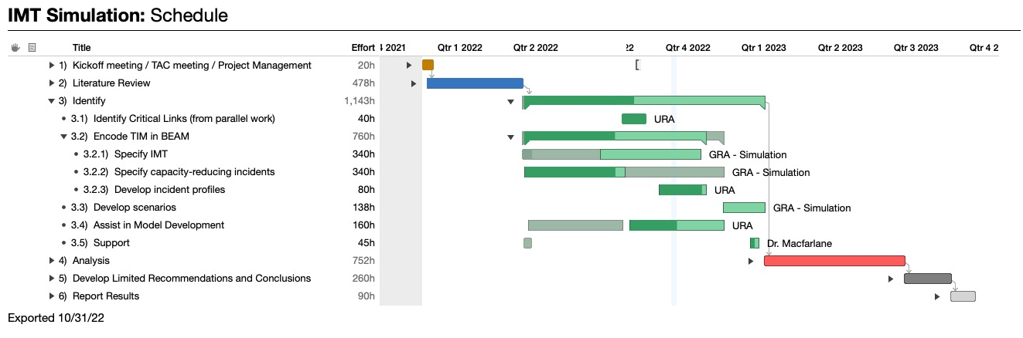
IMT Deployment Optimization

Slide 3
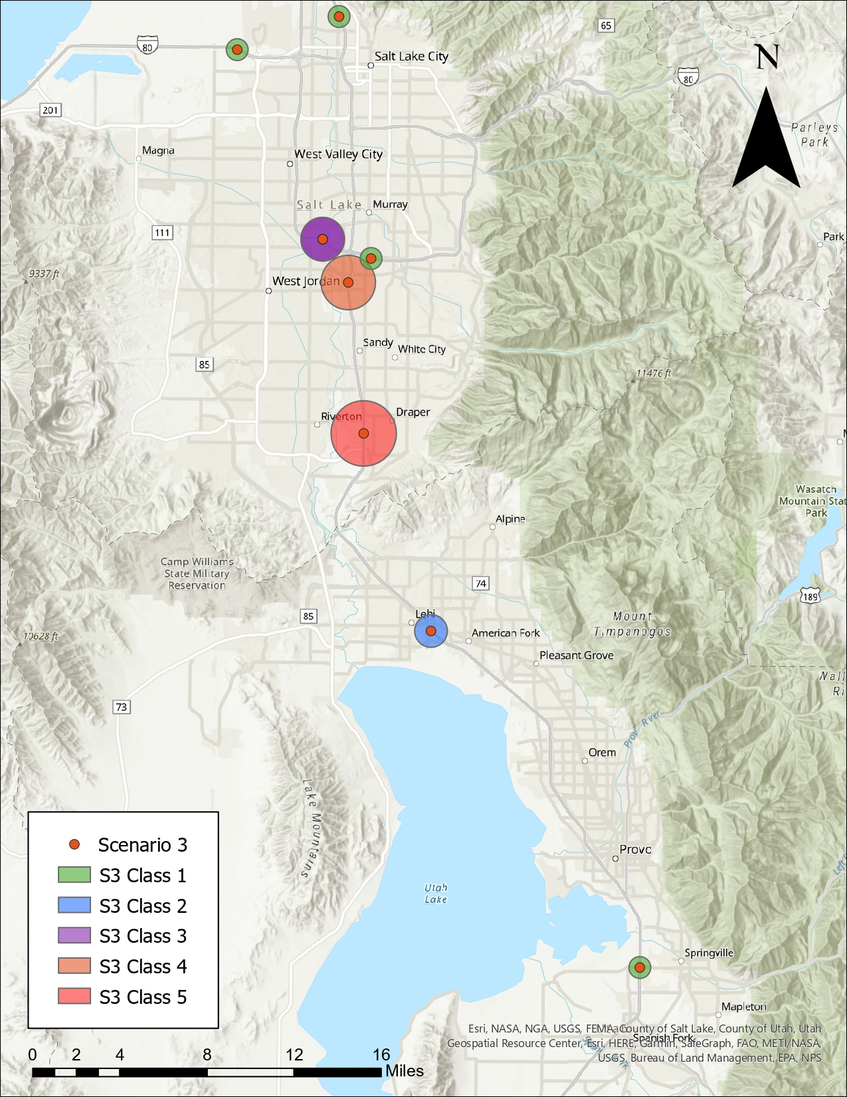
Methodology
Activity-based mesoscopic modeling
Network change events
On-demand vehicle services
Working on vehicle dispatch and IMT effect on incidents

Slide 4
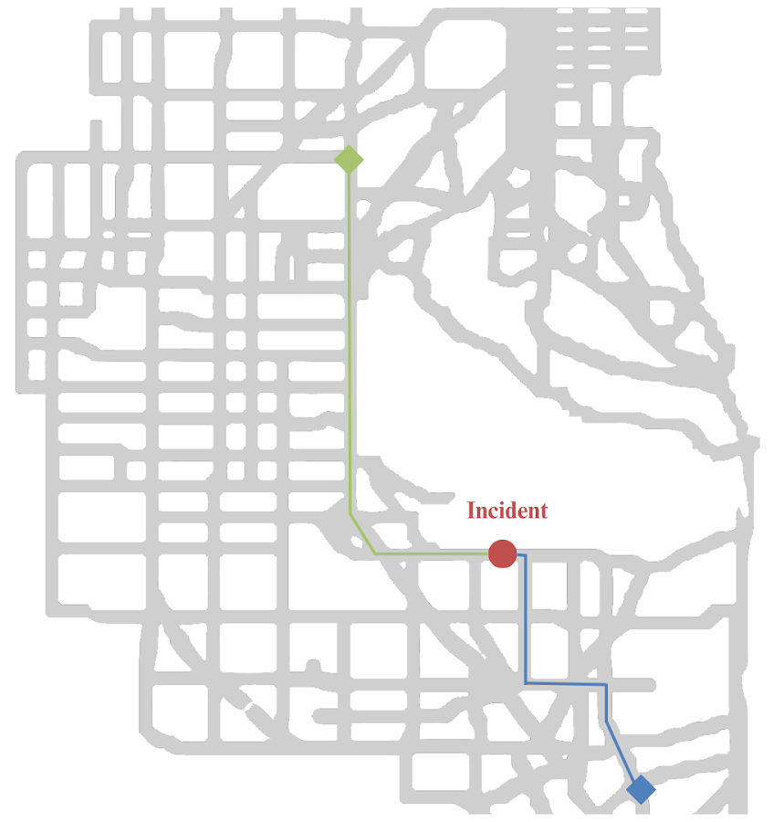
Assignment
Least-cost path (Green)
Distance shortest path (Blue)
IMT vehicles and congestion?
‘Float’ speed

Slide 5
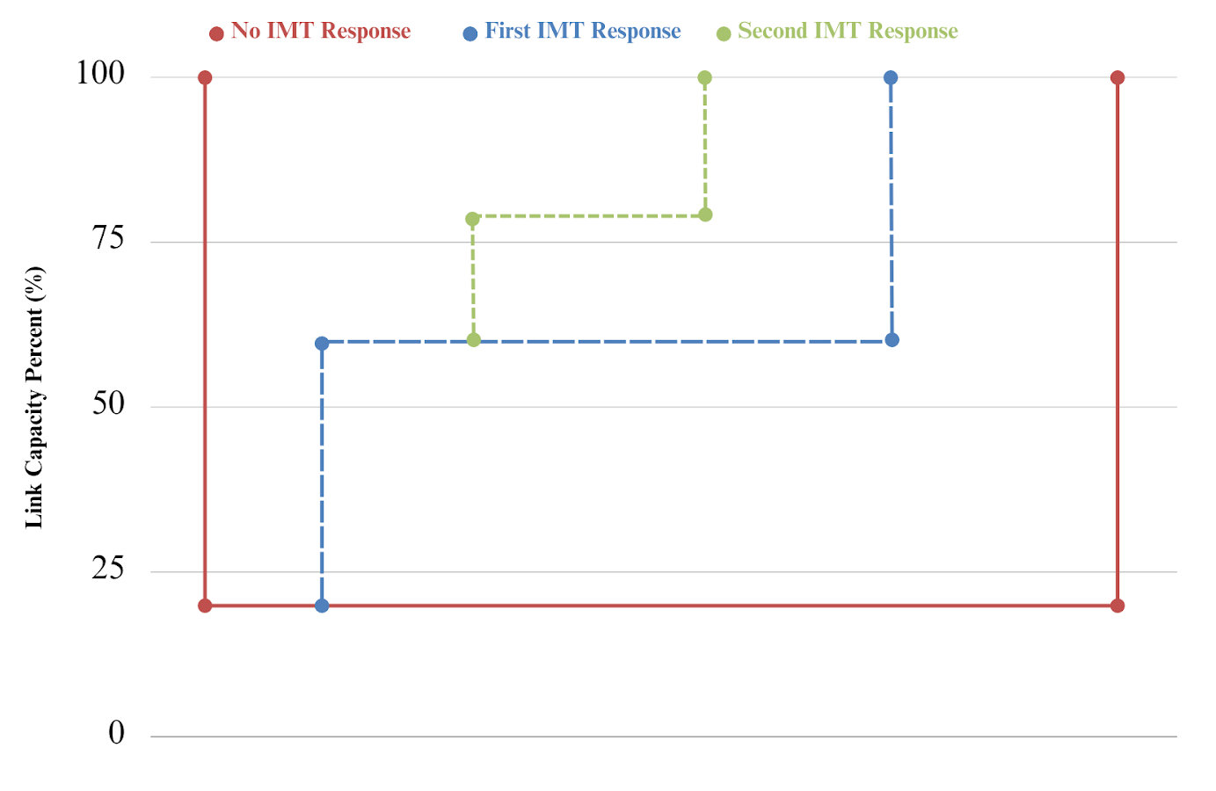
Effects on Network
Changes upon arrival
Improve capacity by ‘X’ percentage upon arrival
Move up the time for capacity to return to normal
Notes:
These are the three main studies you talk about in the lit review; let’s talk about them here. What did they do, what did they not do?
Maybe include the Ozbay minimization functions as an example.

Slide 6
Conclusion
We would like to know your thoughts on IMT dispatch and impact on incident duration.
We hope to continue this conversation in MAY, with scenarios ready for analysis.

Slide 7
Questions?

