Slide 1
Grow-plant

Slide 2
The Goal
The main goal of our project was to make a connected survey station for growing flowers.
We used three different sensors (thermistor, photosensor and a mositure sensor) and a galileo board.

Slide 3
The Plan
We quickly upgrade our original goal and aimed to use a webpage to represent our values through a graphic representation.
So we splitted the job in two parts :
The arduino application
The web application

Slide 4
The arduino
The first difficulty was to run a server on arduino.
To succeed, we used the c++ ethernet library of arduino.
Then we collected the data from teh sensor and we put them on an html page.

Slide 5
The webserver
We choose to used nodejs, express and angular 2 for the graphic front.
The web application treat the data and display them on graphics.
The difficulty was then to connect the webserver with the arduino application since the arduino application was made in windows and the webpage was made on unix.

Slide 6
Conclusion
Since our largest difficutly was compatibility conflict between the two part of the project. We should take better care of avoiding this kind of conflicts in our next project by making compability test more frequently.
At end, we got a functional application which display temperature, moisture statistics qnd lighting datas in our webpage, updated frequently.

Slide 7
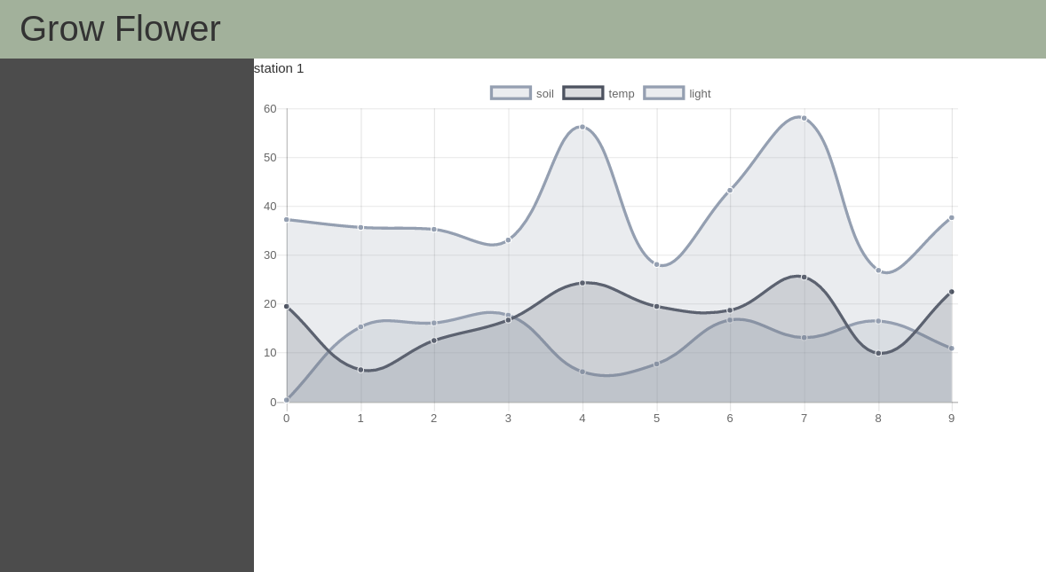
Result

