Slide 1
Fixing recursive header calls

Slide 2
Goals
Have a grid with pointers to objects
Objects themselves can make a move on the grid
  Implies including of grid header

Slide 3
class Grid {
Public:
std::vector<std::vector<grid_object*>> grid;

Slide 4
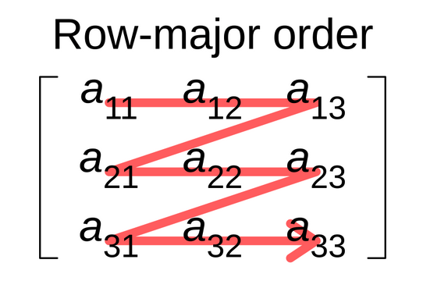
class Grid {
Public:
std::vector<grid_object*> grid;
T* operator()(int row, int col) {
return grid[row * cols + col];
}

Slide 5
grid
grid object

Slide 6
tower, etc
grid
grid object

Slide 7
Game
Player
AI
Enemy
Tower
Owner
Grid
Grid object

Slide 8
What kind of datatype should be on the grid?
  Towers, enemies, castle?
  Grid object?
  Bananas??? Firetrucks???

Slide 9
Templates!!
template <typename T>
class Grid {
std::vector<T*> grid;
grid = Grid<grid_object>(rows, cols);

Slide 10
template<typename T>
void add_obj(int row, int col, Owner<GO>* owner, Grid<GO>* grid) {
int index = owner->return_first_empty_index();
T* ptr = new T(row, col, grid);
this->grid(row, col) = ptr;
owner->operator()(index) = ptr;
}
}
this->add_obj<Tower>(5, 3, &player, &grid);

Slide 11
Game
Owner
Grid object
Grid

Slide 12
Using templates allows for more general and modular code

