Slide 1
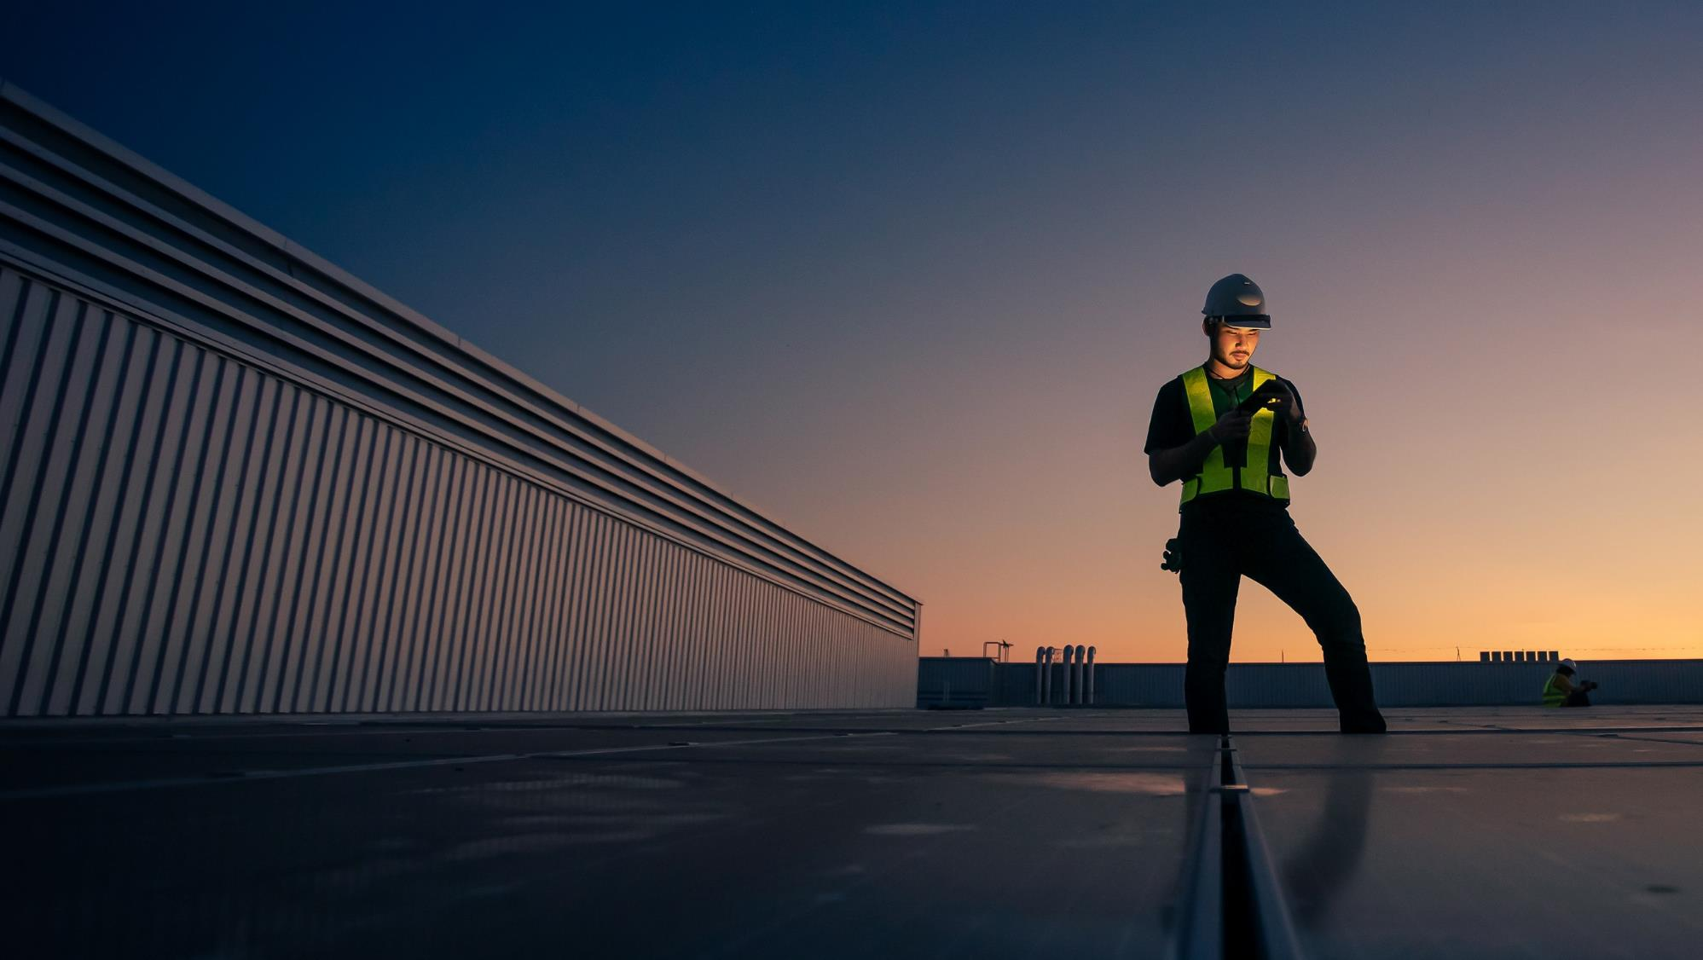

PRJ13797: JMUX Replacement Update Project Manager : Dhananjaya Gunaratne
March 2026

Slide 2
JMUX Replacement: Private Field Area Network
Goal & Objectives
Modernize PSEG LI’s substations communications by replacing legacy JMUX with MPLS nodes to deliver a reliable, scalable and future-ready network.
Objectives
Engineering Services
Detailed site surveys, rack elevations, power design, supplemental documents and as-builts
Each of the substations are fully aligned with PSEG LI standards and stakeholder buy-off
Phase 1 – All “As –Builts” for all Phases will be provided after the JMUX is decommissioned and removed from the network.
Phase 2 site surveys completed in Phase 1. BMcD is working on
Issuing (IFRs) – In Progress
Issuing for Construction (IFC) – In Progress
Procurement & Staging
All equipment purchased by PSEGLI and shipped to Hawkeye’s staging facility, date of delivery – Delivered
Construction and Installation Support
BMcD to provide on-site coordination with engineering team, technical support and commissioning oversight.
SSP document gathering for Phase 2 needs to be filled out for SSP team
Working on remote connectivity to the nodes.
SCOPE | SUBSTATIONS | MPLS SITES | DF RTU SITES | RADIO SHELTER SITES | NOKIA MPLS NODES
PHASE 1 | 49 | 26 | 17 | 6 | 31
PHASE 2 | 45 | 26 | 12 | 7 | 26
PHASE 3 | 35 | 22 | 7 | 6 | 22
TOTAL SCOPE | 129 | 74 | 36 | 19 | 79

Slide 3
Phase-1
Engineering Services
Procurement and Staging
Nokia equipment for Phase 2 has been delivered – Work Completed - 2/19/2026
Equipment moved to new Staging location – Work Completed – 3/05/2026
Call setup with B&M to go over equipment list for Phase 2 – 3/30/2026
Construction and Installation Support
Cat 6 cables needs to be run to NSP in Hicksville – Work Completed
OTDR testing from Hicksville to Syosset – Work Completed
iLO corporate connectivity interfaces turned up at Melville and Hicksville – Work in Progress
BGP design approved 3/16 — Lee Blackman to proceed with Melville & Hicksville
as soon as iLO connectivity is completed – Work in Progress
Remote access into routers (31) to configure routers as per the SSP docs – Work in Progress
Verification of remote access to NSP from Melville and Hicksville. – Work in Progress
.
Highlight Project Accomplishments
Burns & Mac - Phase 1 | Total | Completed
IFR - Issued for review design | 31 | 31
IFC - Issued for construction | 31 | 31
Total Phase 1 scope
Initiation & Planning | 100%
Site Surveys | 100%
Test Plan | 100%
HLD | 100%
IFR/IFC | 100%
Procurement | 100%
Staging | 100%
Field Installation | 100%
Deployment - CWDM | 100%
Pre-Deployment Deployment - Security & Radio | 5%
Deployment - Relay/RTU Cutover | not started

Slide 4
Phase 1 – Layer 1-3 configuration – Next steps
Mobilization | Description | Responsible Stakeholder | Present On Site | Estimated Duration/Site
Initial Installation | • Install power feeds - Completed • Power MPLS router - Completed • Install new communication cables - Completed | Hawkeye | Hawkeye, BMcD, PSEGLI | 5 days
Fiber Integration | • JMUX OC-48 Circuits & Nokia MPLS over CWDM filters - Completed • Establish new MPLS parallel links - Completed • Establish Nokia parallel network & connectivity - Completed | PSEGLI | BMcD, PSEGLI | 1 Week
Layer 3 Connect | • Establish Ethernet circuits with Nokia MPLS in paralled with JMUX where possible • Security • FEMA DA • Two-way Radio • DSCADA • MicroPAQ | BMcD, PSEGLI | BMcD | 5 days
Layer 1 | • Cutover of relay and RTU circuits from JMUX to MPLS • Cutover any other circuits (PAR, DRD, etc.) as possble • Only RTUs/Circuits with no dependency on other JMUX rings | PSEGLI (Relay) | BMcD, PSEGLI | 5 days

Slide 6
Phase 2 Site Surveys: ✅ Complete
# | Substation | Site Survey | IFR | IFC | Construction | Deployment
1 | 7RM Bayport | Complete | Tue 5/26/26 | Tue 6/23/26 | Wed 8/26/26 | Mon 9/23/26
2 | 7R Sayville | Complete | Mon 5/18/26 | Tue 6/16/26 | Wed 8/26/26 | Mon 9/23/26
3 | 7XM Great River | Complete | Tue 6/2/26 | Tue 6/30/26 | Wed 9/2/26 | Thu 9/24/26
4 | 7XM Great River Radio Shelter | Complete | Tue 6/2/26 | Tue 6/30/26 | Wed 9/2/26 | Thu 9/24/26
5 | 6H Hauppauge | Complete | Mon 4/20/26 | Mon 5/18/26 | Wed 8/12/26 | Mon 9/14/26
6 | 6H Hauppauge Tower | Complete | Mon 4/20/26 | Mon 5/18/26 | Wed 8/12/26 | Mon 9/14/26
7 | 6S Kings Hwy | Complete | Fri 3/13/26 | Tue 5/26/26 | Wed 8/12/26 | Fri 9/18/26
8 | Brentwood DO | Complete | Tue 5/26/26 | Tue 6/23/26 | Wed 9/2/26 | Fri 9/25/26
9 | 7H Babylon | Complete | Mon 5/11/26 | Tue 6/9/26 | Wed 8/12/26 | Mon 9/21/26
10 | 7H Babylon Radio Shelter | Complete | Mon 5/11/26 | Tue 6/9/26 | Wed 8/12/26 | Tue 9/22/26
11 | 7D West Babylon | Complete | Mon 5/4/26 | Tue 6/2/26 | Wed 8/12/26 | Mon 9/21/26
12 | 7D West Babylon Radio Shelter | Complete | Mon 5/4/26 | Tue 6/2/26 | Wed 8/19/26 | Mon 9/21/26
13 | 7W Berry St | Complete | Mon 3/30/26 | Tue 6/23/26 | Wed 8/19/26 | Mon 9/23/26
14 | 3J Whiteside | Complete | Mon 4/6/26 | Mon 5/4/26 | Wed 8/12/26 | Mon 9/14/26
15 | 2K Valley Stream | Complete | Tue 2/23/26 | Mon 3/9/26 | Wed 8/5/26 | Mon 9/14/26
2025 Phase-1 Substation Schedule 31 Sites (2 of 2)

Slide 7
Phase 2 Site Surveys: ✅ Complete
# | Substation | Site Surveys | IFR | IFC | Construction | Deployment
16 | 2RB Green Acres | Complete | Mon 3/30/26 | Mon 4/6/26 | Wed 8/5/26 | Mon 9/14/26
17 | Hewlett DO | Complete | Tue 6/2/26 | Tue 6/30/26 | Wed 9/2/26 | Fri 9/25/26
18 | 2ZB EF Barrett PS Inside | Complete | Mon 3/23/26 | Mon 4/20/26 | Wed 8/5/26 | Mon 9/14/26
19 | 2WB Barrett Outside | Complete | Mon 3/23/26 | Mon 4/6/26 | Wed 8/5/26 | Mon 9/14/26
20 | 5HK Hicksville | Complete | Tue 6/2/26 | Tue 6/30/26 | Tue 9/8/26 | Mon 9/28/26
21 | 2H Far Rockaway | Complete | Tue 2/23/26 | Mon 3/9/26 | Wed 8/5/26 | Mon 9/14/26
22 | 2KB Cedarhurst | Complete | Tue 2/23/26 | Mon 3/9/26 | Wed 8/5/26 | Mon 9/14/26
23 | 2R Hewlett | Complete | Mon 2/23/26 | Mon 3/23/26 | Wed 8/5/26 | Mon 9/14/26
24 | 2R Hewlett Shelter | Complete | Mon 2/23/26 | Mon 3/23/26 | Wed 8/5/26 | Mon 9/14/26
25 | 4M Baldwin | Complete | Mon 4/13/26 | Mon 5/11/26 | Wed 8/12/26 | Mon 9/14/26
26 | 4M1 Baldwin Shelter | Complete | Mon 4/13/26 | Mon 5/11/26 | Wed 8/12/26 | Mon 9/14/26
27 | 6K State School | Complete | Mon 4/20/26 | Mon 5/18/26 | Wed 8/12/26 | Fri 9/17/26
28 | 7BH Bohemia | Complete | Fri 3/13/26 | Tue 5/26/26 | Wed 8/12/26 | Fri 9/18/26
29 | 7M MacArthur | Complete | Mon 5/18/26 | Tue 6/16/26 | Wed 8/26/26 | Mon 9/22/26
2025 Phase-1 Substation Schedule 31 Sites (2 of 2)

Slide 8
Phase 2 Site Surveys: ✅ Complete
# | Substation | Site Surveys | IFR | IFC | Construction | Deployment
30 | 8AX Patchogue | Complete | Tue 6/9/26 | Wed 7/8/26 | Wed 9/2/26 | Fri 9/25/26
31 | 8AX Patchogue Shelter | Complete | Tue 6/9/26 | Wed 7/8/26 | Wed 9/2/26 | Fri 9/25/26
32 | 7Z Lindenhurst | Complete | Tue 6/2/26 | Tue 6/30/26 | Wed 9/2/26 | Thu 9/24/26
33 | 7J Sterling | Complete | Mon 3/30/26 | Tue 6/9/26 | Wed 8/26/26 | Mon 9/22/26
34 | 7UM South Farmingdale | Complete | Tue 5/26/26 | Tue 6/23/26 | Wed 8/26/26 | Mon 9/23/26
35 | ACC | Complete | Tue 6/9/26 | Wed 7/8/26 | Tue 9/8/26 | Mon 9/28/26
36 | 6U Ruland | Complete | Tue 6/2/26 | Tue 6/30/26 | Tue 9/8/26 | Mon 9/28/26
2025 Phase-1 Substation Schedule 31 Sites (2 of 2)

Slide 9
Schedule Status
Overall: 🟡 Yellow | Recovery Plan in Place
Recovery Actions:
SCHEDULE PERFORMANCE INDEX (SPI)
--- March 2026 : 0.76 (Yellow ↓)
ILO config (Bill/B&M + Rahiq) 🔴 → BGP config Hicksville & Melville (Lee) → Remote access 31 routers → App cutovers → RTU cutovers → Phase 1 close Jun 2026 SPI = 0.76 (Yellow). ILO is now #1 critical path blocker. Phase 1 construction 100% done; deployment ~5%. June 2026 revised target. Northport DC power RESOLVED ✅ (3/18/2026) — relay team ran new feed. Phase 2 IFR/IFC on track.
"Review the initial project plan vs new plan to determine the SPI." — Vik SPI = 0.76 (Yellow). NSP is sole remaining blocker. Phase 1 construction 100% done; deployment micro-phase ~5%. June 2026 revised target.
Phase 2 IFR/IFC design on track.
--- February 2026 : 0.75 (Orange)
1.00
0.75
1.25
╌╌ January 2026 : 1.00 (Gray)
●
0.50
1.50
Below 0.70 — Critical
●
0.70–0.90 — Yellow
●
0.90–1.10 — On Track
Above 1.10 — Ahead
●
Root Causes:
• SSP documentation delays (security review queue)
0.00
2.00
• CMDB update coordination time
Week | Dates | Planned site (PV) | Actual Sites Completed (EV) | Weekly SPI | Culmative SPI | Key Notes
Northport Fuse issue | 2/26/2026 | 1 milestone (ILO config due) | 0 (DC power blocked) | 0.00 | 0.75 | Northport fuse tripping — ILO work blocked. DC power issue unresolved. Relay team engaged.
OTDR Testing from Syosset to Hicksville, link now active | 3/9/2026 | 1 milestone (OTDR confirm) | 1 (OTDR complete ✅) | 1.00 | 0.75 | OTDR confirmed bad filter at Hicksville. Link now active. Crown Castle issue cleared. ✅
NSP cable run and terminated | 3/10/2026 | 1 milestone (NSP fiber term) | 1 (complete ✅) | 1.00 | 0.76 | Fiber run to NSP completed & terminated at Hicksville by Hawkeye. ✅
BGP design approved | 3/16/2026 | 1 milestone (BGP approval) | 1 (approved ✅) | 1.00 | 0.76 | BGP design formally approved. Lee to begin change docs for Hicksville & Melville. ✅
Moved all eqpt to new Hawkeye trailer for future staging . | 3/10/2026 | 0 (logistics task) | 0.5 (complete ✅) | N/A | 0.76 | Phase 2 Nokia equipment moved to new Hawkeye staging trailer. Not on critical path.
PSEG Long Island | JMUX Replacement Program | Confidential | March 2026

Slide 10
Financials (2024-2026)

Slide 11
Next Steps
✅ Northport DC power RESOLVED (3/18) — relay team ran new feed. 🔴 ILO config — Bill (B&M) working with Rahiq/Brianna to resolve console cable & firmware. #1 blocker. 🔴 BGP config at Hicksville & Melville (Lee) — pending ILO completion. 🔴 Remote access config — 31 routers pending BGP completion. after cabling/OTDR so we can shift to “remote-first” execution.
Start router configuration on the powered routers for Ring 1 and Ring 6 (remote workstream), with standard config + validation.
Current Risk
Legacy JMUX equipment old and delicate. Potential for Outage.
Ran into faulty connectors that are over25 years old and not readily available with vendors.
Potential brittle fiber patch panels, Face plates, connectors and cables.
Weather delay and delay in installing the equipment at sub-station (tracking weekly).
Other major substation project conflicts.

