Slide 1
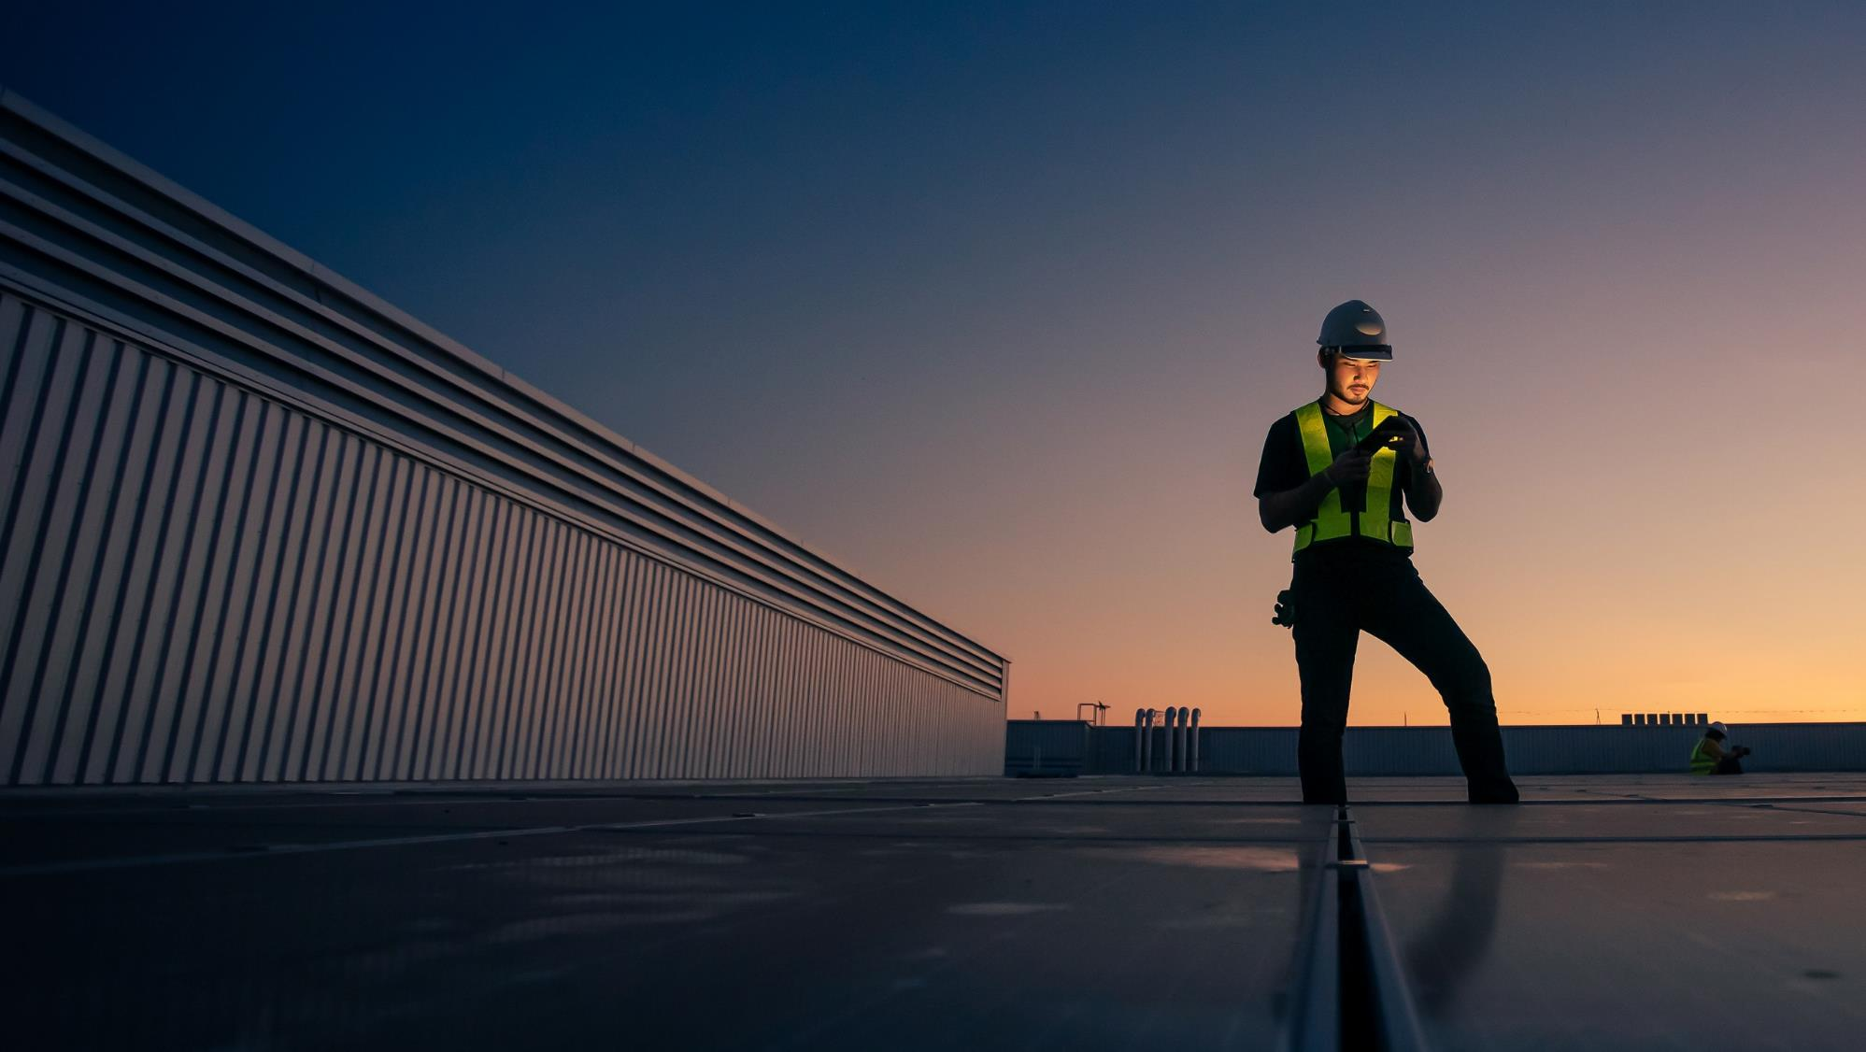

PRJ13797: JMUX Replacement Update Project Manager : Dhananjaya Gunaratne
April 2026

Slide 2
Goal & Objectives
Modernize PSEG LI’s substation communications by replacing legacy JMUX with MPLS nodes to deliver a reliable, scalable and future-ready network.
Objectives
Engineering Services (Burns & McDonnell)
Site surveys, rack elevations, power & cabling design
Node Design – Produce IFR, IFC and As-Built documents
Procurement & Staging (Burns & McDonnell, Nokia, Graybar)
Bill Of Materials creation, MPLS Equipment order, Power and ancillary equipment(Patch panels, Fiber cables, mounting kits etc.)
Construction and Installation Support (Burns & McDonnell, Hawkeye)
BMcD to provide on-site coordination with engineering team, technical support and commissioning oversight.
Hawkeye to assist with shipment, racking, stacking and power during staging. Perform site surveys for construction support. Install all equipment per the approved IFC document
Run Fiber or copper cabling as per the construction documents.
Deployment and Application Migration (PSEG, Burns & McDonnell)
Design and configure Layer 3 networks
Pre-stage the application connectivity
Migrate production applications
SCOPE | SUBSTATIONS | MPLS SITES | DF RTU SITES | RADIO SHELTER SITES | NOKIA MPLS NODES
PHASE 1 | 49 | 26 | 17 | 6 | 31
PHASE 2 | 45 | 26 | 12 | 7 | 26
PHASE 3 | 35 | 22 | 7 | 6 | 22
TOTAL SCOPE | 129 | 74 | 36 | 19 | 79

Slide 5
JMUX Replacement: Private Field Area Network
Phase 2 Site Surveys: ✅ Complete
# | Substation | Site Survey | IFR | IFC | Construction | Deployment
1 | 7RM Bayport | Complete | Tue 5/26/26 | Tue 6/23/26 | Wed 8/26/26 | Mon 9/23/26
2 | 7R Sayville | Complete | Mon 5/18/26 | Tue 6/16/26 | Wed 8/26/26 | Mon 9/23/26
3 | 7XM Great River | Complete | Tue 6/2/26 | Tue 6/30/26 | Wed 9/2/26 | Thu 9/24/26
4 | 7XM Great River Radio Shelter | Complete | Tue 6/2/26 | Tue 6/30/26 | Wed 9/2/26 | Thu 9/24/26
5 | 6H Hauppauge | Complete | Mon 4/20/26 | Mon 5/18/26 | Wed 8/12/26 | Mon 9/14/26
6 | 6H Hauppauge Tower | Complete | Mon 4/20/26 | Mon 5/18/26 | Wed 8/12/26 | Mon 9/14/26
7 | 6S Kings Hwy | Complete | Mon 3/31/26 | Mon 3/31/26 | Wed 8/12/26 | Fri 9/18/26
8 | Brentwood DO | Complete | Tue 5/26/26 | Tue 6/23/26 | Wed 9/2/26 | Fri 9/25/26
9 | 7H Babylon | Complete | Mon 5/11/26 | Tue 6/9/26 | Wed 8/12/26 | Mon 9/21/26
10 | 7H Babylon Radio Shelter | Complete | Mon 5/11/26 | Tue 6/9/26 | Wed 8/12/26 | Tue 9/22/26
11 | 7D West Babylon | Complete | Mon 5/4/26 | Tue 6/2/26 | Wed 8/12/26 | Mon 9/21/26
12 | 7D West Babylon Radio Shelter | Complete | Mon 5/4/26 | Tue 6/2/26 | Wed 8/19/26 | Mon 9/21/26
13 | 7W Berry St | Complete | Mon 3/31/26 | Tue 4/21/26 | Wed 8/19/26 | Mon 9/23/26
14 | 3J Whiteside | Complete | Mon 4/13/26 | Tue 4/21/26 | Wed 8/12/26 | Mon 9/14/26
15 | 2K Valley Stream | Complete | Tue 2/23/26 | Mon 3/9/26 | Wed 8/5/26 | Mon 9/14/26
2025 Phase-1 Substation Schedule 31 Sites (2 of 2)

Slide 6
JMUX Replacement: Private Field Area Network
Phase 2 Site Surveys: ✅ Complete
# | Substation | Site Surveys | IFR | IFC | Construction | Deployment
16 | 2RB Green Acres | Complete | Mon 3/31/26 | Tue 4/21/26 | Wed 8/5/26 | Mon 9/14/26
17 | Hewlett DO | Complete | Tue 6/2/26 | Tue 6/30/26 | Wed 9/2/26 | Fri 9/25/26
18 | 2ZB EF Barrett PS Inside | Complete | Mon 5/11/26 | Mon 6/15/26 | Wed 8/5/26 | Mon 9/14/26
19 | 2WB Barrett Outside | Complete | Mon 5/11/26 | Mon 6/6/26 | Wed 8/5/26 | Mon 9/14/26
20 | 5HK Hicksville | Complete | Tue 6/2/26 | Tue 6/30/26 | Tue 9/8/26 | Mon 9/28/26
21 | 2H Far Rockaway | Complete | Tue 2/23/26 | Mon 3/9/26 | Wed 8/5/26 | Mon 9/14/26
22 | 2KB Cedarhurst | Complete | Tue 2/23/26 | Mon 3/9/26 | Wed 8/5/26 | Mon 9/14/26
23 | 2R Hewlett | Complete | Mon 5/04/26 | Mon 5/11/26 | Wed 8/5/26 | Mon 9/14/26
24 | 2R Hewlett Shelter | Complete | Mon 5/04/26 | Mon 5/11/26 | Wed 8/5/26 | Mon 9/14/26
25 | 4M Baldwin | Complete | Mon 5/04/26 | Mon 5/11/26 | Wed 8/12/26 | Mon 9/14/26
26 | 4M1 Baldwin Shelter | Complete | Mon 5/04/26 | Mon 5/11/26 | Wed 8/12/26 | Mon 9/14/26
27 | 6K State School | Complete | Mon 5/20/26 | Mon 6/18/26 | Wed 8/12/26 | Fri 9/17/26
28 | 7BH Bohemia | Complete | Mon 3/31/26 | Tue 4/21/26 | Wed 8/12/26 | Fri 9/18/26
29 | 7M MacArthur | Complete | Mon 5/18/26 | Tue 6/16/26 | Wed 8/26/26 | Mon 9/22/26
2025 Phase-1 Substation Schedule 31 Sites (2 of 2)

Slide 7
JMUX Replacement: Private Field Area Network
Phase 2 Site Surveys: ✅ Complete
# | Substation | Site Surveys | IFR | IFC | Construction | Deployment
30 | 8AX Patchogue | Complete | Tue 6/9/26 | Wed 7/8/26 | Wed 9/2/26 | Fri 9/25/26
31 | 8AX Patchogue Shelter | Complete | Tue 6/9/26 | Wed 7/8/26 | Wed 9/2/26 | Fri 9/25/26
32 | 7Z Lindenhurst | Complete | Tue 4/27/26 | Mon 5/11/26 | Wed 9/2/26 | Thu 9/24/26
33 | 7J Sterling | Complete | Mon 3/31/26 | Tue 4/21/26 | Wed 8/26/26 | Mon 9/22/26
34 | 7UM South Farmingdale | Complete | Tue 5/26/26 | Tue 6/23/26 | Wed 8/26/26 | Mon 9/23/26
35 | ACC | Complete | Tue 6/9/26 | Wed 7/8/26 | Tue 9/8/26 | Mon 9/28/26
36 | 6U Ruland | Complete | Tue 6/2/26 | Tue 6/30/26 | Tue 9/8/26 | Mon 9/28/26
2025 Phase-1 Substation Schedule 31 Sites (2 of 2)

Slide 8
Financials (2024-2026)
Category | 2024 Actuals | 2025 Actuals | 2026 Actuals | Program Total | % of Program
Internal Labor | $29,357.90 | $181,290.67 | $28,272.39 | $238,920.96 | ~5%
Materials | $601,379.80 | $371,819.58 | $46,040.04 | $1,019,239.42 | ~25%
Outside Services | $103,408.84 | $2,482,742.20 | $1,698,535.37 | $4,284,686.41 | ~67%
Assessments | $7,059.70 | $94,267.21 | $16,970.35 | $118,297.26 | ~3%
TOTAL | $741,206.24 | $3,130,319.66 | $1,789,818.15 | $5,661,344.05 | 100%

Slide 9
Next Steps & Current Risks
PRJ13797: JMUX Replacement | PSEG Long Island | April 2026
📋 Next Steps
1
Work with B&M to test the RTU circuit that was run by CNI team.
Complete testing on test RTU and work with B&M to go over MOP to move production RTU.
2
3
Follow up with Hawkeye to make sure the site surveys are scheduled for Phase 2 sites. 9/36 IFCs sent to Hawkeye.
4
Track PAR control design and equipment ordered for 6 sites.
5
Keep tracking IFR/IFCs – 9/36 received to date.
⚠️ Current Risks
🟡
Legacy JMUX equipment is over 25 years old and brittle — faulty connectors, potential brittle fiber patch panels, face plates, connectors and cables. Potential for Outage.
🟡
Weather (Heat)
🟡
Potential Schedule delays due to other major substation project conflicts.
PSEG Long Island | JMUX Replacement Program | PRJ13797 | Confidential | April 2026

