Slide 1
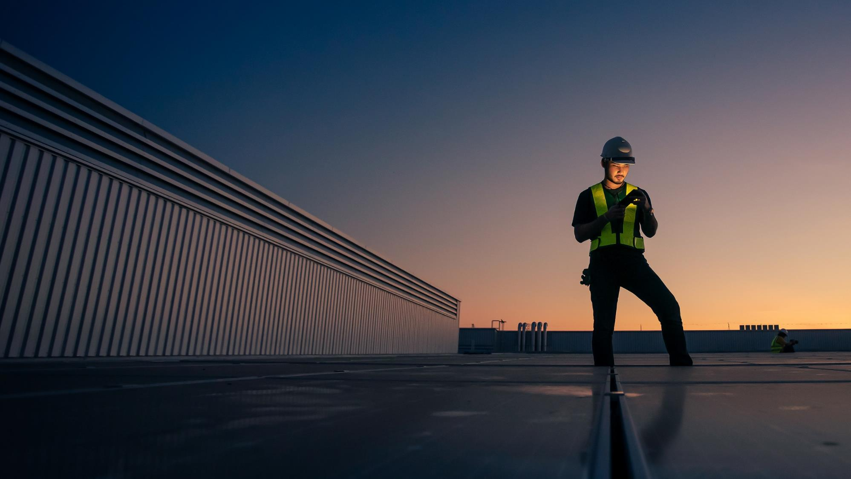

PRJ13797: JMUX Replacement Update Project Manager : Dhananjaya Gunaratne
April 2026

Slide 2
Goal & Objectives
Modernize PSEG LI’s substation communications by replacing legacy JMUX with MPLS nodes to deliver a reliable, scalable and future-ready network.
Objectives
Engineering Services (Burns & McDonnell)
Site surveys, rack elevations, power & cabling design
Node Design – Produce IFR, IFC and As-Built documents
Procurement & Staging (Burns & McDonnell, Nokia, Graybar)
Bill Of Materials creation, MPLS Equipment order, Power and ancillary equipment(Patch panels, Fiber cables, mounting kits etc.)
Construction and Installation Support (Burns & McDonnell, Hawkeye)
BMcD to provide on-site coordination with engineering team, technical support and commissioning oversight.
Hawkeye to assist with shipment, racking, stacking and power during staging. Perform site surveys for construction support. Install all equipment per the approved IFC document
Run Fiber or copper cabling as per the construction documents.
Deployment and Application Migration (PSEG, Burns & McDonnell)
Design and configure Layer 3 networks
Pre-stage the application connectivity
Migrate production applications
SCOPE | SUBSTATIONS | MPLS SITES | DF RTU SITES | RADIO SHELTER SITES | NOKIA MPLS NODES
PHASE 1 | 49 | 26 | 17 | 6 | 31
PHASE 2 | 45 | 26 | 12 | 7 | 26
PHASE 3 | 35 | 22 | 7 | 6 | 22
TOTAL SCOPE | 129 | 74 | 36 | 19 | 79

Slide 4
PAR Circuit Migration — Background & Discovery
PRJ13797: JMUX Replacement | PSEG Long Island | April 2026
📌 WHAT IS PAR CIRCUIT MIGRATION?
🔍 HOW WAS THE FULL SCOPE DISCOVERED?
▸ 6 high-voltage substations require serial-to-IP conversion to connect legacy RTUs to the new Nokia MPLS network
▸ Sites: Northport · Hicksville (5HK) · Melville · Lindenhurst (7Z) · Far Rockaway (2H) · Hewlett (2R)
▸ NERC CIP compliance MANDATES an intermediary system — direct Nokia-to-RTU connection is not supported
▸ Solution selected: Iniven RC-30 — converts direct contact signals to C37.94 IP protocol
▸ No alternative solution exists — compliance is non-negotiable
▸ During Phase 2 detailed site surveys, the relay team was formally engaged for the first time
▸ Site-by-site review of existing RTU technology (SEL-2595 systems) revealed full technical & compliance scope
▸ 6 specific high-impact substations identified as requiring a dedicated intermediary solution
▸ True level of effort and cost first identified at this point — NOT a project management oversight
❓ WHY WASN'T THIS FULLY SCOPED IN 2024?
✅ WHAT WAS EVALUATED & DECIDED
▸ During 2024 kickoff meetings , PAR was acknowledged at a HIGH LEVEL ONLY
no detailed design, cost, or schedule produced
▸ IN 2024 discussion indicated design cost would fall on the technical security team
no dollar figure was agreed upon
▸ PAR was a Phase 3 placeholder with a rough budget of ~$30K–$40K for general support only
▸ Consistent with project methodology — detailed requirements confirmed during each phase's site surveys
▸ All available technology options reviewed at each of the 6 substations
▸ NERC CIP compliance requirements assessed for each site
▸ Only viable compliant solution confirmed: Iniven RC-30 intermediary device
▸ Chakrapani's T&D team engaged for engineering design
▸ PO placed for RC-30 equipment — 8-week lead time
▸ Proactively engaging ALL Phase 3 stakeholders now to prevent further scope gaps
PSEG Long Island | JMUX Replacement Program | PRJ13797 | Confidential | April 2026

Slide 5
PAR Circuit Migration — Schedule & Financial Impact
PRJ13797: JMUX Replacement | PSEG Long Island | April 2026
💰 FINANCIAL IMPACT — ADDITIONAL UNBUDGETED FUNDING REQUIRED
Cost Component
Team Responsible
Est. Cost
Status
Iniven RC-30 Equipment (6 sites)
Iniven (Vendor)
~$59,500
PO Placed ✅
PAR Engineering Design
Chakrapani / T&D Team
TBD *
In Progress ⏳
Installation, Config & Cutover Labor
Relay Team — Johnny's Team
~$495,000 **
Not Started 🔴
TOTAL ADDITIONAL FUNDING REQUIRED
~$550,000+
* Engineering design cost TBD — to be confirmed once Chakrapani's team completes design scope
** Relay labor rate (~$1,100–$1,200/hr) and total hours per site being confirmed with Ethan & Chad
⚠ Chad's current Apr–Jun forecast = $120K (equipment + design only). $495K relay labor NOT YET included — to be spread across months once design is complete.
📅 SCHEDULE IMPACT
🔄 RECOVERY PLAN & ACTIONS TAKEN
▸ Direct schedule impact: ~2–3 months
▸ PAR work running IN PARALLEL with Phase 2 construction — not on critical path
▸ Phase 3 site surveys & detail design accelerated into Phase 2 staging window (~Aug 2026)
▸ Ethan confirmed: Phase 3 engineering starts as soon as Phase 2 staging begins
▸ B&M Phase 3 design: estimated Jun–Dec 2026 (~$900K–$1.29M — to be confirmed)
▸ Projected full recovery: End of 2026
✅ Iniven RC-30 PO placed — equipment on order, 8-week lead time
✅ Chakrapani's team engaged for PAR engineering design
✅ PAR migration parallelized — no impact to Phase 2 deployment critical path
✅ Phase 3 engineering accelerated — site surveys start at Phase 2 staging
✅ CIO (Greg) informed informally at All Hands — not a surprise
⏳ Formal budget Change Request to be submitted
⏳ Relay labor ($495K) to be spread across months.
PSEG Long Island | JMUX Replacement Program | PRJ13797 | Confidential | April 2026

Slide 7
JMUX Replacement: Private Field Area Network
Phase 2 Site Surveys: ✅ Complete
# | Substation | Site Survey | IFR | IFC | Construction | Deployment
1 | 7RM Bayport | Complete | Tue 5/26/26 | Tue 6/23/26 | Wed 8/26/26 | Mon 9/23/26
2 | 7R Sayville | Complete | Mon 5/18/26 | Tue 6/16/26 | Wed 8/26/26 | Mon 9/23/26
3 | 7XM Great River | Complete | Tue 6/2/26 | Tue 6/30/26 | Wed 9/2/26 | Thu 9/24/26
4 | 7XM Great River Radio Shelter | Complete | Tue 6/2/26 | Tue 6/30/26 | Wed 9/2/26 | Thu 9/24/26
5 | 6H Hauppauge | Complete | Mon 4/20/26 | Mon 5/18/26 | Wed 8/12/26 | Mon 9/14/26
6 | 6H Hauppauge Tower | Complete | Mon 4/20/26 | Mon 5/18/26 | Wed 8/12/26 | Mon 9/14/26
7 | 6S Kings Hwy | Complete | Mon 3/31/26 | Mon 3/31/26 | Wed 8/12/26 | Fri 9/18/26
8 | Brentwood DO | Complete | Tue 5/26/26 | Tue 6/23/26 | Wed 9/2/26 | Fri 9/25/26
9 | 7H Babylon | Complete | Mon 5/11/26 | Tue 6/9/26 | Wed 8/12/26 | Mon 9/21/26
10 | 7H Babylon Radio Shelter | Complete | Mon 5/11/26 | Tue 6/9/26 | Wed 8/12/26 | Tue 9/22/26
11 | 7D West Babylon | Complete | Mon 5/4/26 | Tue 6/2/26 | Wed 8/12/26 | Mon 9/21/26
12 | 7D West Babylon Radio Shelter | Complete | Mon 5/4/26 | Tue 6/2/26 | Wed 8/19/26 | Mon 9/21/26
13 | 7W Berry St | Complete | Mon 3/31/26 | Tue 4/21/26 | Wed 8/19/26 | Mon 9/23/26
14 | 3J Whiteside | Complete | Mon 4/13/26 | Tue 4/21/26 | Wed 8/12/26 | Mon 9/14/26
15 | 2K Valley Stream | Complete | Tue 2/23/26 | Mon 3/9/26 | Wed 8/5/26 | Mon 9/14/26
2025 Phase-1 Substation Schedule 31 Sites (2 of 2)

Slide 8
JMUX Replacement: Private Field Area Network
Phase 2 Site Surveys: ✅ Complete
# | Substation | Site Surveys | IFR | IFC | Construction | Deployment
16 | 2RB Green Acres | Complete | Mon 3/31/26 | Tue 4/21/26 | Wed 8/5/26 | Mon 9/14/26
17 | Hewlett DO | Complete | Tue 6/2/26 | Tue 6/30/26 | Wed 9/2/26 | Fri 9/25/26
18 | 2ZB EF Barrett PS Inside | Complete | Mon 3/23/26 | Mon 4/20/26 | Wed 8/5/26 | Mon 9/14/26
19 | 2WB Barrett Outside | Complete | Mon 3/23/26 | Mon 4/6/26 | Wed 8/5/26 | Mon 9/14/26
20 | 5HK Hicksville | Complete | Tue 6/2/26 | Tue 6/30/26 | Tue 9/8/26 | Mon 9/28/26
21 | 2H Far Rockaway | Complete | Tue 2/23/26 | Mon 3/9/26 | Wed 8/5/26 | Mon 9/14/26
22 | 2KB Cedarhurst | Complete | Tue 2/23/26 | Mon 3/9/26 | Wed 8/5/26 | Mon 9/14/26
23 | 2R Hewlett | Complete | Mon 2/23/26 | Mon 3/23/26 | Wed 8/5/26 | Mon 9/14/26
24 | 2R Hewlett Shelter | Complete | Mon 2/23/26 | Mon 3/23/26 | Wed 8/5/26 | Mon 9/14/26
25 | 4M Baldwin | Complete | Mon 4/13/26 | Mon 5/11/26 | Wed 8/12/26 | Mon 9/14/26
26 | 4M1 Baldwin Shelter | Complete | Mon 4/13/26 | Mon 5/11/26 | Wed 8/12/26 | Mon 9/14/26
27 | 6K State School | Complete | Mon 4/20/26 | Mon 5/18/26 | Wed 8/12/26 | Fri 9/17/26
28 | 7BH Bohemia | Complete | Mon 3/31/26 | Tue 4/21/26 | Wed 8/12/26 | Fri 9/18/26
29 | 7M MacArthur | Complete | Mon 5/18/26 | Tue 6/16/26 | Wed 8/26/26 | Mon 9/22/26
2025 Phase-1 Substation Schedule 31 Sites (2 of 2)

Slide 9
JMUX Replacement: Private Field Area Network
Phase 2 Site Surveys: ✅ Complete
# | Substation | Site Surveys | IFR | IFC | Construction | Deployment
30 | 8AX Patchogue | Complete | Tue 6/9/26 | Wed 7/8/26 | Wed 9/2/26 | Fri 9/25/26
31 | 8AX Patchogue Shelter | Complete | Tue 6/9/26 | Wed 7/8/26 | Wed 9/2/26 | Fri 9/25/26
32 | 7Z Lindenhurst | Complete | Tue 6/2/26 | Tue 6/30/26 | Wed 9/2/26 | Thu 9/24/26
33 | 7J Sterling | Complete | Mon 3/31/26 | Tue 4/21/26 | Wed 8/26/26 | Mon 9/22/26
34 | 7UM South Farmingdale | Complete | Tue 5/26/26 | Tue 6/23/26 | Wed 8/26/26 | Mon 9/23/26
35 | ACC | Complete | Tue 6/9/26 | Wed 7/8/26 | Tue 9/8/26 | Mon 9/28/26
36 | 6U Ruland | Complete | Tue 6/2/26 | Tue 6/30/26 | Tue 9/8/26 | Mon 9/28/26
2025 Phase-1 Substation Schedule 31 Sites (2 of 2)

Slide 10
JMUX Replacement: Private Field Area Network
Schedule Status
Overall: 🟡 Yellow | Recovery Plan in Place
Recovery Actions:
SCHEDULE PERFORMANCE INDEX (SPI)
Phase 1 is – 2.8 months behind.
Overall project is still on schedule since we have IFR/IFCs being completed for Phase 2 and we are working with Hawkeye to complete their site surveys as soon as we get the IFC.
SPI = 0.78 (Yellow).
Plan to get to 1.00
Complete the Node build in NMS for all nodes in Phase 1
Complete RTU testing on provided test circuit.
Work with B&M and confirm MOP for migrating production RTU, and start migration.
Keep moving fwd. with Site surveys on IFCs.
--- April 2026 : 0.77 (Orange)
1.00
0.75
1.25
--- March 2026 : 0.80 (Yellow ↓)
●
0.50
1.50
Below 0.70 — Critical
●
0.70–0.90 — Yellow
●
0.90–1.10 — On Track
Root Causes:
●
Above 1.10 — Ahead
• SSP documentation delays (security review queue)
0.00
2.00
• CMDB update coordination time
Week | Dates | Planned site (PV) | Actual Sites Completed (EV) | Weekly SPI | Culmative SPI | Key Notes
Work with B&M to access NOKIA NSP | 4/05/2026 | 1 milestone (BGP approval) | 1 (approved ✅) | .70 | 0.78 | Work with B&M and PSEG tech to access equipment
Build Phase 1 nodes into GUI Interface | 4/18/2026 | 1 milestone (BGP approval) | 1 (approved ✅) | 1.00 | 0.79 | All 31 nodes built into NMS GUI. Also tested and verified configuration as per SSP
9 IFCs sent to Hawkeye to start site surveys | 4/20/2026 | 1 milestone (BGP approval) | 1 (approved ✅) | 1.00 | 0.79 | Hawkeye will complete site survey and make a list of what will be required for installation for each site.
Test circuit to test RTU communication with the EMS at Hicksville | 4/18/2026 | 1 milestone (BGP approval) | 1 (approved ✅) | ** | ** | CNI will run test circuit, so we can verify RTU communication at Hicksville, before touching production RTU.
PSEG Long Island | JMUX Replacement Program | Confidential | March 2026

Slide 11
Financials (2024-2026)
Category | 2024 Actuals | 2025 Actuals | 2026 Actuals | Program Total | % of Program
Internal Labor | $29,357.90 | $181,290.67 | $28,272.39 | $238,920.96 | ~4%
Materials | $601,379.80 | $371,819.58 | $46,040.04 | $1,019,239.42 | ~18%
Outside Services | $103,408.84 | $2,482,742.20 | $1,698,535.37 | $4,284,686.41 | ~76%
Assessments | $7,059.70 | $94,267.21 | $16,970.35 | $118,297.26 | ~2%
TOTAL | $741,206.24 | $3,130,319.66 | $1,789,818.15 | $5,661,344.05 | 100%

Slide 12
JMUX Replacement: Private Field Area Network
Next Steps
Work with B&M to test the RTU circuit that was run by CNI team.
Make sure all Phase 1 nodes are built into the network GUI and can be accessed remotely. Also need to check that all routers are configured as per SSP.
Complete testing on test RTU and work with B&M to go over MOP to move production RTU.
Follow up with Hawkey to make sure the site surveys are scheduled for Phase 2 sites. 9/36 IFCs sent to Hawkeye.
Track PAR control design and equipment ordered for 6 sites.
Keep tracking IFR/IFCs – 9/36 received to date.
Current Risk
Legacy JMUX equipment old and delicate. Potential for Outage.
Ran into faulty connectors that are over 25 years old and not readily available with vendors.
Potential brittle fiber patch panels, Face plates, connectors and cables.
Weather delay and delay in installing the equipment at sub-station (tracking weekly).
Potential Schedule delays due to other major substation project conflicts.

