Slide 1
BANK-AWARE TRANSFER RULE REPLAY
Did a fair budget rescue the simple transfer rule?
Entry 816200 | FPL 2025/26
A leak-free rematch of 46 non-chip transfers
Notes:
This is the fair-budget rematch of the earlier sale-price-only replay. We changed only the candidate price cap. The question is whether access to the real pre-deadline bank rescues the simple form rule.

Slide 2
One change: the rule can use your bank.
OLD CAP
FAIRER CAP
UNCHANGED
sale price
sale + T-1 bank
filters, ranking, scoring
Position match | prior squad exclusion | 45+ prior mean minutes | prior 4-GW form
46 transfers | chip GWs 6, 13, 23, 34 excluded | windows stay [T-4, T-1]
Notes:
For a transfer in gameweek T, we read the bank from the event T minus 1 picks file and divide the stored tenths by ten. Every other filter, tiebreak, holding window, and chip exclusion stays unchanged, so this is a clean one-change comparison.

Slide 3
The fair budget did not close the gap.
RULE MINUS ACTUAL
-197
784 actual points 587 rule points
45 scored transfers | -4.38 per transfer
The sale-only rule was -191. The added bank changed 13 picks and cost 6 more points.
Notes:
The answer is no. Across 45 candidate-available rows, actual picks scored 784 and rule picks scored 587. The bank-aware deficit is 197 points. Compared with minus 191 before, the extra budget changed choices but made the total six points worse.

Slide 4
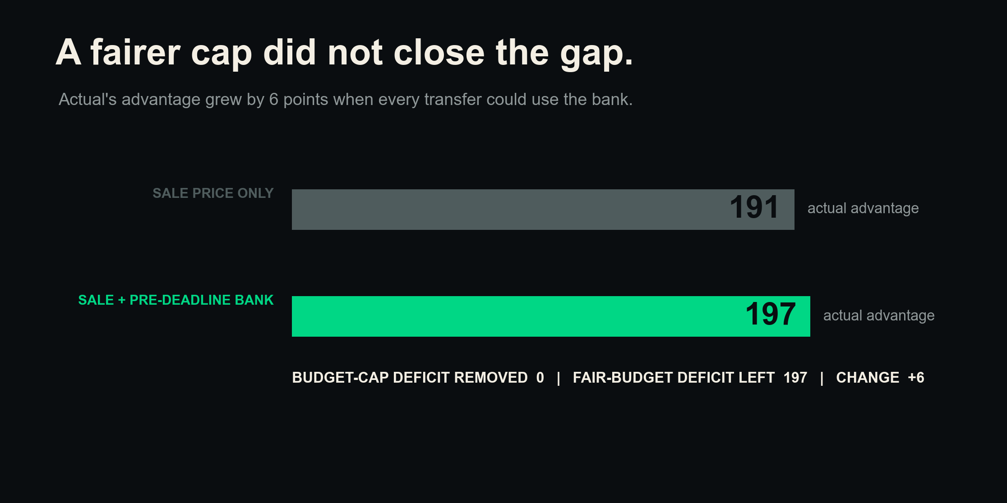
Notes:
The sale-only replay was 191 points behind. The bank-aware replay was 197 behind. The bank changed the pool, but this form ranking did not use the wider pool well enough to close the gap.

Slide 5
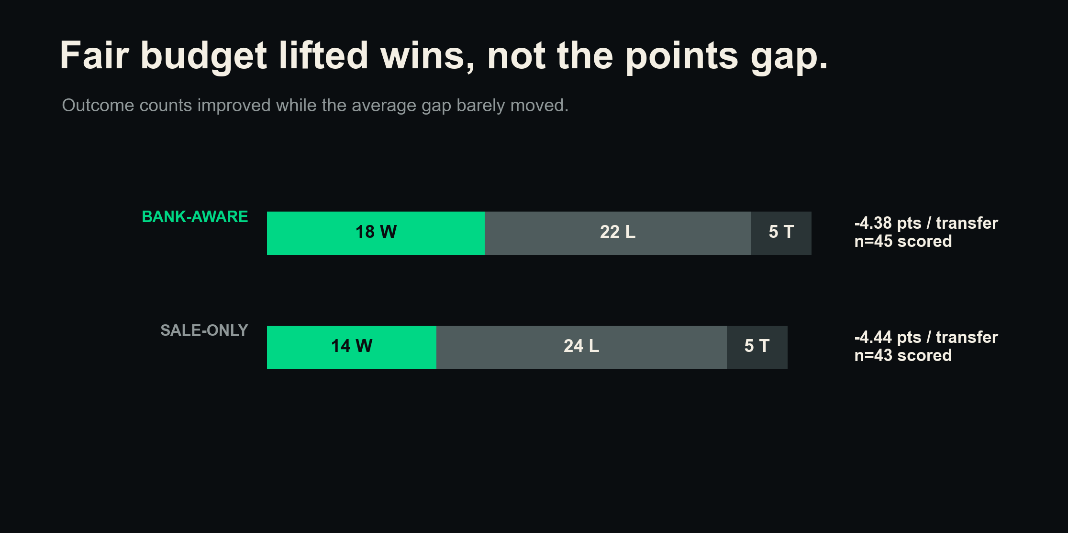
Notes:
The bank-aware rule won 18 fights, lost 22, and tied five. That is a better record than 14, 24, and five before. Yet the average stayed near minus 4.4 points because the size of the losses still mattered.

Slide 6
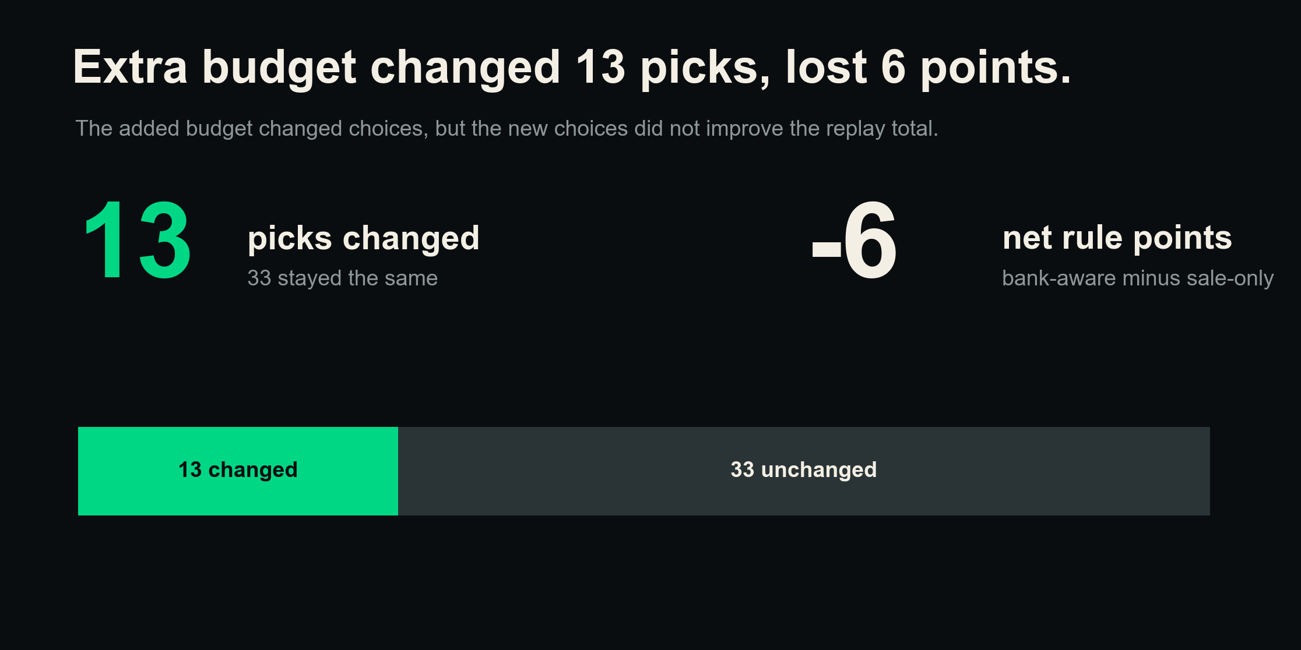
Notes:
Thirteen rule picks changed when the bank was added. Those changes had a net effect of minus six rule points relative to the old replay. More choice did not improve this ranking engine.

Slide 7
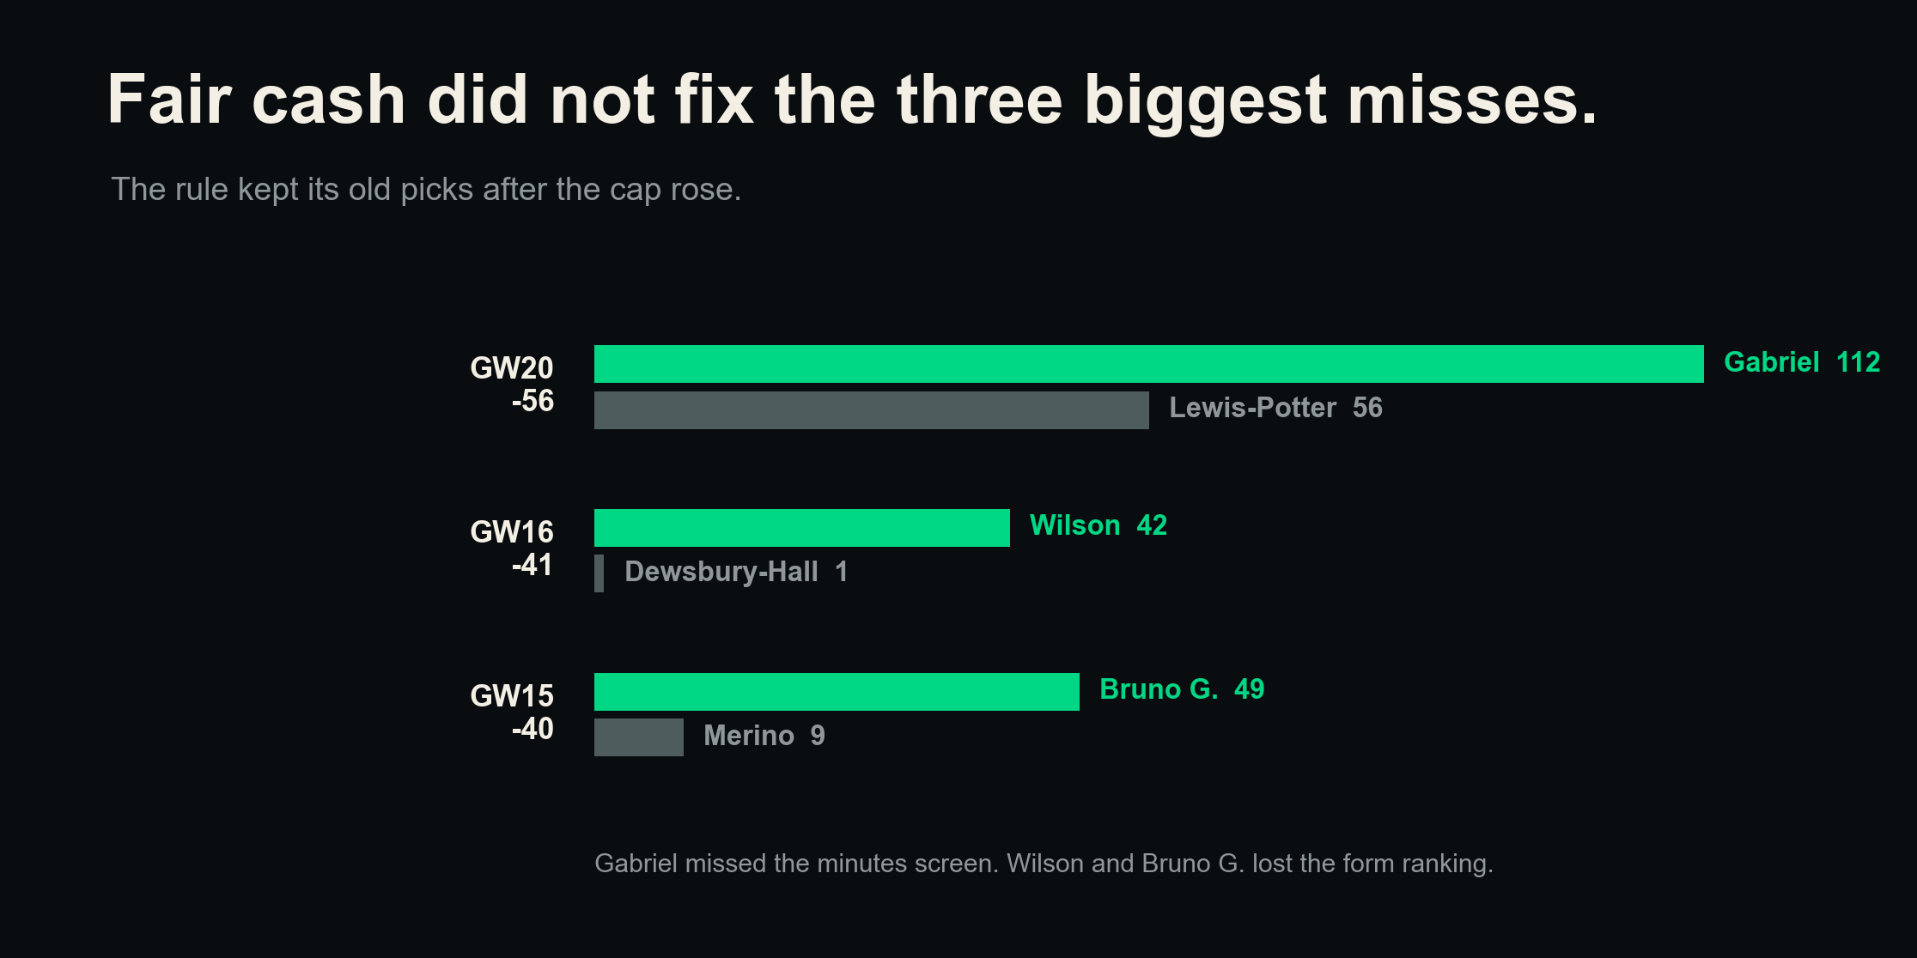
Notes:
The fair budget did not change the three former headline misses. Gabriel was affordable but failed the minutes screen. Wilson and Bruno G. were affordable but lost the form ranking. These large holding-window gaps can still contain luck.

Slide 8
Two things a bigger budget cannot buy.
11 of 46
+0.35 vs +0.19
BUYS THE RULE CANNOT MAKE
xGI BEATS FORM
Injury and rotation returns like Gabriel (24 min) and Saka (29 min) fail a mechanical 45-minute filter, even when affordable.
Trailing xGI ranks an attacker's next 4 gameweeks of goals about twice as well as trailing form (Spearman, prior study). The rule ranks by the weaker signal.
You backed players a filter rejects and read situations a form score misses. Money does not close that.
Notes:
The two real reasons the rule loses, and neither is budget. First, 11 of 46 of your actual buys fail the rule's own minutes or price filters, including injury and rotation returns like Gabriel and Saka that a mechanical screen would never surface. Second, the ranking signal is weak: prior work found trailing xGI links with future goals about twice as strongly as trailing form. These are associations, not guarantees.

Slide 9
Use it to shortlist, not to decide.
1
Use all package cash.
Count the bank and cash released by every planned sale.
2
Screen attackers with trailing xGI.
Use recent FPL points as context, not the engine.
3
Keep the minutes check, then add role and fixtures.
Availability protects the shortlist, but it does not finish it.
4
Let the rule narrow options.
Make the final call with the whole squad and transfer package in view.
Notes:
The operating choice is to keep human judgment but improve the screen. Work with the package budget, use trailing xGI for attacker threat, retain the availability check, and make the final decision with role, fixtures, and squad structure included.

Slide 10
Keep judgment, upgrade the signal.
READ THE RESULT WITH THESE LIMITS
•
One manager and one season. This is descriptive, not causal.
•
37 of 46 moves were in multi-transfer GWs. Full-bank primary: -197. First-leg-only sensitivity: -170 across a smaller scored set.
•
Four actual buys also used cash released by another same-GW leg, so sale plus prior bank was not always the full package budget.
•
Only 35 actual incoming players passed every locked filter. Minutes and feature-price quirks still excluded real buys.
•
Holding windows ignore captaincy, benching, hits, and whether the rule pick would start.
Notes:
The decision stays practical: keep judgment, use the full package budget, and strengthen the player screen. Read the exact totals with care because this is one season, the primary and sensitivity score different candidate-available sets, and the per-leg cap still misses cash released inside some same-week packages.

