Slide 1
TRANSFER RULE REPLAY
Would a simple transfer rule have beaten your judgment?
Entry 816200 | FPL 2025/26
A prior-only replay of 46 real transfers
Notes:
We asked a narrow question: would one simple transfer rule have beaten the manager's real choices? The replay covers entry 816200 in the 2025/26 season. Treat the answer as descriptive, not causal.

Slide 2
We tested one rule on 46 real transfers.
1
2
3
Match the position
Set the screen
Choose on form
Exclude the prior squad and the other same-week incoming players.
Keep players at or below the sale price who averaged 45+ minutes over the prior 4 GWs.
Take the highest prior 4-GW points form.
TEST
Score the rule pick and actual pick over the same real holding window.
Leak-free replay: 46 non-chip transfers | 43 candidates | 3 no-candidate pushes
Notes:
The rule uses only the four gameweeks before each move, so the ranking does not see the outcome. It matches position, applies the minutes and sale-price screens, then ranks by four-gameweek form. We compare both players over the actual holding window and exclude chip gameweeks.

Slide 3
The rule would have cost 191 points.
RULE MINUS ACTUAL
758 actual points 567 rule points
-191
43 scored transfers | -4.44 per transfer
14 wins | 24 losses | 5 ties
Notes:
The answer is no: the rule finished 191 points behind the actual picks across 43 scored transfers. Three no-candidate rows were pushes and do not enter these totals. The score is a holding-window comparison and does not include captaincy, benching, or package effects.

Slide 4
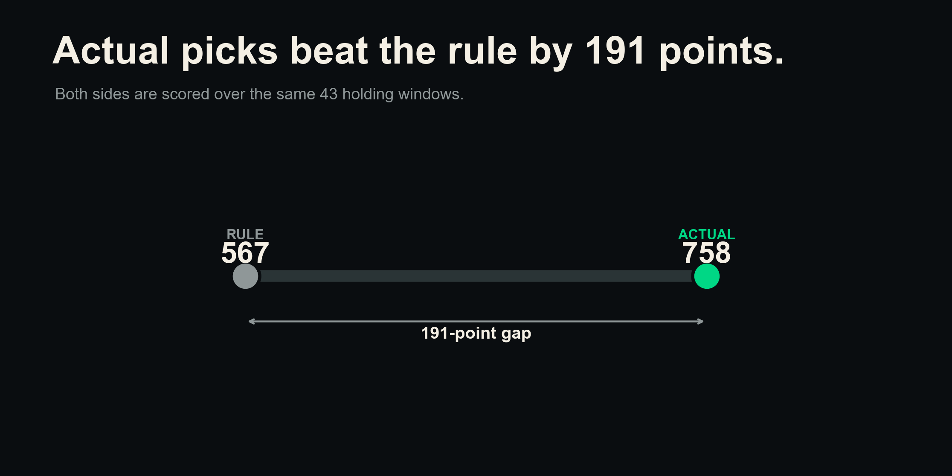
Notes:
Read the dumbbell from left to right: 567 points for the rule and 758 for the actual picks. The 191-point gap uses the same 43 holding windows on both sides. This is the replay outcome under fixed scoring choices, not a causal estimate.

Slide 5
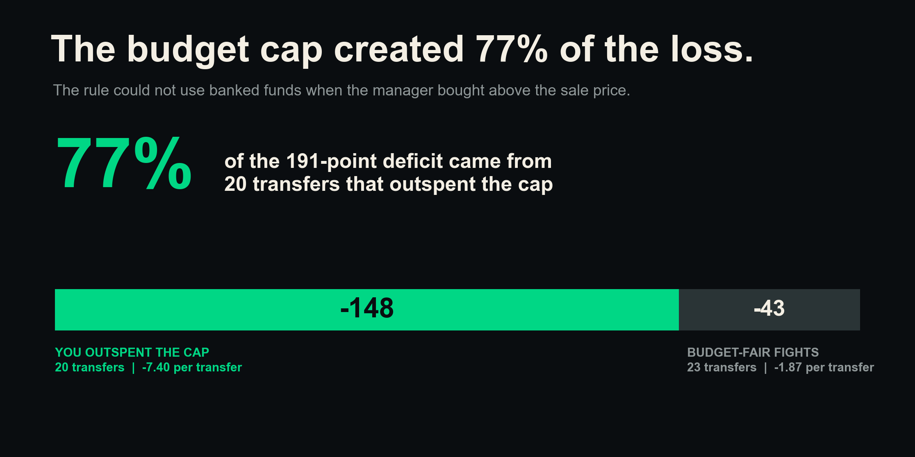
Notes:
This is the twist: 148 of the 191 lost points sit in the 20 transfers where the manager spent above the sale-price cap. That is 77 percent of the full deficit. The rule's own budget constraint drives this arithmetic split.

Slide 6
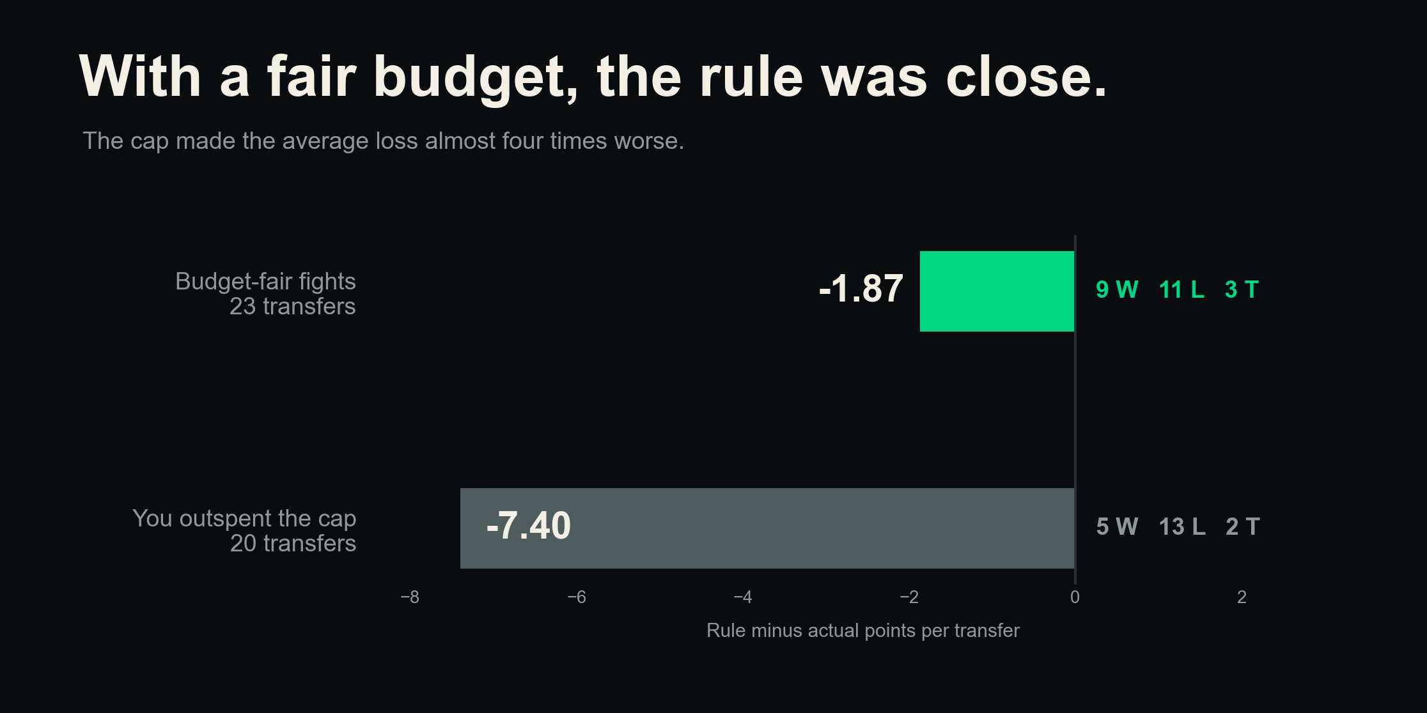
Notes:
When both sides fit the sale-price cap, the rule lost 1.87 points per transfer instead of 7.40. The fair subset finished 9 wins, 11 losses, and 3 ties. With only 23 fair fights, near parity is indicative rather than precise.

Slide 7
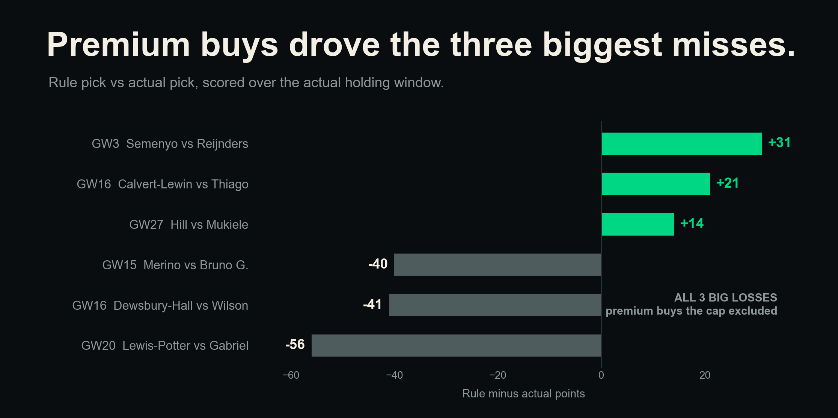
Notes:
The rule produced real wins, led by Semenyo at plus 31, but its largest misses were bigger. Gabriel, Wilson, and Bruno G. were all premium buys that the sale-price cap excluded. These individual holding-window outcomes can still contain a lot of luck.

Slide 8
Form alone is too weak to run the transfer.
+0.35
+0.19
3/46
TRAILING xGI
TRAILING FORM
SAME PICK
Link with next-4-GW goals
Link with next-4-GW goals
The rule rarely matched you
Prior attacker analysis used Spearman links. xGI carried the stronger forward signal.
Notes:
The replay rule chose a different player on 43 of 46 transfers, but difference alone is not quality. Prior work in this repo found trailing xGI more closely linked with next-four-gameweek goals for attackers than trailing form, at +0.35 versus +0.19. These are associations, not causal effects or guarantees.

Slide 9
Keep judgment, but upgrade the screen.
1
Never cap a buy at the sale price.
Keep banked funds in the choice set.
2
Screen attackers with trailing xGI.
Use raw form as context, not the engine.
3
Keep the 45-minute screen.
It protects against weak playing-time bets.
4
Use the rule as a shortlist.
Make the final call with team context and transfer packages.
Notes:
The operating choice is to keep human judgment and improve the first screen. Banked cash must stay available, and attacker shortlists should lean on trailing xGI rather than raw form alone. The minutes filter remains useful, but the rule should narrow options rather than make the final transfer.

Slide 10
Keep judgment, upgrade the signal.
Read the result with these limits:
•
Descriptive replay, not a causal test.
•
One manager, one season, n=43 scored transfers.
•
Candidate prices are season-static, not deadline prices. Cap checks at +£0.3m / -£0.3m stayed negative: -209 / -229.
•
Holding windows ignore captaincy, benching, and multi-transfer packages.
•
The fair-fight subset is small at n=23, so near parity is indicative, not precise.
Notes:
This is a descriptive replay for one manager and one season, with season-static candidate prices and a small fair-fight subset. The scoring also leaves out captaincy, benching, and multi-transfer package effects, while the price sensitivity still remained negative. The decision is to keep judgment, preserve banked-fund flexibility, and upgrade the attacker signal.

