Slide 1
FPL ANALYSIS RECONCILIATION
One FPL truth, not two
Why a simple rule can beat a model and still lose to a skilled human
Entry 816200 | FPL 2025/26
159 and 197 use different metrics. Compare direction, never magnitude.
Notes:
The two reports appear to disagree, but they ask different questions. The key is to separate the opponents and the scoring units. The 159 simulation gap and 197 replay gap use different metrics and cannot be compared as magnitudes.

Slide 2
The headlines look opposite
40-START STRATEGY SIM
45-WINDOW TRANSFER REPLAY
+159
simple rule vs model
+197
human buys vs simple rule
The model also beat hold by 199.
The rule still beat holding by 53.
The signs differ because the opponents differ.
159 is a simulated-season mean. 197 is a summed replay gap.
159 and 197 use different metrics. Compare direction, never magnitude.
Notes:
The left number compares two full strategies across 40 starting squads. The right number compares one manager's actual incoming players with rule picks over fixed holding windows. The 159 and 197 gaps use different metrics and must not be compared in size.

Slide 3
The opponent changed
NOTEBOOK QUESTION
REPLAY QUESTION
Can the rule beat a model and no transfers?
Can the rule beat the manager's actual buys?
Yes, in the 40-start strategy simulation.
No, on the 45 scored transfer windows.
Different opponents can produce different winners without contradiction.
159 and 197 use different metrics. Compare direction, never magnitude.
Notes:
The reconciliation is an opponent change, not a statistical trick. The rule is strong against a model and passivity, but a skilled human can sit above it. The 159 and 197 results remain different metrics.

Slide 4
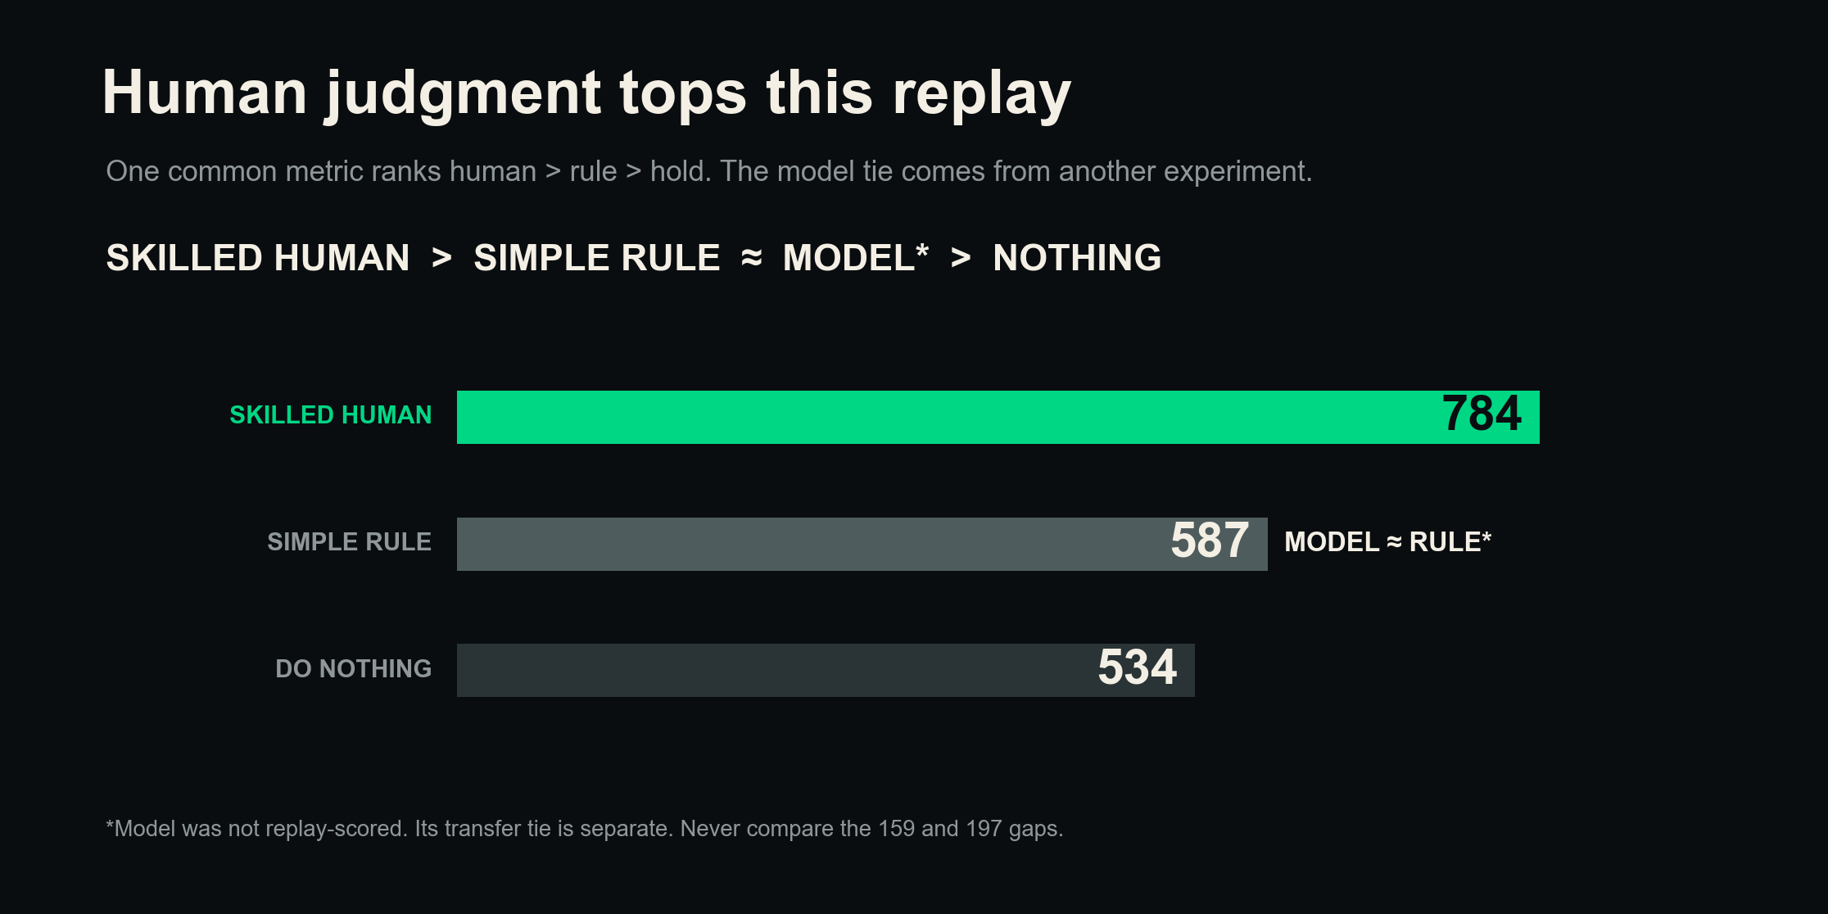
159 and 197 use different metrics. Compare direction, never magnitude.
Notes:
The common replay ranks the human at 784, the rule at 587, and holding at 534. The model sits beside the rule only because the separate transfer-layer simulation was a tie. The 159 and 197 gaps use different metrics.

Slide 5
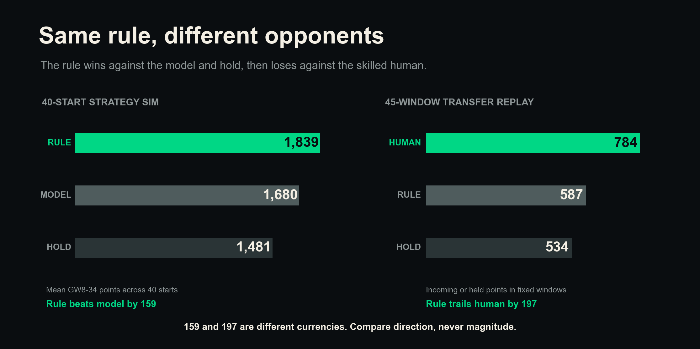
159 and 197 use different metrics. Compare direction, never magnitude.
Notes:
The rule wins against the model and no transfers in the 40-start strategy simulation. It loses against the human but beats holding in the 45-window replay. The 159 simulation gap and 197 replay gap use different metrics.

Slide 6
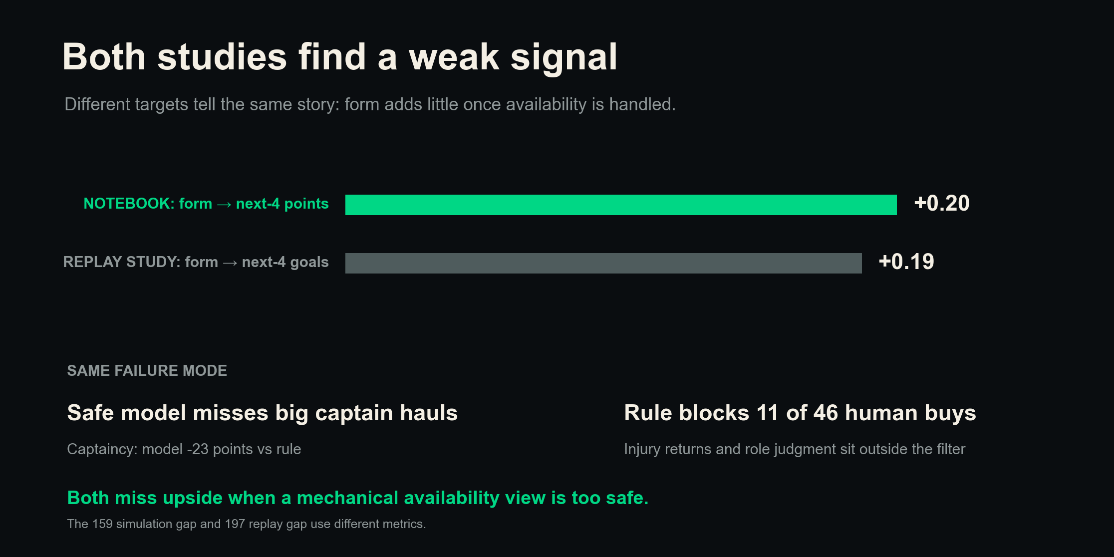
159 and 197 use different metrics. Compare direction, never magnitude.
Notes:
The notebook's screened form-to-points rank link is 0.20. The replay story's form-to-goals link is 0.19. The targets differ, but both are weak. The studies also share a safe-rule failure mode. The 159 and 197 gaps remain different metrics.

Slide 7
The rule is a floor, not a ceiling
SKILLED HUMAN > SIMPLE RULE ~ MODEL > NOTHING
FLOOR
CEILING
Rule beats passivity
Judgment finds upside
Cheap, clear, repeatable
Role changes, news, packages
Use the rule to narrow the field. Use judgment to make the call.
159 and 197 use different metrics. Compare direction, never magnitude.
Notes:
The rule is a strong cheap floor because it beats holding and ties the model on transfers. It is not a ceiling because the human replay result is higher and judgment can use role changes and package context. The 159 and 197 gaps use different metrics.

Slide 8
Use the rule, then add judgment
1
Filter availability
Starts, recent minutes, injury news, likely role
2
Build the shortlist
Recent points as context, plus xGI, fixtures, price
3
Review the package
Bank, cash released, hits, squad structure
4
Make the upside call
Role change, captain ceiling, reasons to break the rule
Only promote a new model when it beats this rule on decision points.
159 and 197 use different metrics. Compare direction, never magnitude.
Notes:
Start with availability, use the rule to shortlist, then add xGI, fixtures, package budget, and ceiling judgment. A new model must beat the rule on full decision points. Keep 159 and 197 separate because they use different metrics.

Slide 9
Keep the two currencies apart
159
197
40-start simulated-season mean gap
45-window summed transfer-replay gap
1
One manager and one season. Luck can shape the replay gap.
2
Replay points ignore XI use, captaincy, benching, and transfer hits.
3
Eleven of 46 human buys failed at least one locked rule filter.
4
The notebook hold baseline means no transfers, with Engine selection and captaincy.
5
The model has no complete clean replay score, so its placement stays qualitative.
159 and 197 use different metrics. Compare direction, never magnitude.
Notes:
This is the main reading rule. The 159 result is a paired mean simulated-season strategy gap. The 197 result is a summed one-manager transfer replay gap. They use different metrics. Other limits include luck, replay omissions, filter exclusions, and no complete model replay score.

Slide 10
Keep the floor. Hunt the ceiling.
The simple rule protects against passivity. Skilled judgment adds role, context, and upside.
Different opponents. One unified truth.
Never compare the 159 and 197 gaps as magnitudes.
159 and 197 use different metrics. Compare direction, never magnitude.
Notes:
The close is practical. Keep the simple floor, then use human judgment for the ceiling. The reports reconcile through different opponents, while the 159 and 197 gaps remain different metrics that cannot be compared in size.

