Slide 1
Ortho Eyes
Dr. Tony Andrioli
Raphael, Brice, Eddie, Hassan, Arjun, Lennart

Slide 2

The Project
Uncategorized medical data from LUMC
Finding classifiers
Contributing parameters
Notes:
Research has been done on different patient groups with shoulder problems. But it is unknown to what extend the data can be used to distinguish these patient groups.
We need to understand the medical data from LUMC
Find classifier to differentiate the patient groups
Which parameters contibute the most?
Can the value of these parameters be measured more easily?

Slide 3
The Data
Origin
Process
A glimpse look at the data
Domain

Slide 4

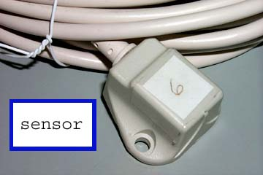
1. Data Origin
LUMC
Flock of Birds (7 sensors)
Shoulder exercises patients
Four different patient groups
Four different protocols
Unclear which exercise is being performed per set

Slide 5

2. Data process
LUMC transposed the data
Raw data
XYZ coordinates and rotation data
Refined data
Relative rotation data

Slide 6
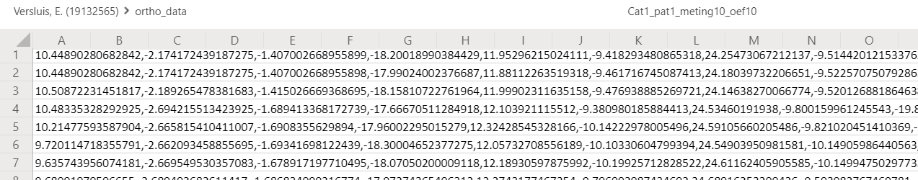
3. A glimpse look at the data
4 patient groups
119 patients
1396 individual exercises
At least 21 different exercises
191292 data samples
26 features per sample
Notes:
Group before made some assumptions.
We don’t want to rely on this

Slide 7
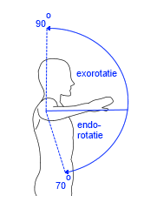
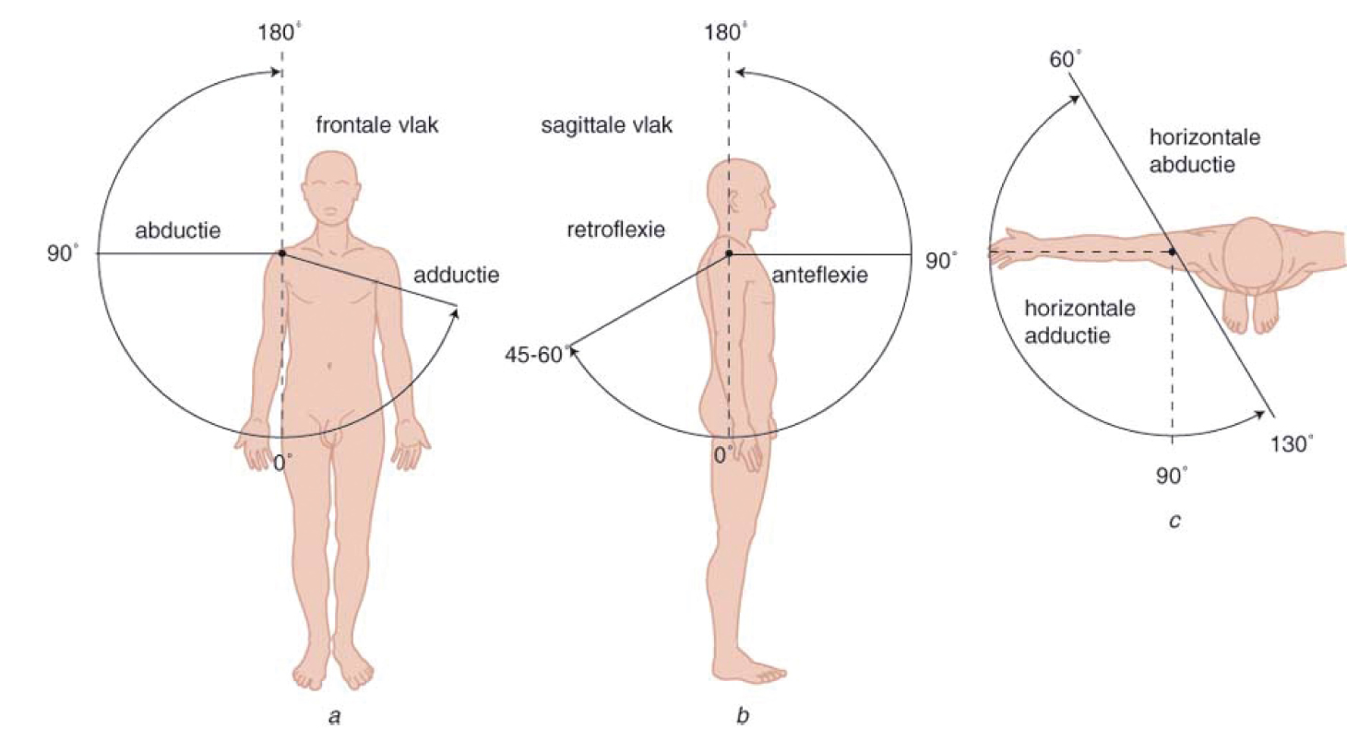
4. Data Domain
‘Roll’ of the humerus:
Exororation
Endorotation
‘Yaw’ and ‘Pitch’ of the humerus
Abduction Retroflextion
Adduction Anteflexion
Notes:
Medical Terms

Slide 8
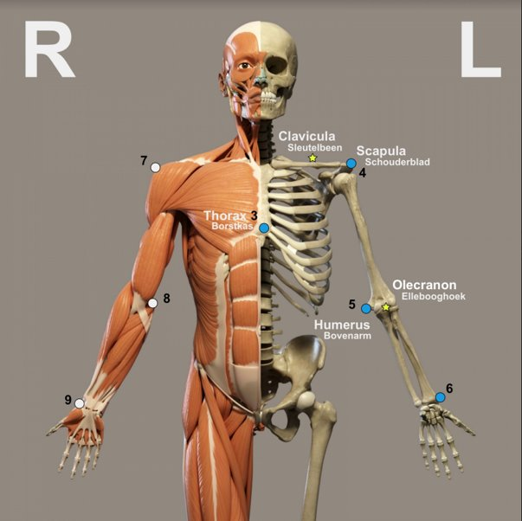
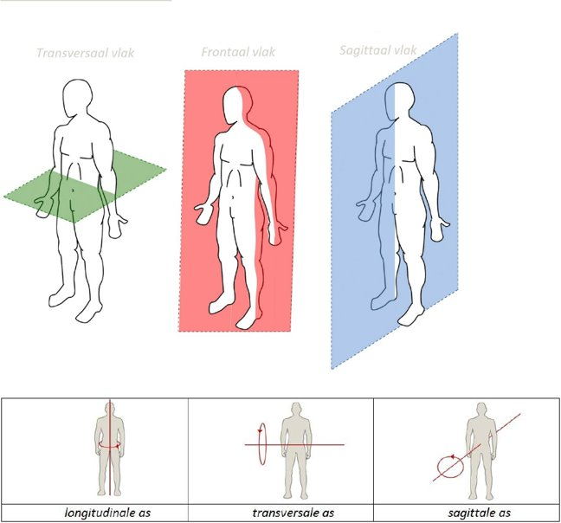
Transversal Frontal Saggital
(coronal)
Bones of the Shoulder:
Clavicula = collarbone
Scapula = Shuldarblade
Humerus = upperarm bone
Thorax = sternum
Notes:
Variables with medical terms

Slide 9
Next steps
Verifying the data
Visualize the data
Get feedback from LUMC on the different exercise protocols
Get our own data for comparison
Visualization of last the group

Slide 10
Any questions or suggestions?

