Slide 1
Book1
File created on: 2/20/24 5:46:50 PM EST

Slide 3
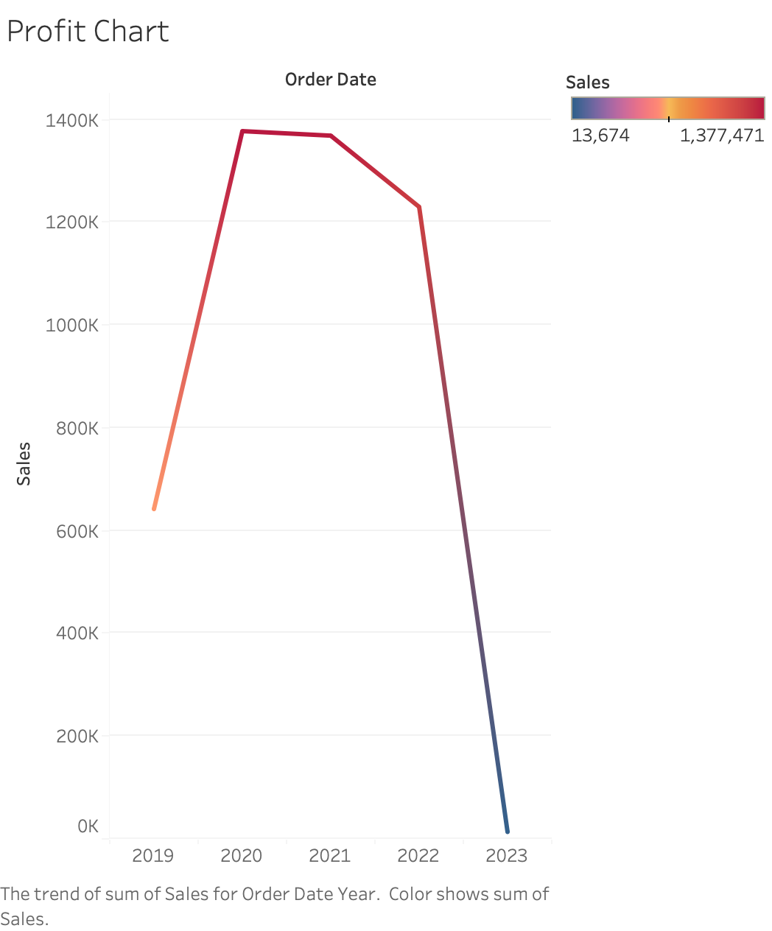

Slide 4
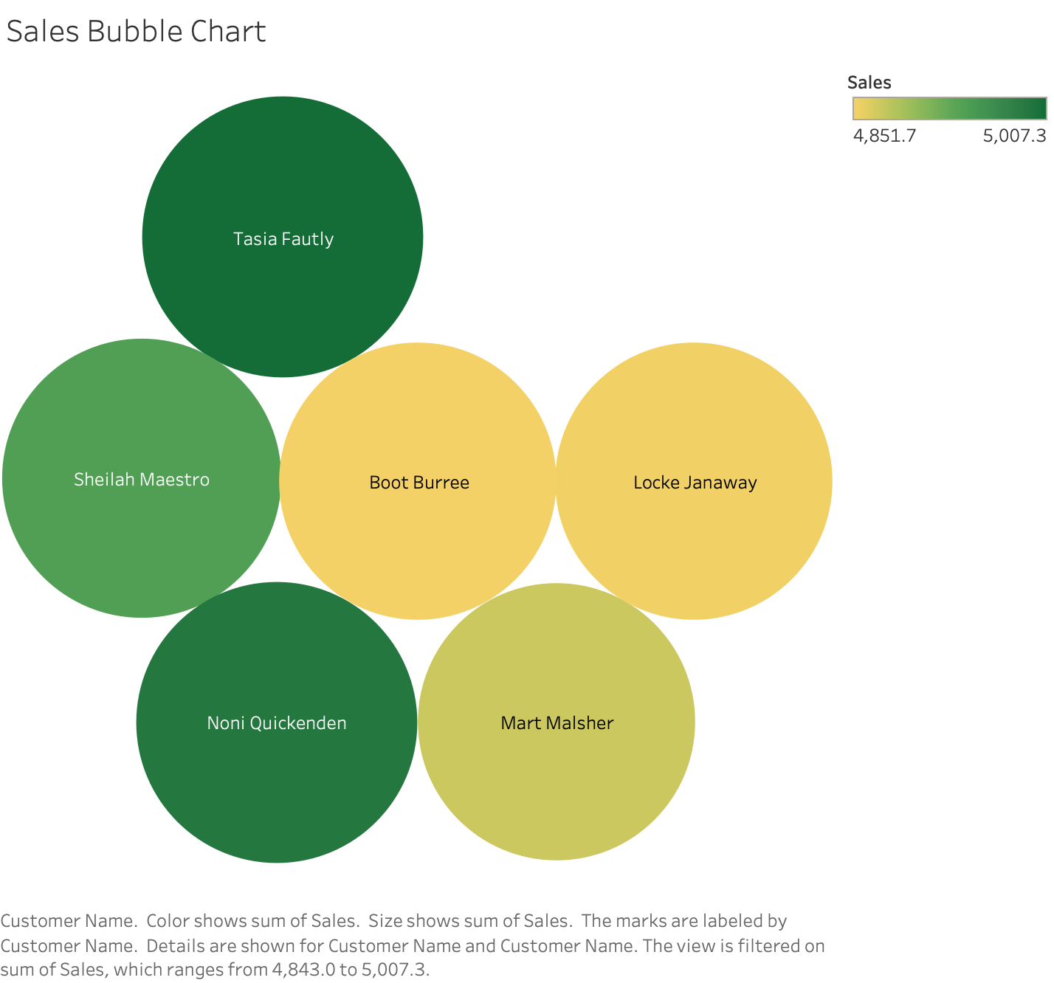

Slide 5
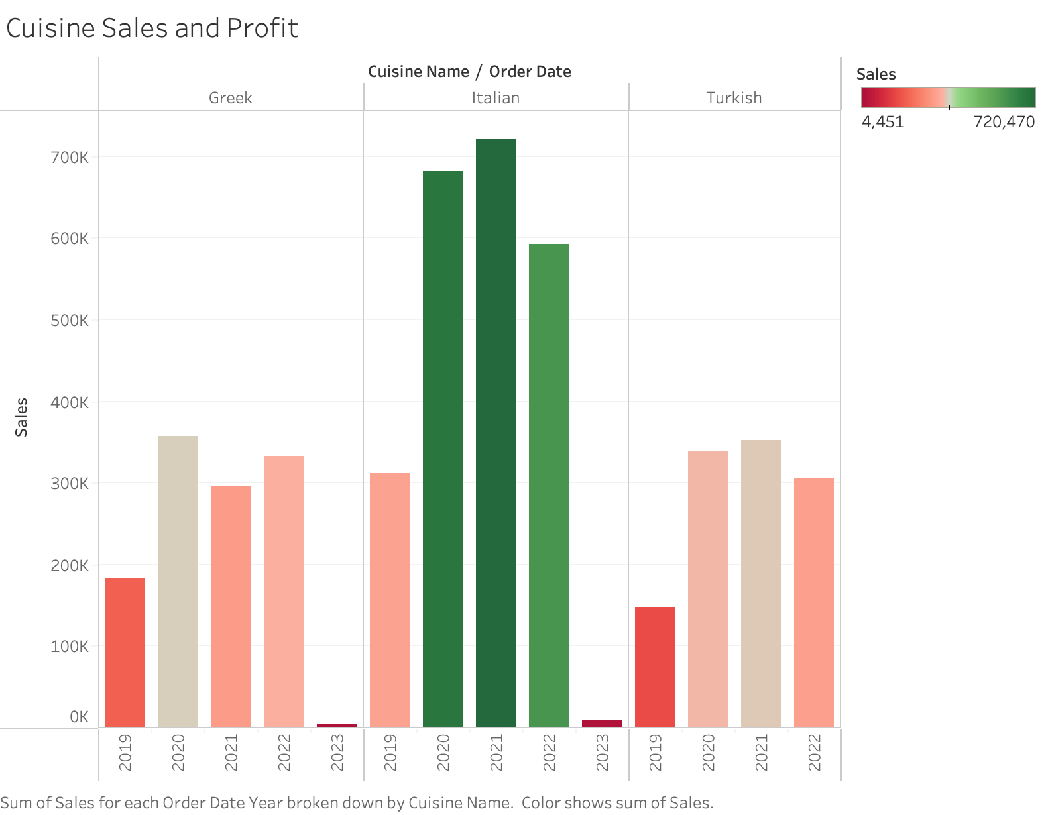

Slide 6
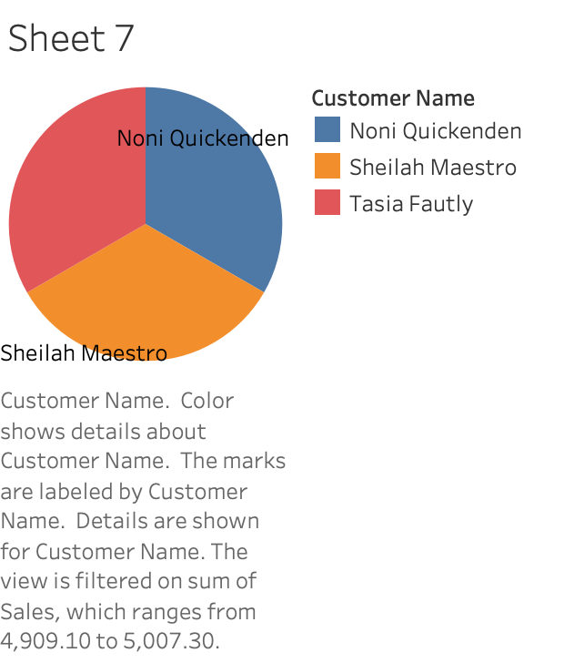

Slide 7
