Slide 1
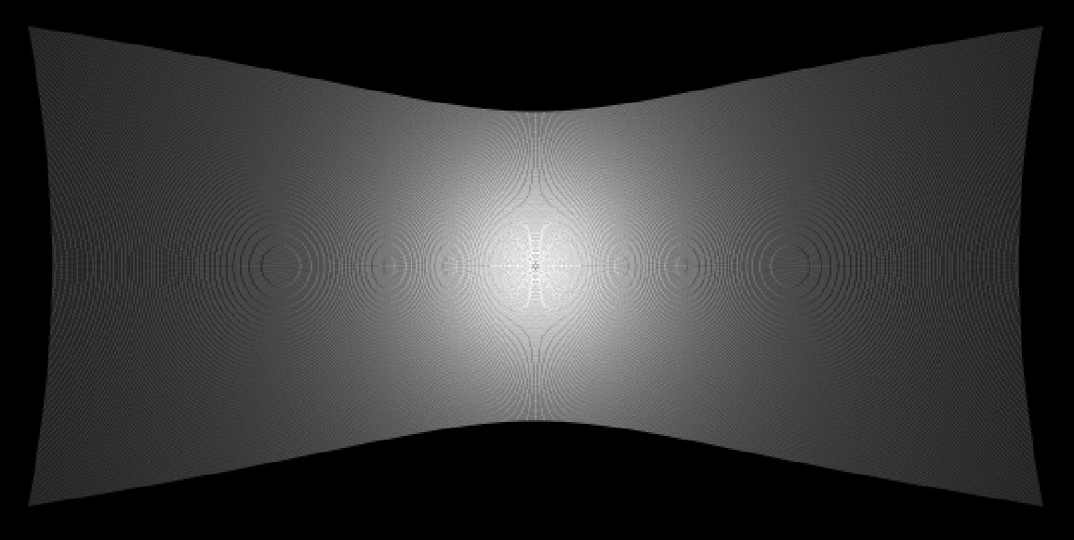

PikeReader application
CPU
GPU (CUDA)
MATLAB thread
FoV-distortion thread
10⁷ – 10⁹ rays traced in parallel from the droplet through the viewing port and lens system to CCD
selecting avi file
MEX synapse
preparing parameters for ray-tracing
.......
RayTracingCUDA
subroutine
MEX synapse
atomic addition of threads
pixels processed in parallel
FoV-distortion arrays
.......
frame-control thread
Decodec: LSB 6-bit inversion & shift
preparing masks & parameters for file-processing
MEX synapse
Demosaic
finding the beginning of file
movie-reading thread
chosen colours in sequence
IntensCalc
subroutine
sequential
file-reading
from hard disk
in 64 kB blocks
field of view correction: division by {intensity field distortion + mask}
monitor
cyclic buffer
moving average:
frame recognition
atomic addition
division
I_{pp} & I_{ss} arrays
MEX synapse
rescaling to 700 data points
0
20
40
time [s]
60
80
100
1.3
1.4
1.5
1.6
1.7
1.8
azimuth angle [rad]

