Slide 1


CodeClan Professional Data Analysis.
Final Project.
David Craig.

Slide 2

Who are Deloitte?
Deloitte is a multinational professional services network that provides a wide range of services, including audit, tax, consulting, and financial advisory.
The company was founded in 1845 and has its origins in London, United Kingdom. It started as a small accounting firm founded by William Welch Deloitte.
Over the years, Deloitte has grown into one of the largest professional services firms globally, with a presence in more than 150 countries. It serves clients across various industries, including technology, finance, healthcare, manufacturing, and more.
Notes:
In this project you’ll be looking at how productivity and GDP are related. You’ll be comparing a range of countries to understand what factors influence both GDP and productivity. What can we learn from high productivity nations?

Slide 3
Brief and Questions.
Gross Domestic Product – measure of monetary value of final goods and services produced in a country. Used as an estimator for a country's wealth.
Project Aim:
Identify insights into GDP, productivity that may improve the UK productivity .
Questions:
How does the UK compare to other developed economies in terms of GDP and exports?
What factors are important in predicting a country’s GDP?
Can you predict GDP estimates/growth from any of these factors?

Slide 4







Data and Project Overview.
Data Sources.
Data Cleaning & Analysis.
Data Modelling.
Equifax Ignite Direct data platform: 50 open data sources.
Data collated into one large CSV files (16578 rows, 20 columns)
.CSV files
Excel files
Libraries:
Tidyverse
Readxl
Janitor
Infer
Libraries:
Pandas
NumPy
SciKitLearn
statsmodels.api
Data Ethics:
No ethical concerns to note.

Slide 5

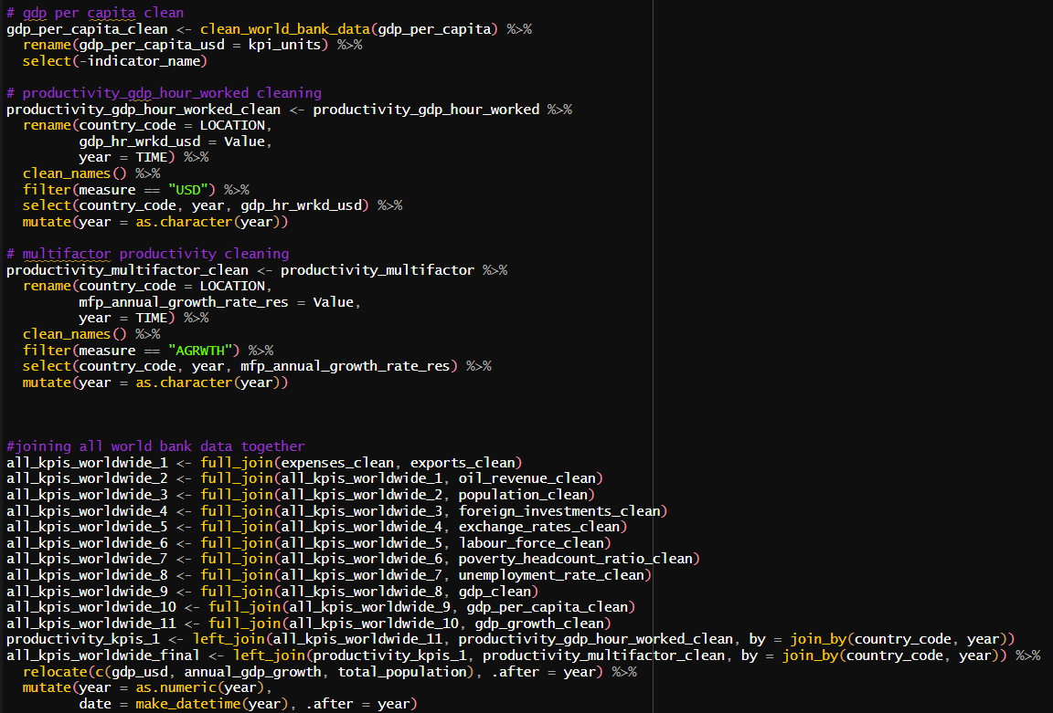
Data Cleaning Code.

Slide 6
How has the UK Productivity compared with other developed economies?
Labour Force Productivity - measures output per labour hour (GDP/ hours worked)
Multifactor Productivity – measure of overall efficiency of the utilisation of labour and capital inputs
Developed Economies:
FTSE group assigns the market status of countries as Developed, Advanced Emerging, Secondary Emerging or Frontier based on their economic size, wealth, quality of markets, depth of markets, breadth of markets.
Examples: United States (USA), Japan (JPN), United Kingdom (GBR), Ireland (IRL) and others.
OECD (2023), Labour productivity forecast (indicator). doi: 10.1787/cb12b189-en (Accessed on 17 June 2023)
OECD (2023), Multifactor productivity (indicator). doi: 10.1787/a40c5025-en (Accessed on 17 June 2023)
Notes:
FTSE group- a provider of economic and financial data

Slide 7
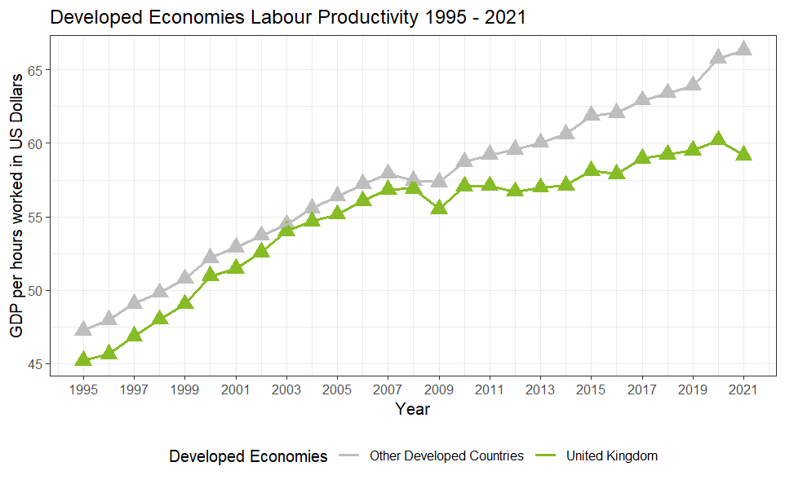
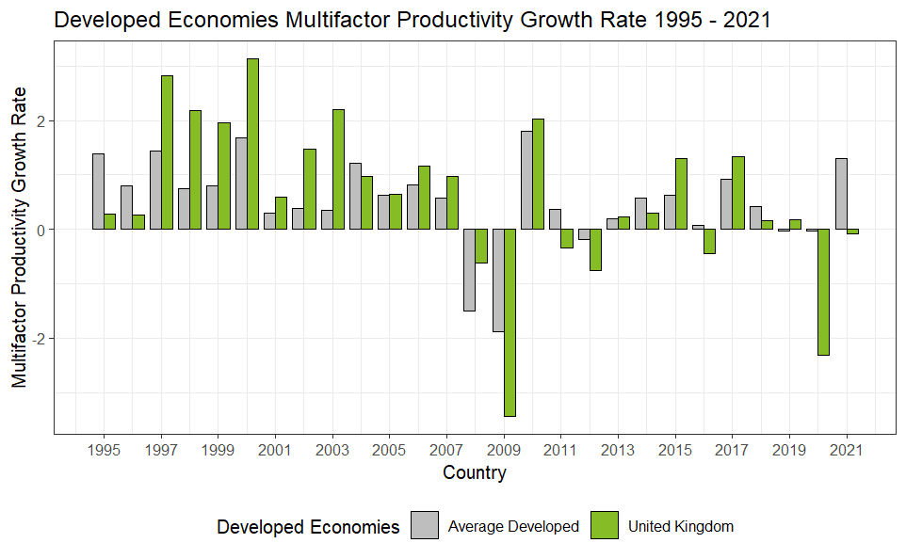
Historically, how has the UK Productivity compared with other developed economies?
Labour Productivity was less than the average of other developed economies from 1995 to 2021.
Multifactor Productivity Growth Rate varies greatly for the UK compared and other developed economies from 1995 to 2021.

Slide 8
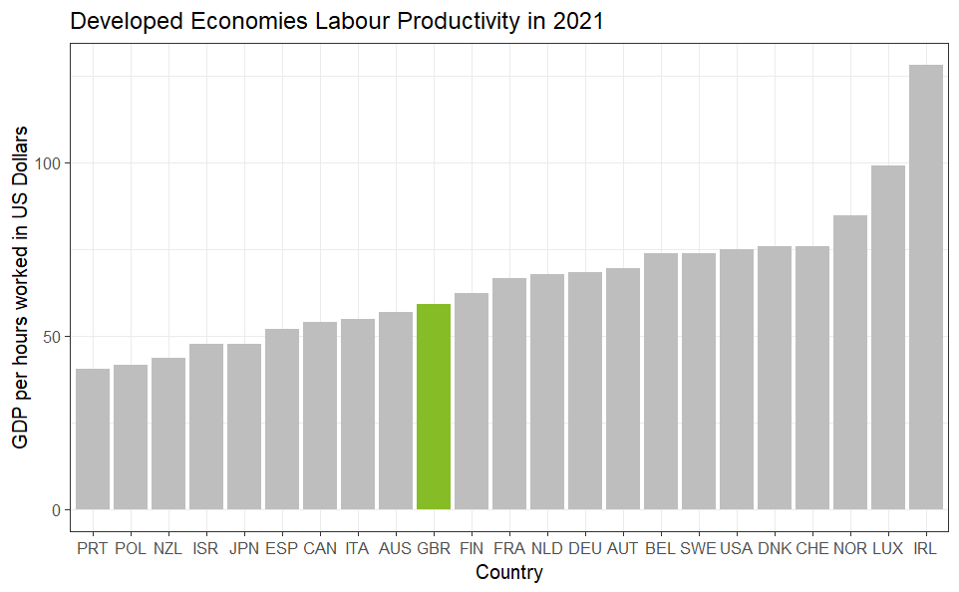
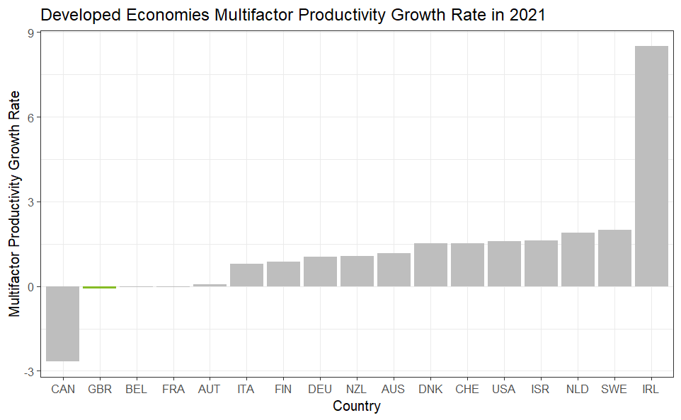
Recently, how has the UK Productivity compared with other developed economies?
The UK is ranked 17th out of 24 for Labour Productivity in 2021.
The UK was ranked 16th out of 17 for Multifactor Productivity Growth in 2021.

Slide 9
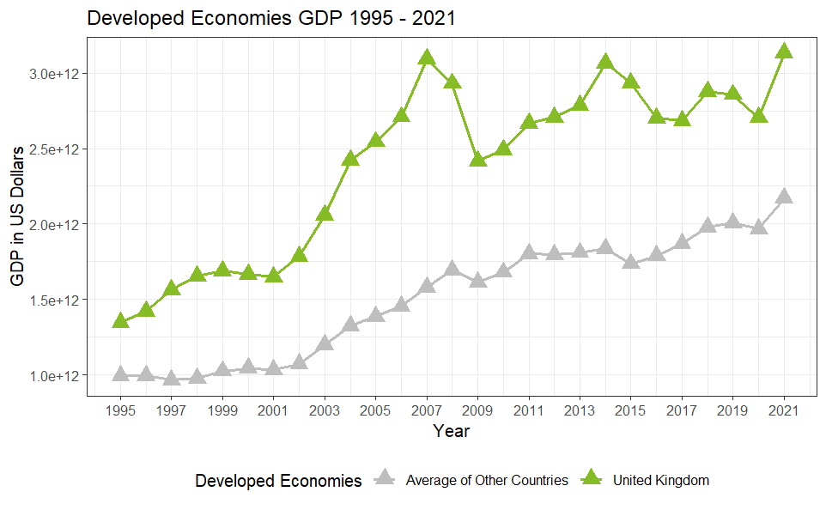
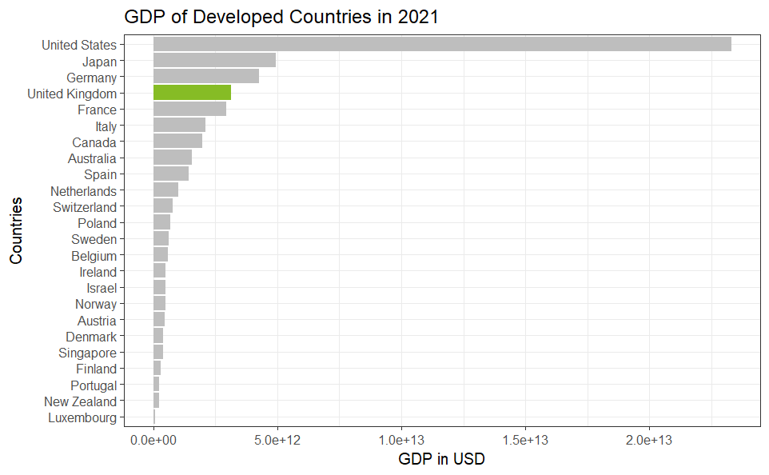
How does the UK compare to other developed economies in terms of GDP?
UK GDP was consistently greater than the average of other developed economies from 1995 to 2021.
The UK was ranked 4th out of 24 developed economies in terms of overall GDP in 2021.

Slide 10
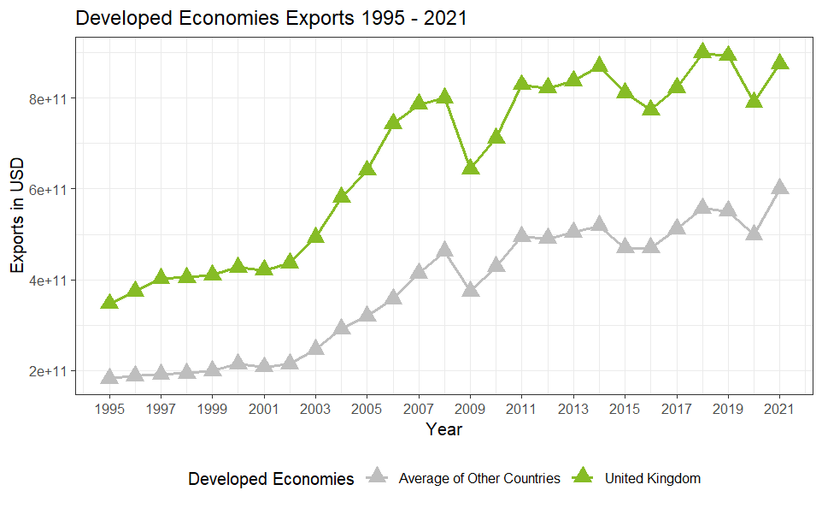
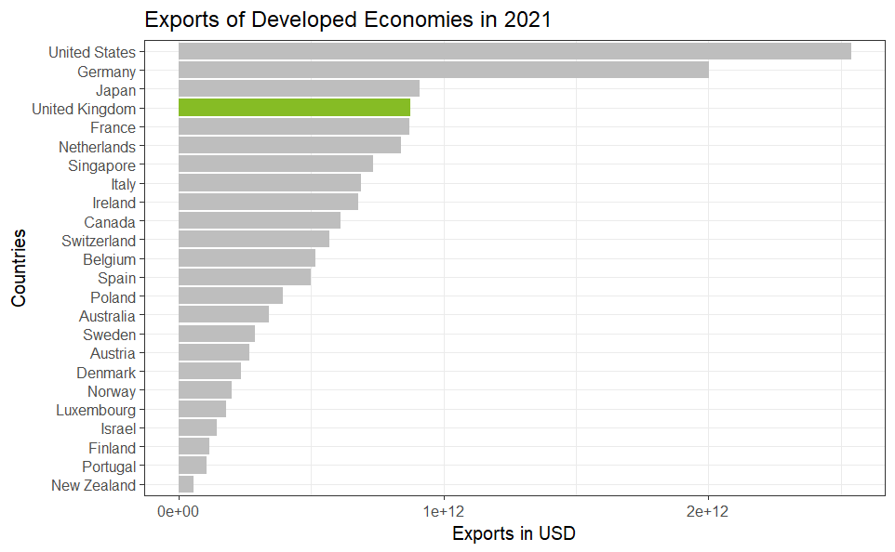
How does the UK compare to other developed economies in terms of exports?
UK exports are consistently greater the average of other developed economies from 1995 -2021.
The UK was ranked 4th out of 24 developed economies in terms of overall exports in 2021.

Slide 11
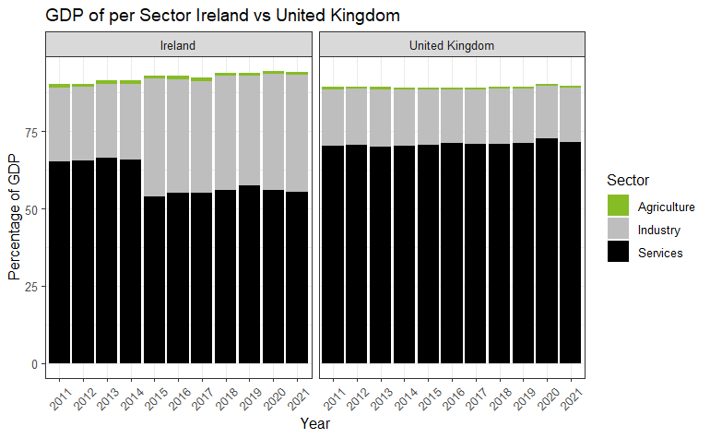
How does the UK compare to a country with higher productivity?
Compared with the UK, Ireland has a greater proportion of GDP coming from the industrial sector .
This may be an area for consideration for investment and expansion for the UK in order to boost productivity.

Slide 12
Summary 1.
UK productivity is lower than many other developed economies.
Compared with other developed economies the UK ranks highly in both GDP and exports and has historically been greater than the average GDP and exports of all other developed economies.
Expanding the UK’s industrial sector may yield a more productive economy.

Slide 13
What factors are important in predicting a country’s GDP?
Candidate Factors in predicting GDP:
Exports
Population
Government expenditure
Oil rents percentage (oil revenue)
Foreign Direct Investments
Exchange Rate Local Currency Units to USD
Total Labour Force
Unemployment (% of Total Labour Force)
Poverty Headcount Ratio
S.C. Agu, F.U. Onu, U.K. Ezemagu, D. Oden, Predicting gross domestic product to macroeconomic indicators, Intelligent Systems with Applications, Volume 14, 2022.
Notes:
Exports of goods and services represent the value of all goods and other market services provided to the rest of the world. They include the value of merchandise, freight, insurance, transport, travel, royalties, license fees, and other services, such as communication, construction, financial, information, business, personal, and government services. They exclude compensation of employees and investment income (formerly called factor services) and transfer payments. Data are in current U.S. dollars.
Oil rents are the difference between the value of crude oil production at regional prices and total costs of production.
Official exchange rate refers to the exchange rate determined by national authorities or to the rate determined in the legally sanctioned exchange market. It is calculated as an annual average based on monthly averages (local currency units relative to the U.S. dollar).

Slide 14
Can you predict GDP estimates from any of these factors?
Variable Selection.
Target Variable:
GDP
Correlation Matrix
Highly Correlated Variables:
Total Population
Exports
Foreign Investments
Train Test Split ratio 8:2
Multiple Linear Regression Modelling.
Train Accuracy (R²) = 0.9935
Train MAE = 139,891,248,936.6
(0.6% of GDP range)
Test Accuracy (R²) = 0.9951
Test MAE = 147,105,800,070.0
(0.6% of GDP range)
Outcome model:
Can predict GDP from developed countries
Does this model work for
less Developed Economies?
Accuracy (R²) = 0.9918
MAE = 322,652,239,935.6
(0.3% of GDP range)
Created a model to accurately predict the GDP of both developed and less developed countries.
MAE = Mean Average Error
Notes:
Range - 23,295,540,000,000 24 trillion
Max - 23,295,540,000,000
Min - 19,563,836,265

Slide 15
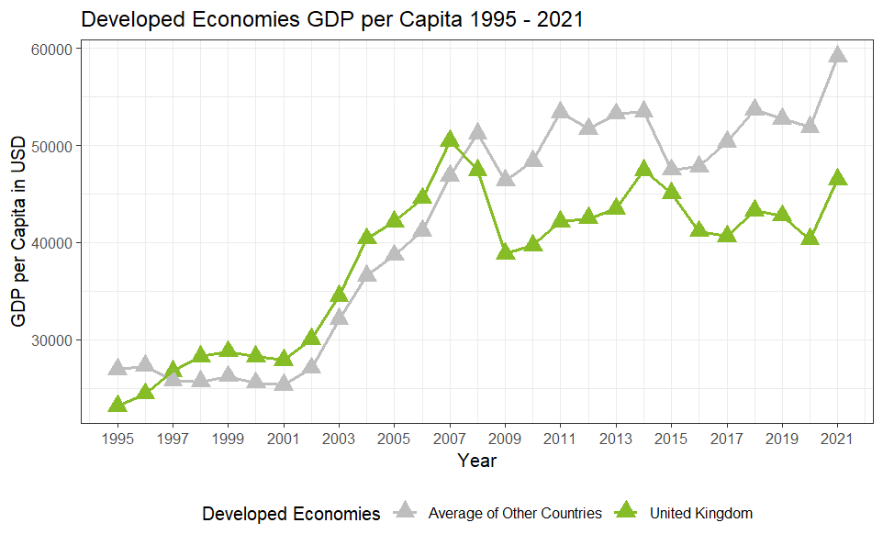
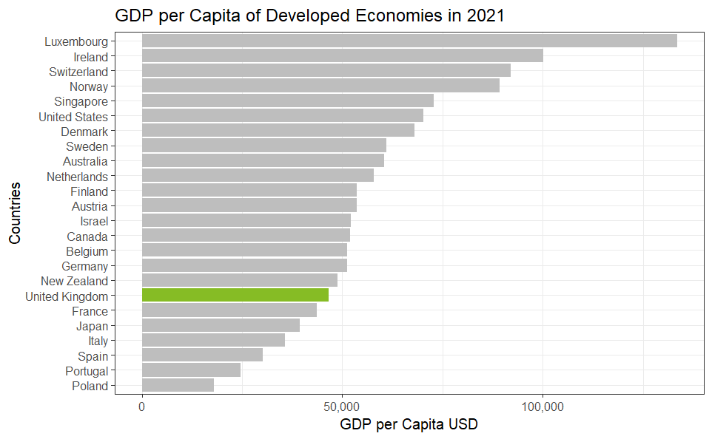
How does the UK compare to other developed economies in terms of GDP per capita?
UK GDP per capita is less than the average of other developed economies in recent years.
The UK was ranked 18th out of 24 developed economies in terms of overall GDP in 2021.

Slide 16
Summary 2.
From the research and published studies a host of factors are important for predicting a countries GDP Exports:
Exports
Population
Government expenditure
Oil rents percentage (oil revenue)
Foreign Direct Investments
Exchange Rate Local Currency Units to USD
Total Labour Force
Unemployment (% of Total Labour Force)
Poverty Headcount Ratio
The model can accurately predict GDP using the variables: population, exports and foreign investments.
The UK ranks 18th out of 24 for GDP per capita – not very productive.

Slide 17
Actionable Insights.
How can we enhance GDP and Productivity?
Investment.
Skilled Workforce
Research and Development
Technology
Promotion of Exports
Industrial Sector
Strategies.
Labour Workforce
(% of population)
Enhance Exports
Outcome.
GDP
Productivity

Slide 18

Thank you!
djcraig2304@gmail.com
www.linkedin.com/in/david-craig2304
Questions?

Slide 19
Challenges, Limitations and Future Work.
Challenges:
Vast number of data sources available – difficulty in finding and selecting the most relevant.
Lots of missing values from different countries so had to exclude pre-1995 data.
Limitations:
GDP overall was examined, would account for inflation in future analyses.
Future Work:
Further explore the UK GDP and compare that with other high productivity countries to see how we can improve UK productivity.

Slide 20
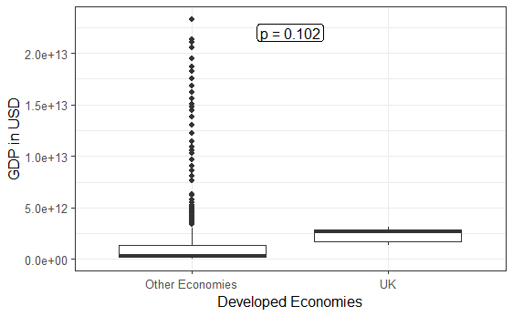
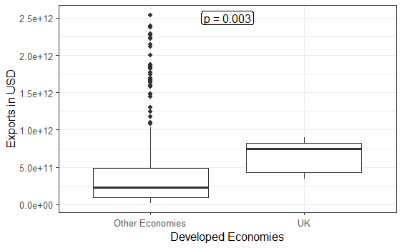
How does the UK compare to other developed economies in terms of GDP and exports?
Is the total UK GDP greater the average of other developed economies from 1995 -2021?
Are the total UK exports greater the average of other developed economies from 1995 -2021?
There was no significant difference (p > 0.05) in the total UK GDP from that of other developed economies from 1995 to 2021.
There was a significant difference (p < 0.05) in the total UK GDP from that of other developed economies from 1995 to 2021.

Slide 21
How does the UK compare to other developed economies in terms of GDP and exports?
However, the mean GDP from 1995 to 2021 did not differ significantly from that of all other developed economies.
The mean exports from 1995 to 2021 did was significantly greater than that of all other developed economies.

Slide 22
Project Brief.
Productivity is key to the development of local businesses and the wider economy. Over the past decade, productivity has slowed down globally with the UK lagging behind some other developed countries.
Project Aim:
Understand how productivity and GDP are related.
Understand what factors influence both GDP and Productivity
Notes:
“Productivity is commonly defined as a ratio between the output volume and the volume of inputs. In other words, it measures how efficiently production inputs, such as labour and capital, are being used in an economy to produce a given level of output.” - OECD
In this project you’ll be looking at how productivity and GDP are related. You’ll be comparing a range of countries to understand what factors influence both GDP and productivity. What can we learn from high productivity nations?

