Slide 1
“Everything should be made as simple as possible, but not simpler.”
- Albert Einstein

Slide 2


River Crossing
Group 12

Slide 3
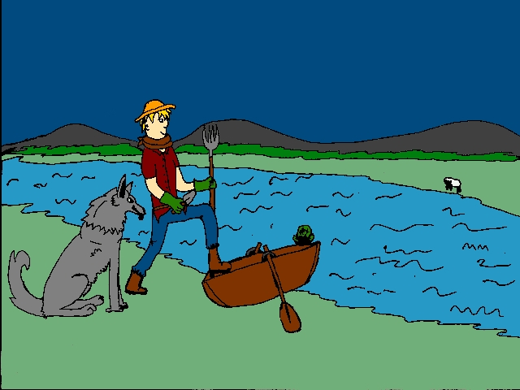

Slide 4

Rc > game

Slide 5
Fundamentals
Virtual simulation of the “River Crossing” problem
Logic solving puzzle for young adults
Graphically pleasing
Original implementation

Slide 6
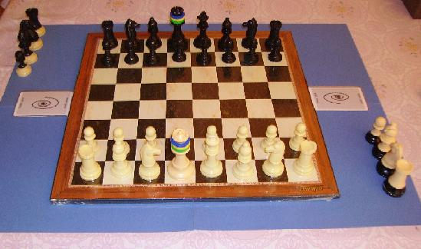
Game.

Slide 7

Think.

Slide 8
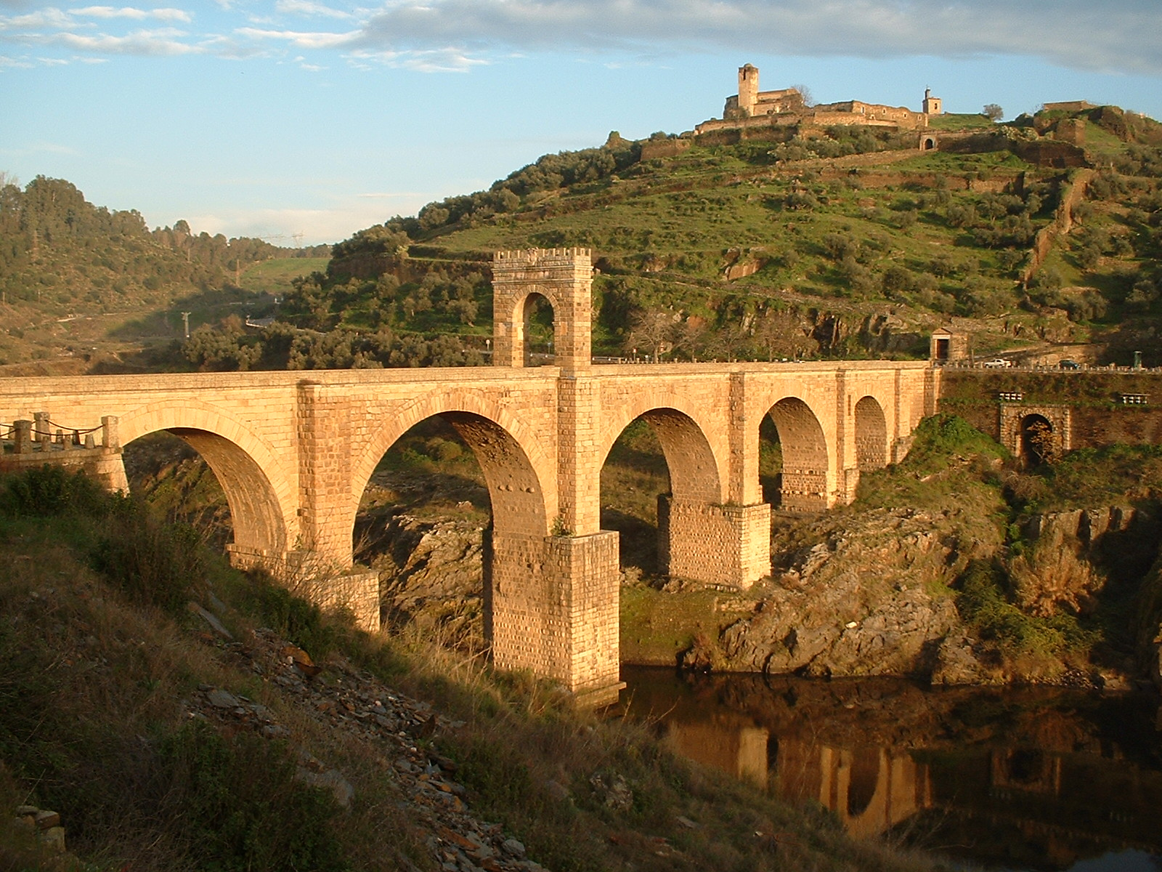

Slide 9
Education + Gaming

Slide 10
Smartphones
Facebook
Xbox
Playstation
Nintendo
WWW
Ipods

Slide 11



+
=
+
=

Slide 12
+
=

Slide 13
(Market) Research
Dates back to ~9th century
Entered folklore of different ethnic groups
Porting: iOS (iPod, iPad), Android, Linux, Mac, FreeBSD
  Multiple platforms & devices
Availability of Python on the above

Slide 14
Features Implemented
Feature | Benefit
4 button game | Easy to play
Range of colour, graphical transparency | “Eye-candy”
Sounds for individual objects | Interaction
In-game fonts | Feedback

Slide 15
Future Releases
Key mapping
Timer and move counter
Winning and losing
Multiple languages
Multiple resolutions
Multiple platforms

Slide 16
Philosophy
Educational Engine
Open elements = customisation
Classroom-friendly
Elegant code base
<250 LOC
“UNIX”

Slide 17
Reflection
Change
Modify
Learn via the source code
Insight into problem solving
Inspire future careers of young adults

Slide 18
Questions?
Shoot

Slide 19
Credits
Ashley Workman
Sam Weed
Michael Marron
Charles Mills
Oliver Cumming
Daniel Jake Davies

