Slide 1
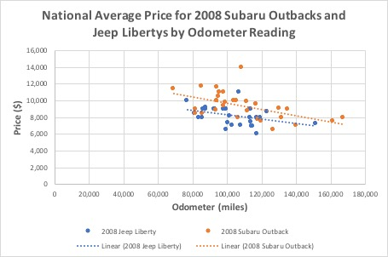
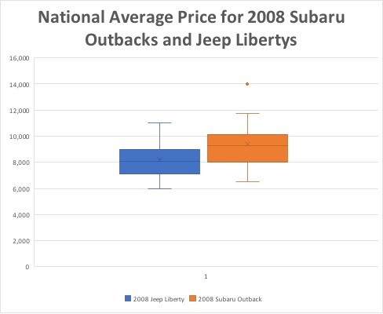
NATIONAL USED SALE VALUES OF 2008 JEEP LIBERTYS and 2008 SUBARU OUTBACKS
THE STUDY:
Mid-2000’s Jeep Libertys and Subaru Outbacks are extremely common to see in Colorado. They are both hatchbacks equipped with some form of AWD (so both are very functional in snow), and they are priced similarly off the lot. However, they are also very different. The Libertys are lifted with 4WD, so they are more equipped for off-roading. The Outbacks have a more fuel efficient engine, so they may often be referred to as ‘Grocery Getters.’ My goal was to discover whether there was a significant difference between the mean selling price of these cars.
HYPOTHESIS:
There is a statistical significance between the national mean selling price of 2008 Jeep Libertys and 2008 Subaru Outbacks; Subaru Outbacks have a higher mean price.
PROCESS:
Label states 1-50 in alphabetical order. Perform SRS(WR) until 30 sample states have been selected.
Find Carmax location for state. If there are multiple locations in state, do SRS with the states ordered 1-X top-bottom. Record zip code of location. If there is no Carmax in the state, do a 1-50 SRS until a state that has not yet been selected is drawn.
Plug previously selected zip code into CarGuru with 50 mile radius for Jeeps and Subarus.
Select first vehicle that matches criteria—record price and odometer reading.
CRITERIA: Must be within state. Must be a 2008 model. Search for first vehicle between 80,000 and 120,000 miles. If none appear, pick the next closest odometer reading. No Subaru Outback XTs.
Repeat for Jeeps and Subarus on all 30 states in the sample.
Perform 2-sample t-test—the Null hypothesis will assume the Jeeps and Subarus are priced the same, the alternative hypothesis will assume the Subarus are worth more than the Jeeps.
Data:
2008 Jeep Liberty:
Sample Mean/Price ($)→ 8,169
Sample Standard Deviation/Price ($)→ 1,112.19
Sample Mean/Odometer (miles)→ 104,627
Sample Standard Deviation/Odometer (miles)→ 16,026
Average Dollars/Mile→ 0.078 ($/mile)
2008 Subaru Outback:
Sample Mean/Price ($)→ 9,382
Sample Standard Deviation/Price ($)→ 1,591.47
Sample Mean/Odometer (miles)→ 109,269
Sample Standard Deviation/Odometer (miles)→ 22,372
Average Dollars/Mile→ 0.086 ($/mile)
CONCLUSION:
In the end it can be concluded that used Subaru Outbacks sell for more than used Jeep Libertys (the 2008 models, anyway). Although both cars were similarly priced off the lot, the data collected from the sample shows that the Subarus, on average, sell for a noticeably larger price than the Jeeps. This could be because they have a lower depreciation rate (they hold their value better). It could also be seen that there is a larger demand for the Subarus, so the price would naturally be higher.
Although there was a large range of odometer readings in the sample (which has a large impact on the value of the car), the mean value of both Subarus and Jeeps turned out to be within 5,000 miles of each other. A 2-sample t-test between the two mean odometer readings at the 0.05 significance level determined that there was not enough evidence to support that the mean odometer reading was not the same. Therefore, it can be assumed that the odometer reading was not a confounding factor. The Subarus also had a slightly higher dollars/mile average, which supports the idea that Subarus depreciate better than Jeeps.
RESULTS:
We [successfully] reject the Null Hypothesis. There is enough evidence to support the claim that the true mean selling price of 2008 Subaru Outbacks is larger than the true mean selling price of 2008 Jeep Libertys.

