Slide 1
Text classification
Prepared by:
Omargazy Daniyar
Mukhametzhanov Assylbek
Kospan Ulan

Slide 2
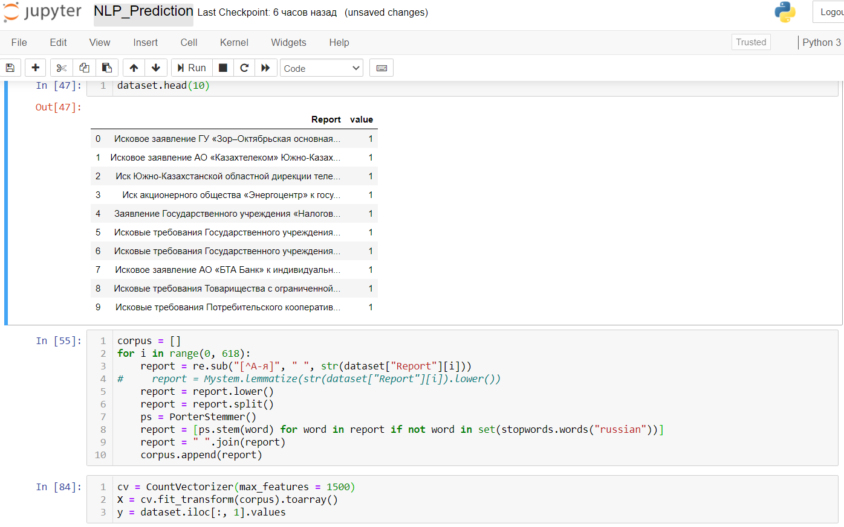
Dataset processing
1) Text stemming
2) StopWords
3) Bag of words (CountVectorizer)
4) Features

Slide 3
Naive Bayes Model
TP = 80;
FP = 5;
TN = 28;
FN = 11;
Accuracy = TP + TN/Total = 0.87
Precision = TP/TP+ FP = 0.94
Recall = TP/TP + FN = 0.88
F1 Score = 2 * Precision * Recall / (Precision + Recall) = 0.91

Slide 4
Decision Tree
TP = 85;
FP = 0;
TN = 38;
FN = 1;
Accuracy = TP + TN/Total = 0.99
Precision = TP/TP+ FP = 1
Recall = TP/TP + FN = 0.99
F1 Score = 2 * Precision * Recall / (Precision + Recall) = 0.99

Slide 5
Random Forest
TP = 85;
FP = 0;
TN = 38;
FN = 1;
Accuracy = TP + TN/Total = 0.99
Precision = TP/TP+ FP = 1
Recall = TP/TP + FN = 0.99
F1 Score = 2 * Precision * Recall / (Precision + Recall) = 0.99

Slide 6
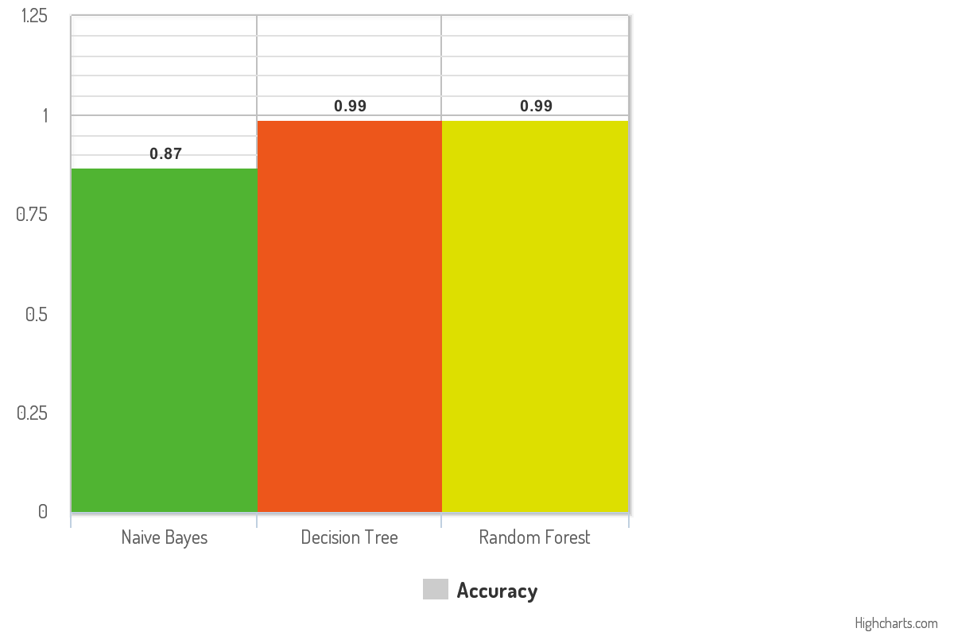
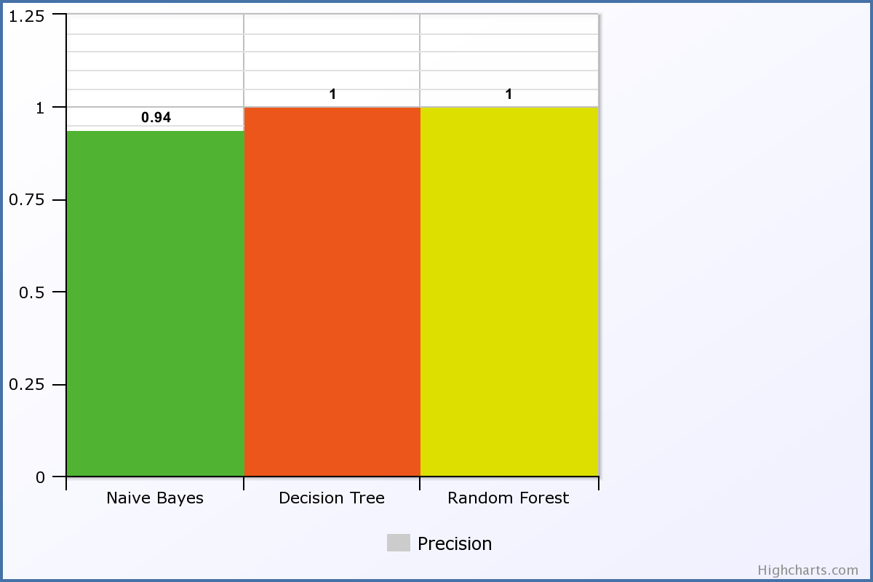

Slide 7
