Slide 1
MOVIE RECOMMENDER SYSTEM
Kelvin Njenga

Slide 2
Table of Contents
Project Overview
Business Problem
Data Understanding
Visualization
Modelling
Conclusion
Recommendations

Slide 3
Project Overview
The project aims to develop a movie recommender system that prioritizes personalization through collaborative and content-based filtering techniques.
It seeks to deliver precise and relevant movie recommendations based on individual user preferences and viewing history, ultimately enhancing the overall user experience.

Slide 4
Business Problem
The aim is to improve user satisfaction and retention. The current absence of personalized recommendations may lead to disengagement. Using historical ratings and tags, the proposed solution seeks to enhance overall user engagement on the platform.

Slide 5
Data Understanding
The Ml-latest-small dataset, generated by 610 users between 1996 and 2018, comprises 100,836 ratings and 3,683 tags across 9,742 movies. Split into four files, it includes movie information, external identifiers, user ratings, and user-generated tags.

Slide 6
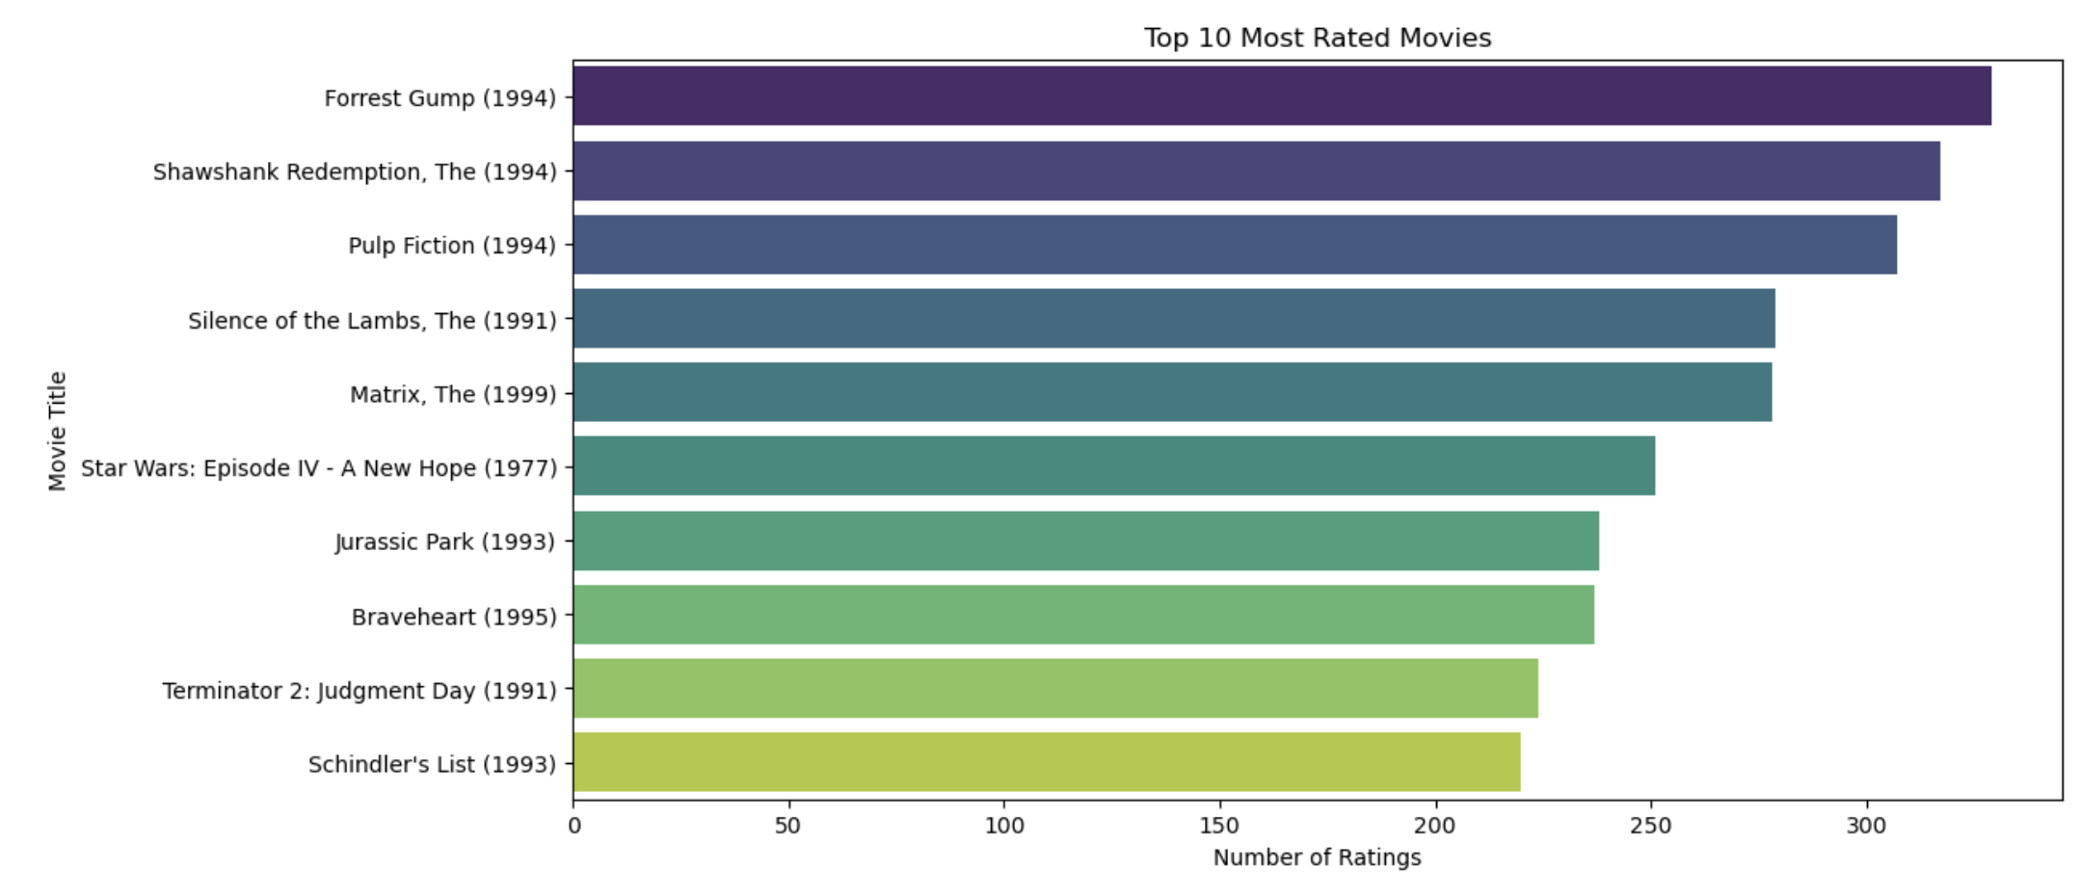
Visualizations

Slide 7
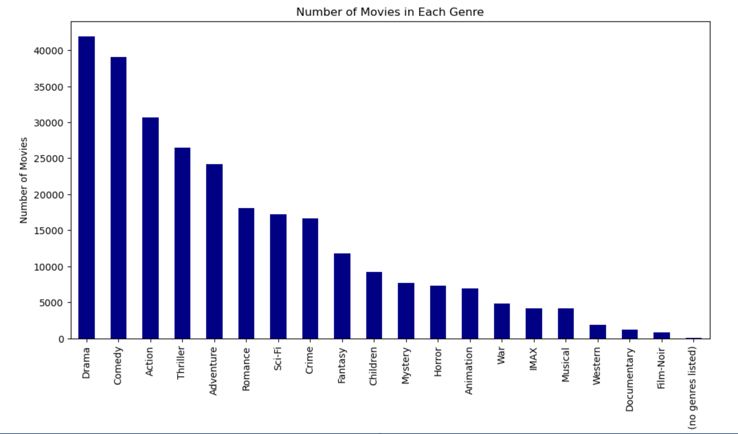
Visualizations

Slide 8
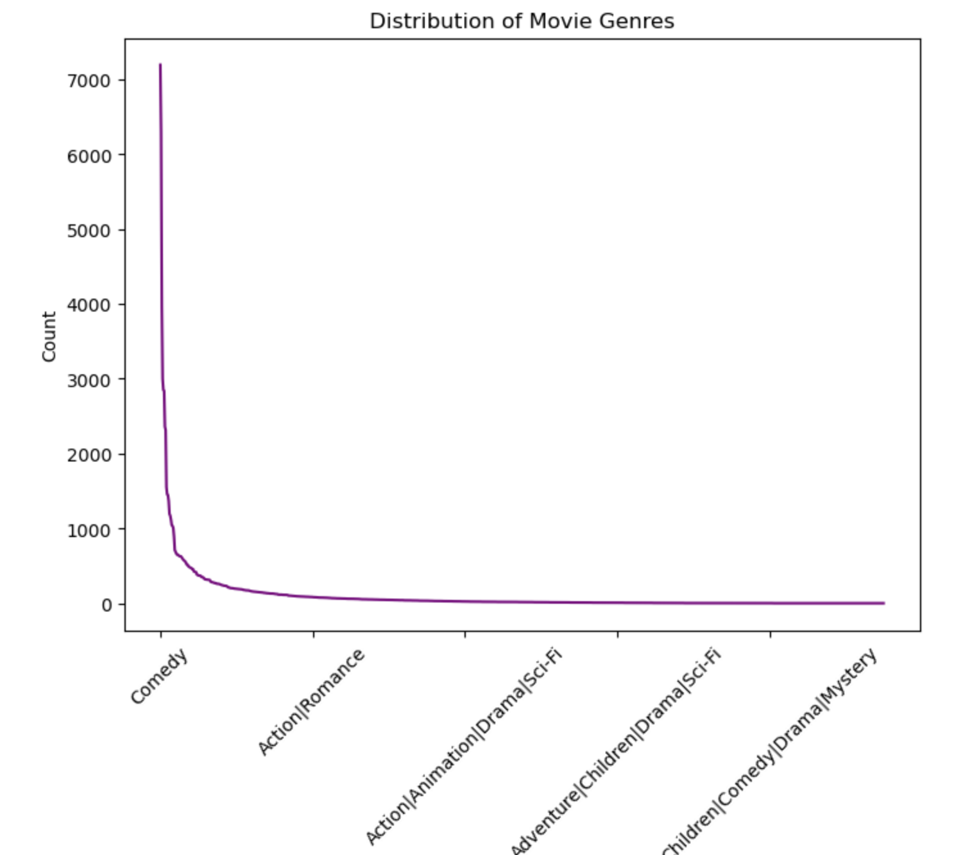
Visualizations

Slide 9
Modelling
The following modelling strategies are incorporated:
Content Based Filtering
Model-Based Collaborative Filtering
Neighborhood-Based Collaborative Filtering

Slide 10
Conclusion
Content Based Filtering
Strengths: Relies on item features for recommendations.
Limitations: May struggle with diverse user preferences.
Neighborhood-Based Collaborative Filtering
Strengths: Leverages user-item interactions effectively.
Limitations: Scalability issues and a challenge with the cold start problem.

Slide 11
Conclusion
Model-Based Collaborative Filtering
Strengths: Utilizes matrix factorization for personalized recommendations.
Limitations: Requires hyperparameter tuning and may face the cold start problem.

Slide 12
Recommendations
To enhance collaborative filtering, consider thorough hyperparameter tuning and model evaluation, especially with a larger dataset. Regular updates based on user feedback and evolving content will contribute to sustained effectiveness.
For an effective movie recommender system, i propose adopting a hybrid model that combines the strengths of content-based and collaborative filtering. This hybrid approach ensures personalized and diverse recommendations by leveraging detailed user interactions and content features.

Slide 13
Recommendations
Ultimately, the choice ofthe recommender system should align with specific needs, user preferences, and data set characteristics. A well-balanced and continually refined hybrid model stands out as a promising solution for delivering accurate and engaging movie recommendations.

Slide 14
Thank You

