Slide 1
ANALYSIS OF TRAFFIC ACCIDENTS CAUSES, INSIGHTS AND RECOMMENDATIONS

Slide 2
Introduction
Problem Statement: The City of Chicago faces serious road safety issues due to frequent traffic accidents, prompting a need to analyze crash data to identify their main causes and develop targeted solutions to improve safety for residents.
Objective: Determine the main factors behind traffic accidents and provide practical recommendations for their prevention.

Slide 3
Data preparation
Addressed missing data through imputation or column removal,
Engineered cyclical and interaction features for time-related complexity, and
Grouped rare causes into an "Other" category to optimize model performance.

Slide 4
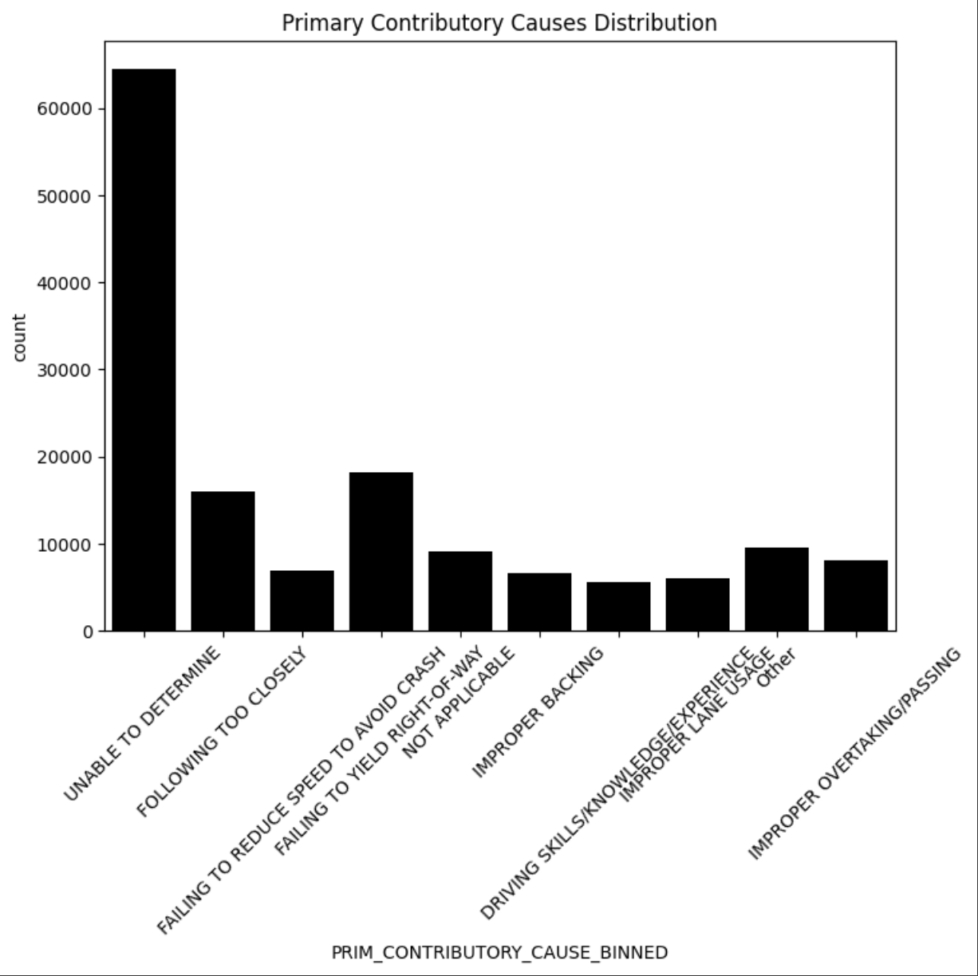
EXPLORATORY DATA ANALYSIS (EDA)

Slide 5
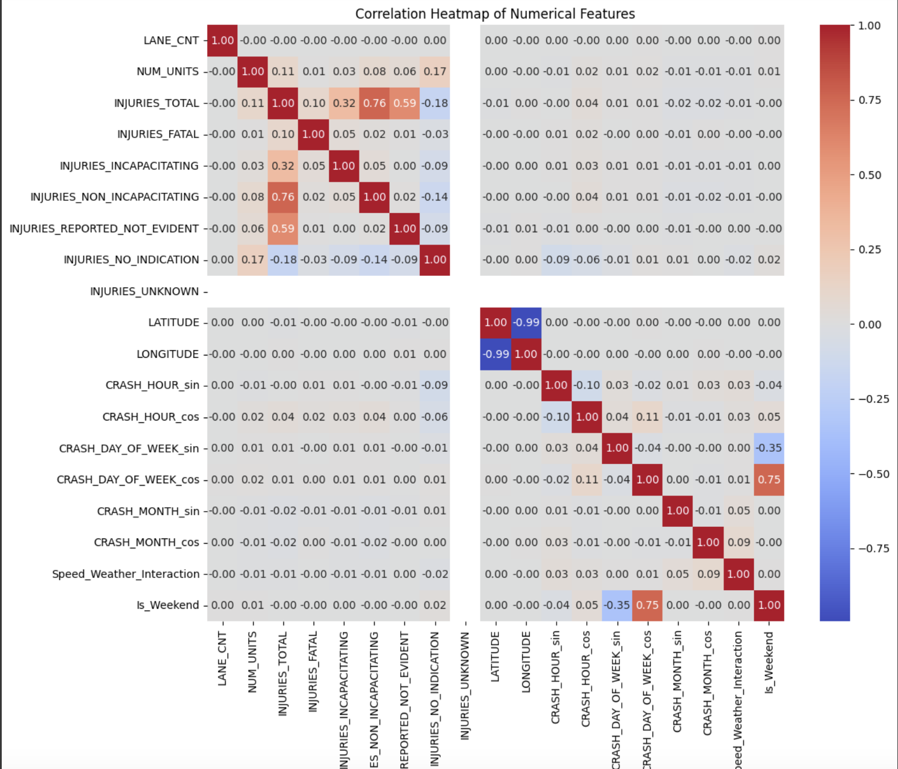
EXPLORATORY DATA ANALYSIS (EDA)

Slide 6
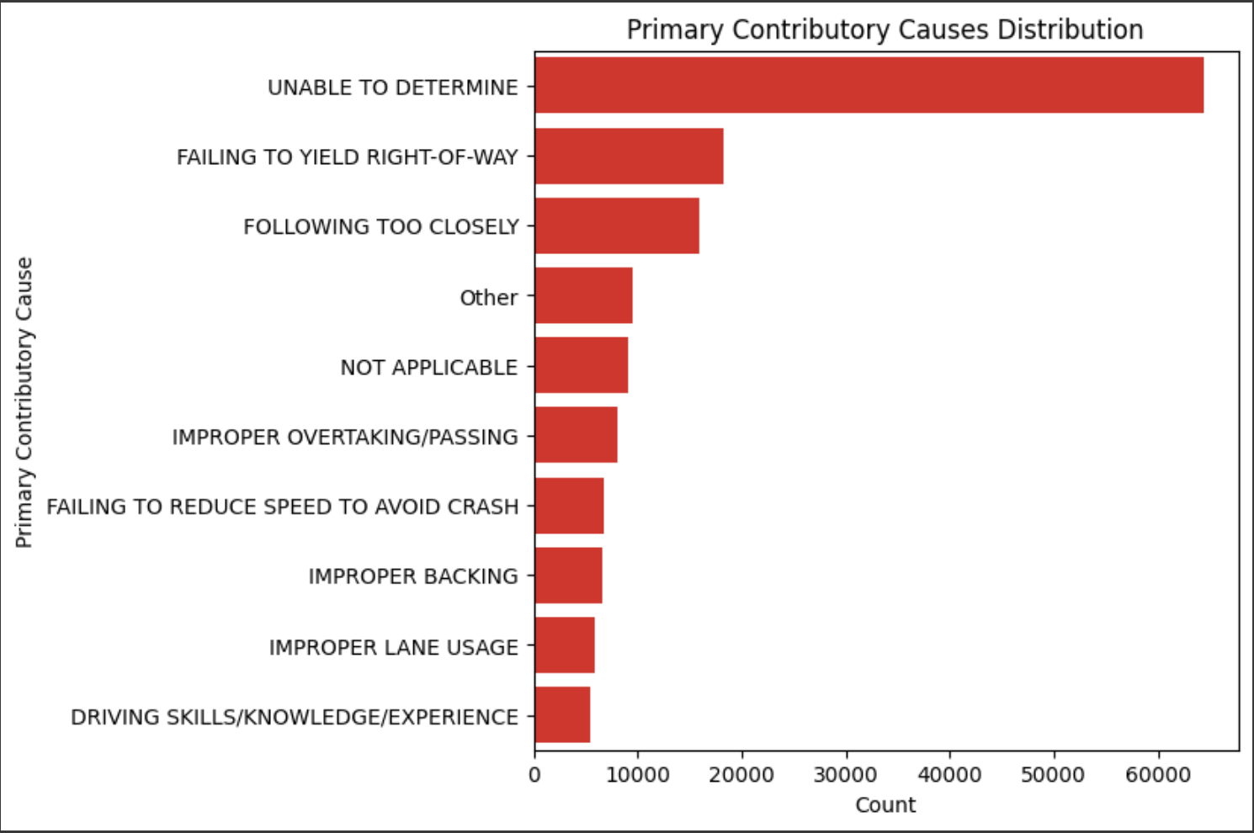
EXPLORATORY DATA ANALYSIS (EDA) Univariative analysis

