Slide 1
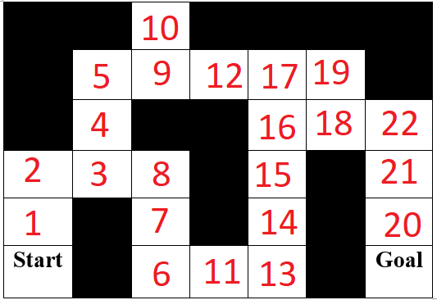
Stack: {S}
Closed: {}
S

Slide 2
Stack: {1}
Closed: {S}
1
S

Slide 3
Stack: {2}
Closed: {S, 1}
2
1
S

Slide 4
Stack: {3}
Closed: {S, 1, 2}
2
3
1
S

Slide 5
Stack: {4, 8}
Closed: {S, 1, 2, 3}
4
2
3
8
1
S

Slide 6
Stack: {4, 7}
Closed: {S, 1, 2, 3, 8}
4
2
3
8
1
7
S

Slide 7
Stack: {4, 6}
Closed: {S, 1, 2, 3, 8, 7}
4
2
3
8
1
7
S
6

Slide 8
Stack: {4, 11}
Closed: {S, 1, 2, 3, 8, 7, 6}
4
2
3
8
1
7
S
6
11

Slide 9
Stack: {4, 13}
Closed: {S, 1, 2, 3, 8, 7, 6, 11}
4
2
3
8
1
7
S
6
11
13

Slide 10
Stack: {4, 14}
Closed: {S, 1, 2, 3, 8, 7, 6, 11, 13}
4
2
3
8
1
7
14
S
6
11
13

Slide 11
Stack: {4, 15}
Closed: {S, 1, 2, 3, 8, 7, 6, 11, 13, 14}
4
2
3
8
15
1
7
14
S
6
11
13

Slide 12
Stack: {4, 16}
Closed: {S, 1, 2, 3, 8, 7, 6, 11, 13, 14, 15}
4
16
2
3
8
15
1
7
14
S
6
11
13

Slide 13
Stack: {4, 17, 18}
Closed: {S, 1, 2, 3, 8, 7, 6, 11, 13, 14, 15, 16}
17
4
16
18
2
3
8
15
1
7
14
S
6
11
13

Slide 14
Stack: {4, 17, 19, 22}
Closed: {S, 1, 2, 3, 8, 7, 6, 11, 13, 14, 15, 16, 18}
17
19
4
16
18
22
2
3
8
15
1
7
14
S
6
11
13

Slide 15
Stack: {4, 17, 19, 21}
Closed: {S, 1, 2, 3, 8, 7, 6, 11, 13, 14, 15, 16, 18, 22}
17
19
4
16
18
22
2
3
8
15
21
1
7
14
S
6
11
13

Slide 16
Stack: {4, 17, 19, 20}
Closed: {S, 1, 2, 3, 8, 7, 6, 11, 13, 14, 15, 16, 18, 22, 21}
17
19
4
16
18
22
2
3
8
15
21
1
7
14
20
S
6
11
13

Slide 17
Stack: {4, 17, 19, GOOOAL}
Closed: {S, 1, 2, 3, 8, 7, 6, 11, 13, 14, 15, 16, 18, 22, 21, 20}
17
19
4
16
18
22
2
3
8
15
21
1
7
14
20
S
6
11
13
G

Slide 18
Stack: {4, 17, 19, GOOOAL}
Closed: {S, 1, 2, 3, 8, 7, 6, 11, 13, 14, 15, 16, 18, 22, 21, 20}
Final path: S->1->2->3->8->7->6->11->13->14->15->16->18->22->21->20->G
16
18
22
2
3
8
15
21
1
7
14
20
S
6
11
13
G

