Slide 1
Office Queue Management System (Week 1) Team SE04
MARINO Diego - CANNARELLA Alessandro - CAVALLO Simone - GOURLET Katell - lANFRANCO Dario - ACQUARO Claudio - LISCIANDRELLO Mattia

Slide 2
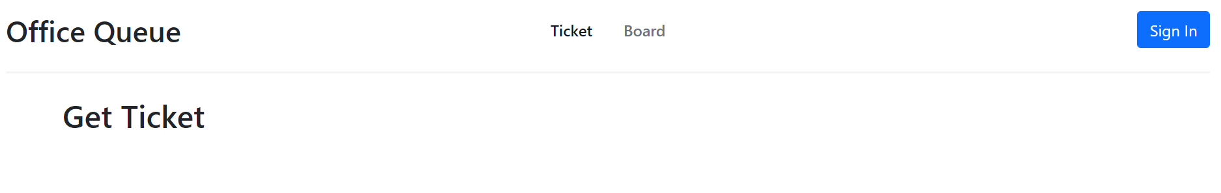
Main Page
To get a ticket (current page)
To get to the tickets queue
Button to login
You need to be login to be able to get a ticket

Slide 3
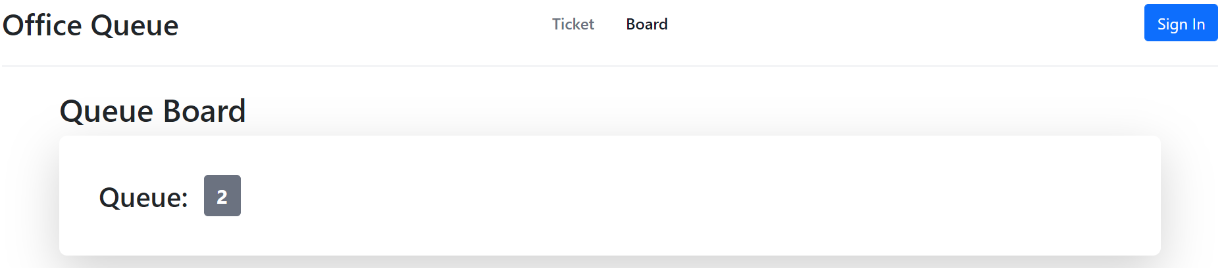
Board
Anyone can access to that page without login
Ticket(s) waiting in the queue

Slide 4
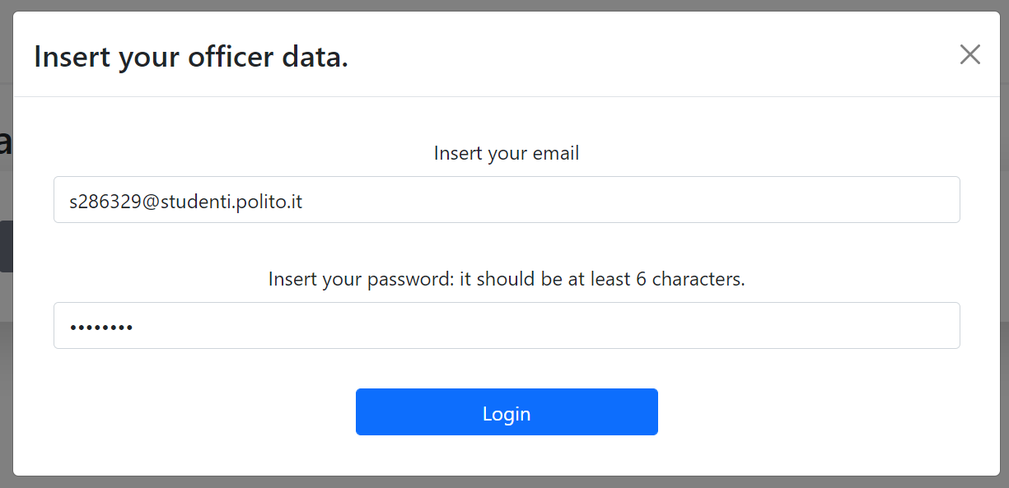
Login
The officers and the clients login here
User Id
User password

Slide 5
Clients page
Current client signed in
The differences services available.

Slide 6
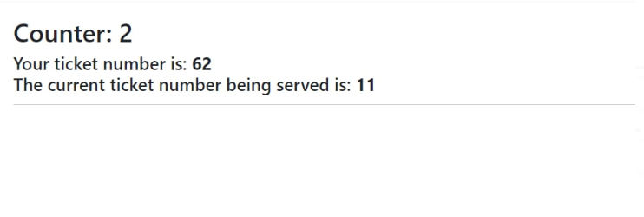
Client waiting board
The desk he is waiting for

Slide 7
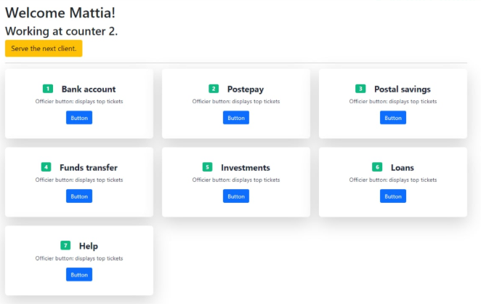
Officers page
Current officer signed in
To use when he finished serving a client
All services available

