Slide 1
Office Queue Management System (Week 1) Team SE04
MARINO Diego - CANNARELLA Alessandro - CAVALLO Simone - GOURLET Katell - LANFRANCO Dario - ACQUARO Claudio - LISCIANDRELLO Mattia

Slide 2
Stories implemented
The stories we implemented during this sprint where:
- As a customer I want to specify a service type So that I can be served later
- As an officer I want to call the next client So that I can serve him
- As a client I want to see the current ticket number being served

Slide 3
Stories not implemented
The stories we have chosen to not implement during the sprint where (not in order):
- As an officer I want to see the length of the queues So that I can see how many people i have to serve
- As a manager I want to see statistics So that I can evaluate the performances of the system
- As a client I want to see the number of people waiting for each type
- As a client I want to be notified when my queue is updated So that I can check if it is my turn
- As a client I want to see my waiting time

Slide 4
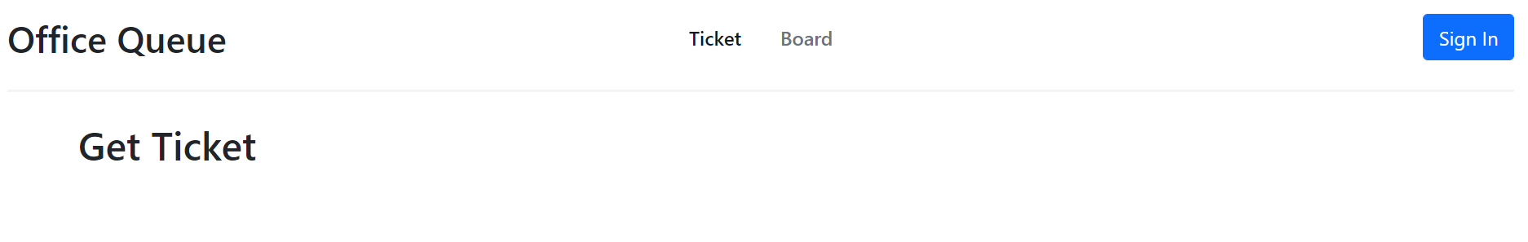
Main Page
To get a ticket (current page)
To get to the tickets queue
Button to login
You don’t need to login to be able to get a ticket

Slide 5
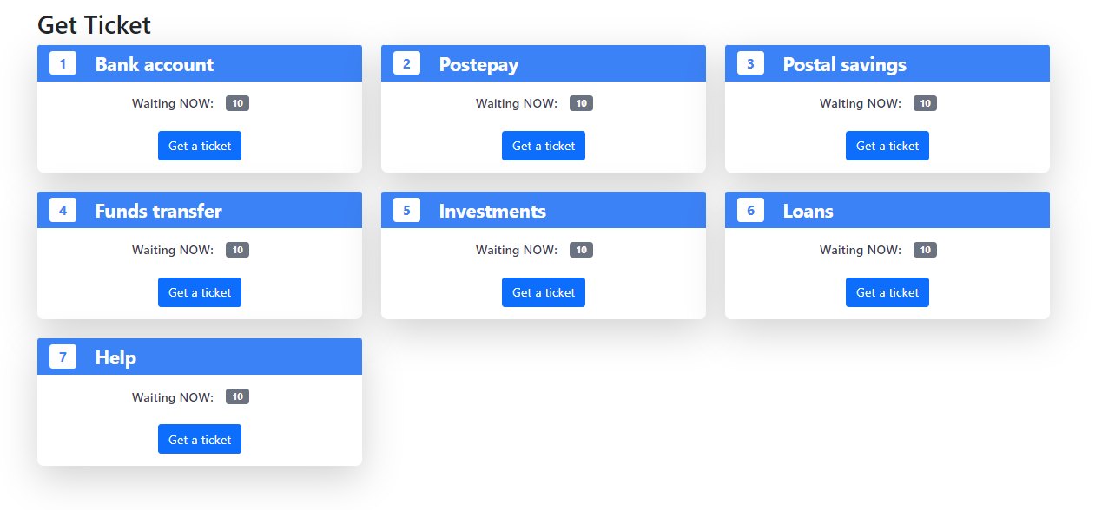
Ticket
Get a ticket for that service type

Slide 6
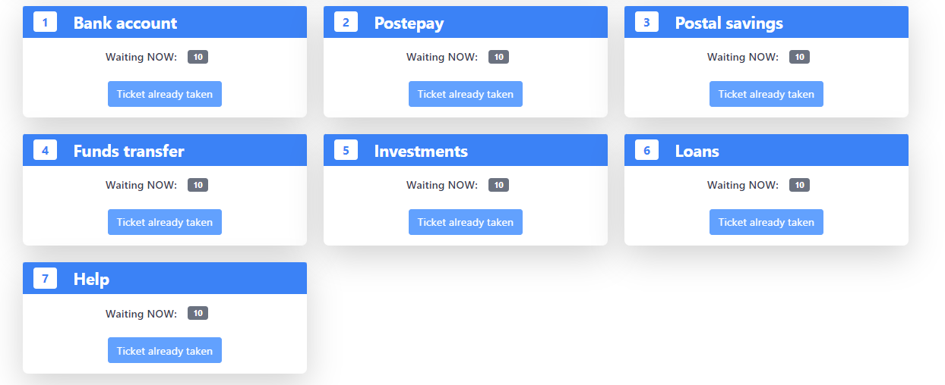
Ticket selected

Slide 7
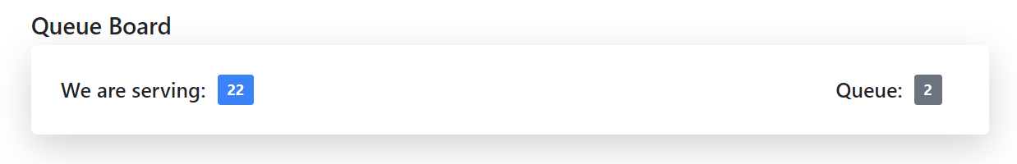
Board
Anyone can access to that page without login
Ticket being served currently

Slide 8
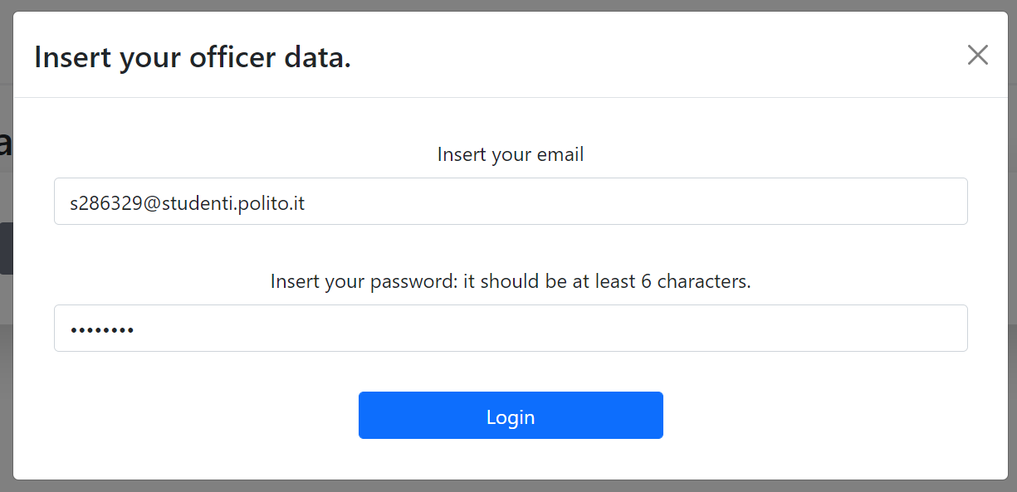
Login
The officers and the manager login here
User email
User password

Slide 9
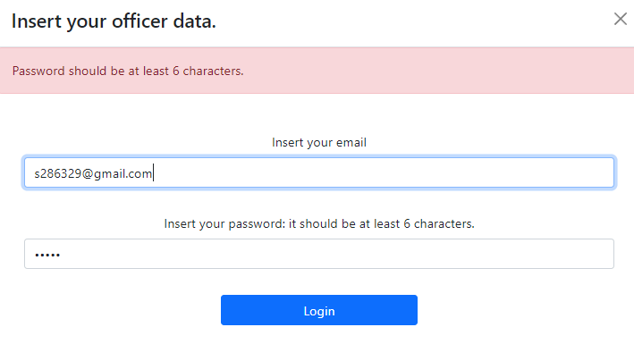
Login validation
The officers and the manager login here
Password
And email validation

Slide 10
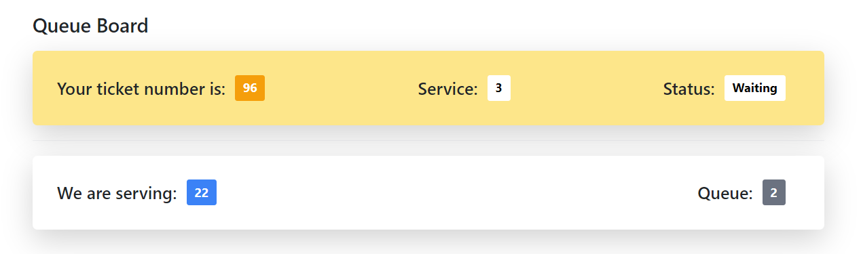
Client waiting board
The service he is waiting for

Slide 11
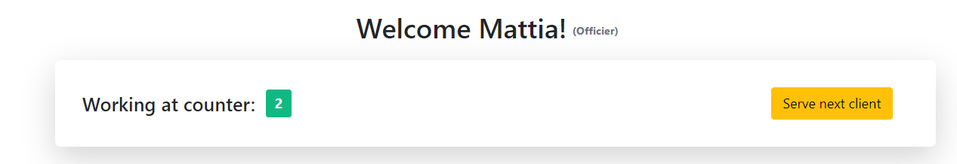
Officers page
Current officer signed in
To use when he finished serving a client

Slide 12
Thanks for your attention!

