Slide 1
Office Queue Management System (Week 1) Team SE04
MARINO Diego - CANNARELLA Alessandro - CAVALLO Simone - GOURLET Katell - LANFRANCO Dario - ACQUARO Claudio - LISCIANDRELLO Mattia

Slide 2
Stories implemented
As a customer I want to specify a service type So that I can be served later - Done
As an officer I want to call the next client So that I can serve him – Partially completed (only one officer implemented + a part of the ticket selection algorithm is missing)
As a client I want to see the current ticket number being served – Done but only for one counter
Notes:
1=> complete
2=> almoth okay. Only one counter for now
3=> yes but for one counter

Slide 3
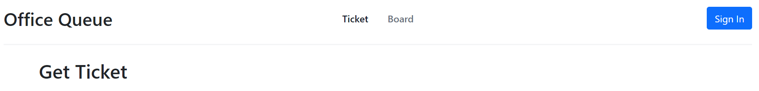
Main Page
You don’t need to login to be able to get a ticket
To get a ticket (current page)
To get to the tickets queue
Button to login

Slide 4
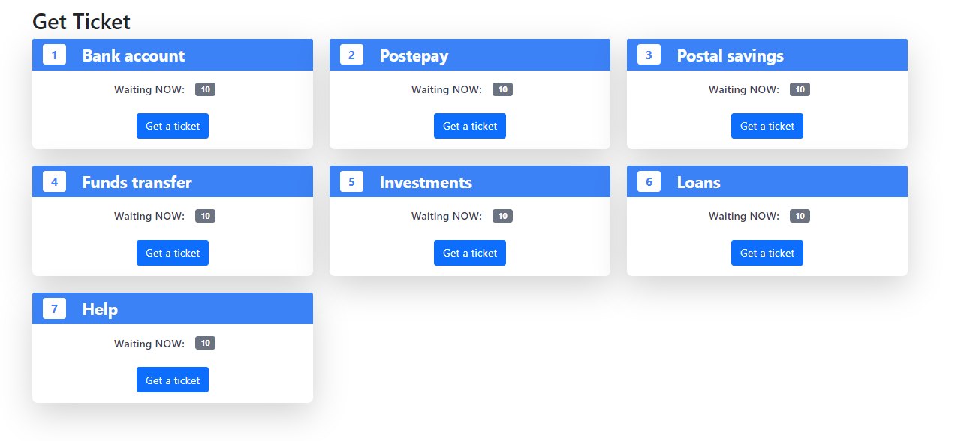
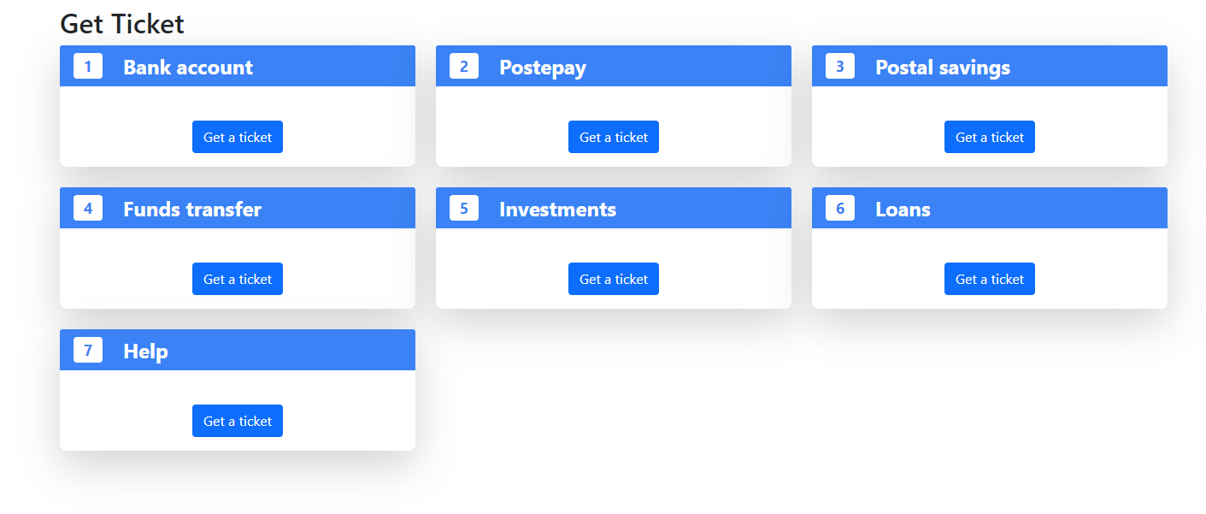
Ticket
We chose to have 7 services
Get a ticket for that service type

Slide 5
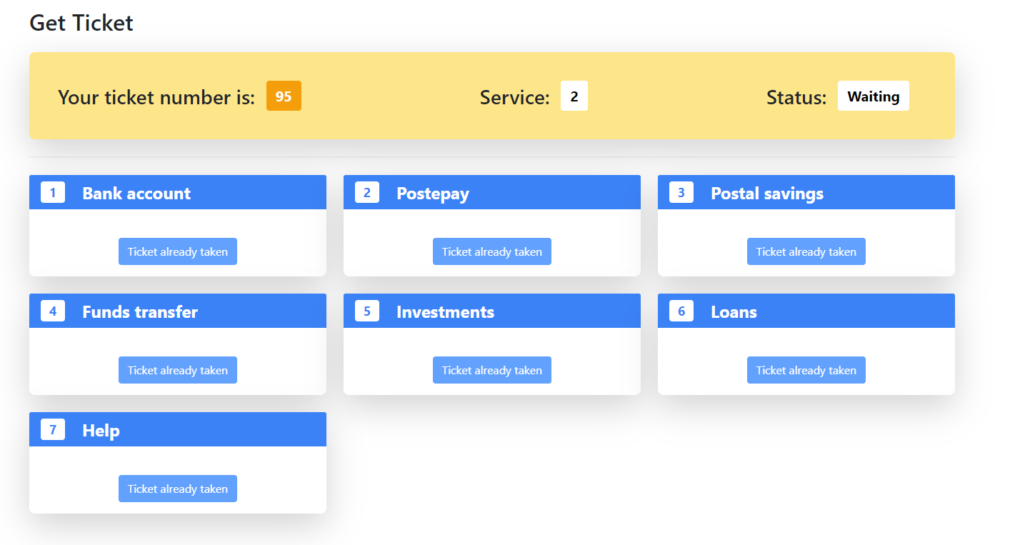
Ticket selected
After the selection of one story

Slide 6
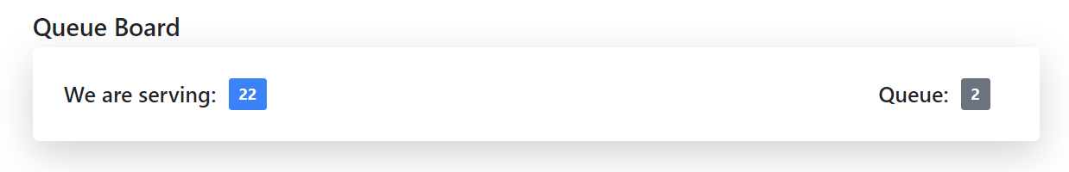
Board
Counter:
Anyone can access to that page without login
Ticket being served currently

Slide 7
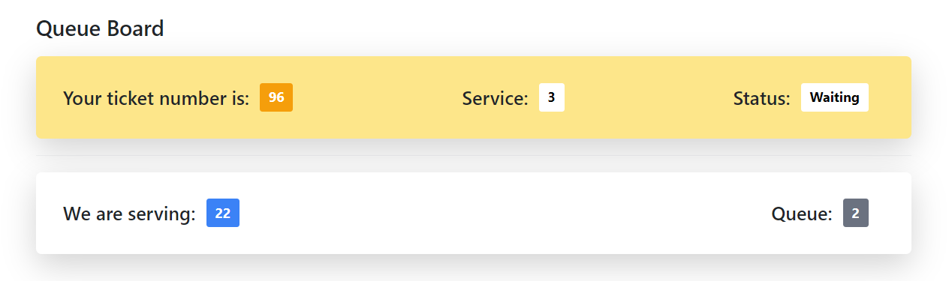
Client waiting board
The service he is waiting for
Counter:

Slide 8
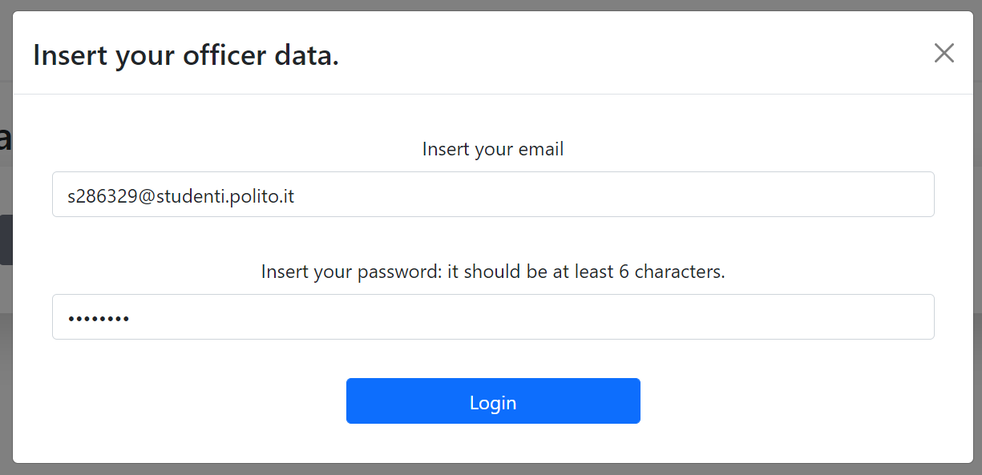
Login
Only the officers and the manager login here
User email
User password

Slide 9
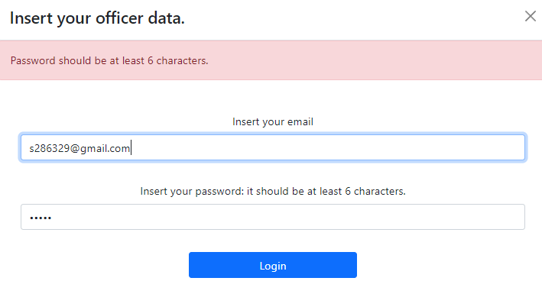
Login validation
Password
and email validation

Slide 10
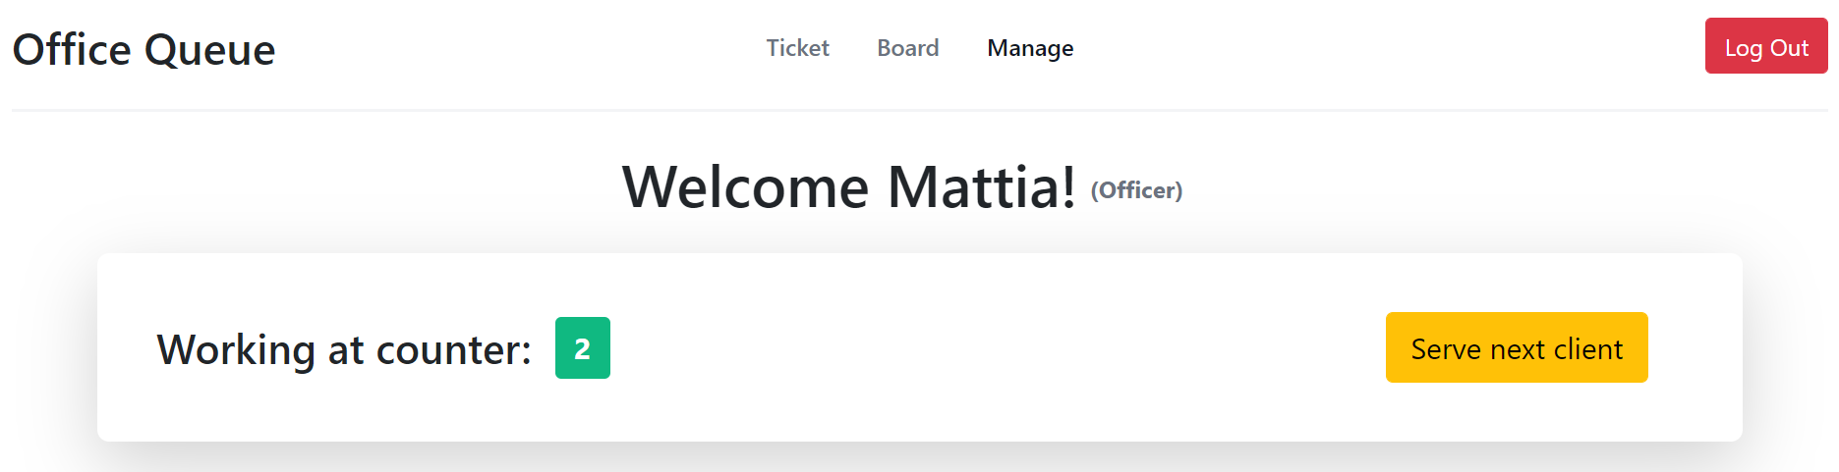
Officers page
Current officer signed in
Button to log out
To use when he finished serving a client

Slide 11
Thanks for your attention!

