Slide 1
Office Queue Management System (Week 1) Team SE04
MARINO Diego - CANNARELLA Alessandro - CAVALLO Simone - GOURLET Katell - LANFRANCO Dario - ACQUARO Claudio - LISCIANDRELLO Mattia

Slide 2
Stories implemented
As a customer I want to specify a service type So that I can be served later - Done
As an officer I want to call the next client So that I can serve him – Partially completed (only one officer implemented + a part of the ticket selection algorithm is missing)
As a client I want to see the current ticket number being served – Done but only for one counter
Notes:
1=> complete
2=> almoth okay. Only one counter for now
3=> yes but for one counter

Slide 3
Stories not implemented
As an officer I want to see the length of the queues So that I can see how many people I have to serve
As a manager I want to see statistics So that I can evaluate the performances of the system
As a client I want to see the number of people waiting for each type
As a client I want to be notified when my queue is updated So that I can check if it is my turn
As a client I want to see my waiting time

Slide 4
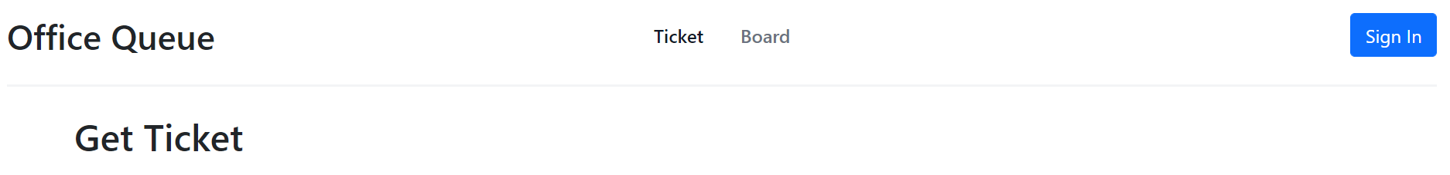
Main Page
You don’t need to login to be able to get a ticket
To get a ticket (current page)
To get to the tickets queue
Button to login

Slide 5
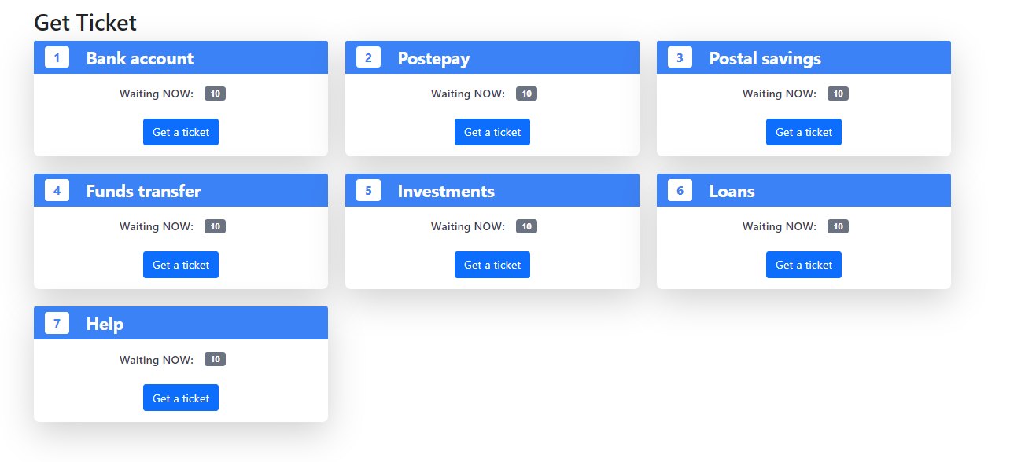
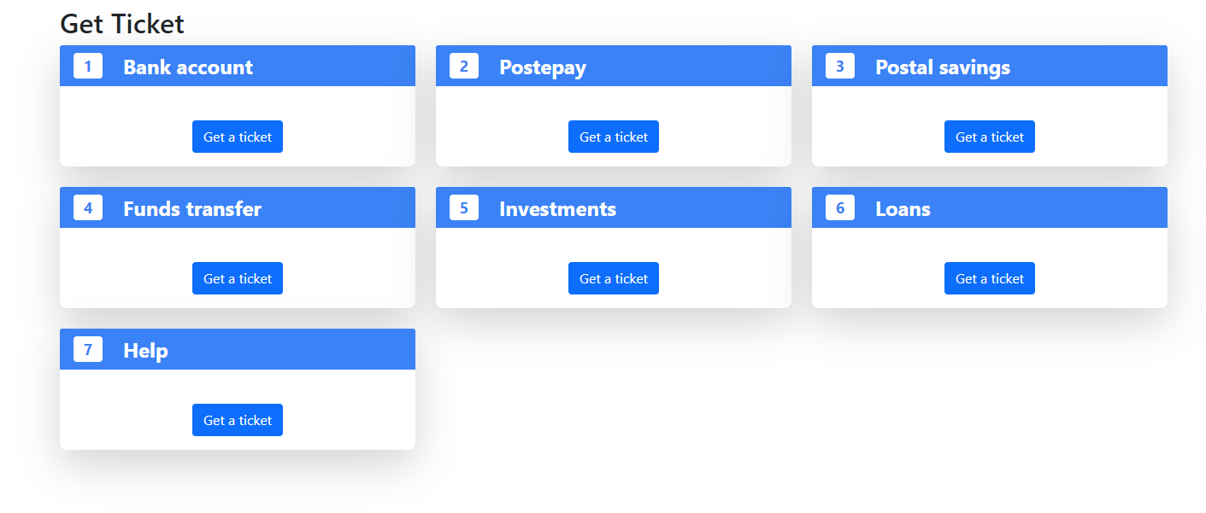
Ticket
We chose to have 7 services
Get a ticket for that service type

Slide 6
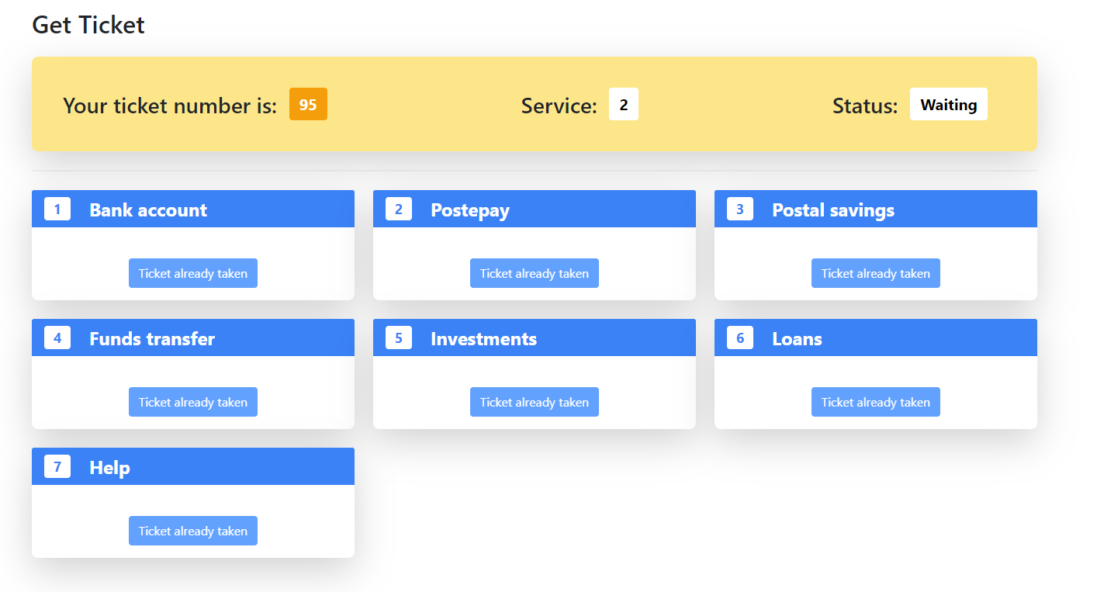
Ticket selected
After the selection of one story

Slide 7
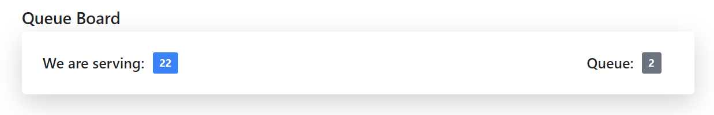
Board
Counter:
Anyone can access to that page without login
Ticket being served currently

Slide 8
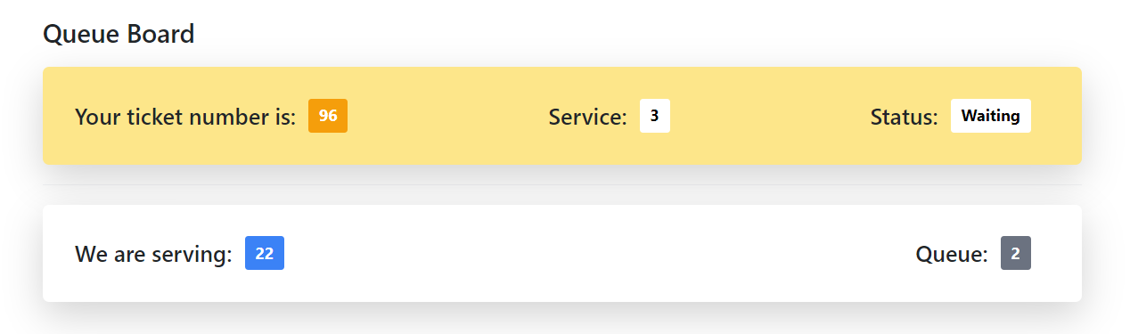
Client waiting board
The service he is waiting for
Counter:

Slide 9
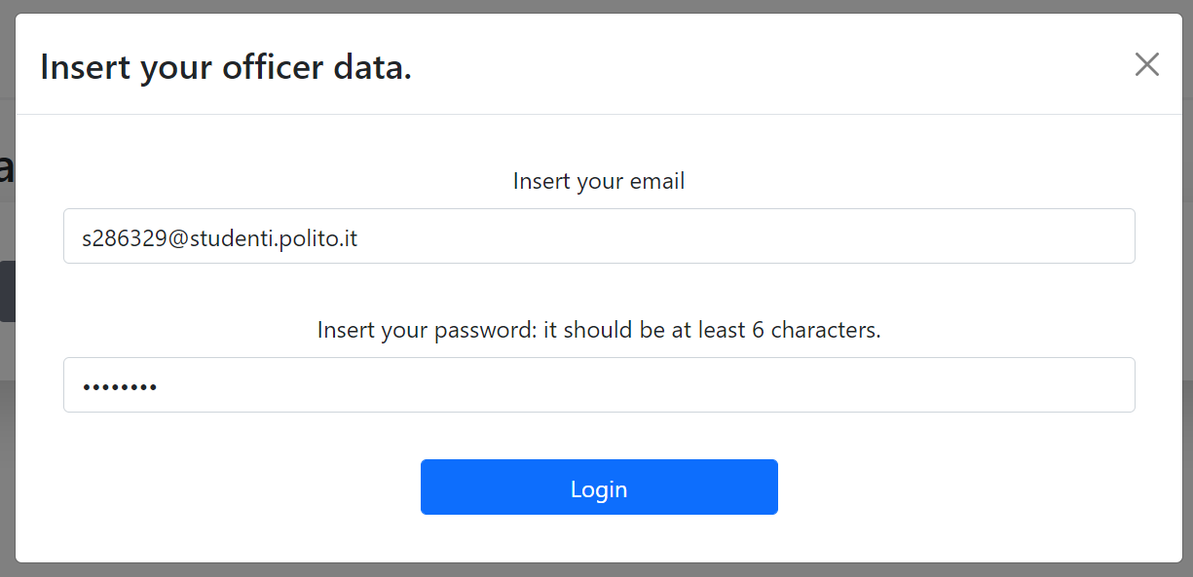
Login
Only the officers and the manager login here
User email
User password

Slide 10
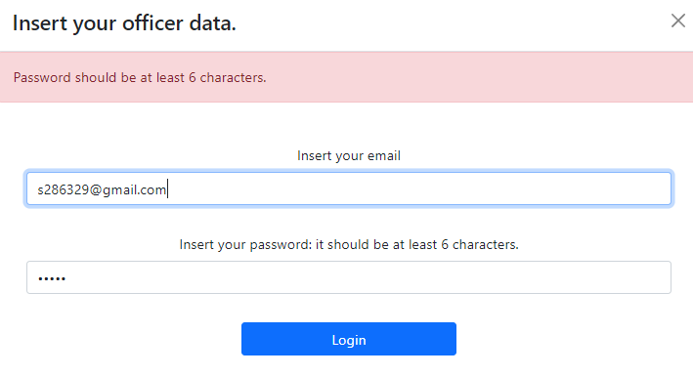
Login validation
Password
and email validation

Slide 11
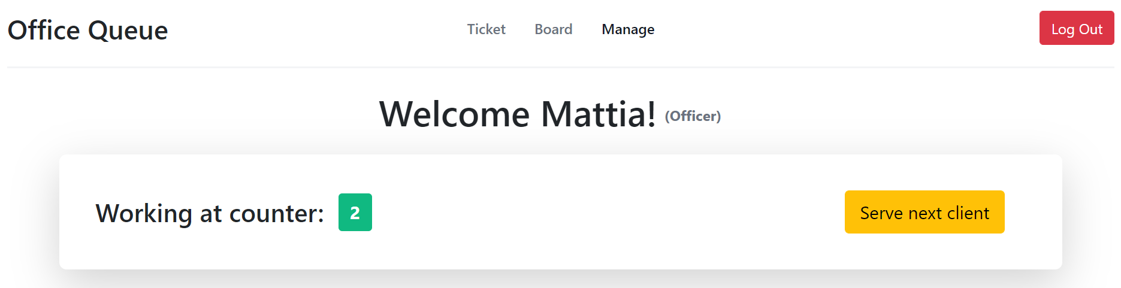
Officers page
Current officer signed in
Button to log out
To use when he finished serving a client

Slide 12
Thanks for your attention!

