Slide 1
Office Queue Management System (Week 1) Team SE04
MARINO Diego - CANNARELLA Alessandro - CAVALLO Simone - GOURLET Katell - LANFRANCO Dario - ACQUARO Claudio - LISCIANDRELLO Mattia

Slide 2
Stories implemented
The stories we implemented during this sprint where:
- As a customer I want to specify a service type So that I can be served later
- As an officer I want to call the next client So that I can serve him
- As a client I want to see the current ticket number being served

Slide 3
Stories not implemented
The stories we have chosen to not implement during the sprint where (not in order):
- As an officer I want to see the length of the queues So that I can see how many people i have to serve
- As a manager I want to see statistics So that I can evaluate the performances of the system
- As a client I want to see the number of people waiting for each type
- As a client I want to be notified when my queue is updated So that I can check if it is my turn
- As a client I want to see my waiting time

Slide 4
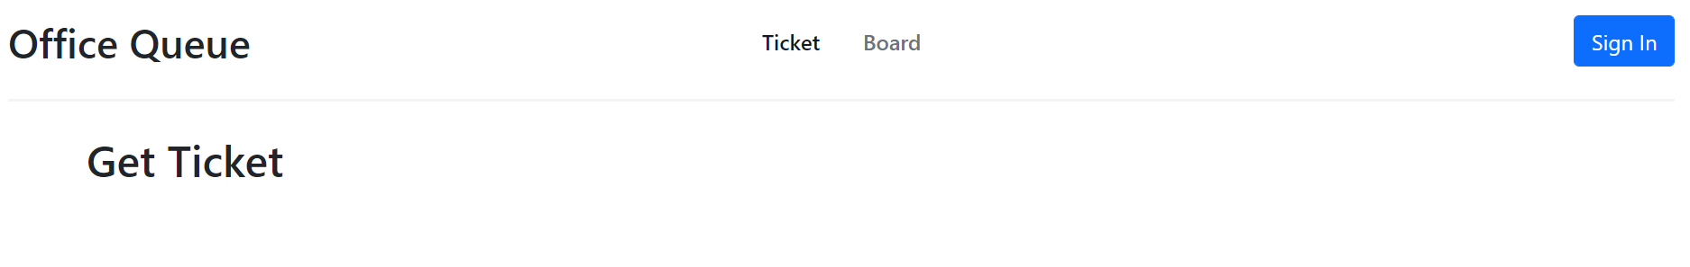
Main Page
To get a ticket (current page)
To get to the tickets queue
Button to login
You don’t need to login to be able to get a ticket

Slide 5
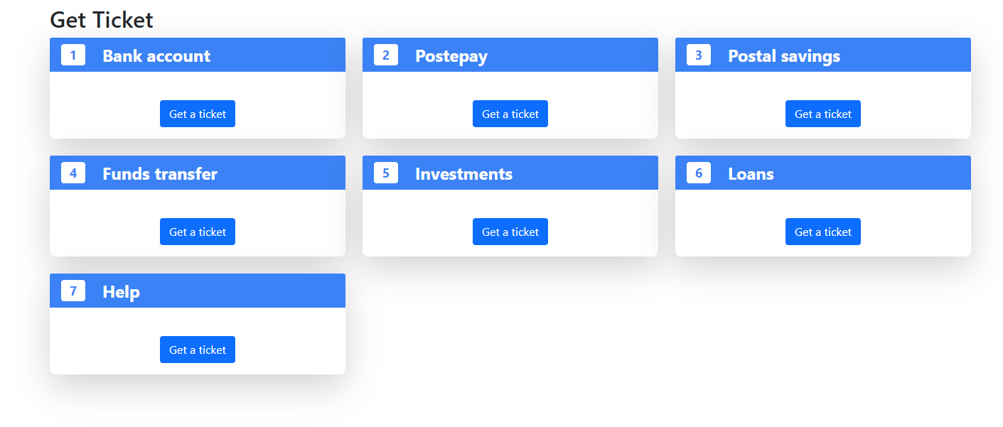
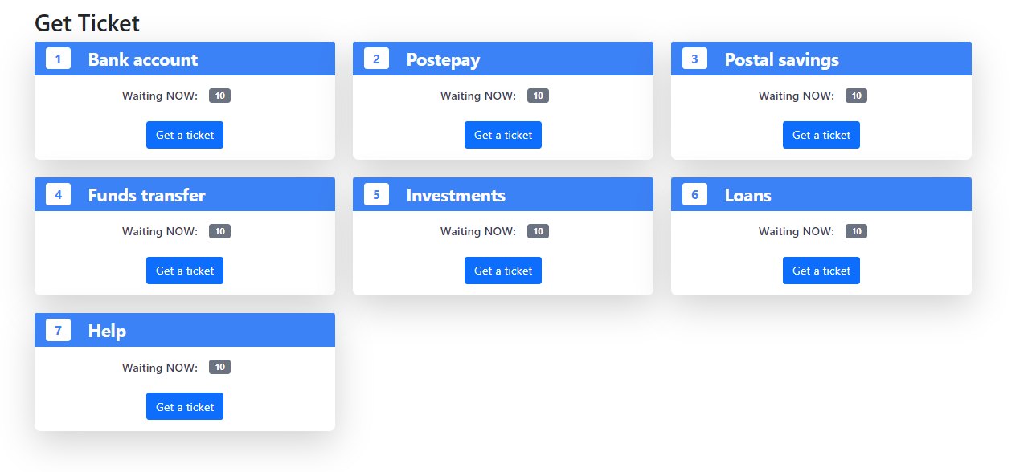
Ticket
Get a ticket for that service type

Slide 6
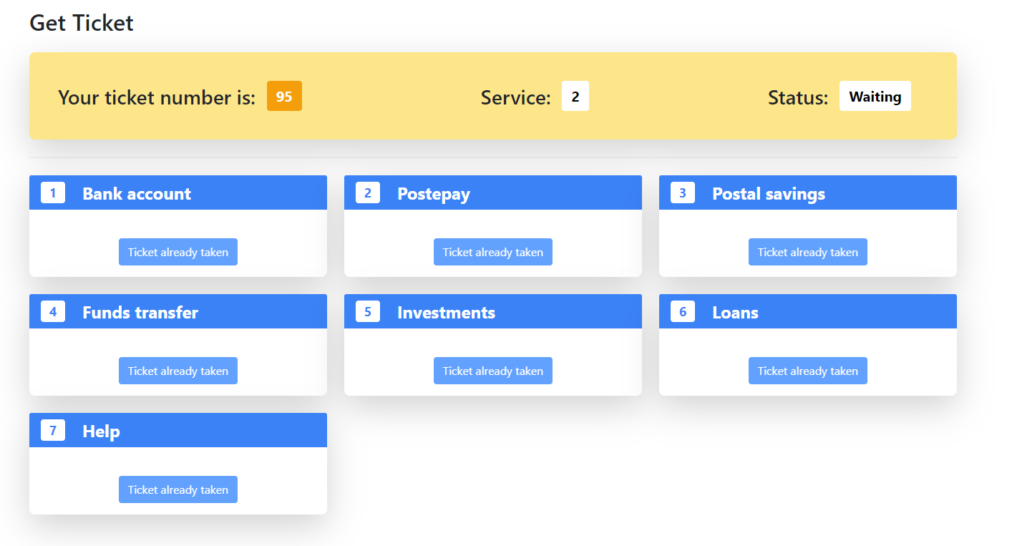
Ticket selected

Slide 7
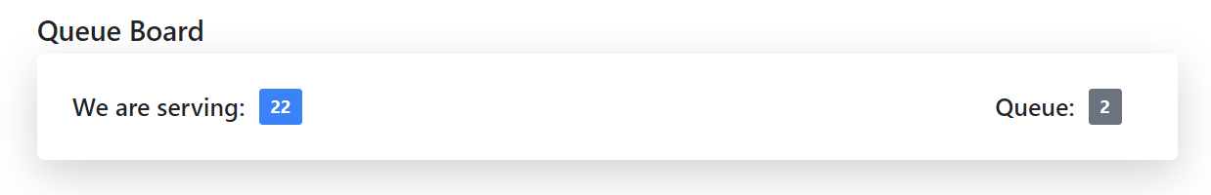
Board
Counter:
Anyone can access to that page without login
Ticket being served currently

Slide 8
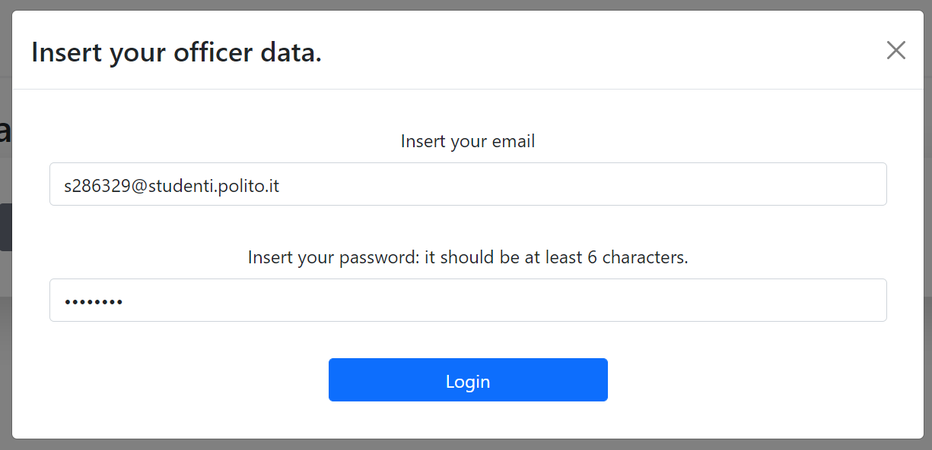
Login
The officers and the manager login here
User email
User password

Slide 9
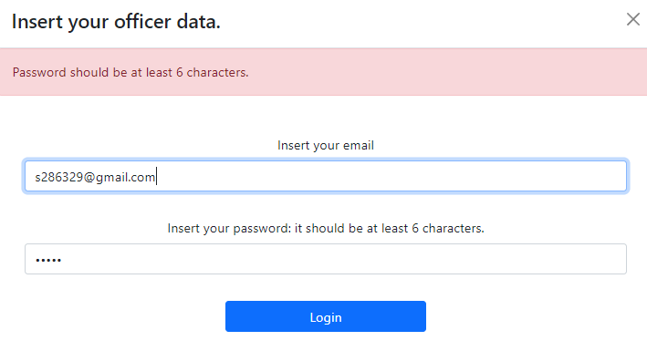
Login validation
The officers and the manager login here
Password
And email validation

Slide 10
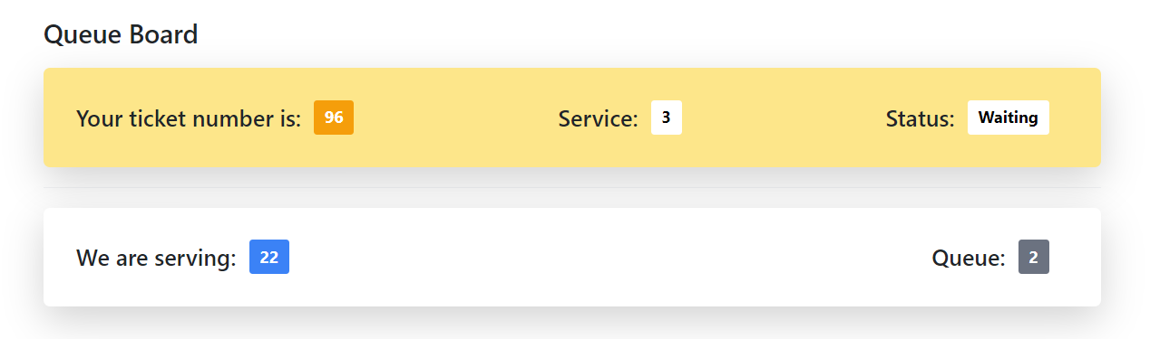
Client waiting board
The service he is waiting for
Counter:

Slide 11
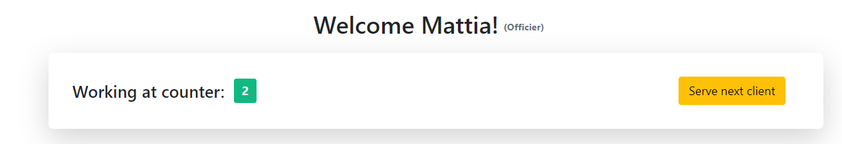
Officers page
Current officer signed in
To use when he finished serving a client

Slide 12
Thanks for your attention!

