Slide 1



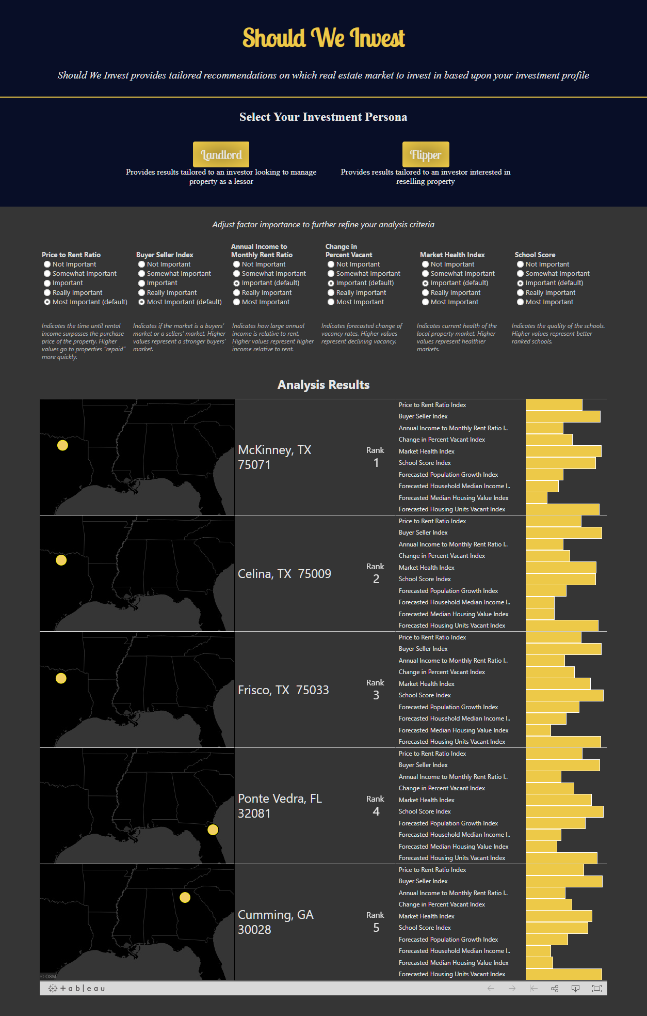










ShouldWeInvest.com
Stephen Wagner (swagner34), Kayla Looney (klooney3), Jacob Pierson (jpierson7), Sam Bryan (sbryan35), David Jesse Moody (dmoody6)
Summary
Shouldweinvest.com solves the problem of identifying geographic markets where real estate investors should focus their investment activity. The process of identifying investment opportunities is streamlined - increasing the ability to identify high ROI investments and decrease time spent researching opportunities. Interactive configuration and results interfaces are used to present market recommendations based on custom investment personas. Recommendations are provided by aggregating and analyzing data predictive of investment property returns.
Data
Algorithm
Two predefined investor personas, tailored to the goals and objectives specific to each, are provided for users. The algorithm factors are:
Ideals Common to Both Personas:
Healthy market with declining home vacancy and good schools
Flipper Ideals:
Properties that are older and sell quickly
Landlord Ideals:
A buyer's market with a high income to rent ratio
238 columns x 248,013 rows
~200 columns x ~20,000 rows
16 columns x ~74,000 rows
Shouldweinvest.com users are presented with the option to select between two investment personas –
Landlord and Flipper.
1
2
After selecting a persona, the user can customize the recommendation algorithm by adjusting the importance of the algorithm factors.
This feature allows each user to tailor results to their individual investment goals and priorities.
After algorithm customization, the user is presented five markets that most match their investment criteria.
3
4
Each market location is displayed on a map as well as the relative index of factors included in the algorithm and additional forecasted variables.
Experimentation
Experimentation was done by testing a variety of different use cases in the app. By toggling between the different “personas” and manually adjusting the weight of available variables, we were able to observe that our algorithms took the variables into consideration and made appropriate recommendations. The recommendations were verified by the team members to assure their validity.
Design was experimented on iteratively by presenting each design to team members with a fresh perspective and gathering feedback on areas to improve.
Tech Stack
Design
ZIP Codes are small areas of the United States. Shouldweinvest.com uses large 'haystack' circles to visualize the top five markets for each persona. Using Tableau, these 'haystacks' move to the best markets in close to real time.
The single page website is designed to allow users to quickly generate customized results. Parameters are pre-filled based on research backed best practices, but allow the user to customize these parameters to their individual situation.
Example of how it could look

