Slide 1
Should We Invest
LANDING PAGE
Should We Invest helps you, as an investor, identify residential real estate markets that provide the best investment opportunities based upon your investment criteria
Select an Investor Profile
Flipper
Landlord
Custom
The Flipper profile is optimized for investors who have a short time-horizon and are looking to re-sell their investment quickly
The Landlord profile is optimized for investors who have a long time-horizon and are looking to lease their investments
The Custom profile is weighted evenly between the investment factors and can be further refined
Adjust the sliders to further refine your criteria importance
Criteria A
Criteria B
Criteria C
Low ------------------ Importance ------------------ High
View results

Slide 2
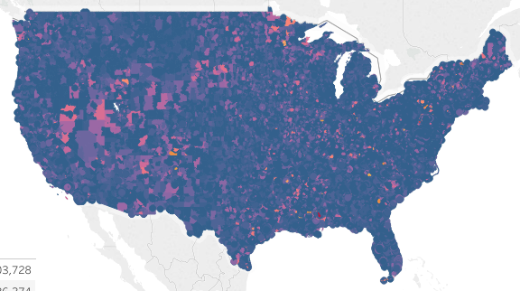
Recommended Markets
RESULTS PAGE
Rank 1
55408 – Minneapolis, MN
Percentile
92
SCORE
Population
25,125
Median Income
$82,135
Avg. Days on Market
32
Rank 2
90210 – Beverly Hills, CA
Percentile
90
SCORE
Population
31,230
Median Income
$162,234
Avg. Days on Market
43
Rank 3
55555 – Middle America, MO
Percentile
89
SCORE
Population
19,325
Median Income
$62,324
Avg. Days on Market
15

Slide 3
SHOULD WE INVEST

