Slide 1



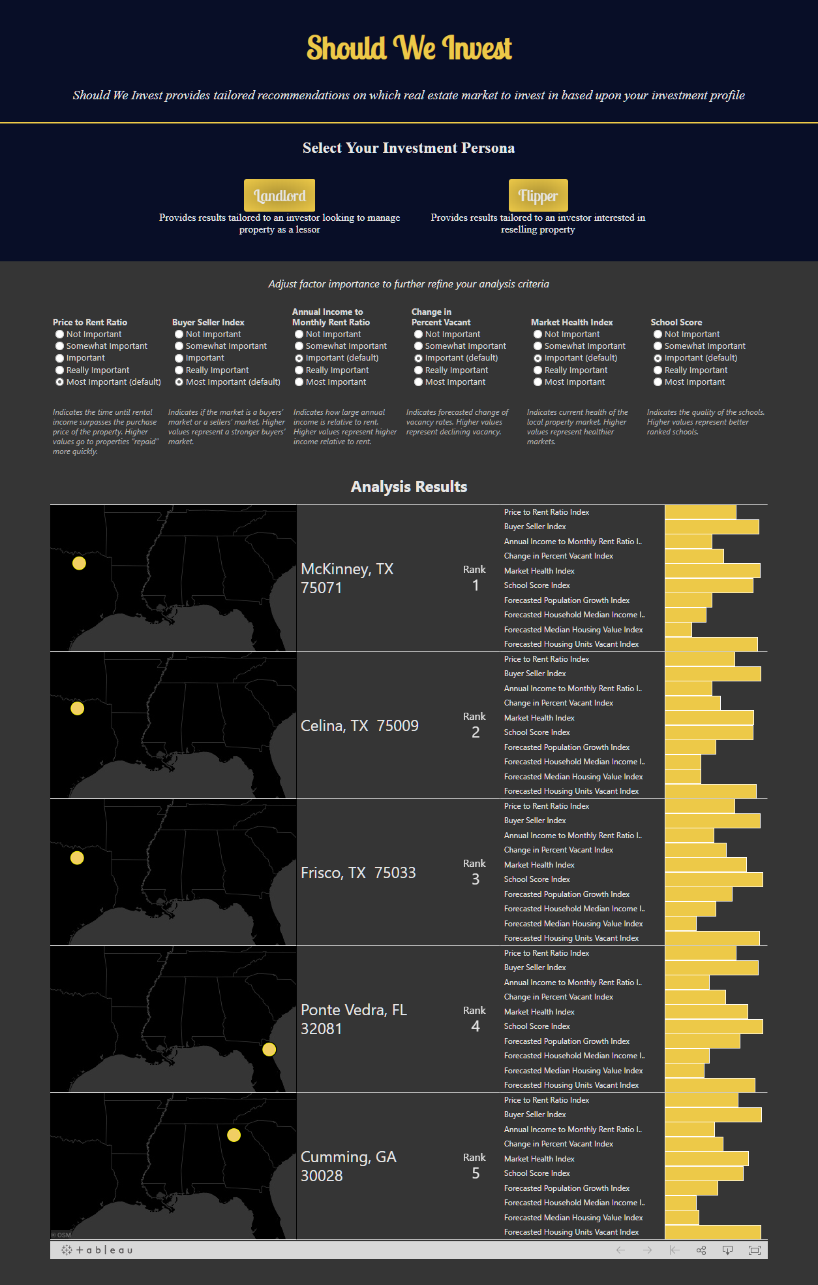










ShouldWeInvest.com
Stephen Wagner (swagner34), Kayla Looney (klooney3), Jacob Pierson (jpierson7), Sam Bryan (sbryan35), David Jesse Moody (dmoody6)
Summary
Shouldweinvest.com solves the problem of identifying geographic markets where real estate investors should focus their investment activity. The process of identifying investment opportunities is streamlined - increasing the ability to identify high ROI investments and decrease time spent researching opportunities. Interactive configuration and results interfaces are used to present market recommendations based on custom investment personas. Recommendations are provided by aggregating and analyzing data predictive of investment property returns.
Data
Algorithm
Two predefined investor personas, tailored to the goals and objectives specific to each, are provided for users. Each persona has a related algorithm that produces five ZIP Codes™ recommended for investment. The algorithms have the following factors:
Ideals Common to Both Personas:
Healthy market with declining home vacancy and good schools
Flipper Ideals:
Properties that are older and sell quickly
Landlord Ideals:
A buyer's market with a high income to rent ratio
Summary
Shouldweinvest.com solves the problem of identifying geographic markets where real estate investors should focus their investment activity. The process of identifying investment opportunities is streamlined - increasing the ability to identify high ROI investments and decrease time spent researching opportunities. Interactive configuration and results interfaces are used to present market recommendations based on custom investment personas. Recommendations are provided by aggregating and analyzing data predictive of investment property returns.
238 columns x 248,013 rows
~200 columns x ~20,000 rows
16 columns x ~74,000 rows
Shouldweinvest.com users are presented with the option to select between two investment personas –
Landlord and Flipper.
1
2
After selecting a persona, the user can customize the recommendation algorithm by adjusting the importance of the algorithm factors.
This feature allows each user to tailor results to their individual investment goals and priorities.
After algorithm customization, the user is presented five markets that most match their investment criteria.
3
4
Each market location is displayed on a map as well as the relative index of factors included in the algorithm and additional forecasted variables.
Experimentation
Experimentation was done by testing a variety of different use cases in the app. By toggling between the different “personas” (Flipper and Landlord) and manually adjusting the weight of available variables, we were able to observe that our algorithms took the variables into consideration and made appropriate recommendations. The recommendations were manually verified by the team members to assure that they were valid investment opportunities. Design was also experimented iteratively by presenting each design to team members with a fresh perspective and gathering feedback on areas to improve. We believe the final result is clean, easy to use and effective.
Tech Stack
Design
ZIP Codes™ are small areas of the United States. Shouldweinvest.com uses large 'haystack' circles to visualize the top five markets for each persona. Using Tableau, these 'haystacks' move to the best markets in close to real time.
Example of how it could look

