Slide 1
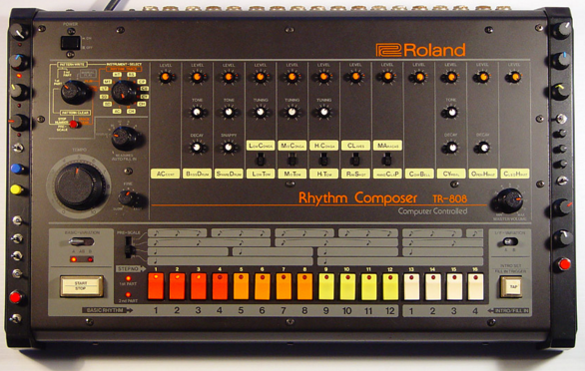
Project 3: Drum Machine
John McCain, Hari Ramanan, Audrey Evans, Alan Wang

Slide 2
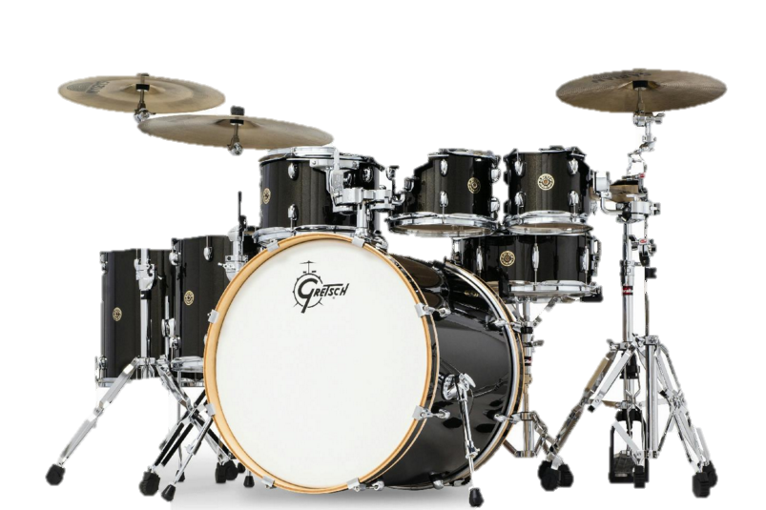
Platform
Webpage
Html, Javascript, CSS

Slide 3
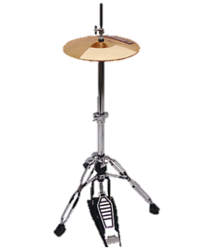
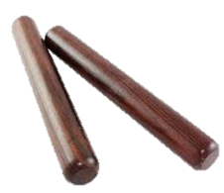
Work Allocation
John
Playing audio
playing multiple audio sources
software knobs
Audrey
Rhythm interface
presentation
Hari
Rhythm interface
General extra help
Alan
Software knobs
UML diagrams

Slide 4
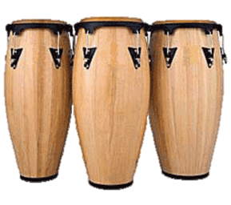
Challenges
Knobs are tricky
Audrey and Hari had to figure out CSS

Slide 5
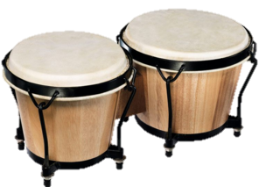
Up and coming features
Better user interface
Knobs that control temp, volume

Slide 6
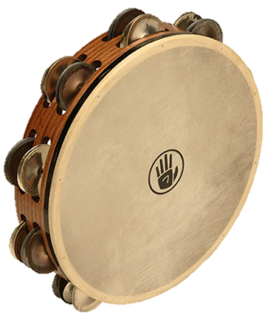
Retrospective

